Slide 1
Early Education Division Webinar
Early Education Division (EED)
Fiscal and Administrative Services Division (FASD)
Date: May 19, 2022
Time: 3:30 p.m. to 5:00 p.m.

Slide 2

Welcome and Introductions

Slide 3
Meeting Agenda
Part One:
  May Revise Proposals
  Universal PreKindergarten Implementation (UPK) Updates
  Rate and Quality Workgroup
  Questions and Answers
Part Two:
  Child Development Management Information System (CDMIS) Maintenance and Optimization (M&O) Updates
  Questions and Answers

Slide 4

Budget Process Timeline (1)
January 10: Governor’s proposed budget released
February 1: Trailer Bill Language released
Late February: Budget Subcommittee hearings began
May 13: May Revision released
Late May- early June: Budget Committee hearings
June 15: Budget Bill must be passed

Slide 5
Governor's May Revision Proposals:
Universal Transitional Kindergarten (UTK)
Funds the first year of transitional kindergarten (TK) expansion to expand eligibility for TK to all children turning five-years-old between September 2 and February 2.
Makes it easier for schools to find TK teachers by:
  Allowing teachers with preschool teaching permits who hold bachelors' degrees, meet basic skills requirements, and are enrolled in a credential program by July 1, 2024 to be assigned as the teacher of record in a TK classroom until June 30, 2026
  Clarifying that substitute TK teachers are not required to meet the additional TK teacher requirements around child development
Includes fiscal penalties for not meeting class size, ratio, and teacher requirements in TK
Requires TK data to be collected separately from kindergarten data

Slide 6
Governor's May Revision:
California State Preschool Program (CSPP)
Waives family fees for 2022–23
Extends Hold Harmless currently operating through the end of 2022–23
Includes a 1.8 adjustment factor to the contract rate for two-year old children
Makes technical adjustments to the way that dual language learners will be identified in CSPP
Provides a 6.56 percent Cost of Living Adjustment (COLA)

Slide 7
Governor's May Revision:
Infrastructure
Provides additional $1.8 billion for TK-12 school facilities construction
Provides additional $1.8 billion to address outstanding school maintenance issues
Amends language to allow Community Colleges to receive facilities funding from the CSPP, TK, and Full-Day Kindergarten Facilities Grant Program
$200.5 million to develop and repair existing child care and preschool infrastructure at non-local educational agencies (LEAs), especially in low-income communities

Slide 8
Governor's May Revision:
Expanded Learning and Opportunity Program (ELO-P)
The May Revision increases ELO-P by an additional $403 million ongoing Proposition 98 General Fund, bringing the ongoing program total to $4.8 billion, and full funding implementation (four years ahead of schedule) of $2,500 for every low-income student, English language learner, and youth in foster care in the state.
An increase of $63 million one-time Proposition 98 General Fund, for a total of $1 billion one-time Proposition 98 General Fund, to support ELO-P infrastructure, with a focus on integrating arts and music programming into the enrichment options for students.

Slide 9
Governor's May Revision: Other Key Proposals
Provides $1.5 Billion to expand access to the community schools grants to every eligible LEA that opts to apply on behalf of its high-need schools.
Provides $85 million to expand and augment work of the Early Math initiative and coordinate that initiative with other efforts around math and science
Significant investments in educator workforce pathways and professional learning
$15 million to support teachers in completing the coursework necessary to receive a supplementary state certification in reading and literacy

Slide 10
Rate and Quality Workgroup
Purpose: To assess the existing quality standards for childcare and development and preschool programs and the methodology for establishing reimbursement rates for those programs. The work group will provide recommendations relating to specified topics to the Joint Labor Management Committee (JLMC), Department of Finance (DOF), and the Joint Legislative Budget Committee no later than August 15, 2022.
Meets Monthly
Next Meeting is May 20, 2022 from 8:30 a.m. to 11:30 a.m.

Slide 11
UPK Implementation Updates
LEA plans for implementing UPK must be presented to their local governing board or body by June 30, 2022
Starting in the upcoming school year, the TK eligibility window will be expanded to admit all children turning five between September 2 and February 2
The California Department of Education (CDE) is in the process of releasing funds to LEAs for planning and implementation

Slide 12
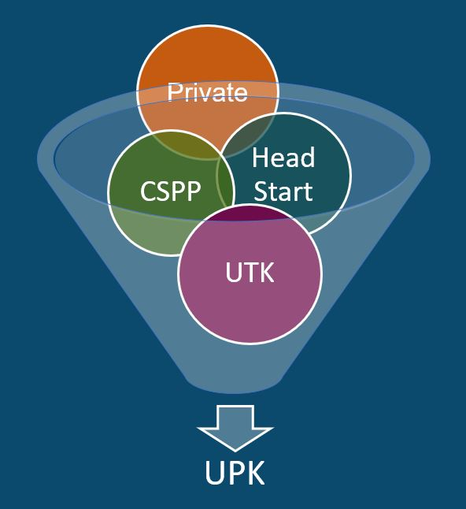
What is UPK?
UPK will bring together programs across early learning and K-12, relying heavily on UTK and CSPP, as well as Head Start, community-based organizations (CBOs), and private preschool.
Universal means that by 2025–26,
regardless of background, race, zip code, immigration status, or income level – every child– has access to a quality learning experience the year before Kindergarten.

Slide 13
UPK Resources
California Educators Together:
  https://www.caeducatorstogether.org/groups/e0cfjrjf/upk-p-3
UPK Resources:
  https://www.cde.ca.gov/ci/gs/em/
UPK FAQs:
  https://www.cde.ca.gov/ci/gs/em/kinderfaq.asp
UPK Office Hour:
  https://www.cde.ca.gov/ci/gs/em/upkofficehours.asp
System of Support for Expanded Learning:
  https://www.cde.ca.gov/ls/ex/sosexplearncontacts.asp

Slide 14
Governor's Budget Process Timeline (1)
January 10, 2022: Budget must be submitted by Governor or Governor's Proposed Budget Released
February 1, 2022: Trailer Bill Language Released
Late February: Budget Subcommittee hearings began
May 12-16, 2022: May Revision Released
June 15, 2022: Budget Bill must be passed by midnight

Slide 15
Governor's Budget Process Timeline (2)
January 10: Governor’s Proposed Budget released
February 1: Trailer Bill Language released
Late February: Budget Subcommittee hearings began
May 13: May Revision released
Late May – early June: Budget Committee hearings
June 15: Budget Bill must be passed

Slide 16
Governor's Budget Updates
May 2, 2022 Senate Budget and Fiscal Review Subcommittee Number 1 on Education
  Increasing reimbursement rates to the 90th percentile of the Regional Market Rate (RMR)
  Extending the age range for the toddler adjustment factor to three year old children
  Waives family fees for an additional two years and retains hold harmless policies to pay providers based on enrollment for an additional year.
  Expanding Preschool eligibility for three and four year old children for families at 100 percent of the state median income level
  Establish Local Preschool Councils

Slide 17
Reimbursement For Contractors Based Off Attendance
Reimbursement for Contractors Based off Attendance
Add uncodified language as follows: (New for May Revision)
Notwithstanding any other law, reimbursement for the 2022–23 fiscal year (FY) shall be based on the lesser of the following:
  The maximum reimbursable amount stated in the contract. (2) Net reimbursable program costs.
  (3) The product of the adjusted child days of enrollment for certified children times the contract rate set forth in Section 8242 per child days of enrollment.

Slide 18
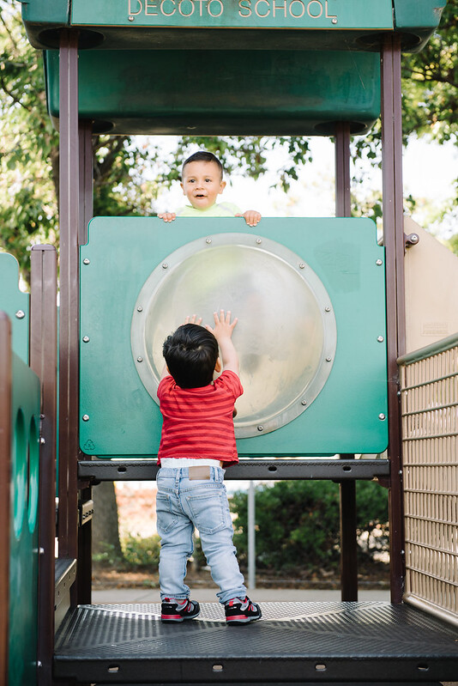
The Early Education Teacher Development Grant
The Request for Funding Application (RFA) is due May 27, 2022
Please visit the RFA's webpage for:
  Erratum
  Application
  Instructions
  Technical Assistance webinar recording
Questions? Email:
UPKWorkforceRFA@cde.ca.gov
Photo Credit: Kidango Decoto Center; Union City, CA

Slide 19
Support for UPK Implementation (1)
UPK Resources
  Planning Template: Offer planning questions to support development of comprehensive plans for UPK (not required)
  Guidance: Corresponds to the template and introduces early education concepts, research, resources, programs, partnership opportunities, and policies
UPK Frequently asked questions (FAQs): Our FAQ page is updated periodically and covers a variety of UPK topics.

Slide 20
Support for UPK Implementation (2)
California Educators Together: A UPK and Preschool through Grade 3 (P-3) Group on the platform shares resources and guidance for local education agencies and partners to use in preparation for the implementation of UPK in California.
UPK Office Hour: Office Hours provide technical assistance to LEAs and county offices of education (COEs) around planning and implementation of UPK.
UPK Webinar: This webinar is a collaboration with Head Start leaders to explore how to leverage the different funding sources with TK programs to meet the needs of families, students, and programs.

Slide 21
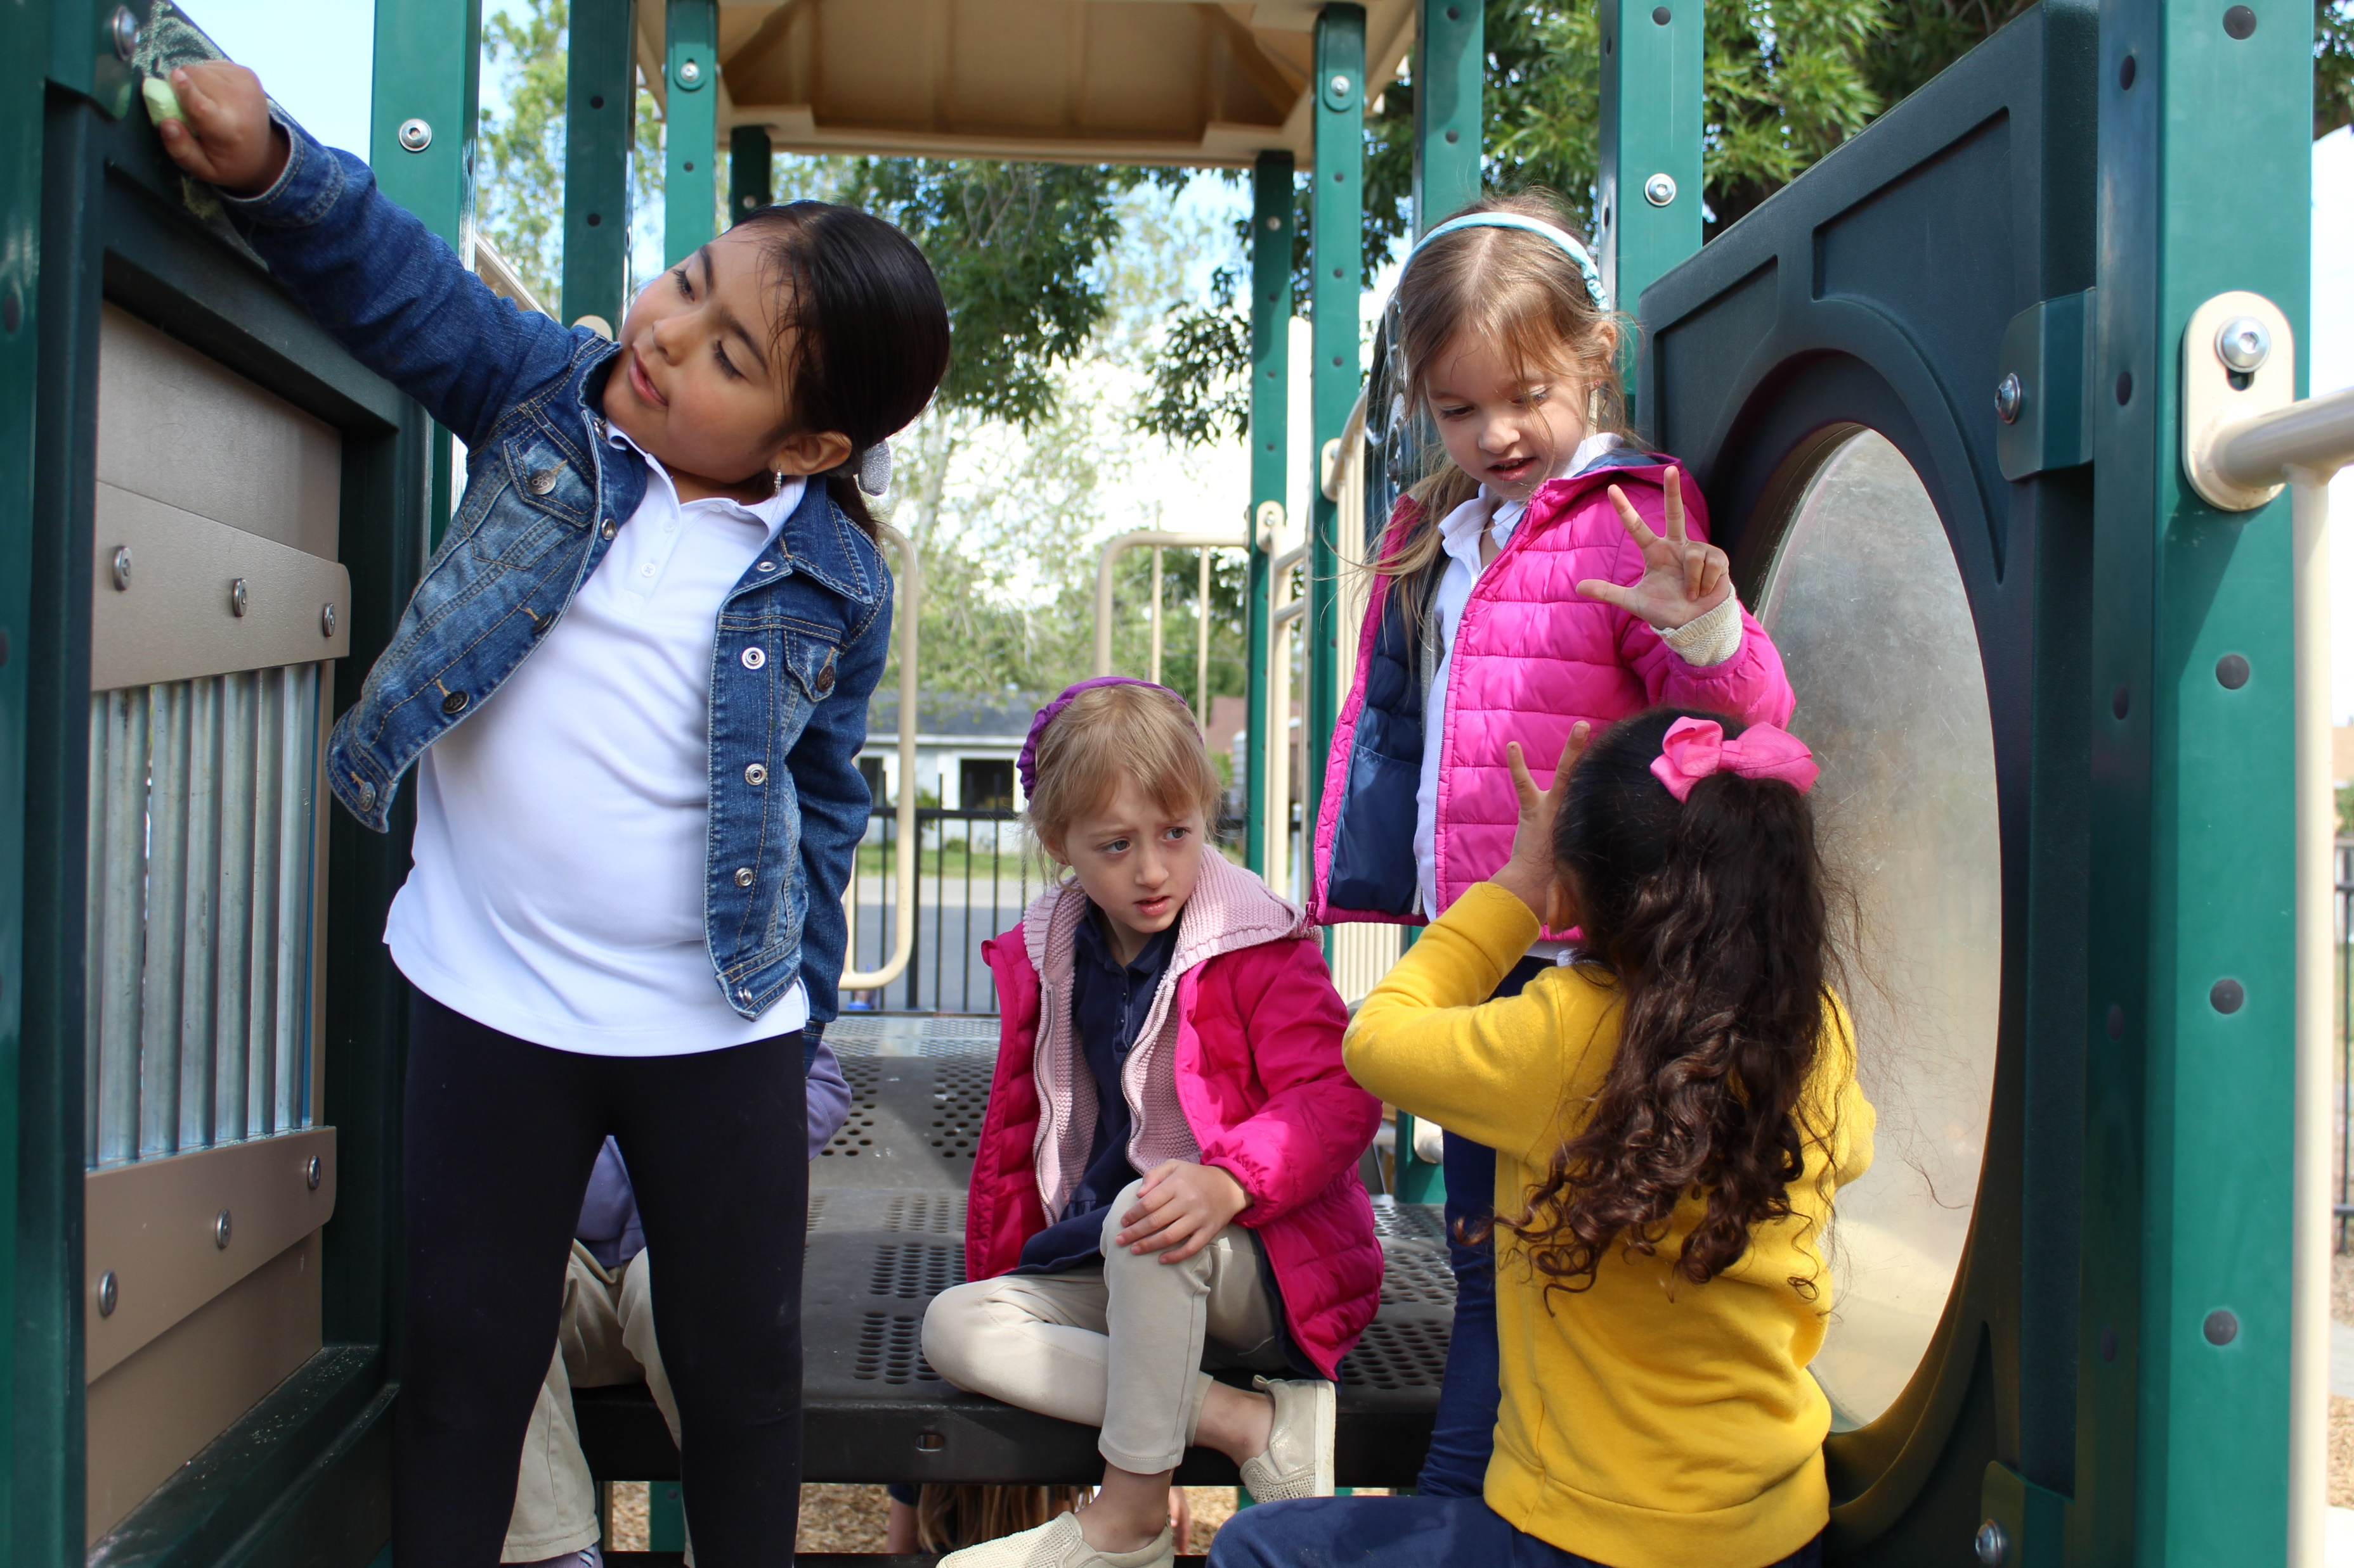
Live Questions on Part One
Photo Credit: Tree of Life International Charter School; Anderson, CA

Slide 22
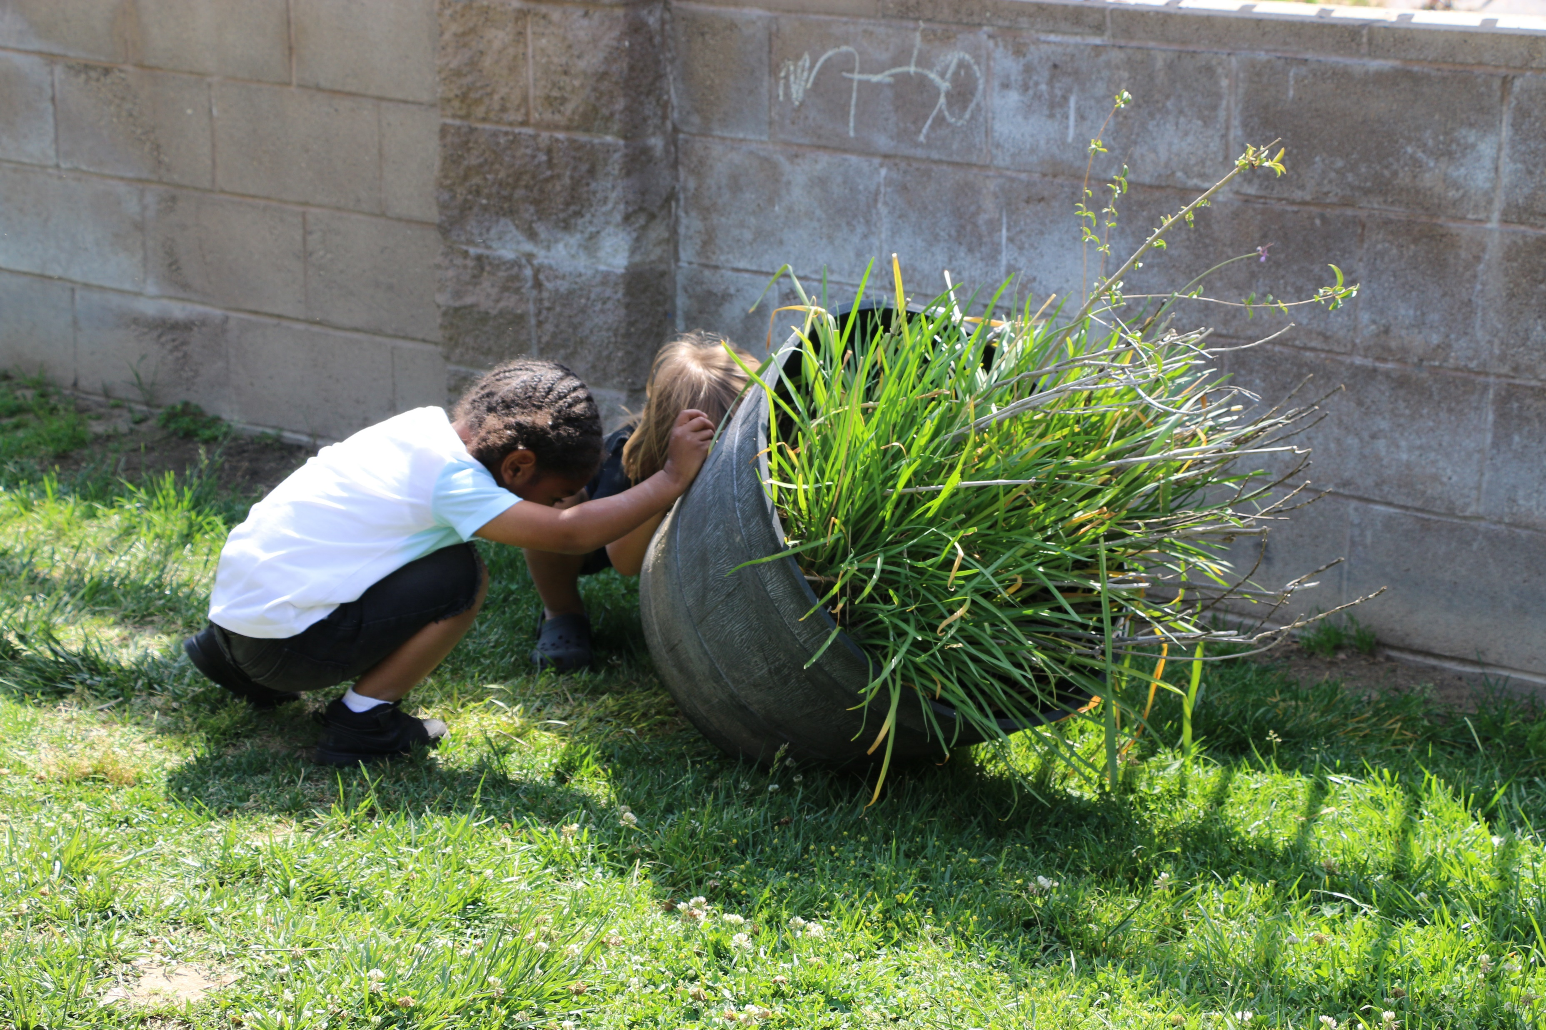
Part Two
Child Development Management Information System
Maintenance and Optimization Update
Photo Credit: LaVera Williams Early Learning Center; Fresno, CA

Slide 23
Child Development Management Information System (CDMIS)
Maintenance and Optimization (M&O) Update
May 19, 2022

Slide 24
Introduction of the CDMIS Team
Jane Liang, Ed.D. − Administrator​, Applied Data Research and Evaluation Office (ADRE)
Josie Chan − Staff Services Analyst, ADRE
Steven Granados − Staff Services Analyst, ADRE

Slide 25
Overview
Purpose of CDMIS M&O
CDMIS M&O Contract
What to Expect
Implementation Plan
Partnership with CDMIS Users
Timeline
Resources and Contact Information

Slide 26
Purpose of the CDMIS Improvement Project
To better serve all partners of early education and care programs
To improve the user experience
To modernize an old database system

Slide 27
CDMIS M&O Contract
Contractor: Capitol Tech Solutions (CTS)
Apply new technology to make the CDMIS look and feel like a modern database system
Shorten electronic file transfer processing times and provides instant reports to the CDD-801A Management Report Summary
Add new functionalities and features

Slide 28
What to Expect
Expanded device compatibility
Automation of tasks
New functionalities
Communication between CDE and CDSS and contractors
Status checks

Slide 29
Username Recovery
Historical Process
  User must contact their Agency Super User or CDMIS Support to recover their username
  User cannot independently identify this information
Updated Process
  Users can utilize the "Forgot Username" function, enter in their CDMIS registered email, and receive an email with a link to view their username

Slide 30
Password Recovery
Historical Process
  User contacts their Agency Super User or CDMIS Support for their most recent password
  If they reach out to CDMIS Support, a phone call must be scheduled with a support staff
Updated Process
  Users can utilize the "Forgot Password" function, enter in their CDMIS username, and receive instructions on resetting password via email

Slide 31
Account Reactivation
Historical Process
  Super Users must request for deactivated users to be reactivated
  CDMIS Staff must manually reactivate accounts
  User must remember username and password upon reactivation to log in
Updated Process
  If the user has been deactivated due to 90 days of inactivity, they can reactivate their account by entering in their username and receiving an activation email from CDMIS

Slide 32
801A Submittal Status
Users will be able to view their agency's 801A submittal status via the "CDD-801A Submittal Status" option
View information for a specific reporting period (month and year)
Compare selected reporting period numbers with previous month numbers, broken down by Program Type
  Children Submitted
  Families Submitted

Slide 33
Account Transaction History
Users will be able to view their agency's account transaction history via the "Account Transaction History" option
801A submissions, manual and electronic, submitted between the selected time frame will appear here
Users can select a time frame to display all submissions between those dates
Users can view report types (801A, 801B, SPR), the month the report was submitted for, total submitted records, submission dates, and report statuses (Submitted, Rejected)

Slide 34
Updated Processing Times
Current Processing Times for Submission Status
  Test site: Up to four hours
  Live site: Overnight
Updated Processing Times for Submission Status
  Test site: Not applicable
  Live site: Instant (up to five seconds)

Slide 35
Messages and Notifications
Users will receive notices for late or missing reports, lock date reminders, warnings of apportionment withholding, and many more useful notifications on the CDMIS landing page.
Users will receive messages directly from their Program Quality Improvement (PQI) consultants and CDMIS team members.
PQI Consultants will now receive email notices when CDMIS users request any additions, deletions, or revisions to their agency information.

Slide 36
Modernized Website
The CDMIS website will be updated to support a high-quality Cascading Style Sheets (CSS) framework called Bootstrap.
Increased compatibility: CDMIS will support the latest versions of each major platform’s default browsers. Additionally, CDMIS will now be accessible through mobile devices, such as smartphones and tablets.
Digital Responsiveness: Web pages will scale up or down to the screen size of the device they are being used on.

Slide 37
Accessibility
Section 508 of the Rehabilitation Act of 1973
  Due to updated federal Section 508 regulations, all of CDE’s Information and Communications Technology (ICT) must be accessible to persons with disabilities.
  CDE consistently strives to develop and maintain electronic information that is accessible, inclusive, and shares a universal design.
  Bootstrap will enhance CDMIS to support Assistive Technology (AT) such as text-to-speech converters, speech-to-text converters, screen magnifiers, and much more.

Slide 38
Implementation Plan
Communication:
  CDMIS updates, emails, webinars
User Acceptance Tests (UAT):
  Seeking user feedback on new features
Documentation:
  Updating the CDMIS user manual, guides, and instructions
User training webinars:
  Hosting a series of online training sessions

Slide 39
Partnership with CDMIS Users
The CDMIS improvement project aims to enhance the user experience
User feedback helps us identify these areas
Collaboration with CDMIS users to target improvement areas

Slide 40
Timeline
Technical Work (Software Updates):
  August 2021–August 2022
Implementation
  May–November 2022
Phase 1 – (June 6th, 2022: 10:30 a.m. to 11:30 a.m.)
  Username Recovery
  Password Recovery
  Account Reactivation (Due to 90 days of inactivity)

Slide 41
Resources and Contact Information
CDMIS technical assistance inbox:
  CDMIS@cde.ca.gov
CDMIS Resources Webpage:
  http://www.cde.ca.gov/sp/cd/ci/ccdata.asp
CDMIS Live Site:
  https://www4.cde.ca.gov/cdmis

Slide 42

Questions
Photo Credit: Kidango Decoto Center; Union City, CA

Slide 43
Resources
The EED COVID-19 Guidance web page
  https://www.cde.ca.gov/sp/cd/re/elcdcovid19.asp
    Webinar slides, MBs, Frequently Asked Questions (FAQs)
The EED Emergency email inbox
  EEDEmergency@cde.ca.gov
The PQI Office Regional Consultants
  https://www.cde.ca.gov/sp/cd/ci/assignments.asp
    Consultants are most easily reached by email
    or by phone at 916-322-6233

Slide 44
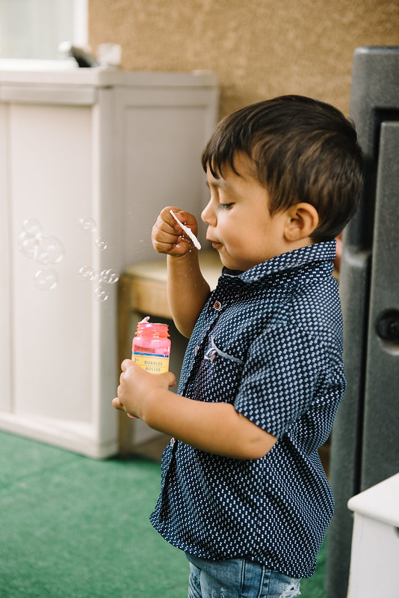
Closing
Photo Credit: Debra Manrique Family Child Care; Oxnard, CA

