Slide 1
The Biliteracy Pathway Recognitions:
Information for Parents and Families
California Department of Education (CDE)
Multilingual Support Division
Notes:
[Total presentation time: 45 minutes. This can be adjusted as needed to fit your timeframe]
[A note for facilitators: These slides include a few interactive elements. If interaction is not supported on the platform you are using, please feel free to take out these slides. If you would like to add information specific to the school or school district, please feel free to customize this presentation to fit your needs and provide relevant local information to families.]
[1 minute]
Welcome! This presentation is titled, “The Biliteracy Pathway Recognitions: Information for Parents and Families.
The information in this presentation comes from the California Department of Education, or CDE, Multilingual Support Division.
If you have additional questions about these recognitions after the presentation, contact information for the CDE Multilingual Support Division will be provided.
[Facilitator introduces themselves]
[Click to advance slide]

Slide 2

Presentation Outline
Overview: Purpose, Program Overview, Multilingualism and Multiliteracy
Criteria:
  Biliteracy Program Participation Recognition
  Home Language Development Recognition
  Biliteracy Attainment Recognition
How You Can Support Your Child: Information and Resources
Questions and Answers
Notes:
[1 minute]
First, I would like to provide you with an outline for this presentation.
Today, we will begin with an overview of the program focusing its purpose, structure, and information on the value of multilingualism and multiliteracy.
Then, I will review the criteria for the three Biliteracy Pathway Recognitions: the Biliteracy Program Participation Recognition, the Home Language Development Recognition, and the Biliteracy Attainment Recognition.
Next, we will discuss how you can support your child in developing biliteracy or multiliteracy at home and I will provide some information and resources that may be helpful.
Finally, we will end with time for questions and answers. Again, if you have questions for the CDE Multilingual Support Division, their contact information will be provided at the end of the presentation.
[Click to advance slide]

Slide 3

Overview
Notes:
[10 seconds]
I would like to begin by providing an overview of the Biliteracy Pathway Recognition Program.
[Click to advance slide]

Slide 4
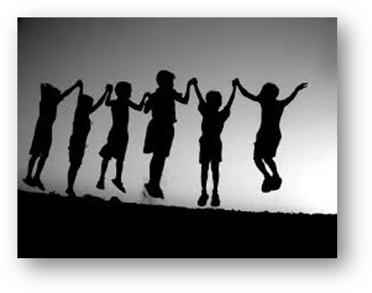
Purpose
To recognize preschool, kindergarten, elementary, and middle school students who have demonstrated progress toward proficiency in speaking, listening, reading, and writing in one or more languages in addition to English.
Notes:
[1 minute]
The purpose of this program is to recognize preschool, kindergarten, elementary, and middle school students who have demonstrated progress toward proficiency in speaking, listening, reading, and writing in one or more languages in addition to English.
Just as the State Seal of Biliteracy recognizes high school graduates who have achieved a high level of literacy in one or more languages in addition to English, this program provides recognition for students who are on the path to biliteracy at key educational segments along their educational journey.
[Click to advance slide]

Slide 5
Additional Purposes (1)
To encourage students to study languages, continue their language study, and become multilingual.
To raise awareness about the State Seal of Biliteracy requirements and ensure that multilingual students have the information they need to meet these requirements and earn the State Seal of Biliteracy upon graduation from high school.
To certify progress toward biliteracy.
To prepare students with twenty-first century skills.
Notes:
[1 minute]
In addition to the overall purpose, there are several other goals that this program hopes to achieve. These include:
To encourage students to study languages, continue their language study, and become multilingual;
To raise awareness about the State Seal of Biliteracy requirements and ensure that multilingual students have the information they need to meet these requirements and earn the State Seal of Biliteracy upon graduation from high school;
To certify progress toward biliteracy; and
To prepare students with twenty-first century skills.
[More on next slide]
[Click to advance slide]

Slide 6
Additional Purposes (2)
To recognize and promote world language instruction in public schools.
To strengthen intergroup relationships, affirm the value of diversity, and honor the multiple cultures, histories, and languages of a community.
To implement principles one and four of the English Learner Roadmap Policy by creating an aligned and articulated pathway to multilingualism that embraces students’ home and community languages and cultures as assets.
Notes:
[1 minute]
Goals also include:
To recognize and promote world language instruction in public schools;
To strengthen intergroup relationships, affirm the value of diversity, and honor the multiple cultures, histories, and languages of a community.; and
To implement principles one and four of the English Learner Roadmap Policy by creating an aligned and articulated pathway to multilingualism that embraces students’ home and community languages and cultures as assets.
[Click to advance slide]

Slide 7
Program Overview
Optional program: Participation is voluntary
Local educational agencies (LEAs) may customize the criteria to fit their needs
The CDE provides:
  Optional criteria
  Optional certificate templates
  Guidance
Recognitions may be awarded in any world language in addition to English, including indigenous languages, languages without a written system, and American Sign Language
Notes:
[1 minute]
The Biliteracy Pathway Recognitions are an optional program and participation is voluntary. Local educational agencies, or LEAs, may customize the criteria to fit their local needs and to ensure the criteria reflects their program goals. Unlike the State Seal of Biliteracy, this program is not established in California Education Code and therefore the criteria are suggested only and may be modified.
The CDE provides optional criteria, guidance, and certificate templates as a resource. LEAs may choose to use or modify the materials provided. No student information must be submitted to the CDE in order to participate. LEAs should keep records locally.
The Biliteracy Pathway Recognitions may be awarded in any world language in addition to English, including indigenous languages, languages without a written system, and American Sign Language.
[Click to advance slide]

Slide 8
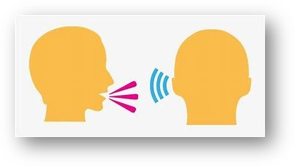

-lingual literate
Notes:
[1 minute]
What is the difference between multilingual or bilingual and multiliterate or biliterate?
“Lingual” refers to the ability to speak and listen in the language. These are valuable skills that allow individuals to communicate with others.
“Literate” also include the ability to read and write in the language. These skills further increase an individual’s ability to communicate in the language and also offer more opportunities to individuals who can speak, listen, read, and write in the language.
Not all languages include a written system and not all people who are bilingual or multilingual are also biliterate or multiliterate.
Therefore, supporting your child to develop bilingualism or multilingualism is an important gift, whether or not you also support them in developing literacy in the home language.
[Click to advance slide]

Slide 9
Benefits of Multilingualism
Cognitive Benefits | Educational Benefits
Increased executive function: Attention control Task switching (mental flexibility) May delay the onset of age-related cognitive decline and the onset of illnesses such as Alzheimer’s disease | Students enrolled in dual language programs have comparable or higher achievement as compared to students in English-only programs Improved learning outcomes in various subjects Associated with increased high school graduation rates among children of immigrants
Notes:
[1 minute]
Multilingualism has many benefits. These include cognitive, educational, sociocultural, and economic benefits.
Some of the cognitive benefits of multilingualism are:
Increased executive function, including attention control and task switching, or mental flexibility.
Multilingualism may also delay the onset of age-related cognitive decline and the onset of illnesses such as Alzheimer’s disease.
Some of the educational benefits of multilingualism are that students enrolled in dual language programs have comparable or higher achievement as compared to students in English-only programs.
They also have improved learning outcomes in various subjects.
Multilingualism is also associated with increased high school graduation rates among children of immigrants.
[Click to advance slide]

Slide 10
Benefits of Multilingualism (2)
Sociocultural Benefits | Economic Benefits
Greater understanding of other world cultures Increased empathy Enhanced connection to heritage cultures Promotes global awareness, reduced discrimination, improved self-esteem, and stronger cross-group relationships | Greater job opportunities in multiple public and private sectors Greater business opportunities Raises occupational status and earning potential Language skills are in high demand for employment with the Federal Government
Notes:
[1 minute]
The sociocultural benefits include greater understand of other world cultures, increased empathy, and enhanced connection to heritage cultures.
Multilingualism also promotes global awareness, reduced discrimination, improved self-esteem, and stronger cross-group relationships.
Finally, the economic benefits include greater job opportunities in multiple public and private sectors and greater business opportunities.
Multilingualism also raises occupational status and earning potential. Along with many other employers, language skills are in high demand for employment with the Federal Government.
[Click to advance slide]

Slide 11
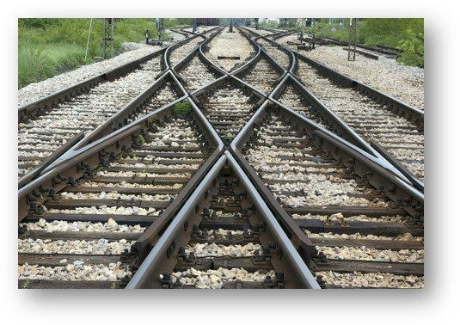
Multiple Paths to Biliteracy
There are multiple paths to biliteracy and these recognitions provide LEAs with the opportunity to highlight some of these paths to encourage students to pursue biliteracy or multiliteracy in high school and beyond.
Notes:
[1 minute]
As you know, there are multiple paths to biliteracy.
These recognitions provide schools and districts with the opportunity to highlight some of these paths to encourage students to pursue biliteracy or multiliteracy in high school and beyond.
If these recognitions do not mesh well with the path to biliteracy established at the school or district, they may be modified or the school or district may choose to create its own recognition or criteria that better reflects the program model or models offered.
[This may be a good time to discuss the paths to multilingualism offered at the school or in the district]
[Click to advance slide]

Slide 12

Multilingual Programs
For more information on multilingual education, including descriptions of program models, information on the benefits of multilingualism, and parent resources, visit the CDE Multilingual Education web page at https://www.cde.ca.gov/sp/el/er/multilingualedu.asp.
Notes:
[1 minute]
For more information on multilingual education, including descriptions of program models, information on the benefits of multilingualism, and parent resources, visit the CDE Multilingual Education web page at https://www.cde.ca.gov/sp/el/er/multilingualedu.asp.
[Click to advance slide]

Slide 13

The Power of Biliteracy and Multiliteracy
For more information on the power of biliteracy and multiliteracy, visit the Alas Y Voz website at https://californianstogether.org/alas-y-voz/.
  Includes resources, videos, and information for parents and families in Spanish.
Notes:
[1 minute]
For more information on the power of biliteracy and multiliteracy, visit the Alas Y Voz website at https://californianstogether.org/alas-y-voz/.
This web page includes resources, videos, and information for parents and families in Spanish.
[Click to advance slide]

Slide 14

Criteria
Notes:
[10 seconds]
Next, I will go over the suggested criteria for each of the recognitions.
[Click to advance slide]

Slide 15

Biliteracy Pathway Recognitions (2)
The three Biliteracy Pathway Recognitions available are:
The Biliteracy Program Participation Recognition;
The Home Language Development Recognition; and
The Biliteracy Attainment Recognition.
Notes:
[1 minute]
To recognize the importance of multilingualism, the CDE has established the Biliteracy Pathway Recognitions.
The three Biliteracy Pathway Recognitions available are:
1. The Biliteracy Program Participation Recognition,
2. The Home Language Development Recognition, and
3. The Biliteracy Attainment Recognition.
[Click to advance slide]

Slide 16

Biliteracy Program Participation Recognition
This recognition is:
Available to students enrolled in programs leading to biliteracy in preschool, kindergarten, elementary, and middle school
A participation recognition provided to all students enrolled in the program and is not based on the student’s proficiency
An entry on the path to biliteracy or multiliteracy
Notes:
[1 minute]
The first recognition is the Biliteracy Program Participation Recognition.
This recognition is:
Available to students enrolled in programs leading to biliteracy in preschool, kindergarten, elementary, and middle school;
A participation recognition provided to all students enrolled in the program and is not based on the student’s proficiency; and
An entry on the path to biliteracy or multiliteracy.
Any student enrolled in any kind of multilingual program can earn this recognition by participating. This could include Dual-Language Immersion, or DLI, Transitional Bilingual, Developmental Bilingual, Foreign Language Elementary Experience, or FLEX, and Foreign Language in Elementary Schools, or FLES. The program types are not limited to these, but these tend to be the most common.
This would also include students who are enrolled in a community multilingual program, such as a tribal or community center program designed for students recovering a heritage language.
Finally, for young preschool dual language learners, any program that exposes students to two or more languages would count as a multilingual program for this recognition’s purposes.
[Click to advance slide]

Slide 17

Home Language Development Recognition
This recognition is:
Available to emergent bilingual students with a home language other than English in preschool, kindergarten, elementary, and middle school
Provided to students who demonstrate that they are continuing to develop the home language by engaging in age-appropriate activities in the home language
An entry on the path to biliteracy or multiliteracy
Notes:
[1 minute]
The next recognition is the Home Language Development Recognition.
This recognition is:
Available to emergent bilingual students with a home language other than English in preschool, kindergarten, elementary, and middle school;
Provided to students who demonstrate that they are continuing to develop the home language by engaging in age-appropriate activities in the home language; and
An entry on the path to biliteracy or multiliteracy.
Even if a school does not offer a bilingual program or other language program, the school may still recognize students with a home language other than English for their continued work in this language and the asset that it represents with this award.
Schools and districts may decide how best to track whether students have met this criteria. For younger children, home language development may be observed during a home visit, for example. Other ways to verify whether students are on track to earn this recognition would be in parent-teacher meetings or by administering a survey to parents.
[Click to advance slide]

Slide 18

Biliteracy Attainment Recognition
This recognition is:
Available to students at the end of elementary school and the end of middle school
Based on proficiency
  Awarded to students who meet specific proficiency criteria in English and one or more languages in addition to English
Aligned with the State Seal of Biliteracy requirements
  Indicates that if a student continues on this path in high school they will be prepared to meet the requirements to earn the State Seal of Biliteracy
Notes:
[1 minute]
The final recognition is the Biliteracy Attainment Recognition.
This recognition is:
Available to students at the end of elementary school and the end of middle school;
Based on proficiency and awarded to students who meet specific proficiency criteria in English and one or more languages in addition to English;
Aligned with the State Seal of Biliteracy requirements; and
Indicates that if a student continues on this path in high school they will be prepared to meet the requirements to earn the State Seal of Biliteracy.
[Click to advance slide]

Slide 19
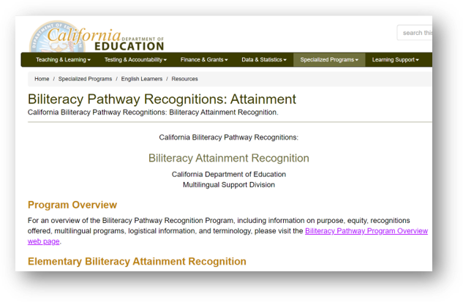
Biliteracy Attainment Recognition (2)
Criteria is available on the CDE Biliteracy Pathway Recognitions: Attainment web page at https://www.cde.ca.gov/sp/el/er/blitattainment.asp
Notes:
[1 minute]
I would like to walk you through the criteria for the Biliteracy Attainment Recognition, as this recognition has more in-depth criteria than the other two.
[Facilitator can pull up this web page and walk participants through the various ways that students may show proficiency in English and in one or more languages in addition to English]
[Click to advance slide]

Slide 20

Discussion
Which recognition, or recognitions, do you think your child might be eligible for?
How can you reach out to your child’s teacher, counselor, or an administrator at the school to inquire about this recognition?
How can you share this information with other parents?
Notes:
[5 minutes]
[If in person, the facilitator can ask participants to discuss in small groups or with partners. In a virtual setting, the facilitator can divide participants into small breakout rooms for discussion.]
Please take a few minutes to discuss in small groups:
Which recognition, or recognitions, do you think your child might be eligible for?
How can you reach out to your child’s teacher, counselor, or an administrator at the school to inquire about this recognition?
How can you share this information with other parents?
[Give participants 4 minutes to discuss]
Does anyone have any ideas of how you could reach out to others to spread the word about these recognitions?
[Give participants time to share ideas and record ideas if possible]
[Click to advance slide]

Slide 21
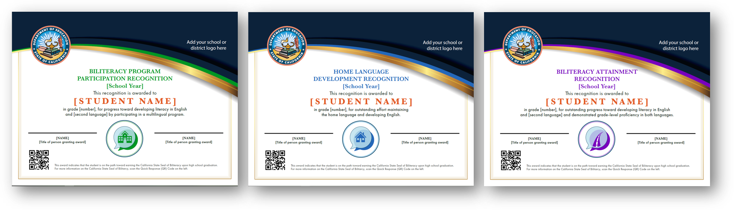
Certificates
Each student that meets the requirements may be awarded a certificate
Notes:
[1 minute]
So, what do students who earn one or more of these recognitions receive?
Each student who meets the requirements may be awarded a certificate. There are different certificates for each recognition.
Some schools or districts may also choose to create their own certificates or provide another time of recognition in addition to or instead of these.
[If the school or district has additional recognitions, share that information now]
[Click to advance slide]

Slide 22

Questions
Notes:
[2 minutes]
Are there any questions so far?
[Pause to answer questions, either using the chat or verbally]
[Click to advance slide]

Slide 23

How You Can Support Your Child
Notes:
[10 seconds]
Next, I will provide information on how you can support your child to develop biliteracy, whether they are enrolled in a multilingual program or not.
This information is especially relevant for parents or families hoping to assist children to develop or maintain the home language and earn the Home Language Development Recognition.
[Click to advance slide]

Slide 24

Home Language Development
If you speak a language other than, or in addition to English, at home find opportunities to read, write, speak, and listen with your child in the home language.
Notes:
[1 minute]
If you speak a language other than or in addition to English at home, find opportunities to read, write, speak, and listen with your child in the home language.
If you are not able to assist with all of these parts of biliteracy, you are still giving your child an important gift by providing them opportunities to engage in whichever of these means of communication that you can support them in.
[Click to advance slide]

Slide 25

Reading
For younger children: Reading or being read an age-appropriate story or nonfiction text with a caregiver in the home language. Recognizing letters or characters in the home language with a caregiver. Recognizing or sounding out words or characters in the home language. Playing rhyming, alphabet, or letter/character games in the home language, etc.
For older children: Reading an age-appropriate book (fiction or nonfiction), story, comic, recipe, magazine, or other text in the home language, including reading to a younger child in the home language, etc.
Notes:
[1 minute]
There are many ways to assist your child with reading in the home language.
For younger children, you as they caregiver can help them develop their reading skills by supporting them to read or reading them an age-appropriate story or nonfiction text in the home language. You can also help them recognize letters or characters in the home language or help them recognize or sound out words or characters in the home language. Another way you can help your child with early literacy is by playing rhyming, alphabet, or letter/character games in the home language.
For older children, you can encourage them to read an age-appropriate book (fiction or nonfiction), story, comic, recipe, magazine, or other text in the home language, including reading to a younger child in the home language. Reading together as a family is also a great activity for kids of any age.
[Click to advance slide]

Slide 26

Writing
For younger children: Using a combination of drawing, dictating, and writing to tell a story or describe something in the home language. Practicing writing letters or characters in the home language or writing simple words in the home language with a caregiver, etc.
For older children: Writing a story, poem, or letter in the home language, keeping a journal in the home language, etc.
Notes:
[1 minute]
There are also many ways to assist your child with writing in the home language.
For younger children, you as they caregiver can help them use a combination of drawing, dictating, and writing to tell a story or describe something in the home language. When they are drawing a picture, you could ask them to describe it to you in the home language and write down what they tell you. You can also support them to practice letters or characters in the home language or by writing simple words in the home language together.
For older children, you can encourage them to write a story, poem, or letter in the home language. They could write to another family member in the home language or create a comic for a younger sibling. You could also encourage them to keep a journal in the home language.
[Click to advance slide]

Slide 27

Speaking
For younger children: Asking and answering questions while helping a caregiver make a meal or while playing with a sibling, pointing out and naming objects in the home language, talking about a story with a caregiver in the home language, singing songs in the home language, playing games or doing puzzles in the home language, etc.
For older children: Teaching a sibling a game in the home language, telling a story in the home language, explaining what they learned in school that day in the home language, talking on the phone with a relative in the home language, interviewing an older relative in the home language, etc.
Notes:
[1 minute]
Another important way you can support your child in the home language is through speaking.
For younger children, you as they caregiver can ask them questions and encourage them to answer in the home language while they are helping you make a meal or while playing with you or a sibling. You can also point out and name objects in the home language. When you read together, you can talk about the story in the home language and ask them questions about it. You can also sing songs, play games, or do puzzles in the home language.
For older children, you can encourage them to teach a sibling a game in the home language, tell a story in the home language, explain what they learned in school that day in the home language, talk on the phone with a relative in the home language, interview an older relative in the home language, etc.
[Click to advance slide]

Slide 28

Listening
For younger children: Learning a new skill from a caregiver who is speaking the home language, listening to a story in the home language, playing a game that includes listening in the home language, etc.
For older children: Learning a new skill from a caregiver who is speaking the home language; listening to a story in the home language; interviewing an older relative in the home language; listening to the radio, a movie, or television program in the home language and discussing it afterwards; listening to a speech or sermon in the home language; etc.
Notes:
[1 minute]
The final element of biliteracy that you can support your child with is listening.
For younger children, you as they caregiver can teach the child a new skill while speaking the home language, have the child listen to a story in the home language, play a game that includes listening in the home language, etc.
For older children, you can also teach them a new skill while speaking the home language; have them listen to a story in the home language; encourage them to interview an older relative in the home language; listen to the radio, a movie, or television program in the home language and discuss it afterwards; listen to a speech or sermon in the home language; etc.
[Click to advance slide]

Slide 29
Discussion (2)
What is one way you currently support your child in developing literacy (reading, writing, speaking, and listening) in the home language?
What is one new way you could support your child in developing literacy (reading, writing, speaking, and listening) in the home language?
Notes:
[6 minutes]
[If in person, the facilitator can ask participants to discuss in small groups or with partners. In a virtual setting, the facilitator can divide participants into small breakout rooms for discussion.]
Please take a few minutes to discuss in small groups:
What is one way you currently support your child in developing literacy (reading, writing, speaking, and listening) in the home language?
What is one new way you could support your child in developing literacy (reading, writing, speaking, and listening) in the home language?
[Give participants 4 minute to talk in groups. Then ask participants to share ideas.]
[Click to advance slide]

Slide 30
Home Language Development Resources
For more ideas on developing biliteracy at home, visit:
First 5 California Everyday Opportunities for Speech, Language, and Literacy Development web page at https://www.first5california.com/en-us/articles/everyday-opportunities-for-speech-language-and-literacy-development-newborn-baby-toddler-preschooler/
First 5 California Multiple Languages in the Home, Benefits and Myths web page at https://www.first5california.com/en-us/articles/multiple-languages-in-the-home-benefits-and-myths-newborn-baby-toddler-preschooler/
Notes:
[30 seconds]
There are many resources that can help you support your child to develop biliteracy.
For example, the First 5 California Everyday Opportunities for Speech, Language, and Literacy Development web page and the First 5 California Multiple Languages in the Home, Benefits and Myths web page are both helpful resources.
[Place links to these web pages in the chat or provide this presentation to participants. More resources on next slide.]
[Click to advance slide]

Slide 31
Home Language Development Resources (2)
U.S. Department of Education Early Learning: Talk, Read, and Sing! web page at https://www.ed.gov/early-learning/talk-read-sing
¡Colorín, Colorado! For Families web page at https://www.colorincolorado.org/families
Notes:
[30 seconds]
Additionally, the U.S. Department of Education Early Learning: Talk, Read, and Sing! web page and the ¡Colorín, Colorado! For Families web page provide resources that may be helpful.
[Place links to these web pages in the chat or provide this presentation to participants.]
[Click to advance slide]

Slide 32
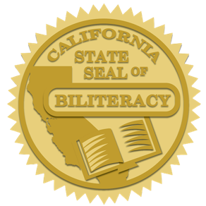
Preparing Early for the State Seal of Biliteracy
Visit the CDE State Seal of Biliteracy web page at https://www.cde.ca.gov/sp/el/er/sealofbiliteracy.asp
Know the requirements and discuss them with your child’s counselor in middle school and the transition to high school
Get your child excited about the State Seal of Biliteracy:
  What it is
  Why it matters
Notes:
[1 minute]
The Biliteracy Pathway Recognitions are steps along the path to developing biliteracy.
The State Seal of Biliteracy is awarded to high school graduates who have demonstrated a high level of proficiency in reading, writing, listening, and speaking in one or more languages in addition to English.
This prestigious award is something that you can discuss with your child and their teachers and counselors early to ensure that your child is ready to meet this standard in high school.
You can find more information on the CDE State Seal of Biliteracy web page.
A good place to start with younger children is to let them know what this award is and why it matters. Explain how valuable biliteracy is and what it means to you, your family, your community, and for your child’s future in college, career, and beyond.
[Click to advance slide]

Slide 33

Questions and Answers
Notes:
[10 seconds]
Finally, we will have some additional time for questions and answers before we close.
[Click to advance slide]

Slide 34
Questions (2)
Notes:
[5 minutes]
Are there any questions?
[Pause and take questions either in the chat or verbally.]
[Click to advance slide]

Slide 35

Contact Information
For questions regarding the Biliteracy Pathway Recognition Program, please contact:
  CDE Multilingual Support Division
  Phone: 916-319-0938
  Email: SEAL@cde.ca.gov
CDE Biliteracy Pathway Recognitions web page at https://www.cde.ca.gov/sp/el/er/biltrcypathwy.asp
Notes:
[1 minute]
[Add a slide with the facilitator’s contact information for questions specific to the school or district]
For questions about the Biliteracy Pathway Recognition Program, please contact the CDE Multilingual Support Division by phone at 916-319-0938 or by email at SEAL@cde.ca.gov.
The CDE Biliteracy Pathway Recognitions web page also contains additional information and resources related to this program.
[Click to advance slide]

Slide 36
Thank You!
Notes:
[20 seconds]
Thank you all for supporting your children and for your interest in this program.
[Click to advance slide]

