Slide 1
Item 01: Overview of Assembly Bill 1505 and the Funding Determination Process

Slide 2
Purpose of this Presentation
The purpose of this presentation is to provide Advisory Commission on Charter Schools (ACCS) members with an overview of the impact of Assembly Bills 1505 and 1507 with an emphasis on its role in the charter appeal process.
In this presentation, ACCS members will also be provided with an overview of the funding determination request process.
This is an information item only; no action will be taken by the ACCS.

Slide 3
Today’s Objective
The focus of today’s overview will be on the following points:
  Background of the funding determination request process
  General overview of AB 1505 and summary of the California Department of Education’s (CDE) implementation efforts
  State Board of Education (SBE) appeals and review standards
  Renewal criteria and performance criteria, including the consideration of verified data
  Role of the CDE and ACCS in the appeal process
  Requirements for nonclassroom-based (NCB) and “treat as continuing” charter schools

Slide 4
Nonclassroom-Based
Determination of Funding Requests

Slide 5
Funding Determination Background
Senate Bill 740 established the funding determination process
A charter school may receive funding for its NCB instruction only if a determination for funding is made by the SBE
  NCB instruction: total average daily attendance (ADA) is less than 80 percent classroom-based

Slide 6
Funding Determination Form
Developed to process determination of funding requests
  Report of revenues received and funds expended by NCB charter schools
  Used to calculate appropriate levels of funding for NCB ADA
Submitted to the CDE and presented to the ACCS and SBE
Advisory Commission on Charter Schools
State Board of Education
California Department of Education

Slide 7
Funding Determination Levels
Funding Level | Percent Spent on Instructional Certificated Staff Salaries and Benefits | Percent Spent on Instruction and Related Services | Independent Study Pupil to Full Time Equivalent Certificated Teacher Ratio
100% (full funding) | ≥ 40% | ≥ 80% | 25:1
85% | ≥ 40% | ≥ 70% | N/A
70% | ≥ 35% | ≥ 60% | N/A
0% (denial) | < 35% | < 60% | N/A

Slide 8
“Reasonable Basis”/Mitigating Circumstances
Permits a funding determination recommendation other than one that results from the expenditure requirements required by regulations. May include the following:
  Documented data regarding individual circumstances of the charter school
  One-time expenses; unique or exceptional expenses

Slide 9
Funding Determination Submission Deadlines and Funding Periods
New NCB charter school
  December 1 of its first year of operation
  Funding determination shall be for a period of two years
Existing NCB charter school
  February 1 of the fiscal year prior to the year the funding determination will be effective
  Funding determination shall be for a minimum of two years and a maximum of five years

Slide 10
Assembly Bills 1505 and 1507

Slide 11
Impacts and Requirements
AB 1505 impacts various aspects of charter school law and establishes certain requirements, including, but not limited to, the following:
  Charter school establishments and renewals
  Charter school appeals
  Role of the ACCS
  CDE-provided aggregate enrollment data
  Consideration of verified data
  Geographic and site limitations
  Temporary prohibition on NCB charter schools
  “Treat as continuing” requirements
  Teacher credentialing requirements
  Bill implementation tracking

Slide 12
California Department of Education Implementation Efforts
SBE information memoranda (October 2019 and June 2020)
Charter Schools Division newsletter and Frequently Asked Questions
Technical assistance and support
  The CDE is prepared to process appeals and make new/continuing charter school determinations, per AB 1505 and 1507
Verified data list and aggregate enrollment data
Stakeholder engagement opportunities
Implementation tracking of bill

Slide 13
Charter School Renewals:
Criteria for Performance Categories

Slide 14
Alternative Schools: State and Local Indicators
Dashboard Alternative Schools Status (DASS) schools are not placed in a performance category (California Education Code [EC] Section 47607[c][7])
For DASS renewals, charter authorizers shall consider the following:
  Performance on the state and local indicators in the California School Dashboard (Dashboard)

Slide 15
Alternative Schools: Alternative Metrics
In addition, charter school authorizers must meet with the charter school during the first year of the charter school’s term to mutually agree to discuss alternative metrics to be considered and shall notify the charter school of the alternative metrics to be used within 30 days of the meeting

Slide 16
Three Performance Categories
High Performing: Presumptive renewal if the charter school meets the established renewal criteria – EC Section 47607
Low Performing: Presumptive non-renewal if the charter school meets the non-renewal criteria; however, the law allows for a second review opportunity – EC Section 47607.2
Middle Performing: These schools will be evaluated using additional data – EC sections 47607(c)(5) and 47607.2(b)
Note: The CDE publicly posted a data file that provides the performance categories for all non-DASS charter schools, which is available at https://www.cde.ca.gov/sp/ch/ab1505.asp

Slide 17
Additional Criteria for Denying a Renewal
Per EC Section 47607(e), a chartering authority may deny renewal of DASS charter schools and non-DASS charter schools in any of the three performance categories if:
  There is finding that the school is unlikely to successfully implement the program due to substantial fiscal or governance factors, or
  The charter school is not serving all pupils who wish to attend

Slide 18
Terminology: Academic Indicators
Academic Indicators are defined in AB 1505 as follows (EC Section 47607[c][3]):
  English Language Arts/Literacy (ELA)
  Mathematics
  College/Career Indicator (CCI)
  English Learner Progress Indicator (ELPI)

Slide 19
Terminology: Statewide Average
AB 1505 requires the performance of charter schools, and their student groups, be compared with the statewide average on the four state academic indicators
“Status” is being used as the “statewide average” for the academic indicators because:
  The term “average” refers to a number
  Status is much more precise than a color

Slide 20
Criteria for Performance Categories
A school may be placed into the high, middle, low performance categories based on two different methodologies:
  Criterion 1: Based on the colors received for all the state indicators in the Dashboard
    Schoolwide data only
  Criterion 2: Based on the “Status” for all academic indicators with 30 or more students
    Schoolwide and student-group data considered

Slide 21
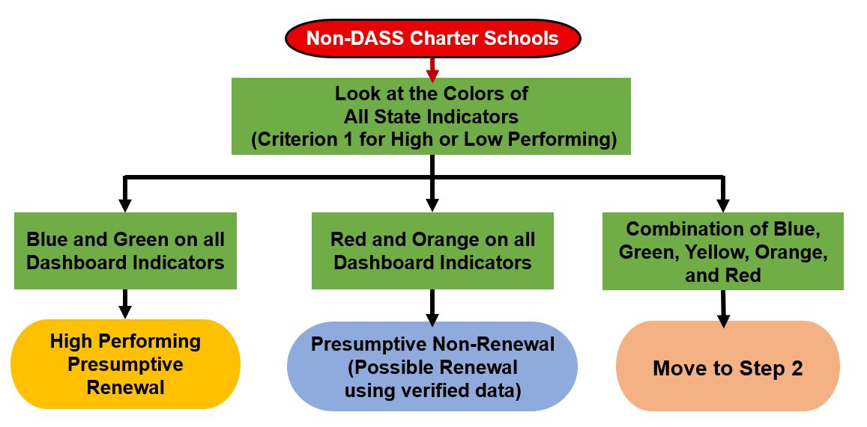
Flowchart for Charter Renewal: Step 1

Slide 22
Descriptive Text for
Flowchart for Charter Renewal: Step 1
For all Non-DASS charter schools, Look at the Colors of All State Indicators (Criterion 1 for High or Low Performing):
  If Blue and Green on all Dashboard Indicators then High Performing Presumptive Renewal.
  If Red and Orange on all Dashboard Indicators then Presumptive Non-Renewal (Possible Renewal using verified data).
  If Combination of Blue, Green, Yellow, Orange, and Red then Move to Step 2.

Slide 23
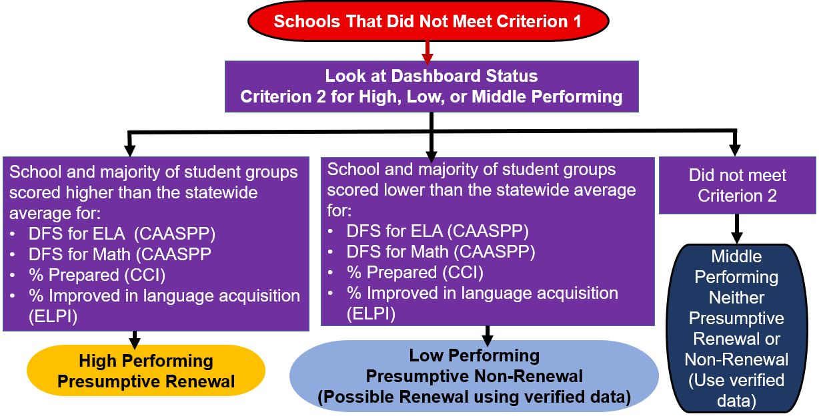
Flowchart for Charter Renewal: Step 2

Slide 24
Descriptive Text for Flowchart for Charter Renewal: Step 2 (Slide 1)
Schools That Did Not Meet Criterion 1 – Look at Dashboard Status Criterion 2 for High, Low, or Middle Performing
School and majority of student groups scored higher than the statewide average for: DFS for ELA (CAASPP), DFS for Math (CAASPP), % Prepared (CCI), % Improved in language acquisition (ELPI) then High Performing Presumptive Renewal.

Slide 25
Descriptive Text for Flowchart for Charter Renewal: Step 2 (Slide 2)
School and majority of student groups scored lower than the statewide average for: DFS for ELA (CAASPP), DFS for Math (CAASPP), % Prepared (CCI), % Improved in language acquisition (ELPI) then Low Performing Presumptive Non-Renewal (Possible Renewal using verified data).
Did not meet Criterion 2 then Middle Performing Neither Presumptive Renewal or Non-Renewal (Use verified data).

Slide 26
Results for Low- and High-Performing
Charter Schools

Slide 27
Low and High Performing Results: Based on Colors
(Criterion 1: Schoolwide Only)
School Type | Low Performing (Red/Orange for 2 years) | High Performing (Blue/Green for 2 years)
Elementary Schools | 0 | 18
Middle Schools | 0 | 0
High Schools | 0 | 7
K-12 Schools | 0 | 2
All School Types Total | 0 | 27
Note: There are approximately 1,200 charter schools that have been open for 2 years. Results produced using 2018 and 2019 Dashboard Performance Levels (colors)
None of the high performing schools were on the Differentiated Assistance list for the 2019–20 school year
Notes:
This slide may need to be updated depending on the results of including the ELPI or not with the proxy for color. Important to note whether it was chosen to be included or not!!!

Slide 28
High and Low Performing Results: Based on Status
(Criterion 2)
School Type | Low | High
Elementary Schools | 22 | 106
Middle Schools | 24 | 28
High Schools | 4 | 25
K-12 Schools | 22 | 19
All School Type Totals | 72 | 178
Note: Schools that met Criterion 1 for high or low performing are not included since they need to meet only one of the criteria for the high performing level

Slide 29
Results for the Three Categories
Based on the 2018 and 2019 Dashboard
Note: DASS schools are not to be included in any of the performance categories
Schools in the Low and Middle Performance categories are subject to the verified data in the renewal process
School Type | Low | Middle | High | Total
Elementary Schools | 22 | 410 | 124 | 556
Middle Schools | 24 | 89 | 28 | 141
High Schools | 4 | 172 | 32 | 208
K-12 Schools | 22 | 184 | 21 | 227
All School Type Totals | 72 (6.4%) | 855 (75.5%) | 205 (18.1%) | 1,132

Slide 30
Appeals Heard by the State Board of Education

Slide 31
Appeals to the State Board of Education
What appeals are heard by the SBE?
  How does the review standard and process differ for establishment appeals and renewal appeals?
  What are the new findings for the denial of an establishment petition?
What information is considered in the review of an appeal?
What are the timelines for the appeal process?
Which charter schools are currently authorized by the SBE? Which counties have jurisdiction over a single school district?

Slide 32
Appeal Review Standards
Petition Type | Review Standard
New and Renewal Petitions Denied by a Single District County | De Novo Review
Renewal Petitions for SBE-Authorized Schools Denied at the Local Level | De Novo Review
New and Renewal Petitions Denied by a District and County Board | Abuse of Discretion Review
Revocation Petitions | Substantial Evidence Review

Slide 33
De Novo Review Standard (Slide 1)
What appeals are reviewed under this standard?
  Appeals of new and renewing petitions for charter schools denied by a county board that has jurisdiction over a single school district, and renewing petitions for SBE-authorized charter schools
What information is considered?
  All required elements and prior history
What is the role of the ACCS?
  Reviews the item and recommendation from the CDE, and makes an independent recommendation to the SBE.

Slide 34
De Novo Review Standard (Slide 2)
What is the role of the SBE?
  Independently considers all of the issues previously considered by the district and county, and makes an independent determination regarding the petition

Slide 35
Abuse of Discretion Review Standard (Slide 1)
What appeals are reviewed under this standard?
  Appeals of new and renewing petitions for charter schools denied by a district and county board
What information is considered?
  District and county findings, documentary record, written submission detailing how the district and/or county abused its discretion, written opposition from district and/or county
What is the role of the ACCS?
  Recommends to the SBE to either hear or summarily deny the appeal (option to make no recommendation)

Slide 36
Abuse of Discretion Review Standard (Slide 2)
What is the role of the SBE?
  Reviews the documentary record and decides whether there was an abuse of discretion by the school district and/or the county board of education

Slide 37
Findings for Denial for the
Establishment of a New School
The petition presents an unsound educational program
The petitioners are demonstrably unlikely to successfully implement the program
The petition does not contain a reasonably comprehensive description of the 15 required charter elements
The petition does not contain the required signatures
The petition does not contain an affirmation of each of the conditions described in subdivision (e)
New: The school is demonstrably unlikely to serve the interests of the entire community in which the school proposes to locate
New: The school district is not positioned to absorb the fiscal impact of the charter school

Slide 38
Additional Findings for Denial for the
Establishment/Material Revision of a School (Slide 1)
Community Impact
The school is demonstrably unlikely to serve the interests of the entire community in which the school proposes to locate
Includes the following considerations:
  Fiscal impact of the proposed school
  Extent to which the proposed school would substantially undermine existing services, academic offerings, or programmatic offerings
  Whether the proposal duplicates a program currently offered by the school district

Slide 39
Additional Findings for Denial for the
Establishment/Material Revision of a School (Slide 2)
Fiscal Impact
The school district is not positioned to absorb the fiscal impact of the charter school
A school district satisfies these criteria if the following is met:
  It is under the authority of a state trustee or administrator,
  It is in negative certification, or
  It is in qualified certification and the county superintendent and FCMAT certify that approval of the charter school would result in the district having a negative certification

Slide 40
Role of the California Department of Education
The CDE will continue to review petitions on appeal and make recommendations to the SBE; however, the recommendations of the CDE will differ as they are dependent upon the type of appeal being reviewed:
  Review and provide a recommendation to grant or deny an appeal from a district decision where the county has jurisdiction over a single school district and SBE-authorized charter schools
  Review and provide a recommendation on whether the district and/or county abused its discretion after denial by a county

Slide 41
Role of the Advisory Commission on
Charter Schools
Prior to AB 1505, the role of the ACCS was not required by statute
  The historical role of the ACCS has been to serve as an advisory body that holds public meetings to make recommendations to the SBE on NCB funding determination requests and on whether it should approve or deny charter petitions on appeal, amongst other duties
AB 1505 contemplates a statutory role for the ACCS
  EC Section 47605(k)(2)(D) codifies the current role of the ACCS

Slide 42
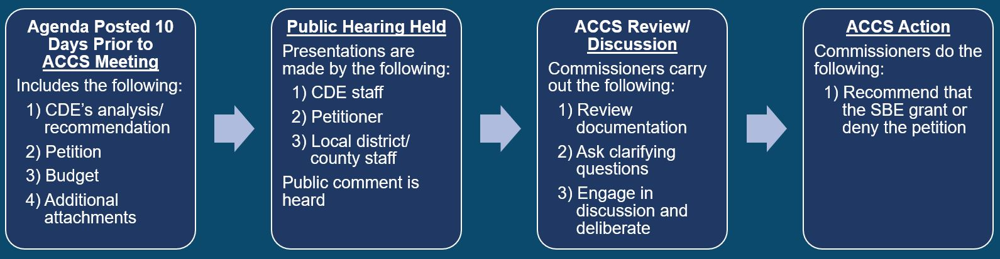
ACCS Process: De Novo Review
This process will be used when hearing the following appeals:
  New and renewing petitions for charter schools denied by a county board that has jurisdiction over a single school district
  Renewing petitions for SBE-authorized charter schools

Slide 43
Descriptive Text for
ACCS Process: De Novo Review (Slide 1)
Agenda Posted 10 Days Prior to ACCS Meeting
  Includes the following: 1) CDE’s analysis/recommendation, 2) petition, 3) budget, and 4) additional attachments
Public Hearing is Held
  Presentations are made by the following: 1) CDE staff, 2) petitioner, and 3) local district/county staff
  Public comment is heard

Slide 44
Descriptive Text for
ACCS Process: De Novo Review (Slide 2)
ACCS Review/Discussion
  Commissioners carry out the following: 1) review documentation, 2) ask clarifying questions, and 3) engage in discussion and deliberate
ACCS Action
  Commissioners do the following: 1) recommend that the SBE grant or deny the petition

Slide 45
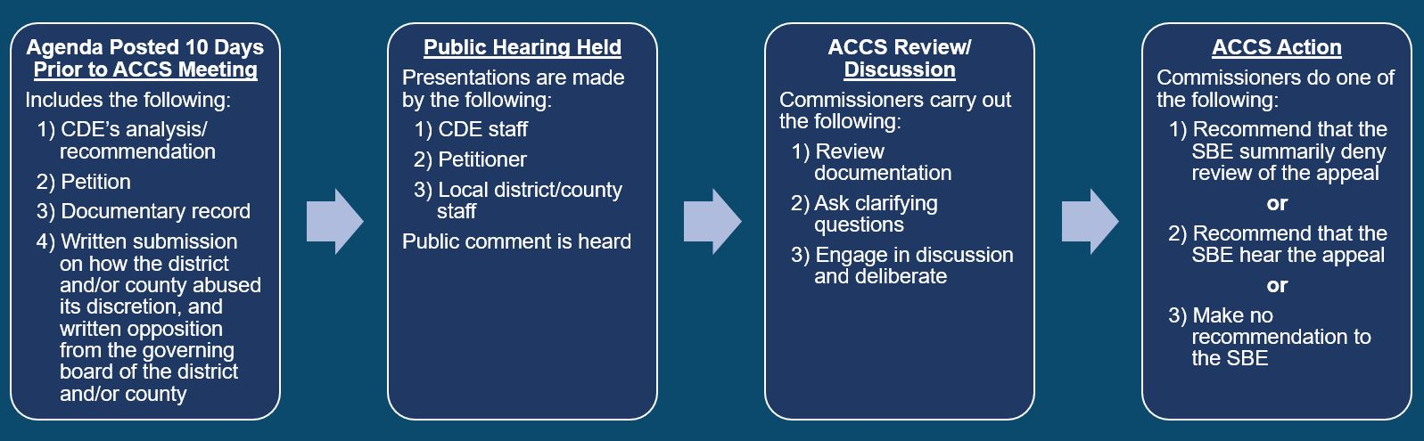
ACCS Process: Abuse of Discretion Review
This process will be used when hearing the following appeals:
  Appeals of new and renewing petitions for charter schools denied by a district and county board

Slide 46
Descriptive Text for ACCS Process: Abuse of Discretion Review (Slide 1)
Agenda Posted 10 Days Prior to ACCS Meeting
  Includes the following: 1) CDE’s analysis/recommendation, 2) petition, 3) documentary record, and 4) written submission on how the district and/or county abused its discretion, and written opposition from the governing board of the district and/or county
Public Hearing is Held
  Presentations are made by the following: 1) CDE staff, 2) petitioner, and 3) local district/county staff
  Public comment is heard

Slide 47
Descriptive Text for ACCS Process: Abuse of Discretion Review (Slide 2)
ACCS Review/Discussion
  Commissioners carry out the following: 1) review documentation, 2) ask clarifying questions, and 3) engage in discussion and deliberate
ACCS Action
  Commissioners do one of the following: 1) recommend that the SBE summarily deny review of the appeal or 2) recommend that the SBE hear the appeal or 3) make no recommendation to the SBE

Slide 48
Role of the State Board of Education (Slide 1)
Charter Petitions | SBE Action
Denied by a County Board that has Jurisdiction Over a Single School District | Review the petition de novo If the SBE grants the establishment or renewal of the petition, the SBE shall designate the chartering authority
SBE-Authorized School Denied by a Governing Board of a District | Review the petition de novo If the SBE grants the renewal of the petition, the SBE shall designate the chartering authority

Slide 49
Role of the State Board of Education (Slide 2)
Charter Petitions | SBE Action
Denied by a District and County Board | Shall either hear the establishment or renewal appeal, or summarily deny review of the appeal based on the documentary record If the SBE hears the appeal, the SBE may affirm the decision of the district or county, or both, or may reverse only upon finding that there was an abuse of discretion If the SBE reverses the denial of a petition, the SBE shall designate the chartering authority

Slide 50
Timelines for the Appeal Process (Slide 1)
Action | Timeline
Petition received by district | Public hearing shall be held no later than 60 days after receipt. Charter shall be granted or denied within 90 days of receipt (+30 days by mutual agreement of the parties).
Petition submitted on appeal to the county, upon denial by the district | Within 30 days of denial by the district
Petition received by county | Public hearing shall be held no later than 60 days after receipt. Charter shall be granted or denied within 90 days of receipt (+30 days by mutual agreement of the parties).

Slide 51
Timelines for the Appeal Process (Slide 2)
Action | Timeline
Petition subject to judicial review, if the county fails to act on the petition | Within 180 days of receipt
Petition submitted on appeal to the SBE, upon denial by the county or denial by the district if the county has jurisdiction over a single district | Within 30 days of denial by the county
Petition subject to judicial review, if the SBE fails to act on the petition | Within 180 days of receipt

Slide 52
State Board of Education-Authorized
Charter Schools
Currently, 36 charter schools operate under the SBE’s authorization as follows:
  One statewide benefit charter, operating a total of nine sites
  Seven districtwide charters, operating a total of 18 sites
  28 charter schools, authorized on appeal after local or county denial
The SBE delegates oversight duties of the districtwide charters to the county office of education of the county in which the districtwide charter is located
The SBE delegates oversight duties of the remaining charter schools to the CDE with the exception of TIME Community School

Slide 53
Temporary Prohibition on
New Nonclassroom-Based Charter Schools
Prohibits the approval of a petition for the establishment of a new charter school that offers NCB instruction from January 1, 2020, to January 1, 2022
Exceptions
  Charter schools required to submit a petition to comply with EC Section 47605.1, or to retain current program offerings or enrollment
  Charter schools required to submit a petition to comply with Anderson Union High School District v. Shasta Secondary Home School (2016) 4 Cal. App. 5th 262, or other relevant court ruling, and the petition is necessary to retain current program offerings or enrollment

Slide 54
“Treat as Continuing” Charter Schools
(Slide 1)
Charter schools may restructure to comply with the statutory changes due to AB 1505 and 1507
  Wholly changing its authorizer
  Dividing into multiple charter schools by having its sites approved by a different chartering authority
In most cases, restructured charter schools are required to be treated as continuing by the CDE for all purposes (e.g., accountability, funding)
One known instance of a restructured charter school in fiscal year 2020–21

Slide 55
“Treat as Continuing” Charter Schools
(Slide 2)
Senate Bills 98 and 820 included clean-up language to implement “treat as continuing”
  New: Reporting Requirement (EC Section 47653)
  New: Definitions for Charter Restructuring (EC Section 47654)
  Amend: Existing funding laws to provide a methodology for calculations with components based on prior year data

Slide 56
Senate Bill 820 Section 75
Modifies the funding determination request process for existing NCB charter schools for fiscal years 2020–21 and 2021–22
  Extends the deadline to submit a request to June 30
  Permits existing charters that submit a request by June 30 to maintain their current level of funding for NCB instruction for two years
  Grants 85 percent funding for NCB instruction for two years to existing charters who submit a request after June 30

Slide 57
Item 01 Public Comment
Call-In Information
Telephone Number: 712-770-4906
Access Code: 1166083#
Notes: Turn down the volume of your computer or live webcast to avoid background echoes.​
When it is your turn, an operator will announce, “Please say your name and affiliation and begin public comment. Your time begins now.”

