Slide 1

Tuesday @ 2
School Nutrition Town Hall
March 26, 2024
California Department of Education
Nutrition Services Division

Slide 2
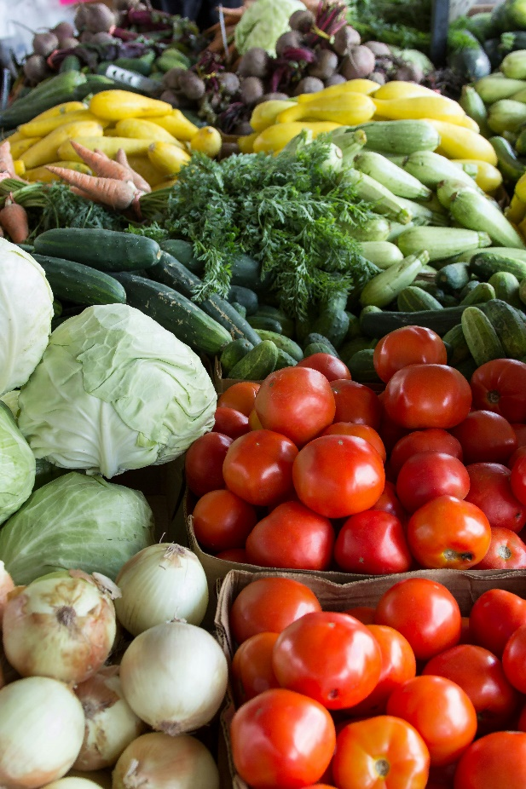
Town Hall at a Glance
Celebrations
District Spotlights
State and Federal Updates
Operational Reminders
Funding Updates
Important Dates
Resources & Other Announcements

Slide 3
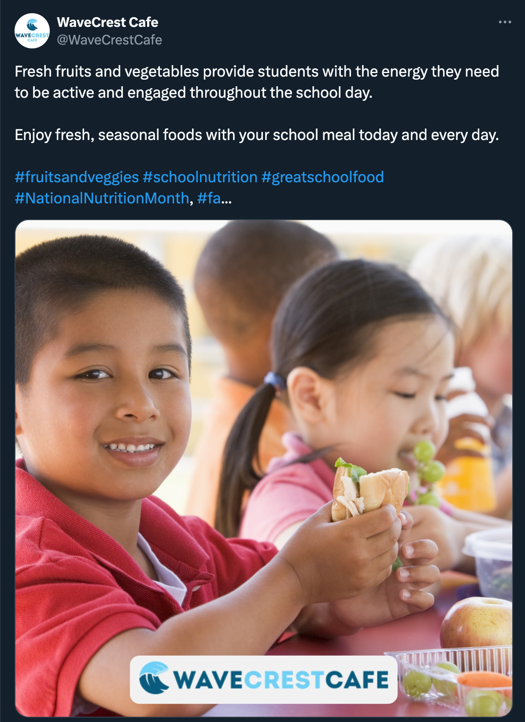

National Nutrition Month 2024

Slide 4
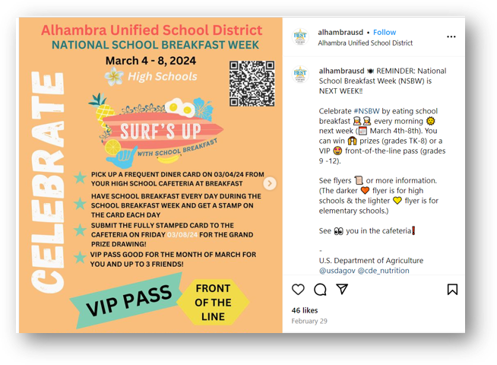
National School Breakfast Week March 4-8th

Slide 5
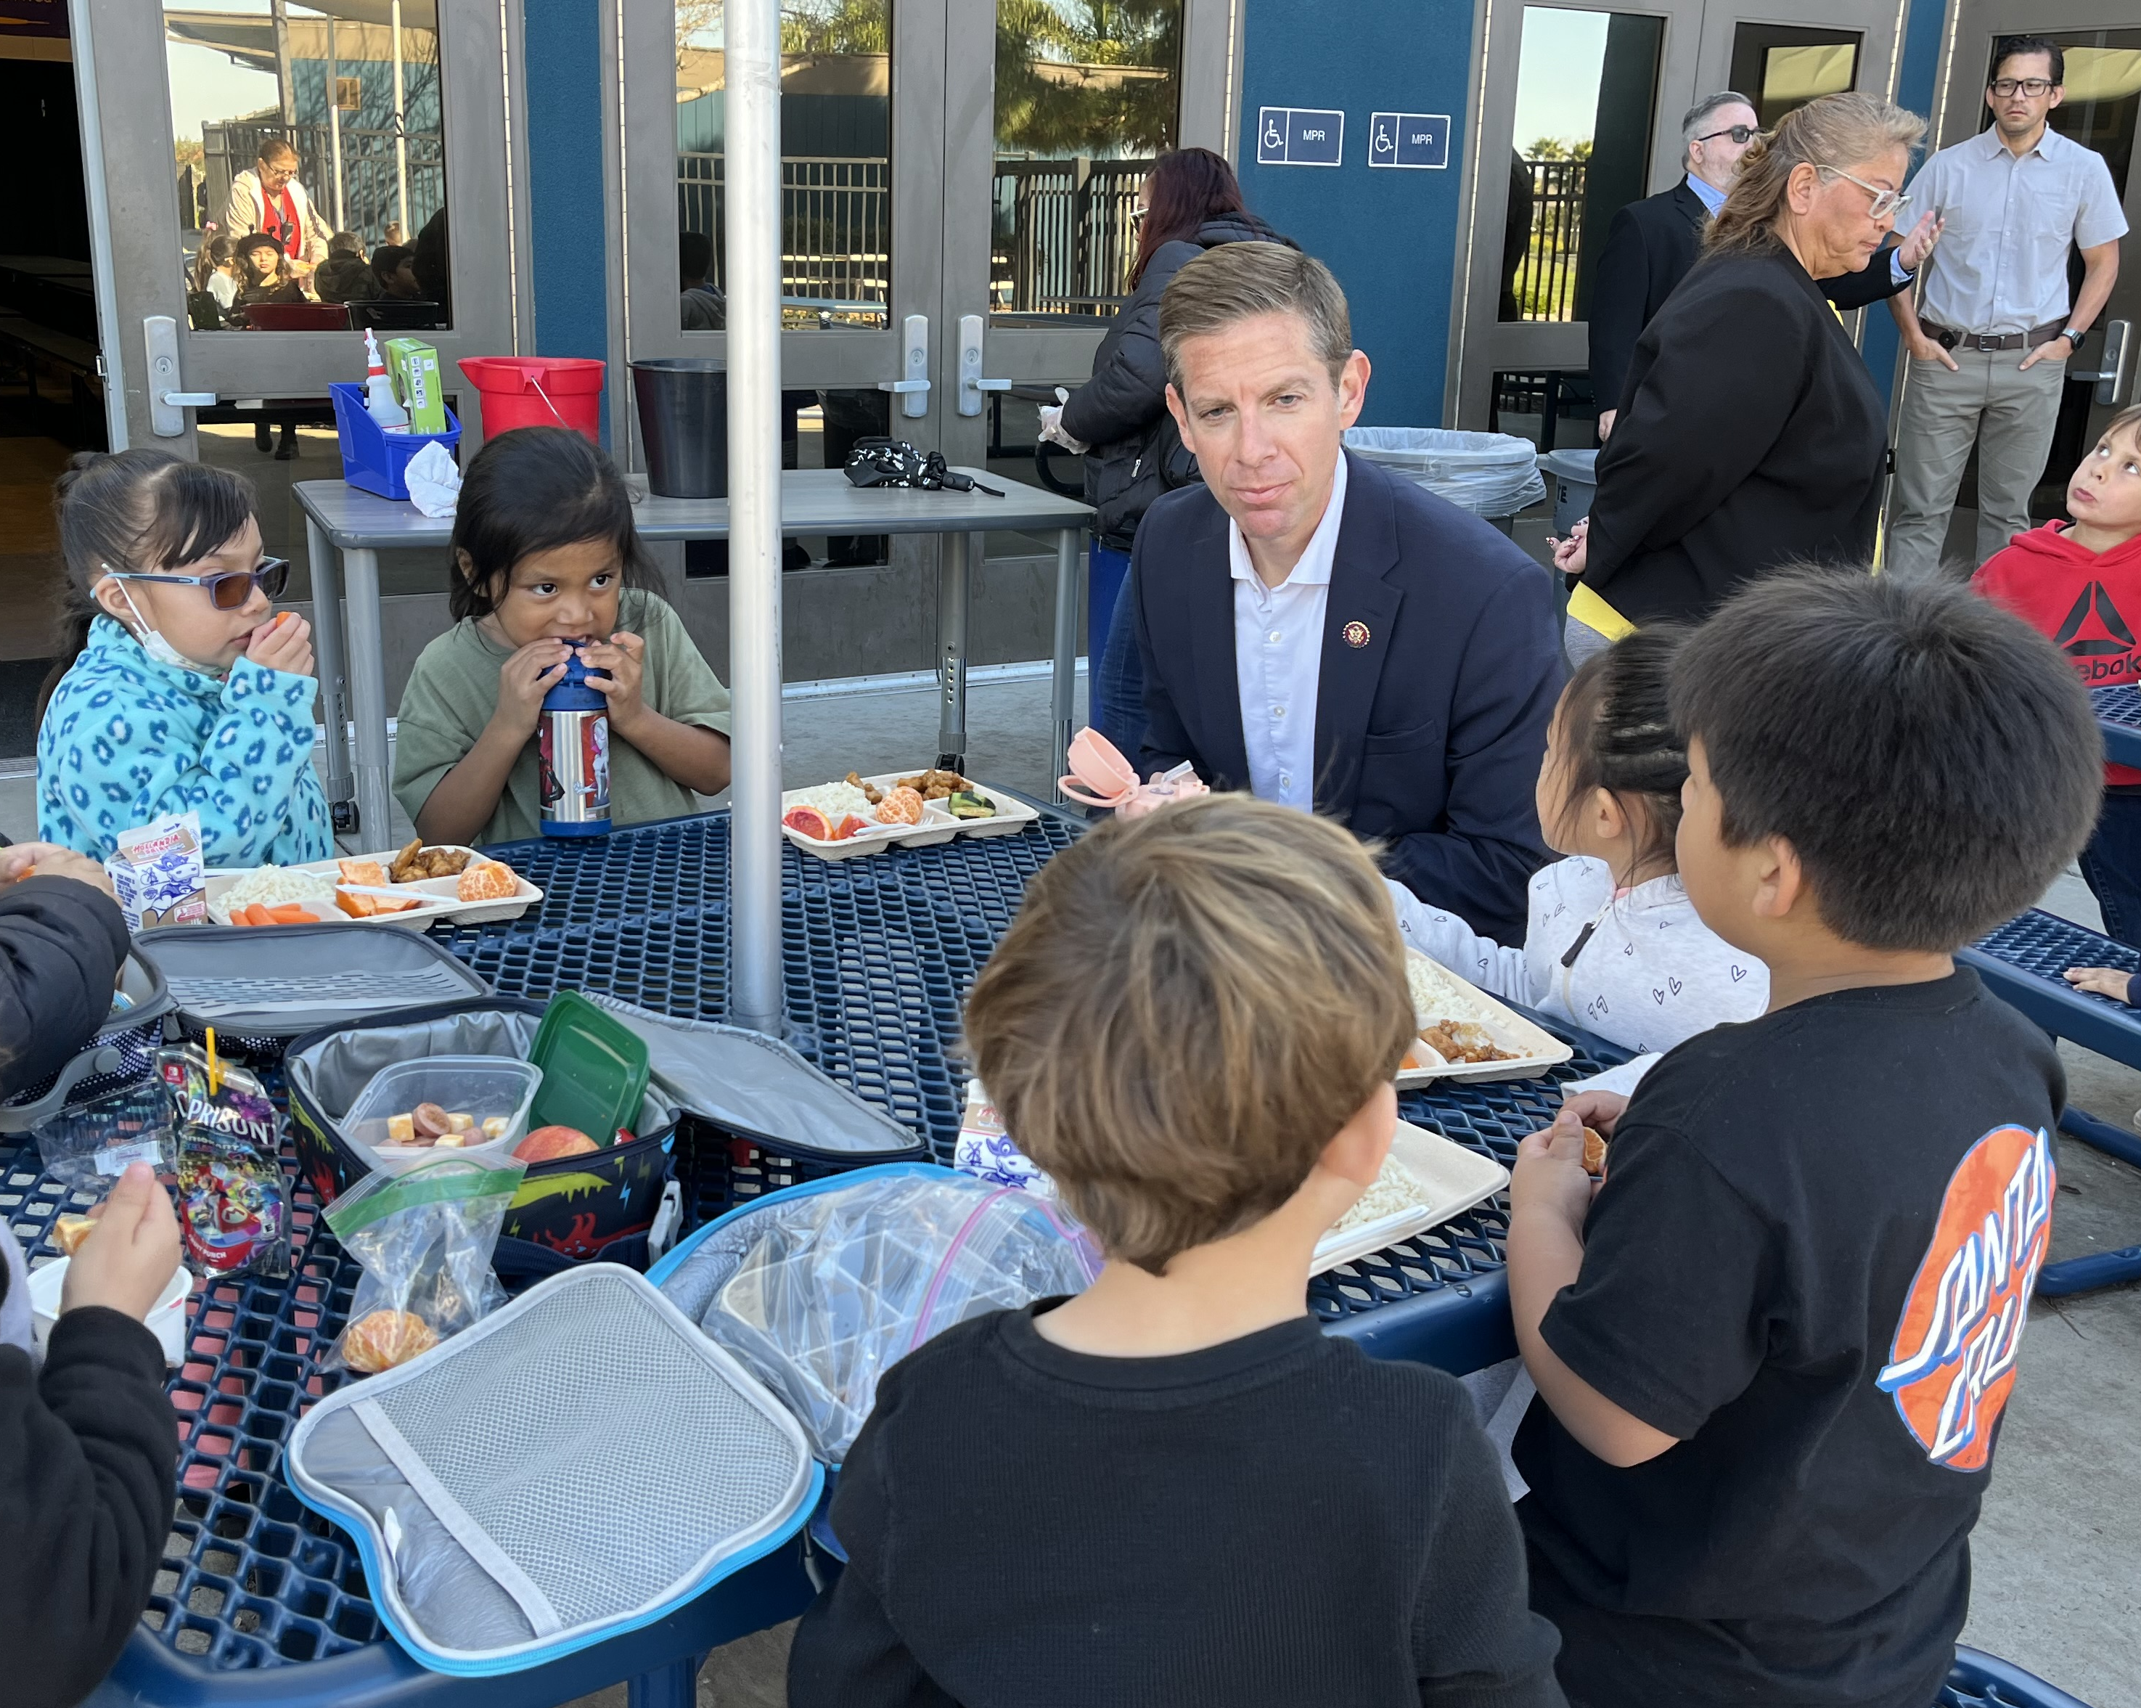
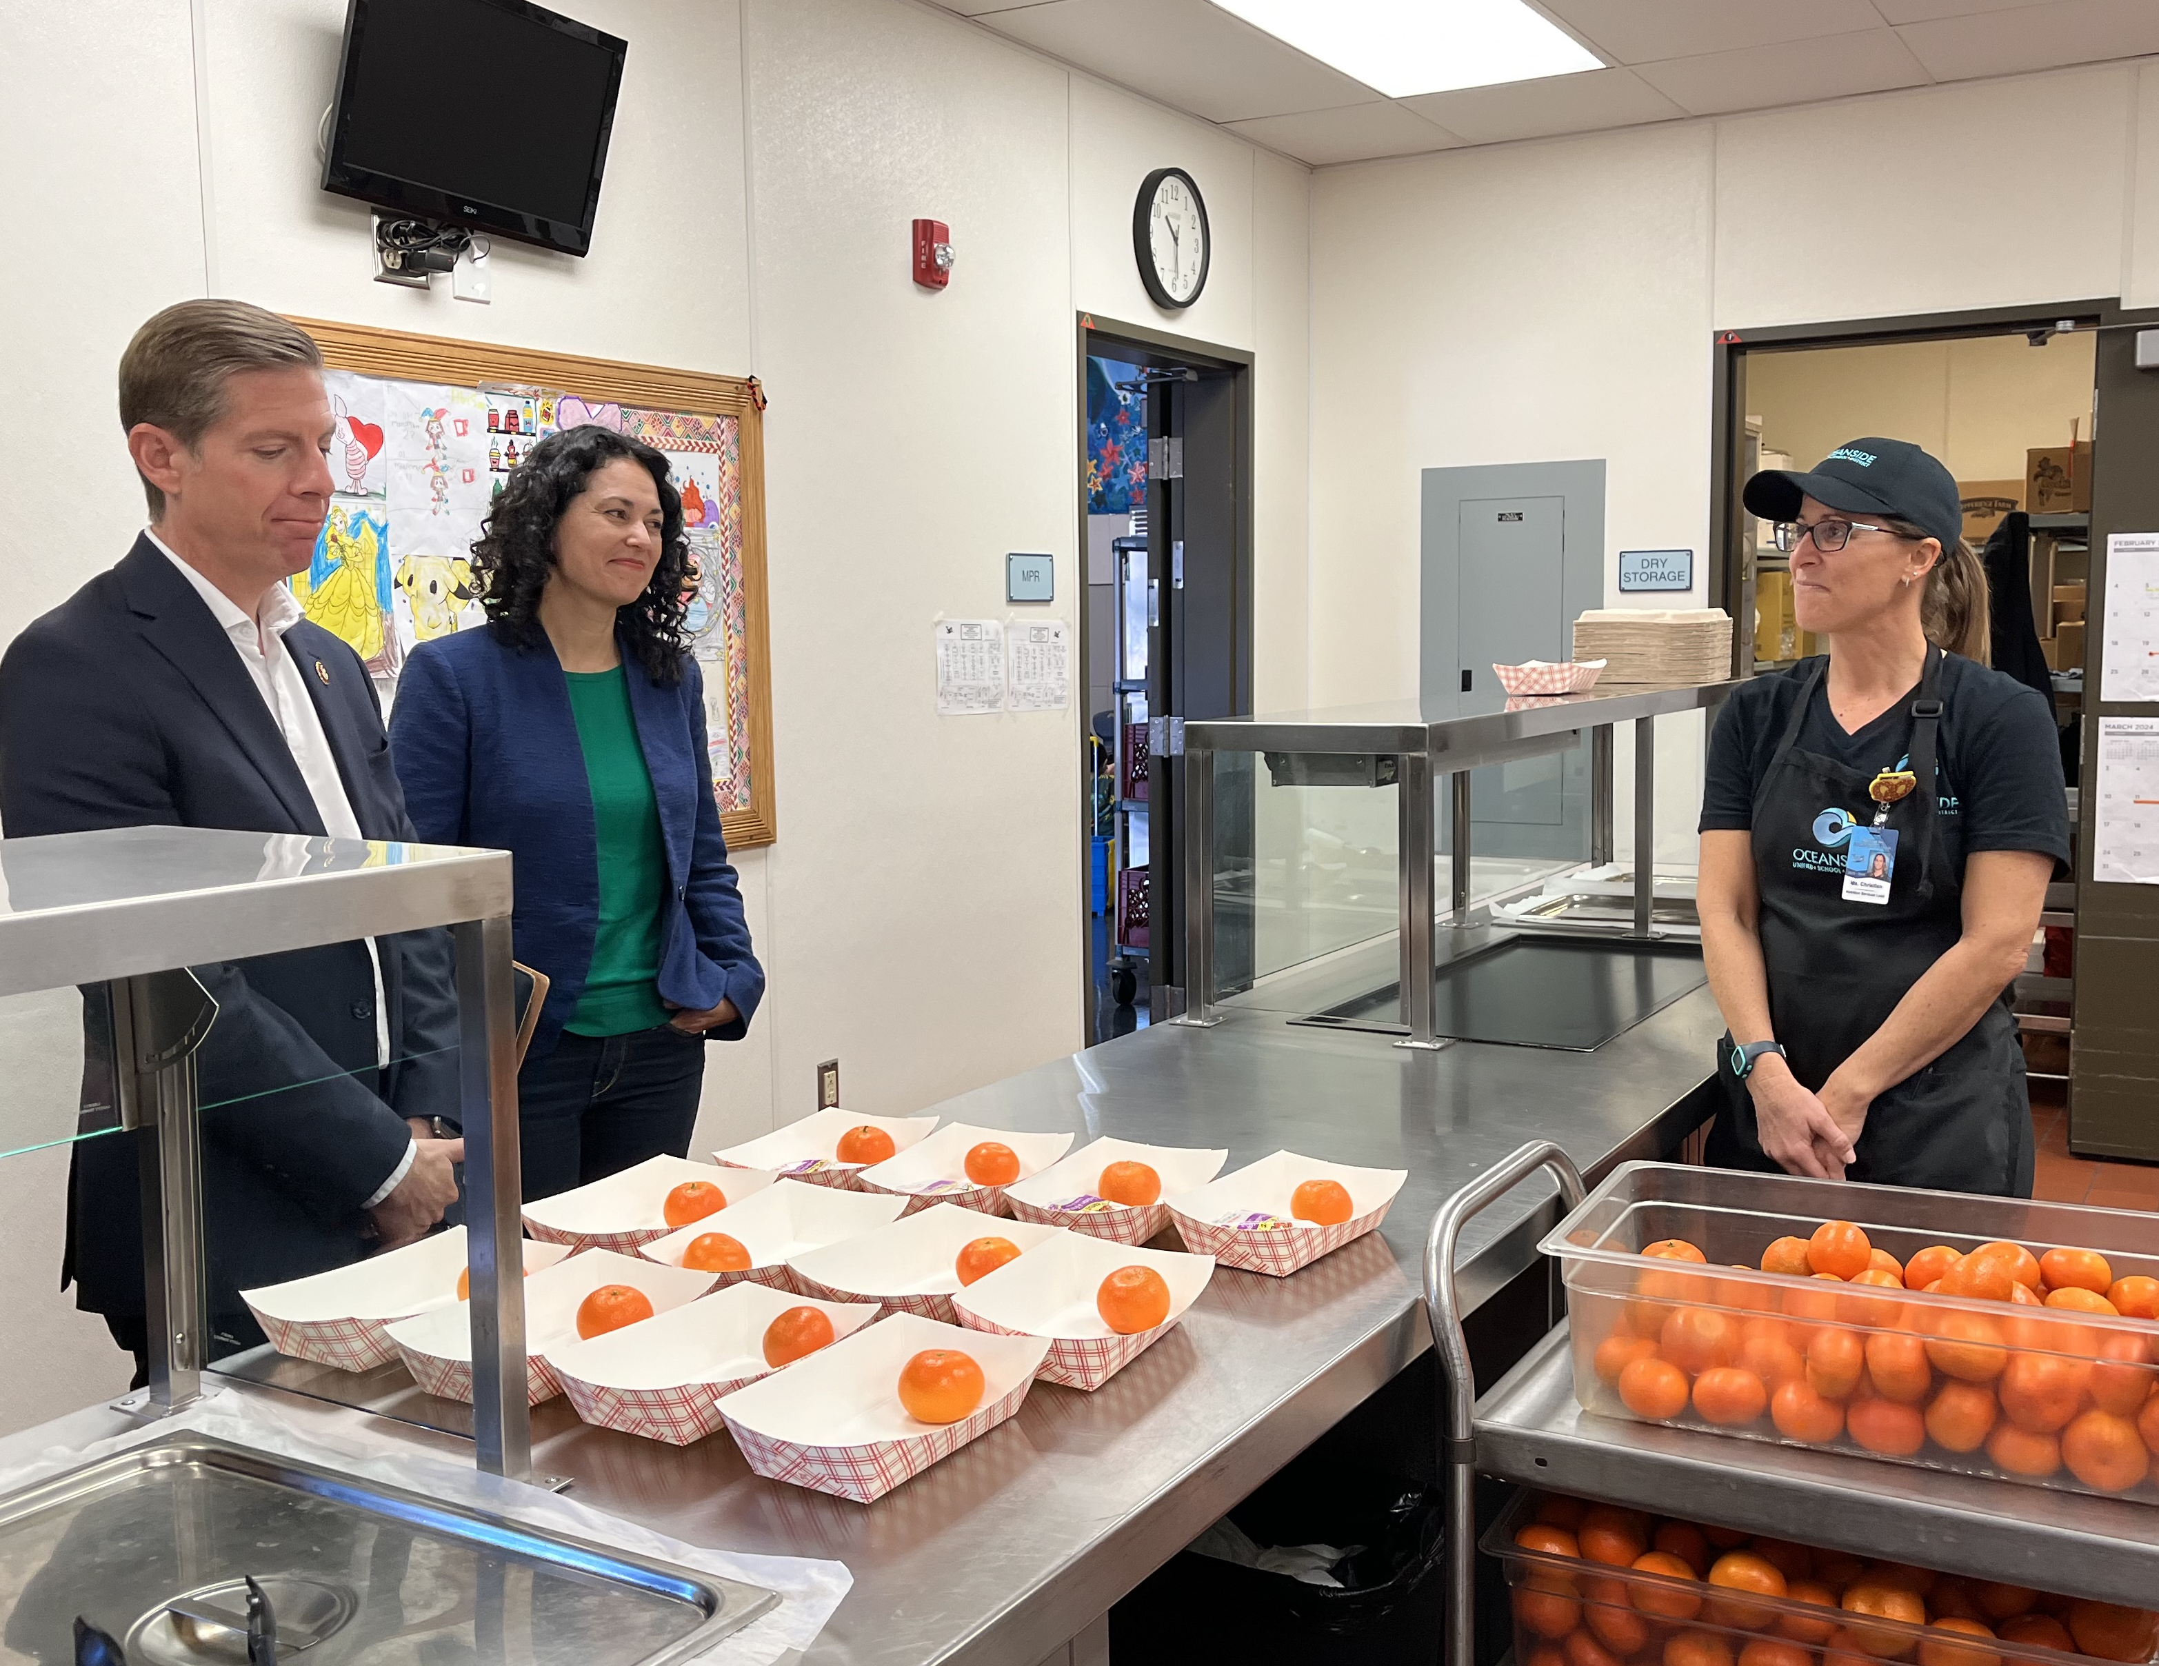
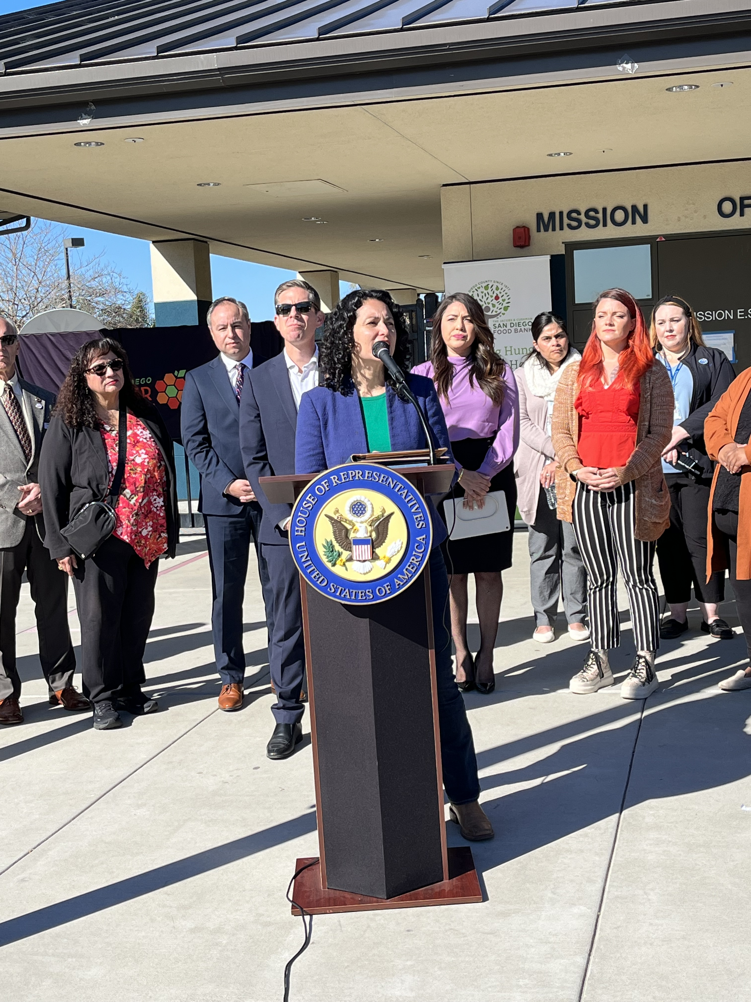
Celebrating National School Breakfast Week at Mission Elementary School

Slide 6
District Spotlight: National School Breakfast Week
No Kid Hungry (NKH) highlighted two California Breakfast After the Bell (BAB) Programs
  Day 1. The Why: Warren Ryan, Assistant Director, San Bernardino City Unified School District (USD)
  Day 5. Launching and Sustaining: Frances Montoya, Nutrition Director, Vaughn Next Century Learning Center
View the five BAB videos on the NKH Best Practices web page at https://bestpractices.nokidhungry.org/resource/national-school-breakfast-week-2024?mc_cid=d7876519a3&mc_eid=727f7fd3e5

Slide 7
District Spotlight: Compostable Utensils Pilot Program
San Diego USD “Love Food Not Waste” food rescue and recovery program. Spearheaded by two students, this program aims to reduce the use of plastic sporks in the school café.
Read the article “University City High launches compostable utensils pilot program” in the La Jolla Village News at https://sdnews.com/university-city-high-launches-compostable-utensils-pilot-program/.

Slide 8

Earth Day is April 22!
Find one small step to take next:
  Reduce pre-packaged items.
  Go paperless with digital menu boards.
  Invest in water refill stations.
  Use re-usable or eco-friendly trays and utensils.
  Get a jump start on composting!
  Begin or revive your school garden.
  Invest in condiment dispensers.
  Try Meatless Monday!

Slide 9

Celebrate School Nutrition Culinary Professionals
Mark your calendars!
  School Nutrition Employee Week is April 29-May 3, 2024
  School Lunch Hero Day, May 3, 2024

Slide 10

2023 Turnip the Beet Award Winners (1)
Gold Award Winners
  Fullerton School District
  Goleta Union School District
  Moreno Valley USD
  Ontario Montclair School District
  Rialto USD
  Santa Cruz City Schools
  Yuba City USD

Slide 11
2023 Turnip the Beet Award Winners (2)
Silver Award Winners
  Fallbrook Union Elementary School District
  Hesperia USD
  Morongo USD
  San Ysidro Elementary School District
  Taft City School District
Bronze Award Winner
  Natomas USD

Slide 12
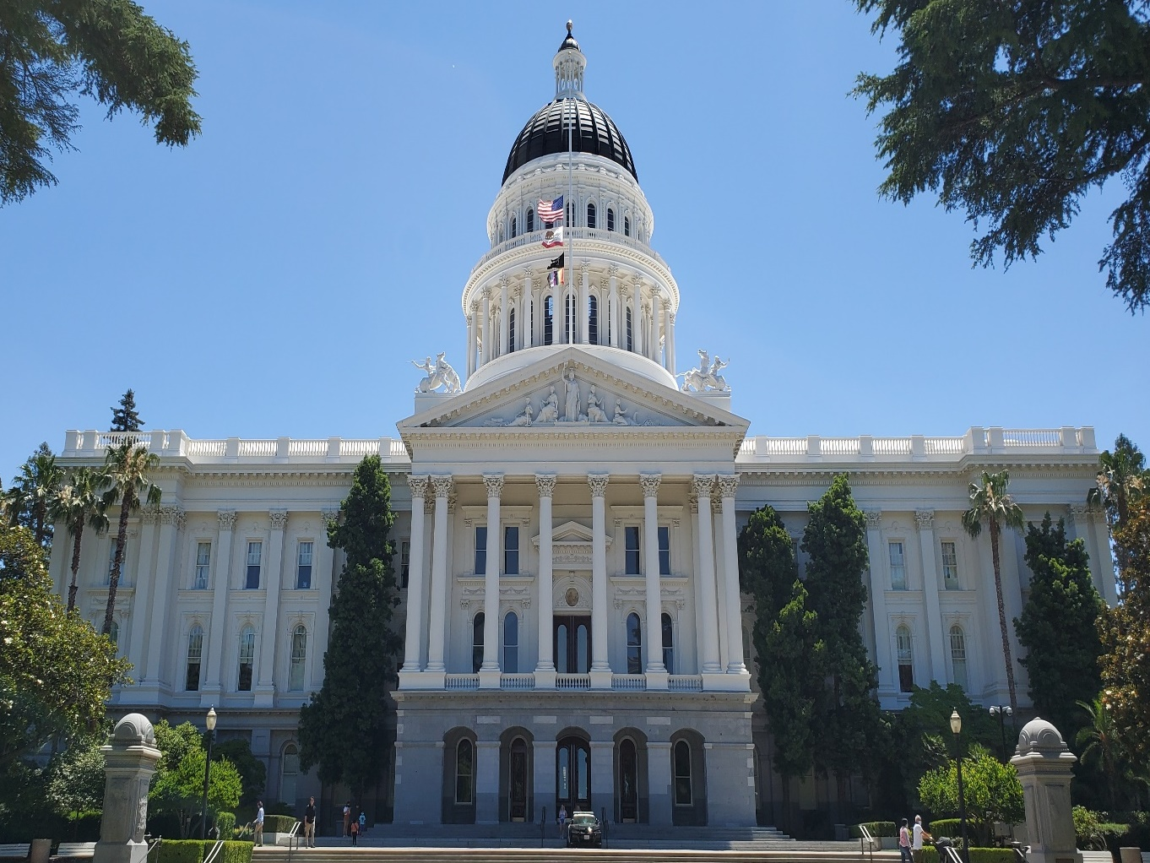
State Updates

Slide 13
State Budget Update
Early Action Budget Package:
  On March 20, 2024, Governor Gavin Newsom, Senate President pro Tempore Mike McGuire, and Speaker of the Assembly Robert Rivas issued statements that they have reached an agreement that will address $12-18 billion in overall state budget shortfall.
Universal Meals: Good stewardship of state and federal funds

Slide 14
State Nutrition Related Bills
Assembly Bill (AB) 2316 Pupil Nutrition: substances: prohibition
AB 2595 School Nutrition: guardian meal reimbursement
AB 2090: Office of Farm to Fork: food deserts: transportation
Senate Bill 1080: Halal and Kosher Food Options
AB 2009: School districts: public contracts
AB 1961: End Hunger in California Act of 2024

Slide 15
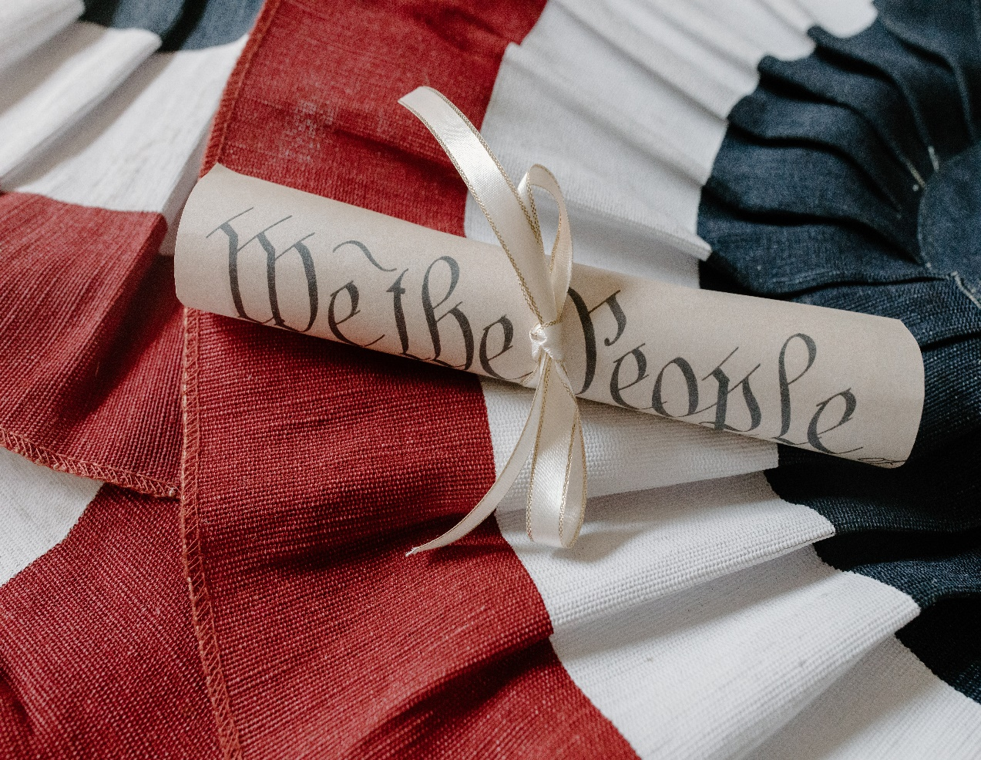
Federal Updates

Slide 16
Non-Congregate Meal Service in Rural Areas (1)
SFSP 03-2024, SP 05-2024 Implementation Guidance for the Rural Non-Congregate Option Provisions of the Interim Final Rule, Establishing the Summer Electronic Benefits Transfer (EBT) Program and Rural Non-Congregate Option in the Summer Meal Programs – Issued January 12, 2024.
SFSP 07-2024, SP 13-2024 Non-Congregate Meal Service in Rural Areas Questions and Answers – Issued February 21, 2024.

Slide 17
Non-Congregate Meal Service in Rural Areas (2)
Determine if you are rural
Determine if you are area eligible
Consider which rural non-congregate model(s) you would like to offer:
  Multi-Day meal distribution
  Parent-Guardian pick up
  Bulk Meals
  Meal Delivery

Slide 18
Non-Congregate Meal Service in Rural Areas (3)
Non-Congregate feeding program integrity plan – an integrity plan is required by federal regulations.
California Department of Education (CDE) Management Bulletin (MB) coming in April.
Non-Congregate Feeding Listening Session:
  Save the Date: Tuesday, April 30, 2024
  Registration link coming to your inbox soon

Slide 19
Seamless Summer Site Applications
Congregate Seamless Summer Option (SSO) site applications are open now
  Do submit congregate SSO sites.
  Do not submit non-congregate SSO sites.
    You must require a program integrity plan to be submitted in tandem.
All applications must be submitted and approved prior to the start of operations

Slide 20

Summer Food Service Program Application Deadline
Applications opening on April 2, 2024
Summer Food Service Program (SFSP) Applications Due:
  May 15, 2024, OR
  30 days prior to meal service operations, whichever comes first

Slide 21



U.S. Department of Agriculture Summer Program Rebranding
Collectively Sun Program
Traditional Summer Meals
New Rural Non-Congregate Meals

Slide 22

Summer EBT is SUNBucks
SunBucks English and Spanish informational flyers available in the Child Nutrition Information and Payment System, Download Forms.
The California Department of Social Services customer service helpline and website are coming soon.

Slide 23
Community Eligibility Provision (1)
Reminder: Pull direct certification lists and site enrollment figures on April 1, 2024.
Under current state law, if your Identified Student Percentage is equal to or greater than 25 percent, you must apply for a federal provision (Community Eligibility Provision [CEP] or Provision 2).

Slide 24
Community Eligibility Provision (2)
Consider the following:
  Will any school sites be closing for School Year (SY) 2024–25?
  Will any school sites combine with other school sites for SY 2024–25?
  Are you adding any sites to your CEP group?
If the answer is “yes” to any of the questions above:
  Pull data on April 1, 2024.
  Contact your specialist to determine if you need to re-apply.

Slide 25
Important Operational Dates:
Next 30 to 90 days
Action | Date
Deadline to update mailing addresses in California Longitudinal Pupil Achievement Data System, also known as CALPADS, for Summer EBT benefits | March 29, 2024 (revised)
Pull Direct Certification and Enrollment for CEP | April 1, 2024
SFSP Application Deadline | May 15, 2024, or 30 days prior to meal service operations, whichever comes first.

Slide 26
Important Operational Dates:
Next 30 to 90 days (2)
Action | Date
Use DoD Fresh Entitlement in Fresh Fruit and Vegetables Order Receipt System (FFAVORS) | May 1, 2024
Notification for scheduled Local Agency Procurement Review and School Nutrition Review | Update in May
CEP Application Deadline | June 30, 2024

Slide 27
Meal Reimbursement
Claim Deadlines
Claim Month | Submission Deadline
January 2024 | Monday April 1, 2024
February 2024 | Monday April 29, 2024
March 2024 | Thursday May 30, 2024

Slide 28

Funding Updates

Slide 29
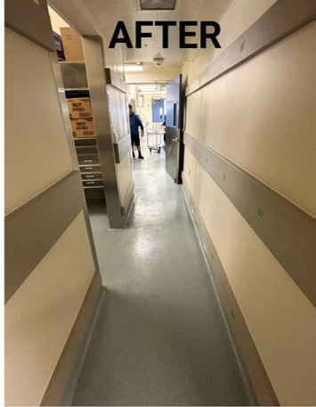
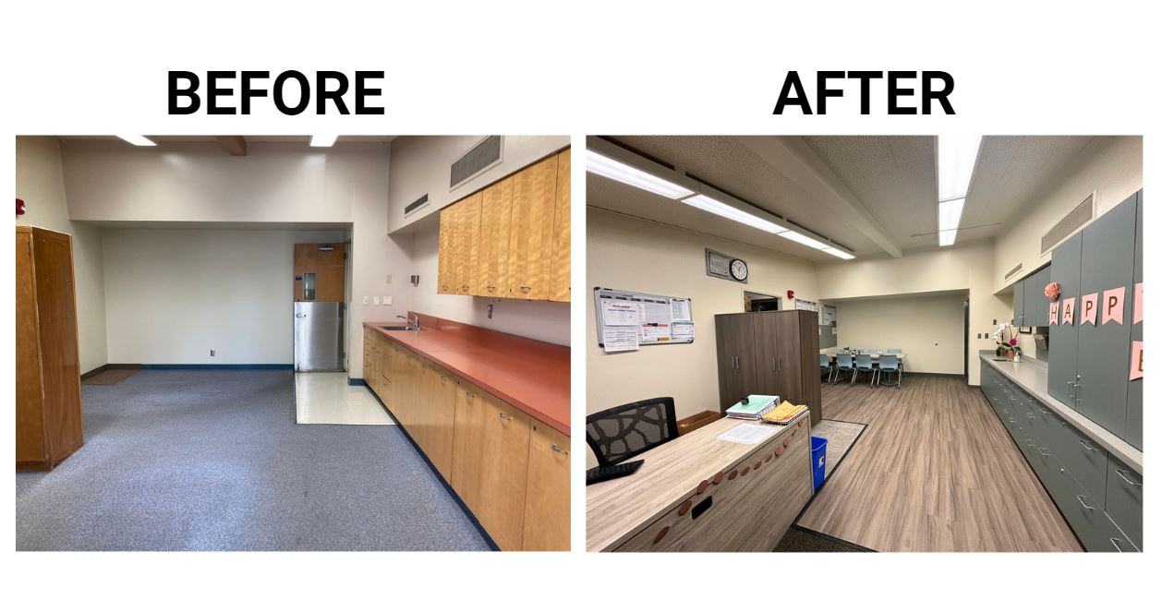
Goleta Union School District Kitchen Infrastructure and Training (KIT) Improvements (1)
New Hallway Guards
Front Office

Slide 30
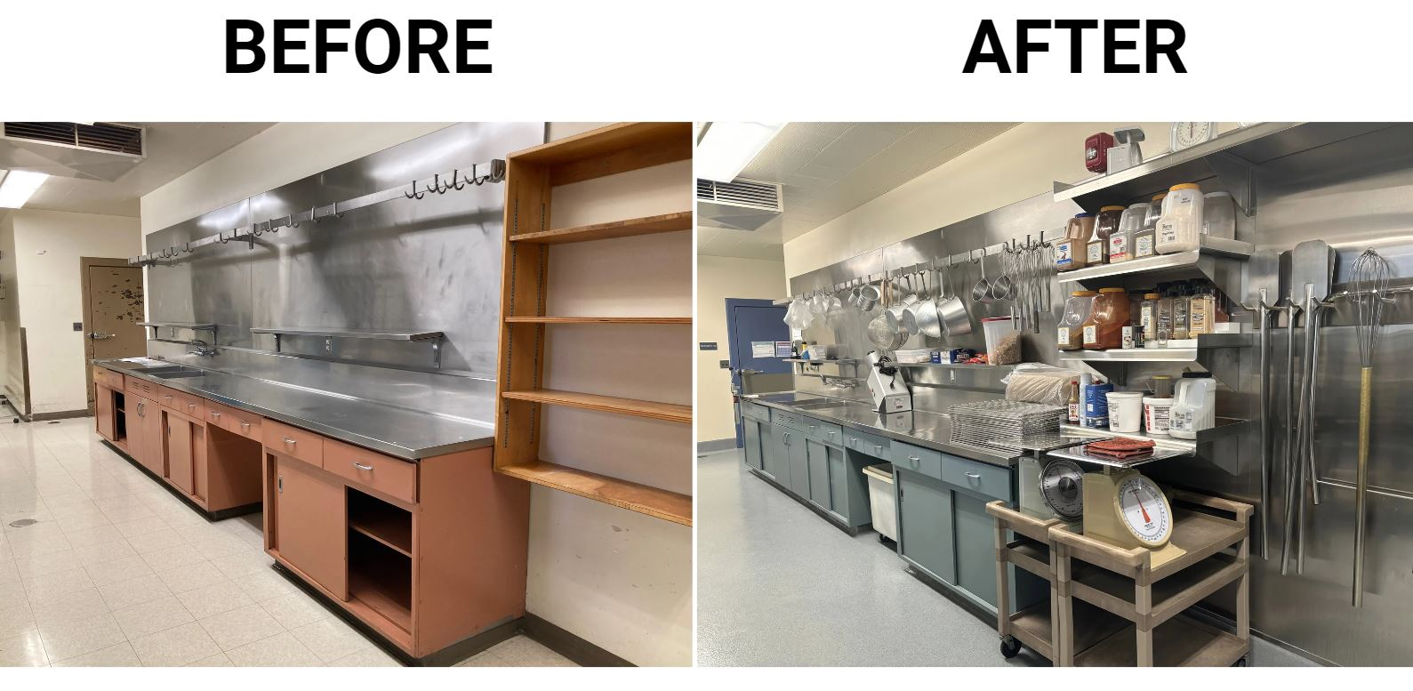
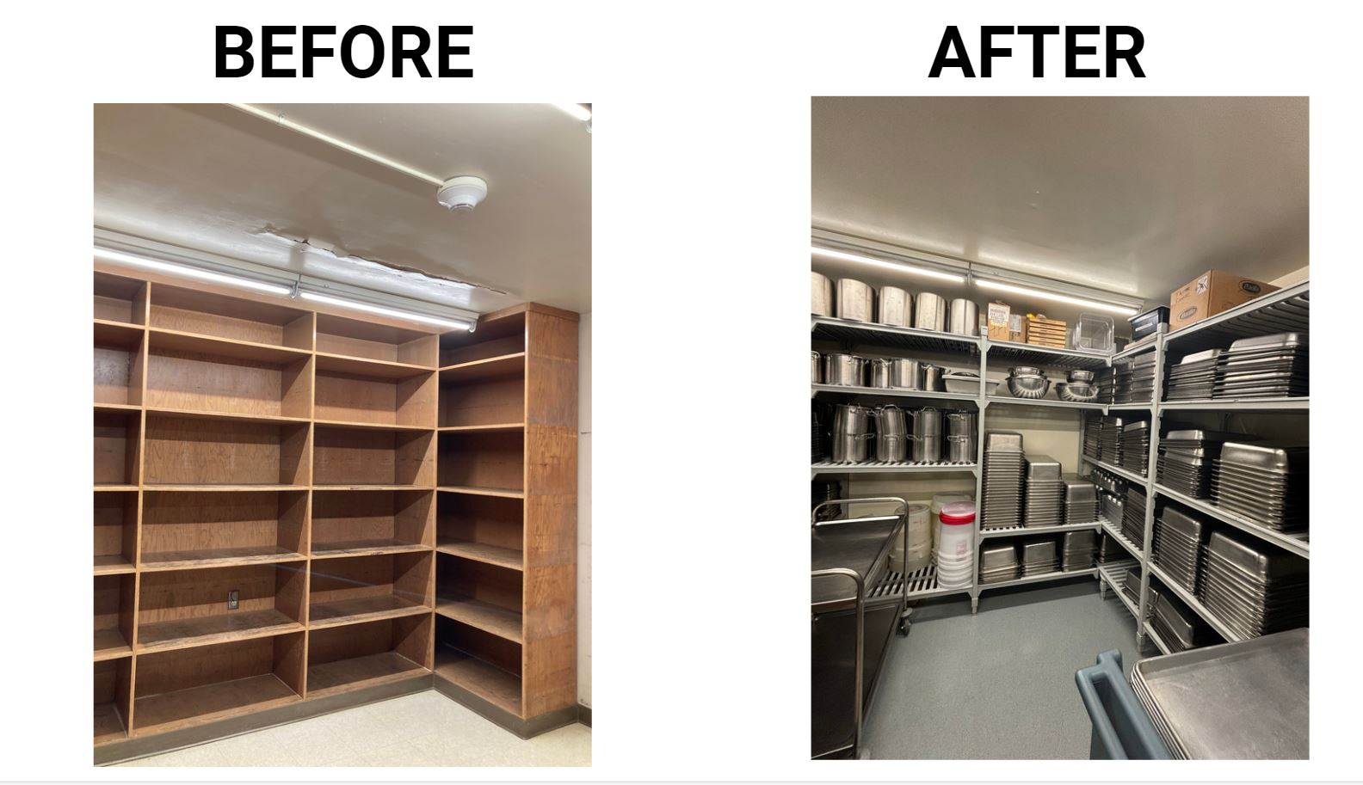
Goleta Union School District: KIT Improvements (2)
Pan Room
Kitchen Prep Area

Slide 31
2021 KIT Funds
KIT Fund Year | Previous Requirement | New Flexibility | What is required
2021 | Spend by June 30, 2024 | Can be spent beyond June 30, 2024 Recommend practice to obligate by June 30, 2024 | Report by June 30, 2024
2022 | Spend by June 30, 2025 | Encumbered by June 30, 2025 | Funds encumbered by June 30, 2025

Slide 32
2021 KIT Funds Challenge
The 2021 KIT Funds Challenge offers motivation to use KIT General Funds for other nonprogram purposes.
There is an increased risk for misappropriation of funds.
Option to move funds to cafeteria account.
Note: If KIT funds are deposited into the cafeteria account, the limitations for café funds are used in addition to KIT guidelines.

Slide 33
2021 KIT Funds Final Report
Due Date: June 30, 2024 (Sunday)
Questions:
  Amount obligated, amount unobligated
  Categories of expenditures, expenditures
  Large scale infrastructure projects
  Impact on access and quality of school meals
  Topics and number of trainings
  Photos, quotes

Slide 34
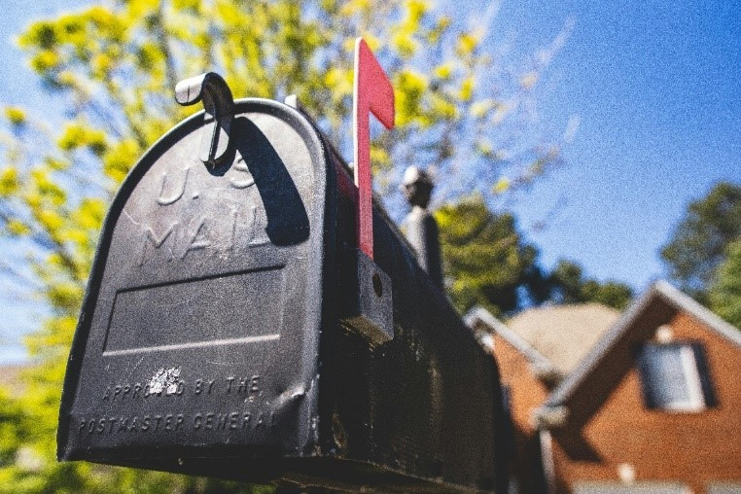
2022 KIT Funds
$15 million Allocation
For School Food Authorities (SFA) participating in Freshly Prepared Onsite Meals funding only
Anticipate distribution in April
Same encumbrance deadline of June 30, 2025

Slide 35

KIT Office Hours & Contact Information
The next office hours will be held April 25, 2024, at 2 p.m.
Registration will be forthcoming.
Send your questions to KITfunds@cde.ca.gov.

Slide 36
Local Food for Schools Updates
The Local Food for Schools (LFS) Funds expenditure deadline is extended to Friday, November 29, 2024.
The second mandatory Quarterly Report is due April 19, 2024: Report LFS expenditures made January 1, 2024, through March 31, 2024.
Questions may be submitted to: LFSGrant@cde.ca.gov.

Slide 37
Commercial Dishwasher Competitive Grant Request for Applications
Management Bulletin SNP 04-2024 Availability of the Commercial Dishwasher Grant (CDG) Request for Applications (RFA)
Released Date: April 3, 2024, 5 p.m., no late applications or partial submissions accepted
Per site award up to $40,000
Maximum five (5) sites per SFA for $200,000
Questions: cdg@cde.ca.gov

Slide 38
CDG RFA Informational Webinar
Date: Wednesday March 27, 2024, 2 to 3 p.m.
Webinar topics:
  Application and scoring overview
  Funding details
  Frequently asked questions

Slide 39
2024–25 Fresh Fruit and Vegetable Program Grant Request for Applications
Deadline: Tuesday, April 2, 2024; No late applications or partial submissions will be accepted.
Grant Period: July 1, 2024–June 30, 2025.
Purpose: To provide all children in a participating high-need elementary school with a variety of free, fresh fruit and vegetable snacks during the school day.
Application web page: Visit the CDE RFA Fresh Fruit and Vegetable Program (FFVP) web page at https://www.cde.ca.gov/fg/fo/r9/ffvp24rfa.asp.
Questions: Submit questions to FFVP@cde.ca.gov.

Slide 40
Grant Funds Overview (1)
Grant | Timeline
LFS funding disbursed | April 2024 (revised date)
Supply Chain Assistance funds disbursed (round four) | April 2024 (revised date)
2024–25 FFVP RFA Application Due. | April 2, 2024
CDG RFA Due Date | April 3, 2024

Slide 41
Grant Funds Overview (2)
Grant | Timeline
2021 KIT Funds Encumbrance Deadline | No longer an encumbrance deadline
School Breakfast and Summer Expansion | Application closed
Equipment Assistance Grants | Funding released upon receipt of completed Grant Agreement
Expend LFS funds | November 29, 2024 (revised)

Slide 42
Summer 2024 Youth Engagement and Empowerment Grants (1)
NKH is offering grants to rural non-congregate operators for Summer 2024.
Purpose: Learning new methods to increase youth engagement for program implementation and developing promising practices.
Total: $5,450 each grant award.

Slide 43
Summer 2024 Youth Engagement and Empowerment Grants (2)
Due Date: May 15, 2024 - a letter of Interest submission is required.
Must be SFSP/SSO planning to offer non-congregate meals.
Email questions to NKH staff members Kristen Dunphey at kdunphey@strength.org or Riya Rahman at rrahman@strength.org.

Slide 44

Resources & Other Announcements

Slide 45
Spring Training Announcement
Topics: Resource Management and Procurement.
Target audience: Food Service Directors, Chief Financial Officers, and procurement professionals.
KIT training and cafeteria funds can be used for travel.

Slide 46
Reminder: School Nutrition Department Vacancy Survey
Sponsors: Chef Ann Foundation, Food Insight Group and Urban Institute.
Goal: The survey assesses school nutrition department; Models available for wages, benefits, and staffing across California.
Access: A unique survey link was sent from Beth Katz to each SFA on Friday, March 1, 2024.
Survey ends Thursday, March 29, 2024.
Questions: Contact Beth Katz at beth@foodinsightgroup.com.

Slide 47
Tuesday @ 2pm Town Hall Schedule
Held on the fourth Tuesday of the month
Month | Format | Date
April | State Update and Guest Speaker | 4/23/24
May | State Update | 5/28/24
June | State Update and Guest Speaker | 6/25/24

Slide 48
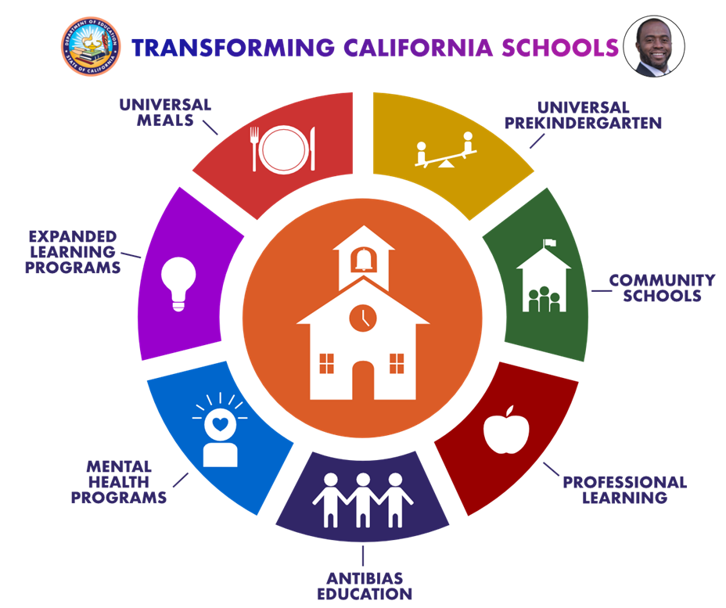
Thank you!
Next Town Hall:
April 23, 2024
This institution is an equal opportunity provider.

