Slide 1
School Facilities and Transportation Services Division Presentation date (February 23, 2023)

Slide 2
CDE Organization Chart
A graphical version of the Organization Chart can be found here: https://www.cde.ca.gov/re/di/or/documents/ orgchartoverview.pdf
An accessible list version of the Organization Chart can be found here: http://www.cde.ca.gov/re/di/or/overview.asp

Slide 3
School Facilities and Transportation Services Division
Office of Learning Environments | Office of School Transportation | Emergency Services Team | Business Services Office
Facilities Planning Policy and Standards | School Bus Driver Instructor Curriculum | Mitigation | Building Operations and Services
Facilities Field Operations | School Bus Driver Instructor Training | Preparedness | Office Services
Administrative and Analytical Support | School Bus Driver Instructor Certification | Response | None
None | None | Recovery | None

Slide 4
Conference Office Hours with the CDE
The Office of Learning Environments will hold office hours where you can meet your field representatives from your region and ask for guidance and support. Please stop by our table and say hello.
Thursday, February 23, 2023
10:15-11:15 Angel Doughty
11:00-Noon Bryan Boyd, Haley Leguizamo
Friday, February 24, 2023
10:15 – 11:15 George Garcia, Bryan Boyd
11:00 – Noon Jennifer Schwinn

Slide 5
Workshops
Thursday, February 23, 2023
Mini Workshop, 10:00 a.m. ‐ 10:45 a.m.
All Access Restroom Guidance
Diane Waters, Bryan Boyd, John Gordon (CDE)
Friday, February 24, 2023
Workshop, 9:00 a.m. ‐ 10:15 a.m.
Campus Planning for an Inclusive Future
Mariana Lavezzo, LPA Design Studios
Diane Waters (CDE)

Slide 6
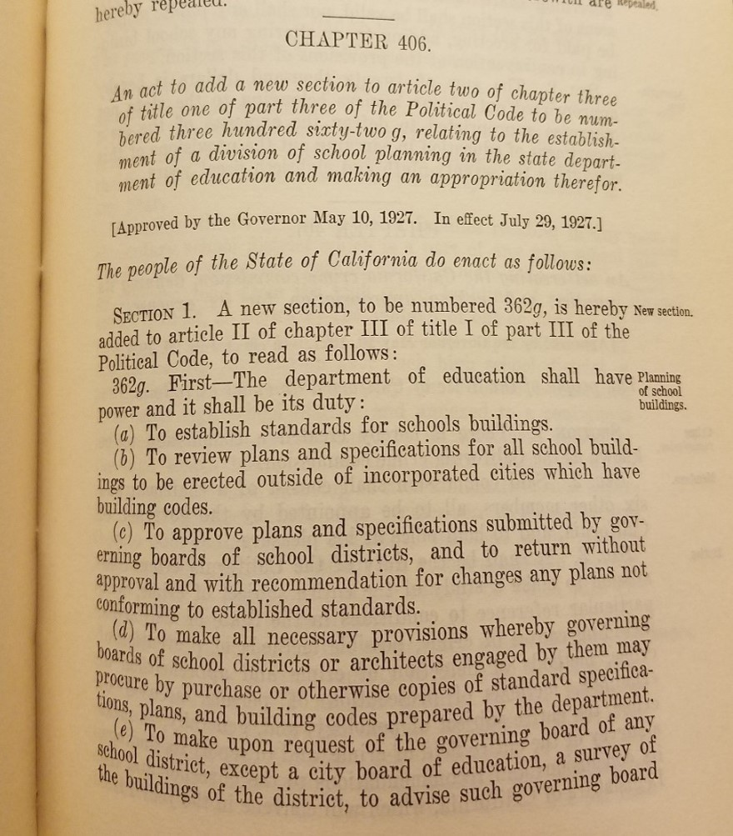
Over 95 Years developing “schoolhouse” standards
Division of School House Planning created in 1927
Established in Political Code Section 362g
(a) Establish standards for school buildings
(b) Review plans and specifications for all school buildings outside Cities which have building codes
Notes:
Many of you might not know but we’ve been around for a very long time. In fact, our Division was created in 1927 and originally called the Division of School House Planning. From its inception, our Division was charged with developing standards for school buildings. Back then, we also reviewed plans and specifications for all school buildings outside of areas that had building codes. I bet many of you didn’t know that, right? I sure didn’t.

Slide 7
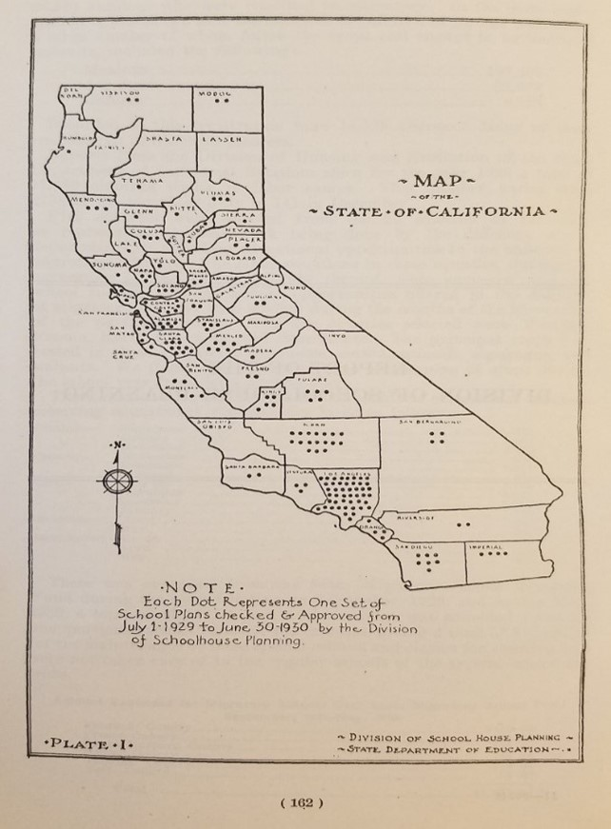
Plans Approved in FY 1929-1930
County (Number of Projects)
Alameda - 5
Colusa - 3
Fresno - 2
Humboldt - 1
Kern - 17
Lake - 1
Madera - 1
Mendocino - 3
Modoc - 2
Napa - 3
Placer - 2
Riverside - 2
San Bernardino - 4
San Francisco - 1
San Mateo - 5
Santa Clara - 9
Sierra - 1
Solano - 3
Stanislaus - 4
Tehama - 1
Tulare - 5
Yolo - 1
Butte - 1
Contra Costa - 6
Glenn - 1
Imperial - 4
Kings - 5
Los Angeles - 46
Marin - 2
Merced - 6
Monterey - 5
Orange - 4
Plumas - 3
Sacramento - 3
San Diego - 7
San Joaquin - 2
Santa Barbara - 2
Santa Cruz - 1
Siskiyou - 2
Sonoma - 1
Sutter - 1
Tuolumne - 2
Ventura - 3
Yuba - 2

Slide 8
CDE’s Field Operations Unit Role
Education Code, Section 17251
"...develop standards for use by school districts in the selection of school sites.“
“…establish standards for use by school districts to ensure the design and construction of school facilities are educationally appropriate and promote school safety.”
California Code of Regulations, Title 5,
Section 14010 – Standards for School Site Selection
Section 14030 – Standards for Development of Plans for the Design and Construction of School Facilities

Slide 9
“Traditional” Waivers of Education Code
Exceeding statutorily set bond debt percentage
Elementary or High School District = 1.25 percent
Unified School District = 2.5 percent
Sale or lease of surplus property
Sealed bid requirement
Request for Proposal

Slide 10
School District Organization Items
Actions to form a new school district
Dissolving, forming, unifying, or de-unifying
Actions to transfer territory
Between existing districts
Learn more at https://www.cde.ca.gov/re/lr/do/
Contact SDO@cde.ca.gov

Slide 11
Emergency Services Team
California Department of Education (CDE)
Department Operations Center (DOC)
Schools Emergency Response System (SERS)
Governor’s Office of Emergency Services (Cal OES)
Unified Coordination Group
Schools Task Force
State Operations Center (SOC)
Preparedness, Response, Recovery, Mitigation

Slide 12
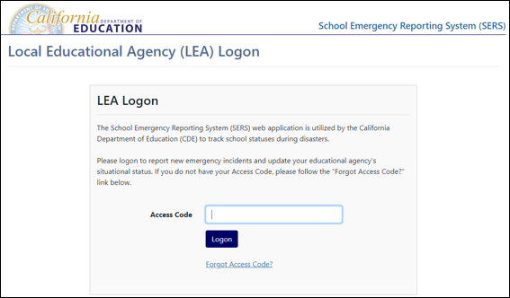
Emergency Services: SERS
School Emergency Reporting System
Direct contact from Local Educational Agencies (LEA) to CDE
Maintains situational awareness of schools in disasters
LEAs able to express needs immediately
Public-facing site: https://www3.cde.ca.gov/sers
Notes:
Jake

Slide 13
ESSER I, ESSER II, ESSER III and GEER I
LEAs must get preapproval to use the following fund sources for capital expenditure projects:
Elementary and Secondary School Emergency Relief I (ESSER I) Fund: $1,481,078,452
ESSER II Fund: $6,038,670,479
ESSER III Fund: $13,561,996,091
Governor’s Emergency Education Relief I (GEER I) Fund: $355,227,000
https://www.cde.ca.gov/fg/cr/documents/fedfundscapitalexp.pdf
Projects must fit allowable uses (https://www.cde.ca.gov/fg/cr/) and be needed to prevent, prepare for, and respond to COVID-19.
Capital Expenditure FAQs: https://www.cde.ca.gov/fg/cr/capexpfaqs.asp

Slide 14
Preapproval Application
This is required for any single big-ticket purchases at the cost of $5,000 or more using the funding sources cited above. These purchases can include general purpose equipment, buildings, and land, including material improvements. For the application, it is expected that LEAs demonstrate the following:
Requestor/LEA Information
Funding Source/Cost
Description of Project
Fit with Allowable Uses
Reasonable, Necessary, and Allowable
Other Options
Proper Bidding Process

Slide 15
ESSER
Received over 3200 Capitol Expenditures Applications for a total of $3.2 Billion
Main Types of Applications:
951 HVAC Requests - $1.6 Billion
392 Outdoor Shade Structure Requests - $260 Million
123 Updating Portable/Modular Classroom Requests - $219 Million

Slide 16
Green Schoolyard Grants California Department of Forestry and Fire Protection
The guidelines for Green Schoolyard Grants can be found on the California Department of Forestry and Fire Protection (CalFire) website at: https://34c031f8-c9fd-4018-8c5a-4159cdff6b0d-cdn-endpoint.azureedge.net/-/media/calfire-website/what-we-do/grants/urban-and-community-forestry/grant-guidelines_green-schoolyards_02272023.pdf

Slide 17
Facility Master Planning
Guide for the Development of a Long-Range Facilities Plan, 1986
Education needs, existing facilities, demographic study, implementation plan, and evaluation plan
https://www.cde.ca.gov/ls/fa/sf/longrangeplan.asp
Working with the Center for Cities and Schools at UC Berkeley to do research on policy and best practice

Slide 18
Center for Cities and Schools Presentation on: School District Educational Facility Master Planning
For a copy of the presentation made by Jeff Vincent of the Center for Cities and Schools, U.C. Berkeley, please contact him at:
jvincent@berkeley.edu

Slide 19
California Preschool, Transitional, Kindergarten and Full-Day Kindergarten Facilities Grant Program Funding
School districts can apply for this service to construct new classrooms or retrofit existing school facilities for the purpose of providing transitional kindergarten or full-day kindergarten instruction. Next funding round is open:
February 1, 2023 – March 2, 2023

Slide 20
Early Learning Facilities What is CDE’s Role?
Supporting LEAs Planning
Early Education Centers
Unused Property or closed schools
Shifts in grade spans
Costs, Topography and difficult access to sites.
Need help?
Bryan Boyd bboyd@cde.ca.gov Early Learning Facilities Lead

Slide 21
Flood Resources
The CDE has updated the Floods Resource Page with the Readiness and Emergency Management for Schools best practice guide on school preparedness including incorporating flooding in Emergency Operations Plans.
Contact: EmergencyServices@cde.ca.gov
Or go to the CDE website and search “school floods.” It should be the first link.

Slide 22
The Menstrual Equity for All Act: A Handbook for California Public School Districts January 2023
AB367 The Menstrual Equity Act of 2021 is a California state mandate that requires all public schools serving grades 6-12 to supply free period supplies directly in the restrooms.
The California Association of Student Councils recently produced a handbook that supports districts with implementing AB367 on their campuses. This resource is available for free:
https://www.casc.net/resourcelist
“Menstrual Equity Coalition Bill AB367”

Slide 23
Tips and Reminders for Project Submissions

Slide 24
CDEbox Web Page
Online portal for submission of site and plan review requests.
CDEbox is available at https://www.cde.ca.gov/ls/fa/sf/schoolfacilitiescdebox.asp
If you have any questions, CDEbox web page contains a:
Frequently Asked Questions and Additional Resources page
Short training video
You can also contact:
Brandon Wolfe – Email: bwolfe@cde.ca.gov
Dana Neubauer – Email: dneubauer@cde.ca.gov
Notes:
If we only have five minutes, we may want to remove CDEbox stuff, unless it’s just a mentionof having a webpage and resources.

Slide 25
Common Areas With Missing or Inaccurate Information in Project Submittals - Plans
LEA Contact information
LEA Contact for questions
Beginning and ending classroom counts that focus only on the classrooms in the project scope (4.08 modernization form)
Specification of a net loss or net gain in capacity
Space Conversions worksheet (SFPD 4.08C, Part 2, page 11)
Site sizes – provide gross and net acres
Notes:
The LEA Contact is the representative authorized by the governing board of the LEA to submit the project application and to request exemptions pursuant to Title 5, Section 14030(r).
The LEA Contact for questions is the individual to be the first point of contact for the project if different from the LEA representative.
Please provide accurate gross and net acres when reporting site sizes. Be consistent with site sizes. If there is a discrepancy in site sizes reported in previous projects, we will ask you to clarify the difference.

Slide 26
Common Areas With Missing or Inaccurate Information in Project Submittals - Sites
Matching legal description with parcel map
Written response from air quality management district regarding the presence of hazardous air facilities and emitters within a ¼-mile of the site
Notes:
The LEA Contact is the representative authorized by the governing board of the LEA to submit the project application and to request exemptions pursuant to Title 5, Section 14030(r).
The LEA Contact for questions is the individual to be the first point of contact for the project if different from the LEA representative.
Please provide accurate gross and net acres when reporting site sizes. Be consistent with site sizes. If there is a discrepancy in site sizes reported in previous projects, we will ask you to clarify the difference.

Slide 27
Best Practices for Submitting SFPD Forms
Complete all sections/areas of the forms with correct information.
Ensure all areas of the forms are signed by the appropriate individual.
Submit forms unlocked and unprotected – especially if using electronic signatures.
Notes:
90 day turn around…this is the goal, having complete submittals help to get projects in and out.
Ensure information is consistent between forms, plan summaries, and drawings. (For the level of approval you want, if only a prelim, certain things are not needed.) For example SDUSD.
Required sigs here and here, be specific. (Regarding signatures on forms) – Please be aware that some of the forms have multiple areas that need to be signed, such as on the 4.07 and 4.08 forms that have 2 areas for LEA signatures.
Avoid having the document locked as we will need to annotate the PDF forms.

Slide 28
Best Practices for Submitting Drawings
The set of drawings should be unlocked, unprotected, and contain:
Overall site plan that covers entire site (including parking lots and play yards)
Demo site plan
Demo and proposed floor plans
Interior and exterior elevations
Door and window schedules
Notes:
These are the minimum elements that we will need to see to review your project.

Slide 29
Best Practices for Submitting Drawings (cont.)
Provide drawings with a scale, dimension measurements, and a scale bar.
Preferred that drawings not be DSA-approved.
Drawing sizes
Electronic submissions – Submit PDFs in as flattened a format as possible.
Submit as one file and not as separate pages.
Paper submission – Submit an 11” X 17” set with half-sized drawings.

Slide 30
Tips for Making Drawings Easier to Review
Identify the “what,” “where,” and “how many.”
Be specific, label, highlight, color code when identifying the areas of work.
Specify what is in the scope of the 4.07 and 4.08 projects and clearly differentiate phases, if there is more than one.
Ensure all spaces on the demo and proposed floor plans are clearly labeled.

