Slide 1
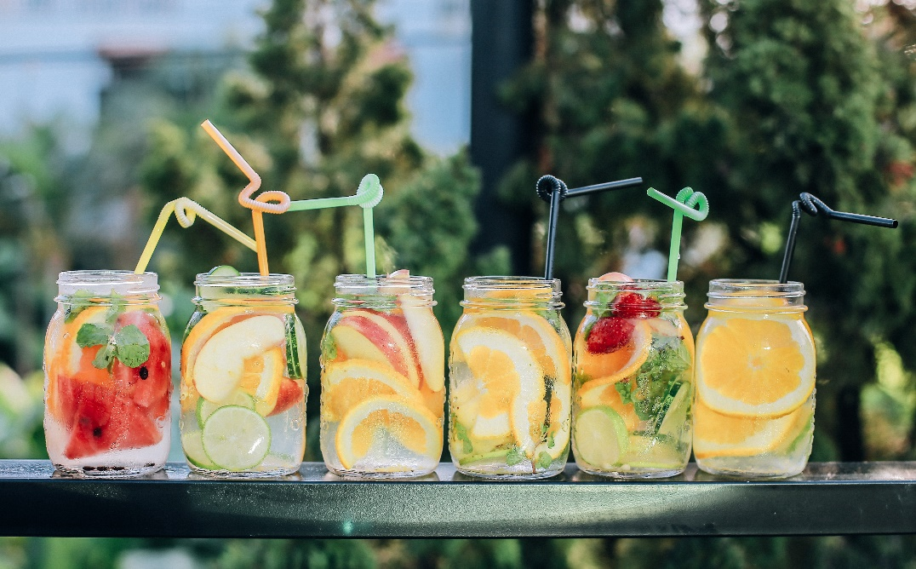
Tuesday @ 2
School Nutrition Town Hall
June 2023
California Department of Education
Nutrition Services Division

Slide 2
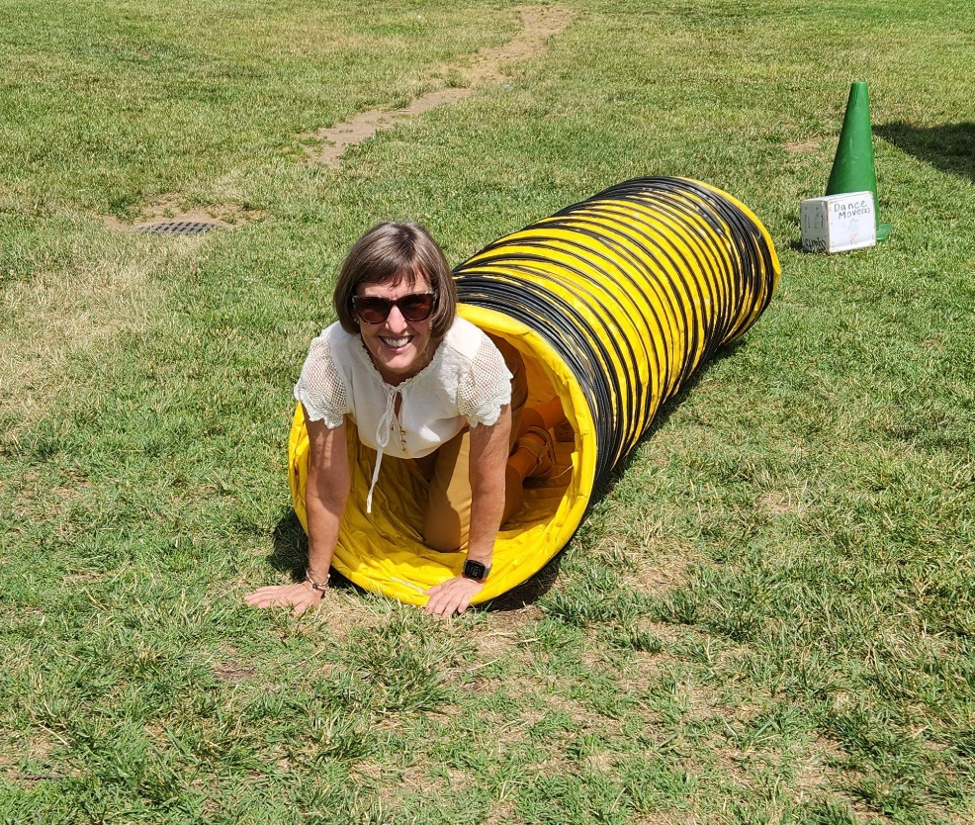
Welcome
Housekeeping:
  Lines muted
  Links in chat
  Live caption option
  Q&A for questions

Slide 3
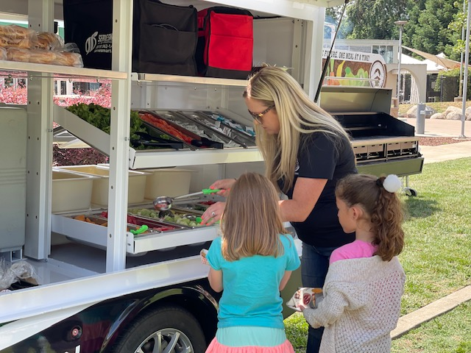
Town Hall-At a Glance
Celebrations
Federal Updates
State Updates
Funding Updates
Important Dates
Resources & Other Announcements
In the News

Slide 4
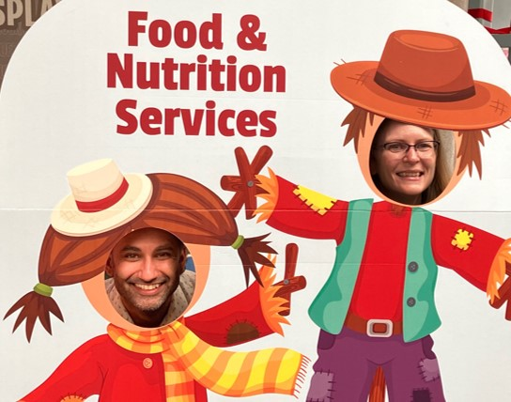
Celebrate Summer

Slide 5
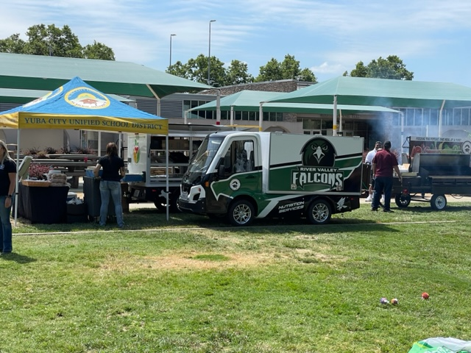
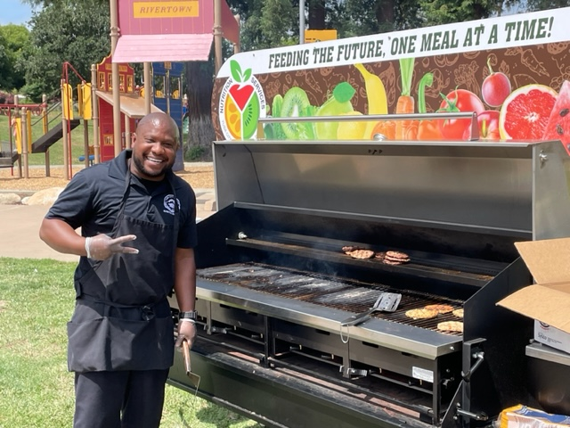
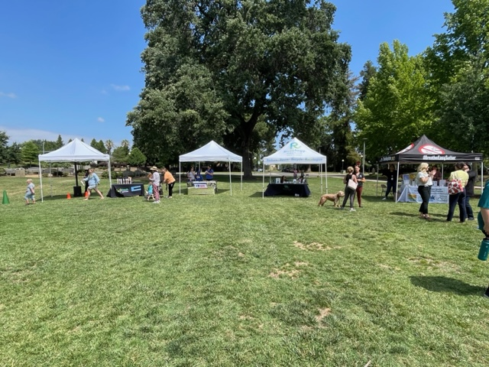
Summer Meals Kickoff Event
Yuba City Unified School District (USD)

Slide 6
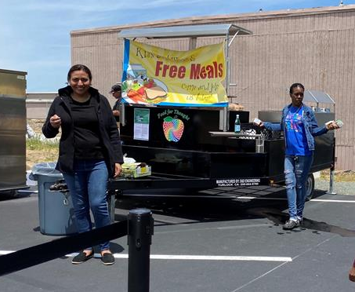
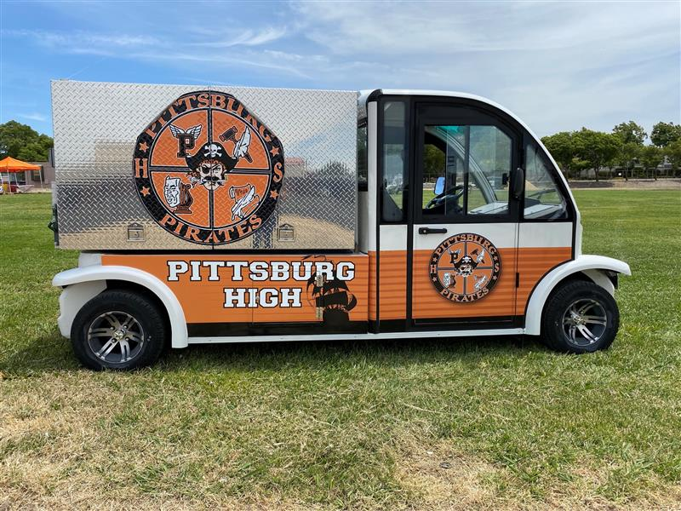
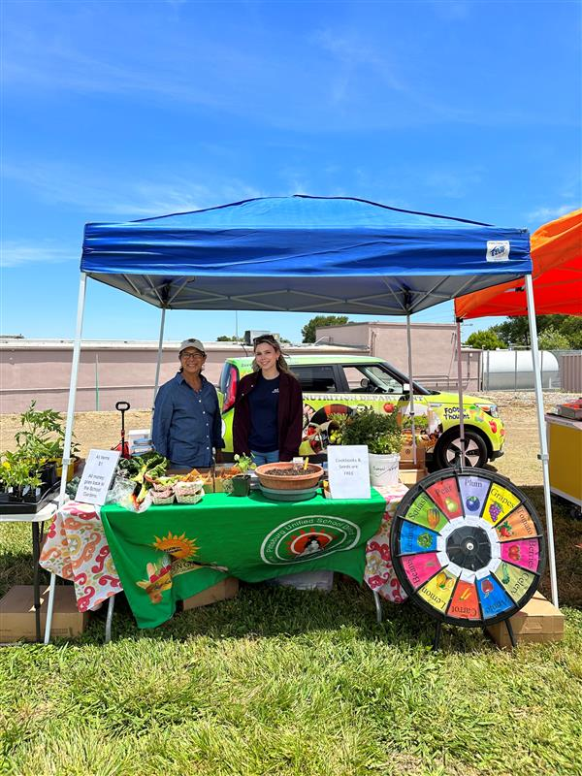
Pittsburgh USD
Summer Food Service Program Kickoff

Slide 7
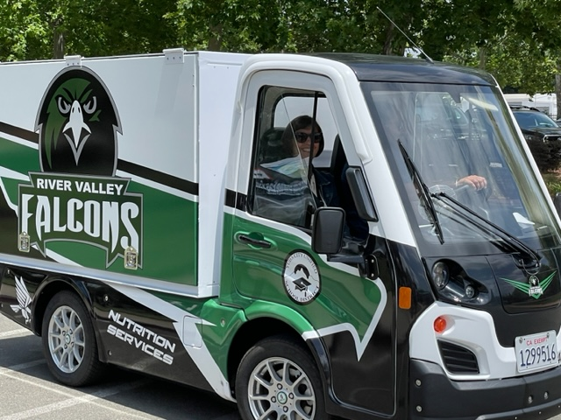
Invite CDE to Your Next Event!
Email event invites to NSDTownHall@cde.ca.gov
Put us to work
We look forward to visiting you soon!

Slide 8

Turnip the Beet Awards for
Summer 2023
Recognition for outstanding Summer Meal Program Sponsors
Open to Summer Food Service Program and Seamless Summer Option
Nominations due to CDE by
August 30, 2023

Slide 9
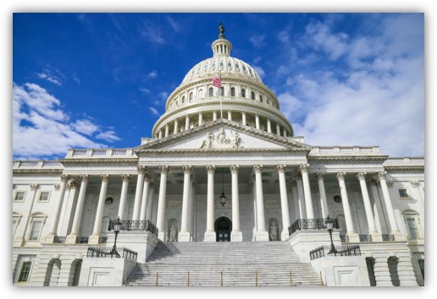
Federal Updates

Slide 10
Reminder: National School Lunch Program (NSLP) Sodium Limits Change
Sodium Target and Date | Grades K-5 | Grades 6-8 | Grades 9-12
Target 1A Effective July 1, 2023 | ≤ 1,110 mg | ≤ 1,225 mg | ≤ 1,280 mg
Target 1 Ends June 30, 2023 | ≤ 1,230 mg | ≤ 1,360 mg | ≤ 1,420 mg
Averaged over the course of the week
No change for breakfast; sodium limits remain at Target 1 for SY 2023-2024

Slide 11

Annual Release of the Meal
Reimbursement Rates for
School Year (SY) 2023–2024
Typically, the U.S. Department of Agriculture (USDA) releases the new rates in July

Slide 12
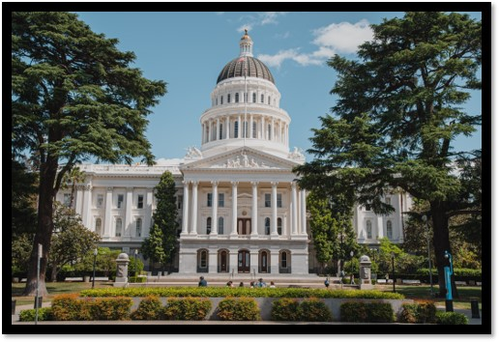
State Updates

Slide 13
Universal Meals Program (UMP) Guidelines
Final guidelines are posted on CDE web page:
  Universal Meals Public Comment web page at https://www.cde.ca.gov/ls/nu/sn/umpguidepubliccomment.asp
  CA UMP Meals Program web page at https://www.cde.ca.gov/ls/nu/sn/cauniversalmeals.asp

Slide 14
SY 2023–2024 Annual Updates for School Nutrition Programs
CNIPS will open for SY 2023–2024 annual updates on June 30, 2023
  Application packet must be approved before submitting a claim for reimbursement
  Note: Do not submit Seamless Summer applications for Summer 2024

Slide 15

Provision Application Deadlines for SY 2023–24
Due June 30, 2023:
  Community Eligibility Provision
  Provision 2

Slide 16
Local School Wellness Policy (LSWP)
Triennial Assessment (TEA) (1)
The LSWP TEA is due June 30, 2023
  For all National School Lunch Program and School Breakfast Program school food authorities (SFA) in operation prior to June 30, 2020.
All COVID-19 LSWP TEA waivers expire on June 30th.

Slide 17
LSWP TEA (2)
The CDE does not collect LSWPs or TEAs.
Keep LSWP TEA documentation on file for your next Administrative Review.
LSWP TEA Template available at https://www.healthyeating.org/triennialassessment
CDE LSWP web page: https://www.cde.ca.gov/ls/nu/he/wellness.asp

Slide 18
What Should You Do if You Can't Make the LSWP TEA Deadline?
Continue to work on completing the TEA as soon as possible and keep all your documentation on file.
You may receive corrective action for not completing the TEA at your next Administrative Review.
You will still have to conduct the next LSWP TEA three years from the June 30, 2023, deadline.
If you have any additional questions, please contact the CDE at lswp@cde.ca.gov.

Slide 19
Food Service Management Company Contract Preapproval
Management Bulletin (MB) SNP-05-2023
Updated process for contracts that include the Child and Adult Care Program (CACFP)
  Transfer of CACFP to the California Department of Social Services (CDSS) requires the addition of a contract addendum
  Addendum includes CDSS requirements

Slide 20
Buy American Provision (SB 490)
Effective January 1, 2024 through January 1, 2029
Applies to local educational agencies (LEA) who receive over $1,000,000 in federal meal reimbursement annually
Requires LEAs to only purchase agricultural food products grown, packaged and processed domestically with
Three exceptions:
  Price
  Quality
  Insufficient quantities
Does not apply to contracts already in place on January 1, 2024.

Slide 21
AB 778 Institutional Purchasers: Purchase of California-grown Agricultural Food Products
Include CA grown in solicitations and bids for agricultural food products.
Accept the bid for a CA grown item before accepting a bid for a domestic item grown outside the state when both conditions are met:
  The CA grown food does not exceed the lowest bid for a domestic product produced outside the state.
  The quality of the CA grown food is comparable to the domestic items produced in another state.

Slide 22
Reminder: Proposition 12
Animal Care Program (1)
For Egg and Pork Purchases, Effective September 1, 2022,
  Federal purchases in California, such as those made by the USDA for the USDA Foods Program, are exempt from the regulation
  Commercial purchases of shelled or liquid eggs and pork meat must comply with the requirements of the Final Rule

Slide 23
Reminder: Proposition 12
Animal Care Program (2)
CDE Management Bulletin FDP-03-2022, Proposition 12 Final Rule, the Farm Animal Confinement Initiative https://www.cde.ca.gov/ls/nu/fd/mb-fdp-03-2022-a.asp
California Department of Food and Agriculture Animal Care Program, Proposition 12, Farm Animal Confinement web page https://www.cdfa.ca.gov/AHFSS/AnimalCare/

Slide 24
Leftover Food Donation in the School Nutrition Programs
Updates to the Bill Emerson Good Samaritan Food Donation Act did not change for SFAs.
  Allowed: food donations to food banks and other charitable organizations
  Not Allowed: food donations directly to end recipients
    This is restricted by the National School Lunch Act

Slide 25
Food Distribution Program (FDP)
Administrative Fee Suspension for SY 2023–2024 (1)
Suspension of the administrative fee ($0.90 per case or case equivalent) will continue in SY 2023-2024 only
  Direct delivery products
  Bulk foods to processors
Temporary: SFAs are encouraged to budget for these fees in future years

Slide 26
FDP Administrative Fee Suspension for SY 2023-2024 (2)
Program Fee | Standard Fee | Temporary Fee
Administrative fee for bulk and direct delivery USDA Foods sent to processors, distributors or direct to recipient agencies | $0.90 | $0.00
USDA Foods delivered by the State Distribution Centers (SDCs) | $2.85 | $1.95

Slide 27
FDP Administrative Fee Suspension for SY 2023-24 (3)
Program Fee | Standard Fee | Temporary Fee
USDA Foods picked up at the SDCs | $2.40 | $1.50
*Note that Department of Defense (DoD) Fresh and the Fresh Fruit and Vegetable Pilot Program administrative fees are not included in this temporary suspension.

Slide 28
Important Operational Dates:
Next 30 days (1)
Action | Date
Site Visit for New Summer Sites | First visit within 2 weeks of operation (may combine with review visit required in first 4 weeks)
Community Eligibility Provision (CEP) Application Deadline for SY 2023–2024 | June 30
Provision 2 Application Deadline for SY 2023–2024 | June 30
LSWP TEA, if applicable | June 30

Slide 29
Important Operational Dates:
Next 30 days (2)
Action | Date
Two Food Safety Inspections | End of SY
School Nutrition Program (SNP) Annual Updates | Beginning July 1
SNP Eligibility Determinations: Meal Applications | July 1 annually
SNP Eligibility Determinations: Direct Certification | Beginning of the SY
FDP Contract Packet due | July 31

Slide 30
Important Operational Dates:
Next 60 days
Action | Date
Complete Mandatory Food Safety Inspection Reports in CNIPS | August-October

Slide 31

Funding Updates

Slide 32
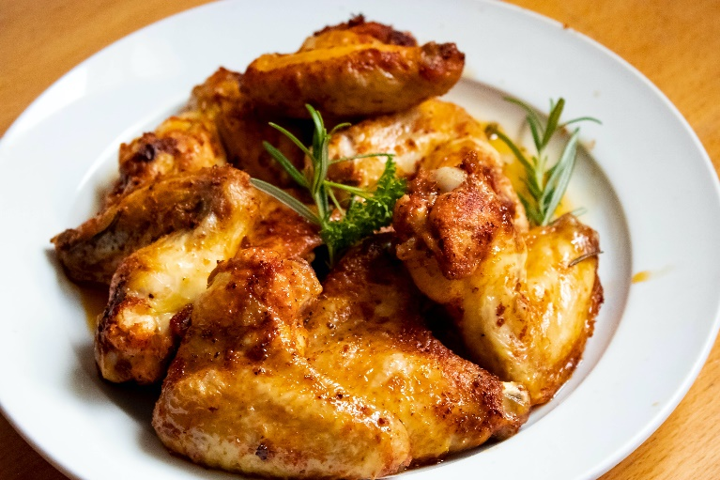
Supply Chain Assistance (SCA) Funds
Fourth Round
California will receive $142,575,990
Attestation will be available in August 2023
Anticipated release of funds by December 2023
Questions: SCAfunds@cde.ca.gov

Slide 33
Local Food for Schools (LFS):
Funding Information
Funding apportionment posted https://www.cde.ca.gov/fg/fo/r9/lfsfundresults22.asp
Deposit funds into the Nonprofit Food Service Account (Fund 13)
  SACS Resource Code: 5467
  Revenue Object Code: 8220

Slide 34

LFS: Opt-in Part 2 Deadline
Submission deadline: 5 pm Friday, July 21, 2023
  Vendor information
  Procurement documents
  Purchasing schedule
Two-step submission process
  Online survey
  Box.com file upload
Reference listserv sent June 15, 2023

Slide 35
Grant Funds Overview (1)
Grant | Timeline
2023 Federal Equipment Grant Funds Issued | End of June 2023
SCA Funds Issued (Rounds Two & Three) | End of June 2023
SCA Attestation (Round Four) | August 2023
SCA Funds Issued (Round Four) | December 2023

Slide 36
Grant Funds Overview (2)
Grant | Timeline
School Breakfast and Summer Meals Program Start Up Grant Award Notifications | July 2023
2023–24 Fresh Fruit and Vegetable Program (FFVP) First Allocation Award Notifications | July 2023
LFS submission deadlines for vendor information, procurement documents, and purchasing schedules | 5 p.m. July 21, 2023
School Food Best Practices Award Notifications | End of July 2023

Slide 37
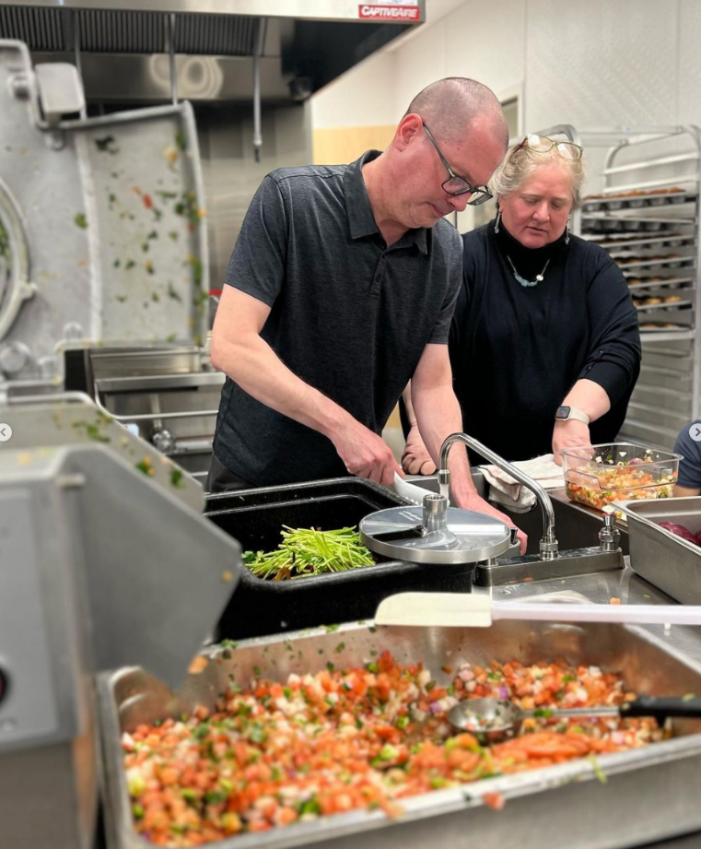
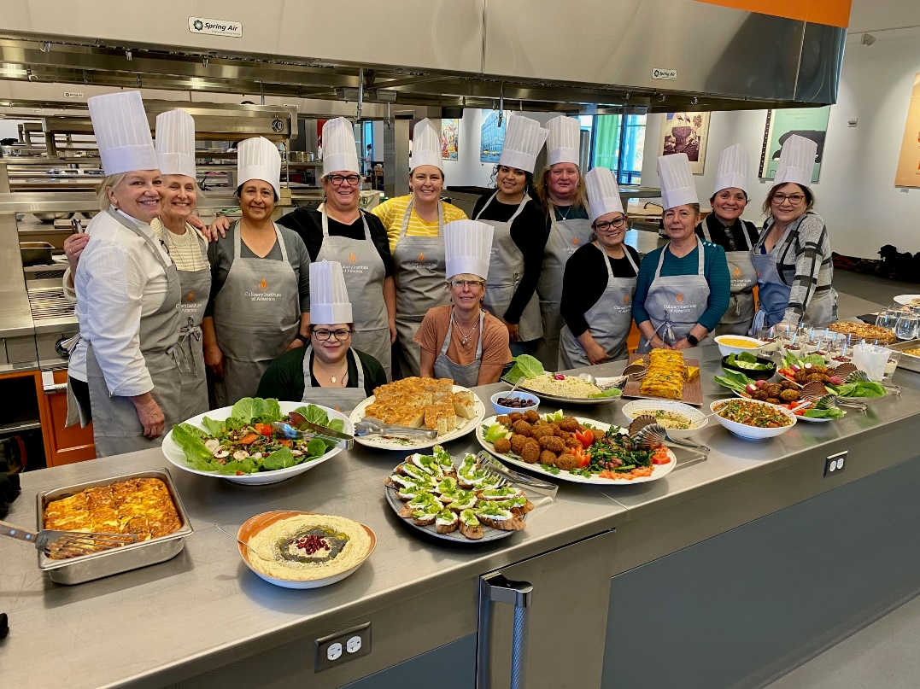
Thank You for Completing the
Kitchen Infrastructure and Training (KIT)
2021 Mid-Term Report

Slide 38
Bulk Milk Grants
Chef Ann Foundation
$5,000 value
Supports waste reduction
Helps transition from conventional milk to bulk milk served in reusable tumblers
Provides equipment such as:
  Dispenser and stand
  Reusable cups
  Dish rack
  Marketing & training materials
Applications Due: July 31, 2023

Slide 39

Resources & Other Announcements

Slide 40
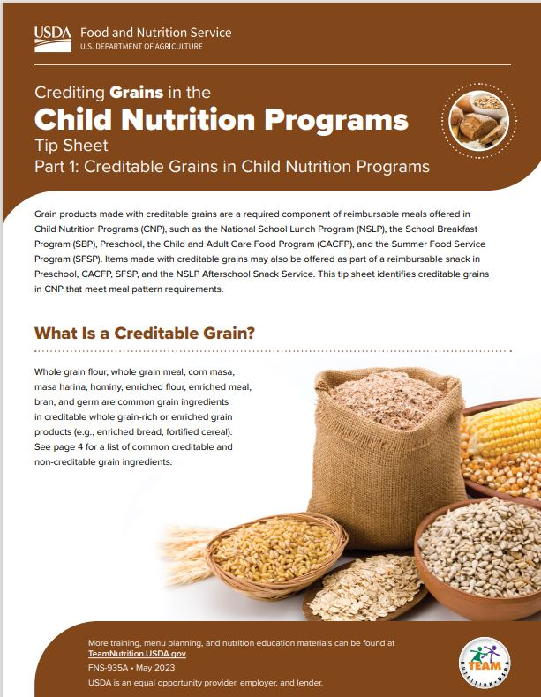
New Resources: Crediting Grains in Child Nutrition Programs Tip Sheets
Three easy-to-use tip sheets:
  Crediting, identifying, and understanding program grain requirements
Check out this resource and the four other crediting tip sheets in the series: fruit, vegetables, meat/meat alternates, and fluid milk

Slide 41
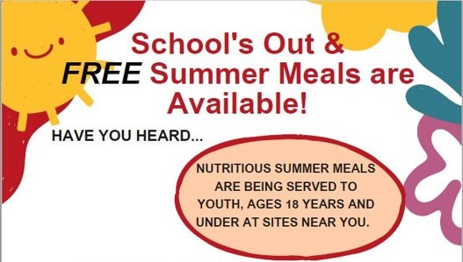
NEW: Summer Meals Flyer
School's Out & FREE Summer Meals are available flyer
Share with parents and community partners
Coming soon to the CDE Summer Food Service Program web page

Slide 42

2024 California Green Ribbon Schools
Recognition Program
Honors excellence in whole-school sustainability
Awardees receive CDE recognition and award plaque
First step: complete the Application Interest Survey
Applications due Friday, October 27, 2023
Apply early, submit what you are currently doing, then request application support from CDE staff

Slide 43
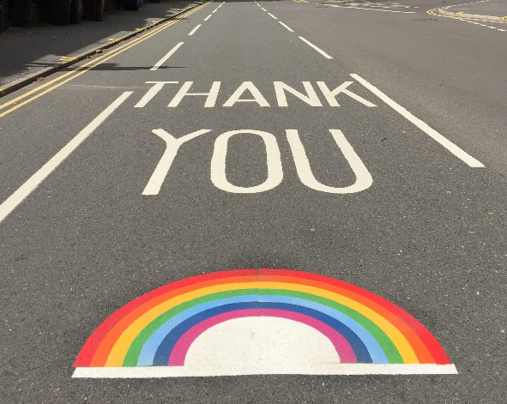
CA School Nutrition Association's (CSNA) and Chef Anne Foundation Vacancy and Turnover Rate Survey
Goal: Assess California's school food labor challenges
Responses will be used to identify solutions.
CSNA is distributing the survey via email
Due: August 25, 2023

Slide 44

In the News...

Slide 45
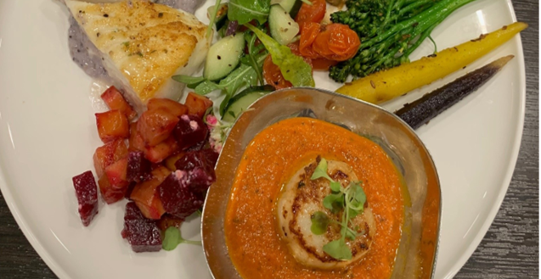
Wonderful College Prep Academy and Chef Devinder Kumar Featured in Forbes Magazine (June 2023)
Taste of CA Challenge Ambassador
Creator of the Curryfornia Bowl
Farm to School
Serving 2,400 students and preparing 6,500 scratch-cooked meals daily

Slide 46
"Continuing to Improve the Quality of School Nutrition in CA"
EdSource Commentary May 28, 2023
Authors:
  Erin Primer, Director of Food and Nutrition Services in San Luis Coastal USD
  Lena Alsarraf, Osteopathic Physician and General Practitioner
Highlights the importance of school meals and San Luis Coastal USD's shift towards locally sourced, freshly prepared, healthy menu options

Slide 47
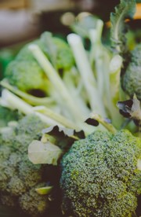
Santa Clara USD’s District Farm
Featured in Bay Area Bountiful on Public Broadcasting Service (PBS)
Video segment features Peterson Middle School students harvesting broccoli at their farm, serving it in the cafeteria, and nutrition education in the classroom
Partnership with Center for Ecoliteracy

Slide 48
Tuesday @ 2pm Town Hall Schedule
Held on the fourth Tuesday of the month
Month | Format | Date
July | State Update | 07/25/23
August | State Update and Guest Speaker | 08/22/23
September | State Update | 09/26/23

Slide 49

Thank you!
Next Town Hall:
July 25, 2023
This institution is an equal opportunity provider

