Slide 1
Digital Learning Integration and Standards Guidance Webinar ELA/ELD Standards Guidance
Shanine Coats, Director
Curriculum Frameworks and
Instructional Resources Division

Slide 2
Introductions
Nancy Herota, Deputy Superintendent, Sacramento County Office of Education
Hallie Yopp, California State University, Fullerton
Nancy Brynelson, California State University Chancellor’s Office (retired)
Deborah Costa-Hernandez, California Reading and Literature Project
Martha Hernandez, Californians Together

Slide 3
Leadership Team
Content Development Team
ELA/ELD: Dr. Hallie Yopp, Nancy Brynelson, Dr. Douglas Fisher, Dr. Nancy Frey
Mathematics: Dr. Jo Boaler, Cathy Ann Williams
Digital Learning: Dr. Kathryn Kennedy
Assessment: Dr. Douglas Fisher, Dr. Nancy Frey
Social Emotional Learning: Dr. Lorea Martinez

Slide 4
Advisory Committee
Content Experts
Advancement Via Individual Determination
CDE 2021 Mathematics Framework Writing Team Lead
California Subject Matter Project
Californians Together
County Offices of Education
El Dorado
Imperial
Kern
San Bernardino
San Diego
Tulare
School Districts
Madera Unified School District
Modesto City Schools
Professional Associations &
Educational Organizations
California Charter Schools Association
California Teachers Association
Policy Analysis for California Education
The Education Trust-West
California Parent Teachers Association
California Federation of Teachers

Slide 5
Expanded Outreach
California County Superintendents Educational Services Association (CCSESA)
Curriculum and Instruction Steering Committee (CISC)
Mathematics Subcommittee
English Language Arts Subcommittee
Families in Schools
Californians for Justice

Slide 6
Digital Learning Integration and Standards Guidance At-a-Glance
Section A: | Section B: | Section C:
Implementing Research-Based Digital Learning Practices | Standards Guidance for Mathematics | Standards Guidance for ELA, Literacy, & ELD
Notes:
Nancy Herota
[Kyle: push out links to website again if needed and Guidance
https://www.cde.ca.gov/ci/cr/dl/documents/cadlisguidance-excerptc.docx ]

Slide 7
Illustrative Examples of Classroom Practice
Voices from the Field - Interviews
Vignettes
Spotlights

Slide 8
Section C: Purpose
Provides information about digital learning in ELA, literacy, and ELD in in-person and online learning environments
Presents standards and instructional guidance to support the continuum of learning from TK/K through grade 12 and prioritizes critical areas of instructional focus for each grade level
Serves as a companion resource to the ELA/Literacy Standards, the ELD Standards, ELA/ELD Framework, EL Roadmap, CA State Literacy Plan, and CA Dyslexia Guidelines

Slide 9
Section C: Overview
Standards Guidance for English Language Arts, Literacy, and English Language Development
Chapter 10:
Digital Learning in ELA, Literacy, and ELD
Chapter 11:
Introduction to Standards Guidance for ELA, Literacy, and ELD
Chapters 12–16:
Standards guidance organized by grade level

Slide 10
Chapter 10
Digital Learning in ELA, Literacy, and ELD
Preparing and Supporting Teachers for Digital Teaching
Designing Meaningful Digital Learning Experiences

Slide 11
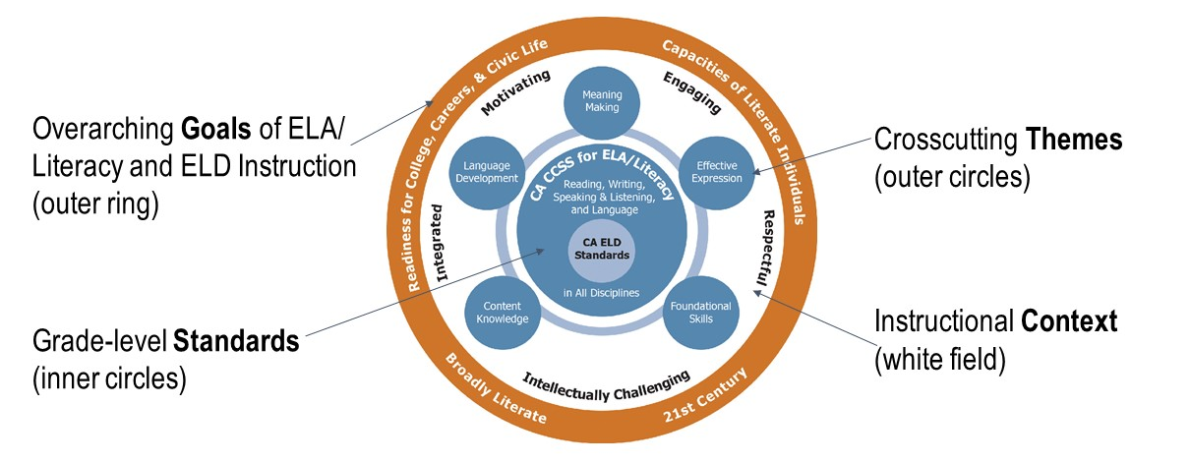
Organization of Standards (1)
The Big Picture of California’s
ELA, Literacy, and ELD Instruction
Circles of Implementation Graphic from 2014 ELA/ELD Framework
Long description

Slide 12
Organization of Standards (2)
Crosscutting Themes
Meaning Making
Language Development
Effective Expression
Content Knowledge
Foundational Skills
The organization of the standards highlights their interrelationships and reflects an integrated model of instruction.

Slide 13
Organization of Standards (3)
A chart for each of the critical areas of instructional focus (themes) is provided for every grade level.
Key ELA/literacy and ELD standards are identified for each theme. These may include substandards.
Interrelated key standards are grouped together.
Some key standards support multiple themes, so they are repeated. Color coding highlights this repetition.
Related standards and instructional considerations are included.

Slide 14
Critical Area of Instructional Focus: Meaning Making
Example: Kindergarten (p. 249)

Slide 15
Example: Kindergarten
Key ELA/Literacy & ELD Standard(s) | Related Standards and Instructional Considerations
RL/RI.K.1 ...ask and answer questions about key details in a text. SL.K.2 Confirm understanding of a text read aloud or information presented orally or through other media by asking and answering questions about key details … ELD.PI.K.5.Ex Demonstrate active listening to read-alouds and oral presentations by asking and answering questions, with oral sentence frames and occasional prompting and support. | Text-dependent questions prompt children to attend closely to texts (ELD.PI.K.6.Ex). Questions are developed to support… (RL.K.3,9; RI.K.2,3,7; RL/RI.K.7; RL/RI.K.9). Children…are also encouraged to ask questions about a text or information presented through other media.… (SL.K.3). All children participate in teacher read-aloud experiences with increasingly complex texts ...variety of text types ...

Slide 16
Key Standards (Column 1)
Include those that
Research indicates are crucial
Can serve as a central point around which other standards can be addressed in the same context
Reflect attention to text types, textual evidence, text complexity, and communication
Likely require significant instructional attention

Slide 17
Related Standards & Instructional Guidance (Column 2)
Bulleted text serves to
Clarify, contextualize, or emphasize an aspect of a standard
Highlight related standards, instructional considerations, and research-based practices, with attention to equity

Slide 18
Critical Area of Instructional Focus: Foundational Skills
Example: Grade One (p. 272)

Slide 19
Example: Grade One (1)
Key ELA/Literacy & ELD Standard(s) | Related Standards and Instructional Considerations
RF.1.2 Demonstrate understanding of spoken words, syllables, and sounds (phonemes). | ...children orally produce single-syllable words by blending sounds (RF.1.2b) and segment spoken single-syllable words into their complete sequence of individual sounds (RF.1.2d). ...

Slide 20
Example: Grade One (2)
Key ELA/Literacy & ELD Standard(s) | Related Standards and Instructional Considerations
RF.1.3b Decode regularly spelled one-syllable words. L.1.2d Use conventional spelling for words with common spelling patterns. L.1.2e Spell untaught words phonetically, drawing on phonemic awareness and spelling conventions. | Children are guided to use what they are learning...to read untaught words and to generate spellings of words... Children have many opportunities to practice... Instruction in English for students who are English learners capitalizes on similarities... and highlights differences between the languages. Pronunciation differences due to native language, dialect influences, or regional accent should not be misunderstood as decoding difficulties.

Slide 21
Critical Area of Instructional Focus: Language Development
Example: Grade Three (p. 299)

Slide 22
Example: Grade Three
Key ELA/Literacy & ELD Standard(s) | Related Standards and Instructional Considerations
SL.3.1,4 Engage effectively in a range of collaborative conversations with diverse partners about grade 3 topics and texts; plan and deliver presentations. ELD.PI.3.1,3,9.Ex Contribute to... discussions; offer opinions and negotiate with others...using an expanded set of learned phrases as well as open responses; and plan and deliver brief oral presentations. | Opportunities to use language contribute to language development. Children engage in brief and extended conversations daily...(SL.3.3; ELD.PII.3.3-5.Ex) Teachers ensure a community culture in which all children feel comfortable contributing to conversations, are encouraged to do so, feel heard and respected by others. Agreed-upon discussion norms are established.... Teachers ensure equitable opportunities for all learners to contribute to discussions.

Slide 23
Critical Area of Instructional Focus: Meaning Making
Example: Grade Six ELA & ELD (p. 344)

Slide 24
Example: Grade Six
Key ELA & ELD Standard(s) | Related Standards and Instructional Considerations
RL/RI.6.1 Cite textual evidence to support analysis of what the text says explicitly as well as inferences drawn from the text. W.6.9 Draw evidence from literary or informational texts to support analysis, reflection, and research. SL.6.3 Delineate a speaker’s argument and specific claims, distinguishing claims that are supported by reasons and evidence from claims that are not. ELD.PI.6.6b,11a.Ex Express inferences and conclusions...; justify opinions or persuade others by providing...evidence. | Using textual evidence to support analysis is new... (RI.6.8; SL.6.3). ELA teachers model and scaffold ...scaffolds (planned and “just-in-time”) Text-dependent questions...increasing levels of depth…Teachers analyze texts...engage students in developing their own questions based on the text. All students read a range of literary and informational texts both independently and collaboratively... Teachers occasionally read aloud selected passages to...

Slide 25
Critical Area of Instructional Focus: Content Knowledge
Example: Grades Six through Eight Science and Technical Subjects (p. 399)

Slide 26
Example: Grade Six through Eight (1)
Key Literacy & ELD Std(s) | Related Standards & Instructional Considerations
RST.6-8.4 Determine the meaning of symbols, key terms, and other domain- specific words and phrases as they are used in a scientific or technical context... ELD.PI.6-8.6c.Ex Use knowledge of morphology, context, reference materials, and visual cues to determine the meaning of unknown and multiple- meaning words on familiar and new topics. | Teachers help students examine vocabulary, language structures, organizational structures, and use of media in informational texts for science and technical subjects. Students identify features unique to the discipline, including quantitative and technical information... (RST.6-8.5,7).

Slide 27
Example: Grade Six through Eight (2)
Key Literacy & ELD Std(s) | Related Standards & Instructional Considerations
RST.6-8.10 By the end of the grade 8, read and comprehend science and technical texts in the grades 6–8 text complexity band independently and proficiently. ELD.PI.6-8.6b.Ex Express inferences and conclusions drawn based on close reading of grade-level texts. | All students read broadly in the discipline. ...use of text complements and contributes to content instruction... ...read widely in classroom and virtual settings... ...have frequent opportunities to discuss the content of the texts they read (ELD.PI.6-8.1.Ex) ...have access to informational text in their home languages to amplify content knowledge and support meaning making.

Slide 28
Critical Area of Instructional Focus: Effective Expression
Example: Eleven and Twelve ELA (p. 455)

Slide 29
Example: Grade Eleven and Twelve (1)
Key ELA & ELD Std(s) | Related Standards and Instructional Considerations
W.11-12.1 Write arguments to support claims in an analysis of substantive topics or texts, using valid reasoning and relevant and sufficient evidence. W.11-12.2 Write informative/explanatory texts to examine a topic and convey complex ideas, concepts, and information clearly and accurately through the effective selection, organization, and analysis of content. W.11-12.3 Write narratives to develop real or imagined experiences or events using effective technique, well-chosen details, and well-structured event sequences. | ...students...structure their writing and use language to effectively address their task, purpose, and audience. ...analyze substantive topics or texts...Teachers engage students in the analysis of a variety of mentor texts... ...are expected to...use...rhetorical devices to support assertions. ...write daily in virtual and in-class settings—both independently and collaboratively (W.11-12.10). Teachers model and guide co-construction of increasingly effective text...

Slide 30
Example: Grade Eleven and Twelve (2)
Key ELA & ELD Std(s) | Related Standards and Instructional Considerations
ELD.PI.11-12.10.Ex Write longer literary and informational texts collaboratively and independently by using appropriate text organization and growing understanding of register; write increasingly concise summaries of texts and experiences by using complete sentences and key words. | ...students use technology to produce and publish writing and collaborate with others...(W.11-12.6).

Slide 31
Critical Area of Instructional Focus: At a Glance
Example: Grade Three (p. 294)

Slide 32
Example: At a Glance Grade Three
Theme | Key Standards | Related Standards
Meaning Making | RL/RI.3.1,10; RF.3.4; W.3.1-3; SL.3.1,3,4 ELD.PI.3.1,6,9,10a,11.Ex | RL/RI.3.2,3 ...
Language Development | RL/RI.3.4,10; RF.3.4; SL.3.1,4; L.3.4,5,6 ELD.PI.3.1,3,6,9,12.Ex | RF.3.3a,b ...
Effective Expression | RL/RI.3.10; RF.3.4; W.3.1-3,5; SL.3.1,4 ELD.PI.3.1,4,7-10.Ex | RL3.4-7 ...
Content Knowledge | RL/RI.3.1,10; RI.3.4; W.3.2,7,8,9; SL.3.1,3,4;L.3.4,5 ELD.PI.3.1,5,6,9,10,12.Ex | RI.3.5,6 ...
Foundational Skills | RF.3.3a,b,c,d,4; L.3.2f,3.4b; W.3.1-3 ELD.PI.3.10.Ex | RL/RI.3.10 ...

Slide 33
A Sample Class Spotlight (pp. 323–324)
“Students in Ramal Setty’s 4th-grade class are learning about California history and geography. As part of their unit on the influence of geography on the Indigenous peoples of the region, his students are learning the domain-specific vocabulary needed to understand these concepts. The students are building content knowledge and expanding their language concurrently, both of which contribute to students’ meaning making...In order to facilitate meaning making as students are studying the different regions, he uses a list-group-label process to organize and consolidate their semantic knowledge. He uses a multimedia bulletin board tool (Padlet) so that he and his students can manipulate the information…”
Prominent ELA/Literacy/ELD Themes: Content Knowledge, Language Development, Meaning Making
Associated Standards: RI.4.3,4,7,8; W.4.6,8,9; SL.4.2; L.4.6; ELD.PI.4.6,12a.Ex

Slide 34
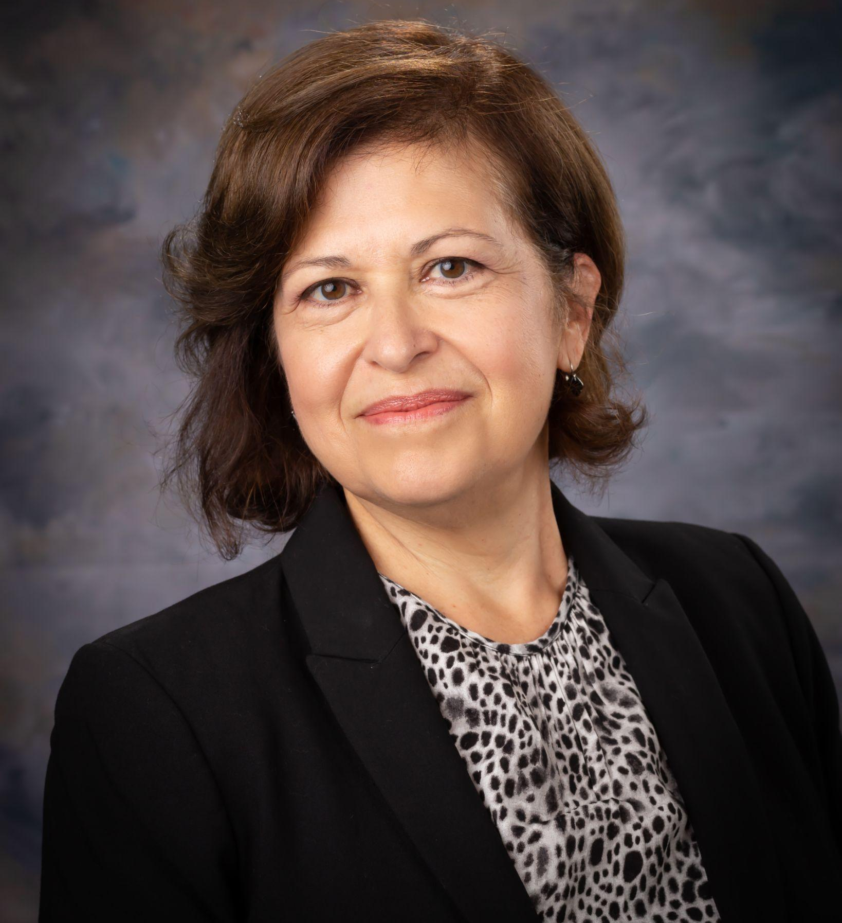
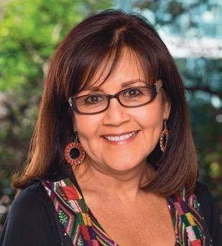
Panel Discussion
Deborah Costa-Hernandez, Ed.D.
Executive Director,
California Reading and Literature Project
Martha Hernandez
Executive Director,
Californians Together

Slide 35
Supplemental Materials
Supplemental Materials
Glossary
References
Appendices
A: Literature Review
B: Digital Tools Matrix
C: Section Resources
D: Mathematics Rubric Samples

Slide 36
Phase 2
Development and release of the California Digital Learning Integration and Standards Guidance
PDF and e-Book
Website
Videos of content experts and teachers

Slide 37
Upcoming California Digital Learning Integration & Standards Guidance Webinars
Webinar 2: Designing Instruction
August 26 at 10 a.m.
FOCUS on Section A: Implementing Research Based Digital Learning Practices
Webinar 3: Mathematics Standards Guidance
August 26 at 2 p.m.
FOCUS on Section B: Standards Guidance for Mathematics
Ways to Access Registration Links:
Contact us at CFIRD@cde.ca.gov
Visit and follow @CDECurriculum on Twitter

Slide 38
Long Description for Circles of Implementation Graphic from 2014 ELA/ELD Framework (1)
The outer ring identifies the overarching goals of ELA/literacy and ELD instruction. By the time California’s students complete high school, they have developed the readiness for college, careers, and civic life; attained the capacities of literate individuals; become broadly literate; and acquired the skills for living and learning in the 21st century. The white field represents the context in which instruction occurs. This framework asserts that the context for learning should be integrated, motivating, engaging, respectful, and intellectually challenging for all students. Circling the standards are the key themes of the standards: Meaning Making, Language Development, Effective Expression, Content Knowledge, and Foundational Skills. These themes highlight the interconnections among the strands of CA CCSS for ELA/Literacy (Reading, Writing, Speaking and Listening, and Language) and the parts of the CA ELD Standards (“Interacting in Meaningful Ways,” “Learning About How English Works,” and “Using Foundational Skills”).
(Continued on next slide)

Slide 39
Long Description for Circles of Implementation Graphic from 2014 ELA/ELD Framework (2)
(Continued from previous slide)
The themes are organizing components for the grade-level discussions. In the center of the graphic are the CA CCSS for ELA/Literacy and the CA ELD Standards, which define year-end expectations for student knowledge and abilities and guide instructional planning and observation of student progress. The CA ELD Standards also identify proficiency level expectations (Emerging, Expanding, and Bridging) and ensure that EL students have full access to the CA CCSS for ELA/Literacy and other content standards. These standards are the pathway to achievement of the overarching goals.
California Department of Education: August 2021
Return to slide

