Slide 1
Early Education Division Webinar
Early Education Division (EED)
Fiscal and Administrative Services Division (FASD)
Date: July 15, 2022
Time: 1:00 p.m. to 2:00 p.m.

Slide 2

Welcome and Introductions

Slide 3
Meeting Agenda
Final Budget Overview
  Universal Transitional Kindergarten (UTK)
  Universal PreKindergarten (UPK) Planning and Implementation Supports
  California State Preschool Program (CSPP) Changes
  Infrastructure
  Other Key Investments
CSPP Regulations
UPK Updates

Slide 4

2022–23 Final Budget
Photo Credit: Kidango Decoto Center; Union City, CA

Slide 5
Universal Transitional Kindergarten (UTK)
Provides $614 million for the first year of Transitional Kindergarten (TK) expansion making TK eligible to all children turning five years old between September 2 and February 2
Includes $383 million for an additional adult to reduce ratios to 1 adult to 12 students and includes fiscal penalties for not meeting class size, ratio, and teacher requirements in TK
Makes it easier to staff TK classrooms by:
  Allowing the Commission on Teacher Credentialing (CTC) to issue a one-year emergency specialist teaching permit in early childhood education that authorizes the permit holder to teach TK
  Clarifying that substitute TK teachers are not required to meet the additional TK teacher requirements around child development
Requires TK data to be collected separately from kindergarten data

Slide 6
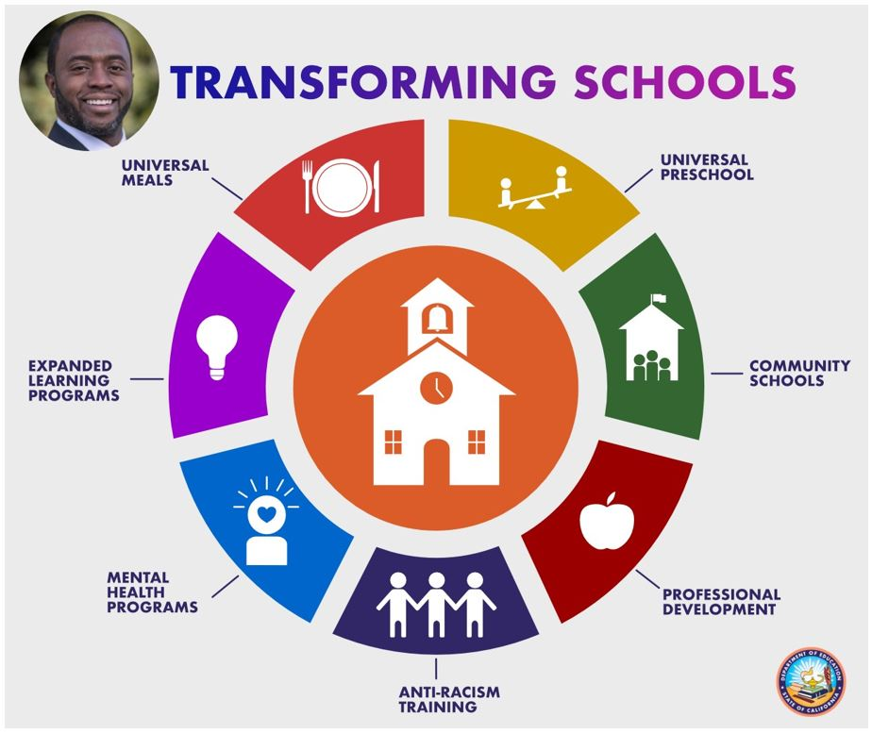
UPK Planning and Implementation Supports
$300 million for UPK Planning and Implementation for districts that have kindergarten enrollment (and therefore are expected to have TK enrollment) and county offices of education (COE) for county-level efforts
$18.3 million per year for three years for California Universal Preschool Planning Grant Program to support preschool planning in Mixed Delivery system. Funds go to Local Planning Councils or Resource and Referral Agencies if local planning councils (LPC) not interested. Link to longer description, slide 19.

Slide 7
California State Preschool Program (CSPP) Fiscal Changes
Increases adjustment factors as follows:
Provides a 6.56 percent Cost of Living Adjustment (COLA)
Includes $21.3 million to waive family fees and extends hold harmless for 2022–23
Changes audit threshold for yearly audits in CSPP
Adjustment Factor Category | Old Adjustment Factor | New Adjustment Factor
Children with exceptional needs | 1.54 | 2.4
Children with severe disabilities | 1.93 | 2.4
Children 47 months or younger | none | 1.8
Children who are dual language learners | 1.1 | 1.2
Early childhood mental health consultation | 1.05 | 1.1

Slide 8
Budget Act Allocations
The Department received various allocations to support several changes in the fiscal year (FY) 2022–23 Budget Act, including funding for:
  NEW Three year old Adjustment Factor
  Dual Language Learner (DLL) and Exceptional Needs and Severely Disabled adjustment factor increases
  Family Fee Waivers
Allocations will be based on June 2022 data, submitted by contractors as of August 20, 2022.
If a June 2022, report has not been received by August 20, allocations will be based on the most recent report submitted by the contractor

Slide 9
FY 2022–23 Budget Act Contract Amendments
All Budget Act allocations will be processed through a contract amendment via the Allocation Letter Process.
The Allocation Letter does not require a signature and looks similar to a contract amendment.
Allocation letter will include the contract face sheet and any changes in funding, where applicable

Slide 10
CSPP Eligibility and Certification Changes
Increases eligibility threshold in CSPP to 100 percent of the State Median Income (SMI), from 85 percent
Allows children with exceptional needs to be categorically eligible for CSPP
Allows children whose income is no more than 15 percent above the income eligibility threshold to be served in full-day CSPP (previously this was limited to part-day CSPP)
Modifies definition of countable income for the purpose of determining eligibility to exclude foster care payments and guaranteed income payments
Allows all students participating in State Preschool to maintain continuous eligibility for 24 months

Slide 11
Additional Support for Children with Disabilities
In addition to categorical eligibility for children with disabilities and an increased adjustment factor for those children, the budget includes:
  Requirement for CSPP contractors to reserve 5 percent of funded enrollment for children with disabilities in 2022–23, moving to 7.5 percent in 2023–24 and 10 percent in 2024–25. Contractors will be fully funded for that enrollment, regardless of attendance.
    Requirement for CDE to review data and provide technical assistance to support increasing inclusion. Potential penalties and waiver process start in 2026-27.
  Provides $250 million to support the Inclusive Early Education Expansion Program
  Provides $2 million for CDE to develop a process and tools for early identification of children at risk for developmental delays and learning disabilities.

Slide 12
Infrastructure
Nearly $6 billion for Prek-12 education facilities, including:
  $1.4 billion General Fund for TK-12 school facilities construction
  $4.2 billion for the School Facility Program
  $100 million for the California Preschool, TK, and Full-Day Kindergarten Facilities Grant in 2023–24, with another $550 million intended for 2023–24
Amends language to allow Community Colleges to receive this funding
  Provides $30 million per year for two years to support eligible facilities costs for the Charter School Facility Grant Program.
$100 million to develop and repair existing child care and preschool infrastructure at non-local educational agencies (LEAs), especially in low-income communities

Slide 13
Other Key Investments
Provides $85 million to expand and augment work of the Early Math initiative and coordinate that initiative with other efforts around math and science
Provides a total of $4 billion for the Expanded Learning Opportunity Program, with full implementation of the program to take place by 2025–26, and a rate increase for other expanded learning programs.
Provides $1.1 billion to expand access to the community schools grants to every eligible LEA that opts to apply on behalf of its high-need schools.
Provides significant funding for educator workforce pathways and professional learning

Slide 14
California State Preschool Program Regulations
The CSPP regulations have been approved and are in effect as of July 1, 2022.
All regulations related to CSPP are now included in Title 5, Chapter 18.5.
Regulations in Title 5, Chapter 19 are no longer applicable to CSPP.
The regulations can be found on the CDE Rulemaking webpage.

Slide 15
Universal PreKindergarten (UPK) Updates
UPK Office Hours will resume on Wednesday, August 3
The UPK Summer Survey for Webinar and Office Hours topics will close today, July 15.
UPK Planning & Implementation Grant Program Surveys (for LEAs and COEs) will be sent out late July and must be submitted by August 31.
UPK Planning & Implementation Apportionment 2 funds (for school districts and charter schools) and the UPK Countywide Planning and Capacity Building Apportionment 2 funds are scheduled to be released in early August.

Slide 16

Questions
Photo Credit: Kidango Decoto Center; Union City, CA

Slide 17
Resources
PQI Office Regional Consultants
  https://www.cde.ca.gov/sp/cd/ci/assignments.asp
    Consultants are most easily reached by email
    or by phone at 916-322-6233
EENFS, Fiscal Apportionment Analyst Directory
  https://www.cde.ca.gov/fg/aa/cd/faad.asp
Regulation Related Questions
  EEDTitle5@cde.ca.gov

Slide 18
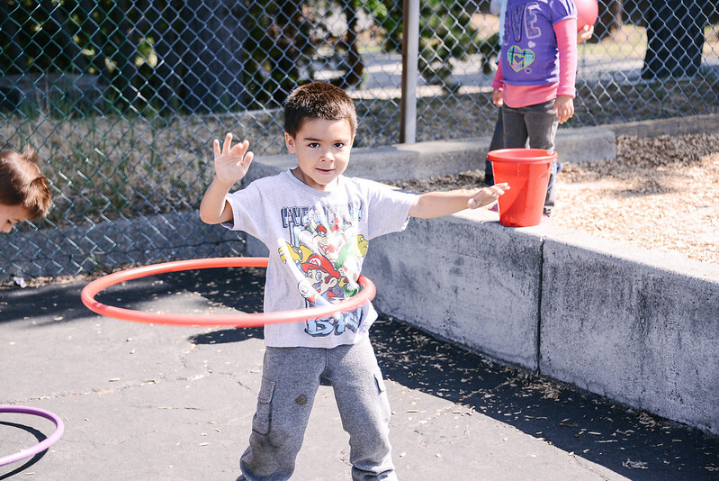
Closing
Photo Credit: Ford and Shannon TK; Richmond, CA

Slide 19
Transforming Schools
Longer description: Transforming Schools graphic. Image of the State Superintendent of Public Instruction, Tony Thurmond on top left corner. The graphic also shows a circle in orange with a schoolhouse along with 7 sections, red, yellow, green, dark red, indigo, blue, and purple on the outer edges of the circle with a line branching out to describe what each image represents. A plate, fork and knife with the words Universal Meals, an image of a seesaw with a person on each end with the words Universal Preschool, a section with image of a schoolhouse with the words Community Schools, a section with a image of an apple with the words Professional Development, a section with an image of three children holding hands with the words Anti-racism Training, a section with image of an upper body and a heart shape on it’s head and spikes to represent that it is lit up showing the words Mental Health Programs, and lastly, a section with image of a light bulb and the words Expanded Learning Programs. Back to image slide 6.

