Slide 1
Early Education Division Webinar
Early Education Division (EED)
Fiscal and Administrative Services Division (FASD)
Date: September 9, 2022
Time: 10:00 a.m. to 11:00 a.m.

Slide 2
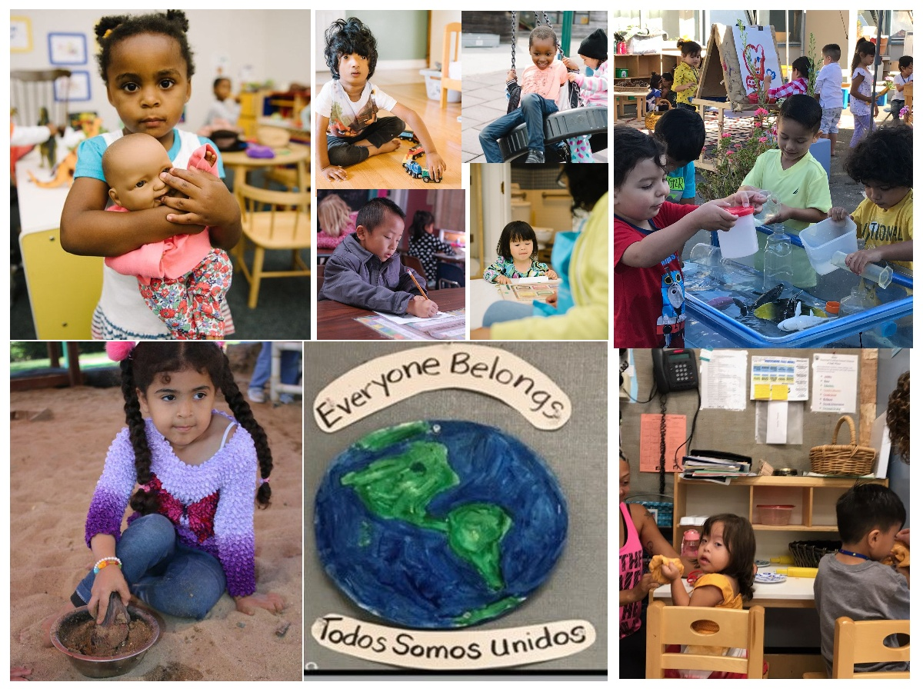
Welcome and Introductions

Slide 3
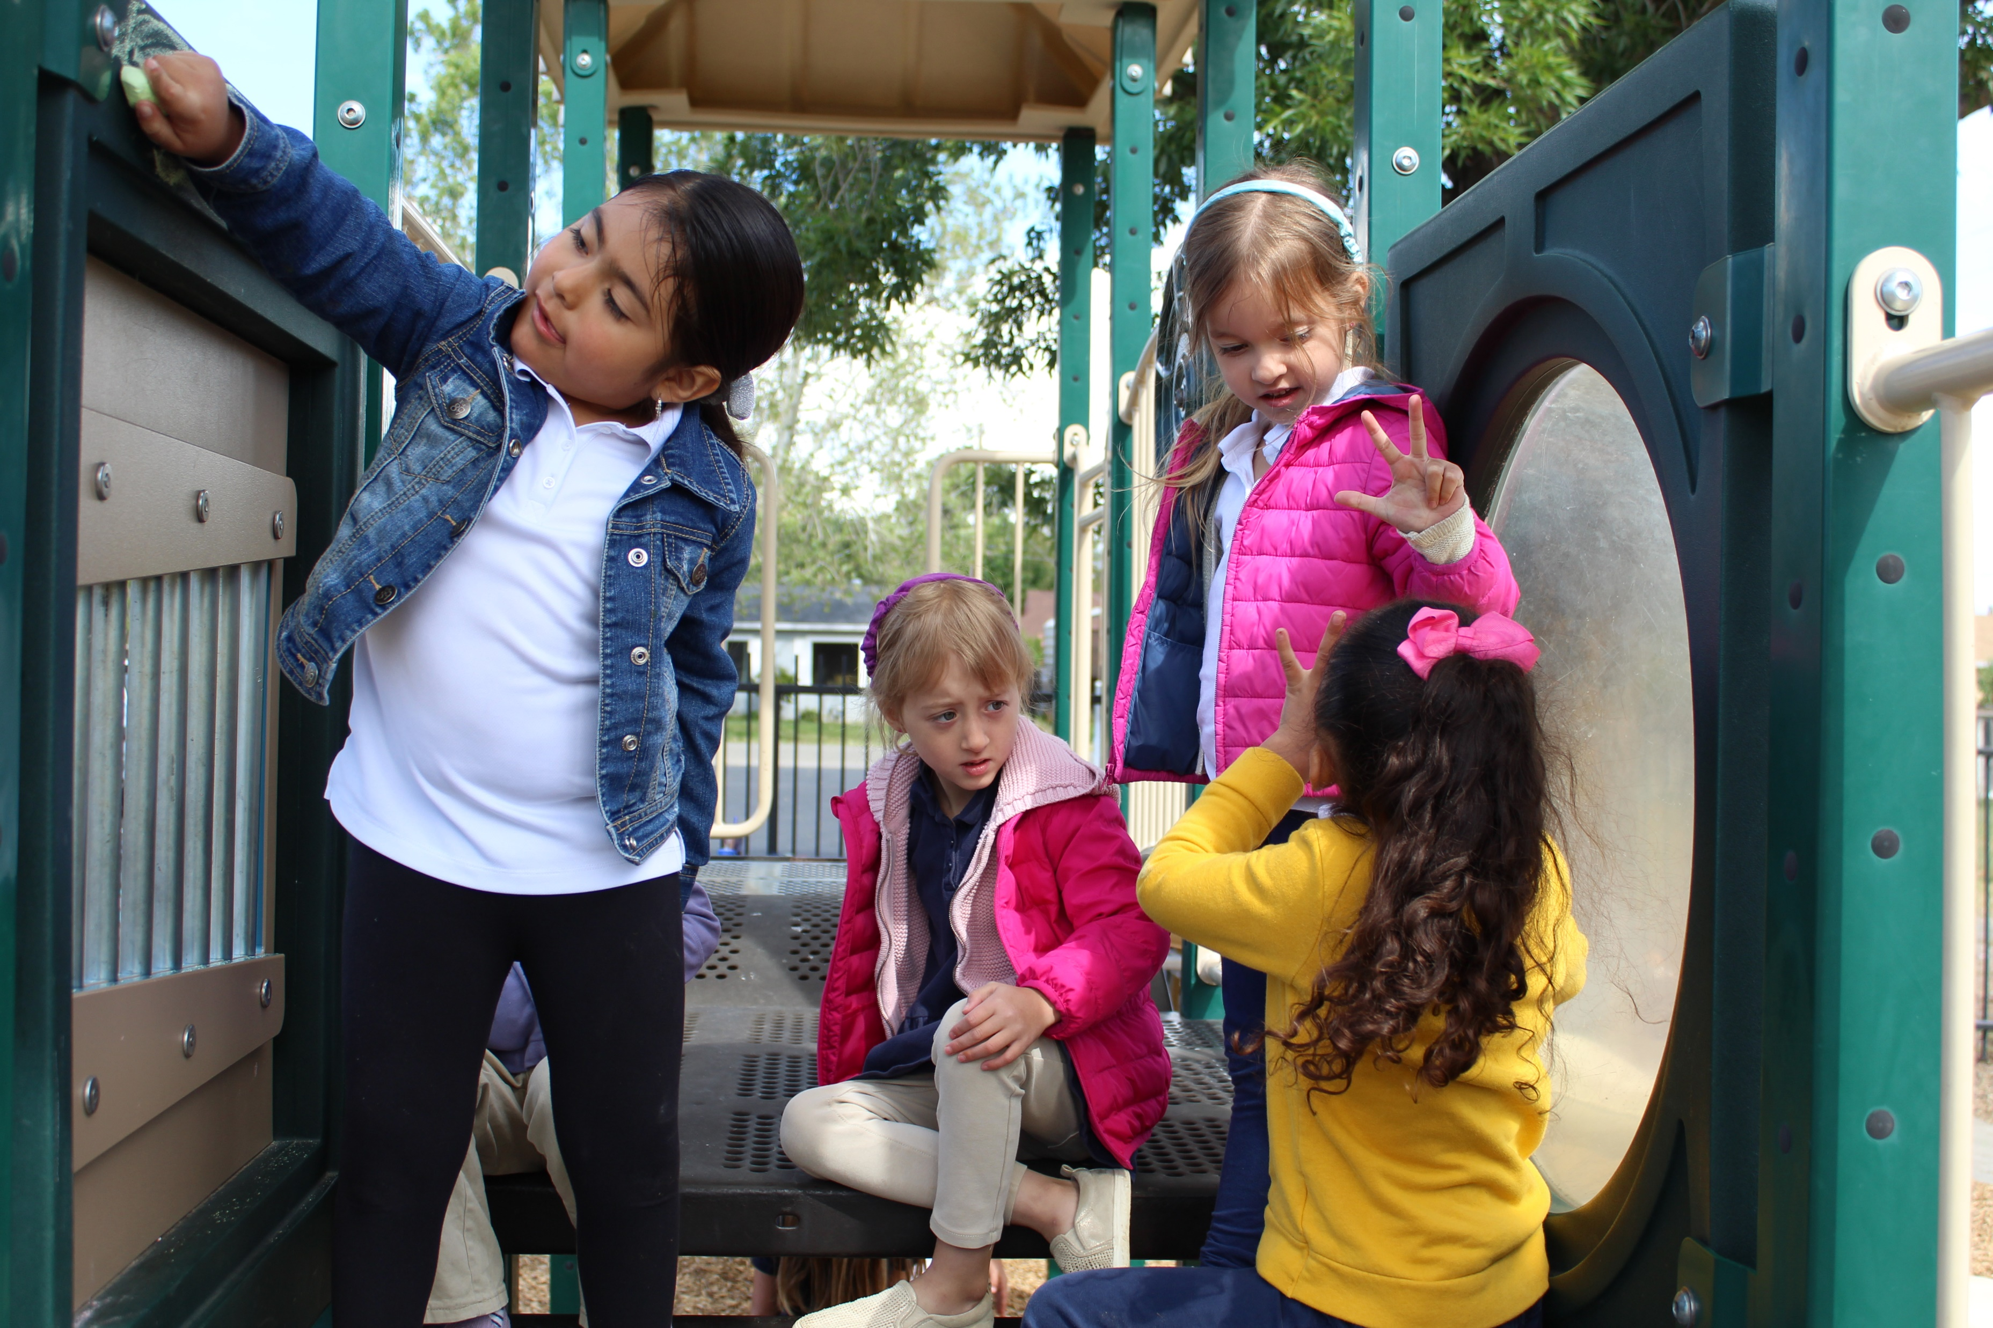
Meeting Agenda
Budget Implementation Updates
Management Bulletin Updates
Universal PreKindergarten (UPK) Updates
Photo Credit: Tree of Life International Charter School; Anderson, CA

Slide 4

2022–23 Budget Implementation Updates
Photo Credit: Kidango Decoto Center; Union City, CA

Slide 5

UPK Planning and Implementation Supports
$318.3 million for UPK Planning and Implementation, including funding dedicated to plan for UPK in the mixed delivery system
Assembly Bill (AB) 185 proposed clean-up language amends the mixed-delivery planning grant:
  Provides collaborative planning requirements
  Establishes inclusive local planning groups, including links to UPK planning efforts led by local educational agencies (LEAs)
Long Description for Transforming Schools Figure

Slide 6
UPK Workgroup
AB 185 would require the Superintendent, in consultation with the Director of Social Services and the executive director of the State Board of Education, to convene a statewide interest holder workgroup.
  The workgroup will include representatives from various programs to represent the diverse needs of children, families, and programs in California.
AB 185 would require the workgroup to focus on providing recommendations on:
  Best practices for increasing access to high-quality universal preschool programs for three- and four-year-old children offered through a mixed-delivery model that provides equitable learning experiences across a variety of settings.
  Updating preschool standards to support equitable access to high-quality preschool and transitional kindergarten programs through the mixed-delivery model and across all appropriate settings and funding sources.

Slide 7
California State Preschool Program (CSPP) Adjustment Factor Changes
Adjustment Factor Category | Old Adjustment Factor | New Adjustment Factor
Children with exceptional needs | 1.54 | 2.4
Children with severe disabilities | 1.93 | 2.4
Children 47 months or younger | none | 1.8
Children who are dual language learners | 1.1 | 1.2
Early childhood mental health consultation | 1.05 | 1.1
Child Development Provider Accounting Reporting Information System (CPARIS) CSPP Enrollment, Attendance and Fiscal Report has been updated to reflect the new adjustment factors for FY 2022–23 CSPP Enrollment, Attendance, and Fiscal Reports.

Slide 8
Fiscal Year (FY) 2022–23 Cost of Living Adjustment (COLA) Implementation
The FY 2022–23 Budget Act provided funding to support a 6.56 percent COLA
Assembly Bill 185 and California Education Code (EC) Section 8242:
  Commencing in the 2022–23 fiscal year, CSPP contractors shall be reimbursed at the greater of the following:
  The 75th percentile of the 2018 regional market rate (RMR) survey.
  The contractor per-child reimbursement amount as of December 31, 2021, as increased by the COLA.

Slide 9
Examples of COLA Implementation
Contractors will be reimbursed at the greater of:
1. The 75th percentile of the 2018 RMR survey or
2. Full-Day Contract Rate as of December 31, 2021, with COLA
County | 1. Full-Day Rate Based on 2018 RMR survey | 2. Full-Day Contract Rate as of December 31, 2021, with COLA | Full-Day Contract Rate Effective July 1, 2022
Fresno | $45.03 | $55.27 | $55.27
Los Angeles | $62.66 | $55.27 | $62.66
Placer | $52.95 | $55.27 | $55.27

Slide 10
Summary of the COLA Implementation
44 counties will receive rate increases due to COLA.
  40 counties will receive a 6.56 percent COLA
  Four counties will receive a COLA that is less than 6.56 percent, due to their current rate being higher than $51.87
Contractors who serve in counties where the reimbursement rate is increasing will receive an allocation this fall.

Slide 11
Child Days of Enrollment (cde) Calculator
Beginning this fiscal year, minimum cdes are no longer on contract face sheets.
Early Education and Nutrition Fiscal Services (EENFS) has developed the cde calculator to provide contractors with a tool to calculate the minimum, full-time equivalent cdes needed to fully earn their contract.
The cde calculator can be found on the CDE website at https://www.cde.ca.gov/fg/aa/cd/

Slide 12
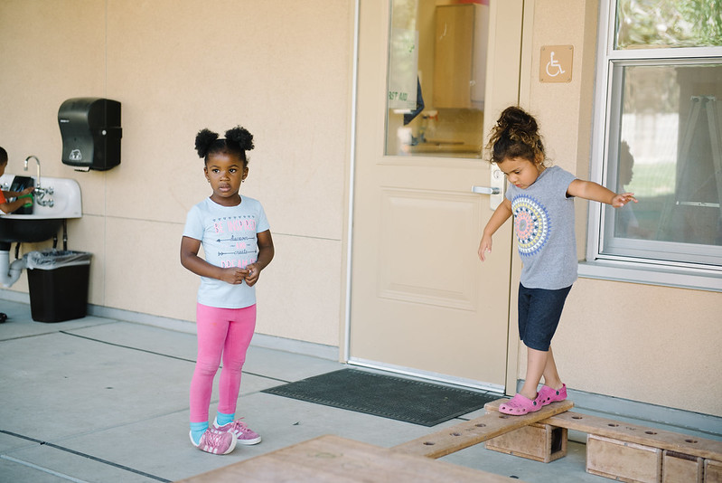
Preschool Dual Language Learners
Management Bulletin 22-04
Photo Credit: Lighthouse for Children CDC; Fresno CA

Slide 13
Management Bulletin (MB) 22-04 Directives
Contractors must determine dual language learner (DLL) status for every child enrolled in CSPP by one of two approaches:
Conduct the Family Language Instrument to determine dual language learner status, or
Obtain information on the child’s designation as an English learner in Transitional Kindergarten (TK) or Kindergarten (K). (This approach is only possible if the child is dually enrolled in CSPP and TK or K for expanded learning and care.)
Teachers or other designated staff must conduct the Family Language and Interest Interview for any children identified as dual language learners.

Slide 14
Management Bulletin (MB) 22-04 Timeline and Adjustment Factor
Timeline
By January 1, 2023, contractors must follow the guidance of MB 22-04 for all currently enrolled children that will continue to receive services after January 1, 2023
Adjustment Factor
Assembly Bill (AB) 210 increased the dual language learner adjustment factor from 1.1 to 1.2

Slide 15
Management Bulletin 22-04 Data Collection
Data Collection Components
  Child home language, language the child uses most, and family/guardian preferred language to receive verbal/written communication
  Race or ethnicity
  Language characteristics of program including but not limited to, whether the program uses the home language for instruction, such as DLL, or other program that supports the development of home languages.
  The language composition of the program staff.
Proposed Data System
  Preschool Language Information System (PLIS)
  Contractors will enter in their user credentials (the same credentials used for the Child Development Management Information System [CDMIS]/801A Data).
  Contractors have the option to enter the data directly into PLIS or upload a file.

Slide 16
Eligibility and Priority Management Bulletin
The Eligibility and Priority MB will cover the following:
  24-month eligibility
  Increase to income threshold: 100 percent of State Median Income (SMI)
  New eligibility categories
  New enrollment priorities
  New non-countable income changes

Slide 17
24-Month Eligibility
At certification or recertification all families in CSPP will be given 24-month eligibility:
  Part-day: A child shall be deemed eligible for a part-day California state preschool program for the remainder of the program year and for the following program year, if applicable age-eligibility requirements are met.
  Full-day: a family shall be considered to meet all eligibility and need requirements for those services for not less than 24 months, if the eligibility period ends before the end of a program year, eligibility shall be extended until the end of the program year, if applicable age-eligibility requirements are met

Slide 18
Changes to Eligibility
Part-day and Full-day:
  Children with exceptional needs now have categorical eligibility
  Three-year-old children are now able to enroll under free- or reduced-price meal (FRPM) eligibility
  All families enrolled in CSPP now have 24-month eligibility
Part-day CSPP:
  TK and K age children for CSPP extended learning and care
Full-day CSPP:
  Children from families whose income is no more than 15 percent above the income eligibility threshold

Slide 19
Changes to Priority
Part-day and Full-day:
  Children with exceptional needs with families that have incomes below the income threshold are second priority for services.
Part-day CSPP:
  TK and K age children for CSPP extended learning and care are now prioritized seventh, after all other priorities.
Full-day CSPP:
  Children from families whose income is no more than 15 percent above the income eligibility threshold are now prioritized fifth.

Slide 20
CSPP Extended Learning and Care
As of July 1, 2022 children enrolled in a TK or K program may be enrolled in part-day CSPP for extended learning and care services during the hours that they are not receiving educational services in a TK or Kindergarten program.
CSPP contractors are required to follow all current laws in place for CSPP, including eligibility, priority, and certification.
CSPP part-day hours cannot overlap with the hours of TK or K.
Assembly Bill 185 (pending on Governor's desk) will make additional changes and clarifications

Slide 21
Children with Exceptional Needs
The MB will include guidance on the following:
Change to the definition of children with exceptional needs
Categorical eligibility
Enrollment set-aside and reserving space for children with exceptional needs
The new adjustment factor for children with exceptional needs and severe disabilities

Slide 22
Transitioning from an Individualized Family Service Plan (IFSP) to an Individualized Education Program (IEP)
Toddlers enrolled in CSPP with an active IFSP and receiving early intervention services count toward the set-aside.
  If a child with an IFSP is turning 3 years old and has an IEP assessment appointment, the child can count toward the set-aside until their IEP appointment.
  If the child qualifies for an IEP, the child continues to count. If the child does not qualify for an IEP, then child no longer counts toward the set-aside

Slide 23
Children with an IEP
Children enrolled in CSPP with an active IEP and receiving early intervention services or appropriate special education count as children with exceptional needs
  If a child is referred for an IEP assessment, then the child does not count toward the set-aside until they have an active IEP
Additional documentation previously required to demonstrate that a child requires special attention from adults pursuant to Title 5 Section 17770(b) is no longer necessary to receive the adjustment factor for children with exceptional needs or severe disabilities

Slide 24
Additional Upcoming Management Bulletins
State Median Income
Hold Harmless
Family Fee Waiver
Non-Covid Emergency Closures
Free and Reduced Priced Meals Update
Audit Threshold Increase

Slide 25
Universal PreKindergarten (UPK) Updates
Next UPK Office Hours is on Wednesday, September 14
21-22 UPK Program Surveys (for LEAs and County Offices of Education)
  Distributed August 22
  Due September 30
TK penalties regarding class size, ratio, and teacher education requirements
  Contact PASE@cde.ca.gov

Slide 26
Workforce Updates
The Early Education Teacher Development Grant Funding Awards are posted.
  Email for the grant program is EarlyEducatorGrant@cde.ca.gov
The Preschool through Third Grade (PK-3) Early Childhood Education (ECE) Specialist Instruction Credential
  Not a credential yet.
  Could be as soon as January 2023.
Emergency Specialist Teaching Permit in Early Childhood Education
  Valid for one year and renewable one time.

Slide 27

Questions
Photo Credit: Kidango Decoto Center; Union City, CA

Slide 28
Resources (1)
Program Quality Implementation (PQI) Office Regional Consultants
  https://www.cde.ca.gov/sp/cd/ci/assignments.asp
  Consultants are most easily reached by email or by phone at 916-322-6233
Early Education and Nutrition Fiscal Services (EENFS)
  Fiscal Apportionment Analyst Directory: https://www.cde.ca.gov/fg/aa/cd/faad.asp
  Child days of enrollment calculator: https://www.cde.ca.gov/fg/aa/cd/
Regulation Related Questions
  EEDTitle5@cde.ca.gov
  Title 5 Regulations: https://www.cde.ca.gov/ls/fa/sf/title5regs.asp

Slide 29
Resources (2)
2022–23 Budget
Final Budget https://www.ebudget.ca.gov/FullBudgetSummary.pdf
Assembly Bill 185 (Education finance: education omnibus trailer bill): https://leginfo.legislature.ca.gov/faces/billNavClient.xhtml?bill_id=202120220AB185
Dual Language Learners
Management Bulletin 22-04 (Dual Language Learners): https://www.cde.ca.gov/sp/cd/ci/mb2204.asp [Link no longer available]
Assembly Bill 210: https://leginfo.legislature.ca.gov/faces/billNavClient.xhtml?bill_id=202120220AB210
Education Code Section 8241.5: https://leginfo.legislature.ca.gov/faces/codes_displaySection.xhtml?sectionNum=8241.5.&lawCode=EDC

Slide 30
Resources (3)
Definition of Children with Exceptional Needs in EC Section 8205(h): https://leginfo.legislature.ca.gov/faces/codes_displaySection.xhtml?sectionNum=8205.&lawCode=EDC
UPK
To subscribe to CDE’s Preschool through third grade (P-3)/UPK listserv, email “subscribe” to subscribe-cdep3updates@mlist.cde.ca.gov
UPK Planning & Implementation Grant Program surveys: https://www.cde.ca.gov/ci/gs/em/
TK penalties regarding class size, ratio, and teacher education requirements: Contact PASE@cde.ca.gov
Office Hours: https://www.cde.ca.gov/ci/gs/em/upkofficehours.asp

Slide 31
Resources (4)
Early Educator Grant webpage: https://www.cde.ca.gov/fg/fo/r2/eetdg22rfa.asp
  Grantees can email the grant program team at: EarlyEducatorGrant@cde.ca.gov
August California Commission on Teacher Credentialing (CTC) Meeting: https://www.ctc.ca.gov/docs/default-source/commission/agendas/2022-08/2022-08-5a.pdf?sfvrsn=463327b1_3
Subscribe to CTC's listserv for up-to-date information on the credential: https://www.ctc.ca.gov/commission/newsletters/psd-news
Career in teaching opportunities and job announcements: https://www.cde.ca.gov/re/di/jb/ssojob.asp
How to apply to be a Child Development Consultant: https://www.cde.ca.gov/re/di/jb/childdevelopmentcons.asp

Slide 32

Closing
Photo Credit: Ford and Shannon TK; Richmond, CA

Slide 33
Transforming Schools
Long description: Transforming schools graphic. Image of the State Superintendent of Public Instruction, Tony Thurmond on top left corner. The graphic also shows a circle in orange with a schoolhouse along with 7 sections, red, yellow, green, dark red, indigo, blue, and purple on the outer edges of the circle with a line branching out to describe what each image represents. A plate, fork, and knife with the words Universal Meals, an image of a seesaw with a person on each end with the words Universal Preschool, a section with the image of a schoolhouse with the words Community Schools, a section with the image of an apple with the words Professional Development, a section with an image of three children holding hands with the words Anti-Racism Training, a section with the image of an upper body and a heart shape on its head and spikes to represent that it is lit up, showing the words Mental Health programs, and lastly, a section with the image of a light bulb and the words Expanded Learning Programs. Back to figure.

