Slide 1
Webinar on COVID-19 Guidance for
Early Learning and Care Contractors
Early Learning and Care Division and
Fiscal and Administrative Services Division
Date: March 5, 2021
Time: 10:00 AM – 11:00 AM

Slide 2

Welcome and Introductions

Slide 3
Meeting Agenda
Introduction and Director's Welcome
Policy Updates
Program Quality Implementation Updates
Fiscal Updates
Questions
Closing

Slide 4
Upcoming Guidance
Extension of Emergency Childcare Services, and New Enrollments in Emergency Childcare Services for Essential Workers and At-Risk Populations
Reimbursement and Data Collection Requirements for Alternative Payment Programs and Providers; Non-Operational Days for Closures Related COVID-19
Reopening and Reimbursement Requirements for Direct Service Contractors; Non-Operational Days for Closures Related to COVID-19

Slide 5
Transitional Kindergarten Frequently Asked Questions
Frequently Asked Question (FAQ) | Answer
Some families want California State Preschool Program (CSPP) instead of Transitional Kindergarten (TK). Why wouldn’t we enroll those families in CSPP now? | The California Department of Education (CDE) understands that many families would prefer to keep TK-age eligible children enrolled in CSPP. However, beginning July 1, 2019, the California Education Code (EC) sections 8208(ai) and 8208(aj) redefined what constitutes a three (3) and four (4)-year-old, effectively leaving TK-age eligible children ineligible for CSPP.
Where can I find information for serving TK-age eligible children in CSPP for the 2020–21 program year? | Contractors can find information for serving TK-age eligible children for the 2020–21 program year in Management Bulletin (MB) 21-04.

Slide 6
FAQs (2)
Frequently Asked Question (FAQ) | Answer
Management Bulletin (MB) 21-04 indicates TK and Kindergarten (K) age-eligible children may remain enrolled if specific conditions are met. Is the agency required to complete additional documentation to justify the condition, like a Notice of Action (NOA) or a statement from the parent? | Contractors should document that they have met the requirements in EC sections 18131.5(d)(1) and (2) and/or sections 18131.6(b)(1) and (2), as applicable. Families should use self-certification to document that they have met the requirements in EC section 18131.5(d)(3) and/or section 18131.6(b)(3), as applicable. Self-certification options should be as easy as possible for families and can include, but are not limited to; an electronic form, sending an email, or a text message. Documentation should be kept in the family data file.

Slide 7
FAQs (3)
Frequently Asked Question (FAQ) | Answer
Can children in full-day CSPP that are TK and K age-eligible remain in CSPP until September 30 still? | Yes, full-day CSPP children that were enrolled prior to June 30 may remain in CSPP until September 30, at which time the child must be disenrolled from CSPP.
Can part-day CSPP children that are TK and K age-eligible remain in CSPP until September 30? | No, children in part-day CSPP are only provided services through the end of the program year and the family must initially certify for services for the following program year; therefore, part-day CSPP children that are TK and K age-eligible are not age eligible to be certified for services that begin after June 30.

Slide 8
General Frequently Asked Questions
Frequently Asked Question (FAQ) | Answer
When elementary schools begin to reopen, are Local Education Agency (LEA) contractors required to open early learning and care programs at the same time? | Yes, once the LEA or the state or local public health agency decides its campus(es) are safe to reopen, the programs on the respective LEA campus(es) must physically reopen as well.
After the transfer of childcare programs to the California Department of Social Services (CDSS), will CSPPs still be required to be licensed? | Yes, CSPPs will still be required to be licensed after the transition.
Will Title 5 regulations continue to apply to all contracts after the transfer? | All Title 5 regulations will remain in place and be applicable to contractors at boththe CDE and the CDSS until the CDSS is able to adopt regulations.

Slide 9
Program Quality Implementation Update
Environment Rating Scale (ERS)
Reliable assessment tool required by law and used for several purposes:
    Program Self-Evaluation (PSE)
    Monitoring
    Quality Rating
For fiscal year (FY) 2020–21, although the tool is required, the CDE/Early Learning and Care Division (ELCD) has provided flexibility for the use of the tool during the pandemic in the form of a self-certification

Slide 10
Program Quality Implementation Update (2)
The Environment Self-Certification During Pandemic Conditions Questionnaire has been developed to use during monitoring and for the PSE
  Five questions related to five of the subscales from the ERS tools
  A minimum of one self-certification is required for each direct service contract type held
The PSE management bulletin will be forthcoming
Training will be provided – tentative date Wednesday, April 7

Slide 11
Fiscal Update: Additional Prop 64 Funds for Additional On-going CAPP Enrollments
$21.486 million provided as an adjustment to the FY 2020–21 budget
The CDE and Department of Health Care Services (DHCS) are in the final stages of completing the Interagency Agreement, which is required in order for the CDE to have access to these funds
CAPP = California Alternative Payment Program

Slide 12
Fiscal Update: Per Child Stipend
Assembly Bill (AB) 82 allocates $244 million to provide a flat-rate stipend amount of $525 per child enrolled in a state-subsidized childcare or preschool program.
Allocation based on the number of subsidized children enrolled in November 2020, using the following data sources:
Contract Type | Data Source
CalWORKs Stage 2 (C2AP) CalWORKs Stage 3 (C3AP) Alternative Payment Program (CAPP) Migrant Alternative Payment Program (CMAP) | CalWORKs/Alternative Payment Online Reporting System
General Child Care and Development (CCTR) Severely Disabled Program (CHAN) Migrant Child Care and Development Program (CMIG) California State Preschool Program (CSPP) Family Childcare Home Education Networks (CFCC) | Child Development Management Information System (CDMIS) CDD-801A

Slide 13
Fiscal Update: Stipend Allocation
Allocation will include an additional 5 percent to address the costs associated with distributing stipends to providers
Stipend allocations will be issued outside of the early learning and care contract
Contractors can expect to receive their allocation in April
Additional guidance related to the stipend allocation is forthcoming

Slide 14
Fiscal Update: Emergency Child Care
Assembly Bill 82 provides:
  $76 million to extend Emergency Childcare services through June 30, 2022, for families currently enrolled in Emergency Childcare who have been unable to transition into ongoing care
  $80 million for CAPP and CMAP contractors to enroll additional children of essential workers, at-risk children, and children with disabilities or special health care needs
The CDE expects to issue contract amendments to CAPP and CMAP contractors related to these two purposes in March 2021

Slide 15
Fiscal Update: Paying Providers at the Maximum Certified Hours of Care
Contractors received an allocation to reimburse Alternative Payment (AP) providers up to the maximum certified hours of care, including license-exempt providers, through June 30, 2021, or until the funding was exhausted, whichever was sooner
Contractors were required to track these additional costs in order to ensure the funds were being used appropriately, and to track when funds will be exhausted
It was brought to CDE’s attention that some contractors have exhausted their allocation for this purpose

Slide 16
Fiscal Update: Interim Guidance for Paying Providers at the Maximum Certified Hours of Care
The CDE has worked with the Administration and the State Legislature on the issue of continuing reimbursements to providers at the maximum certified hours of care, given that some contractors have exhausted their funding allocation
While the CDE works with the Department of Finance (DOF) to obtain additional funds for this purpose, contractors should continue to pay providers at the maximum certified hours of care by utilizing current contract funds

Slide 17
Fiscal Update: Interim Guidance for Paying Providers at the Maximum Certified Hours of Care (2)
All contractors that have exhausted funds appropriated pursuant to Senate Bill (SB) 820 for this purpose, or those that project to exhaust their allocation, must contact the Child Development and Nutrition Fiscal Services (CDNFS) office to inform their Fiscal Analyst of the projected shortfall
Allocations will not be provided to any contractor that does not contact the CDNFS to provide the necessary data in order to process a contract augmentation

Slide 18

Questions
Photo Credit: Family Child Care Center in Oxnard, CA

Slide 19
Resources
The ELCD COVID-19 Guidance webpage
  https://www.cde.ca.gov/sp/cd/re/elcdcovid19.asp
  Webinar slides, MBs, Frequently Asked Questions (FAQs)
The ELCD Emergency email inbox
  ELCDEmergency@cde.ca.gov
The PQI Office Regional Consultants
  https://www.cde.ca.gov/sp/cd/ci/assignments.asp
  Consultants are most easily reached by email
  or by phone at (916) 322-6233

Slide 20
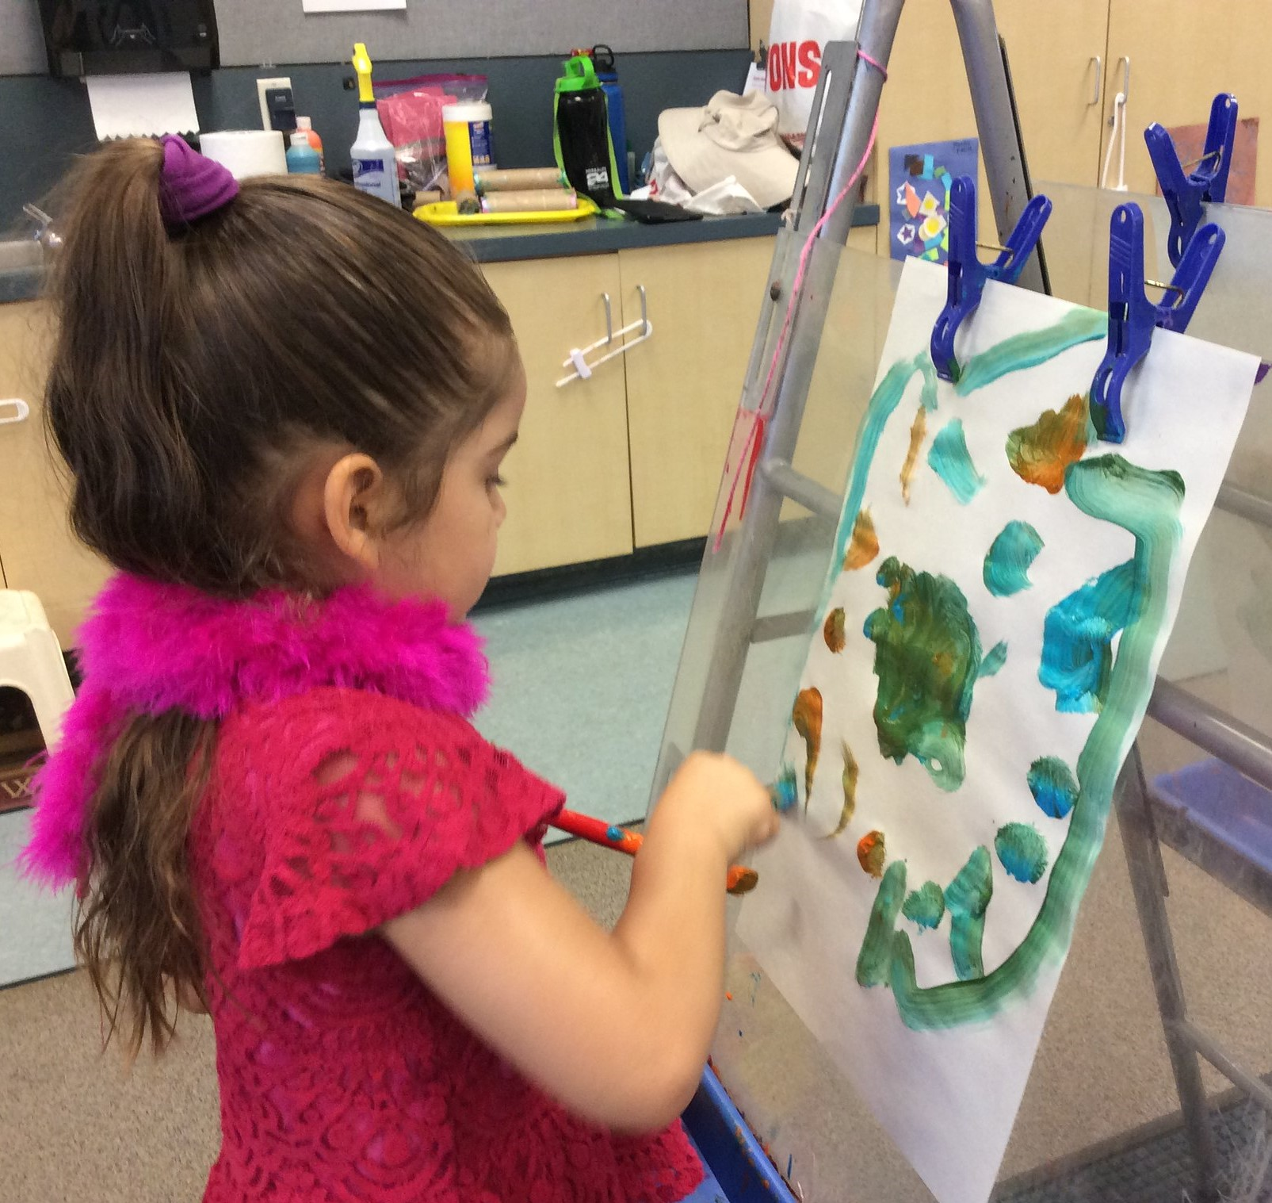
Closing
Photo Credit: CSU Channel Islands; Camarillo, CA

