Slide 1
Webinar on COVID-19 Guidance for Early Learning and Care Contractors
Early Learning and Care Division and
Fiscal and Administrative Services Division
Date: May 21, 2021
Time: 11:00 AM – 12:00 PM

Slide 2
Welcome and Introductions

Slide 3
Meeting Agenda
Introduction and Welcome
Governor's May Revision
Program Quality Implementation Update
Questions
Closing

Slide 4
Governor's May Revision: Universal Transitional Kindergarten (UTK)
UTK would be implemented as follows under the proposal:
School Year (SY) | Birthdate
2021–22 SY | Fifth birthday between September 2 and December 2 – shall be admitted to transitional kindergarten (TK). Districts receive average daily attendance (ADA) for students with birthdays between December 3 and the end of the school year (early admittance TK [ETK]) from the beginning of the school year, if they choose to serve them.
2022–23 SY | Fifth birthday between September 2 and March 2 – shall be admitted to TK. Districts continue to receive ADA for ETK students from the beginning of the school year.

Slide 5
Governor's May Revision: Universal Transitional Kindergarten (UTK) (2)
School Year (SY) | Birthdate
2023–24 SY | Fifth birthday between September 2 and June 2 – shall be admitted to TK. Districts continue to receive ADA for ETK students from the beginning of the school year.
2024–25 SY | Fifth birthday between September 2 and August 31 – shall be admitted to TK
$740 million ongoing to support an additional staff person in TK classrooms
$250 million TK Planning Grant
$190 million for TK facilities
$50 million Workforce Development for California State Preschool Program and TK
$10 million update to the Preschool Learning Foundations

Slide 6
Governor's May Revision California State Preschool Program (CSPP)
Maintains Funding for CSPP
Development of a Comprehensive Plan
1.7 percent Cost of Living Adjustment (COLA)

Slide 7
Governor's May Revision: Child Care Providers United Union (CCPU) Tentative Agreement (1)
The second COVID-19 Relief Tentative Agreement was signed between the Child Care Providers United union and the administration on April 19, 2021, and was proposed to the Legislature as part of the May Revision
The Administration will shortly be releasing Trailer Bill language that details the Tentative Agreement for the Legislature to vote on
The Trailer Bill will need to be approved by the Legislature and signed by the Governor before becoming law

Slide 8
Governor's May Revision: Child Care Providers United Union (CCPU) Tentative Agreement (2)
The tentative agreement includes:
Continuation of family fee waivers
$600 per child stipends to providers based on subsidized children enrolled
Stipends based on licensed capacity (distributed by the California Department of Social Services)
Additional 16 paid nonoperational days for providers
Continuation of the hold harmless flexibilities
Continuation of the parent signature waiver
$25 million for the Child Care Initiative project; and
Funding for the California Inclusion and Behavior Consultation Network project

Slide 9
Program Quality Implementation Update
Program Self-Evaluation (PSE)
Due Tuesday, June 1, 2021
Submitted online via a snap survey
Submit only one survey per agency
Read Management Bulletin 21-05 for information and directions
Please ensure that the agency name and vendor number are accurate prior to submission
Questions can be submitted to fy2021pse@cde.ca.gov [Link no longer available]

Slide 10
You Are Heroes!! Year-End Celebration
Date: June 9, 2021
Time: 10–11:30 a.m.
Thank you to our contractors for your submissions
For questions, please contact Roxane Fidler at RFidler@cde.ca.gov

Slide 11
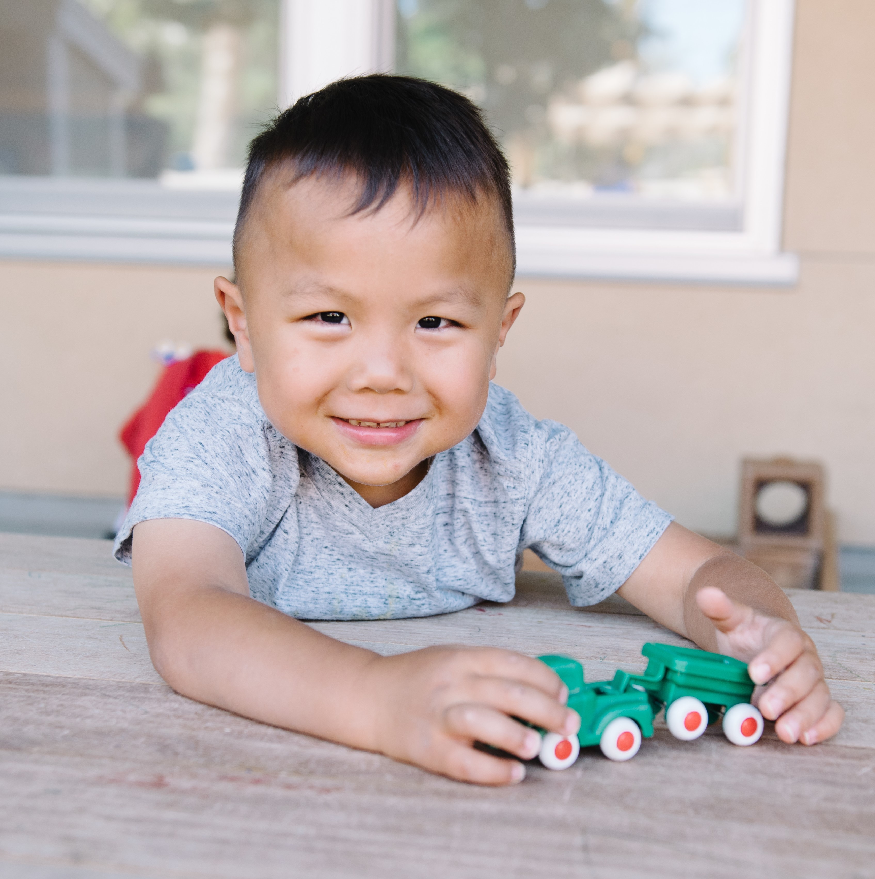
Questions
Photo Credit: Lighthouse for Children CDC; Fresno, CA

Slide 12
Resources
The ELCD COVID-19 Guidance web page
https://www.cde.ca.gov/sp/cd/re/elcdcovid19.asp
Webinar slides, MBs, Frequently Asked Questions (FAQs)
The ELCD Emergency email inbox
ELCDEmergency@cde.ca.gov
The PQI Office Regional Consultants
https://www.cde.ca.gov/sp/cd/ci/assignments.asp
Consultants are most easily reached by email
or by phone at 916-322-6233

Slide 13
Closing
Photo Credit: Kidango Decoto Center; Union City, CA

