Slide 1
Webinar on COVID-19 Guidance for
Early Learning and Care Contractors
Early Learning and Care Division and
Fiscal and Administrative Services Division
Date: November 6, 2020
Time: 10:00 AM–11:00 AM

Slide 2

Welcome and Introductions

Slide 3
Meeting Agenda
Introduction and Director's Welcome
Ongoing CDE Guidance Work–What's New and What's Ahead
Program Quality Implementation Updates
Fiscal Updates
Nutrition Services Division Updates
Questions

Slide 4
CDE Upcoming Guidance
Guidance on Non-COVID-19 Emergency Closures
Additional $110 Million in Coronavirus Relief Funding (CRF) For Addressing:
  Waived Family Fees (Revision to MB 20-19)
  Costs for School-Age Children Served

Slide 5

Program Quality Implementation
November 10, 2020, 1:00 pm to 4:00 pm
By Invitation Only
Part 1: Remote Monitoring
Part 2: How to Get Ready for a Review Using the Instrument
November 18, 2020, 10:00 am to 1:00 pm
Guidance on Certification, Recertification and Notice of Action in a Virtual Environment (Direct Service Programs)
Photo Credit: Colusa Hand-in-Hand; Colusa CA

Slide 6

Program Quality Implementation (2)
November 18, 2020 1:00 pm to 4:00 pm
Guidance on Certification, Recertification and Notice of Action in a Virtual Environment (Alternative Payment Programs)
December 9, 2020 10:00 am to 12:00 pm
Results of the Improper Payments Elimination and Recovery Improvement Act (IPERIA)
December 16, 2020 10:00 am to 1:00 pm
New Contractors Orientation
Photo Credit: Tulare City School District, Garden School; Tulare, CA

Slide 7

Program Quality Implementation (3)
Coming Soon in 2021!
Maintaining Program Quality During a Pandemic
Regional Cafes
Remote Monitoring
Program Self Evaluations
Photo Credit: Kidango Decoto Center;
Union City, CA

Slide 8

Continued Funding Application (CFA)
Reminder: The FY 2021–22 CFA is due next Tuesday, November 10, 2020, for all contractors
If you have any issues submitting your CFA, please refer to Management Bulletin (MB) 20-16 or contact CDE at CFA@cde.ca.gov
Photo Credit: Ventura Day Care- Sandoval Family Child Care Ventura, CA

Slide 9

General Child Care (CCTR) Expansion Update
Status of funding
Releasing expansion funding
Operations before expansion funding is released
Photo Credit: St. Vincent's Day Home; Oakland, CA

Slide 10
Interim Directive on School-Age Children in California State Preschool Programs (CSPP)
Many contractors have asked what to do with children age-eligible for Transitional Kindergarten (TK) or Kindergarten who were enrolled in CSPP last year and wish to continue to be served.
CDE Directive–Until CDE Issues Further Guidance:
  Do not disenroll these children from CSPP
  Do not enroll any additional TK or Kindergarten-age children into CSPP
  Hold off on recertifying families who are TK or Kindergarten eligible
  Reporting
    801A
    Reporting enrollment on the Child Development and Nutrition Fiscal Services (CDNFS) Attendance and Fiscal Reports.
Management Bulletin Forthcoming

Slide 11
Fiscal Updates: Reporting Reminders
Family Fee Allocation for California State Preschool (CSPP), General Childcare (CCTR), Migrant Childcare (CMIG) and Family Child Care (CFCC) Contractors
Child Development Provider Accounting Reporting Information System (CPARIS) Reporting
  September Attendance and Fiscal Reports were due on October 20, 2020
  Requirement to submit the Certification of Assurances

Slide 12
Nutrition Services Division Updates
USDA waivers: applications needed only for area eligibility and the meal pattern; home delivery falls under the non-congregate waiver
Meal Benefit Forms must be certified each year (no waiver); but families are not required to return them and can still qualify for base reimbursement
Consumption on Site: waivers allow for offsite consumption

Slide 13
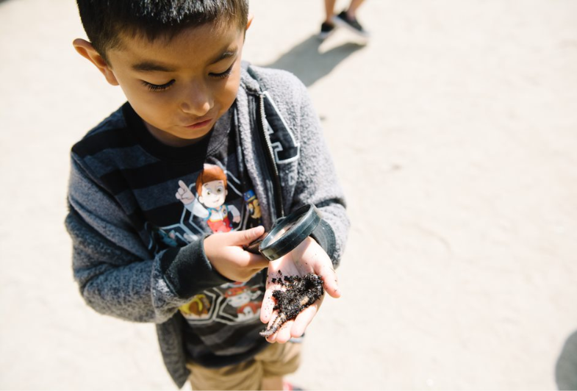
Questions
Photo Credit: St. Vincent's Day Home; Oakland, CA

Slide 14
Resources
Webinar slides, MBs, Frequently Asked Questions (FAQs), can be found on the ELCD COVID-19 Guidance web page at:
  https://www.cde.ca.gov/sp/cd/re/elcdcovid19.asp
You may submit additional questions to the ELCD Emergency email inbox at:
  ELCDEmergency@cde.ca.gov
To contact your assigned PQI Office Regional Consultant, a list of consultants can be found on the ELCD Consultant Regional Assignments web page at:
  https://www.cde.ca.gov/sp/cd/ci/assignments.asp
  Consultants are most easily reached by email
  or by phone at 916-322-6233

Slide 15

Closing
Photo Credit: St. Vincent's Day Home; Oakland, CA

