Slide 1
Webinar on COVID-19 Guidance for
Early Learning and Care Contractors
Early Learning and Care Division and
Fiscal and Administrative Services Division
Date: September 18, 2020
Time: 10:00 AM–11:00 AM

Slide 2

Welcome and Introductions

Slide 3
Meeting Agenda
Introduction and Director's Welcome
Ongoing CDE Guidance Work–What's New and What's Ahead
Fiscal Updates
Program Quality Implementation Updates
Questions

Slide 4
Ongoing CDE Guidance
Interim Guidance for Collecting Family Fees-Fiscal Year (FY) 2020–21
  Family fees for July and August 2020
    Issue a refund or credit to future services to families by October 31, 2020
  Family fees for September 2020 through June 2021
    Fees waived for remainder of year only for families not receiving in-person services due to distance learning or sheltering-in-place

Slide 5
Family Fee Allocations: July and August
Alternative Payment (AP) and Migrant Alternative Payment contractors
  Notified via email of their allocation
Stage 2 and Stage 3 contractors
  Notified that they will not receive a subsequent amendment, but will be augmented as necessary
General Child Care (CCTR), California State Preschool (CSPP), California Migrant Child Care (CMIG), Family Child Care Home Education Networks (CFCC), and for Children with Severe Disabilities (CHAN) contractors
  Will receive an amendment to increase the contract after Senate Bill (SB) 820 is signed by the Governor.

Slide 6
If no Federal Funds are Provided for Family Fee Waivers for the Remainder of FY 2020–21
Family fee waivers for September 2020 through June 2021, must be absorbed and implemented as follows:
  Direct service contractors will not receive reimbursement through their contract to cover the cost of the family fee waiver.
  AP contractors who collect family fees directly will not receive reimbursement through their contract to cover the cost of the family fee waiver and therefore will adjust the amount reimbursed to the provider by the amount of family fees that would have been collected if fees were not waived.
  AP Providers that typically collect the family fee will receive reimbursement from their AP contractor as usual, but will not collect the fee from the family.

Slide 7
Ongoing CDE Guidance (2)
MB 20-17: Requirements for Distance Learning Plans, Program Quality, and Distance Learning Services
  Program Quality Requirements
  Distance Learning Service Requirements
  Distance Learning Plan Requirements
  Distance Learning Plans Due October 1, 2020

Slide 8
Fiscal Updates: Allocations
FY 2020–21 AP Completed Allocations
FY 2020–21 AP and Direct Service Pending Allocations
FY 2019–20 Direct Service Completed Allocations

Slide 9
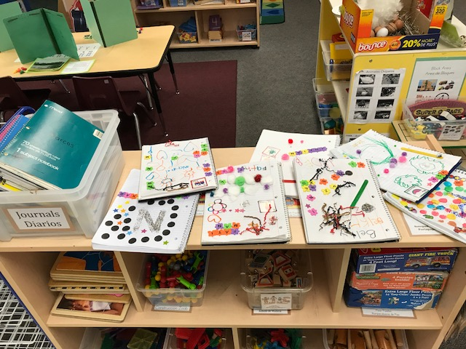
Program Quality Implementation Update
Proposed training for FY 2020–21
Upcoming FPM reviews
Ongoing discussion regarding Desired Results Developmental Profiles (DRDPs) for FY 2020–21
Photo Credit: Redwood City

Slide 10
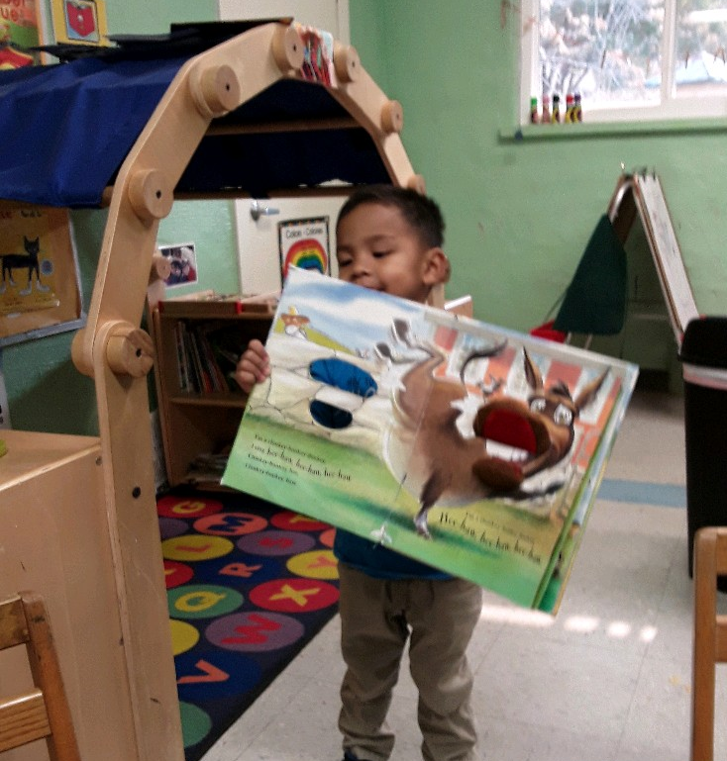
Questions
Photo Credit: Martinez Early Childhood Center

Slide 11
Resources
Webinar slides, MBs, FAQs, can be found on the ELCD COVID-19 Guidance web page at:
  https://www.cde.ca.gov/sp/cd/re/elcdcovid19.asp
You may submit additional questions to the ELCD Emergency email inbox at:
  ELCDEmergency@cde.ca.gov
To contact your assigned PQI Office Regional Consultant, a list of consultants can be found on the ELCD Consultant Regional Assignments web page at:
  https://www.cde.ca.gov/sp/cd/ci/assignments.asp
  or by phone at 916-322-6233

Slide 12
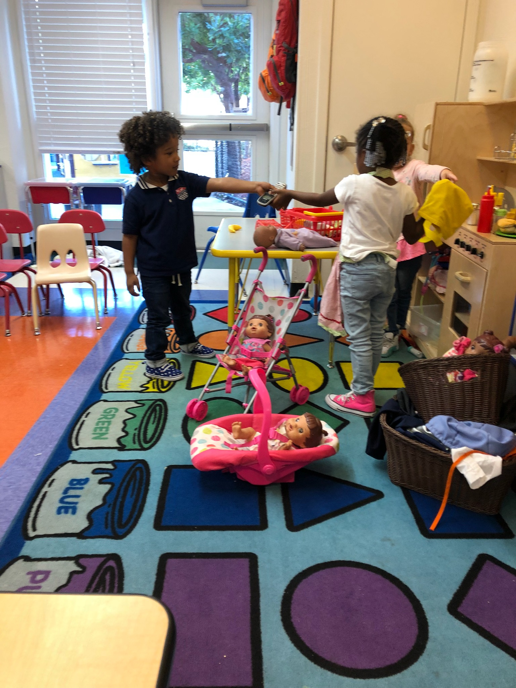
Closing
Photo Credit: YMCA of East Bay

