Slide 1
Update on the Implementation of the Integrated Local, State, and Federal Accountability and Continuous Improvement System: Action to Implement the 2023 Dashboard Workplan and ESSA Amendments and Updates on Continuing Work for Future Dashboards. California Practitioners Advisory Group August 25, 2023

Slide 2
2023 Accountability Workplan Updates (1)
College/Career Indicator (CCI)
Update on new career measures
Removal of Non-Registered Pre-Apprenticeship in 2023–24
Graduation Rate Indicator
Multi-year extended graduation rate
Chronic Absenteeism and DataQuest

Slide 3
2023 Accountability Workplan Updates (2)
Student Level Growth Model
Completion of the English Learner Progress Indicator (ELPI)
Change Cut Points
Color Scheme for 5x5
Summative Alternate ELPAC Incorporation
Aligning the Dashboard with Additional Data
Address Data Quality and Participation Issues in a Uniform Way throughout the Dashboard
Differentiated Assistance Criteria for 2023

Slide 4
College/Career Indicator

Slide 5
What is the College/Career Readiness?
Measures how well districts and schools are preparing its graduates for college/career.

Slide 6
Which Students Are Included in the CCI?
Includes the same set of students as in the Graduation Rate Indicator (i.e., combined four- and five-year graduation rate).
The following is an example of how the CCI is calculated using students who were prepared:
Class of 2022 Grads + Fifth-Year Graduates from Class of 2021
Divided
Class of 2022 + Fifth-Year Graduates from Class of 2021

Slide 7
2023 CCI Workplan (1)
The 2023 Workplan for CCI focused on expanding new career measures in the CCI.
At the March 2023 State Board of Education (SBE) meeting, the California Department of Education (CDE) presented the following work for the CCI:
Exploring inclusion of four new career measures:
Internships
Student-Led Enterprises
Simulated Work-Based Learning (WBL)
Armed Services Vocational Aptitude Battery (ASVAB)

Slide 8
2023 CCI Workplan (2)
Exploring the development of two new measures:
Civic engagement
Industry certifications
Review of current CCI career measures to determine if any adjustments are needed.

Slide 9
Exploration of New Career Measures

Slide 10
Review and Analysis of Data
At least two years of data are needed to review the validity of the collection and begin the evaluation of the data for consideration in the Dashboard.
Following the review and analyzation of the data for these measures, the results are shared with educational partners to receive feedback as to whether:
If the measure should be included in the CCI and
What the “prepared” and “approaching prepared” criteria should be for graduates.

Slide 11
Available Years of Data
Measure | 2019–20 | 2020–21 | 2021–22
ASVAB* | X | X | X
Internships | N/A | X | X
Student-Led Enterprise | N/A | X | X
Simulated WBL | N/A | X | X
Note: In the first year of ASVAB data collection, local educational agencies (LEAs) could report two years of scores (i.e., 2019–20 and 2020–21).

Slide 12
Statewide Completion Counts
Year | ASVAB | Internships | Student-Led Enterprise | Simulated WBL
2019–20 | 8,628 | N/A | N/A | N/A
2020–21 | 607 | 9,187 | 5,040 | 14,023
2021–22 | 6,071 | 18,333 | 6,140 | 21,967
Total | 15,306 | 27,520 | 11,180 | 35,990

Slide 13
2022 Combined Four-and Five-Year Graduation Rate and New Measures
The following slides reflect completion data for the four new measures disaggregated by graduates and non-graduates for:
Class of 2022 four-year cohort, and
Class of 2021 fifth-year graduates (who graduated in 2021–22)

Slide 14
Class of 2022: Internship Completion
Students | 2020–21 | 2021–22
Graduates | 2,873 | 8,609
Non-Graduates | 94 | 144
Total | 2,967 | 8,753
Total number of students in the Class of 2022 = 497,884

Slide 15
Class of 2022: Student-Led Enterprise Completion
Students | 2020–21 | 2021–22
Graduates | 1,533 | 2,218
Non-Graduates | 67 | 38
Total | 1,600 | 2,256
Total number of students in the Class of 2022 = 497,884

Slide 16
Class of 2022: Simulated Work-Based Learning Completion
Students | 2020–21 | 2021–22
Graduates | 7,110 | 4,311
Non-Graduates | 139 | 195
Total | 7,249 | 4,506
Total number of students in the Class of 2022 = 497,884

Slide 17
Class of 2022: ASVAB Completion
Students | 2019–20 | 2020–21 | 2021–22
Graduates | 1,406 | 311 | 1,501
Non-Graduates | 97 | 17 | 48
Total | 1,503 | 328 | 1,549
Total number of students in the Class of 2022 = 497,884

Slide 18
Class of 2021 Fifth-Year Graduates Completion of Four New Measures
Year | ASVAB | Internships | Student-Led Enterprise | Simulated WBL
2019–20 (Fifth-Year Graduates=4,413) | 59 | N/A | N/A | N/A
2020–21 (Fifth-Year Graduates=3,823) | 3 | 13 | 22 | 56
2021–22 (Fifth-Year Grads=14,640) | 13 | 46 | 7 | 14
Total | 75 | 59 | 29 | 70

Slide 19
Educational Partner Feedback on CCI New Measures (1)
The data for these four measures show that less than 2 percent of students participated in these career related programs.
Since the academic years analyzed occurred primarily during the COVID-19 pandemic, the CDE was interested to learn from educational partners on whether another year of data (i.e., 2022–23) should be reviewed and analyzed before proceeding with further analysis of including these measures in the CCI.
Note: The 2022–23 End-of-Year data collections are currently open, and LEAs must certify their data by August 25, 2023.

Slide 20
Educational Partner Feedback on CCI New Measures (2)
Technical Design Group (TDG): Recommended to wait and review the 2022–23 data prior to making any recommendations due to overall small n-sizes.
CCI Work Group: Recommended to wait on including any of the measures because:
Of hardships that schools have faced since the pandemic, such as teacher shortages, staff turnovers, and the need to rebuild relationships with industries since students had not been working within their spaces during the pandemic.

Slide 21
Educational Partner Feedback on CCI New Measures (3)
Not appropriate to review and analyze prior year data when it does not reflect the current conditions where limited LEAs are able to meet the existing career measures within the CCI.
The CDE should review the data collection guidance and definitions to ensure that LEAs understand the measures and are submitting valid data.

Slide 22
Civic Engagement and Industry Certifications

Slide 23
Civic Engagement
In September 2020, the SBE directed the CDE to determine how to incorporate civic engagement into the CCI. Since this time, the CDE has:
Convened a Civic Engagement Work Group and met regularly with this group.
Engaged in conversations with the CCI Work Group, Civic Engagement Work Group, and TDG on the necessary data points to collect.

Slide 24
Industry Certifications
For the past few years, the CDE has also been exploring industry certifications based on feedback from LEAs on this career activity.

Slide 25
Next Steps: Seal of Civic Engagement
2024 Workplan
Continue to support and monitor the progress of the first student-level data collection for the Seal of Civic Engagement
Continue to explore options for inclusion of industry certifications

Slide 26
Current CCI Measures

Slide 27
CCI Measures Approved by the SBE
College Measures
Advanced Placement (AP) exams
International Baccalaureate (IB) exams
College Credit Courses
a–g Completion
State Seal of Biliteracy (SSB)
Smarter Balanced Summative Assessments
https://www.cde.ca.gov/ta/ac/cm/documents/ccicollege.pdf
Career Measures
CTE Pathway Completion
Leadership/Military Science
Pre-Apprenticeship
State and Federal Job Programs [for Dashboard Alternative School Status (DASS) schools only]
Transition Classroom and Work-Based Learning Experiences (for Students with Disabilities only)
https://www.cde.ca.gov/ta/ac/cm/documents/ccicareer.pdf

Slide 28
Review of Current CCI Measures
In the ongoing effort to continuously improve the accountability system, the CDE sought feedback on current CCI measures.
Goal of review was to determine if existing definitions needed to be updated or if more significant changes should occur.
One measure brought forward for review by practitioners was pre-apprenticeships.

Slide 29
Pre-Apprenticeships
In September 2020, the SBE approved the inclusion of two types of pre-apprenticeships into the CCI:
Registered
Non-registered

Slide 30
Preparedness Criteria for DASS/Non-DASS Schools
CCI Measure | School Type | Prepared Criteria | Approaching Prepared Criteria
Registered Pre-Apprenticeship | Non-DASS | Completion of Program | Not Applicable
Registered Pre-Apprenticeship | DASS | Completion of Program | Not Applicable
Non-Registered Pre-Apprenticeship | Non-DASS | Completion of Program plus completion of a CTE Pathway | Completion of Program
Non-Registered Pre-Apprenticeship | DASS | Completion of program plus completion of one semester/two quarters/two trimesters of a CTE course with a C- or better | Completion of Program

Slide 31
Registration of Pre-Apprenticeships
New state law on January 1, 2019:
Allows Division of Apprenticeship Standards (within California Department of Industrial Relations) to recognize pre-apprenticeships that have formal linkage agreements with existing state registered apprenticeship programs.
Registration with Division of Apprenticeship Standards distinguishes registered pre-apprenticeships from non-registered pre-apprenticeships.

Slide 32
Proposal to Remove Pre-Apprenticeships
With registered pre-apprenticeships now fully in place, there is a movement to move away from state-supported non-registered pre-apprenticeships.
Reasons:
No clear metric to discern what occurs within these programs
No accountability as it is not validated by the Division of Apprenticeship Standards.

Slide 33
Statewide Student Completion in Non-Registered Pre-Apprenticeship
School Type | # of Students 2019–20 | # of Students 2020–21 | # of Students 2021–22
Non-DASS | 2,229 (1,814,992) | 289 (1,827,353) | 415 (1,817,791)
DASS | 254 (138,706) | 0 (133,714) | 0 (128,612)
Total | 2,483 (1,953,698) | 289 (1,961,067) | 415 (1,946,403)
For context, the denominator in parentheses identifies student enrollment in grades nine through twelve.

Slide 34
Educational Partner Feedback on Non-Registered Pre-Apprenticeships
CCI Work Group: Recommended the removal of non-registered pre-apprenticeships however, they suggested that the CDE provide guidance that would assist LEAs in how they can transfer their non-registered program to a registered pre-apprenticeship or to another work-based learning activity that they can receive credit for on the CCI.
TDG: Recommended that the 2021–22 data should be examined first before any recommendations are made given the decrease in the number of students completing this measure.

Slide 35
Next Steps: Pre-Apprenticeships
2024 Workplan: Should the SBE approve the removal of non-registered pre-apprenticeship at their September 2023 meeting, the recommendation would include that the actual removal would not take place until the 2023–24 school year. This will:
Provide CDE time to announce the removal and provide any support needed to schools currently operating non-registered pre-apprenticeships.
Allow LEAs time to prepare for this change.

Slide 36
CPAG Questions for CCI
Does CPAG have any questions or concerns about:
Waiting until the 2022–23 data are available to analyze the four new career measures before determining if any should be included in the CCI?
The removal of Non-Registered Pre-Apprenticeship from the CCI?

Slide 37
Graduation Rate Indicator

Slide 38
What is the Graduation Rate Indicator?
The rate of high school students who graduate with a regular high school diploma in either four or five years.

Slide 39
Denial of Use of Modified Methods
July 2022 Letter from U.S. Department of Education (ED):
Denied California's waiver request to continue use of modified methods for DASS schools
Removes use of DASS one-year graduation rate.
The letter included options, such as an extended-year adjusted cohort graduation rate.

Slide 40
Proposal: Extended-Year Graduation Rate
2023 Accountability Workplan explored what the impact of adding an extended-year graduation rate would have on the overall Graduation Rate Indicator
Gives credit to schools when students receive a regular high school diploma within six years or more
Can be applied to all high schools (DASS and non-DASS)

Slide 41
Extended-Year Rate Simulations
2022 Dashboard resulted in overidentification of DASS schools eligible for Comprehensive Support and Improvement (CSI) – Low Graduation.
Simulations were run to determine if multi-year graduation rate would be beneficial to DASS schools.

Slide 42
Simulation Formula: Students Who Graduated in 2021–22

Slide 43
Simulation Formula: Students Who Graduated in 2021–22 (Descriptive Text)
Numerator = 4th-Yr Grads (from the Class of 2022) plus 5th-Yr Grads (from the Class of 2021) plus 6th-Yr Grads (from the Class of 2020)
Denominator = Students from the Class of 2022 plus 5th-Yr Grads (from the Class of 2021) plus 6th-Yr Grads (from the Class of 2020)

Slide 44
Simulation Questions
The simulations were designed in consultation with the TDG and to respond to two specific questions, which are noted on the following slides along with the results.

Slide 45
Question 1
What improvement does an extended-year rate make to the Graduation Rate for DASS and non-DASS Schools?

Slide 46
Question 1 Results
DASS High Schools:
Improved rates in 285 (35 percent) out of 808 schools
No effect on 523 (65 percent) schools.
Non-DASS High Schools:
Improved rates in 125 (7 percent) out of 1,729 schools
No effect on 1,604 (93 percent) schools.

Slide 47
Question 2
For schools with a 2022 Four- and Five-Year Combined Graduation Rate of less than 68 percent, does adding six- and seven-year graduates raise their rate above 68 percent?
i.e., potentially removing them from qualifying for CSI – Low Graduation Rate

Slide 48
Question 2 Results
No potential for a large reduction in the overidentification of DASS schools for CSI-Low Graduation.
15 high schools would have a 2022 graduation rate above 68 percent
However, CSI-Low Graduation requires the average rate over three years to exceed 68 percent.
Likely that number of schools removed from CSI-Low Graduation with an extended-year rate would be less than 15.

Slide 49
Educational Partner Feedback on Graduation Rate
TDG: Recommended to not move forward with a multi-year graduation rate because it resulted in such small gains.
DASS School Representatives and COEs: Concurred that it would not make a large impact on programs and likely be confusing.

Slide 50
CPAG Questions for Graduation Rate
Does the CPAG have any questions/concerns/feedback about not going forward with the multi-year Graduation Rate?

Slide 51
Chronic Absenteeism Indicator and DataQuest Reports

Slide 52
Chronic Absenteeism Indicator
At their July 2023 meeting the SBE requested that CDE reopen the 2023 Dashboard workplan to discuss possible actions/changes to the Chronic Absenteeism Indicator
CDE presented multiple short-term and long-term options to the SBE for discussion

Slide 53
Options Considered
Short Term Options:
Option 1a: Modifications to Cut Points for Status and/or Change Levels
Option 1b: Modifications to Performance Level Color Scheme for Five-by-Five Colored Grid
Option 1c: Modifications to Chronically Absent Student Calculation Methodology.
Long-Term Options:
Option 2a: Modify the Granularity of Information Collected Around Student Absences
Option 2b: Replace the Chronic Absenteeism Indicator from the Dashboard for Accountability Purposes

Slide 54
SBE Guidance
Based on the available options, the SBE provided the following guidance at their July 2023 Meeting:
Affirmed their commitment to maintaining the current indicator methodology for the 2023 Dashboard
Explore collecting and reporting granular data on reason for absence (Option 2a)
Provide a link to Dataquest’s Absenteeism by Reason on the Dashboard for additional context about the type of absences reported

Slide 55
Absenteeism By Reason Reports
Given that the SBE would like to add a link to these reports on the Dashboard, we would like to know CPAG's preferences on the following:
Which page/data do we want to link to? (URL)
Where should that link appear on the Dashboard? (Location)

Slide 56
Choice 1: Which Page/Data Do We Want to Link to? (URL)
CDE "Absenteeism Data" webpage
https://www.cde.ca.gov/ds/ad/crabtop.asp
DataQuest "Absenteeism by Reason" State Summary Page
https://dq.cde.ca.gov/dataquest/DQCensus/AttAbsByRsnLevels.aspx?agglevel=State&cds=00&year=2021-22
DataQuest "Absenteeism by Reason" LEA or School page with Filters
https://dq.cde.ca.gov/dataquest/DQCensus/AttAbsByRsn.aspx?cds=1062166&agglevel=District&year=2021-22&initrow=Eth&ro=y

Slide 57
Choice 2: Where should the link appear on the Dashboard? (Location)
We need find a place to share this link within the Dashboard:
Within the introduction text on the expanded Chronic Absenteeism section
At the end of the expanded Chronic Absenteeism section

Slide 58
CPAG Questions for Absenteeism by Reason Reports
In groups of two, discuss the following items:
Which page/data do we want to link to?
Choice 1: A/B/C
Where should that link appear on the Dashboard?
Choice 2: 1/2
Following your discussion, share out to the larger group

Slide 59
Student-Level Growth Model Update

Slide 60
California’s Growth Model Journey
California has been actively working since 2015 to develop a student-level growth model.
The Educational Testing Service (ETS), California’s assessment contractor, continues to assist with the development of the growth model, aggregate measures of student academic growth, and growth model reporting prototypes.
The next set of aggregated student growth data will be available in late 2024 based on the 2021–22, 2022–23, 2023–24 Smarter Balanced Assessments administrations.

Slide 61
Growth Model Essentials
Results will be limited to Grades 4 through 8
Growth model results will be provided for districts and schools with grades 4 through 8 only—no growth scores will be provided for high schools.
No Relationship with the Accountability System At This Time
The SBE has not yet determined how the growth model could eventually be incorporated into the accountability system.

Slide 62
2023 Workplan for Growth Model
Develop visualizations for growth model data in anticipation of release of next set of growth model data in 2024
Hold multiple focus groups with various audiences and educational partners to refine visualizations

Slide 63
Visualization Audiences
Create visualizations for multiple audiences:
Audience 1: DASHBOARD style level - Parents, guardians, teachers, policymakers, general public
Audience 2: School and LEA data administrators
Audience 3: Data professionals

Slide 64
Feedback on Visualizations
Provide a summary of average growth scores for all student groups in a school or LEA showing the growth category each group falls into
Change the location of the average scores, associated confidence intervals, and percentile ranks
Assign categories associated with average growth scores given as
Below/Similar to/Above - typical growth on average
Rescale the growth reporting scale to prevent misinterpretations
Remove percentile ranks from display

Slide 65
Growth Score Data Reporting
Audience 1
Copyright © 2023 by ETS. All rights reserved. ETS and the ETS logo are registered trademarks of ETS.

Slide 66
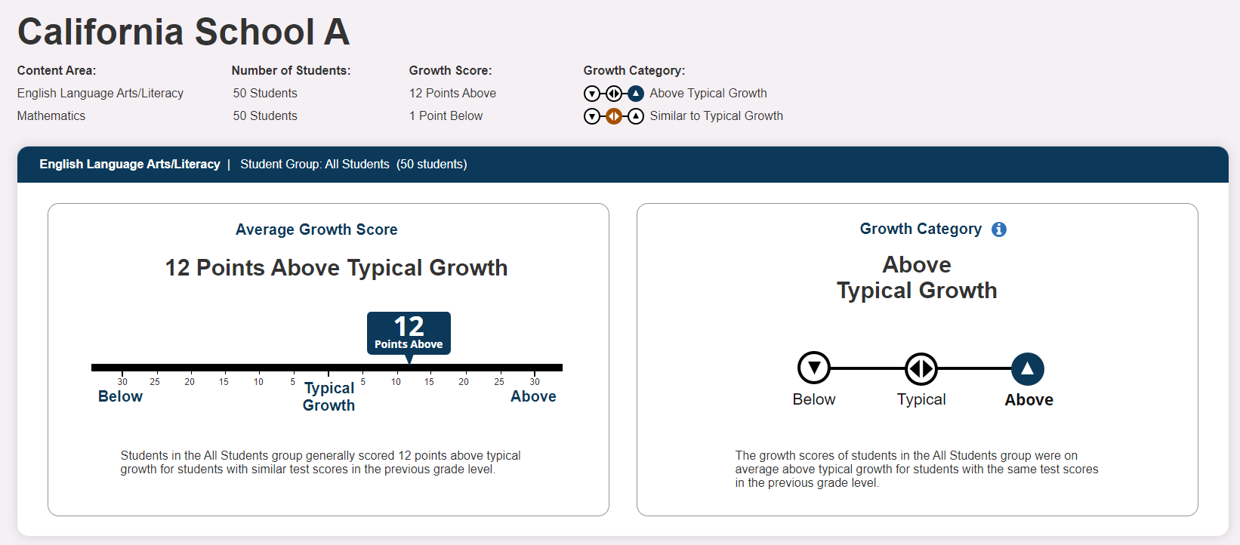
Growth Score Snapshot
Notes:
This slide refers to the growth score snapshot for California School A.
The top of the screen includes the content area, number of students, growth score, and growth category for California School A.
The left tile, the growth reporting scale, refers to the English language arts/literacy, or ELA, average growth score for all 50 students. Average growth scores are described as below, similar to, or above typical growth.
The growth reporting scale indicates that students in the All Students group generally scored 12 points above typical growth for students with similar test scores in the previous grade level.
The right tile refers to the growth category. The straight line represents three points, the arrow pointing down representing below typical growth, the arrows pointing left and right representing typical growth, and the arrow pointing up representing above typical growth. The growth scores of students in the All Students group were on average above typical growth for students with the same test scores in the previous grade level.

Slide 67
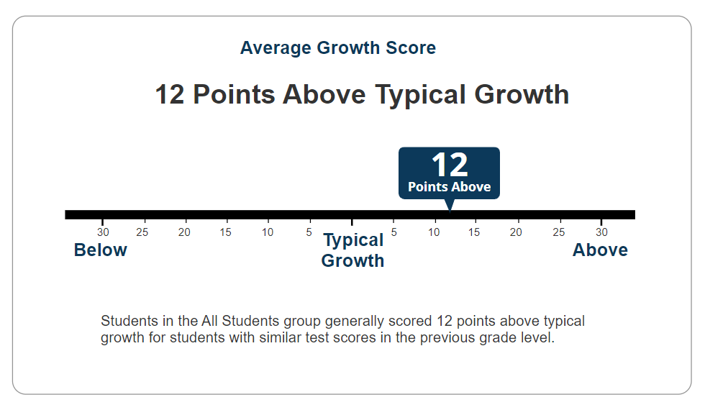
Growth Score and Scale
Notes:
The growth reporting scale refers to the ELA average growth score for all 50 students. Average growth scores are described as below, similar to, or above typical growth.
The growth reporting scale indicates that students in the All Students group generally scored 12 points above typical growth for students with similar test scores in the previous grade level.

Slide 68
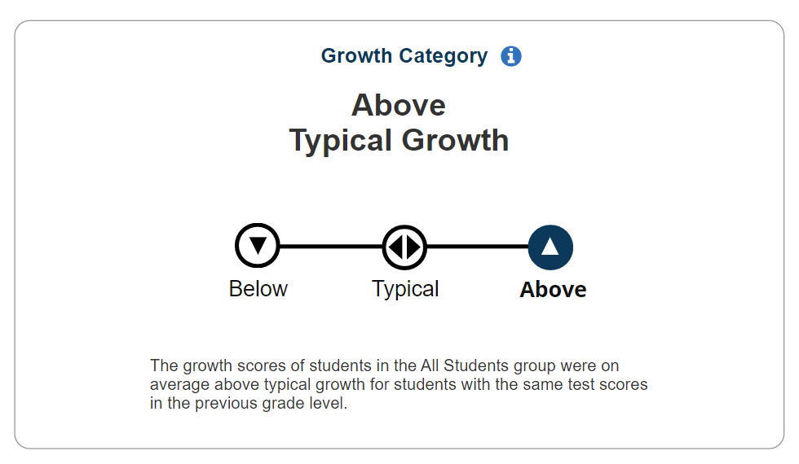
Growth Category
Notes:
There are three growth categories, the arrow pointing down representing below typical growth, the arrows pointing left and right representing typical growth, and the arrow pointing up representing above typical growth. The growth scores of students in the All Students group were on average above typical growth for students with the same test scores in the previous grade level.

Slide 69
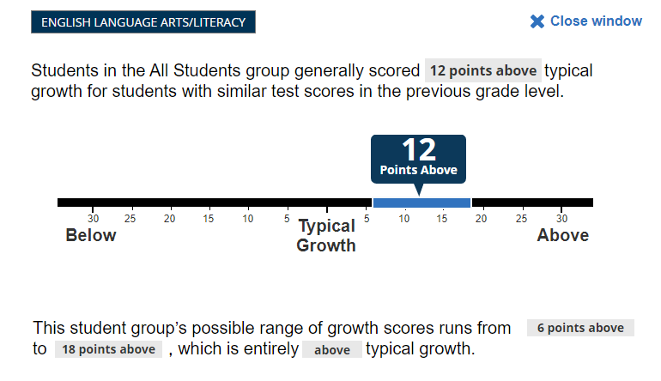
Possible Range
Possible range shown as additional information (pop-up window)
Notes:
Average growth score is linked to the growth category in a pop-up window and refers to the possible range of growth scores for all 50 students in ELA.
The growth reporting scale refers to the ELA average growth score for all 50 students. Average growth scores are described as below, similar to, or above typical growth. ​
The growth reporting scale indicates that students in the All Students group generally scored 12 points above typical growth for students with similar test scores in the previous grade level. This student group’s possible range of growth scores runs from 6 points above to 18 points above, which is entirely above typical growth.

Slide 70
Reporting Scenarios
Audience 1
Copyright © 2023 by ETS. All rights reserved. ETS and the ETS logo are registered trademarks of ETS.

Slide 71
Six Scenarios
Scenario | Growth Score | Growth Category
1 | Above | Similar to Typical Growth
2 | Above | Above Typical Growth
3 | Below | Similar to Typical Growth
4 | Below | Below Typical Growth
5 | At Typical Growth | Similar to Typical Growth
6 | Not Reportable | N/A
Notes:
This slide refers to the six scenarios for growth score and growth category.
Scenario 1: Growth Score is Above and Growth Category is Similar to Typical Growth
Scenario 2: Growth Score is Above and Growth Category is Above Typical Growth
Scenario 3: Growth Score is Below and Growth Category is Similar to Typical Growth
Scenario 4: Growth Score is Below and Growth Category is Below Typical Growth
Scenario 5: Growth Score is At Typical Growth and Growth Category is Similar to Typical Growth
Scenario 6: Growth Score is Not Reportable and Growth Category is N/A

Slide 72
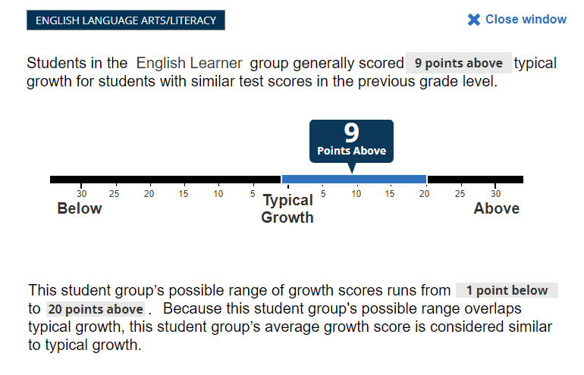
Scenario 1: Growth Score—Above, Growth Category—Similar to Typical Growth
Notes:
This slide refers to Scenario 1: Growth Score—Above and Growth Category—Similar to Typical Growth.
The left tile, the growth reporting scale, refers to the ELA average growth score for all 50 students. Average growth scores are described as below, similar to, or above typical growth.
The growth reporting scale indicates that students in the English Learner group generally scored 9 points above typical growth for students with similar test scores in the previous grade level.
The right tile refers to the growth category. There are three growth categories, the arrow pointing down representing below typical growth, the arrows pointing left and right representing typical growth, and the arrow pointing up representing above typical growth. The growth scores of students in the English Learner group were on average above typical growth for students with the same test scores in the previous grade level.
The pop-up window refers to the possible range of growth scores for all 50 students in ELA. Average growth scores are described as below, similar to, or above typical growth. ​The growth reporting scale indicates that students in the English Learner group generally scored 9 points above typical growth for students with similar test scores in the previous grade level. This student group’s possible range of growth scores runs from 1 point below to 20 points above. Because this student group’s possible range overlaps typical growth, this student group’s average growth score is considered similar to typical growth.

Slide 73
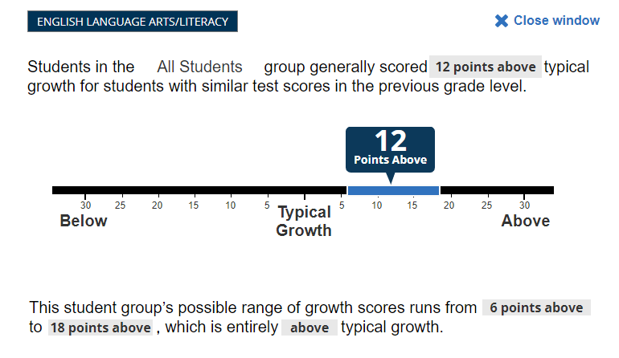
Scenario 2: Growth Score—Above, Growth Category—Above Typical Growth
Notes:
This slide refers to Scenario 2: Growth Score—Above and Growth Category—Above Typical Growth.
The left tile, the growth reporting scale, refers to the ELA average growth score for all 50 students. Average growth scores are described as below, similar to, or above typical growth.
The growth reporting scale indicates that students in the All Students group generally scored 12 points above typical growth for students with similar test scores in the previous grade level.
The right tile refers to the growth category. There are three growth categories, the arrow pointing down representing below typical growth, the arrows pointing left and right representing typical growth, and the arrow pointing up representing above typical growth. The growth scores of students in the All Students group were on average above typical growth for students with the same test scores in the previous grade level.
The pop-up window refers to the possible range of growth scores for all 50 students in ELA. Average growth scores are described as below, similar to, or above typical growth. ​The growth reporting scale indicates that students in the All Students group generally scored 12 points above typical growth for students with similar test scores in the previous grade level. This student group’s possible range of growth scores runs from 6 points above to 18 points above, which is entirely above typical growth.

Slide 74
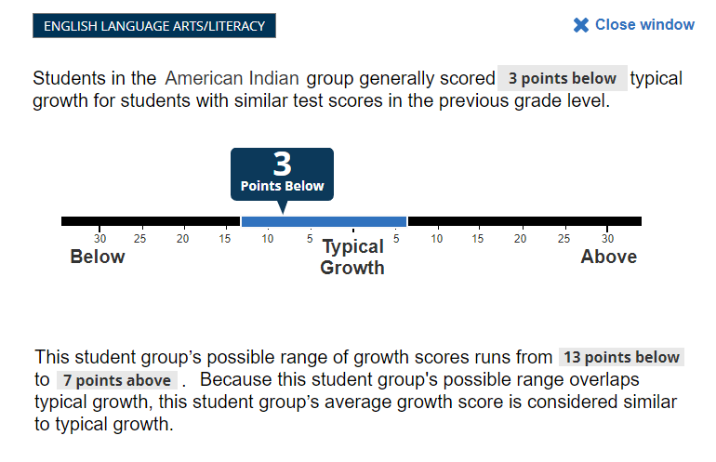
Scenario 3: Growth Score—Below, Growth Category—Similar to Typical Growth
Notes:
This slide refers to Scenario 3: Growth Score—Below and Growth Category—Similar to Typical Growth.
The left tile, the growth reporting scale, refers to the ELA average growth score for 12 American Indian students. Average growth scores are described as below, similar to, or above typical growth.
The growth reporting scale indicates that students in the American Indian group generally scored 3 points below typical growth for students with similar test scores in the previous grade level.
The right tile refers to the growth category. There are three growth categories, the arrow pointing down representing below typical growth, the arrows pointing left and right representing typical growth, and the arrow pointing up representing above typical growth. The growth scores of students in the American Indian group were on average similar to typical growth for students with the same test scores in the previous grade level.
The pop-up window refers to the possible range of growth scores for 12 American Indian students in ELA. Average growth scores are described as below, similar to, or above typical growth. ​The growth reporting scale indicates that students in the American Indian group generally scored 3 points below typical growth for students with similar test scores in the previous grade level. This student group’s possible range of growth scores runs from 13 points below to 7 points above. Because this student group’s possible range overlaps typical growth, this student group’s average growth score is considered similar to typical growth.

Slide 75
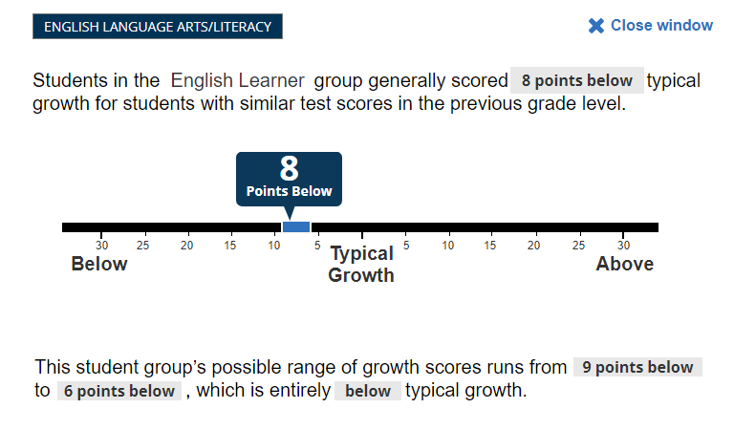
Scenario 4: Growth Score—Below, Growth Category—Below Typical Growth
Notes:
This slide refers to Scenario 4: Growth Score—Below and Growth Category—Below Typical Growth.
The left tile, the growth reporting scale, refers to the ELA average growth score for 1,469 English learner students. Average growth scores are described as below, similar to, or above typical growth.
The growth reporting scale indicates that students in the English Learner group generally scored 8 points below typical growth for students with similar test scores in the previous grade level.
The right tile refers to the growth category. There are three growth categories, the arrow pointing down representing below typical growth, the arrows pointing left and right representing typical growth, and the arrow pointing up representing above typical growth. The growth scores of students in the English Learner group were on average above typical growth for students with the same test scores in the previous grade level.
The pop-up window refers to the possible range of growth scores for 1,469 English learner students in ELA. Average growth scores are described as below, similar to, or above typical growth. ​The growth reporting scale indicates that students in the English Learner group generally scored 8 points below typical growth for students with similar test scores in the previous grade level. This student group’s possible range of growth scores runs from 9 points below to 6 points below, which is entirely below typical growth.

Slide 76
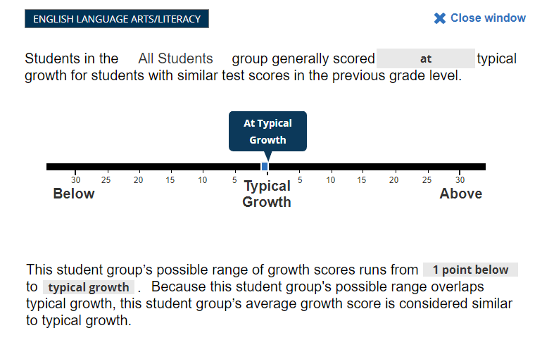
Scenario 5: Growth Score—At Typical Growth, Growth Category—Similar to Typical Growth
Notes:
This slide refers to Scenario 5: Growth Score—At Typical Growth and Growth Category—Similar to Typical Growth.
The left tile, the growth reporting scale, refers to the ELA average growth score for 5,798 students. Average growth scores are described as below, similar to, or above typical growth.
The growth reporting scale indicates that students in the All Students group generally scored at typical growth for students with similar test scores in the previous grade level.
The right tile refers to the growth category. There are three growth categories, the arrow pointing down representing below typical growth, the arrows pointing left and right representing typical growth, and the arrow pointing up representing above typical growth. The growth scores of students in the All Students group were on average similar to typical growth for students with the same test scores in the previous grade level.
The pop-up window refers to the possible range of growth scores for the All Students group. Average growth scores are described as below, similar to, or above typical growth. ​ The growth reporting scale indicates students in the All Students group generally scored at typical growth for students with similar test scores in the previous grade level. This student group’s possible range of growth scores runs from 1 point below to typical growth. Because this student group’s possible range overlaps typical growth, this student group’s average growth score is considered similar to typical growth.

Slide 77
Scenario 6: Growth Score—Not Reportable, Growth Category—N/A

Slide 78
Student Group Summary
Audience 1
Copyright © 2023 by ETS. All rights reserved. ETS and the ETS logo are registered trademarks of ETS.

Slide 79
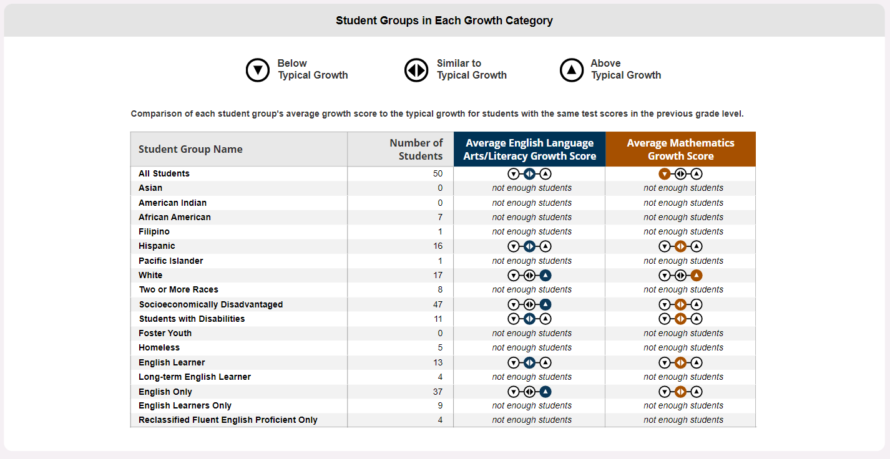
Student Group Summary (1)
Notes:
This slide compares each student group’s average ELA and mathematics growth score to the typical growth for students with the same test scores in the previous grade level. Student groups compared are the following:
All Students
Asian
American Indian
African American
Filipino
Hispanic
Pacific Islander
White
Two or More Races
Socioeconomically Disadvantaged
Students with Disabilities
Foster Youth
Homeless
English Learner
Long-term English Learner
English Only
English Learners Only
Reclassified Fluent English Proficient Only
Average ELA Growth Score
Student groups with similar to typical growth scores include the following:
All Students
Hispanic
Students with Disabilities
English Learner
Student groups with above typical growth include the following:
White
Socioeconomically Disadvantaged
English Only
Student groups with not enough students to report include the following:
Asian
American Indian
African American
Filipino
Pacific Islander
Two or More Races
Foster Youth
Homeless
Long-term English Learner
English Learners Only
Reclassified Fluent English Proficient Only
Average Mathematics Growth Score
The student group with below typical growth scores is All Students.
Student groups with similar to typical growth scores include the following:
Hispanic
Socioeconomically Disadvantaged
Students with Disabilities
English Learner
English Only
The student group with above typical growth is White.
Student groups with not enough students to report include the following:
Asian
American Indian
African American
Filipino
Pacific Islander
Two or More Races
Foster Youth
Homeless
Long-term English Learner
English Learners Only
Reclassified Fluent English Proficient Only

Slide 80
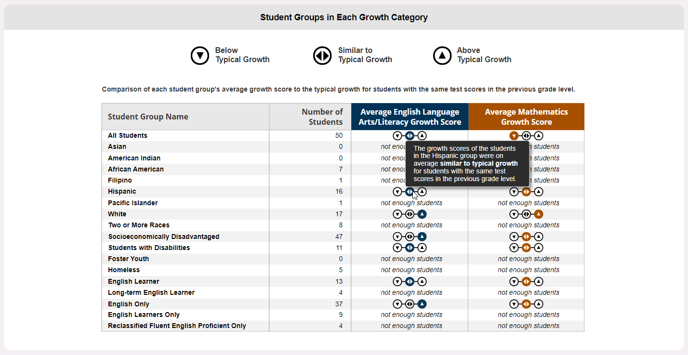
Student Group Summary (2)
Notes:
This slide compares each student group’s average ELA and mathematics growth score to the typical growth for students with the same test scores in the previous grade level. Student groups compared are the following:
All Students
Asian
American Indian
African American
Filipino
Hispanic
Pacific Islander
White
Two or More Races
Socioeconomically Disadvantaged
Students with Disabilities
Foster Youth
Homeless
English Learner
Long-term English Learner
English Only
English Learners Only
Reclassified Fluent English Proficient Only
The pop-up refers to the growth scores of the students in the Hispanic group being on average similar to typical growth for students with the same test scores in the previous grade level.
Average ELA Growth Score
Student groups with similar to typical growth scores include the following:
All Students
Hispanic
Students with Disabilities
English Learner
Student groups with above typical growth include the following:
White
Socioeconomically Disadvantaged
English Only
Student groups with not enough students to report include the following:
Asian
American Indian
African American
Filipino
Pacific Islander
Two or More Races
Foster Youth
Homeless
Long-term English Learner
English Learners Only
Reclassified Fluent English Proficient Only
Average Mathematics Growth Score
The student group with below typical growth scores is All Students.
Student groups with similar to typical growth scores include the following:
Hispanic
Socioeconomically Disadvantaged
Students with Disabilities
English Learner
English Only
The student group with above typical growth is White.
Student groups with not enough students to report include the following:
Asian
American Indian
African American
Filipino
Pacific Islander
Two or More Races
Foster Youth
Homeless
Long-term English Learner
English Learners Only
Reclassified Fluent English Proficient Only

Slide 81
Next Steps: Growth Model
2024 Accountability Workplan:
Begin discussions about SBE will explore how growth will be incorporated into the Dashboard and state/federal Accountability system
CDE will prepare communications materials to assist the field to understand the 2024 growth scores
2025 Accountability Workplan:
SBE adoption of the growth model in the Dashboard and state/federal accountability system

Slide 82
CPAG Questions on Growth Model
Does CPAG have any questions/feedback on the growth model visualizations?

Slide 83
Completion of the English Learner Progress Indicator and Incorporating the Summative Alt-ELPAC

Slide 84
English Learner Progress Indicator
The ELPI shows the percentage of current English learners making progress towards English language proficiency or maintaining the highest performance level on the end-of-year English Language Proficiency Assessments for California (ELPAC).
English learners take the ELPAC to measure progress towards English language proficiency.
Each student receives one of four ELPAC performance levels.
The four ELPAC performance levels are then divided into six ELPI levels to allow students enough time to demonstrate progress toward English language proficiency in the ELPI.

Slide 85
ELPI Change Cut Points

Slide 86
How to Set Change Cut Points
Calculate current “Status” year for ELPI
Calculate “Change” by subtracting prior year status from current year status
Current Year ELPI Status rate minus Prior Year ELPI Status rate
Look at distribution of LEA “Change” to set cut points

Slide 87
ELPI Change Simulations
The original plan was to use three years of (2020, 2021 and 2022) ELPAC summative results for change simulations
Original plan represented 805 LEAs
Partial Summative ELPAC data file (February 1 through May 9, 2023) became available which represents 1,149 LEAs.
The ELPI change simulations uses the expanded data set (2021, 2022 and 2023 ELPAC summative results), which includes student level results from February 1 through May 9, 2023.

Slide 88
Historical Reference for ELPI
The SBE adopted ELPI Change cut points for use in the 2017 Dashboard
Based on California English Language Development Test results
Included the progress of students who moved from Proficient to Reclassified Fluent English Proficient
Proposed cut points for 2023:
Based on ELPAC summative test results
Only includes test-based progress of students

Slide 89
Distribution used to set the ELPI Change Levels in 2017 (LEAs =1 ,181)
Percentile | % Point Change from Prior Year to Current Year
5 | -18.88
10 | -11.60
20 | -6.20
30 | -3.54
40 | -1.42
50 | 0.00
60 | 1.40
70 | 3.20
80 | 5.90
90 | 12.00
95 | 18.30

Slide 90
2023 LEA Distribution (LEAs =1,149)
Percentile | % Point Change from Prior Year to Current Year
5 | -20.2
10 | -14.6
20 | -8.3
30 | -4.7
40 | -1.9
50 | 0.0
60 | 2.4
70 | 4.8
80 | 8.3
90 | 13.2
95 | 19.95

Slide 91
ELPI Change Distribution Comparison
Percentile | % Point Change from Prior Year to Current Year | 2017 Historic % Point Change from Prior Year to Current Year
5 | -20.2 | -18.88
10 | -14.6 | -11.60
20 | -8.3 | -6.20
30 | -4.7 | -3.54
40 | -1.9 | -1.42
50 | 0.0 | 0.00
60 | 2.4 | 1.40
70 | 4.8 | 3.20
80 | 8.3 | 5.90
90 | 13.2 | 12.00
95 | 19.95 | 18.30

Slide 92
Proposed ELPI “Change” Levels
Change Level | 2023 Proposed Change Cut Points
Declined Significantly | ELPI status declined by more than 10%.
Declined | ELPI status declined 2.0% to 10%.
Maintained | ELPI status declined or increased by less than 2.0%.
Increased | ELPI status increased by 2.0% to less than 10%.
Increased Significantly | ELPI status increased by 10% or more.

Slide 93
Comparison of Proposed ELPI “Change” to Historic “Change”
Change Level | 2017 Change Cut Points | 2023 Proposed Change Cut Points
Declined Significantly | ELPI status declined by more than 10%. | ELPI status declined by more than 10%.
Declined | ELPI status declined 1.5% to 10%. | ELPI status declined 2.0% to 10%.
Maintained | ELPI status declined or increased by less than 1.5%. | ELPI status declined or increased by less than 2.0%.
Increased | ELPI status increased by 1.5% to less than 10%. | ELPI status increased by 2.0% to less than 10%.
Increased Significantly | ELPI status increased by 10% or more. | ELPI status increased by 10% or more.

Slide 94
Educational Partners Feedback on “Change” Cut Points
TDG:
Recommend to adopt the proposed “Change” cut points presented by the CDE.
ELPI Workgroup: Feedback will be provided verbally during the CPAG meeting.

Slide 95
ELPI “Change” Questions
Work with the partner next to you:
Do you support the recommended Change cut points for the ELPI?
If not, what suggested cut points would you choose?

Slide 96
ELPI Color Scheme

Slide 97
ELPI 5x5 Color Grid
Re-Establish 5x5 Color Grid
Two 5x5 color schemes used on the Dashboard:
Traditional (5x5 used for the ELPI on the 2017 Dashboard)
Balanced (5x5 used for the Academic Indicators on the Dashboard)

Slide 98
LEA: 5x5 ELPI Simulation Results
Performance Level | Change: Declined Significantly | Change: Declined | Change: Maintained | Change: Increased | Change: Increased Significantly
Status: Very High | 1 (0.0%) | 8 (0.4%) | 10 (0.5%) | 21 (1.1%) | 48 (2.6%)
Status: High | 11 (0.6%) | 39 (2.1%) | 39 (2.1%) | 106 (5.8%) | 69 (3.8%)
Status: Medium | 44 (2.4%) | 132 (7.3%) | 119 (6.6%) | 145 (8.0%) | 47 (2.6%)
Status: Low | 75 (4.1%) | 77 (4.2%) | 37 (2.0%) | 32 (1.8%) | 8 (0.4%)
Status: Very Low | 56 (3.1%) | 15 (0.8%) | 6 (0.3%) | 4 (0.2%) | 0 (0.0%)

Slide 99
“Traditional” 5x5 Color Scheme
Performance Level | Change: Significantly Declined | Change: Declined | Change: Maintained | Change: Increased | Change: Significantly Increased
Status: Very High | Yellow | Green | Blue | Blue | Blue
Status: High | Orange | Yellow | Green | Green | Blue
Status: Medium | Orange | Orange | Yellow | Green | Green
Status: Low | Red | Orange | Orange | Yellow | Yellow
Status: Very Low | Red | Red | Red | Orange | Yellow

Slide 100
Summary of “Traditional” 5x5 Color Scheme Results for LEAs
Color | Number of Performance Levels on Traditional 5x5
Blue | 148
Green | 345
Yellow | 199
Orange | 305
Red | 152
No Color | 666
Total | 1,815

Slide 101
“Balanced” 5x5 Color Scheme
Performance Level | Change: Significantly Declined | Change: Declined | Change: Maintained | Change: Increased | Change: Significantly Increased
Status: Very High | Green | Green | Blue | Blue | Blue
Status: High | Green | Green | Green | Green | Blue
Status: Medium | Yellow | Yellow | Yellow | Green | Green
Status: Low | Orange | Orange | Orange | Yellow | Yellow
Status: Very Low | Red | Red | Red | Orange | Orange

Slide 102
“Balanced” 5x5 Color Scheme Results for LEAs
Color | Number of Performance Levels on Balanced 5x5
Blue | 148
Green | 396
Yellow | 335
Orange | 193
Red | 77
No Color | 666
Total | 1,815

Slide 103
Comparison of the two 5x5 Color Scheme Results
Color | Number of Performance Levels on Balanced 5x5 | Number of Performance Levels on Traditional 5x5
Blue | 148 | 148
Green | 396 | 345
Yellow | 335 | 199
Orange | 193 | 305
Red | 77 | 152
No Color | 666 | 666
Total | 1,815 | 1,815

Slide 104
Additional ELPI Color Scheme Simulations
Small LEAs
Non-Small Schools (excluding charter schools
Small Schools (excluding charter schools)

Slide 105
Comparison of Small LEAs “Balanced” 5x5 vs “Traditional” 5x5 (Excludes Charter Schools)
Color | Number of Performance Levels on Balanced 5x5 | Number of Performance Levels on Traditional 5x5
Blue | 114 | 114
Green | 192 | 159
Yellow | 146 | 78
Orange | 112 | 156
Red | 67 | 124
No Color | n/a | n/a
Total | 631 | 631

Slide 106
Comparison of Non-Small Schools “Traditional” 5x5 vs “Balanced” 5x5 (Excludes Charter Schools)
Color | Number of Performance Levels on Balanced 5x5 | Number of Performance Levels on Traditional 5x5
Blue | 138 | 138
Green | 323 | 276
Yellow | 305 | 166
Orange | 229 | 321
Red | 80 | 174
No Color | n/a | n/a
Total | 1,075 | 1,075

Slide 107
Comparison of Small Schools “Traditional” 5x5 vs “Balanced” 5x5 (Excludes Charter Schools)
Color | Number of Performance Levels on Balanced 5x5 | Number of Performance Levels on Traditional 5x5
Blue | 901 | 901
Green | 1,183 | 948
Yellow | 835 | 474
Orange | 673 | 932
Red | 284 | 621
No Color | n/a | n/a
Total | 3,876 | 3,876

Slide 108
Educational Partners Feedback on ELPI Color Scheme
TDG:
Recommend to adopt the “Balanced” color scheme.
ELPI Workgroup:
Feedback will be provided verbally during the CPAG meeting.

Slide 109
ELPI Color Scheme Questions
Does CPAG recommend the use of the:
“Traditional” color scheme or “Balanced” color scheme? Why?
Or is there another option for a color scheme?
Do you have any additional questions?

Slide 110
Summative Alternate ELPAC

Slide 111
Summative Alternate ELPAC and the ELPI
The U.S. Department of Education requires California to include the Alternate ELPAC Summative in the ELPI for the 2023 Dashboard.
2023 Accountability Workplan:
Determine what methodology to use to determine that a student has made progress in English Language Development on the Summative Alternate ELPAC from one year to the next
Incorporate those students into the 2023 Dashboard ELPI

Slide 112
Options for Incorporation
Option 1: Performance Level Method
Option 2: Scale Score Method
Option 3: Scale Score & Performance Level Method

Slide 113
Option 1: Performance Level Method
If a student moves up a performance level or remains at Level 3, then they have made progress:
Level 1 to Level 2
Level 2 to Level 3
Level 1 to Level 3
Remain at Level 3
Scale score ranges for each performance level on the Alternate ELPAC are narrow.
At the April 2023 meeting, the TDG did not recommend splitting ELPAC levels 1 or 2 due to lack of data and technical information.

Slide 114
Option 2: Using Scale Scores for Progress
The CDE simulated a ten-point change in scale score from the prior year to the current year test administration to determine EL progress.
Using a scale score change outside the measurement of error on the Summative Alternate ELPAC decreases the likelihood that the change is due to measurement error.
Notes:
The Summative Alternate ELPAC is not vertically aligned compared to the Summative ELPAC which is vertically aligned.
The Alternate ELPAC technical report was publicly released late April 2023:
Alternate English Language Proficiency Assessments for California 2021–22 Operational Field Test Technical Report
According to the report, the average standard error across grades is 5.0. See Handout 4, table 2.
Scale scores can allow for equal intervals of growth to be measured from any point on the continuum of English language proficiency only when the scores from different grades are vertically equated.

Slide 115
Option 2 and 3: Scale Score Simulation
In order to calculate the scale score change, the first digit of the scale score is removed.
Example: a scale score of 244 in kindergarten gets converted to 44 and a scale score of 359 in grade 1 gets converted to 59. The difference was calculated between 59 and 44. A scale score change of +15.

Slide 116
Results for Options 1, 2, and 3
The table below provides the statewide results comparing the Option 1, 2, and 3.
Option | # of Summative Alt-ELPAC Students Progressed | # Did Not Progress
Option 1 | 3,926 (35.6%) | 7,206 (65.4%)
Option 2 | 3,815 (34.6%) | 7,206 (65.4%)
Option 3 | 4,641 (42.1%) | 6,380 (57.9%)

Slide 117
Questions for CPAG on Alt-ELPAC Incorporation
Which of the three options do you recommend?

Slide 118
Aligning the Dashboard with Additional Data

Slide 119
Priority 1: Teacher Assignment Data Setting Objective Criteria

Slide 120
Why Are We Modifying Priority 1?
California Education Code (EC) Section 52064.5(e)(2)
“the standards for local indicators for which the department collects or otherwise has access to relevant and reliable school-level data for all schools statewide shall, to the extent practicable, be based on objective criteria, which may include, but are not necessarily limited to, the extent of any disparities across schoolsites within a school district or county office of education or performance relative to statewide data.”

Slide 121
Background on Priority 1 Local Indicator
EC Section 52060(d)(1)
(1) The degree to which the teachers of the school district are appropriately assigned in accordance with Section 44258.9, and fully credentialed in the subject areas, and, for the pupils they are teaching, every pupil in the school district has sufficient access to the standards-aligned instructional materials as determined pursuant to Section 60119, and school facilities are maintained in good repair, as defined in subdivision (d) of Section 17002.

Slide 122
Considerations
As of June 30, 2023, two-years of Teaching Assignment Monitoring Outcome (TAMO) reports are available
For the 2022–23 Local Control and Accountability Plan year, local educational agencies were directed to review the TAMO data at the next regularly scheduled meeting of the local governing board/body following the availability of these data
The SBE will need to adopt objective criteria at their September 2023 meeting for inclusion in the 2023 Dashboard

Slide 123
Additional Considerations (1)
The TAMO reports include seven assignment monitoring outcomes: Clear, Out-of-Field, Intern, Ineffective, Incomplete, Unknown, Not Applicable
The definitions for these outcomes are available on the Information about the Teaching AMO Report web page at https://www.cde.ca.gov/ds/ad/tamoinfo.asp#amodefinitions

Slide 124
Additional Considerations (2)
The clear outcome aligns most closely with the Priority 1 Local Indicator EC Section 52060(d)(1); however, solely using this definition does not include individuals in the educator pipeline, such as interns and out-of-field educators.
Educators who are out-of-field have a credential and need to demonstrate subject matter competency in a new subject area assignment
Educators who are interns have a bachelor’s degree, subject matter competency, and are working towards obtaining a credential

Slide 125
Options for Reporting Teacher Assignments for 2023 Dashboard

Slide 126
Multi-year TAMO Report
For background purposes, it is recommended that the multi-year TAMO Report be included for each LEA in their Priority 1 report similar to the one below.
Academic Year | Total Teaching FTE | Clear | Out-of-Field | Intern | Ineffective | Incomplete/Unknown/N/A
2021–22 | 279,044.9 | 84.0% | 4.3% | 1.7% | 4.3% | 5.7%
2020–21 | 274,759.1 | 83.1% | 4.4% | 1.5% | 4.1% | 6.9%

Slide 127
Options for Objective Criteria
The second set of information for Priority 1-teacher data requires that objective criteria to be developed for the Clear definition
There are three options under consideration:
Option 1: LEA/County/Statewide Comparisons in Chart Form and Narrative Box
Option 2: Teacher Data in a Narrative
Option 3: Teacher Data in a Narrative with Above/At/Below

Slide 128
Option 1 – LEA/County/Statewide Comparisons in Chart Form
Name | Total Teaching FTE | Clear (% of teaching FTE)
Sacramento City Unified | 1,688.4 | 87.3%
Sacramento | 9,887.7 | 88.3%
Statewide | 246,966.4 | 85.8%
Optional Narrative (Limited to 1,500 characters): Provide any additional information in the text box provided in the Dashboard that the LEA believes is relevant to understanding its progress towards this measure.

Slide 129
Option 2 – Teacher Data in a Narrative
In the 2021–22 school year, 87.3 percent of teacher assignments were authorized by a clear or preliminary credential or authorized by a local assignment option made pursuant to the California Code of Regulations [T5 §80005(b)] for specific state course codes where a credential or permit does not exist to authorize the indicated teaching assignment (e.g., student government or study hall). This compares to 88.3 percent of assignments being clear at the county level and 85.8 percent of assignments being clear at the state level.

Slide 130
Option 3 – Teacher Data in a Narrative-with Above/At/Below
In the 2021–22 school year, 87.3 percent of teacher assignments were authorized by a clear or preliminary credential or authorized by a local assignment option made pursuant to the California Code of Regulations [T5 §80005(b)] for specific state course codes where a credential or permit does not exist to authorize the indicated teaching assignment (e.g., student government or study hall). This is below the county average of 88.3 percent and above the state average of 85.8 percent.

Slide 131
Priority 1 Educational Partner Feedback
Priority One Teacher Workgroup discussed options for setting objective criteria based on the two years of TAMO data.
CDE sent a follow-up survey to the Workgroup members on the three options and requested their preference among the options.
Option 1 was overwhelmingly favored by the Workgroup.

Slide 132
Questions for CPAG on Reporting of Teacher Data
Which of the three options do you recommend? And why?

Slide 133
Least Restrictive Environment

Slide 134
Update on Least Restrictive Environment Reports
EC Section 56049.1 requires that, on or before November 30, 2023, CDE shall publish data related to federal measures of least restrictive environment (LRE) for pupils with disabilities on its internet website and shall include it as a resource on the Dashboard, established pursuant to subdivision (f) of Section 52064.5.
LEAs currently submit information about LRE to the CDE through the California Longitudinal Pupil Achievement Data System (CALPADS).

Slide 135
LRE on the Dashboard
The data published on the CDE website will utilize data from the CALPADS Fall 1 submission (Census Day) and this information will be disaggregated by race or ethnicity and LEA.
The CDE will provide a direct link to the DataQuest report on the main menu page structure of the Dashboard.

Slide 136
Science Data on the Dashboard

Slide 137
Science Assessments and the 2023 Dashboard
September 2022: The SBE approved the reporting of the California Science Test (CAST) results on the Dashboard.
Acknowledges the importance of science and the assessments and allows users to directly connect to the CAST results.
2023 Dashboard: link to each school/LEA’s CAST science results.

Slide 138
Science Assessments and the 2024 Dashboard
2024 Dashboard Workplan:
CDE will explore the inclusion of the CAST results on the Dashboard.
CDE has two years of results (2021–22 and 2022–23 CAST) that were based on the revised blueprint for accountability purposes and can develop options toward inclusion of this test on the Dashboard for the SBE to consider.

Slide 139
Address Data Quality and Participation Issues in a Uniform Way throughout the Dashboard

Slide 140
Data Quality

Slide 141
Data Quality Workplan for 2023
In the 2023 Workplan, the CDE indicated that it would explore the alignment of implications for schools and LEAs who fail to certify data in the California Longitudinal Pupil Achievement Data System (CALPADS) or following submission, report to the CDE that the data is incorrect.
Senate Bill 114, signed into law in July 2023, now requires that LEAs that do not certify their data in CALPADS will receive one year of Technical Assistance from their county office of education.

Slide 142
Participation Rate Alignment

Slide 143
ELPI Participation Rate
CDE committed in the 2023 Accountability Workplan to:
Evaluate aligning the ELPI participation rate penalty with the penalty used for the Academic Indicator
This would replace the “Automatic Orange”

Slide 144
2022 Dashboard ELPAC Participation Rates
District Participation Rates
95 percent or higher: 87 percent of Districts
90-94.9 percent: 8 percent of Districts
Less than 90 percent: 5 percent of Districts
School Participation Rates
95 percent or higher: 89 percent of Schools
90-94.9 percent: 6 percent of Schools
Less than 90 percent: 5 percent of Schools

Slide 145
Issues with Current Participation Rate Business Rule
An “Orange” Status is automatically assigned to LEAs and schools regardless of the ELPAC participation rate.
Example: a school with a 94.7 percent ELPAC participation rate is treated the same as a school with 75.5 percent rate.
An “Orange” Status assignment is not currently used in LCFF assistance determinations
“Orange” can play a part in ESSA determinations

Slide 146
Updating Participation Rate Business Rule
CDE explored changes the participation rate rule that would:
Eliminate the “one penalty fits all” approach
Differentiate the penalty based on the participation rate
The lower the participation rate, the more impact the penalty has
Not exclude an LEA/School from receiving a “Red”

Slide 147
New Participation Rate Business Rule: “No Progress”
For each LEA and school with at least 30 EL students enrolled in the current Dashboard year based on ETS enrollment:
Calculate the minimum number of students needed to reach equal to or greater than a minimum participation rate (95 percent).
The resulting number of students will be counted as not making progress on the current ELPI Status calculation.

Slide 148
Calculation of “No Progress”
Students Tested | Students Enrolled | Summative ELPAC Participation Rate | Number of Students Needed to Meet Participation Rate Goal (Rounded Up) | Difference Needed to Meet Goal
21 | 35 | 60% (21/35=60%) | 33.25 (rounded up to 34) | 34 – 21 = 13 Students
In this scenario 13 students will be added to the current ELPI Status denominator.

Slide 149
“No Progress” Methodology Example
As mentioned, in this scenario 13 students will be added to the current ELPI Status denominator:
Methodology | ELPI Numerator | ELPI Denominator | ELPI Status | ELPI Status Level
Current ELPI | 7 | 10 | 70% | Very High
“No Progress” | 7 [7 + (0 x 13)] | 23 [10 (+13)] | 30.4% | Very Low

Slide 150
“No Progress” Methodology Features
Uses a single year of participation rate data to apply the participation rate penalty.
Applies the participation rate penalty to:
Kindergarten students that were enrolled and not tested in the current year.
Students that were enrolled and not tested in the current year even in instances where a prior year performance level cannot be found.
Has a more subtle and variable impact on ESSA and LCFF determinations than an “Orange” or “Red” Color assignment.
Notes:
Note: Bullets 1-3 are also applicable to the Color assignment methodology. Bullets 2 and 3 would not apply if the LOSS participation rate methodology used for the Academic Indicator were applied to the ELPI since the ELPI Status calculation uses two years of data rather than a single year like the Academic Indicator status calculation.

Slide 151
Differentiated Assistance Criteria

Slide 152
Levels of Assistance
Level 1 – Support for All:
All districts, charter schools, and County Offices of Education (COEs) are eligible for general assistance.
Level 2 – Differentiated Assistance:
All districts, charter schools, and COEs are eligible for Differentiated Assistance based on performance in each Local Control Funding Formula (LCFF) state priority area.

Slide 153
Differentiated Assistance: Timeline for Eligibility and “Exit”
Differentiated assistance eligibility determinations are made annually following the release of the Dashboard.
Differentiated assistance is not a status. Districts, COEs and charter schools do not exit from assistance.

Slide 154
Differentiated Assistance Eligibility Criteria
Both state and local indicator results for each priority area reported on the Dashboard are used to determine eligibility of districts and COEs for Differentiated Assistance.
The following tables identify the student group criteria for each priority area used to make LCFF eligibility for assistance determinations in a year with ALL Indicators available.

Slide 155
Differentiated Assistance Eligibility Criteria for Priorities 1-5
Priority Number | Priority Area | Criteria
1 | Basics | Not Met for Two or More Years on Local Performance
2 | Implementation of State Academic Standards | Not Met for Two or More Years on Local Performance
3 | Parent and Family Engagement | Not Met for Two or More Years on Local Performance

Slide 156
Eligibility Criteria for Priorities 1-5 (Cont.)
Priority Number | Priority Area | Criteria
4 | Pupil Achievement | Red on both English language arts and math tests, or Red on English language arts or math test and Orange on the other test, or Red on the English Learner Progress Indicator (ELPI) (English Learner student group only)
5 | Pupil Engagement | Red on Graduation Rate Indicator, or Red on Chronic Absence Indicator

Slide 157
Differentiated Assistance Eligibility Criteria for Priorities 6-10
Priority Number | Priority Area | Criteria
6 | School Climate | Red on Suspension Rate Indicator, or Not Met for Two or More Years on Local Performance
7 | Access to a Board Course of Study | Not Met for Two or More Years on Local Performance
8 | Outcomes in a Broad Course of Study | Red on College/Career Indicator (CCI)
9 | Coordination of Services for Expelled Pupils – COEs ONLY | Not Met for Two or More Years on Local Performance
10 | Coordination of Services for Foster Youth – COEs Only | Not Met for Two or More Years on Local Performance

Slide 158
Districts and COEs May be Eligible for Differentiated Assistance Based on...
State Indicators Only (Method 1):
One student group meets the criteria in at least two priority areas (e.g., Hispanic student group is Red for Chronic Absenteeism and Suspension—priority areas 5 and 6).
Local Indicators Only (Method 2):
“Not Met for Two or More Years” in at least two priority areas (e.g., priority areas 1 and 2).
A Combination of State and Local Indicators (Method 3):
One or more student group(s) meets(s) the criteria in one priority area (e.g., Students with disabilities receives Red for graduation rate—5), and the LEA or COE meets the “Not Met for Two or More Years” on only one local indicator in a different priority area (e.g., Parent Engagement—3)

Slide 159
Charter Schools May be Eligible for Differentiated Assistance Based on...
The eligibility criteria for charters is identical to districts/COEs eligibility criteria, except for charter schools are required to meet the criteria in two or more years.
State Indicators Only (Method 1):
See previous slide for example.
Local Indicators Only (Method 2):
See previous slide for example.
A Combination of State and Local Indicators (Method 3):
See previous slide for example.

Slide 160
Change in Methodology for 2023 Determinations
Due to the College/Career Indicator (CCI) being “Status Only” in 2023, the criteria would be:
Priority 8: Outcomes in a Broad Course of Study
Currently: Red on CCI
Change to: Very Low Status on CCI

Slide 161
Differentiated Assistance Question for CPAG
What input and feedback do CPAG members have around the proposed adjusted methodology for determining differentiated assistance in 2023?

