Slide 1
Information Item Related to California’s State and Federal Accountability System: Review of the 2022 California School Dashboard and the 2023 Accountability Work Plan California Practitioners Advisory Group February 17, 2023

Slide 2
Topics
Overview of the 2022 California School Dashboard
(Dashboard)
Revisions Under Consideration for the 2023 Dashboard

Slide 3
Overview of the 2022 Dashboard

Slide 4
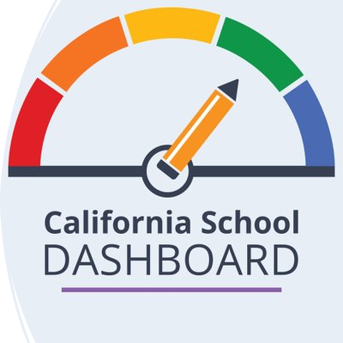
Purpose
The California School Dashboard provides parents and educators with meaningful information on school and district progress so they can participate in decisions to improve student learning.

Slide 5
What is DataQuest?
DataQuest provides meaningful data and statistics about California’s K–12 public educational system that supports a wide variety of informational, research, and policy needs. Summary and detailed data reports are available for multiple subject areas at the school, district, county, and state levels.

Slide 6
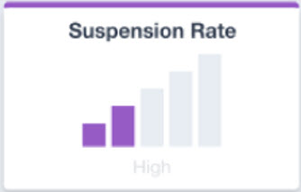
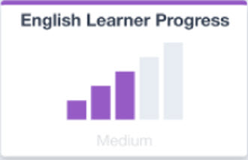
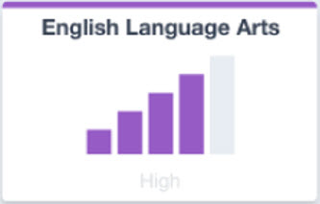
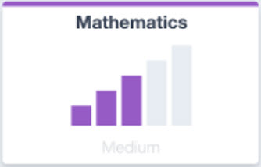
Status Only Dashboard
No indicator colors used for the 2022 Dashboard Measures.
Purple color for all Status Levels
Status Graphic resembles “Cell Phone Bars”.
Five Status Levels

Slide 7
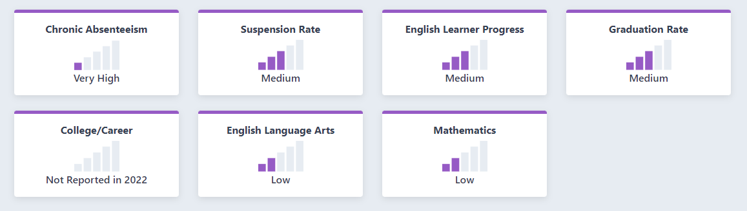
2022 Dashboard State Summary
Note: The College/Career Indicator is not reported on the 2022 Dashboard due to limited statewide testing in 2020–21. This measure will resume with "Status Only" reporting on 2023 Dashboard.

Slide 8
What is the Chronic Absenteeism Rate?
Represents the percent of students that are chronically absent (miss 10 percent or more of days expected)
Includes students expected to attend at least 31 days
Uses attendance data submitted by local educational agencies to the California Longitudinal Pupil Achievement Data System (CALPADS).

Slide 9
Differences Between DataQuest and the Dashboard for Chronic Absenteeism Rate
DataQuest | Dashboard
Use filters to report grade spans | Reports grades K-8 only
Non-public Schools (NPS) included in LEA reports | NPS not included in LEA reports
Use filters to include/exclude charter schools for authorizers | Charter schools excluded from authorizer’s results
Students with Disabilities are reported at the District of Attendance | Students with Disabilities are reported at the District of Residence

Slide 10
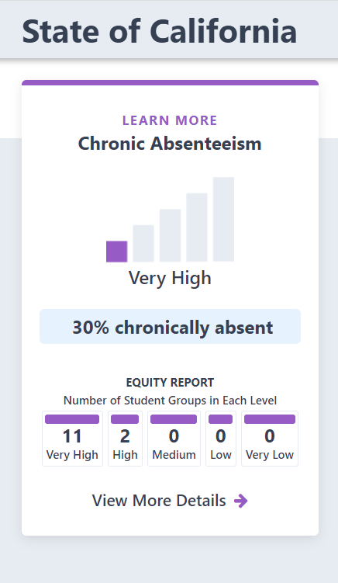
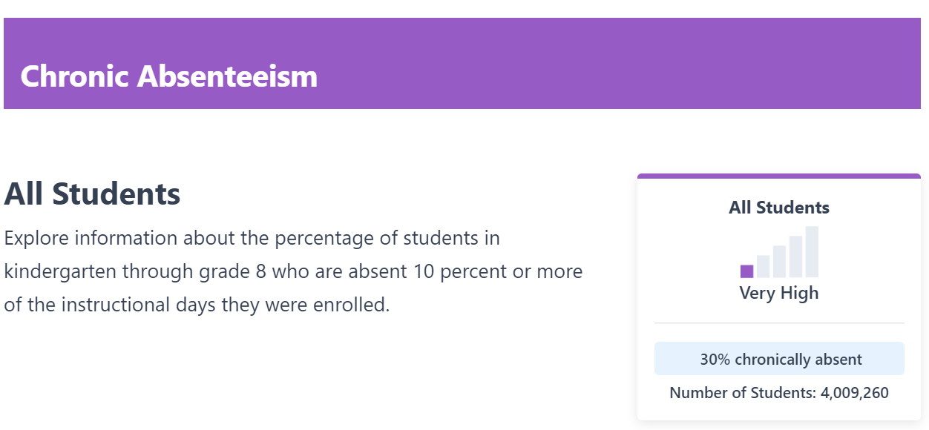
Chronic Absenteeism Indicator Statewide Results (Kindergarten through Grade 8)

Slide 11
Chronic Absenteeism by Academic Year (Kindergarten through Grade 12)
Academic Year | Chronic Absenteeism Eligible Enrollment | Chronic Absenteeism Count | Chronic Absenteeism Rate
2021–22 | 5,995,399 | 1,799,734 | 30.0%
2020–21 | 6,072,413 | 866,842 | 14.3%
2019–20 | Not Applicable | Not Applicable | Not Applicable
2018–19 | 6,258,845 | 755,950 | 12.1%
2017–18 | 6,315,131 | 702,531 | 11.1%
2016–17 | 6,335,748 | 686,409 | 10.8%

Slide 12
Data Observations
Pre-COVID years (2016–17, 2017–18, 2018–19) were focused on data quality as several schools/district had reported perfect attendance in the initial collection cycle.
For the 2019–20 academic year, the CDE determined that absenteeism data are not valid and reliable. This was due to the pandemic which resulted in statewide physical school closures in February/March 2020.
For the 2021–22 academic year, the quarantine requirements varied and most students did not have access to vaccinations until November 2021.

Slide 13
Dashboard Tour
We will now move to a live overview of the 2022 Dashboard.

Slide 14
LEAs Eligible for Differentiated Assistance

Slide 15
Local Control Funding Formula Assistance Categories
California’s accountability and continuous improvement system is based on a three-tiered system:
General Assistance—resources and assistance that are made available to all local educational agencies (LEAs) (i.e., districts, charter schools, and COEs)
Differentiated Assistance—LEAs that meet certain eligibility criteria for additional support
Intensive Intervention—LEAs with persistent performance issues over a period of time

Slide 16
2022 Differentiated Assistance
For 2022, only districts and COEs are eligible for differentiated assistance.
Based on statutory requirements charter schools will not be eligible for differentiated assistance determinations until 2023.
The Dashboard is used to determine which districts and COEs are eligible for differentiated assistance.
For 2022, only state indicators are used for differentiated assistance eligibility determinations.

Slide 17
2022 Differentiated Assistance Eligibility Criteria
Districts and COEs that have one or more student groups that meet the criteria in at least two priority areas are eligible for differentiated assistance.

Slide 18
2022 Differentiated Assistance Criteria by LCFF Priority Area
LCFF State Priority Area | State Indicators Criteria
Pupil Achievement (Priority 4) | Very Low Status on both the ELA and Mathematics Academic Indicator; or Very Low Status on the English Learner Progress Indicator
Pupil Engagement (Priority 5) | Very Low Status on the Graduation Rate Indicator; or Very High Status on the Chronic Absenteeism Indicator
School Climate (Priority 6) | Very High Status on the Suspension Rate Indicator

Slide 19
2022 Districts/COEs in Differentiated Assistance
617 total
Top student groups that determined eligibility:
Students with disabilities
Homeless
Foster Youth
English Learners

Slide 20
Resources

Slide 21
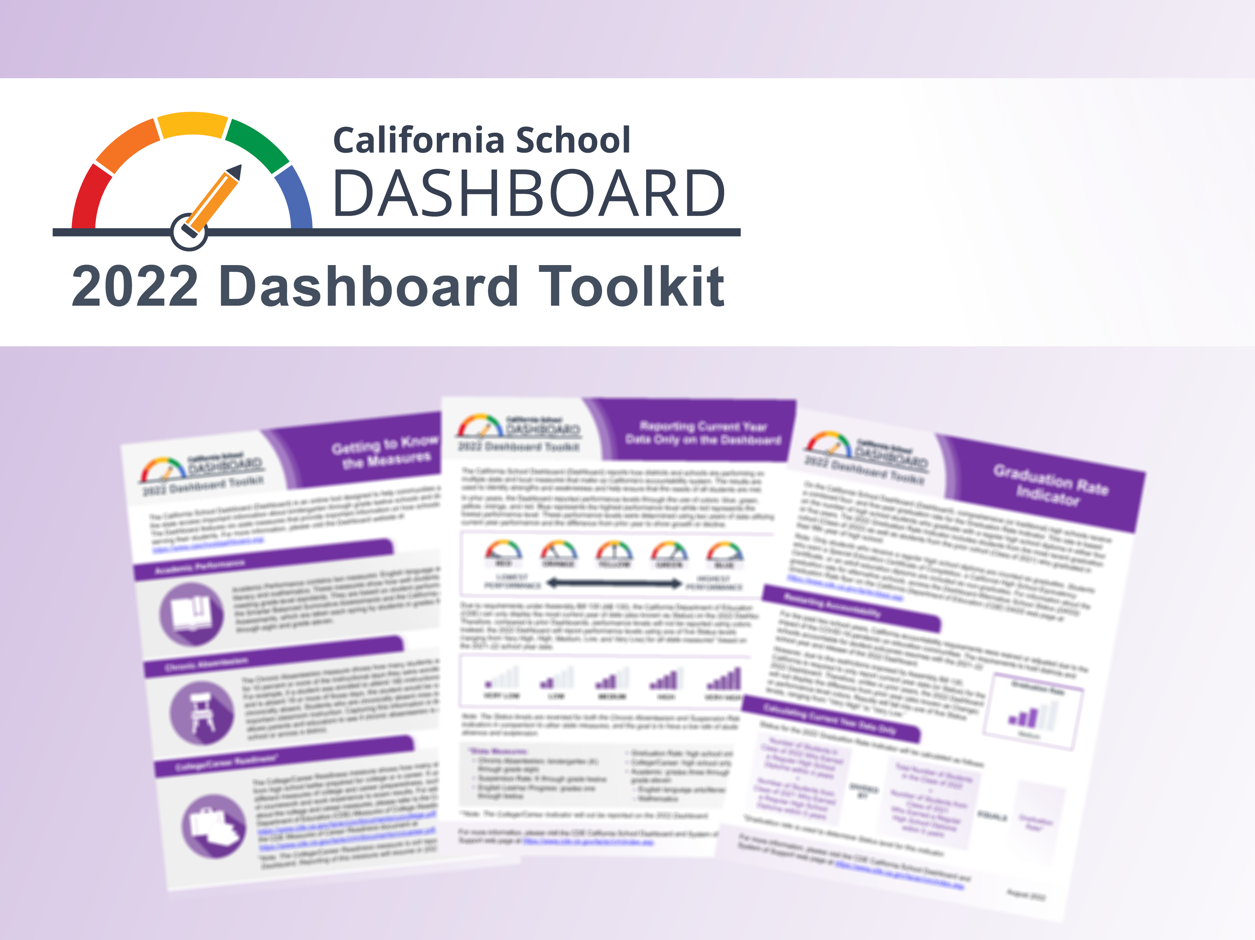
Dashboard Toolkit​
Designed to support LEAs and the public with the 2022 Dashboard Release and includes:
Dashboard Summary Guide
Flyers for Educators and Parents (translations available!)
Webinar slides
Talking points

Slide 22
Pending Dashboard Reports
Dashboard Updates:
DASS one-year graduation rate (Information Only)
Additional Reports:
Student Groups
College/Career Measures
District and Charter School Performance by County

Slide 23
Revisions Under Consideration for the 2023 California School Dashboard

Slide 24
California School Dashboard 2023
The California Department of Education (CDE) is committed to continuous improvement within the Accountability system and Dashboard
CDE's annual work plan reviews the state and local indicators and performance standards, and addresses suggested revisions or updates in the work plan each March.
This work plan is presented annually at the March SBE Meeting.

Slide 25
2023 Accountability Workplan: State Indicators
Completion of English Learner Progress Indicator (ELPI)
Updates and Revisions to State Indicators
Graduation Rate Indicator
College/Career Indicator

Slide 26
2023 Accountability Workplan: Additional Work
Additional Data on the Dashboard
Science Assessment Results (CAST)
Priority 1: Teacher Assignment Data
Least Restrictive Environment Data
Continuing work on Academic Growth
Updated Business Rules for 2023 Dashboard

Slide 27
Completion of the English Learner Progress Indicator (ELPI) and Incorporating the Alt-ELPAC

Slide 28
Components of the Each State Indicator
Status Levels/Cut Scores
5 Levels of current year performance from Very High to Very Low
Change Levels/Cut Scores
5 Levels of performance for year-to-year change in performance from Increased Significantly to Decreased Significantly
5x5 Color Grid
Grid that matches colors (blue/green/yellow/orange/red) to each combination of status/change

Slide 29
Background on the ELPI
2017 Dashboard
First year that ELPI was reported on the Dashboard.
2018 Dashboard
SBE approval for ELPI three-year plan.
SBE approval for ELPI based on Status only.

Slide 30
Background on the ELPI (2)
2019 Dashboard
Determination of methodology and cut scores for ELPI Status creating six ELPI levels based on the ELPAC.
Utilize the “Very Low” Status to determine LEA and school eligibility for support.
2020 and 2021 Dashboards
Production of state indicators suspended per Senate Bill 98, Assembly Bill 130, and approved waiver by U.S. Department of Education.

Slide 31
Components Approved for the ELPI State Indicator
Status Levels/Cut Scores
5 Levels of current year performance from Very High to Very Low

Slide 32
ELPI Status
ELPI Status measures the rate EL students are moving towards English language proficiency (ELP).
Unlike all other state indicators, the ELPI requires two years of data (ELPAC Summative Assessment results) to determine a status

Slide 33
ELPI Indicator Workplan for 2023
Evaluate Change Levels/Cut Scores
5 Levels of performance for year-to-year change in performance from Increased Significantly to Decreased Significantly
Re-Establish 5x5 Color Grid
Grid that matches colors (blue/green/yellow/orange/red) to each combination of status/change

Slide 34
ELPI Change
ELPI Change measures the year-to-year rate change.
Requires three years of ELPAC Summative Assessment results
2023 Work: CDE will review and analyze multiple years of ELPAC Summative Assessment results to determine ELPI Change cut scores.
This work will be shared and reviewed with the ELPI Work Group, Technical Design Group, and CPAG for feedback.

Slide 35
ELPI 5x5 Color Grid
Re-Establish 5x5 Color Grid
Requires multiple years of ELPAC Summative Assessment results
2023 Work: CDE will review and analyze past and current ELPI data to map the colors
This work will be shared and reviewed with the ELPI Work Group, Technical Design Group, and CPAG for feedback.

Slide 36
Alt-ELPAC and the ELPI
The ELPI has only included results from the traditional ELPAC.
The Alt-ELPAC was approved by the State Board of Education (SBE) in 2019.
ELPI needs two years of summative data:
Statewide operational field test: 2021-22
Operational Summative Alternate ELPAC: 2022-23

Slide 37
Incorporating Alt-ELPAC into ELPI
The CDE will review and analyze Alt-ELPAC Summative Assessment results from 2021-22.
This work will be shared and reviewed with the ELPI Work Group, Technical Design Group, and CPAG for feedback.
The availability of two years of alternative ELPAC Summative Assessment results will allow the CDE to incorporate the alternative ELPAC Summative Assessment in the calculation of ELPI Status for the 2023 Dashboard.

Slide 38
Updates and Revisions to State Indicators

Slide 39
Graduation Rate Indicator

Slide 40
History of Graduation Rate Calculations for the Dashboard
Since 2017, the Graduation Rate calculation has varied each year for both Traditional/Non-DASS and DASS Schools.
There have been three rates used at the school level over 4 different Dashboards:
4-Year Cohort Rate
4/5 Year Combination Rate
1-Year Graduation Rate (Modified Method for DASS Schools)

Slide 41
Traditional/Non-DASS School Graduation Rates on the Dashboard By Year
 | 2017 | 2018 | 2019 | 2022
4-Year Cohort Rate | X | X | n/a | n/a
4/5 Year Combination Rate | n/a | n/a | X | X
1-Year Graduation Rate | n/a | n/a | n/a | n/a

Slide 42
DASS School Graduation Rates on the Dashboard By Year
 | 2017 | 2018 | 2019 | 2022
4-Year Cohort Rate | n/a | n/a | n/a | n/a
4/5 Year Combination Rate | n/a | n/a | n/a | X
1-Year Graduation Rate | n/a | X | X | n/a

Slide 43
Removal of “Modified Methods” for DASS Schools
On July 27, 2022, the US Department of Education (ED) declined California’s waiver request that would allow for the continued use of modified methods for calculating the Academic and Graduation Rate Indicators.
ED expressed that the waiver did not “sufficiently demonstrate how the request will advance student academic achievement.”

Slide 44
Exploring a Multiple Extended-Year Graduation Rate
With this shift in federal accountability for DASS schools, the SBE approved the CDE’s recommendation to work on developing long-term options to support these schools.
The CDE will be reviewing options provided in the July 27, 2022 ED letter for the Graduation Rate Indicator:
“The State may propose to incorporate multiple extended-year adjusted cohort graduation rates to give credit to schools in which students are receiving a regular high school diploma in six or more years.”

Slide 45
Impact on DASS and School Support
The use of the 4/5 Year Combination Rate was used to determine Comprehensive Support and Improvement (CSI) and Additional Targeted Support and Improvement (ATSI) for 2022–23.
This increased the number of DASS schools determined as eligible for CSI based on CSI – Graduation Rate criterion as shown on the following slide.

Slide 46
CSI – Graduation Rate Results for DASS Schools
Year | Number of DASS Schools Eligible for CSI
2020–21 | 236
2021–22 | 151
2022–23 | 293

Slide 47
Graduation Rate Workplan for 2023
The CDE will review and analyze data with educational partners and workgroups on:
Options and methodologies to calculate a multiple extended-year rate, and
How a multiple extended-year rate would affect DASS schools.
Although a multiple extended-year graduation rate would be applied to all schools (both DASS and non-DASS), the intended outcome of a new rate should be advantageous to DASS schools.

Slide 48
College/Career Indicator

Slide 49
2022 Dashboard and CCI
The CCI was not published as the 2021 statewide summative assessments administration may not have been the most viable option for some LEAs due to COVID-19.
2021–22 CCI data will be reported in the School Dashboard Additional Reports in Spring 2023.

Slide 50
2023 & 2024 Dashboard and CCI
2023
CCI will be “Status only”.
Change (or the difference from prior year) and performance levels (colors) will not be reported.
2024
CCI will have Status, Change, and performance levels.

Slide 51
CCI Workplan for 2023
Analyze and validate data for four new career measures
Explore modifications to current CCI measures
Establish data collection guidelines for two new CCI measures
All work will be shared and reviewed with the CCI Work Group, Alternative Schools Task Force, Technical Design Group, and CPAG for feedback.

Slide 52
1: Four New Career Measures
Analyze and validate data for four new career measures:
Internships
Student-led enterprise
Simulated work-based learning
Armed Services Vocational Aptitude Battery (ASVAB) Armed Forces Qualification Test (AFQT) Score

Slide 53
Adding Measures to the CCI
The CDE will seek recommendations on the four measures from educational partners to determine:
Whether any are valid to include in the CCI
What the “prepared” and “approaching prepared” criteria should be for graduates.

Slide 54
2: Explore Adjustments to Current Measures
Based on feedback from LEAs, the CDE will be engaging in conversations with educational partners about the current SBE-approved career measures in the CCI. Some potential questions to discuss include:
The expansion of work-based learning (WBL) activities in schools.
The impacts of implementing WBL activities during the COVID-19 pandemic and what schools are able to currently offer.

Slide 55
3: Development of Two New CCI Measures
CDE will also continue the development of two new measures:
Civic Engagement: Determine what and how to collect data for this measure
Data collection to potentially begin at end of 2022–23 school year
Industry Certifications: Continue the conversation and development with educational partners and workgroups.

Slide 56
Additional Accountability Work

Slide 57
Science Data on the Dashboard

Slide 58
Background on Science (1 of 2)
2018
First operational California Science Test was administered to student in grades five, eight, and once in high school.
2020
At the March SBE meeting, CDE discussed the timeline for potential incorporation of the Science test results into the Dashboard.

Slide 59
Background on Science (2 of 2)
2022
At the March meeting, CDE provided an update on the feasibility of when the science results could be incorporated into the Dashboard considering the revised blueprints.
At the September meeting, SBE approved the insertion of a link on the Dashboard Additional Reports to the California Science Test results on the CAASPP website.

Slide 60
CA Science Test (CAST) Science Assessment
The 2021-2022 administration was the first year a significant proportion of eligible students took the CAST.
91.8% of eligible students took the CAST
72.8% of eligible students took the California Alternative Assessment for Science

Slide 61
Science Workplan for 2023
For the 2022 Dashboard, the CDE provided a link to each school/LEA's CAASPP science results through the Additional Reports webpage.
CDE intends to again provide the link in 2023 through the Additional Reports.
Late 2023-2024
Evaluate the inclusion of Science into the Dashboard following the receipt of a 2nd year of test scores

Slide 62
Academic Student Level Growth Model

Slide 63
Background on Academic Student Level Growth Model
January 2017
SBE discussed criteria for selecting a student level growth model used for school and district accountability.
May 2018
SBE directed the CDE to further explore the Residual Gain model for possible inclusion in the Dashboard.

Slide 64
Background on Growth Model (2 of 2)
May 2021
The SBE approved the EBLP weighted average methodology for measuring student growth.
Fall 2024
The first set of Student Level Growth Model data will be released using Smarter Balanced Scores from the following years:
2021-22
2022-23
2023-24

Slide 65
Growth Model 2023 Plan
CDE will solicit feedback from focus groups, educational partners, and the SBE on the best approach to display growth data to various audiences.

Slide 66
Priority 1: Teacher Assignment Data

Slide 67
2022 Local Indicator Resources
Information provided for information purposes on the 2022 Dashboard
Flyer titled “Information on Local Indicators for Parents” available on the Dashboard Toolkit at https://www.cde.ca.gov/ta/ac/cm/documents/localmeasureparents22.pdf
Self-Reflection tool document is available on the Local Indicator web page at https://www.cde.ca.gov/ta/ac/cm/documents/pri1selfreftools2022.docx

Slide 68
Senate Bill 75 (Chapter 51, Statutes of 2019)
Requires that the standards for local indicators for which the department collects or otherwise has access to relevant and reliable school-level data for all schools statewide shall, to the extent practicable, be based on objective criteria
They may include, but are not necessarily limited to, the extent of any disparities across schoolsites within a school district or county office of education or performance relative to statewide data.

Slide 69
Priority 1 Workplan for 2023
Develop objective criteria for reporting the teacher component of Priority 1
Gather feedback for reporting information and resources for the 2023 Dashboard

Slide 70
Least Restrictive Environment (LRE)

Slide 71
Least Restrictive Environment Workplan for 2023
Education Code Section 56049.1 requires:
On or before November 30, 2023, the department shall publish data related to federal measures of least restrictive environment for pupils with disabilities on its internet website and shall include it as a resource on the California School Dashboard, established pursuant to subdivision (f) of Section 52064.5.
The data shall be disaggregated by race or ethnicity and local educational agency.

Slide 72
Business Rules Changes

Slide 73
Business Rule Changes for 2023
Reviewing business rules that affect/change the overall performance levels for state indicators, such as:
ELPI Participation Rate
Lack of Data Certification
Missing/Incorrect Data Following Certification

Slide 74
Next Steps for the State Board

Slide 75
March SBE Meeting
SBE will provide feedback on the 2023 Accountability work plan

Slide 76
September SBE Meeting
SBE will have the opportunity to approve:
Completion of English Learner Progress Indicator (ELPI)
Updates and Revisions to State Indicators
Graduation Rate Indicator
College/Career Indicator
Updated Business Rules for 2023 Dashboard

