Slide 1
Item 1: Related to California’s State and Federal Accountability System: Review of the 2025 California School Dashboard and the 2026 Accountability Work Plan
California Practitioners Advisory Group
December 12, 2025

Slide 2
Agenda
2025 California School Dashboard (Dashboard) Overview
Review the 2026 Accountability Workplan
Mini-Study Session on State Seal of Civic Engagement
Next Steps for the State Board of Education (SBE)
Public Comment

Slide 3
2025
California School
Dashboard
November 2025

Slide 4
California School Dashboard Updates

Slide 5

What is the Science Indicator?
Newest Dashboard Indicator based on Assessment Performance
What Data Is Used for the Science Indicator?
  California Science Test (CAST)
  California Alternate Assessment for Science (CAA Science)
Applies to LEAs and schools with students in Grades 5, 8 and high school.

Slide 6
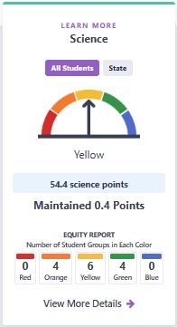
Measuring and
Understanding
Science Performance
Science Points:
  Zero to 100 points
Status/Change and Performance Colors

Slide 7
Addition of
Advanced Placement Courses
Advanced Placement Courses now included in the College/Career Indicator!
  Expands existing Advanced Placement measure which was previously limited to Advanced Placement Exams to now include completion of Advanced Placement Courses
  Also expands the use of Advanced Placement Courses in the University of California/California State University requirements measure

Slide 8
Graduation Rate

Slide 9
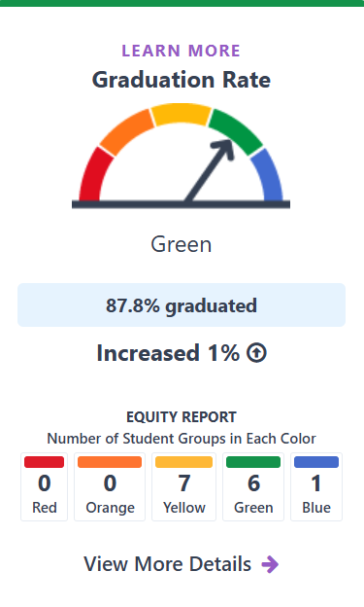
Graduation Rate Indicator
High School
  Measures the percent of students graduating within four or five years

Slide 10
Graduation Rate
Student Group Performance
Red | Orange | Yellow | Green | Blue
N/A | N/A | American Indian, Two or More Races, White, English Learner, Foster Youth, Homeless, Students with Disabilities | African American, Asian, Hispanic, Pacific Islander, Socioeconomically Disadvantaged, Long-Term English Learner | Filipino

Slide 11
Graduation Rate
School and District Performance
This table provides an overview of the number of schools and districts who received a performance color for this indicator and the number for each of the performance categories.
Type | Total | Red | Orange | Yellow | Green | Blue
Schools | 1,934 | 218 (11.3%) | 183 (9.5%) | 260 (13.4%) | 487 (25.2%) | 786 (40.6%)
Districts | 406 | 18 (4.4%) | 20 (4.9%) | 40 (9.9%) | 180 (44.3%) | 148 (36.5%)

Slide 12
College/Career Indicator

Slide 13
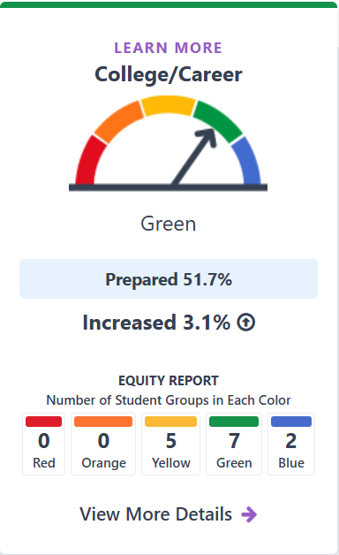
College/Career Indicator Overview
High School
  Measures the percent of students who were prepared for college/career by their school/district

Slide 14
CCI
Student Group Performance
Red | Orange | Yellow | Green | Blue
N/A | N/A | English Learner, Foster Youth, Homeless, Students with Disabilities, Long-Term English Learner | African American, American Indian, Hispanic, Pacific Islander, Two or More Races, White, Socioeconomically Disadvantaged | Asian, Filipino

Slide 15
CCI School and District Performance
This table provides an overview of the number of schools and districts who received a performance color for this indicator and the number for each of the performance categories.
Type | Total | Red | Orange | Yellow | Green | Blue
Schools | 1,916 | 298 (15.6%) | 304 (15.9%) | 310 (16.2%) | 600 (31.3%) | 404 (21.1%)
Districts | 405 | 18 (4.4%) | 38 (9.4%) | 71 (17.5%) | 216 (53.3%) | 62 (15.3%)

Slide 16
Chronic Absenteeism

Slide 17
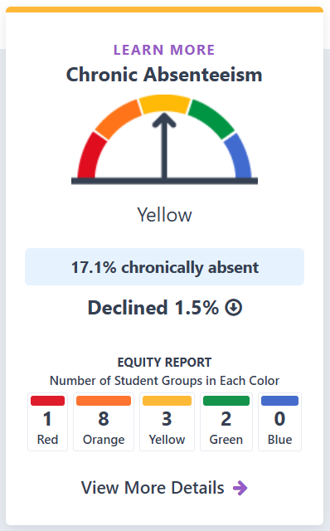
Chronic Absenteeism Indicator
Grades TK-8
  Measures the percent of students who were absent for 10 percent or more of the days they were expected to attend

Slide 18
Chronic Absenteeism
Student Group Performance
Red | Orange | Yellow | Green | Blue
Foster Youth | African American, American Indian, Hispanic, Pacific Islander, Homeless, Socioeconomically Disadvantaged, Students w/ Disabilities, Long-Term English Learner | Two or More Races, White, English Learner | Asian, Filipino | N/A

Slide 19
Chronic Absenteeism School and District Performance
This table provides an overview of the number of schools and districts who received a performance color for this indicator and the number for each of the performance categories.
Type | Total | Red | Orange | Yellow | Green | Blue
Schools | 7,718 | 1,545 (20%) | 1,994 (25.8%) | 2,834 (36.7%) | 1,076 (13.9%) | 269 (3.5%)
Districts | 842 | 108 (12.8%) | 244 (29.0%) | 338 (40.1%) | 131 (15.6%) | 21 (2.5%)

Slide 20
Suspension Rate

Slide 21
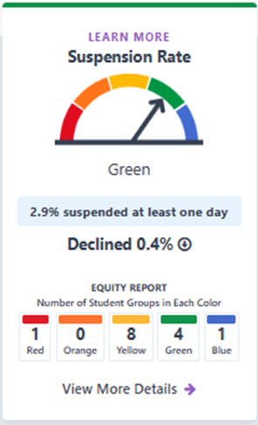
Suspension Rate Indicator
Grades TK-12
  Measures the percentage of students who were suspended for at least one full day at any time during the school year.

Slide 22
Suspension Student Group Performance
Red | Orange | Yellow | Green | Blue
Foster Youth | N/A | African American, American Indian, Pacific Islander, Two or More Races, English Learner, Homeless, Students with Disabilities, Long-Term English Learner | Filipino, Hispanic, White, Socioeconomically Disadvantaged | Asian

Slide 23
Suspension School and District Performance
This table provides an overview of the number of schools and districts who received a performance color for this indicator and the number for each of the performance categories.
Type | Total | Red | Orange | Yellow | Green | Blue
Schools | 9,648 | 562 (5.8%) | 2,029 (21%) | 1,469 (15.2%) | 2,573 (26.7%) | 3,015 (31.3%)
Districts | 943 | 80 (8.5%) | 181 (19.2%) | 206 (21.8%) | 340 (36.1%) | 136 (14.4%)

Slide 24
English Learner Progress Indicator

Slide 25
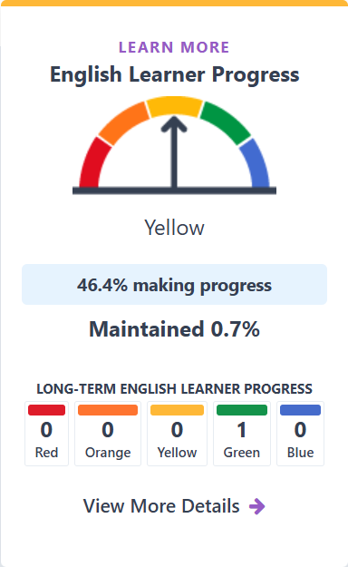
English Learner Progress Indicator Overview
Grades 1-12
  Measures the progress EL students are making towards English language proficiency at their schools and districts

Slide 26
ELPI School and District Performance
This table provides an overview of the number of schools and districts who received a performance color for this indicator and the number for each of the performance categories.
Type | Total | Red | Orange | Yellow | Green | Blue
Schools | 6,394 | 1,291 (20.2%) | 1,611 (25.2%) | 987 (15.4%) | 1,586 (24.8%) | 919 (14.4%)
Districts | 668 | 60 (9.0%) | 236 (35.3%) | 153 (22.9%) | 173 (25.9%) | 46 (6.9%)

Slide 27
Academic Indicators

Slide 28
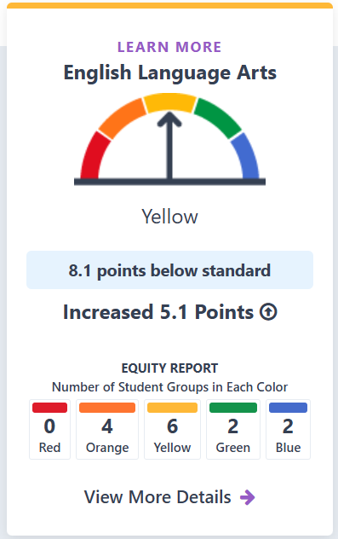
Academic Indicator:
English Language Arts
Grades 3-8 and 11
  Measures how well students are performing on assessments in English Language Arts

Slide 29
Academic ELA
Student Group Performance
Red | Orange | Yellow | Green | Blue
N/A | Foster Youth, Homeless, Students with Disabilities, Long-Term English Learner | African American, American Indian, Hispanic, Pacific Islander, English Learner, Socioeconomically Disadvantaged | Two or More Races, White | Asian, Filipino

Slide 30
Academic ELA School and District Performance
This table provides an overview of the number of schools and districts who received a performance color for this indicator and the number for each of the performance categories.
Type | Total | Red | Orange | Yellow | Green | Blue
Schools | 8,903 | 629 (7.1%) | 2,176 (24.4%) | 2,793 (31.4%) | 2,076 (23.3%) | 1,229 (13.8%)
Districts | 883 | 33 (3.7%) | 196 (22.2%) | 327 (37.0%) | 224 (25.4%) | 103 (11.7%)

Slide 31
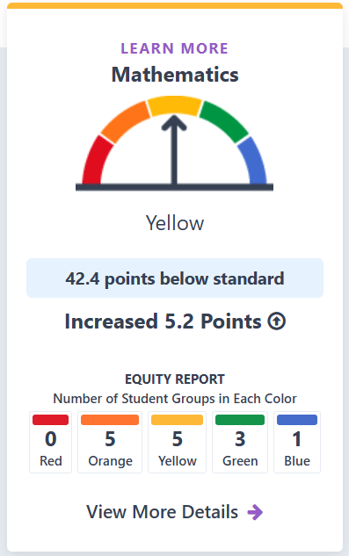
Academic Indicator: Mathematics
Grades 3-8 and 11
  Measures how well students are performing on assessments in Mathematics

Slide 32
Academic Mathematics
Student Group Performance
Red | Orange | Yellow | Green | Blue
N/A | African American, Foster Youth, Homeless, Students with Disabilities, Long-Term English Learner | American Indian, Hispanic, Pacific Islander, English Learner, Socioeconomically Disadvantaged | Filipino, Two or More Races, White | Asian

Slide 33
Academic Mathematics
School and District Performance
This table provides an overview of the number of schools and districts who received a performance color for this indicator and the number for each of the performance categories.
Type | Total | Red | Orange | Yellow | Green | Blue
Schools | 8,909 | 759 (8.5%) | 2,578 (28.9%) | 2,796 (31.4%) | 1,871 (21.0%) | 905 (10.2%)
Districts | 883 | 61 (6.9%) | 273 (30.9%) | 321 (36.4%) | 152 (17.2%) | 76 (8.6%)

Slide 34
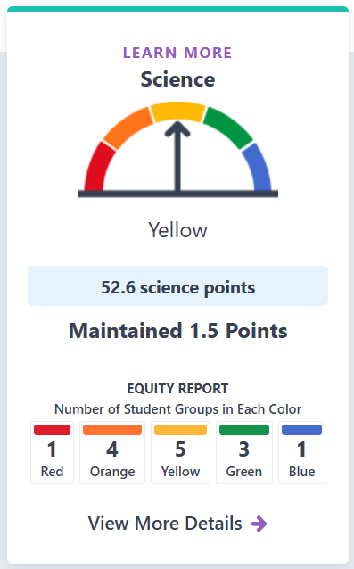
Science Indicator
5th Grade, 8th Grade, High School
  Measures how well students are performing in Science
  Reported with a color for the first time for informational purposes

Slide 35
Science
Student Group Performance
Red | Orange | Yellow | Green | Blue
Long-Term English Learner | African American, Foster Youth, Homeless, Students with Disabilities | American Indian, Hispanic, Pacific Islander, English Learner, Socioeconomically Disadvantaged | Filipino, Two or More Races, White | Asian

Slide 36
Science School and District Performance
This table provides an overview of the number of schools and districts who received a performance color for this indicator and the number for each of the performance categories.
Type | Total | Red | Orange | Yellow | Green | Blue
Schools | 8,247 | 238 (2.9%) | 1,436 (17.4%) | 2,207 (26.8%) | 3,015 (36.6%) | 1,351 (16.4%)
Districts | 799 | 14 (1.8%) | 106 (13.3%) | 267 (33.4%) | 317 (39.7%) | 95 (11.9%)

Slide 37
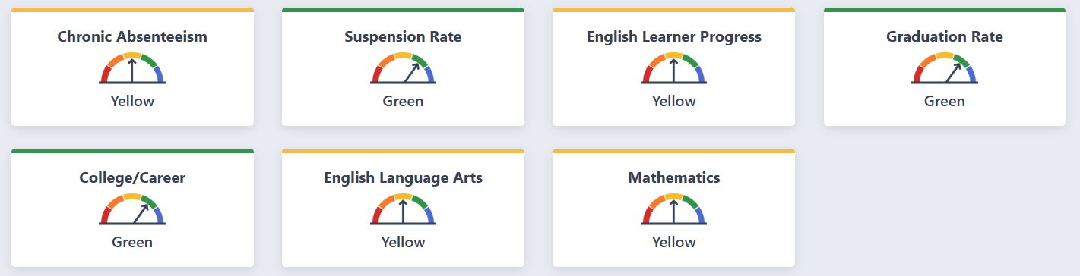
2025 Dashboard State Summary

Slide 38
What is the Dashboard Toolkit?
Informational materials that help explain the data reported on the California School Dashboard
Dashboard Communications Toolkit webpage https://www.cde.ca.gov/ta/ac/cm/dashboardtoolkit.asp

Slide 39
Local Control Funding Formula Eligibility Determinations

Slide 40
Levels of Support
Level of Support | Description of Support
Level 1- Universal Support for All | Resources and assistance that is made available to all local educational agencies
Level 2 – Targeted Support / Supplemental (Differentiated Assistance) | Local educational agencies that meet certain eligibility criteria for additional support
Level 3 – Intensive Intervention (Direct Technical Assistance) | The California Collaborative on Education Excellence (CCEE) provides more intensive support for eligible LEAs
State Level Intervention | The SSPI may, with the approval of the State Board of Education, intervene where the CCEE determines that the LEA meets specified criteria

Slide 41
Differentiated Assistance Criteria
Districts and county offices of education (COEs) are eligible for differentiated assistance based on the following entry criteria:
    Student group performance in two or more LCFF state priority areas, or
    Performance on local indicators in two or more priority areas, or
    A combination of student group performance in one state priority area and local indicator performance in one different priority area.
The eligibility criteria for charters is identical to districts/COEs eligibility criteria, except for charter schools are required to meet the criteria in two or more years.

Slide 42
Differentiated Assistance Eligibility Criteria for Priority Areas 1 to 3
Priority Area | Criteria
1 – Basics | Not Met for Two or More Years on Local Performance
2 – Implementation of State Academic Standards | Not Met for Two or More Years on Local Performance
3 – Parent and Family Engagement | Not Met for Two or More Years on Local Performance

Slide 43
Eligibility Criteria for Priority Areas 4 and 5
Priority Area | Criteria
4 – Pupil Achievement | For all student groups except the LTEL student group: Red on both English language arts/literacy (ELA) and Mathematics Indicators, or Red on English language arts or math test and Orange on the other test Red on English Learner Progress Indicator (ELPI) (English Learner Only) For the LTEL student group only: Red or Orange on the ELPI
5 – Pupil Engagement | Red on Graduation Rate Indicator, or Red on Chronic Absence Indicator

Slide 44
Eligibility Criteria for Priority Areas 6 to 10
Priority Area | Criteria
6 – School Climate | Red on Suspension Rate Indicator, or Not Met for Two or More Years on Local Performance
7 – Access to a Broad Course of Study | Not Met for Two or More Years on Local Performance
8 – Outcomes in a Broad Course of Study | Red on College/Career Indicator (CCI)
9 – Coordination of Services for Expelled Pupils – COEs ONLY | Not Met for Two or More Years on Local Performance
10 – Coordination of Services for Foster Youth – COEs Only | Not Met for Two or More Years on Local Performance

Slide 45
Multi-Year County Office of Education/District
Differentiated Assistance Eligibility
Category | 2019 | 2022 | 2023 | 2024 | 2025
Districts/COEs | 333 | 617 | 466 | 436 | 418

Slide 46
2025 County Office of Education/District
Differentiated Assistance Eligibility
Category | 2025
COEs/Districts no longer eligible | 164
Newly eligible COEs/Districts | 69

Slide 47
County Offices of Educations/Districts
Differentiated Assistance Key Points
In 2025, 164 or 37 percent of the COEs/Districts eligible for differentiated assistance in 2024 made significant improvements and are no longer eligible for differentiated assistance.
In 2025, 418 districts and COEs are eligible for differentiated assistance under LCFF.
The three student groups in greatest need of support are:
  Students with Disabilities
  Long-Term English Learners
  Homeless

Slide 48
Multi-Year Charter School
Differentiated Assistance Eligibility
Category | 2023 | 2024 | 2025
Charter Schools | 203 | 173 | 135

Slide 49
2025 Charter School
Differentiated Assistance Eligibility
Category | 2025
Charter Schools no longer eligible | 94
Newly eligible Charter Schools | 67

Slide 50
Charter School
Differentiated Assistance Key Points
In 2025, 94 or 54 percent of the charter schools eligible for differentiated assistance in 2024 made significant improvements and are no longer eligible for differentiated assistance.
In 2025, 135 or 11 percent of charter schools are eligible to receive differentiated assistance.
The three student groups in greatest need of support are:
  Students with Disabilities
  Socioeconomically Disadvantaged
  English Learners

Slide 51
Geographic Lead Agency Assistance Criteria
Districts are eligible for Geographic Lead Agency differentiated assistance if one or more student groups meet the differentiated assistance criteria in three or more consecutive years.
The same student group must meet the eligibility criteria in three or more consecutive years for the student group to be eligible for Geographic Lead Agency differentiated assistance.
Please note that the LTEL student group will not meet the inclusion rules for this requirement until 2026.
Additional information, including examples, are available in the LCFF Technical Guide

Slide 52
Geographic Lead Agency Eligibility
Category | 2025
Districts | 78

Slide 53
Direct Technical Assistance Criteria
For districts/COEs with three or more student groups meeting the criteria for DA, at least three of the same student groups would have to meet the criteria for DA in three out of four years to be eligible for DTA.
For districts/COEs with two or fewer student groups within the LEA, all student groups would have to meet the DA criteria in at least three out of four years to be eligible for DTA.
A charter school is eligible for DTA when three or more student groups meet the differentiated assistance criteria in 2023, 2024, and 2025.
For charter schools with two or fewer student groups, all student groups need to meet the differentiated assistance criteria in 2023, 2024, and 2025.

Slide 54
Direct Technical Assistance Eligibility
Category | 2024 | 2025
COEs/Districts | 67 | 64
Charter Schools | 11 | 39

Slide 55
Additional Accountability Releases
December 2025
  Growth Data on the Dashboard
  Federal Support Determinations
  Dashboard Alternative School Status One-year Graduation Rate

Slide 56
2026 LCFF Assistance Determinations
Assembly Bill 121 (Chapter 8, Statutes of 2025) requires the State Board of Education (SBE) to update differentiated assistance criteria:
  No later than July 15, 2026, the state board shall update the performance criteria, taking into consideration the findings and recommendations from the state-funded evaluation of the state’s differentiated assistance system and its implementation, and the need to appropriately focus resources and supports where the demonstrated needs are greatest.
The SBE will continue to consider options for updates to the differentiated assistance criteria in 2026.

Slide 57
2026 Accountability Workplan

Slide 58
2026 California School Dashboard
The California Department of Education (CDE) is committed to continuous improvement within the accountability system and Dashboard.
CDE's annual workplan reviews the state and local indicators and performance standards and addresses suggested revisions or updates in the workplan each January and approves all action by the July meeting of that year.
Following the July 2025 SBE meeting, the CDE provided the SBE an information memorandum in August 2025 with an update on action taken at the meeting and overview of the items pending for the 2026 Accountability Workplan.

Slide 59
2026 Workplan Items
Student-Level Growth Model for Grades 4 through 8 in English Language Arts and Mathematics as full indicators
Science Indicator
College/Career Indicator
Application Based Dashboard Alternative School Status
Priority 1 Teacher Assignment Data
Long-Term English Learner Student Group
Participation Rate for Academic Indicators and Science
Modification of Academic Indicator language
Release Plan for the 2026 Dashboard
Every Student Succeeds Act State Plan

Slide 60
California School Dashboard Principles
The SBE adopted eleven Dashboard Principles in 2022 which are detailed on the California School Dashboard Principles web page
The Dashboard Principles serve as an anchor for future Dashboard decisions and to assist with guiding the SBE’s work moving forward
Each accountability workplan items describes the associated Dashboard Principle(s) it advances to ensure alignment with this framework

Slide 61
English Language Arts and Mathematics Growth

Slide 62
2026 Workplan: Student-Level Growth Data for Grades 4 through 8 in English Language Arts (ELA) and Mathematics (Math)
ELA and Math Growth as State Indicators
  Consider full state indicator status for ELA and Math Growth, starting with the 2026 Dashboard.
    Full state indicator status adds the Indicator to state and/or federal support determination criteria.

Slide 63
Student Level Growth Workplan and Dashboard Principles
This work aligns with the following Dashboard Principles:
  Principle 2: Reports opportunity and performance gaps among student groups through the Equity Report that is available for each state indicator.
  Principle 4: Values each indicator equally.
  Principle 5: Values high performance and growth equally.
  Principle 8: Reflects technical quality through measures that are valid and reliable.
  Principle 11: Is subject to continuous revision and improvement.

Slide 64
Timeline of Student Level Growth Data:
2016-2021
2016–2018
  California Department of Education (CDE), State Board of Education (SBE) and Educational Testing Service (ETS) work on the development of a student-level growth measurement based on new CAASPP assessments
July 2018
  California pauses adoption of a growth measurement due to instability.
May 2021
  ETS proposes a solution for the instability issues with the addition of a third year of test scores. The SBE adopts this growth measurement, and CDE announces that growth data will be available following the administration of the 2023–24 CAASPP.

Slide 65
Timeline of Student Level Growth Data:
January 2025
January 2025
  The 2024 Dashboard was updated growth score data for schools, districts and student group levels for the purpose of assisting the SBE in setting performance standards for growth.
  The release was supported with the following resources
    Growth Webpage: Explanation and resources for the student-level growth model.
    Growth FAQs: Frequently asked questions and answers for student growth.

Slide 66
Timeline of Student Level Growth Data:
May-December 2025
May 2025
  The SBE approved growth performance categories (levels and cut scores).
December 2025
  The CDE will release ELA and mathematics growth performance levels using three years of assessment data from 2022–23, 2023–24 and 2024–25 on the Dashboard and in a downloadable file.

Slide 67
2026 Workplan for Growth
January 2026 SBE Meeting
  SBE approves Accountability Workplan
March 2026 CPAG Meeting
May 2026 SBE Meeting
  SBE will consider full state indicator status for ELA Growth and Math Growth
July 2026 SBE Meeting
  SBE will incorporate any decisions into revised criteria for state assistance determinations

Slide 68
Science Indicator
Workplan

Slide 69
2026 Workplan: Science Indicator
Science as Full State Indicator:
  Consider full state indicator status for the Science Indicator, beginning with the 2026 Dashboard.
    Full state indicator status adds the Indicator to state and/or federal support determination criteria.

Slide 70
Science Workplan and Dashboard Principles
Principle 5: Values high performance and growth equally.
Principle 8: Reflects technical quality through measures that are valid and reliable.
Principle 11: Is subject to continuous revision and improvement.

Slide 71
Background on Science (1 of 4)
2018
  First operational California Science Test was administered to students in grades five, eight, and once in high school.
2020
  At the March SBE meeting, CDE discussed the timeline for potential incorporation of the Science test results into the Dashboard.

Slide 72
Background on Science (2 of 4)
March 2022 SBE Meeting
  CDE provided an update on the feasibility of when the science results could be incorporated into the Dashboard considering the revised blueprints.
September 2022 SBE Meeting
  SBE approved the insertion of a link on the Dashboard Additional Reports to the California Science Test results on the CAASPP website.

Slide 73
Background on Science (3 of 4)
December 2022 and 2023
  2022 Dashboard Additional Reports links to the California Science Test (CAST) results on the CAASPP website.
July 2024 SBE Meeting
  SBE approves a metric to measure Science on the Dashboard, inclusion of a participation rate, and a high school methodology
November 2024
  Science Indicator published on the 2024 Dashboard with status and change for informational purposes only

Slide 74
Background on Science (4 of 4)
May 2025 SBE Meeting
  SBE approved the following pieces of the Science Indicator:
    Status Cut Points
    Change Cut Points
    Balanced Color Scheme for the Five-by-Five Color Grid

Slide 75
2026 Science Assessment Workplan:
State Eligibility
January 2026
  SBE Workplan Approval
March CPAG Meeting
May 2026 SBE Meeting
  SBE will consider full state indicator status for Science
July 2026 SBE Meeting
  SBE will incorporate any decisions into revised criteria for state assistance determinations

Slide 76
College/Career Indicator Workplan

Slide 77
2026 Workplan:
College/Career Indicator (CCI) Part 1
Study Session: The SBE will hold a Study Session to provide a wholistic review of the CCI, including goals for the indicator, current measures, and future path for adding new measures to the indicator.
International Baccalaureate (IB) Courses: Provide an analysis of the IB program to identify possible courses for inclusion on the CCI.
Cambridge International: Consider options for adding Cambridge International courses and exams as a measure of the CCI.
State Seal of Civic Engagement: Consider options for adding the State Seal of Civic Engagement to the CCI for the 2026 Dashboard.

Slide 78
2026 Workplan:
CCI Part 2
New Career Measures: Evaluate new career measures for potential inclusion in the CCI including:
  Internships
  Student-Led Enterprises
  Simulated Work-Based Learning
  Armed Services Vocational Aptitude Battery (ASVAB)
In addition, the SBE indicated it would like to examine how other career measures, such as apprenticeships, may be addressed within the CCI, and how to include students with extensive support needs.

Slide 79
College/Career Workplan and Dashboard Principles
The work on this state indicator aligns with the following Dashboard Principles:
  Principle 2: Reports opportunity and performance gaps among student groups through the Equity Report that is available for each state indicator.
  Principle 3: Reports each indicator separately.
  Principle 4: Values each indicator equally.
  Principle 8: Reflects technical quality through measures that are valid and reliable.
  Principle 11: Is subject to continuous revision and improvement.

Slide 80

What is the College/Career Indicator?
Measures how well districts and schools are preparing its graduates for college/career.

Slide 81
Development of the CCI
The CCI was developed to provide a more complete picture of how well schools ensure students experience a broad and rigorous course of study that prepares them for college and career success (Priority 8).
It was originally adopted by the State Board of Education (SBE) in July 2016 and performance levels (colors) were reported for the first time on the 2018 Dashboard.
It is based on students in each four-year graduation cohort and uses specific criteria that are reliant on assessments and course completion data to determine if students have been “Prepared” for college/career by their schools/districts or remain “Approaching Prepared,” or “Not Prepared”.

Slide 82
2026 Workplan: CCI Study Session
The SBE will hold a Study Session to provide a wholistic review of the CCI, including goals for the indicator, current measures, and future path for adding new measures to the indicator.
  Scheduled for the January 2026 SBE Meeting

Slide 83
2026 Workplan: Additional Course Inclusion
The SBE added successful completion of Advanced Placement (AP) courses to the CCI
In 2026, the SBE requests CDE to evaluate the following courses for inclusion in the CCI as well:
  International Baccalaureate (IB)
  Cambridge International (Cambridge)

Slide 84
2026 Workplan: State Seal of Civic Engagement
CDE created an ad-hoc data collection to the 2023–24 End-of-Year (EOY) process for LEAs to submit student-level information for those who have earned the State Seal of Civic Engagement.
CDE will consider options for adding the State Seal of Civic Engagement to the CCI.
The CPAG will engage in a mini-study session on this topic today.

Slide 85
2026 Workplan: Additional Career Measures
Continue evaluating career measures for potential inclusion with an additional year of data
  Internships
  Student Led Enterprises
  Simulated Work-Based Learning
  Armed Services Vocational Aptitude Battery (ASVAB)

Slide 86
2026 CCI Workplan
January 2026
  SBE Workplan Approval
  SBE Study Session on CCI
March 2026 SBE Meeting
  SBE will consider inclusion of State Seal of Civic Engagement and Additional Career Measures in CCI
March CPAG Meeting
May 2026 SBE Meeting
  SBE will consider inclusion of Additional Courses in CCI

Slide 87
Application-Based
Dashboard Alternative School Status (DASS)

Slide 88
2026 Workplan: DASS Application/ Renewal Criteria
Credit Deficient Students:
  Evaluate the Application-Based DASS criteria as they address credit-deficient students.

Slide 89
DASS Application/Renewal Criteria Workplan and Dashboard Principles
The work on this state indicator aligns with the following Dashboard Principles:
Principle 4: Values each indicator equally.
Principle 8: Reflects technical quality through measures that are valid and reliable.
Principle 11: Is subject to continuous revision and improvement.

Slide 90
Dashboard Alternative School Status
California Education Code (EC) Section 52052(g) requires the Superintendent of Public Instruction, with approval of the SBE, to develop an alternative accountability system for schools that serve a large percentage of high-risk students.
DASS:
  The EC identifies specific types of schools as alternative (e.g., juvenile court, county community day, etc.) that would automatically be eligible to participate in alternative school accountability.
Application-Based DASS
  CDE manages an application-based system for charter schools and alternative schools of choice for the same system

Slide 91
Application-Based DASS: Alternative Schools Not Included in Education Code
In 2003, the SBE adopted the first definition of alternative schools eligible for inclusion in the alternative school system.
This definition includes alternative schools of choice and charter schools in which 70 percent of the school’s total enrollment is composed of the following high-risk groups:
  Expelled
  Suspended
  Wards of the court
  Pregnant and/or parenting
  Recovered dropouts
  Habitually truant or habitually insubordinate and disorderly
  Retained more than once in kindergarten through grade eight

Slide 92
Criteria Updates in 2017 to Application-Based DASS
In July 2017, the SBE adopted the following additional criteria for Application-Based DASS schools:
  Define recovered dropouts based on EC Section 52052.3(b) as students who: (1) are designated as dropouts pursuant to the exit and withdraw codes in the California Longitudinal Pupil Achievement Data System (CALPADS), or (2) left school and were not enrolled in a school for a period of 180 days.
  Students who are credit deficient (i.e., one semester or more behind in the credits required to graduate on-time)
  Students with a gap in enrollment
  Students with high level transiency
  Foster Youth
  Homeless Youth

Slide 93
Criteria Update in 2025
At the July 2025 meeting, the SBE:
  Removed wards of the court from the Application-Based DASS criteria.

Slide 94
2026 DASS Workplan
January 2026
  SBE Workplan Approval
March 2026 SBE Meeting
  SBE will consider DASS application criteria around credit deficient students

Slide 95
Priority 1 Teacher Assignment Data

Slide 96
2026 Workplan: Priority 1 Teacher Assignment Data
Align Teacher Assignment Data Terminology:
  Ensure clarity of teacher assignment data terminology on the Dashboard, the School Accountability Report Card (SARC), and the Teaching Assignment Monitoring Outcomes report to ensure data terms are aligned and accessible to the public.
Obtain Additional Interest Holder Feedback, including on Intra-District Comparisons:
  The SBE will seek additional feedback and guidance related to Priority 1 Teacher Assignment Data on the Dashboard, including considerations for intra-district comparison data. This effort should reflect the intent of the SBE and the CDE to engage with external agencies and partners in shaping future enhancements and ensuring meaningful, collaborative input.

Slide 97
Priority 1–Teacher Data Workplan and Dashboard Principles
This work aligns with the following Dashboard Principles:
  Principle 8: Reflects technical quality through measures that are valid and reliable.
  Principal 9: Leverages the expertise and perspectives of a broad set of educational partners and community members.
  Principle 10: Promotes coherence between data reporting and support/improvement programs.
  Principal 11: Is subject to continuous revision and improvement.

Slide 98

Priority 1—Teacher Data Background (1 of 2)
2023:
The SBE approved the display of 2021–22 Teacher Assignment Monitoring Outcomes (TAMO) data and a self-reflection tool on the Dashboard as a part of Priority 1

Slide 99
Priority 1—Teacher Data Background (2 of 2)
2025:
At the July 2025 meeting, the SBE approved modifications to Priority 1 to adopt a new Dashboard card on each school and LEA Dashboard landing page, titled "Teacher Assignments," to display TAMO data more prominently on the Dashboard.

Slide 100
2026 Priority 1 Workplan
January 2026
  SBE Workplan Approval
March 2026 SBE Meeting
  SBE will seek feedback on, and consider modifications to, Priority 1 Teacher Assignment Data on the Dashboard, including terminology and options for intra-district comparison data.
March CPAG Meeting
May 2026 SBE Meeting
  SBE will consider adopting modifications to Priority 1 Teacher Assignment Data, including terminology and intra-district comparison data.

Slide 101
Long Term English Learner (LTEL) Student Group

Slide 102
2026 Workplan: LTEL Student Group
Include Recently Reclassified Students (RFEP) in the ELPI:
  Augment the ELPI calculation to include students who have recently reclassified to fluent English proficient status.
Suspension Indicator:
  Consider whether modifications for LTEL students in the Suspension Rate Indicator are warranted.

Slide 103
LTEL Student Group Workplan and Dashboard Principles
Principle 5: Values high performance and growth equally.
Principle 8: Reflects technical quality through measures that are valid and reliable.
Principle 11: Is subject to continuous revision and improvement.

Slide 104
LTEL Student Group Definition
The 2024 Dashboard is the first time LTELs were reported on the Dashboard
The definition is the following:
  “Long-term English learners, defined as a pupil who has not attained English language proficiency within seven years of initial classification as an English learner.” [Education Code Section 52052 (a)(2)(C)]

Slide 105
LTEL Student Group on the Dashboard
2024 Dashboard
    Suspension Rate Indicator
    Graduation Rate Indicator
    College/Career Indicator
    Chronic Absenteeism Indicator
    Academic Indicators
    English Learner Progress Indicator
2025 Dashboard (in addition to the 2024 metrics):
    Science Indicator
    Growth Model

Slide 106
Evaluating LTEL Performance Metrics on the Dashboard
The CDE will evaluate the following in 2026:
  Inclusion of Recently Reclassified Students (RFEP) in the English Learn Progress Indicator (ELPI)
  The LTEL student group in the Suspension Indicator

Slide 107
Inclusion of Recently Reclassified Students in the English Learner Progress Indicator
The CDE will explore augmenting the ELPI calculation to include students who have recently reclassified to fluent English proficient status.

Slide 108
2026 LTEL Workplan
January 2026
  SBE Workplan Approval
March 2026 SBE Meeting
  SBE will consider the proposed changes to the Suspension 5x5s for LTELs
March 2026 CPAG Meeting
  Explore data around adding reclassification as an additional level to the ELPI for LTELs
May 2026 SBE Meeting
  SBE will consider adding reclassified students as an additional level to the ELPI for LTELs

Slide 109
Participation Rate for Academic Indicators and Science

Slide 110
2026 Workplan: Participation Rate for Academic Indicators and Science
Participation Rate Grace Periods:
  Explore removal of the participation rate grace periods for the Academic Indicators and the Science Indicator.

Slide 111
Academic and Science Indicators Dashboard Principles
The work on this state indicator aligns with the following Dashboard Principles:
  Principle 4: Values each indicator equally.
  Principle 8: Reflects technical quality through measures that are valid and reliable.
  Principle 11: Is subject to continuous revision and improvement.

Slide 112
Participation Rate Rules
The Dashboard incorporates a participation rate penalty into the status for all schools/districts/student groups that fall below 95 percent
  Business rules were established in 2018 to include a grace period at the start and end of the assessment windows for participation
In response to feedback from the field, the CDE will evaluate the reliability and validity of the grace periods using recent assessment and Dashboard information and provide an update to the SBE.

Slide 113
2026 Participation Rate Grace Periods Workplan
January 2026
  SBE Workplan Approval
March 2026 SBE Meeting
  SBE will consider the proposed changes the participation rate grace periods

Slide 114
Modification of Academic Indicator language

Slide 115
Addition to Workplan: Modification of Academic Indicator Language
Modify language around Academic Indicators to address concerns with the continued use of the word "Standard"

Slide 116
Requested Language Updates for the
2025 Dashboard
The CDE updated the following 2025 Dashboard items and related resources per a request from the SBE:
  Updated "meeting grade-level standards" on Dashboard cards, Dashboard descriptive text, and flyers to:
    "meeting proficiency standards"
  Updated "standard met" on Dashboard website graphs and flyers to:
    "Level 3/proficient"
  Updated "standard" on Dashboard flyers to:
    "Level 3/proficient"

Slide 117
2026 Academic Indicator Language Workplan
January 2026
  SBE Workplan Approval
March 2026 CPAG Meeting
  Explore requests to make additional modifications to the Academic Indicator Language
May 2026 SBE Meeting
  SBE will consider additional modifications to the Academic Indicator Language

Slide 118
Mini-Study Sessions: Considerations for Adding the
State Seal of Civic Engagement to the College/Career Indicator

Slide 119
The
State Seal of
Civic Engagement
December 12, 2025
CALIFORNIA DEPARTMENT OF EDUCATION
Tony Thurmond, State Superintendent of Public Instruction

Slide 120
Introductions
Sarah Smith, Education Programs Consultant
Julia Agostinelli, Education Administrator
Monique McWayne, Division Director
Professional Learning Innovations Office (PLIO)
Professional Learning Support Division (PLSD)

Slide 121
Overview and Background
California Education Code (EC) sections 51470–51474 direct the State Superintendent of Public Instruction to develop, and the State Board of Education (SBE) to adopt, a set of criteria for awarding the State Seal of Civic Engagement (SSCE).
The SBE adopted statewide criteria in September 2020.
Since 2020–21, the California Department of Education collects the total number of insignia requests, participating local educational agencies (LEAs), and insignia distribution.
Individual student data collection for SSCE was planned for the 2021–22 school year but was suspended until 2023–24 to allow CALPADS to undergo a re-architecture of its infrastructure.

Slide 122
Statewide Criteria (1)
LEAs are provided a framework, five criteria, and implementation guidance to help them make determinations of the student qualifications required to earn the SSCE, based on their own local contexts. All students must:
Be engaged in academic work in a productive way.
Demonstrate a competent understanding of United States and California constitutions; functions and governance of local governments; tribal government structures and organizations; the role of the citizen in a constitutional democracy; and democratic principles, concepts, and processes.

Slide 123
Statewide Criteria (2)
The student must:
Participate in one or more informed civic engagement project(s) that address real-world problems and require students to identify and inquire into civic needs or problems, consider varied responses, take action, and reflect on efforts.

Slide 124
Statewide Criteria (3)
The student must:
Demonstrate civic knowledge, skills, and dispositions through self-reflection.
Exhibit character traits that reflect civic-mindedness and a commitment to positively impact the classroom, school, community and/or society.

Slide 125
Assembly Bill 422
Signed by Governor Newsom on October 13, 2025.
When the SBE next revises SSCE criteria, the Superintendent shall recommend revised criteria for awarding the SSCE, requiring, along with meeting all other eligibility criteria for the award, a demonstrated understanding of the importance of preserving democracy and its vital institutions, including, but not limited to, the free press, free access to libraries, compulsory education, and the federalist system.
The Superintendent shall limit recommendations to content that is not already included in the established criteria.

Slide 126
Eligibility
The SSCE is offered at the LEA level. This includes county offices of education (COEs), school districts, charter schools.
Individual school sites may not offer the SSCE without it also being available district- or county-wide.
Any grade ten, eleven, or twelve pupil enrolled in California public schools, the juvenile justice system, or in alternative school settings at a participating LEA is eligible to earn a SSCE.
Students must demonstrate attainment of all five statewide criteria, as well as any locally-adopted requirements, to be eligible for an SSCE.

Slide 127
Documents
Eligible documents include:
  High school diploma
  Alternate high school diploma (EC 51225.31);
  General Educational Development Certificates
  Certificates of Completion (EC Section 56390)
  Transcripts (grades ten, eleven or twelve)
Students receive only one insignia.

Slide 128
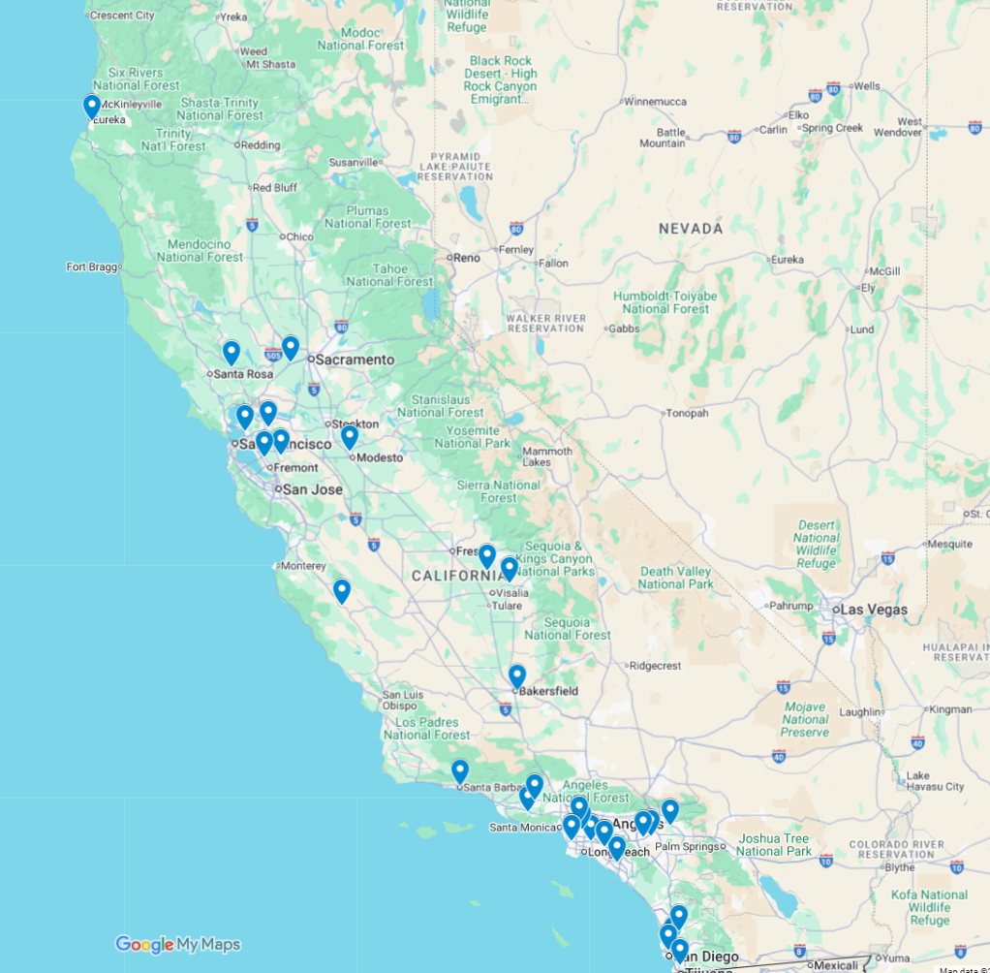
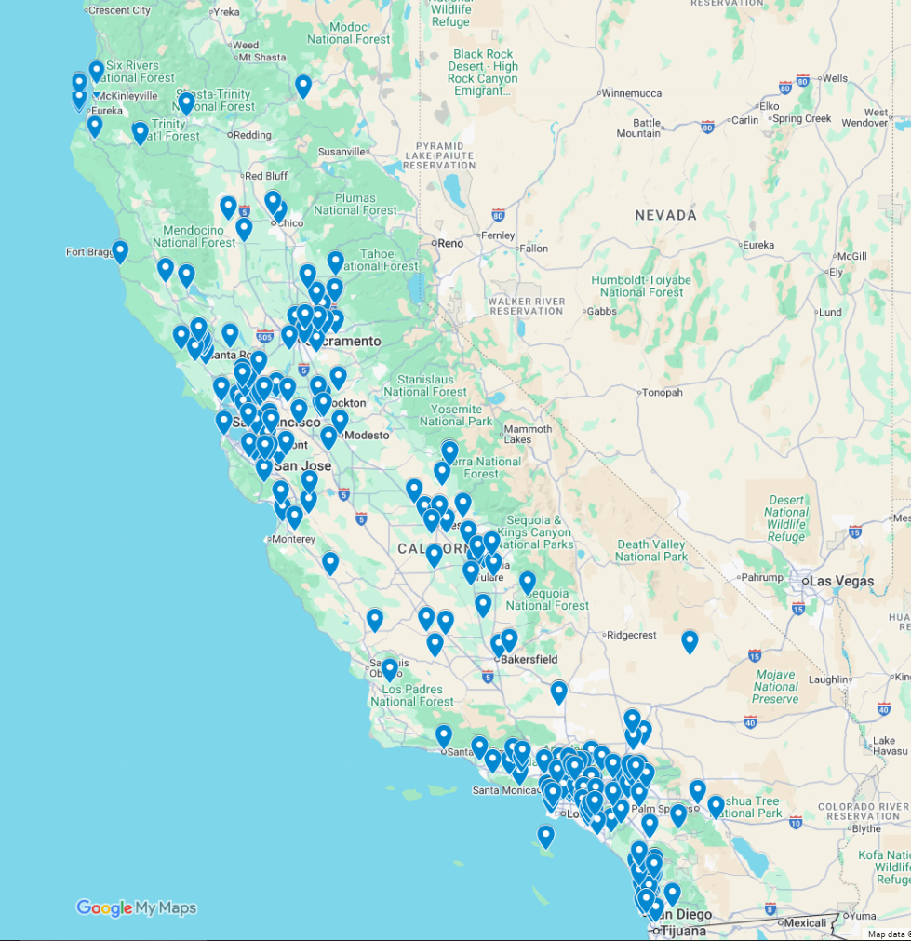
SSCE Participation Maps
2020–21
All LEAs

Slide 129
Statewide Insignia Request Data (1)
Participants | 2020–21 | 2021–22 | 2022–23 | 2023–24 | 2024–25
Counties | 16 | 26 | 29 | 32 | 33
Local Educational Agencies | 28 | 68 | 88 | 111 | 161
School Sites | 103 | 182 | 260 | 345 | 492
Total Insignias Requested | 4,821 | 10,122 | 12,566 | 15,648 | 23,040

Slide 130
Statewide Insignia Request Data (2)
Document | 2020–21 | 2021–22 | 2022–23 | 2023–24 | 2024–25
Diplomas | 4,286 | 8,372 | 9,883 | 15,072 | 21,313
Alternate Diplomas | N/A | N/A | N/A | N/A | 170
GEDs | 1 | 0 | 2 | 0 | 2
Certificates of Completion | 2 | 59 | 14 | 4 | 74
Grade Ten Transcripts | N/A | N/A | N/A | N/A | 0
Grade Eleven Transcripts | N/A | 61 | 136 | 335 | 448
Grade Twelve Transcripts | 532 | 1,630 | 2,531 | 237 | 1,033
Total | 4,821 | 10,122 | 12,566 | 15,648 | 23,040

Slide 131
Thank you!
California Department of Education
Professional Learning Support Division
SSCE@cde.ca.gov
CALIFORNIA DEPARTMENT OF EDUCATION
Tony Thurmond, State Superintendent of Public Instruction

Slide 132
State Seal of Civic Engagement in CCI

Slide 133
Adopted College Measures
Smarter Balanced Summative Assessments
Advanced Placement (AP) Exams and Courses
Met University of California/California State University Requirements
(a–g)
International Baccalaureate (IB) Exams
State Seal of Biliteracy
College Credit Courses

Slide 134
Adopted Career Measures
Pre-Apprenticeships
State and Federal Job Programs
Transition Classroom and Work-Based Learning Experiences
Career Technical Education (CTE) Pathway
Leadership/Military Science

Slide 135
Inaugural SSCE Student Level Data Collection
CDE created an ad-hoc data collection for the 2023–24 End-of-Year (EOY) process for LEAs to submit student-level information for those who have earned the SSCE.
By collecting this information at the student level, we can analyze the disaggregated data by student group and review whether schools/LEAs have already met “prepared” or “approaching prepared” status for those students from another CCI measure.
In 2023–24, 14,552 students earned a State Seal of Civic Engagement (this represents 2.9 percent of the 2023–24 cohort of 507,621 students)

Slide 136
Class of 2024 SSCE Earners by Race/Ethnicity
Race/Ethnicity | Number of Prepared Students | Number of Approaching Prepared Students | Number of Not Prepared Students | Total Students
American Indian | 24 | 7 | 2 | 33
Asian | 2,622 | 121 | 64 | 2,807
African American | 308 | 107 | 58 | 473
Filipino | 425 | 51 | 20 | 496
Hispanic | 4,402 | 1,291 | 891 | 6,584
Pacific Islander | 33 | 9 | 6 | 48
Two or More | 489 | 59 | 23 | 571
White | 2,920 | 371 | 202 | 3,493

Slide 137
Class of 2024 SSCE Earners by Program Participation
Program | Number of Prepared Students | Number of Approaching Prepared Students | Number of Not Prepared Students | Total Students
English Learner | 558 | 358 | 349 | 1,265
Foster | 17 | 16 | 21 | 54
Homeless | 326 | 139 | 140 | 605
LTEL | 335 | 284 | 257 | 876
Socioeconomically Disadvantaged | 6,029 | 1,619 | 1,088 | 8,736
Students with Disabilities | 40 | 325 | 326 | 691

Slide 138
Discussion Questions
Is the State Seal of Civic Engagement measure robust enough to adopt as a stand-alone measure for prepared on the CCI?
What other criteria would you suggest be combined to add this as a college measure to the CCI?
Is there anything else that you need to know about the State Seal of Civic Engagement to provide feedback on this proposed measure?

Slide 139
2026
Release Plan

Slide 140
Update to Dashboard Schedule
SB 114 (Chapter 48, Statutes of 2023) moves up the publication date of the 2026 Dashboard to October 15, 2026. Note: this aligns the requirement for releasing assessment results on October 15 pursuant to California Education Code Section 60641.
This is a full month ahead of any prior release.
  Prior Release Dates:
    2025: November 13
    2024: November 21
    2023: December 15

Slide 141
Planning for 2026
Accountability Release #1 (October 15 release requirements):
  California School Dashboard (caschooldashboard.org)
  LCFF Differentiated Assistance Files
Accountability Release #2 (supplementary items):
  Dashboard Additional Reports
  Growth data and data files
  DataQuest reports and accompanying downloadable files
  Federal support determinations
  School Accountability Report Card (SARC) files
  Dashboard Alternative School Status One-year Graduation Rate

Slide 142
Every Student Succeeds Act State Plan

Slide 143
ESSA State Plan Considerations
In 2026, the SBE may provide additional direction on whether to amend the ESSA State Plan to address items, as needed, to the U.S. Department of Education

Slide 144
Next Steps for the State Board of Education

Slide 145
January SBE Meeting
SBE will provide feedback and adopt the 2026 Accountability Workplan
The SBE will hold a Study Session to provide a wholistic review of the CCI, including goals for the indicator, current measures, and future path for adding new measures to the indicator.

Slide 146
SBE Additional Work in 2026
The SBE will be developing updates to DA to improve effectiveness and address the challenges surfaced in the November 2025 SBE meeting and DA study session
The SBE will solicit ongoing input and guidance, and it is anticipated that these changes will come to the SBE for action by July 2026

Slide 147
Public Comment

Slide 148
Public Comment Call-in Number
Phone number: 717-908-1926
Participant Access Code: 1166083#
Notes: Turn down the volume of your computer or live webcast to avoid background echoes.
When it is your turn, an operator will announce, “Please say your name and affiliation and begin public comment. Your time begins now.”

