Slide 1
California Practitioners Advisory Group Item 1: February 18, 2022

Slide 2
Today’s Topics
2021 Data Release
Reporting Status Only on the 2022 California School Dashboard (Dashboard)
Future Dashboards and Next Steps

Slide 3
2021 Data Release

Slide 4
2021 Federal Accountability Waiver
In April 2021, the CDE received a federal waiver from specific Every Student Succeeds Act accountability requirements for the 2020–21 school year which removed the requirement to publish state level indicators on the Dashboard.

Slide 5
2021 State Accountability Requirements
In July 2021, Assembly Bill (AB) 130 was signed into law which states that the CDE shall:
Suspend the reporting of state indicators on the 2021 Dashboard,
Report available data that would have been included in the Dashboard if they were determined to be valid and reliable,
Report Local Indicator data for informational purposes only.

Slide 6
2021 Dashboard
Released on January 7, 2022, however due to AB 130, only school and district enrollment and demographic information were reported on the Dashboard.
Local indicators were reported for informational purposes only.
“Met” or “Not Met” determinations were not made.

Slide 7
Data Published on DataQuest
The CDE provided data on graduation and dropout rates, discipline, absenteeism, stability rates, and cumulative enrollment as DataQuest reports and/or downloadable data files.

Slide 8
Data Published Through the School Dashboard Additional Reports
In addition, the CDE released the following data on the School Dashboard Additional Reports and Data web page:
Combined four- and five-year graduation rate,
DASS graduation rate (i.e., one-year graduation rate),
College/Career Indicator-related data.

Slide 9
2022 Dashboard

Slide 10
Reporting Status Only
For purposes of identifying local educational agencies (LEAs) for support, AB 130 restricts the CDE to only use performance data on state and local indicators using data from the 2021–22 school year.
Therefore, state indicators will display status only
Exception: College/Career Indicator will not be reported due to lack of 2021 statewide grade 11 assessment data
2022 Dashboard will not report Change (i.e., the difference from prior year data) and performance level colors due to restrictions imposed by AB 130.

Slide 11
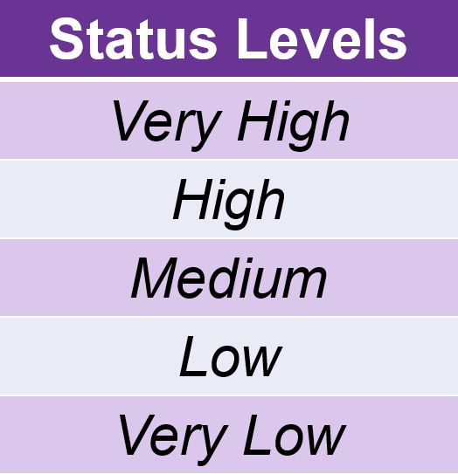
What Does “Reporting Status Only” Mean? (1)
Each state indicator has five Status levels

Slide 12
What Does “Reporting Status Only” Mean? (2)
Performance Level | Declined Significantly from Prior Year | Declined from Prior Year | Maintained from Prior Year | Increased from Prior Year | Increased Significantly from Prior Year
Very High 95.0% or greater | N/A | Blue | Blue | Blue | Blue
High 90.5% to less than 95.0% | Orange | Yellow | Green | Green | Blue
Medium 80.0% to less than 90.5% | Orange | Orange | Yellow | Green | Green
Low 68.0% to less than 80.0% | Red | Orange | Orange | Yellow | Yellow
Very Low Less than 68.0% | Red | Red | Red | Red | Red
The SBE approved separate Status cut scores for each state indicator.
Accessible through the five-by-five colored tables https://www.cde.ca.gov/ta/ac/cm/fivebyfivecolortables19.asp

Slide 13
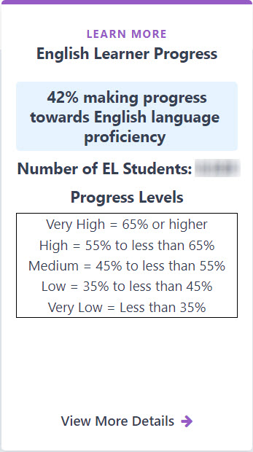
What Does “Reporting Status Only” Mean? (3)
2022 Dashboard will report one of five Status levels for each LEA, school, and student group.
For example, only Status levels were reported for the English Learner Progress Indicator in the 2019 Dashboard (right).

Slide 14
Descriptive Text for Image on Prior Slide
The image is a copy of the English Learner Progress “baseball card” on the 2019 Dashboard and it reflects Status level data only. This was used as an example of what reporting of Status only could look like.
The card itself notes that 42 percent of students were making progress towards English language proficiency. It also notes the number of EL students and the progress levels. The progress (or Status) levels for the English Learner Progress Indicator are as follows:
Very High = 65 percent or higher
High = 55 percent to less than 65 percent
Medium = 45 percent to less than 55 percent
Low = 35 percent to less than 45 percent
Very Low = Less than 35 percent
More details about the data can be accessed after selecting the “View More Details” arrow at the bottom of the card.

Slide 15
What 2021–22 Data May be Used to Calculate Status?
State Indicator | Data Used
Academic Indicator | 2022 Smarter Balanced Summative Assessment results
Suspension and Chronic Absenteeism Indicators | 2021–22 enrollment data
Graduation Rate Indicator | Students in Class of 2022 Students in Class of 2021 who graduate in 2021–22 (fifth-year graduates) DASS students who graduate in 2021–22
English Learner Progress Indicator (ELPI) | 2020–21 and 2021–22 English Language Proficiency Assessments for California results (two years of data needed to produce Status)

Slide 16
Impact of COVID-19: Re-Set Cut Scores?
With the continuance of the COVID-19 pandemic, and given the disruptions in classrooms due to the health crisis, a question has surfaced if cut scores should be reset so that the LEAs/schools are not expected to meet unattainable standards.

Slide 17
TDG Feedback
In October 2021, the question of resetting the Status cut scores was discussed with the Technical Design Group (TDG).
TDG members did not support the adjustment of cut scores:
May cause the accountability system to lose credibility
Resetting cut scores for 2022 does not mean that interest groups may recommend resetting again in 2023. Continued resetting could undermine the system and cut scores should be changed as infrequently as possible.
Continuing to use the same cut scores will allow the education community to gauge whether LEAs/schools have “returned to normal.”

Slide 18
CPAG Discussion Questions
Do the CPAG members have concerns with using any of the data reflected in Slide 16 to establish Status for 2022?
Should cut scores be reset in 2022?
What would be the reason to changing or keeping the same cut scores?

Slide 19
Future Dashboards and Next Steps

Slide 20
2023 Dashboard and Beyond
2023: Status, Change, and performance colors will be reported for all the state indicators, except for the CCI.
CCI will have Status only.
2024: CCI will have Status, Change and performance colors.

Slide 21
Next Steps (1)
In Spring 2022, the CDE will release a new student-level CCI data file through the Student Online Accountability Record Status (SOARS) System.
SOARS is an online portal for CDE to share student-level data with LEAs and charter schools, which has been a continued request.
In February 2021, the CDE presented to the CPAG on the development of two new potential measures for the CCI: civic engagement and industry certifications.
Throughout 2022, the CDE will continue work on the development of these measures and data collection method.

Slide 22
Next Steps (2)
In February 2020, the CDE presented to the CPAG on the potential use of the California Science Test (CAST) for the 2022 Dashboard. However, several factors have to be considered:
Limited number of students completing this assessment due to the COVID-19 pandemic,
The use of a revised blueprint for the 2021–22 administration of the CAST, and
The need to begin conversations with the ED on the inclusion of this new state indicator in California’s ESSA Consolidated State Plan
The CDE will continue to monitor when this test may be used for accountability and will continue to apprise the CPAG at future meetings.

Slide 23
Next Steps (3)
In May 2021, the SBE approved a student growth model methodology to measure the academic growth for students in grade four through eight.
Methodology requires assessment results from three consecutive years of Smarter Balanced Assessments in ELA and Mathematics. Therefore, the next set of aggregated student growth data will be available in late Fall 2024 based on the 2021–22, 2022–23, 2023–24 Smarter Balanced Assessments administrations.
CDE will continue to work with LEAs and the public to develop best practices for communication, data use and data visualization strategies with regards to student growth and the aggregate student growth data scores.
Note that the SBE has not taken any action as to include upcoming student growth data, when available, either on the Dashboard or within the accountability system.

Slide 24
Thank You!

Slide 25
Public Comment
Phone number: +1 669 219 2599 +1 213 338 8477 +1 408 638 0968 Meeting ID: 883 5120 3855 Passcode: 206112

