Slide 1
Every Student Succeeds Act (ESSA) Accountability Implementation

Slide 2
ESSA Background
Signed into law by President Obama December 2015
Reauthorization of the federal Elementary and Secondary Education Act (ESEA)
Replaces the No Child Left Behind Act
Ensures educational equity and opportunity for disadvantaged and high-needs students
Supplements state programs

Slide 3
State Plan Update (1)
July 12, 2018: U.S. Department of Education (ED) approved California’s Consolidated ESSA State Plan (State Plan).
November 8, 2018: California State Board of Education (SBE) approved the California Department of Education’s (CDE’s) recommendation to amend California’s ESSA State Plan for submission to the ED.
Amendments based on action taken during the 2018 calendar year

Slide 4
State Plan Update (2)
November 8, 2019: U.S. Department of Education (ED) approved California’s Amended Consolidated ESSA State Plan (State Plan).
January 8, 2020: California State Board of Education (SBE) approved the California Department of Education’s (CDE’s) recommendation to amend California’s ESSA State Plan for submission to the ED.
Amendments based on action taken during the 2019 calendar year

Slide 5
Review of 2019 Amendments

Slide 6
July 2019 SBE Actions
Extended Rate for the Graduation Rate Indicator
Combined four- and five-year graduation rate for the Graduation Rate Indicator

Slide 7
September 2019 SBE Actions
Raised the Low Graduation Threshold to “below 68 percent”

Slide 8
November 2019 SBE Actions
Clarified the Definitions of “Ineffective Teacher” and “Out of Field” Teacher
Status cut scores and methodology for English Learner Progress Indicator
Identify schools for support under ESSA
Status Cut Scores for the Graduation Rate Indicator

Slide 9
Other Amendments
Update to reflect incorporation of the Participation Rate into the calculation of the Academic Indicator
Revisions to reflect the evolution and additional details regarding the System of Support
Other typographical corrections

Slide 10
ESSA School Support and Improvement Eligibility, Planning and Assistance

Slide 11
ESSA School Support and Improvement Eligibility
ESSA requires states to identify multiple categories of schools for different types of support with the following associated planning requirements:
At least the lowest performing 5 percent of Title I schools - comprehensive support and improvement
High schools with graduation rates below 67 percent - comprehensive support and improvement
Schools with “consistently underperforming” student groups - targeted support and improvement
Schools identified under number 3 where a student group on its own is performing at or below the level of schools identified under number 1 - additional targeted support and improvement

Slide 12
ESSA, Section 1003: 2018 California Budget Act (1)
Senate Bill 862 (Supplemental to SB 840)
Fiscal Year 2018 Grants to LEAs
Provision 6 of Schedule (2)
Not less than $128,814,000
Formula
Use of Funds—Federal requirements and:
Strategies aligned to goals, actions, and services identified in the LEA’s local control and accountability plan (LCAP)
Shall not be expended to hire additional permanent staff

Slide 13
ESSA, Section 1003: 2018 California Budget Act (2)
Senate Bill 862 (Supplemental to SB 840)
Fiscal Year 2018 Grants to County Offices of Education (COEs)
Schedule (1)
$10 Million
Formula
Use of Funds
Supporting the statewide system of technical assistance and support for LEAs that serve schools identified for CSI

Slide 14
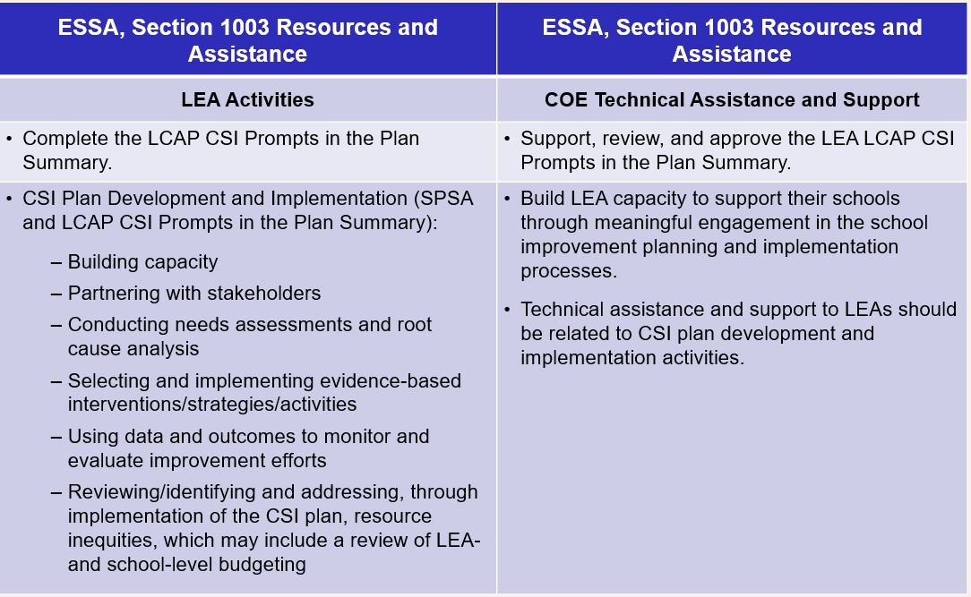
ESSA, Section 1003: Use of Funds (1)

Slide 15
ESSA, Section 1003: Use of Funds (3)
LEA Activities
Complete the LCAP CSI Prompts in the Plan Summary.
CSI Plan Development and Implementation (SPSA and LCAP CSI Prompts in the Plan Summary):
Building capacity
Partnering with stakeholders
Conducting needs assessments and root cause analysis
Selecting and implementing evidence-based interventions/ strategies/activities
Using data and outcomes to monitor and evaluate improvement efforts
Reviewing/identifying and addressing, through implementation of the CSI plan, resource inequities, which may include a review of LEA- and school-level budgeting

Slide 16
ESSA, Section 1003: Use of Funds (2)
COE Technical Assistance and Support
Support, review, and approve the LEA LCAP CSI Prompts in the Plan Summary
Build LEA capacity to support their schools through meaningful engagement in the school improvement planning and implementation processes.
Technical assistance and support to LEAs should be related to CSI plan development and implementation activities.

Slide 17
ESSA Planning and Assistance
January 2019:
ESSA assistance status private preview period for LEAs
https://www.cde.ca.gov/sp/sw/t1/csi.asp posted publicly
https://www.cde.ca.gov/re/lc/ New School Plan for Student Achievement template and instructions released
ESSA Comprehensive Support and Improvement https://www.cde.ca.gov/sp/sw/t1/csi.asp Frequently Asked Questions Posted
Trainings and Webinars announced

Slide 18
ESSA Scheduled Webinars
January 29, 2019: Local Control and Accountability Plan changes to the Plan Summary
February 5, 2019: CSI LEA Funding Walk-through
February 5, 2019: School Plan for Student Achievement
February 12, 2019: CSI County Office of Education Funding Walk-through
February 15, 2019: ESSA Stakeholder Implementation Session

Slide 19
Looking Forward
Additional School Planning Guidance
January 2020 ESSA School Eligibility (2019 Dashboard)
In November 2018, SBE approved revisions to California’s ESSA Consolidated State Plan to:
Align identification of schools with the Local Control and Accountability Plan (LCAP) timeline
Include English learner (EL) progress “Status” as one of the identification criteria

