Slide 1
Support for Distance Learning: the History–Social Science and English Language Arts/English Language Development Frameworks
Kyle Petty, California Department of Education
Erin Jacks, California Department of Education
Kenneth McDonald, California Department of Education
Jennifer Elemen, Monterey County Office of Education
Beth Slutsky, California History–Social Science Project
May 14, 2020

Slide 2
Presentation Topics
Instructional shifts
Framework resources
Local efforts and the strategies being implemented to support distance learning
Access and equity in a distance learning environment

Slide 3
The English Language Arts/ English Language Development Framework
Schooling should help all students achieve their highest potential.
The responsibility for learners’ literacy and language development is shared.
ELA/literacy and ELD curricula should be well designed, comprehensive, and integrated.
Effective teaching is essential to student success.
Motivation and engagement play crucial roles in learning.

Slide 4
Considerations for Planning and Practice
Build, but not from scratch
Redefine, when necessary
Teach the class, but reach the child

Slide 5
Consideration: Build, but not from scratch
Amplify and extend
Indulge student ambition and creativity
Seek to provide multiple means of representation

Slide 6
Consideration: Redefine, when necessary
Engagement
Participation
Timelines
Reframing option

Slide 7
Optional Reframing
Long Description: https://www.cde.ca.gov/ci/rl/cf/documents/elaeldfwchapter2.pdf#page=4

Slide 8
Consideration: Teach the class, but reach the child
Acknowledge trauma
Create norms and schedules
Promote communication, promote community
journals, blogs, discussion threads, group calls, online gaming platforms, meetups and hangouts
Provide choices and foster student autonomy
Make it meaningful

Slide 9
Instructional Shifts in Reading
Access to texts
Type
Length
Checks for understanding

Slide 10
Instructional Shifts in Writing
Writing
Criteria
Collaboration and process
Options
Connections across contents and genres

Slide 11
Instructional Shifts in Listening and Speaking
Listening
Dispel beliefs in multitasking
Guiding questions and checkpoints
Speaking
Formal and informal
Live and recorded

Slide 12
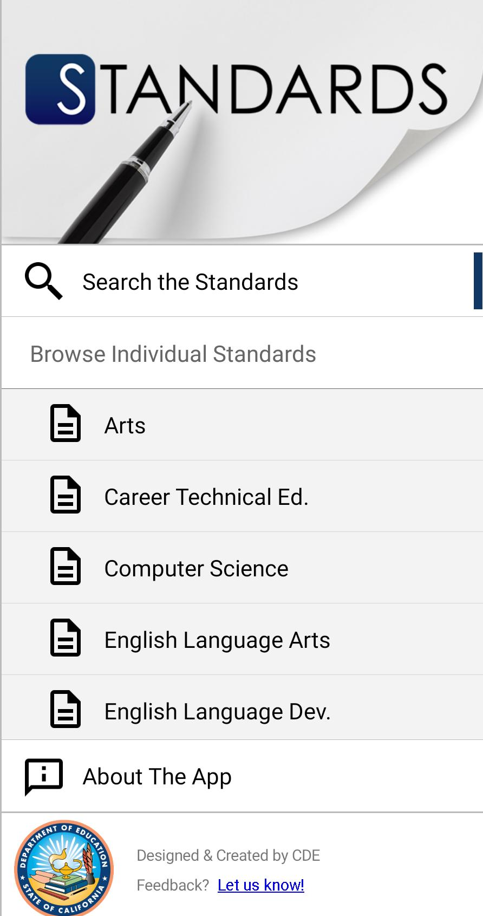
Connect
CA Standards App
@CDECurriculum

Slide 13
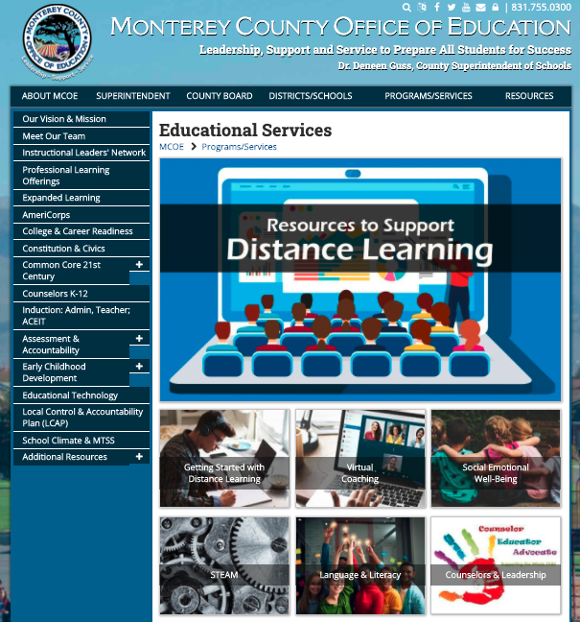
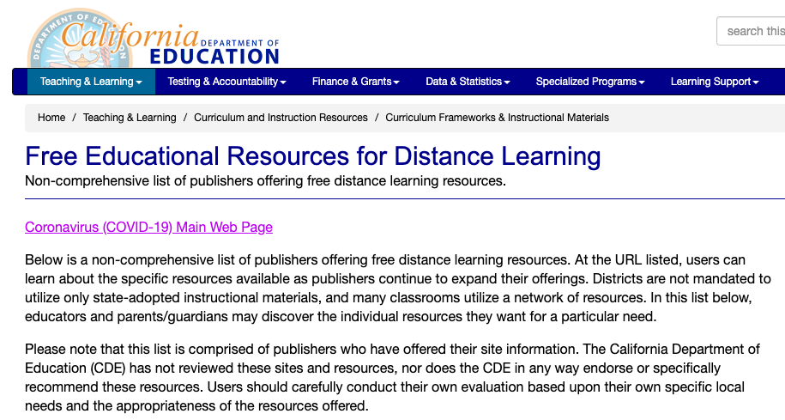
Monterey County Office of Education
http://MontereyCOE.org
https://www.cde.ca.gov/ci/cr/cf/distancelearnresources.asp

Slide 14
English Language Arts and Development (ELA/ELD) in Distance Learning
English learners must continue to receive designated and integrated English Language Development (ELD) as part of their educational curriculum.
Local educational agencies (LEAs) have the flexibility to determine how services will be provided to English learners.

Slide 15
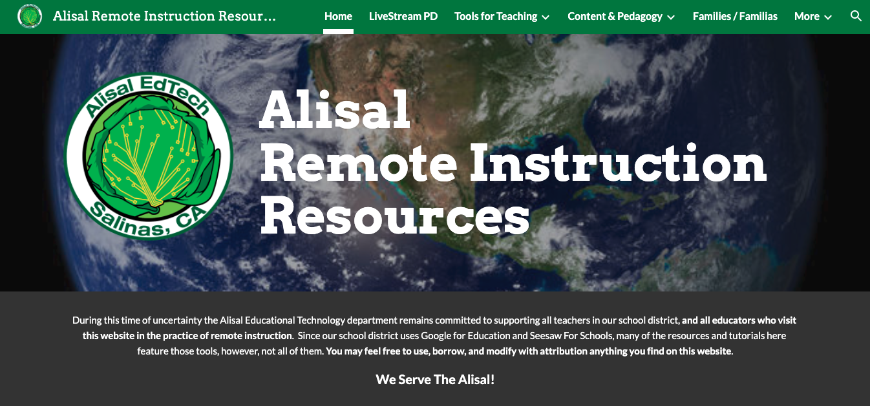
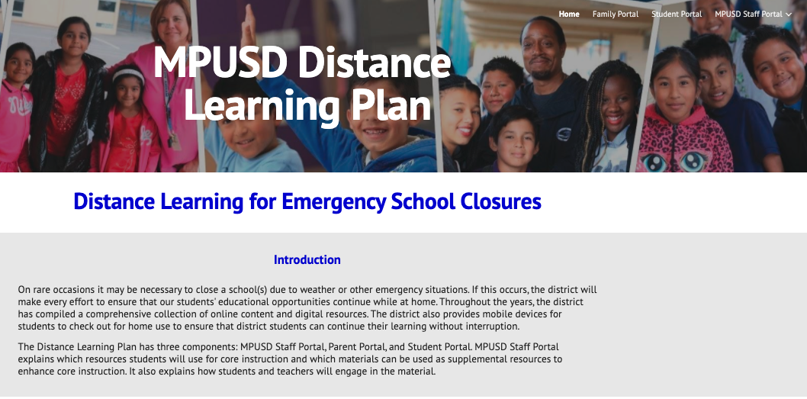
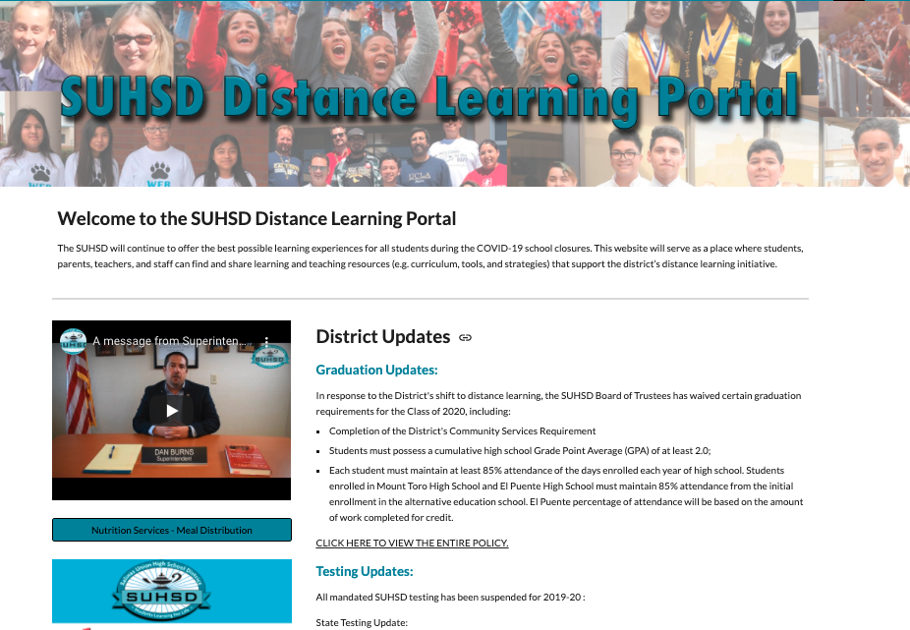
Class, School, & District Website Examples
https://sites.google.com/greenfield.k12.ca.us/brownbearoakkinder/home?pli=1&authuser=1
https://sites.google.com/alisal.org/ausdri/
https://sites.google.com/mpusd.k12.ca.us/instructional-continuity-plan/ula Unified School District
https://sites.google.com/mpusd.k12.ca.us/instructional-continuity-plan/

Slide 16
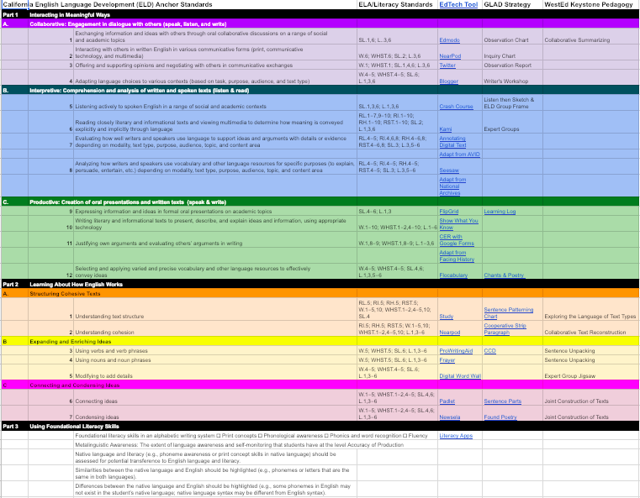
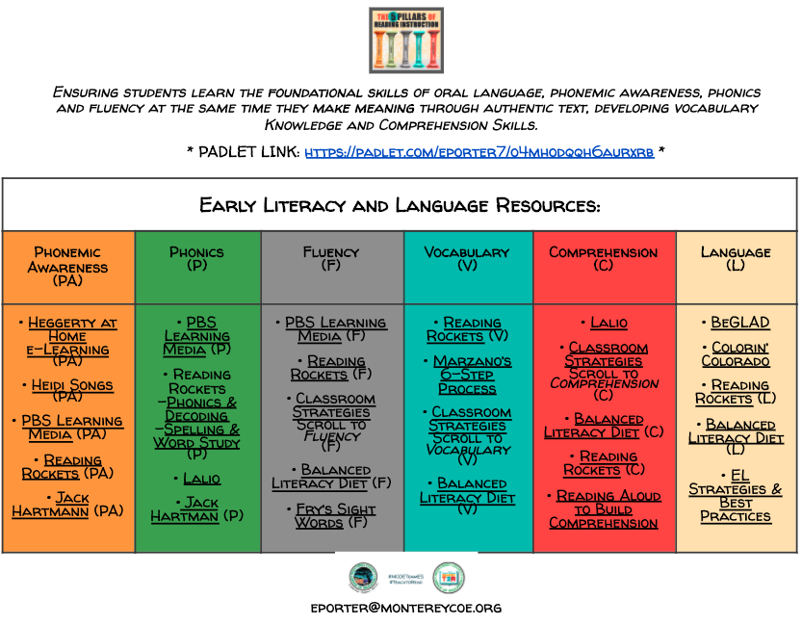
ELA & ELD Standards-Aligned Strategies
Source: Jennifer Elemen
https://docs.google.com/spreadsheets/d/11TLD5Ku8Lu-o6ksLT5O9xK2A4qsLd1AicXsXpM2IzYM/edit?usp=sharing
Source: Edi Porter
https://docs.google.com/document/d/1J2nmSs79lz8y8DBFeKjpD69YoRJLPd_i62On8V07zEU/edit

Slide 17
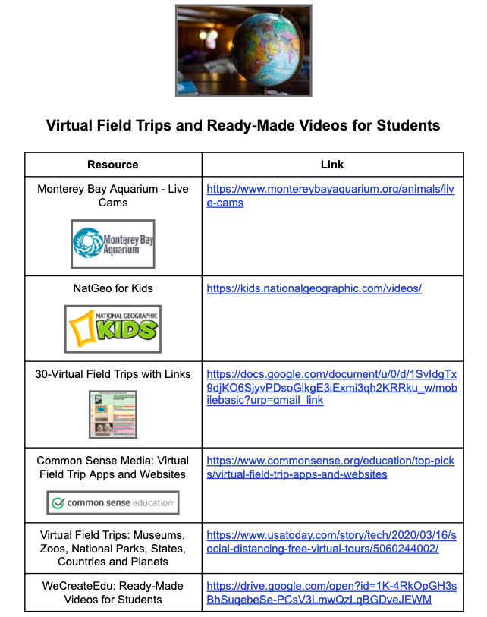
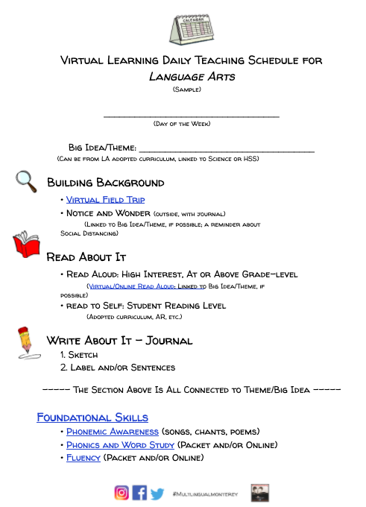
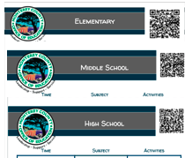
Distance Learning Planning
https://docs.google.com/document/d/1X1K23CY2Sq4OamFdOgJmfgc3gEqDx9COhZncb3jfHEU/edit

Slide 18
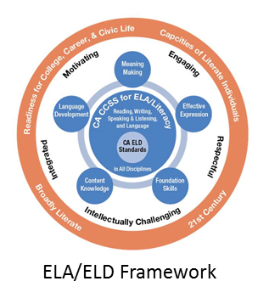
Asynchronous & Synchronous Learning
*Relationships, Social and Emotional Learning

Slide 19
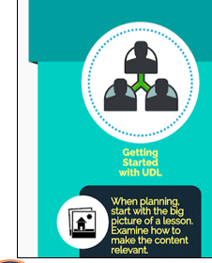
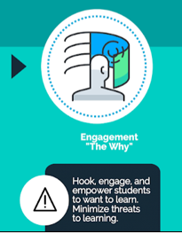
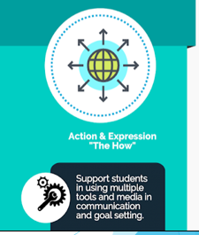
Universal Design for Learning (UDL)
Universal Design for Learning is a process of planning learning experiences for ALL students. UDL emphasizes CHOICE and PROACTIVE planning over the one-size-fits-all experiences that offer accommodations or modifications as an afterthought.
Source: Irina McGrath & Michelle Shory
https://sites.google.com/view/ell20/udl?authuser=0

Slide 20
Distance Learning Lesson Design
Source: Katherine Goyette; http:\\WonderExploreLearn.com

Slide 21
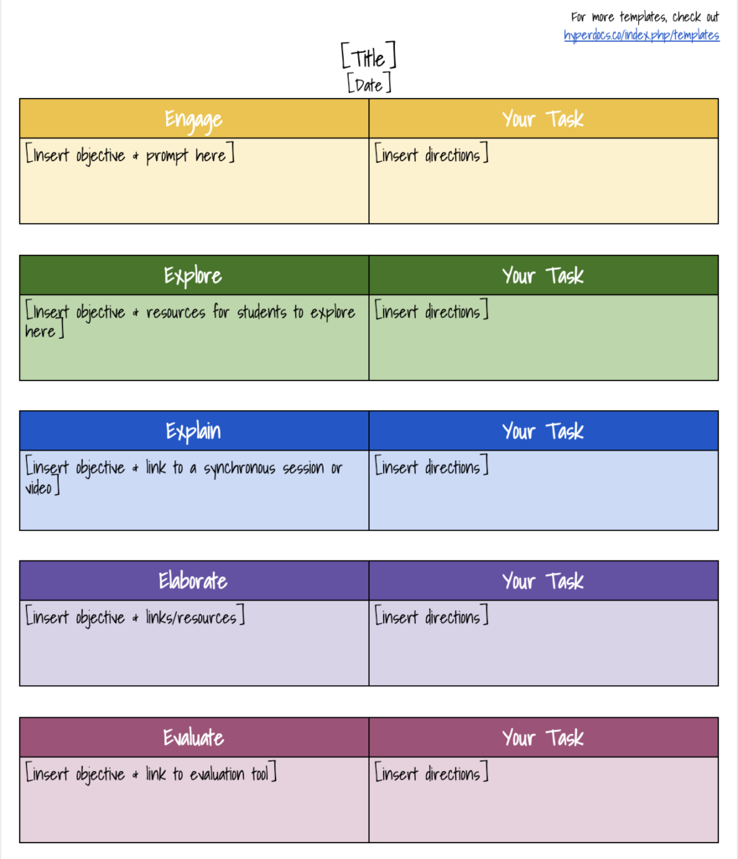
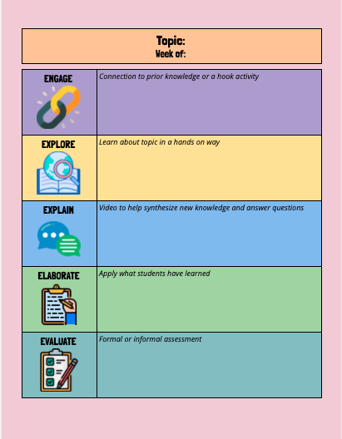
Templates: Inquiry Arc, 5 Es, and Hyperdocs
Inquiry Arc
Dimension 1: Developing Questions and Planning Inquiries.
Dimension 2: Applying Disciplinary Tools
Dimension 3: Evaluating Sources and Using Evidence
Dimension 4: Communicating Conclusions and Taking Informed Action
Source: C3 Framework, National Council for the Social Studies
Source: Catlin Tucker
https://hyperdocs.co/
Source: Brienne Peers

Slide 22
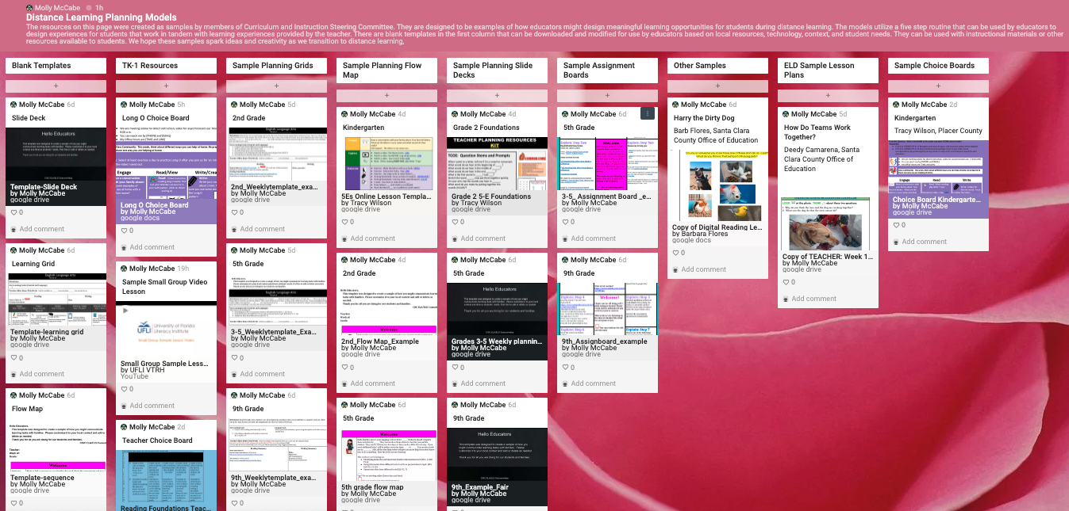
ELA/ELD Templates for Distance Learning
Padlet
Source: Molly McCabe, CISC ELA/ELD Subcommittee, CCSESA
https://padlet.com/molly1alex/46cd5i6g08rcmc72

Slide 23
Designated ELD Template
DESIGNATED ENGLISH LANGUAGE DEVELOPMENT
A 15 – 30 Minutes Lesson Planning Template
Four Key components
ELD Standards: What standard(s) are you working on?
Academic Vocabulary: Look at your lesson. What key vocabulary must the students know to be successful (no more than 5 words each week)?
Oral Language Development: What structures/scaffolds will you have in place for students to practice oral language?
Meaningful Interactions: How will the students have meaningful interactions?
https://drive.google.com/file/d/1EB0DGJmHRc7r0TaDclZQZbHRge7DFBqH/view?ths=true

Slide 24
Choice Boards
*High Tech, Low or No Tech
Designated ELD
Choice Boards
Overview & Recommendations
Link to slides:
https://bit.ly/choiceELDoverview
Link to screencast:
https://bit.ly/choiceELDscreencast
Source: Theresa Blanchard

Slide 25
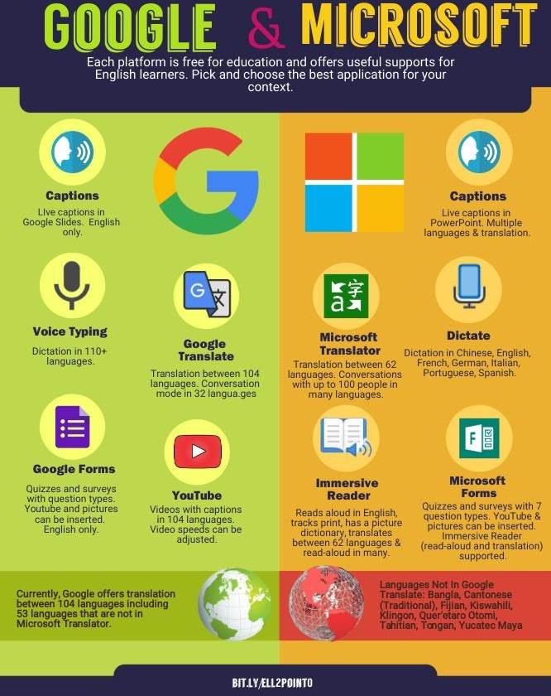
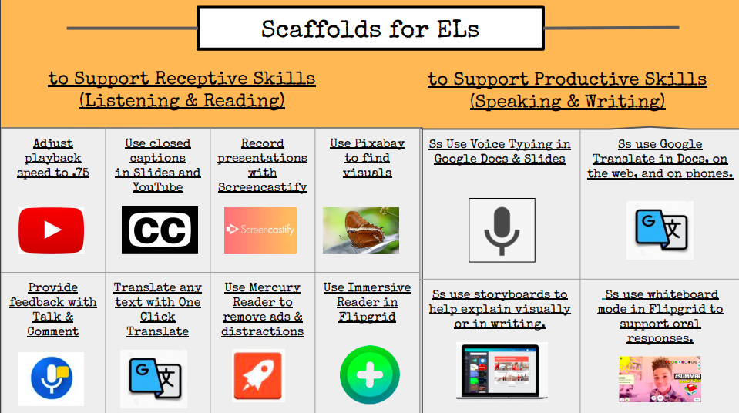
Accessibility Features
Source: Irina McGrath & Michelle Shory
https://sites.google.com/view/ell20/google-microsoft-for-els

Slide 26
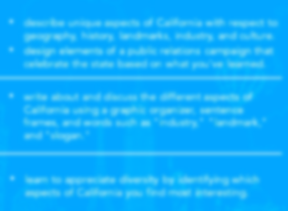
EdTech Tools
http://Nearpod.com; http://PearDeck.com

Slide 27
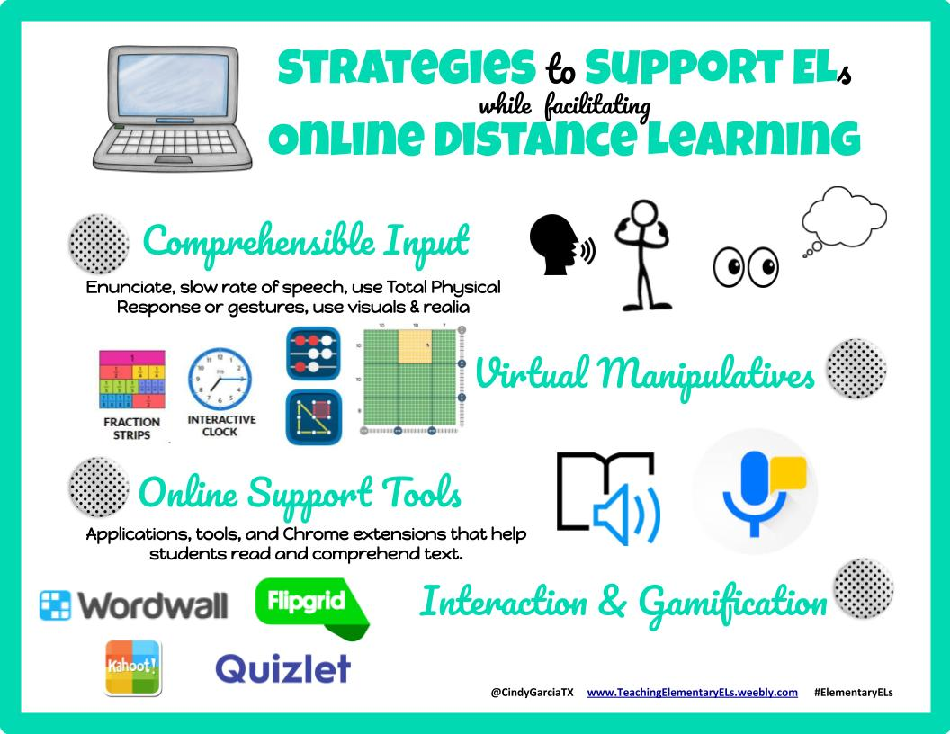
Strategies to Support ELs
Source: Cindy Garcia (http://teachingelementaryels.weebly.com/)

Slide 28
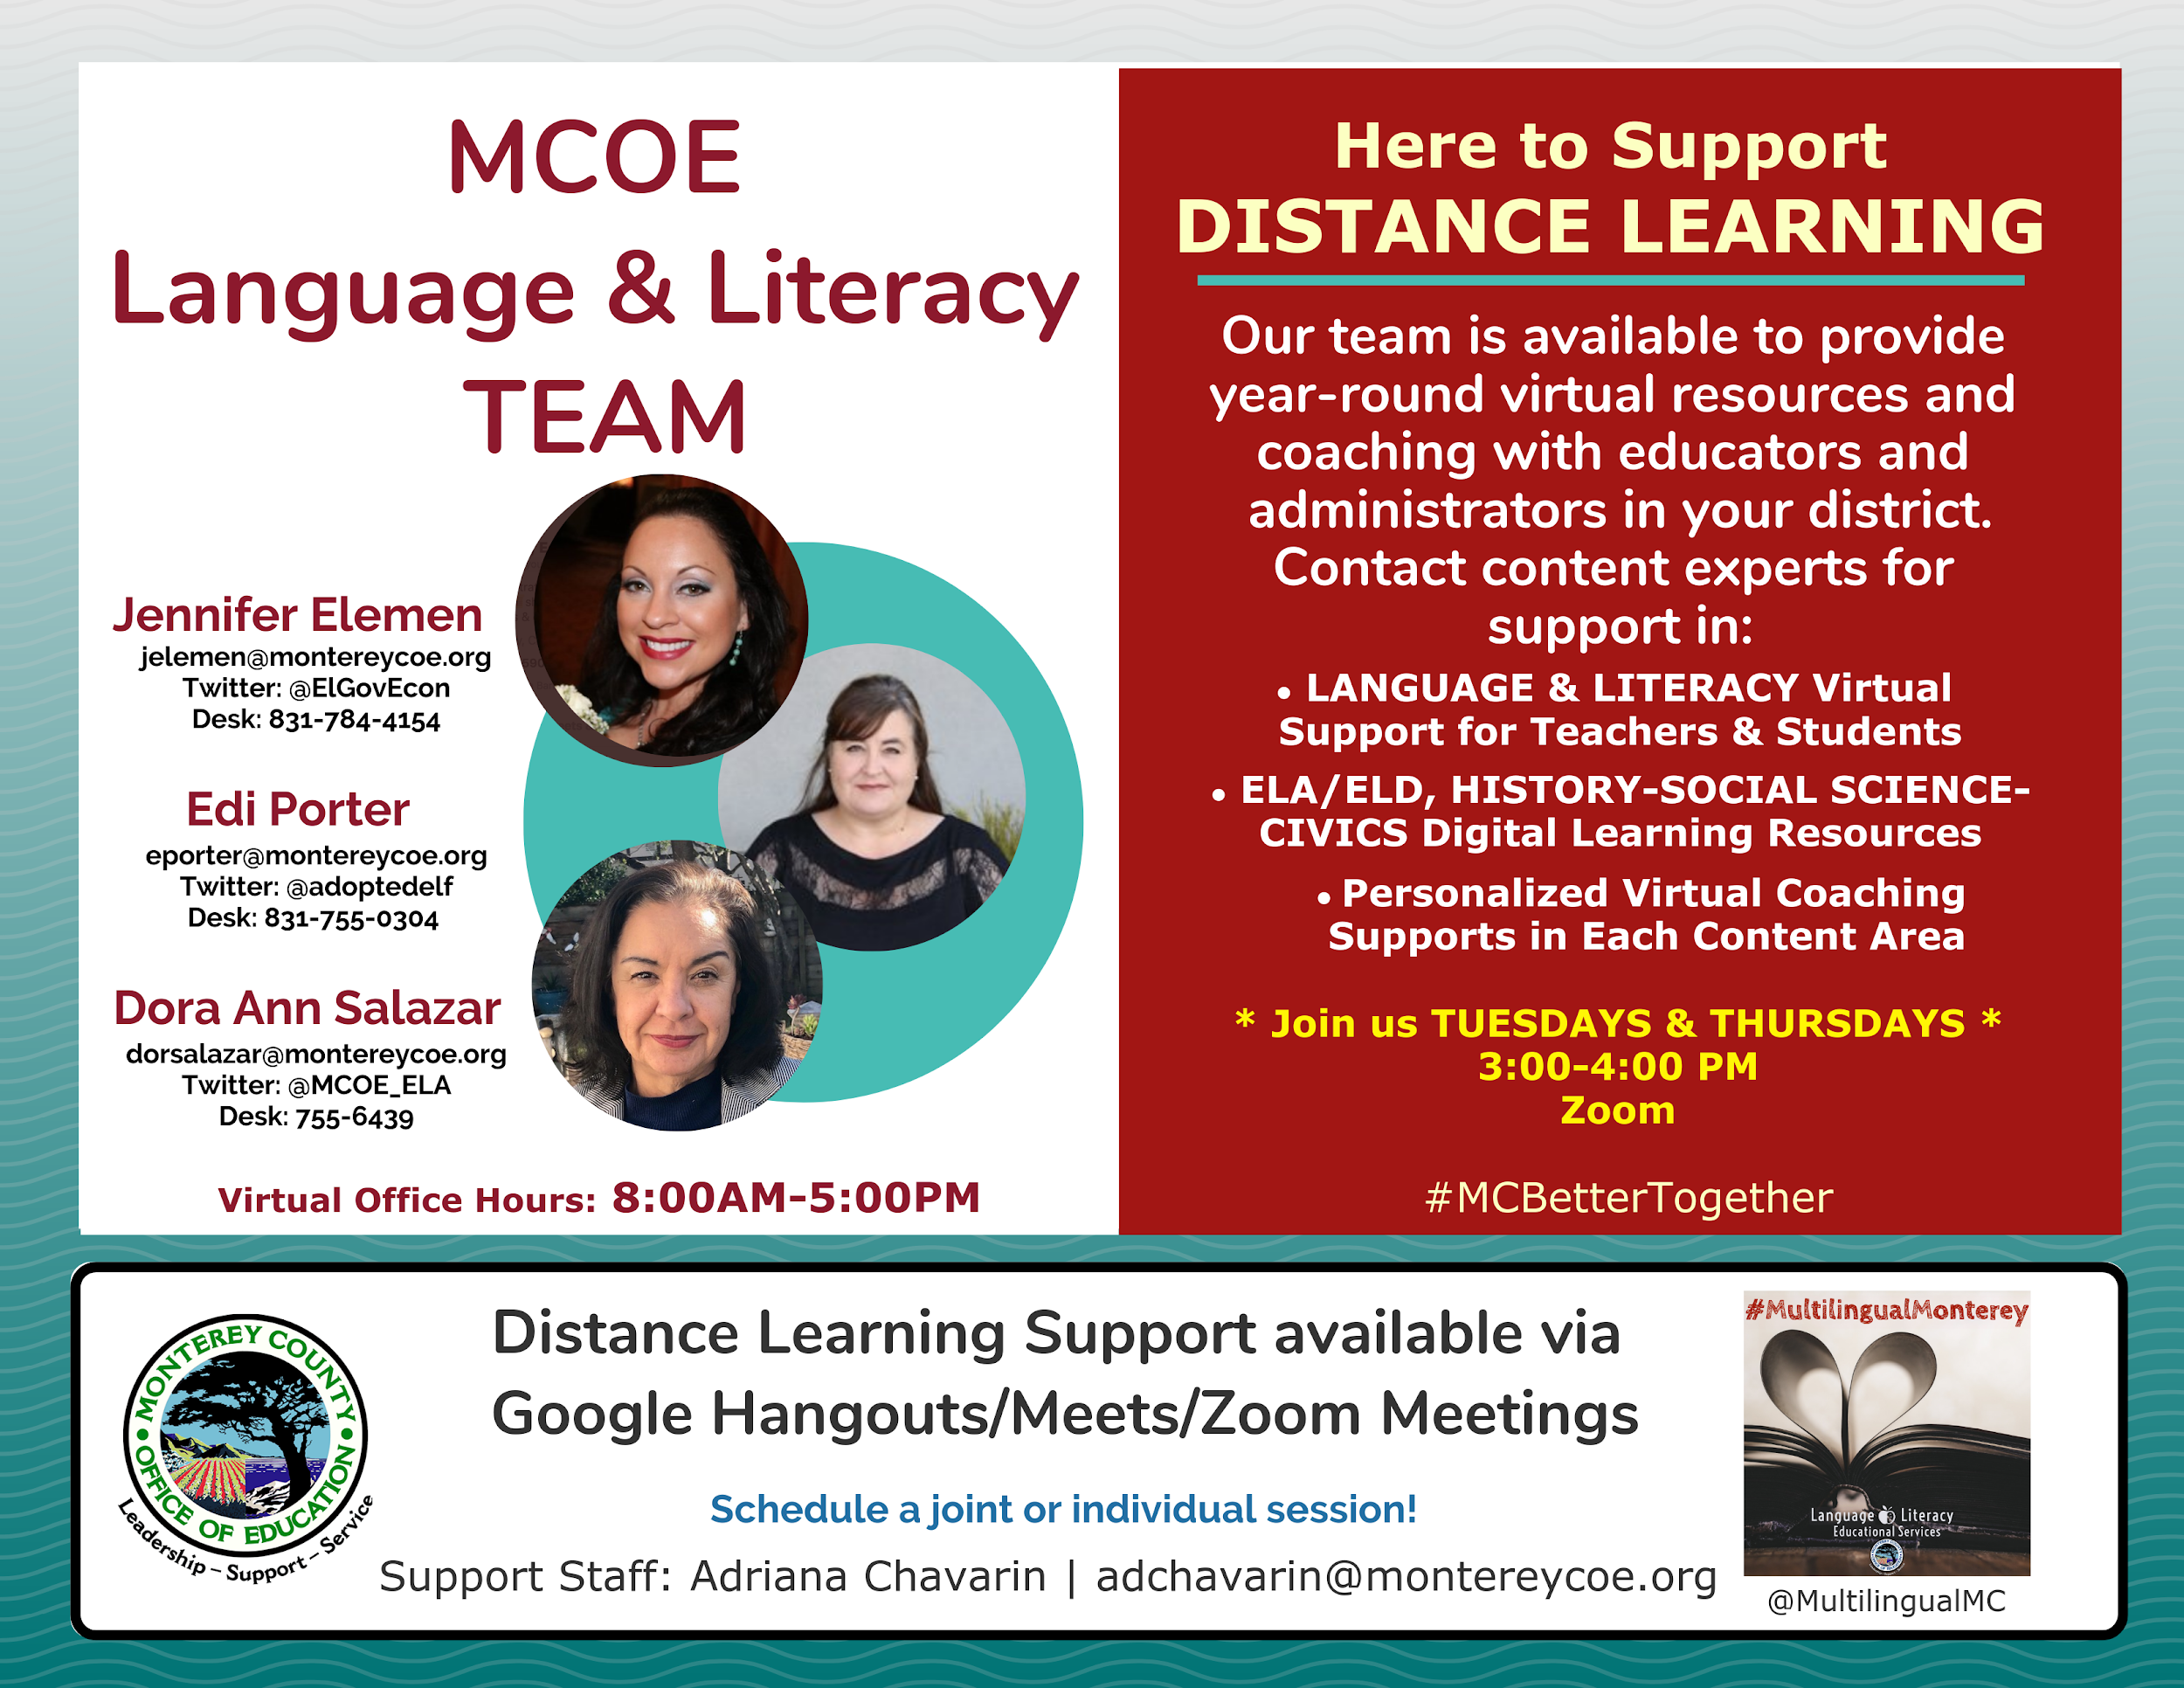
Professional Learning
https://www.montereycoe.org/programs-services/ed-services/common-core/language-literacy/

Slide 29
The History–Social Science Framework

Slide 30
Instructional Shifts
Inquiry
Content
Literacy
Citizenship

Slide 31
Inquiry
Student-Centered Learning Model Well Suited to Distance Learning
Guiding Questions
Additional Guidance in the Instructional Strategies Chapter

Slide 32
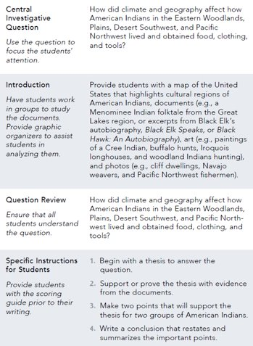
Instructional Strategies
Long Description: https://www.cde.ca.gov/ci/hs/cf/documents/hssfwchapter21.pdf#page=7

Slide 33
Content
Disciplinary Core Skills: History, Geography, Economics, Civics
Alignment to Standards: Lessons Shouldn’t Just Be Filler
Use of Primary Sources
Adapting Classroom Examples to Distance Learning

Slide 34
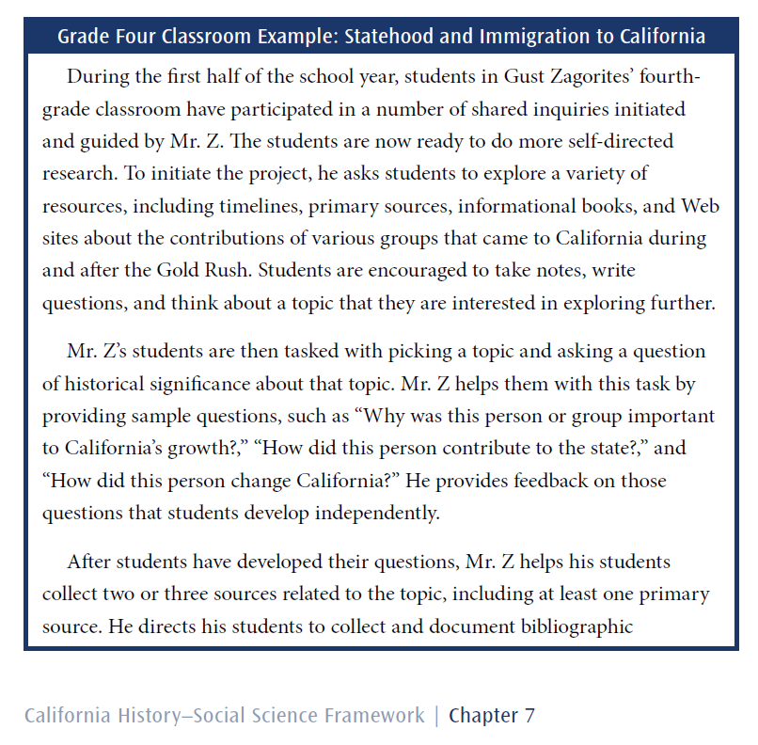
Classroom Example – Grade Four
Long Description: https://www.cde.ca.gov/ci/hs/cf/documents/hssfwchapter7.pdf#page=20

Slide 35
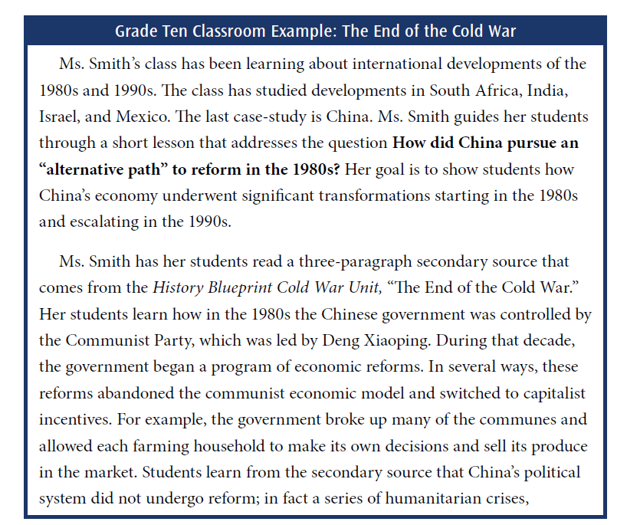
Classroom Example – Grade Ten
Long Description
https://www.cde.ca.gov/ci/hs/cf/documents/hssfwchapter15.pdf#page=48

Slide 36
Literacy
Reading, Writing, Listening, Speaking
Alignment to CCSS Grade-Level Expectations
Guidance in the Framework
English Language Development Support
https://www.cde.ca.gov/ls/he/hn/covid19webinars.asp

Slide 37
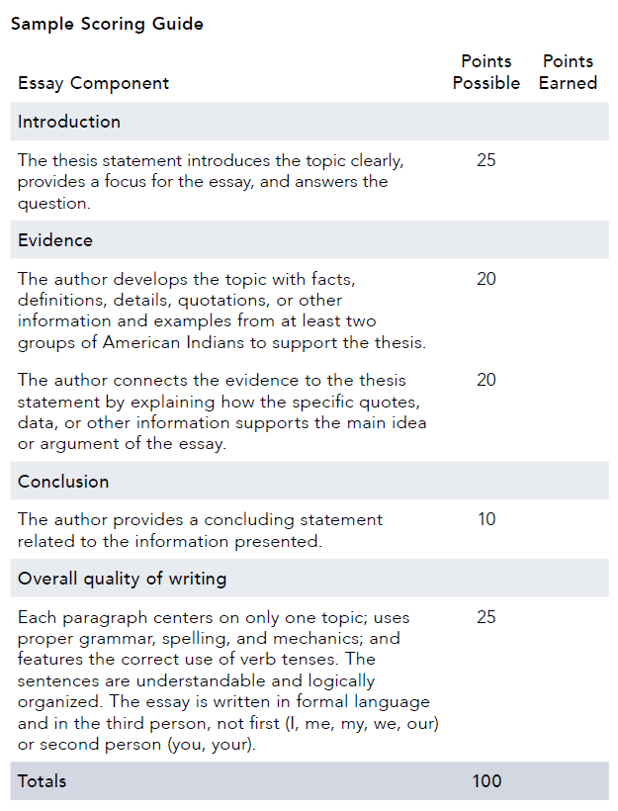
Sample Scoring Guide
Long Description: https://www.cde.ca.gov/ci/hs/cf/documents/hssfwchapter21.pdf#page=8

Slide 38
Citizenship
Student Engagement and Civic Action
Role of Government and Citizenry in Crisis
Empowerment

Slide 39
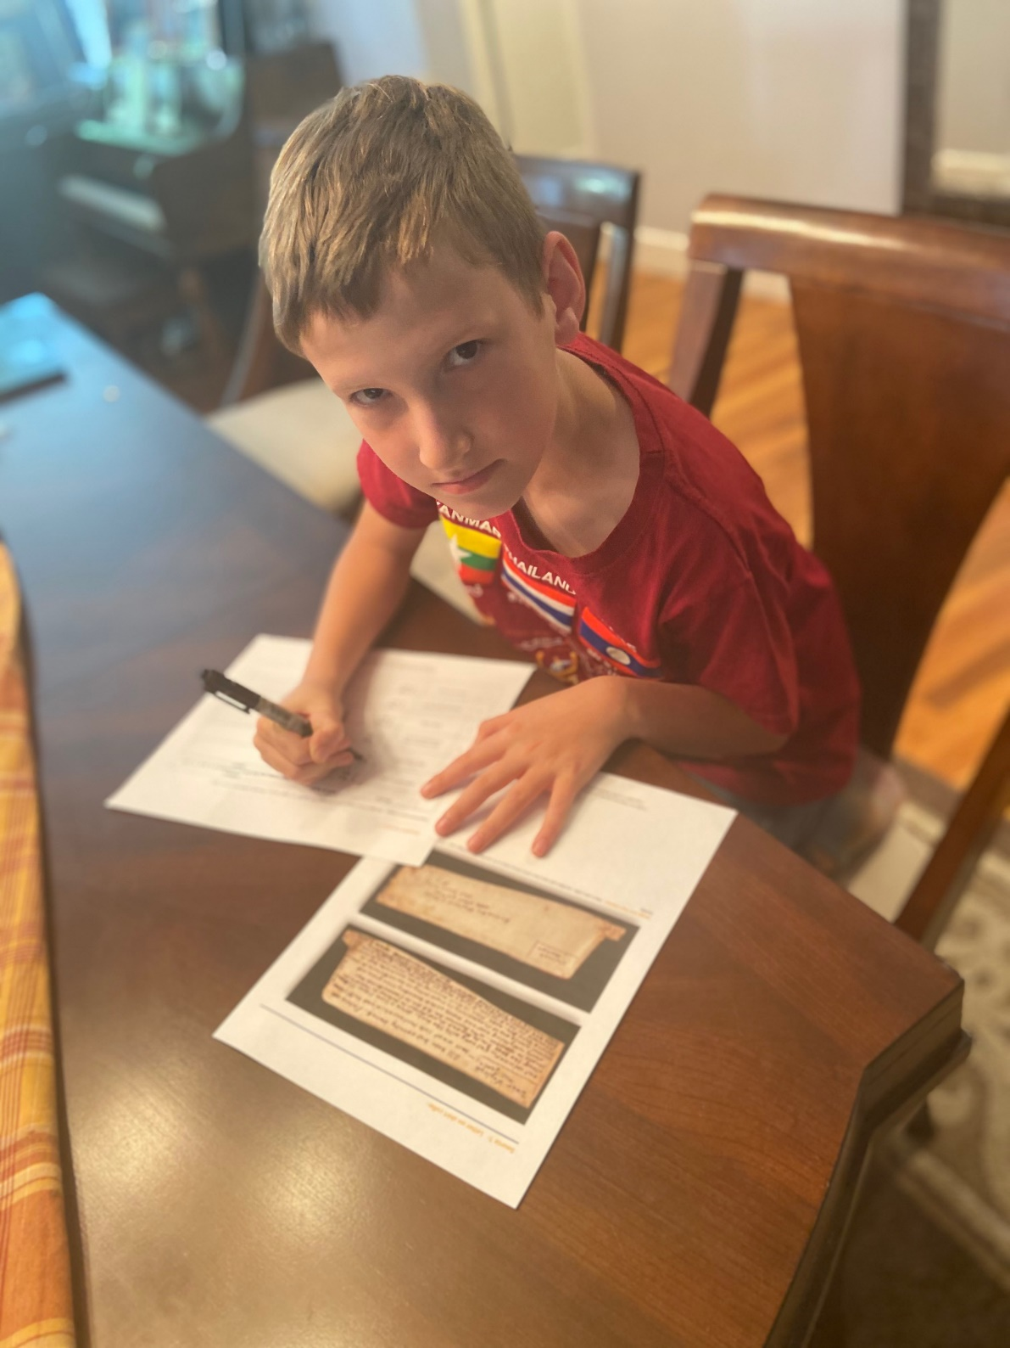
What does and what can distance learning in history-social science look like?
Prioritize Your Goals
Context: Instructional Shifts (tie in with CDE material covered in earlier slides)
Options for Scope and Sequence
Framework Alignment: Develop Skills with Content
Resources and More Resources

Slide 40
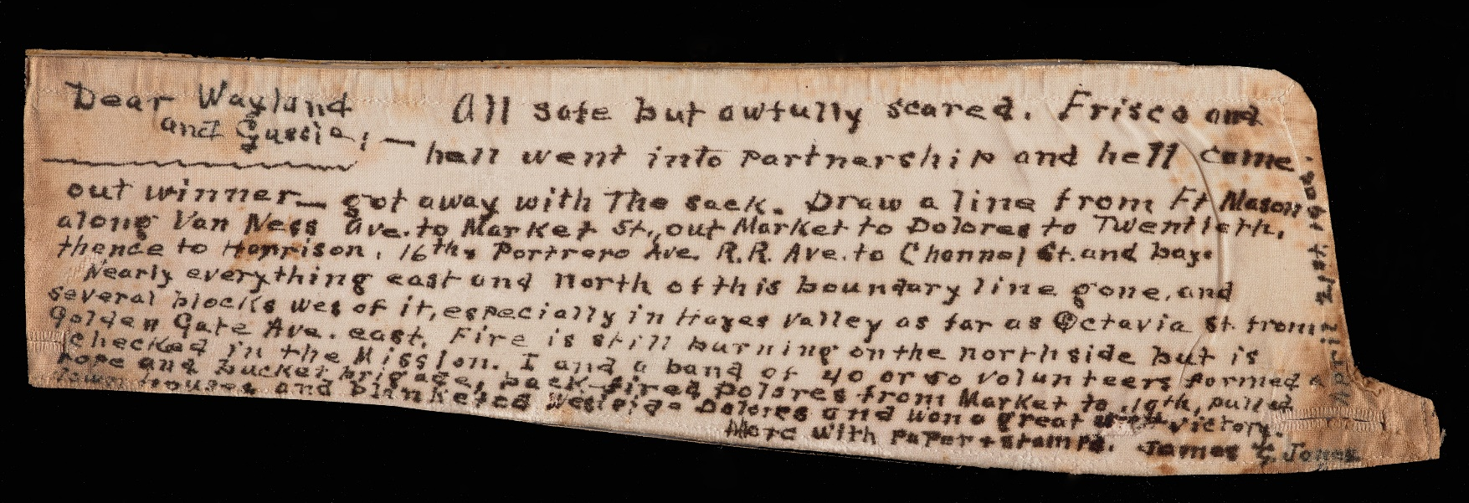
Prioritize Your Goals: Considerations in Distance Learning Instruction
Accessibility
Attention to equity
Diversify Instructional Approach
Independent Students with Teacher Support
Teacher provides context and direction (e.g., statement of why we’re about to learn what we’re going to learn) and direction
Engaging and varied instructional materials
Assessments that demonstrate skill development and content knowledge
https://www.teachingcalifornia.org/inquiry-sets/2-2-why-do-people-move/source/mans-shirt-collar-1-b-2907/

Slide 41
Scope and Sequence Options: Starting Small
Document pandemic by having students create their own primary sources through journal project(s) (https://tinyurl.com/ur9xrkd):
Directions to Students: Each day, take note of what you are seeing and hearing on the news, among your friends, within your family, and in your community.
Original Assignment (https://tinyurl.com/covid-journal), webinar (https://youtu.be/9hS7MCDcBEI), UC Berkeley History-Social Science Project (https://ucbhssp.berkeley.edu/teacher-resources), Bryan Shaw, Mt. Diablo Unified School District, California, USA. Adaptations for lower grade levels, different languages, abilities, and purposes

Slide 42
Scope and Sequence Options: Starting Small – continued
Teach about the pandemic in historical context with a short lesson (https://tinyurl.com/wxhqpqx) that compares the 1918 flu pandemic with Covid-19 (blog that describes teacher approach https://chssp.ucdavis.edu/blog/pandemicshistory)

Slide 43
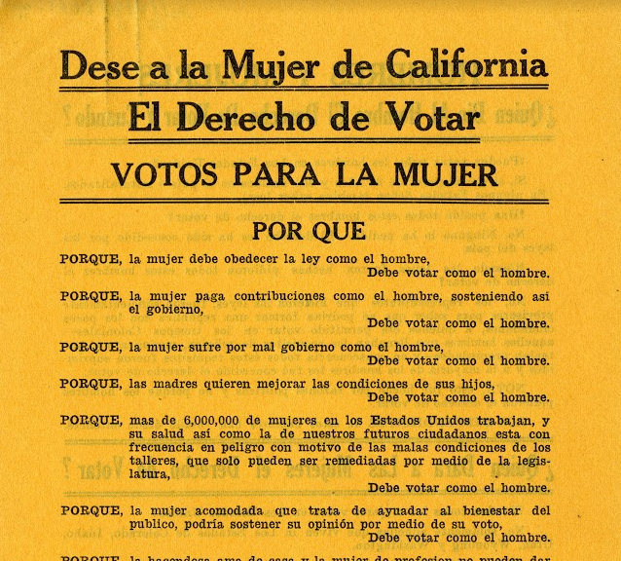
Scope and Sequence Options: Building Steam with Framework Alignment
Content: Be selective with content by focusing on enduring themes and questions
Inquiry: Cultivate disciplinary skills
Narrow the breadth of material, and prioritize fewer sources for students to explore in more depth
Literacy: Assess skill development through multiple modalities
Citizenship: Invite students’ creativity and relevance to their connection to one another and the world around them
https://www.teachingcalifornia.org/inquiry-sets/11-2-womens-suffrage/

Slide 44
Resources and More Resources
#CHSSP Live: https://chssp.ucdavis.edu/coronavirus-support/coronavirus
Lessons
Primary Source Sets
Secondary Sources on Current Events
Teacher Features
Parents’ Guide: Grade Level Overview of Material Covered from April-June: https://ucdavis.app.box.com/s/68x46p3q4oom7talnigqw2jtian4ejp0
Recordings of Source Analysis
https://chssp.ucdavis.edu/blog/earthday

Slide 45
CDE ELA References
ELA/ELD Framework: https://www.cde.ca.gov/ci/rl/cf/elaeldfrmwrksbeadopted.asp
Integrated Instruction Snapshot 5.7, p. 479 (Ch. 5)
Socratic Seminar Snapshot 7.2, p.732 (Ch. 7)
Structures for Engaging All Students in Academic Conversations, p. 86–7
Designated ELD Snapshots
4.4, p.337
5.3, p. 446
6.2, p. 553
CDE Resources to Support Social-Emotional Learning: https://www.cde.ca.gov/eo/in/socialemotionallearning.asp
CDE Resources to Support Students in Crisis: https://www.cde.ca.gov/ls/cg/mh/studentcrisishelp.asp

Slide 46
HSS References
History–Social Science Framework:
https://www.cde.ca.gov/ci/hs/cf/hssframework.asp
Instructional Strategies: Inquiry-Based Lesson Example, p. 552 (Ch. 21)
Classroom Example: Statehood and Immigration to California, pp. 85-86 (Ch. 7)
Classroom Example: The End of the Cold War, pp. 363-364 (Ch. 15)
Instructional Strategies: Sample Rubric, p. 553 (Ch. 21)

Slide 47
CDE Distance Learning Resources
CDE Distance Learning Page:
https://www.cde.ca.gov/ci/cr/dl/index.asp
Free Publisher Resources:
https://www.cde.ca.gov/ci/cr/cf/distancelearnresources.asp
COVID-19 Webinar Series:
https://www.cde.ca.gov/ls/he/hn/covid19webinars.asp

Slide 48
For questions or to get more information on future webinars, please contact us at: Covid19@cde.ca.gov
For weekly email updates from the California Department of Education on COVID-19, send a blank email to:
join-covid19-update@mlist.cde.ca.gov

Slide 49
California Department of Education Posted May 2020

