Slide 1
Universal PreKindergarten (UPK) Implementation
Office Hour
Early Education Division (EED)
April 27, 2022

Slide 2

Welcome and Introductions

Slide 3
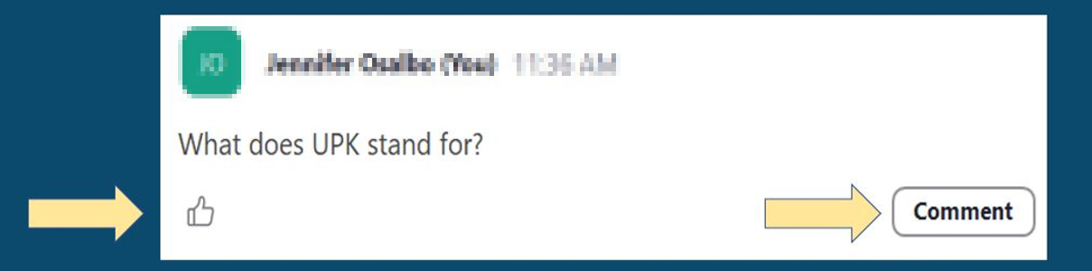
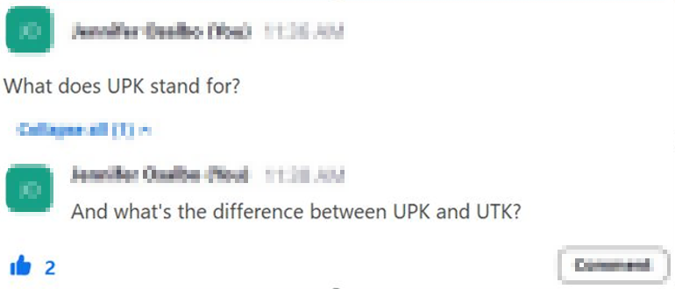
Asking Questions and Upvoting

Slide 4
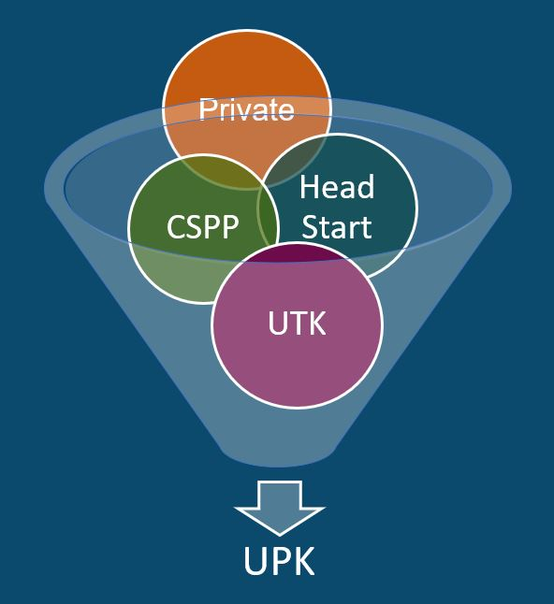
What is UPK?
UPK will bring together programs across early learning and K-12, relying heavily on Universal Transitional Kindergarten (UTK) and California State Preschool Program (CSPP), as well as Head Start, community-based organizations (CBOs), and private preschool.
Universal means that by 2025–26,
regardless of background, race, zip code, immigration status, or income level – every child– has access to a quality learning experience the year before Kindergarten.

Slide 5
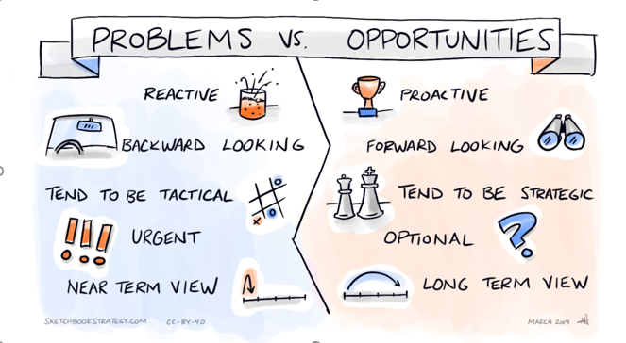
Problems versus Opportunities
Reactive vs. Proactive
Backward looking vs. Forward looking
Tend to be Tactical vs. Tend to be Strategic
Urgent vs. Optional
Near Term View vs. Long Term View
Image Credit: Sketchbookstrategy.com, CC-BY-40, March 2019

Slide 6

Elephants and Rumors
Districts don’t actually need to plan (rumor)
There is a Special Education Template (rumor)
We have to have a TK class at every elementary site (rumor)
Image Credit: https://artprojectsforkids.org/elephant-tutorial/

Slide 7
Transitional Kindergarten Teaching Requirements
By August 1, 2023, for apportionment purposes, TK Teachers must have ONE of the following:
(A) At least 24 units in early childhood education, or childhood development, or both.
  Units generally mean Carnegie units which are from an approved regionally-accredited program
(B) As determined by the local educational agency employing the teacher, professional experience in a classroom setting with preschool age children that is comparable to the 24 units of education described in subparagraph (A).
(C) A child development teacher permit issued by the Commission on Teacher Credentialing.

Slide 8
Transitional Kindergarten Assignments for
2022–2023
Current Legal Assignments for 2022–23
•Multiple Subject Credential Holders
•Multiple Subject Interns
•Multiple Subject – Short Term Staff Permit
•Multiple Subject – Provisional Internship Permit
•Multiple Subject – Variable Term Waivers
•Local Assignment Options, as approved by local School Boards

Slide 9
Upcoming PK-Three ECE Specialist Credential
Preschool through 3 Grade (PK-3) Early Childhood Education Specialist Credential
Will provide a bridge for Early Childhood Educators with a BA and Preschool experience
Child Development Permit Holders with a BA will be allowed to apply their preparation and experience teaching in PreK toward earning the ECE Specialist Credential
Will provide a bridge for teaching credential holders and a pathway to meet the 24 ECE Unit requirement
Requirements and standards for preparation currently under field review
Draft regulations to establish the ECE Credential will be taken up this summer by the CTC, possibly finalized by January 2023

Slide 10
Live Questions and Answers (Q&A)

Slide 11
Closing and Next Steps
  Inbox for questions and comments: UPK@cde.ca.gov
  We will post this week's slides on: https://www.cde.ca.gov/ci/gs/em/
We look forward to more opportunities to discuss
the implementation of UPK!
Thank you!

Slide 12
UPK Resources
California Educators Together:
  https://www.caeducatorstogether.org/groups/e0cfjrjf/upk-p-3
UPK Resources:
  https://www.cde.ca.gov/ci/gs/em/
UPK FAQs:
  https://www.cde.ca.gov/ci/gs/em/kinderfaq.asp
UPK Office Hour:
  https://www.cde.ca.gov/ci/gs/em/upkofficehours.asp
System of Support for Expanded Learning:
  https://www.cde.ca.gov/ls/ex/sosexplearncontacts.asp
K-12 Omnibus Trailer Bill:
  https://esd.dof.ca.gov/trailer-bill/public/trailerBill/pdf/527 [Link no longer available]

Slide 13
ELO-P Resources
ELO-P Main Page:
  https://www.cde.ca.gov/ls/ex/elopinfo.asp#elopfaqs
ELO-P Program Plan Guide:
  https://www.cde.ca.gov/ls/ex/documents/elopprogplanguide.pdf
ELO-P FAQs:
  https://www.cde.ca.gov/ls/ex/elofaq.asp
ELO-P Fireside Chats:
  https://www.afterschoolnetwork.org/elo-program
ELO-P Email Box:
  ExpandedLearning@cde.ca.gov

Slide 14
Facilities Resources
Access California Preschool, Transitional, Kindergarten and Full-Day Kindergarten Facilities Grant Program Funding (FDK grant program)
  https://www.dgs.ca.gov/OPSC/Services/Page-Content/Office-of-Public-School-Construction-Services-List-Folder/Access-Full-Day-Kindergarten-Facilities-Grant-Program-Funding
  Facilities Contacts:
  Joshua Potter
    Phone: 279-946-8454
    E-mail: Joshua.Potter@dgs.ca.gov
  Lindsey Gordon
    Phone: 279-946-8458
    E-mail: Lindsey.Gordon@dgs.ca.gov

