Slide 1
California State Preschool Program (CSPP) and Universal PreKindergarten (UPK) Budget Implementation
Office Hour
Early Education Division (EED)
October 12, 2022

Slide 2
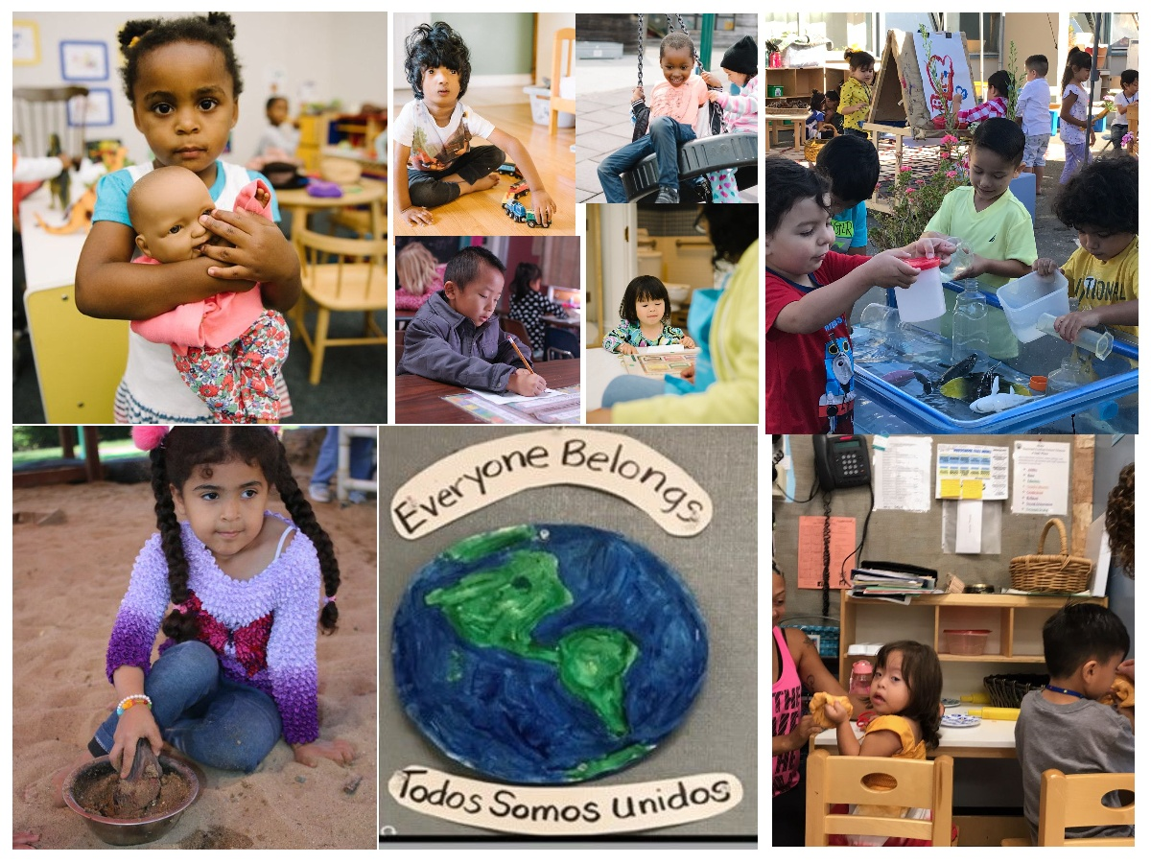
Welcome and Introductions

Slide 3
CDE Recent Webinars
Fiscal Year (FY) 2022–23 Attendance Accounting and Instructional Time Requirements Webinar
Early Education Division September Webinar

Slide 4
CDE Upcoming Webinar
Transitional Kindergarten Webinar
  October 20, 2022 from 1:00 p.m. – 3:00 p.m.
  School Fiscal Services Division (SFSD), in partnership with the Early Education Division (EED) Transitional Kindergarten (TK) requirements under the Local Control Funding Formula

Slide 5
UPK Planning and Implementation
Key Dates
Local educational agencies (LEAs) and county offices of education (COEs) that received UPK Planning & Implementation grant funds must meet all deadlines for reporting as a condition of grant apportionment.
  November 2022: UPK Expenditure Data Collection survey will distributed
  December 2022: Expenditure report submissions due to CDE

Slide 6
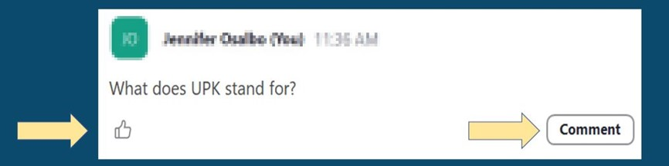
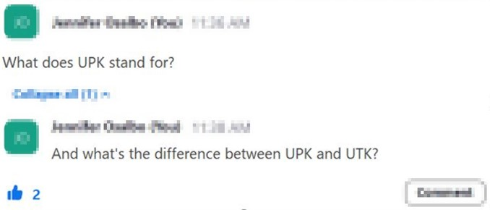

Asking Questions

Slide 7

Questions
&
Answers
Photo Credit: Kidango Decoto Center; Union City, CA

Slide 8
Closing and Next Steps
  Inbox for questions and comments: UPK@cde.ca.gov
  We will post this week's slides on: https://www.cde.ca.gov/ci/gs/em/
We look forward to more opportunities to discuss
the implementation of UPK!
Thank you!

Slide 9
Resources
Program Quality Implementation (PQI) Office Regional Consultants
  https://www.cde.ca.gov/sp/cd/ci/assignments.asp
    Consultants are most easily reached by email
    or by phone at 916-322-6233
Early Education and Nutrition Fiscal Services (EENFS), Fiscal Apportionment Analyst Directory
  https://www.cde.ca.gov/fg/aa/cd/faad.asp
Regulation Related Questions
  EEDTitle5@cde.ca.gov

Slide 10
UPK Resources
California Educators Together:
  https://www.caeducatorstogether.org/groups/e0cfjrjf/upk-p-3
UPK Resources:
  https://www.cde.ca.gov/ci/gs/em/
UPK FAQs:
  https://www.cde.ca.gov/ci/gs/em/kinderfaq.asp
UPK Office Hour:
  https://www.cde.ca.gov/ci/gs/em/upkofficehours.asp
System of Support for Expanded Learning:
  https://www.cde.ca.gov/ls/ex/sosexplearncontacts.asp
Kindergarten through Grade 12 (K-12) Omnibus Trailer Bill:
  https://esd.dof.ca.gov/trailer-bill/public/trailerBill/pdf/527

Slide 11
Budget Resources
Final Budget Summary
  https://www.ebudget.ca.gov/FullBudgetSummary.pdf
Senate Bill (SB) 154
  https://leginfo.legislature.ca.gov/faces/billNavClient.xhtml?bill_id=202120220SB154
Assembly Bill (AB) 210
  https://leginfo.legislature.ca.gov/faces/billNavClient.xhtml?bill_id=202120220AB210
AB 181
  Bill Text - AB-181 Education finance: education omnibus budget trailer bill.

Slide 12
Expanded Learning Opportunities Program (ELO-P) Resources
ELO-P Main Page:
  https://www.cde.ca.gov/ls/ex/elopinfo.asp#elopfaqs
ELO-P Program Plan Guide:
  https://www.cde.ca.gov/ls/ex/documents/elopprogplanguide.pdf
ELO-P FAQs:
  https://www.cde.ca.gov/ls/ex/elofaq.asp
ELO-P Fireside Chats:
  https://www.afterschoolnetwork.org/elo-program
ELO-P Email Box:
  ExpandedLearning@cde.ca.gov

Slide 13
Facilities Resources
Access California Preschool, Transitional, Kindergarten and Full-Day Kindergarten Facilities Grant Program Funding (FDK grant program)
  https://www.dgs.ca.gov/OPSC/Services/Page-Content/Office-of-Public-School-Construction-Services-List-Folder/Access-Full-Day-Kindergarten-Facilities-Grant-Program-Funding
Facilities Contacts:
  Joshua Potter
    Phone: 279-946-8454
    E-mail: Joshua.Potter@dgs.ca.gov
  Lindsey Gordon
    Phone: 279-946-8458
    E-mail: Lindsey.Gordon@dgs.ca.gov

