Slide 1
Universal PreKindergarten (UPK) Implementation
Office Hour
Early Education Division (EED)
May 25, 2022

Slide 2
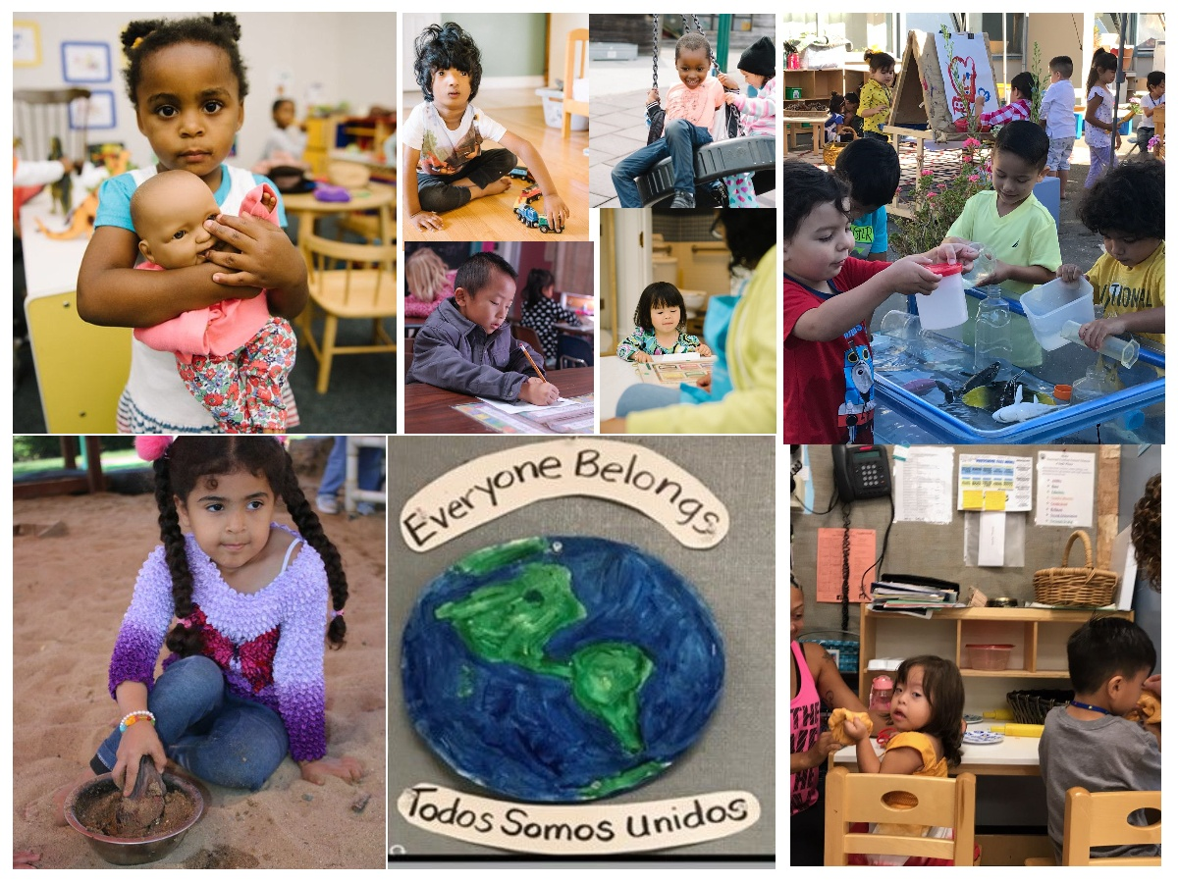
Welcome and Introductions

Slide 3
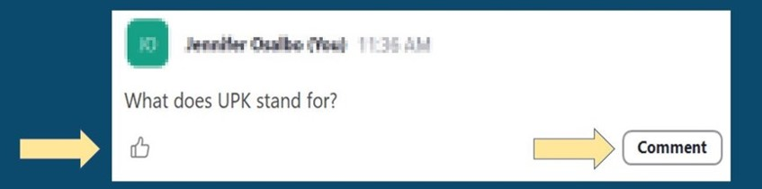
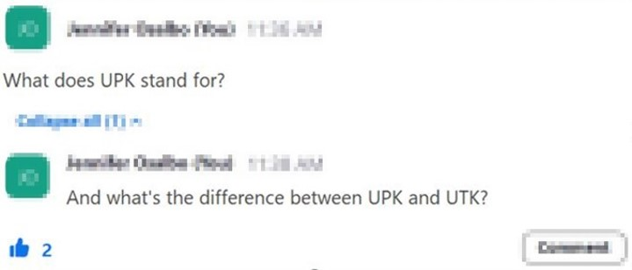
Asking Questions and Upvoting

Slide 4
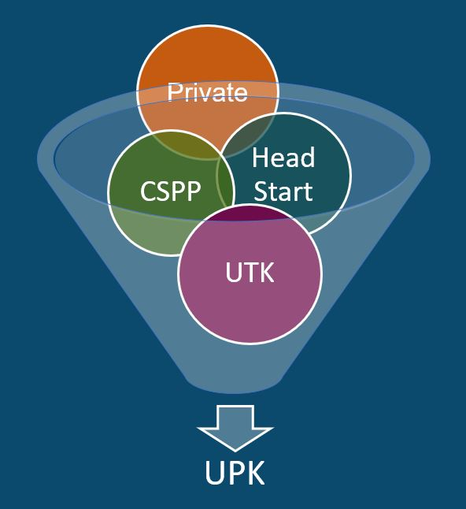
What is UPK?
UPK will bring together programs across early learning and K-12, relying heavily on Universal Transitional Kindergarten (UTK) and California State Preschool Program (CSPP), as well as Head Start, community-based organizations (CBOs), and private preschool.
Universal means that by 2025–26,
regardless of background, race, zip code, immigration status, or income level – every child– has access to a quality learning experience the year before Kindergarten.

Slide 5
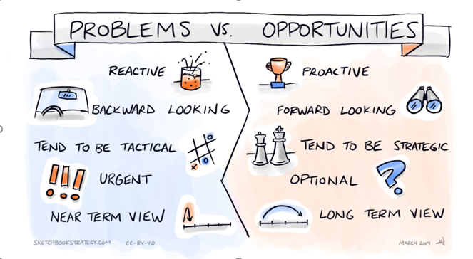
Problems versus Opportunities
Reactive vs. Proactive
Backward looking vs. Forward looking
Tend to be Tactical vs. Tend to be Strategic
Urgent vs. Optional
Near Term View vs. Long Term View
Image Credit: Sketchbookstrategy.com, CC-BY-40, March 2019

Slide 6
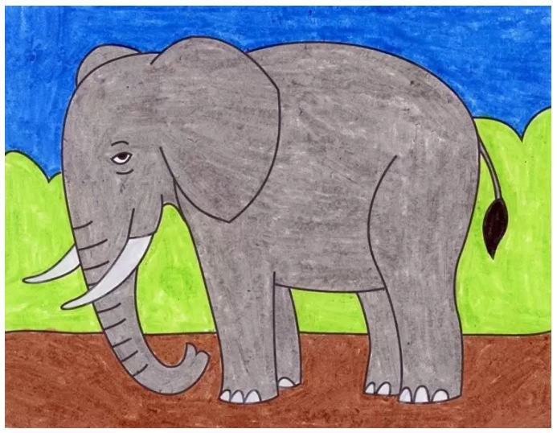
Elephants and Rumors
Districts don’t actually need to plan for UPK (rumor)
All TK classroom must be 1350 square feet (rumor)
Most unserved students reside in districts that don’t offer TK (rumor)
Image Credit: https://artprojectsforkids.org/elephant-tutorial/

Slide 7
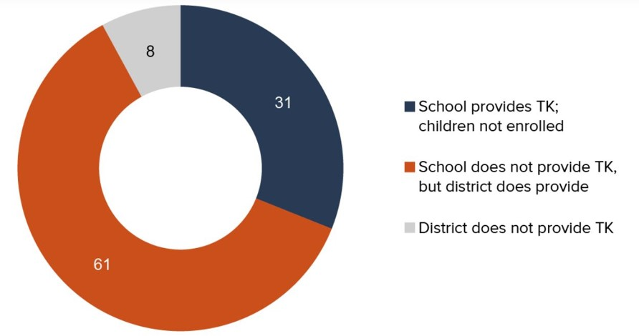
Most unserved children attend a school that does not offer TK, even though their district offers TK
Setting the Stage for Universal Preschool: Is Transitional Kindergarten Serving Students Equitably? by Laura Hill and Emmanuel Prunty. Supported with funding from the Sobrato Family Foundation

Slide 8
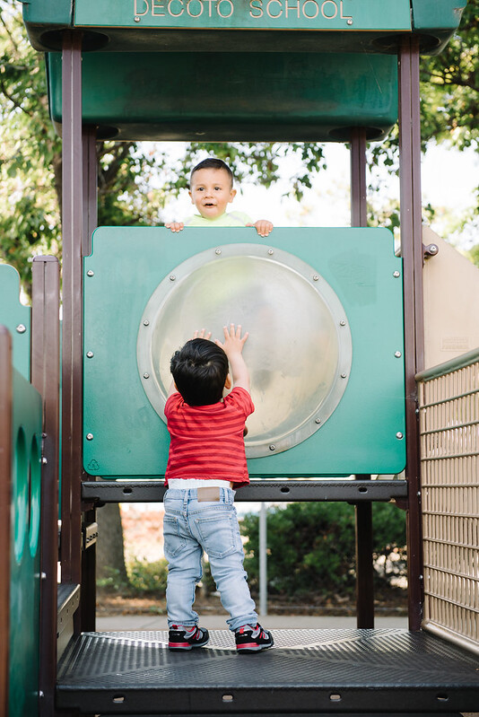
The Early Education Teacher Development Grant
Goals of the grant are to increase CSPP and Transitional Kindergarten (TK) teachers and to increase specific competencies for CSPP, TK, and Kindergarten (K) teachers
The Request for Funding Application (RFA)
is due May 27, 2022
Please visit the RFA's web page for:
  Erratum, Application, Instructions, and Technical Assistance webinar recording
Questions? Email:
  UPKWorkforceRFA@cde.ca.gov
Photo Credit: Kidango Decoto Center; Union City, CA

Slide 9

New Proposed Investments in UPK Implementation
Photo Credit: Kidango Decoto Center; Union City, CA

Slide 10
Universal Transitional Kindergarten (UTK)
Funds the first year of TK expansion to expand eligibility for TK to all children turning five-years-old between September 2 and February 2.
Funding to support an additional educator in TK classrooms
Makes it easier for schools to staff TK classrooms by:
  Allowing teachers with preschool teaching permits who hold bachelors' degrees, meet basic skills requirements, and are enrolled in a credential program by July 1, 2024 to be assigned as the teacher of record in a TK classroom until June 30, 2026
  Clarifying that substitute TK teachers are not required to meet the additional TK teacher requirements around child development
Includes fiscal penalties for not meeting TK class size, ratio, and teacher requirements
Requires TK data to be collected separately from kindergarten data.

Slide 11
California State Preschool Program (CSPP)
Increases support for inclusive preschool classrooms
Invests in family choice and program stability
Supports programs to serve younger children
Supports programs to better serve dual language learners

Slide 12

Live Questions and Answers (Q&A)

Slide 13
Upcoming June CDE Events
CDE P-3 Webinar: Curriculum and Assessments
June 2, 2022 from 3:30 p.m. – 5:00 p.m.
UPK Implementation Webinar: Local Partnership Opportunities
June 8, 2022 from 3:30 p.m. – 5:00 p.m.
UPK Office Hours
June 22, from 4:00 p.m. – 5:00 p.m.

Slide 14
Closing and Next Steps
  Inbox for questions and comments: UPK@cde.ca.gov
  We will post this week's slides on: https://www.cde.ca.gov/ci/gs/em/
We look forward to more opportunities to discuss
the implementation of UPK!
Thank you!

Slide 15
UPK Resources
California Educators Together:
  https://www.caeducatorstogether.org/groups/e0cfjrjf/upk-p-3
UPK Resources:
  https://www.cde.ca.gov/ci/gs/em/
UPK FAQs:
  https://www.cde.ca.gov/ci/gs/em/kinderfaq.asp
UPK Office Hour:
  https://www.cde.ca.gov/ci/gs/em/upkofficehours.asp
System of Support for Expanded Learning:
  https://www.cde.ca.gov/ls/ex/sosexplearncontacts.asp
K-12 Omnibus Trailer Bill:
  https://esd.dof.ca.gov/trailer-bill/public/trailerBill/pdf/527

Slide 16
Expanded Learning Opportunities Program (ELO-P) Resources
ELO-P Main Page:
  https://www.cde.ca.gov/ls/ex/elopinfo.asp#elopfaqs
ELO-P Program Plan Guide:
  https://www.cde.ca.gov/ls/ex/documents/elopprogplanguide.pdf
ELO-P FAQs:
  https://www.cde.ca.gov/ls/ex/elofaq.asp
ELO-P Fireside Chats:
  https://www.afterschoolnetwork.org/elo-program
ELO-P Email Box:
  ExpandedLearning@cde.ca.gov

Slide 17
Facilities Resources
Access California Preschool, Transitional, Kindergarten and Full-Day Kindergarten Facilities Grant Program Funding (FDK grant program)
  https://www.dgs.ca.gov/OPSC/Services/Page-Content/Office-of-Public-School-Construction-Services-List-Folder/Access-Full-Day-Kindergarten-Facilities-Grant-Program-Funding
  Facilities Contacts:
  Joshua Potter
    Phone: 279-946-8454
    E-mail: Joshua.Potter@dgs.ca.gov
  Lindsey Gordon
    Phone: 279-946-8458
    E-mail: Lindsey.Gordon@dgs.ca.gov

