Slide 1
Universal PreKindergarten
Implementation:
Local Partnership Opportunities Webinar
Early Education Division (EED)
Date: June 8, 2022
Time: 3:30 p.m. to 5:00 p.m.

Slide 2

Welcome and Introductions

Slide 3
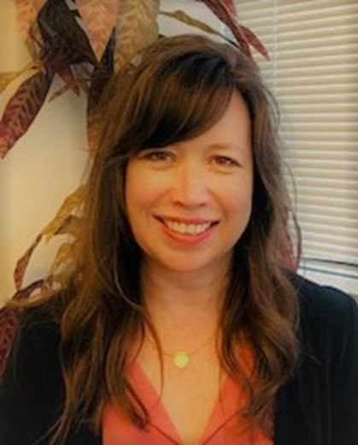
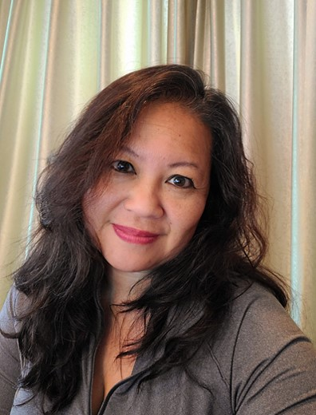
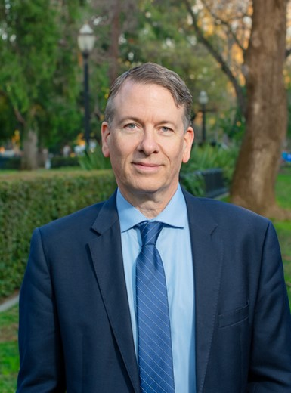
Guest Speakers (1)
Stephanie Myers, California Department of Social Services
Cynthia Yao, Office of Head Start, Administration for Children and Families
Christopher Maricle, Head Start California

Slide 4
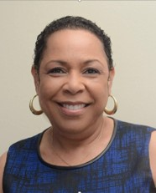
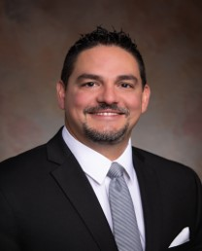
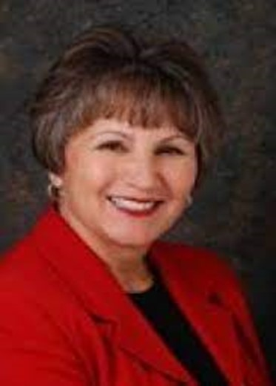

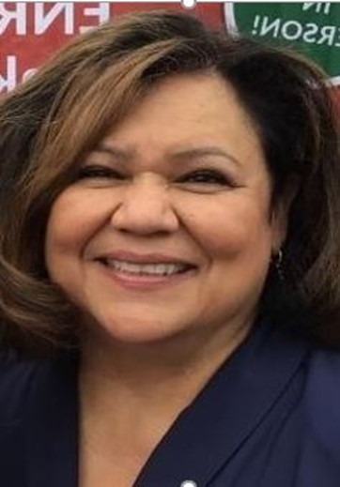
Guest Speakers (2)
Keesha Woods, LA County Office of Education Head Start and Early Learning Division
Tony Jordan, Stanislaus COE and Families Services Division
Aida Buelna, Sacramento City Unified School District
Dr. Julie Montali,
Sacramento County Office of Education (SCOE)
Yolanda Perez, All Kids Academy Head Start

Slide 5
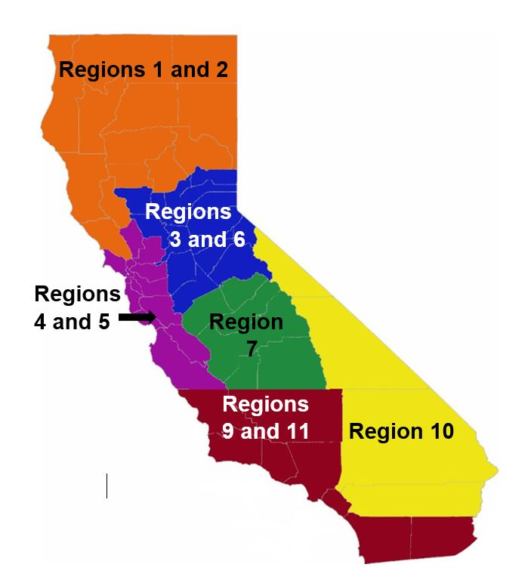
Who is in the ‘room’ with us today?
California County Superintendents Educational Services Association (CCSESA) regions:
Northern CA: Regions 1 and 2 (orange)
Greater Sacramento: Regions 3 and 6 (blue)
Bay Area or Coastal: Regions 4 and 5 (purple)
Central Valley: Region 7 (green)
Inland Empire: Region 10 (yellow)
Southern CA: Regions 8, 9 and 11 (red)
CCSESA: http://CCSESA.org/regions/

Slide 6
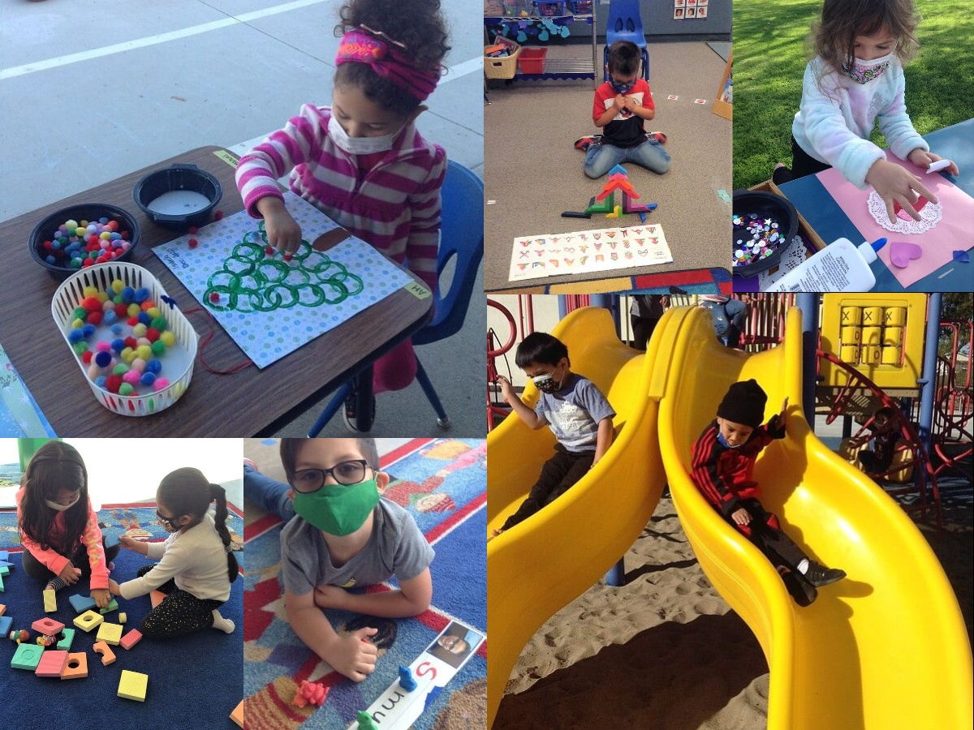
Review of Universal PreKindergarten
Photo Credit: UPS Preschool; Camarillo, CA

Slide 7
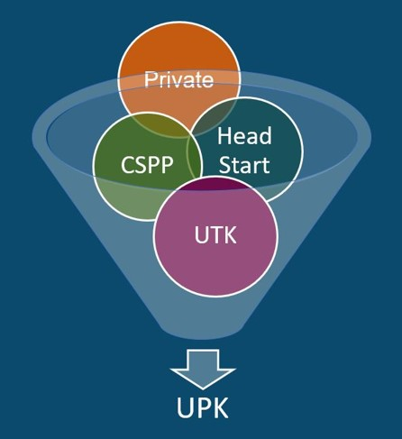
What is Universal PreKindergarten (UPK)?
UPK will bring together programs across early learning and K-12, relying heavily on Universal Transitional Kindergarten (UTK) and the California State Preschool Program (CSPP), as well as Head Start, community-based organizations (CBOs), and private preschool to ensure every four-year old child – regardless of background, race, zip code, immigration status, or income level – has access to quality learning experiences the year before kindergarten.

Slide 8
UPK Implementation Schedule:
TK and Early Admittance TK (ETK)
Birthdays | 2021–22 | 2022–23 | 2023–24 | 2024–25 | 2025–26
Sept. 2–Dec. 2 | TK | TK | TK | TK | TK
Dec. 3–Feb. 2 | ETK | TK | TK | TK | TK
Feb. 3–Apr. 2 | ETK | ETK | TK | TK | TK
Apr. 3–Jun. 2 | ETK | ETK | ETK | TK | TK
Jun. 3–Jun. 30 | ETK | ETK | ETK | ETK | TK
Jul. 1–Sep. 1 | Other | Other | Other | Other | TK

Slide 9
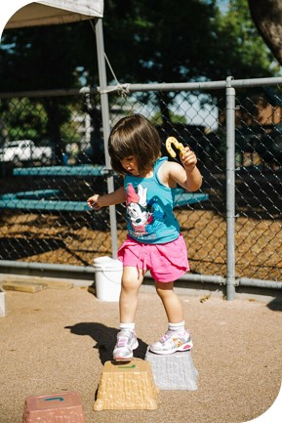
California State Preschool Program (CSPP)
Photo Credit: Kidango Decoto Center; Union City, CA

Slide 10
CSPP Overview
Part-day and Full-day options
Eligibility Criteria
Local educational agencies (LEAs) may apply for license exemption if they are serving only four-year-old children
Staffing, ratio, environment, and assessment requirements

Slide 11
CSPP Eligibility Criteria (Current Law)
Three and four-year old children–as well as TK and kindergarten-age children are eligible for part- and full-day CSPP if the child's family is:
A current aid recipient
Income eligible (income below 85 percent of state median income)
Homeless
One whose children receive child protective services or identified or at risk
Lives within and attends a CSPP program within the attendance boundaries of a school where 80 percent or more of pupils are eligible for free- or reduced-price meals
For Part-Day CSPP only:
Children from families with incomes slightly above the income threshold
Children with exceptional needs with income above eligibility threshold

Slide 12
Selected CSPP Programmatic Standards
Item | More Details
Environment Rating Scales | For preschool, instrument is the Early Childhood Environment Rating Scale, Revised Edition, 1998 (ECERS-R) Must be completed annually as part of the self-evaluation process Achieve a minimum average score of "good" on each subscale
Staffing and Ratios | Maintain a minimum of a 1:8 adult-child ratio and 1:24 teacher-child ratio Teacher must have at least a Child Development Associate Teacher Permit Adult means someone at least 18 years of age
Desired Results Developmental Profile (DRDP) | Must use an age-appropriate version of the DRDP: Comprehensive View, Fundamental View, or Essential View of the DRDP Preschool Initial DRDP completed for each child between 60 and 90 calendar days Second rating period six months after the initial rating

Slide 13

Partnering with Head Start:
U.S. Department of Health & Human Services and the Office of Head Start
2022

Slide 14
Purpose of Head Start
To promote the school readiness of low-income children by enhancing their cognitive, social, and emotional development in a learning environment that supports their growth comprehensively through the provision to children and their families of health, educational, nutritional, social, and other services that are determined, based on family needs assessments, to be necessary.

Slide 15
Early Head Start Eligibility
Age​
Pregnant Women & ​
Children Birth to Age 3​
Income​
≤ Federal Income Guidelines*​
Other Eligibility Requirements​
Family is eligible for public assistance (TANF, SSI, SNAP)​
Child is homeless ​
Child is in foster care
Minimum of 10 percent of enrolled children must have a diagnosed special need
* Up to 10 percent over income and up to 35 percent income below 130 percent poverty

Slide 16
Head Start Eligibility
Age
Children Aged 3-5*
Income
≤ Federal Income Guidelines*
Other Eligibility Requirements
Family is eligible for public assistance (TANF, SSI, SNAP)
Child is homeless or in foster care
*at least 3 years old, or turn 3 years old by the date used to determine eligibility for public school in the community in which the Head Start program is located; and be no older than the age required to attend school.
Minimum of 10 percent of enrolled children must have a diagnosed special need
* Up to 10 percent over income and up to 35 percent income below 130 percent poverty

Slide 17
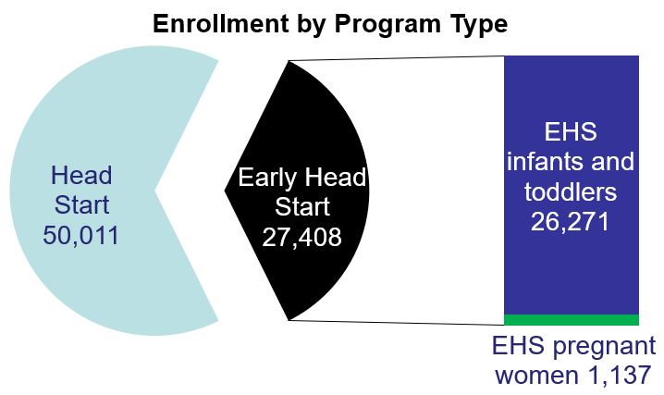
California Program Statistics
Total Funded Enrolment for CA: 88,184
Total Served in CA: 77,419
Approximately 24% operating part day center based services
Long description of pie graph

Slide 18
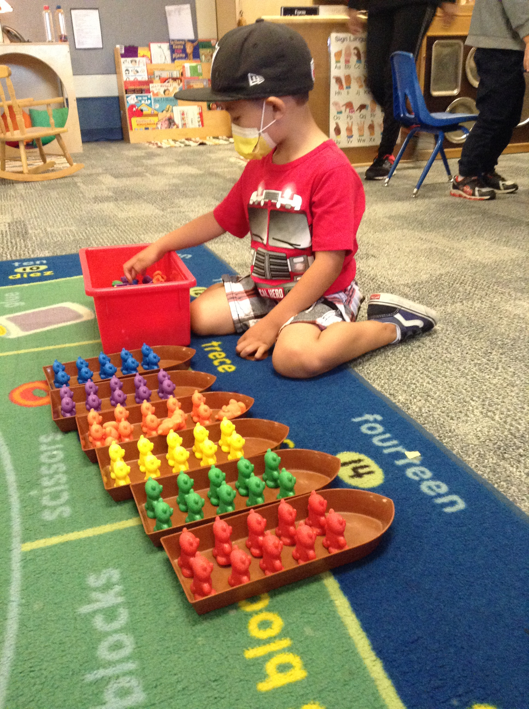
California’s mixed delivery system
Head Start
Head Start and California State Preschool (CSPP)
Early Head Start and CCTR/General Child Care
Early Head Start and Child Care Partnership (EHS-CCP)
Photo Credit: UPS Preschool; Camarillo, CA

Slide 19
California Head Start – By the Numbers
Number | Type
122,704 | Children and Families
1,700 | Sites
147 | Grantees
70% | Have State Preschool or General Childcare Contracts

Slide 20
California Head Start – By Agency Type
Agency | Number | Percent of Children
Private Non-Profit | 59 | 44%
Local Educational Agencies | 56 | 29%
Community Action Programs | 12 | 17%
Tribal Nations | 13 | 1%
Other Government Agencies | 6 | 9%

Slide 21


County Outreach

Slide 22

Master Plan for Early Learning and Care:
Making California For All Kids
A consolidated, coherent system will bring children and their early learning and care professionals the support they need to thrive.
Photo Credit: https://tinyurl.com/5n773tjd

Slide 23
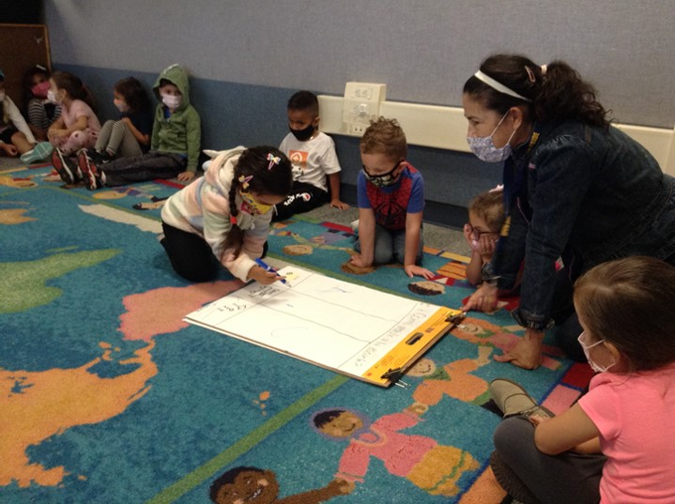
Universal PreKindergarten
Collaboration is Key!
Sharing responsibility: COEs, LEAs, and early learning partners (e.g., Head Start)
Convening collaborative planning meetings between early learning partners, such as Head Start, to cultivate relationships
Facilitating one-on-one and small group communication between LEAs and Head Start
Utilizing existing structures, such as Local Planning Council (LPC), to work with Head Start in leadership roles
Photo Credit: UPS Preschool; Camarillo, CA

Slide 24
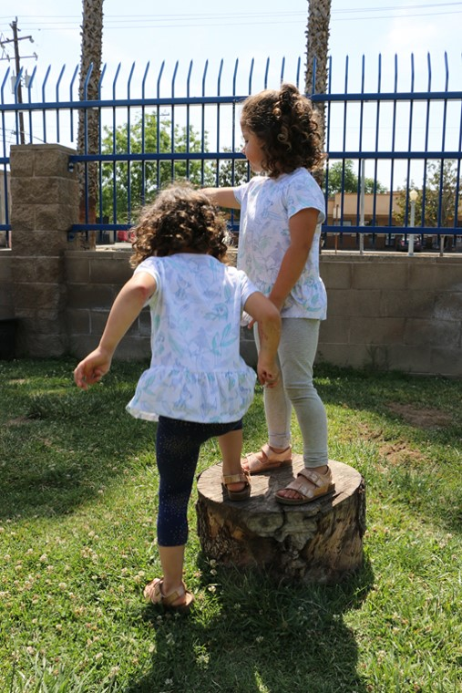
Benefits for LEAs
Shared Costs
Earnings based on enrollment, not attendance
Additional funding for administrative costs
Maximized facility space
Financial support for facilities and outdoor enhancements
Expanded hours at no additional cost to the district
Additional support staff
Photo Credit: LaVera Williams Early Learning Center; Fresno, CA

Slide 25
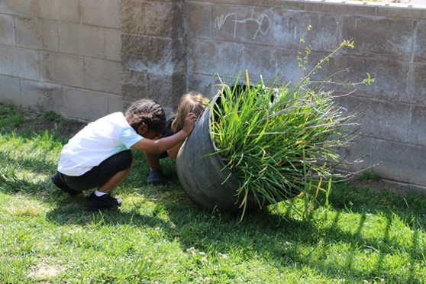
Collaboration Models
Blended Model
Layered: Wrapped or Enhanced
Co-Mingled
Co-Located
Common Combinations
  HS/CSPP
  EHS/CCTR
  MSHS/CMIG
Key Distinctions
  No set times of day
  Concurrent Regulations
  Creates a New Program
  Used for Duration
Supports 1302.20
  Full-day, school/work
  Alternate funding
  Payer of Last Resort
Photo Credit: LaVera Williams Early Learning Center; Fresno, CA

Slide 26
Head Start Working with Districts as a Private Non-Profit Co-Located Program:
Locally Designed Option
Wrapped with part-day CSPP funding and part-day Head Start funding provides full-day services.
Teachers are from the School District.
Contracts include additional Head Start and State requirements: 3rd Assessment (DRDP), Snack, Nap time.

Slide 27
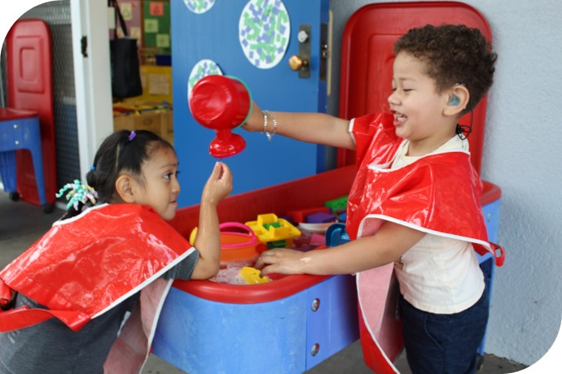
Partnering for the Future
Photo Credit: Breed St. Elementary, Deaf & Hard of Hearing Program; Los Angeles, CA

Slide 28
TK and Head Start Collaborative Pilot (1)
Braiding Head Start with TK to provide comprehensive services
Address under enrollment in Preschool
Adapt to Universal Transitional Kindergarten
Balanced Budget-Fiscal Solvency by braiding funding with California State Preschool Program/Head Start and Transitional Kindergarten
Meets 100% Head Start Performance Standard 1302.21 (c)(2)(iii) - program duration extended day services
Provide extended day opportunity for preschool students
Collaborate with Youth Development to provide extended educational program for after school

Slide 29
TK and Head Start Collaborative Pilot (2)
Collaborate with Special Education to meet the needs of all preschool students (Universal Transitional Kindergarten)
Enrolled families will receive comprehensive Health, Wellness and Education services in alignment with Head Start and California State Preschool Program requirements
Brings equity to the preschool community by a full day opportunity for ALL
Provides equity in working conditions for all preschool classroom staff
Reinstates additional support staff
Implements 2- UTK/HS collaboration pilots

Slide 30

Birth to Kindergarten Transition Systems Alignment Framework (1)
Why Do We Need a Transition Framework?
Successful transitions require many parts working together to create a solid systems approach
Children benefit from a high-quality PreK experience
We need a sturdy bridge into kindergarten to set them on the right path & ensure they continue to thrive
California is large, with thousands of PreK and elementary schools & providers
It takes all of us–teachers, parents, administrators, communities–to come together
The framework provides templates, tools, and resources to build transition systems in each school & community
Link to book on slide 32

Slide 31

Birth to Kindergarten Transition Systems Alignment Framework (2)
Three C’s of Transition Impacting Child Outcomes
Four Subsystems
  Leadership
  Family
  School
  Community
Three Key Elements
  Coordination
  Cooperation
  Collaboration
Photo Credit: LA County Birth to Kindergarten Transition Systems Alignment Framework

Slide 32

Transition Framework
https://tinyurl.com/2x5kxe3r
Return to slide 30

Slide 33
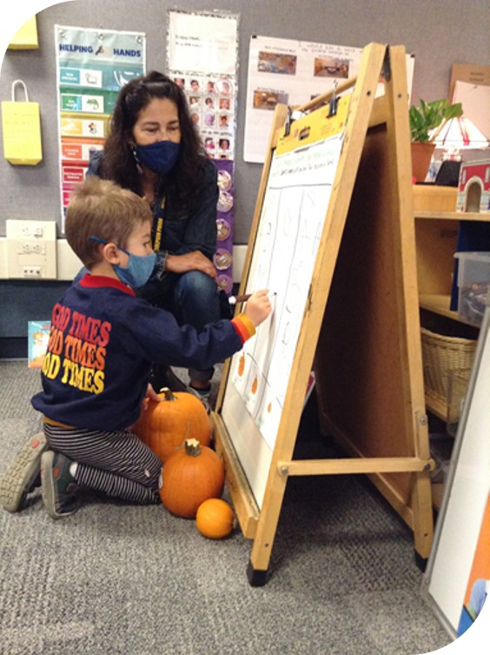
Head Start Partnership Toolkit
Photo Credit: UPS Preschool; Camarillo, CA

Slide 34

Possible Next Steps
Share local needs assessment to determine the scope of need in your community.
Review local agreements and MOUs.
Schedule ongoing meetings to design partnerships to improve and expand early childhood learning and care.​
Photo Credit: Tree of Life International Charter School; Anderson, CA

Slide 35
UPK Resources
CDE Elementary web page with the Planning Templates and Guidance Volumes 1 and 2 (and eventually this webinar’s recording) https://www.cde.ca.gov/ci/gs/em/
California Educators Together: https://www.caeducatorstogether.org/
UPK and P3 Group on California Educators Together https://www.caeducatorstogether.org/groups/e0cfjrjf/upk-p-3
Master Plan: https://californiaforallkids.chhs.ca.gov/assets/pdfs/Master%20Plan%20for%20Early%20Learning%20and%20Care%20-%20Making%20California%20For%20All%20Kids%20(English).pdf
CSPP Program Handbook: https://www.cde.ca.gov/fg/aa/cd/documents/cspp2122.docx

Slide 36
Head Start Resources
Performance Standards
https://eclkc.ohs.acf.hhs.gov/policy/45-cfr-chap-xiii
LACOE Birth to Kindergarten Transition Systems Alignment Framework https://headstartca.org/wp-content/uploads/2021/09/LA-COUNTY-BIRTH-TO-KINDERGARTEN-TRANSITION-SYSTEMS-ALIGNMENT-FRAMEWORK-2ND-EDITION.pdf
Head Start Partnership Toolkit: https://headstartca.org/about/head-start/collaboration-office/partnership-toolkit/
Cynthia Yao, Regional Program Manager for Region 9 Office of Head Start, Administration for Children and Families: cynthia.yao@acf.hhs.gov
Stephanie Myers, California Head Start State Collaboration Office Director, California Department of Social Services: Stephanie.Myers@dss.ca.gov

Slide 37
Closing and Next Steps
  Inbox for questions and comments: UPK@cde.ca.gov
  We will post this webinar: https://www.cde.ca.gov/ci/gs/em/
We look forward to seeing you next time!
Thank you!

Slide 38
Image long descriptions

Slide 39
Pie graph on slide 17
Pie graph of Enrollment by Program Type for Head Start and Early Head Start. Pie graph shows a total of 77,419 children served in California. The pie chart is broken up to show approximately 70 percent, 50,011 for Head Start, 27,408 for Early Head Start and 30 percent, 27,408. Two lines from each corner of the pie chart showing the data for 27,408 is extended and connects to a rectangle representing the total amount of 26,271 of infants and toddlers filled in blue and 1,1137 filled in green at the bottom of the rectangle that represents the Early Head Start program for pregnant women. Return to slide 17.

