Slide 1
Mathematics Framework
Slides for Local Educational Agencies to Use When Talking to Families
California Department of Education, August 2025
(Slide notes are used throughout the document)

Slide 2
How to Customize This Deck
Save the deck to your computer.
Add in any school or district logos to the title slide (slide three).
Add talking points to slide 12.
Present the deck as needed.

Slide 3
Mathematics Framework
for California Public Schools
Kindergarten Through Grade Twelve
Notes:
Let’s cover information about the Mathematics Framework for California Public Schools, Kindergarten through Grade Twelve.
The Framework was adopted by the California State Board of Education in July 2023.

Slide 4

The 2023 Mathematics Framework
It provides implementation guidance grounded in research and reflects best practices across the globe.
It supports equitable and engaging teaching and learning of mathematics for all students!
Notes:
We want to start by stating that the Common Core State Standards for Mathematics, which describe “what” students learn, have not changed.
The standards map out what California students need to know and be able to do, grade by grade, in mathematics.
The 2023 Mathematics Framework gives teachers and educators guidance on teaching and learning math in an equitable and engaging way.
You can think of the Framework as the “how to” manual for the teaching the math standards.
The Framework is based on research, and it reflects best practices across the globe for supporting equitable and engaging teaching and learning of mathematics for all students.
The Framework invites readers to reimagine mathematics and move toward a new century of mathematical excellence for all.

Slide 5
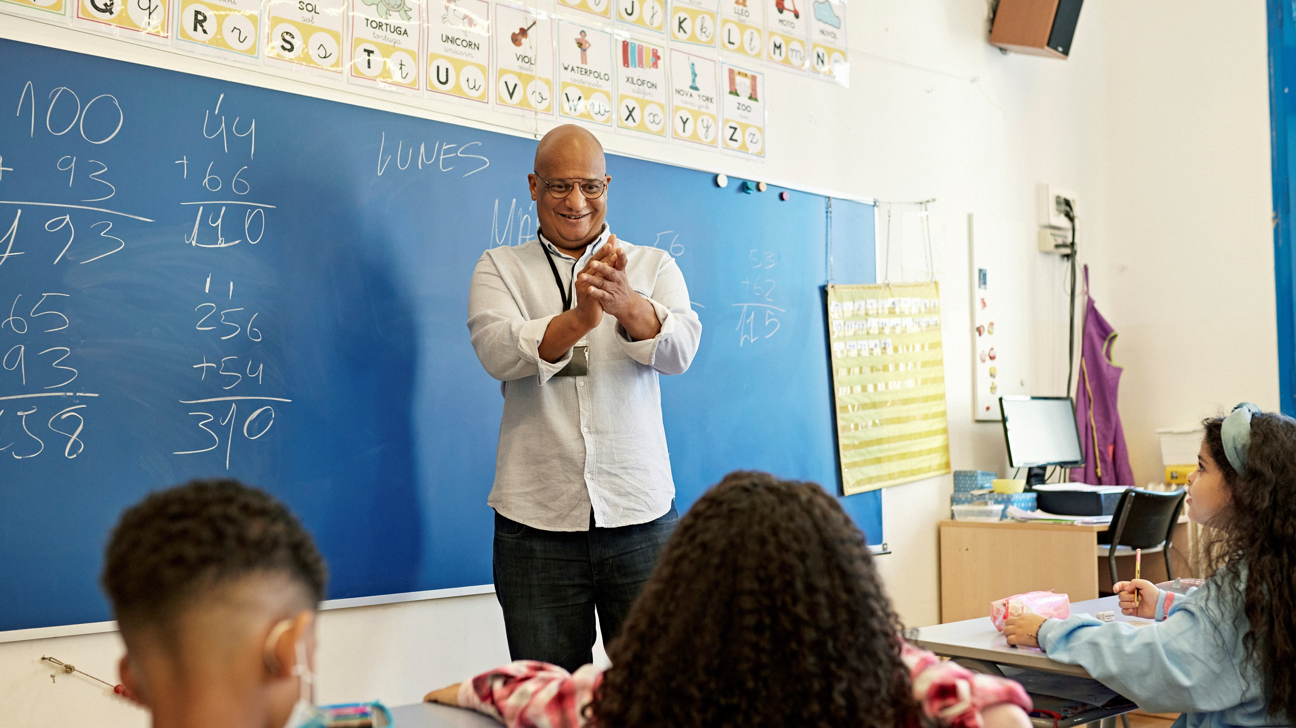
Why a New Framework?
Notes:
So why do we have a new Framework?
It’s been 10 years since the last framework was adopted, and educators and researchers have learned so much more about implementation of the Common Core State Standards since then.
Examples of this include:
Designing lessons and units so that topics are studied more deeply, with applications to real world problems.
Instructional practices include collaborative problem-solving strategies, classrooms with students at different levels, and an integrated approach to mathematics from grade school through high school.
Seeing opportunities for growth in math capacity by supporting students to believe that they can achieve high levels of math with effort and learning.
Multiple studies have found that students with a growth mindset achieve at higher levels in mathematics.
The need for classrooms to be an inclusive environment for all students by encouraging students to leverage the knowledge and experience they bring with them.
Remember, students learn math more deeply and robustly when lessons that engage them with multiple mathematical representations such as numerals, words, visuals, models, algorithms, tables, and graphs and different forms of expression.
Our new Framework takes this approach to make every student a “math student”.

Slide 6
Another Reason for a New Framework
2018–19
2023–24
39.73 percent
Met or Exceeded
standards in Math
35.54 percent
Met or Exceeded
standards in Math
Notes:
The primary reason for the new Framework is that we know that all of our children are capable of math achievement at much greater levels than reflected by current test scores, and we believe that every child can learn math. However, statewide test results show that only a third, or 35.54 percent, of all students met or exceeded the math standards in 2023–24.
This is lower than the 39.73 percent of students who met or exceeded the math standards in 2018–19, before the COVID-19 pandemic.
What is concerning are the differences between test scores for White and Asian students compared to other student groups.
Prior to the pandemic, fewer than 30 percent of students in each student group—except White or Asian students—met or exceeded the standards.
Scores for all student groups, including White and Asian students, declined between 2019 and 2024. Efforts to improve math achievement since 2022 have improved student test scores, but we want to make sure that every child’s achievement in math reflects their potential and supports them to thrive.

Slide 7
Supporting Student Growth in Mathematics
2021–22
2022–23
2023–24
Notes:
As we continue to move forward from the challenges of the pandemic, we’re also seeing real progress in how students are growing in math.
In 2023–24, 35.54 percent of all students across all tested grades met or exceeded the mathematics standard.
This is an increase from the 33.38 percent in 2021-22 and the 34.62 percent in 2022-23.
This steady improvement shows that we’re heading in the right direction.
We know every student brings their own strengths and experiences to the classroom.
With the right support, all students can grow and succeed in math.
We’re committed to setting high expectations and making sure every student has the tools and support to meet them.

Slide 8

Big Ideas
The framework organizes instruction around the Big Ideas that integrate multiple content standards, allowing teachers to guide students in connecting mathematical concepts within and across grade levels.
Notes:
Using the Framework, teachers guide students toward understanding the major math concepts in each grade level.
These are called Big Ideas.
Teachers also use the Framework to guide students toward proficiency in the content standards.
The Big Ideas evolve into more complex math concepts throughout the elementary and middle school grade levels.
This helps students build a strong foundation for success in high school level math courses
The Framework connects learning to the real world, which helps students engage with math and prepares students for an increasingly data-driven world.

Slide 9
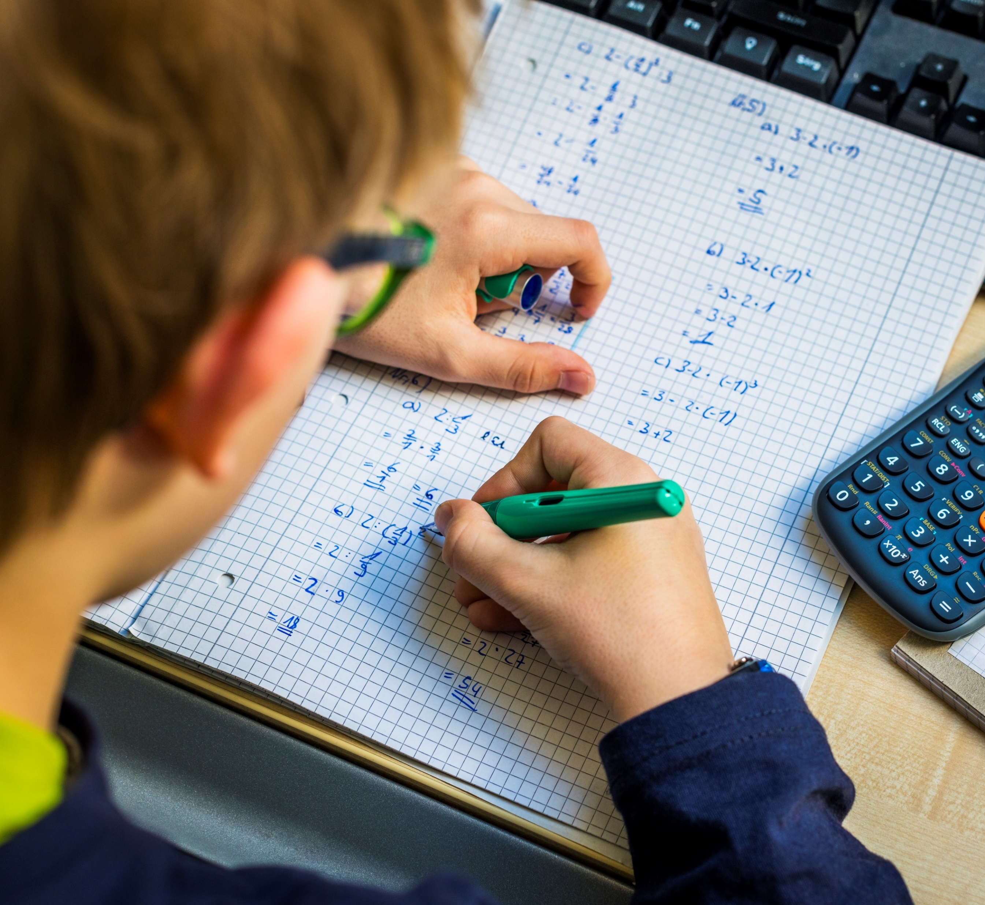
The Mathematics Framework guides educators in designing math lessons.
Notes:
The Framework helps teachers design lessons that start with real-world math questions, provide opportunities for students to learn and practice math skills, and deepen their understanding of essential math concepts
It is also meant to help parents and guardians understand the math their students learn.
It also supports school and community partners with discussions of system structures and materials for all learners.
The Framework is also meant to help parents and guardians understand how their students are learning math rather than understand the math itself.

Slide 10

Students and Math
Notes:
Instead of students working independently on pages of math problems with no context or relevance in the real world, you can expect your child to more often be working on math collaboratively with other students, where they will use real data, critical thinking, and their growing understanding of math concepts to investigate problems and build their mathematical skills.
They will be encouraged to ask questions about their work and justify the answers that they come up with.
Let’s look at a few examples.

Slide 11
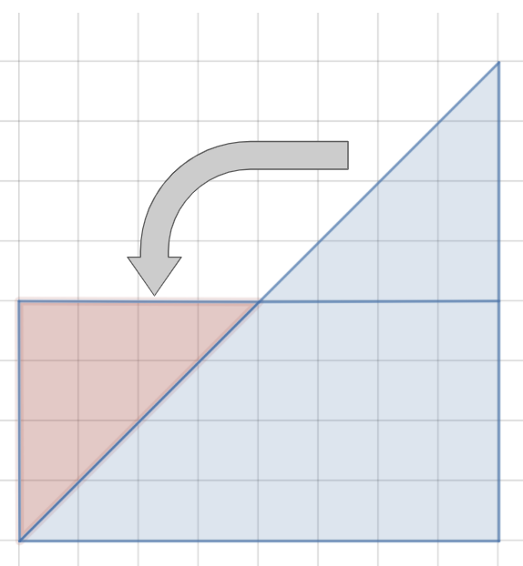
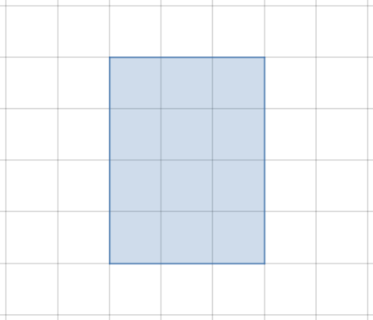
A Middle School Example
Example 1
Example 2
Notes:
One example of this is in middle school.
Our example school takes an approach to math that lets each student, grades six through eight, progress on his or her own learning path.
This is done through teacher-led, collaborative, and independent learning so that students can build deep understanding of math concepts and apply their learnings in real-world contexts.
At the start of the year, each student will take a diagnostic assessment.
The data will be used to build a personalized set of mathematical ideas that the student will learn for the year.
This will help the students, their teachers, and their parents understand what their learning will focus on this year and why.
So Monique, who is a currently high achieving sixth grade student, and Darren, who is less experienced in geometry than Monique, will be able to engage in the same project because it is accessible at many levels.
So in our example one on the slide of a rectangle on a grid, when the teacher asks the students how they would describe this rectangle, possible answers include:
“It’s a 3×4 rectangle.”
“It’s made up of 12 squares.”
“Its perimeter is 14 units.”
“Its area is 12 square units. I know that because 3×4=12.”
This can then be translated into harder shapes such as triangles, using the same basic knowledge, as shown in example two, which is a series of triangles moved to make a rectangle.
In this example:
Students might count or otherwise calculate the number of whole squares first and then move on to the partial squares. They could count these as halves, or pair them up to make wholes.
Students might recognize that two of the triangles make a square, and thus the area of one triangle must be half the area of the square.
Students might notice that the top portion of the triangle can be rotated down to make a rectangle.
This is an example of equity in math, meaning each student brings their own understanding and level to the problem, and the problem is open enough to be solved in many ways, which is equitable for all students.
This was taken from the appendix of the Framework, and there are many more examples to explore.

Slide 12
An Elementary School Example
Problem 1
Problem 2
10+10=□
13+13=□
Notes:
Let’s look at one more example from the appendix of the Framework, this time in elementary school.
In this example, early in the school year, second-graders have started work with addition. They have been building on first-grade concepts, now finding “doubles” with sums greater than 20.
The teacher is trying to raise student understanding of a powerful idea in mathematics: taking things apart and refitting them back together.
To do this, the teacher begins with a number talk.
The intention is to model thinking out loud based on a string of problems the children have explored before. The teacher will then challenge students to calculate in their heads, extending their thinking one step beyond previous work.
The problem is written on the board, and students take several minutes of quiet thinking time.
When they have a solution, students show a quiet thumbs-up signal.
If students solve the problem in more than one way, they show a corresponding number of fingers.
When all (or almost all) students signal that they have an answer, the teacher asks students to share their responses with their elbow partner and to show a thumbs up when they are ready to share with the class.
Student responses are recorded on the board without comment on correctness.
Students explain, defend, or challenge the recorded solutions, and reach consensus as a class.
The teacher refers students to familiar sentence frames for articulating their explanation, defense, or challenges. These provide a foundation for rich discussion of mathematics and can help reduce students’ reluctance to engage.
The first problem posed is 10 + 10 = $◻$.
As expected on this familiar, well-practiced addition problem, almost all the children signal a thumbs up within a short time, and all children agree on the answer.
The teacher writes a second problem below the first:
13 + 13 = $◻$.
Several thumbs rise quickly.
Some children use their fingers to calculate, while others nod their heads, as if counting mentally.
After three minutes, almost all children have found a solution; they whisper to share their answers with their partners.
When the teacher calls for answers, a majority of children say the sum is 26; three children think it is 25.
Three students explain how they found 26:
“I know that 13 is 3 more than 10, but there were two thirteens, and 10 + 10 = 20, so 6 more makes it 26.”
“I started at 13 and counted on 13 more: 14, 15, 16, 17, 18, 19, 20, 21, 22, 23, 24, 25, 26.”
“Well, I knew that 10 + 10 was 20, so I just took off the threes (in the ones place) and added those, and that made 6. So, 20 + 6 = 26.”
The teacher then continues to clarify the learning in a way that is accessible to all students in the class.

Slide 13

Students and Math Revisited
Notes:
I hope you now have a better understanding of how math learning designed this way heightens student engagement, supports those who may struggle, and makes increased math achievement attainable for all students.
[insert a few statements here about math at your school or district]

Slide 14

Thank you for joining us today!
Notes:
Thank you for joining us today as we talked through the new Mathematics Framework.

