Slide 1
Title II, Part A
Consolidated Application & Reporting System (CARS)
SPRING Release
MaY 14, 2024
[Note: Slide notes are used throughout this PowerPoint.]
Notes:
Good afternoon, thank you for taking the time to learn more about the Consolidated Application & Reporting System (CARS) Spring Release. My name is Lisa Fassett and I am one of the Title II, Part A team members.
Additional Title II, Part A Team members joining us in the Chat today are Alice Ng from the Professional Learning Support Division, and Tamara Dow from the Education Data Office.
Today we will go over the Title II, Part A Spring forms in the CARS, the timeline, and provide links to information and additional resources in the chat or at the end of the PowerPoint.
Please use the Chat to ask questions about the CARS Spring forms. Although the focus of today’s webinar is the CARS Spring forms. For questions regarding the Title II, Part A Program, please contact our office. Our contact information is presented at the end of the presentation.
A copy of the PPT will be posted to the Title II, Part A Technical Assistance Webinar web page: https://www.cde.ca.gov/pd/ti/tii-webinars.asp. A link is provided in the Chat.

Slide 2
Check In
Knowing who is in the room helps to ensure our presentation is tailored to your needs. Please share with us your experience with the Consolidated Application and Reporting System (CARS).
How familiar are you with CARS Forms?
      Not familiar
      Somewhat familiar
      Very familiar
Notes:
Check In
Knowing who is in the room helps to ensure our presentation is tailored to your needs. Please share with us your experience with the Consolidated Application and Reporting System (CARS).
How familiar are you with CARS Forms?
Not familiar
Somewhat familiar
Very familiar
Please provide your answer in the chat.

Slide 3
Agenda
Purpose of Title II, Part A
Application/Requirements
Assurances
CARS Spring Forms - Reports Due
Expenditure Deadlines
Important Dates
Notes:
Agenda
Purpose of Title II, Part A
Application
Requirements
Assurances
CARS Spring Forms – Reports Due
Expenditure Deadlines
Important Dates

Slide 4
Title II, Part A Purpose
Increasing student achievement consistent with the challenging state academic standards
Improving the quality and effectiveness of teachers, principals, and other school leaders
Increasing the number of teachers, principals, and other school leaders who are effective in improving student academic achievement in schools
Providing low-income and minority students greater access to effective teachers, principals, and other school leaders
20 United States Code (U.S.C.) Section 6601
Notes:
Let’s take a moment to review the purpose of Title II, Part A.
The purpose of Title II, Part A is:
Increase student achievement consistent with the challenging state academic standards
Improve the quality and effectiveness of teachers, principals, and other school leaders
Increase the number of teachers, principals, and other school leaders who are effective in improving student academic achievement in schools
Provide low-income and minority students greater access to effective teachers, principals, and other school leaders
​
Title II, Part A funded activities in your district should address the areas of greatest need identified through the needs assessment process.

Slide 5
Applying for Title II, Part A Funds
In order to apply for Title II, Part A Funds, a local educational agency (LEA) must complete:
  Local Control and Accountability Plan (LCAP)
  https://www.cde.ca.gov/re/lc/
  LCAP Federal Addendum
  https://www.cde.ca.gov/re/lc/addendumguidance.asp
  Consolidated Application (ConApp) and required forms
  CARS logon page: https://www3.cde.ca.gov/CARS/app/logon.aspx
  ConApp web page: https://www.cde.ca.gov/fg/aa/co/index.asp
Notes:
Applying for Title II, Part A Funds
Most local educational agencies (LEAs) have completed these. For any New LEAs applying for the 1st time, must complete all of the following.
An LEA’s complete application includes:
A Local Control and Accountability Plan (LCAP) which is a three-year plan that describes the goals, actions, services, and expenditures to support positive student outcomes that address state and local priorities. Further information can be found on the LCAP web page: https://www.cde.ca.gov/re/lc/. A link is provided in the Chat.
The LCAP Federal Addendum which is a supplement to the LCAP to ensure that eligible LEAs have the opportunity to meet the LEA Plan provisions of the Every Student Succeeds Act (ESSA). Further information can be found on the LCAP Federal Addendum web page: https://www.cde.ca.gov/re/lc/addendumguidance.asp. A link is provided in the Chat.
The Consolidated Application (ConApp), is a two-part application and reporting process for multiple state and federal, formula-driven, categorical program funds submitted by county offices, school districts, and direct-funded charter schools. LEAs access their application on the CARS logon page: https://www3.cde.ca.gov/CARS/app/logon.aspx. A link is provided in the Chat.
The ConApp is used by the California Department of Education (CDE) to distribute categorical funds from various state and federal programs to county offices of education, school districts, and direct-funded charter schools throughout California. Additional information can be found on the CDE ConApp web page: https://www.cde.ca.gov/fg/aa/co/index.asp. A link is provided in the Chat.

Slide 6
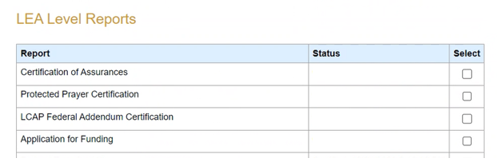
ConApp LEA Forms
LEAs may access their ConApp LEA Forms on the CARS logon page: https://www3.cde.ca.gov/CARS/app/logon.aspx.
Notes:
Here is a screenshot of the ConApp's LEA Forms that all participating LEAs must complete.
LEAs may access their ConApp LEA Forms on the CARS logon page: https://www3.cde.ca.gov/CARS/app/logon.aspx. This link was previously provided in the Chat.
All participating LEAs must complete the following ConApp required forms/certifications:
Certification of Assurances: (which includes general certifications, must keep a copy on file at the LEA)
Protected Prayer Certification
LCAP Federal Addendum Certification
Application for Funding
Let’s go over these forms:

Slide 7
Certification of Assurances
Required to submit every fiscal year (FY).
Must be certified, before certifying any other data.
This form can only be submitted by a CARS user with the role of Authorized Representative.
The Authorized Representative’s signature is required to certify that all applicable state and federal rules and regulations will be observed.
Instructions: https://www.cde.ca.gov/fg/aa/co/ca24sinsca.asp
Notes:
Certification of Assurances
LEAs are required to submit this form every fiscal year (FY).
This form Must be certified, before certifying any other data.
This form can only be submitted by a CARS user with the role of Authorized Representative.
The Authorized Representative’s signature is required to certify that all applicable state and federal rules and regulations will be observed.
Let’s walk through the Certifications of Assurances. Instructions web page: https://www.cde.ca.gov/fg/aa/co/ca24sinsca.asp. A link is provided in the Chat.
LEAs can access Legal Assurances using the link shown in Data Collection Purposes section below.
Data Collection Purpose
The submission of the Certification of Assurances is required every fiscal year (FY). Before certifying any other data, the Certification of Assurances must be certified. The local educational agency (LEA) will only be prompted for this information once per FY. A complete list of legal and program assurances for the FY is available on the CDE Legal Assurances web page: https://www.cde.ca.gov/fg/aa/co/ca22assurancestoc.asp. Once certified, the Certification of Assurances will be available under the LEA’s Reports tab in the CARS for printing purposes.
This data collection form can only be submitted by a CARS user with the role of Authorized Representative. It can be viewed by other users, however, the “Save” button does not display for those other users.
Program Information
The Authorized Representative’s signature is required to certify that all applicable state and federal rules and regulations will be observed, that all assurances will be adhered to, and that the use of all funds will be subject to review or audit according to standards and criteria of the CDE FPM Office and the Standards and Procedures for Audits of California K-12 LEAs, which is used by certified public accounting firms that audit LEAs. For further information, see the CDE FPM Compliance Monitoring web page: https://www.cde.ca.gov/ta/cr/.
Procedures – Consolidated Application Certification Statement
Provide the Full Name of the LEA superintendent or their designee. [Required field. LEA must enter data]
Enter the Title of the LEA superintendent or their designee. [Required field. LEA must enter data]
Enter the Signature Date of the signature of the LEA superintendent or their designee. [Required field. LEA must enter data]

Slide 8
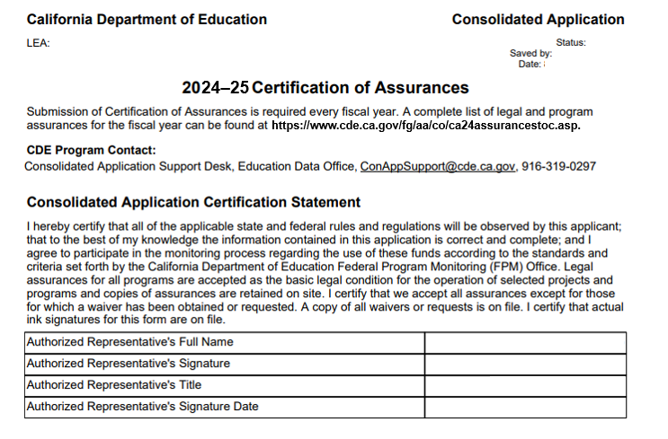
Certification of Assurances (2)
Notes:
A screenshot of Certification of Assurances
By signature of its authorized representative, the LEA assures the California State Board of Education that the agency will adhere to all legal assurances.
LEAs can access this form on the CARS logon page: https://www3.cde.ca.gov/CARS/app/logon.aspx. This link was previously provided in the Chat.
LEAs can access Legal Assurances using the link shown in 2024-25 Certification of Assurances section below.
CDE Contact:
Consolidated Application Support Desk, Education Data Office | ConAppSupport@cde.ca.gov | 916-319-0297
Long Description:
2024-25 Certification of Assurances
Submission of Certification of Assurances is required every fiscal year. A complete list of legal and program assurances for the fiscal year can be found at https://www.cde.ca.gov/fg/aa/co/ca24assurancestoc.asp.
CDE Program Contact:
Consolidated Application Support Desk, Education Data Office, conappsupport@cde.ca.gov, 916-319-0297
Consolidated Application Certification Statement
I hereby certify that all of the applicable state and federal rules and regulations will be observed by this applicant; that to the best of my knowledge the information contained in this application is correct and complete; and I agree to participate in the monitoring process regarding the use of these funds according to the standards and criteria set forth by the California Department of Education Federal Program Monitoring (FPM) Office. Legal assurances for all programs are accepted as the basic legal condition for the operation of selected projects and programs and copies of assurances are retained on site. I certify that we accept all assurances except for those for which a waiver has been obtained or requested. A copy of all waivers or requests is on file. I certify that actual ink signatures for this form are on file.
Authorized Representative's Full Name: [LEA enters]
Authorized Representative's Signature: LEA enters]
Authorized Representative's Title: [LEA enters]
Authorized Representative's Signature Date: [LEA enters]
We will discus the Certification of Consolidated Application Legal Assurances on the following slide.

Slide 9
Legal Assurances
  Consolidated Application Legal Assurances https://www.cde.ca.gov/fg/aa/co/ca24assurancestoc.asp
  General Assurances
  https://www.cde.ca.gov/fg/fo/fm/generalassurances2024-25.asp
  LEA Plan General Assurances
  https://www.cde.ca.gov/fg/aa/co/ca24assuranceleaplan.asp
  Title II, Part A, Supporting Effective Instruction (SEI) Assurances
  https://www.cde.ca.gov/fg/aa/co/ca24assurancet2seins.asp
    20 U.S.C. Section(b)(2)
Notes:
Legal Assurances
Let’s walk through the required items for Title II, Part A on the 2024-25 Consolidated Application Legal Assurances web page: https://www.cde.ca.gov/fg/aa/co/ca24assurancestoc.asp. A link is provided in the Chat.
General Assurances and Certifications 2024-25 web page: https://www.cde.ca.gov/fg/fo/fm/generalassurances2024-25.asp. A link is provided in the Chat.
Local Educational Agency Plan General Assurances web page: https://www.cde.ca.gov/fg/aa/co/ca24assuranceleaplan.asp . A link is provided in the Chat.
Title II, Part A SEI Assurances web page https://www.cde.ca.gov/fg/aa/co/ca24assurancet2seins.asp. A link is provided in the Chat.

Slide 10
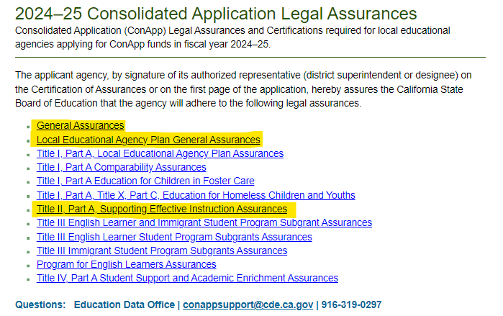
Legal Assurances (2)
ConApp Legal Assurances: https://www.cde.ca.gov/fg/aa/co/ca24assurancestoc.asp
Notes:
A screenshot of the ConApp Legal Assurances web page: https://www.cde.ca.gov/fg/aa/co/ca24assurancestoc.asp. This link was previously provided in the Chat.
The three items required for the Title II, Part A application (are highlighted in yellow):
General Assurances
Local Educational Agency Plan General Assurances
Title II, Part A, Supporting Effective Instruction Assurances
CDE Contact:
Education Data Office, conappsupport@cde.ca.gov, 916-319-0297
Long Description:
Consolidated Application Legal Assurances
Consolidated Application (ConApp) Legal Assurances and Certifications required for local educational agencies applying for ConApp funds in fiscal year 2022–23.
The applicant agency, by signature of its authorized representative (district superintendent or designee) on the Certification of Assurances or on the first page of the application, hereby assures the California State Board of Education that the agency will adhere to the following legal assurances.
General Assurances
Local Educational Agency Plan General Assurances
Title I, Part A, Local Educational Agency Plan Assurances
Title I, Part A Comparability Assurances
Title I, Part A Participation of Students Enrolled in Private Schools Assurances
Title I, Part A Education for Children in Foster Care
Title I, Part A, Title X, Part C, Education for Homeless Children and Youths
Title II, Part A, Supporting Effective Instruction Assurances
Title III English Learner and Immigrant Student Program Subgrant Assurances
Title III English Learner Student Program Subgrant Assurances
Title III Immigrant Student Program Subgrant Assurances
Program for English Learners Assurances
Title IV, Part A Student Support and Academic Enrichment Assurances

Slide 11
Title II, Part A SEI Assurances
  Conduct meaningful consultation
  Comply with the requirements regarding participation by private school children and teachers
  Coordinate professional development activities authorized under this part with professional development activities provided through other Federal, State, and local programs
  Programs and activities described in the LEA plan will be in accordance with the purpose of Title II, Part A and address the learning needs of all students
  Describe how the LEA will identify and address any disparities
  Supplement not supplant non-Federal funds
  All teachers and paraprofessionals working in a program supported with funds under this part meet applicable State certification and licensure requirements
Notes:
Title II, Part A SEI Assurances
Here is an overview of the SEI assurances required in ESSA:
conduct meaningful consultation
comply with the requirements regarding participation by private school children and teachers
coordinate professional development activities authorized under this part with professional development activities provided through other Federal, State, and local programs
programs and activities described in the LEA plan will be in accordance with the purpose of Title II, Part A and address the learning needs of all students
describe how the LEA will identify and address any disparities
supplement not supplant non-Federal funds
all teachers and paraprofessionals working in a program supported with funds under this part meet applicable State certification and licensure requirements
CDE Contact:
Education Data Office, conappsupport@cde.ca.gov, 916-319-0297

Slide 12
Protected Prayer Certification
All participating LEAs must complete this required form as part of their application.
CDE Program Contact:
Miguel Cordova, Title I Policy, Program, and Support Office, MCordova@cde.ca.gov, 916-319-0381
Instructions: https://www.cde.ca.gov/fg/aa/co/ca24sinsppc.asp
Notes:
Protected Prayer Certification
All participating LEAs must complete this required forms as part of their application.
CDE Program Contact:
Miguel Cordova, Title I Policy, Program, and Support Office, MCordova@cde.ca.gov, 916-319-0381
Protected Prayer Certification Instructions web page: https://www.cde.ca.gov/fg/aa/co/ca24sinsppc.asp. A link is provided in the Chat.

Slide 13
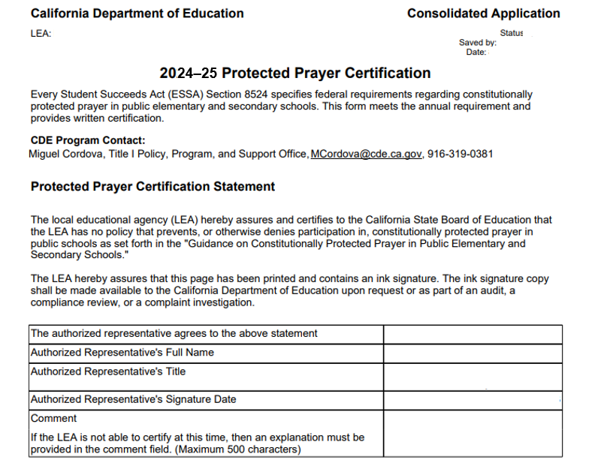
Protected Prayer Certification (2)
Notes:
A screenshot of Protected Prayer Certification form
LEAs can access this form on the CARS logon page: https://www3.cde.ca.gov/CARS/app/logon.aspx. A link was previously provided in the Chat.
Long Description:
2024-25 Protected Prayer Certification
Every Student Succeeds Act (ESSA) Section 8524 specifies federal requirements regarding constitutionally protected prayer in public elementary and secondary schools. This form meets the annual requirement and provides written certification.
CDE Program Contact: Miguel Cordova, Title I Policy, Program, and Support Office, MCordova@cde.ca.gov, 916-319-0381
Protected Prayer Certification Statement
The local educational agency (LEA) hereby assures and certifies to the California State Board of Education that the LEA has no policy that prevents, or otherwise denies participation in, constitutionally protected prayer in public schools as set forth in the "Guidance on Constitutionally Protected Prayer in Public Elementary and Secondary Schools."
The LEA hereby assures that this page has been printed and contains an ink signature. The ink signature copy shall be made available to the California Department of Education upon request or as part of an audit, a compliance review, or a complaint investigation.
The authorized representative agrees to the above statement [LEA enters]
Authorized Representative's Full Name [LEA enters]
Authorized Representative's Title [LEA enters]
Authorized Representative's Signature Date [LEA enters]
Comment: If the LEA is not able to certify at this time, then an explanation must be provided in the comment field. (Maximum 500 characters) [LEA enters]

Slide 14
LCAP Federal Addendum Certification
All participating LEAs must complete this required form as part of their application.
CDE Program Contact:
Local Agency Systems Support Office, LCAPAddendum@cde.ca.gov, 916-323-5233
Instructions: https://www.cde.ca.gov/fg/aa/co/ca24sinslcapfac.asp
Notes:
LCAP Federal Addendum Certification
Reminder - Most LEAs have completed these. For any New LEAs applying for the 1st time, must complete all of the following.
CDE Program Contact:
Local Agency Systems Support Office, LCAPAddendum@cde.ca.gov, 916-323-5233
LCAP Federal Addendum Certification Instructions web page: https://www.cde.ca.gov/fg/aa/co/ca24sinslcapfac.asp. A link is provided in the Chat.

Slide 15
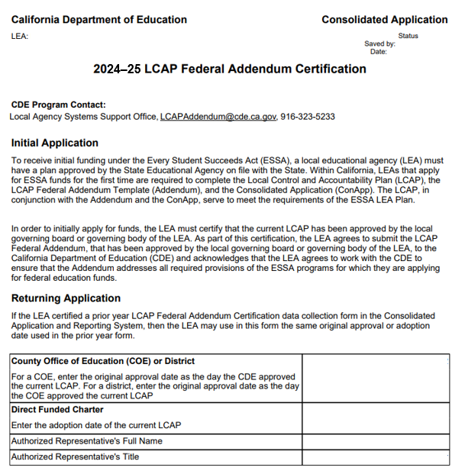
LCAP Federal Addendum Certification
Notes:
LCAP Federal Addendum Certification
LEAs can access this form on the CARS logon page: https://www3.cde.ca.gov/CARS/app/logon.aspx. This link was previously provided in the Chat.
Long Description:
2023–24 LCAP Federal Addendum Certification
CDE Program Contact:
Local Agency Systems Support Office, LCAPAddendum@cde.ca.gov, 916-323-5233
Initial Application
To receive initial funding under the Every Student Succeeds Act (ESSA), a local educational agency (LEA) must have a plan approved by the State Educational Agency on file with the State. Within California, LEAs that apply for ESSA funds for the first time are required to complete the Local Control and Accountability Plan (LCAP), the LCAP Federal Addendum Template (Addendum), and the Consolidated Application (ConApp). The LCAP, in conjunction with the Addendum and the ConApp, serve to meet the requirements of the ESSA LEA Plan.
In order to initially apply for funds, the LEA must certify that the current LCAP has been approved by the local governing board or governing body of the LEA. As part of this certification, the LEA agrees to submit the LCAP Federal Addendum, that has been approved by the local governing board or governing body of the LEA, to the California Department of Education (CDE) and acknowledges that the LEA agrees to work with the CDE to ensure that the Addendum addresses all required provisions of the ESSA programs for which they are applying for federal education funds.
Returning Application
If the LEA certified a prior year LCAP Federal Addendum Certification data collection form in the Consolidated Application and Reporting System, then the LEA may use in this form the same original approval or adoption date used in the prior year form.
County Office of Education (COE) or District
For a COE, enter the original approval date as the day the CDE approved the current LCAP. For a district, enter the original approval date as the day the COE approved the current LCAP: [LEA enters]
Direct Funded Charter
Enter the adoption date of the current LCAP: [LEA enters]
Authorized Representative's Full Name: [LEA enters]
Authorized Representative's Title: [LEA enters]

Slide 16
Application for Funding
The Application for Funding declares that the LEA, authorized by the local governing board, is applying for specified categorical aid funds.
Instructions: https://www.cde.ca.gov/fg/aa/co/ca24sinsaf.asp.
Notes:
Application for Funding
Data Collection Purpose
The Application for Funding declares that the LEA, authorized by the local governing board, is applying for specified categorical aid funds.
Application for Funding Instructions web page: https://www.cde.ca.gov/fg/aa/co/ca24sinsaf.asp. A link is provided in the Chat.

Slide 17
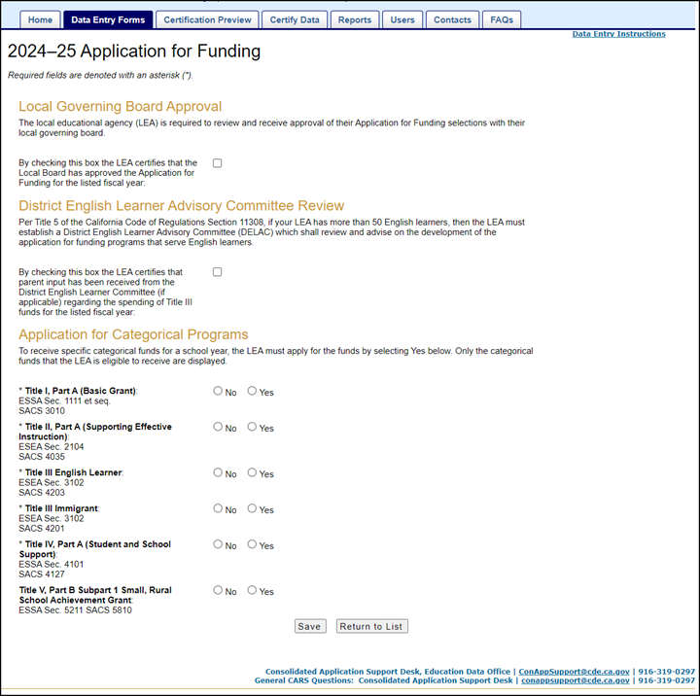
  Application for Funding (2)
Notes:
An example of a 2024-25 Application for Funding Form.
LEAs can access their application on the CARS logon page: https://www3.cde.ca.gov/CARS/app/logon.aspx. This link was previously provided in the Chat.
This page is found on the Data Entry Forms tab.
Local Governing Board Approval: LEA certifies that the Local Board has approved the LEA’s Application for Funding for the listed FY.
DELAC Review: LEA certifies that parent input has been received from the District English Learner Committee (if applicable).
Application for Categorical Programs: LEA selects Yes for Title II, Part A (Supporting Effective Instruction).
If the LEA is eligible for Title V, Part B Subpart 1 Small, Rural School Achievement Grant, this option will appear on the form. The Small, Rural School Achievement (SRSA) Alternative Fund Use Authority (AFUA)
Not applicable to all LEA.
If eligible for SRSA, the LEA may participate in the AFUA.
Further information regarding Title V, Part B AFUA can be found on this web page: https://www.cde.ca.gov/fg/aa/rp/tvpaaltfunduseauth.asp. A link is provided in the Chat.
CDE Contact:
Consolidated Application Support Desk, Education Data Office, ConAppSupport@cde.ca.gov, 916-319-0297
Let’s PAUSE for a few questions from the Chat

Slide 18
2024-25 CARS Title II, Part A
Spring Forms
Reports Due:
  2024–25 Nonprofit Private School Consultation
  2023–24 Title II, Part A Fiscal Year Expenditure Report, 12 Months
  2022–23 Title II, Part A Fiscal Year Expenditure Report, 24 Months
          (20 United States Code Section 6613) Local Uses of Funds
          (20 United States Code Section 6614) Reporting
CARS Calendar: https://www.cde.ca.gov/fg/aa/co/carscalendar.asp
Notes:
2024-25 CARS Title II, Part A Spring Forms
CARS Data Collection Forms Calendar web page provides a list of all spring data collection forms and the deadline schedule: https://www.cde.ca.gov/fg/aa/co/carscalendar.asp. A link is provided in the Chat.
In Spring, LEAs are reporting for three Fiscal Years simultaneously. For the current year, the LEA applies for funding (which we’ve discussed on the previous slides), and the LEA must consult with nonprofit private schools. LEAs also report expenditures for the previous 2 years. This includes the last 12 months as well as the last 24 months.
Program Monitors review the CARS forms when performing a SEI FPM Review for specific LEAs. ESSA Sections related to each form are included in this section for reference. 20 USC Section 7801[47][A]
Let’s walk through each form.

Slide 19
2024–25 Nonprofit Private School Consultation
All participating LEAs must consult with appropriate private school officials and complete this required form as part of their application.
CDE Program Contact:
Title I Policy, Program, and Support Office
    Sylvia Hanna, SHanna@cde.ca.gov, 916-319-0948
    Rina DeRose, RDeRose@cde.ca.gov, 916-323-0472
Instructions: https://www.cde.ca.gov/fg/aa/co/ca24sinsnpsc.asp
Notes:
Nonprofit Private School Consultation
All participating LEAs must consult with appropriate private school officials and complete this required form as part of their application.
CDE Program Contact:
Title I Policy, Program, and Support Office
Sylvia Hanna, SHanna@cde.ca.gov, 916-319-0948
Rina DeRose, RDeRose@cde.ca.gov, 916-323-0472
Nonprofit Private School Consultation Instructions web page:: https://www.cde.ca.gov/fg/aa/co/ca24sinsnpsc.asp A link is provided in the Chat.
Although Title I contacts are the only contacts listed on this form. The instructions page provides the list of contacts for each program. This information is provided in the chat.
CDE Program Staff Contacts:
Consultation for Title II, Part A
Lisa Fassett, Education Programs Consultant, Professional Learning and Monitoring Support Office, lfassett@cde.ca.gov, 916-323-4963
Consultation for Title III Immigrant and English Learner
Geoffrey Ndirangu, Education Programs Consultant, Language Policy and Leadership Office, gndirang@cde.ca.gov, 916-323-5831
Consultation for Title IV, Part A
Kevin Donnelly, Education Programs Assistant, Rural Education and Student Support Office, TitleIV@cde.ca.gov, 916-319-0926

Slide 20
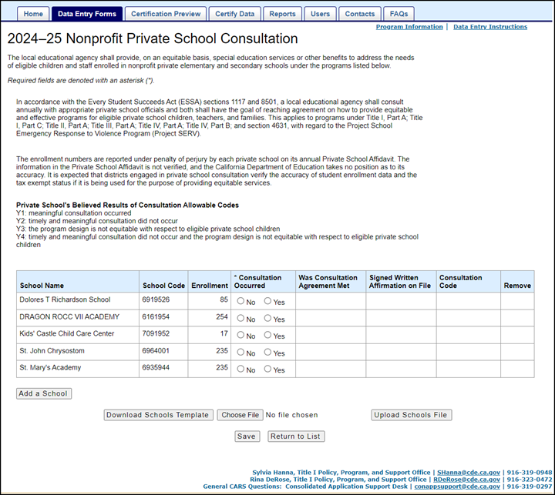
2024–25 Nonprofit Private School Consultation (2)
Notes:
An example of a 2024-25 Nonprofit Private School Consultation Form.
LEAs can access this form on the CARS logon page: https://www3.cde.ca.gov/CARS/app/logon.aspx. This link was previously provided in the Chat.
Nonprofit Private School Consultation Instructions web page: https://www.cde.ca.gov/fg/aa/co/ca24sinsnpsc.asp. This link was previously provided in the Chat.
The LEA shall provide, on an equitable basis, special education services or other benefits to address the needs of eligible children and staff enrolled in nonprofit private elementary and secondary schools…
The purpose of this form is to report the results of consultation to the State and the Ombudsman as required in ESSA. If a nonprofit private school within the LEAs boundaries has completed a current Private School Affidavit correctly, the nonprofit private school is prepopulated onto the Nonprofit Private School Consultation Form.
This form is used by the LEA to document whether or not consultation occurred, whether or not consultation was met, and whether or not a signed written affirmation is on file with the LEA.
Completing this form correctly will affect the Winter Nonprofit Private School Participation Form.
The enrollment numbers are reported under penalty of perjury by each private school on its annual Private School Affidavit. The information filed in the Private School Affidavit is not verified and the CDE takes no position as to its accuracy.
Private School's Believed Results of Consultation Allowable Codes
Y1: meaningful consultation occurred
Y2: timely and meaningful consultation did not occur
Y3: the program design is not equitable with respect to eligible private school children
Y4: timely and meaningful consultation did not occur and the program design is not equitable with respect to eligible private school children.
Table categories:
School Name – Displayed using source data from the CDE CDS database
School Code – Displayed using source data from the CDE CDS database
Enrollment – [LEA Enters] - The numbers are reported under penalty of perjury by each private school on its annual Private School Affidavit.
*Consultation Occurred – (No/Yes) Required field.
Was Consultation Agreement Met – If consultation occurred is “Yes,” then this field is required.
Signed Written Affirmation on File – If consultation occurred is “Yes,” then this field is required.
Consultation Code – If signed written affirmation on file is “Yes,” then this field is required. Allowable values are: Y1, Y2, Y3, Y4 (see details above)
Remove – The system will not allow the LEA to remove an attendance area school.
Add a School (by clicking this button) – While Unified and Non-unified school districts may add nonprofit private schools from outside their district boundaries to this form, with regard to Title II, only non-unified school districts will display the added nonprofit private schools with a Signed Written Affirmation on File in the Winter Nonprofit private school participation form. Unified school districts will not see the added school displayed on the Winter Nonprofit private school participation form.
Refer to the CARS Training and User Documents section of the CDE CARS web page: https://www.cde.ca.gov/fg/aa/co/cars.asp and select the CARS User Guide document for Add a School instructions. A link to this web page is provided at the end of this presentation on the Resources slide.
*This Spring Release Nonprofit Private School Consultation form prepopulates the Title II Part A/Title III Nonprofit Private School Participation form in the Winter Release.
2023–24 Title II/Title III Nonprofit Participation Instructions web page: https://www.cde.ca.gov/fg/aa/co/ca23winst2andt3npsp.asp
If after adding a school and you choose to Remove an added school
Remove – if applicable to remove a previously added non-participating school, click on the Remove hyperlink, then save the form.
Note: After clicking on the Remove hyperlink, the school is removed from the form’s displayed list, but it is not removed from the database until after the form is saved. The system will not allow the LEA to remove an attendance area school

Slide 21
2023–24 Expenditure Deadline
Title II, Part A funds are available for 27 months.
For FY 2023-24 Title II, Part A funds may be obligated:
July 1, 2023 through September 30, 2025.
12 Months Expenditure Report is due during Spring Release.
Notes:
2023–24 Expenditure Deadlines
Title II, Part A funds are available for 27 months.
For FY 2023-24 Title II, Part A funds may be obligated July 1, 2023 through September 30, 2025.
12 Months Expenditure Report is due during Spring Release.
Grant Award Period
Under the federal Tydings Amendment, Section 421(b) of the General Education Provisions Act, any funds that are not obligated at the end of the federal funding period, July 1, 2023, through September 30, 2024, shall remain available for obligation for an additional period of 12 months, through September 30, 2025, within the limits specified in Section 1127 of the ESSA.

Slide 22
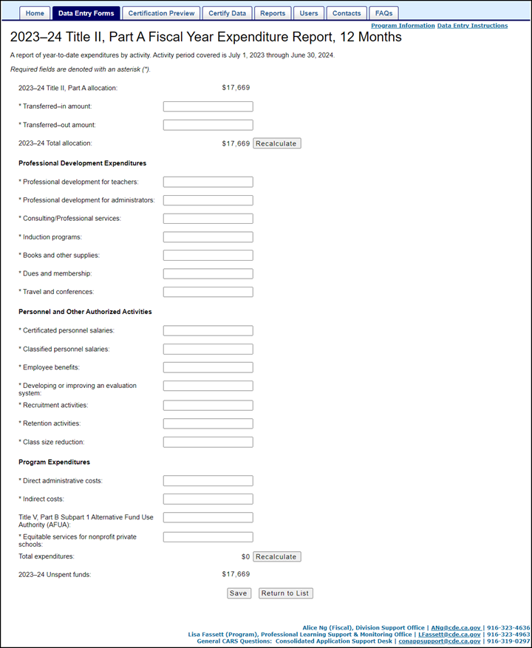
2023–24
Title II, Part A Fiscal Year Expenditure Report,
12 Months
Instructions: https://www.cde.ca.gov/fg/aa/co/ca24sinst2pafyer12.asp
Notes:
Here is a copy of the 2023-24 Title II, Part A Fiscal Year Expenditure Report, 12 Months Form. We have broken the form in half for better viewing on the next two slides. Descriptions provided on the next two slides.
LEAs can access this form on the CARS logon page: https://www3.cde.ca.gov/CARS/app/logon.aspx. This link was previously provided in the Chat.
Title II, Part A Expenditure, 12 Months Instructions web page: https://www.cde.ca.gov/fg/aa/co/ca24sinst2pafyer12.asp. A link is provided in the Chat.

Slide 23
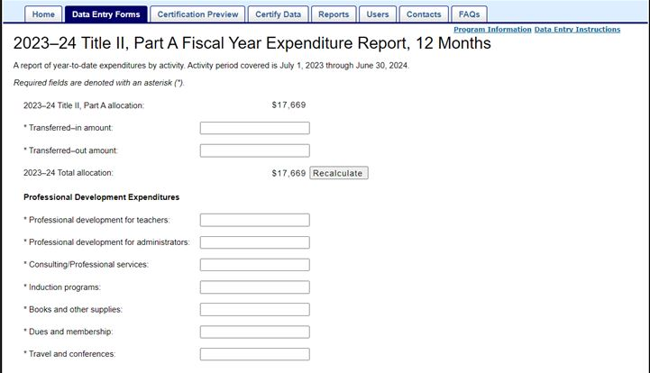
2023–24
Title II, Part A Fiscal Year Expenditure Report,
12 Months (2)
Notes:
2023-24 Title II, Part A Fiscal Year Expenditure Report, 12 Months
Data captured by form:
Allocation - prepopulated
Title II, Part A funding transferred in from other Title/Categorical Programs – [LEA enters]
Title II, Part A funding transferred out from Title II, Part A – [LEA enters]
The form calculates the Total allocation based upon the allocation amount plus the transferred-in amount minus the transferred-out amount.
Collects Professional Development Expenditures by activity:
Professional Development for Teachers – [LEA enters]
Professional Development for Administrators – [LEA enters]
Consulting/Professional Services – [LEA enters]
Induction Programs – [LEA enters]
Books and Other Supplies – [LEA enters]
Dues and Membership – [LEA enters]
Travel and Conferences – [LEA enters]

Slide 24
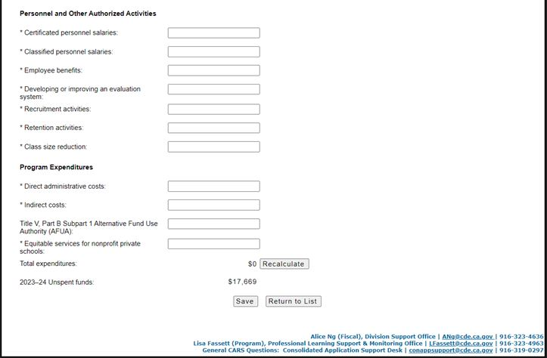
2023–24
Title II, Part A Fiscal Year Expenditure Report,
12 Months (3)
Notes:
2023-24 Title II, Part A Fiscal Year Expenditure Report, 12 Months cont.
Data captured by form continued:
Collects Personnel and Other Authorized Activities:
Certificated Personnel Salaries – [LEA enters]
Classified Personnel Salaries – [LEA enters]
Employee Benefits – [LEA enters]
Developing or Improving an Evaluation System – [LEA enters]
Recruitment Activities – [LEA enters]
Retention Activities – [LEA enters]
Class Size Reduction – [LEA enters]
Collects Program Expenditures
Direct Administrative Costs & Indirect (15% maximum guideline for admin & indirect ) – [LEA enters]
Indirect Costs (15% maximum guideline for admin & indirect) – [LEA enters]
There is no limit on administration in ESSA for Title II. It must be reasonable and necessary. That being said, based upon past LEA costs and following Title I as a guideline, the CDE allows up to 15% for administrative and indirect costs. If an LEA goes beyond 15%, they are contacted for more information.
If the LEA is eligible for Title V, Part B Subpart 1 Small, Rural School Achievement Grant and selected Yes to Title II, Part A funds used through the Alternative Fund Use Authority (AFUA) option on same FY Application for Funding form, then Title V, Part B Subpart 1 AFUA field will display in this form – [LEA enters]
Not all LEAs are eligible for AFUA.
Eligibility info
Further information regarding Title V, Part B AFUA can be found on this web page: https://www.cde.ca.gov/fg/aa/rp/tvpaaltfunduseauth.asp. This link was previously provided in the Chat.
Equitable Services (required if non-profit private schools elected to participate in Title II, Part A funding) – LEA enters
Equitable services are based on identified needs.
Educational services and other benefits provided for nonprofit private school teachers and other educational personnel shall be equitable in comparison to services and other benefits for public school children, teachers, and other educational personnel participating in the program.
ESSA Section 8501(a)
A separate webinar regarding Title II, Part A Equitable Services was held on March 19, 2024. Presentation slides for this webinar: https://www.cde.ca.gov/pd/ti/tii-webinars.asp. A link is provided in the Chat.
Once all data entry fields have been completed, the LEA submits the form.

Slide 25
2022–23 Expenditure Deadline
Title II, Part A funds are available for 27 months.
For FY 2022-23 Title II, Part A funds may be obligated:
July 1, 2022 through September 30, 2024.
24 Months Expenditure Report is due during Spring Release.
Notes:
2022–23 Expenditure Deadlines
Title II, Part A funds are available for 27 months.
For FY 2022-23 Title II, Part A funds may be obligated July 1, 2022 through September 30, 2024.
24 Months Expenditure Report is due during Spring Release.
Grant Award Period
Under the federal Tydings Amendment, Section 421(b) of the General Education Provisions Act, any funds that are not obligated at the end of the federal funding period, July 1, 2022, through September 30, 2023, shall remain available for obligation for an additional period of 12 months, through September 30, 2024, within the limits specified in Section 1127 of the ESSA.

Slide 26
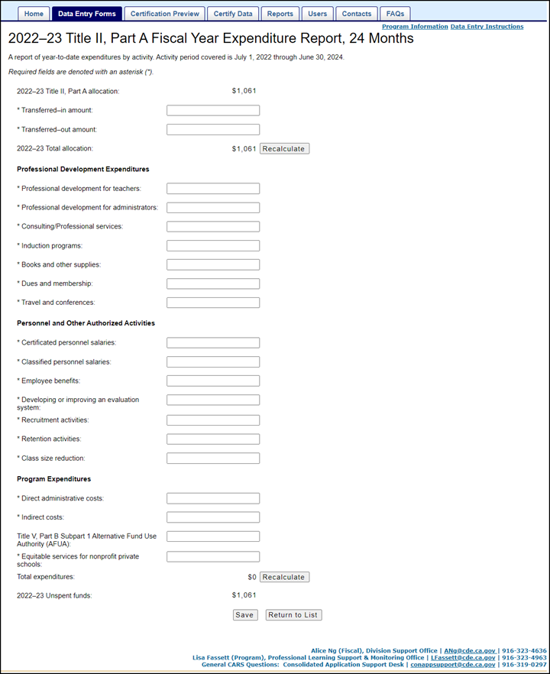
2022–23
Title II, Part A Fiscal Year Expenditure Report,
24 Months
Instructions web page: https://www.cde.ca.gov/fg/aa/co/ca24sinst2exprpt24.asp
Notes:
Here is an example of the 2022-23 Title II, Part A Fiscal Year Expenditure Report, 24 Months Form. We have broken the form in half for better viewing on the next two slides. Descriptions provided on the next two slides.
LEAs can access this form on the CARS logon page: https://www3.cde.ca.gov/CARS/app/logon.aspx. This link was previously provided in the Chat
Title II, Part A Expenditure, 24 Months Instructions web page: https://www.cde.ca.gov/fg/aa/co/ca24sinst2exprpt24.asp. A link is provided in the Chat.

Slide 27
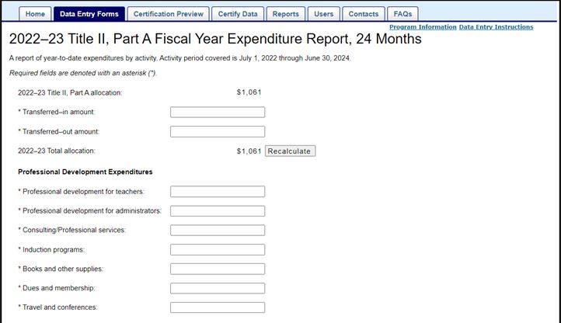
2022–23
Title II, Part A Fiscal Year Expenditure Report,
24 Months (2)
Notes:
2022–23 Title II, Part A Fiscal Year Expenditure Report, 24 Months
Data captured by form:
Allocation - prepopulated
Title II, Part A funding transferred in from other Title/Categorical Programs – [LEA enters]
Title II, Part A funding transferred out from Title II, Part A – [LEA enters]
The form calculates the Total allocation based upon the allocation amount plus the transferred-in amount minus the transferred-out amount.
Collects Professional Development Expenditures by activity:
Professional Development for Teachers – [LEA enters]
Professional Development for Administrators – [LEA enters]
Consulting/Professional Services – [LEA enters]
Induction Programs – [LEA enters]
Books and Other Supplies – [LEA enters]
Dues and Membership – [LEA enters]
Travel and Conferences – [LEA enters]

Slide 28
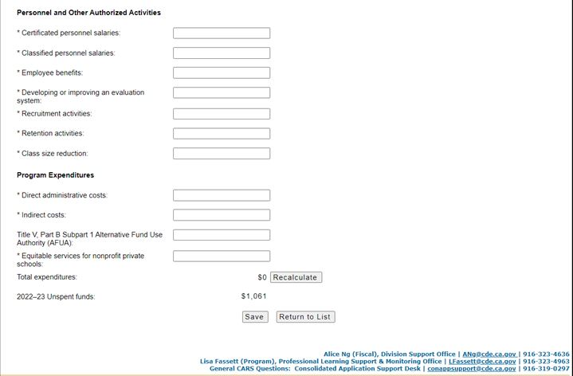
2022–23
Title II, Part A Fiscal Year Expenditure Report,
24 Months (3)
Notes:
2022–23 Title II, Part A Fiscal Year Expenditure Report, 24 Months
Collects Personnel and Other Authorized Activities
Certificated Personnel Salaries – [LEA enters]
Classified Personnel Salaries – [LEA enters]
Employee Benefits – [LEA enters]
Developing or Improving an Evaluation System – [LEA enters]
Recruitment Activities – [LEA enters]
Retention Activities – [LEA enters]
Class Size Reduction – [LEA enters]
Collects Program Expenditures
Direct Administrative Costs & Indirect (15% maximum guideline for admin & indirect ) – [LEA enters]
Indirect Costs (15% maximum guideline for admin & indirect) – [LEA enters]
There is no limit on administration in ESSA for Title II. It must be reasonable and necessary. That being said, based upon past LEA costs and following Title I as a guideline, the CDE allows up to 15% for administrative and indirect costs. If an LEA goes beyond 15%, they are contacted for more information.
If the LEA is eligible for Title V, Part B Subpart 1 Small, Rural School Achievement Grant and selected Yes to Title II, Part A funds used through the Alternative Fund Use Authority (AFUA) option on same FY Application for Funding form, then Title V, Part B Subpart 1 AFUA field will display in this form – [LEA enters]
Not all LEAs are eligible for AFUA.
Eligibility info
Further information regarding Title V, Part B AFUA can be found on this web page: https://www.cde.ca.gov/fg/aa/rp/tvpaaltfunduseauth.asp. This link was previously provided in the Chat.
Equitable Services (required if non-profit private schools elected to participate in Title II, Part A funding) – LEA enters
Equitable services are based on identified needs.
Educational services and other benefits provided for nonprofit private school teachers and other educational personnel shall be equitable in comparison to services and other benefits for public school children, teachers, and other educational personnel participating in the program.
ESSA Section 8501(a)
A separate webinar regarding Title II, Part A Equitable Services was held on March 19, 2024. Presentation slides for this webinar: https://www.cde.ca.gov/pd/ti/tii-webinars.asp. A link was previously provided in the Chat.
Once all data entry fields have been completed, the LEA submits the form.

Slide 29
Important Dates
  2024-25 Spring Release
  Open Date: May 1, 2024
  Deadline Date: June 30, 2024
      Amendment/Review Window – July 1 to August 15, 2024
  Final Close Date: August 15, 2024
Notes:
Important Dates
Annually, typically sometime in May to the end of June, each LEA, using the CARS System submits their spring CARS Forms. The spring release documents participation in these programs and provides assurances that the LEA will comply with the legal requirements of each program.
Forms will not be reopened once they have closed.
Aside from our contact information, this is the single MOST important slide in this PPT.
The CARS Spring Release forms opened on May 1, 2024.
LEAs may submit their Spring forms starting on this date.
LEAs should submit their CARS Spring forms by the Deadline Date of June 30, 2024.
Between June 30, 2024 to August 15, LEAs are able to make corrections to their Spring forms, if needed.
If forms are not submitted by June 30, they are considered missing.
A list of LEAs that have not submitted their Title II, Part A CARS Spring forms by June 30th is generated by the CARS Office.
All LEAs on this list will be contacted by the Title II, Part A Program Office.
August 15, 2024 is the Final Close Date.
After August 15, CARS Spring forms will be CLOSED and will not be reopened.
Which means NO changes may be made to the CARS forms once they have closed.
RECAP The spring release is when LEAs apply for title program funding, report the previous cycle’s 24-month expenditures, report the current cycle’s 12-month expenditures, and nonprofit private school consultation for this program.
Again - Although the focus of today’s webinar is the CARS Spring forms. For questions regarding program, please contact our office. Our contact information is presented at the end of the presentation.
Let’s PAUSE for a few questions from the Chat

Slide 30
Resources
Program Questions:
Title II web page: https://www.cde.ca.gov/pd/ti/
Title II, Part A listserv: join-Title-II@mlist.cde.ca.gov
Technical Questions:
CARS Resources web page: http://www.cde.ca.gov/fg/aa/co/cars.asp
CARS listserv: join-consolidated-application@mlist.cde.ca.gov
Notes:
Resources
Program Questions:
Title II web page: https://www.cde.ca.gov/pd/ti/ A link is provided in the Chat.
Title II, Part A Listserv: If you would like to receive updates via email notification, subscribe to the Title II, Part A listserv by sending a blank message to
join-Title-II@mlist.cde.ca.gov A link is provided in the Chat.
Technical Questions:
CARS Resources web page: http://www.cde.ca.gov/fg/aa/co/cars.asp A link is provided in the Chat.
CARS listserv: join-consolidated-application@mlist.cde.ca.gov A link is provided in the Chat.
For technical questions such as login in issues or CARS questions, please reach out to CONAPP Support at ConAppSupport@cde.ca.gov
Types of CARS system questions
CARS access and roles
Release deadlines
Origin of source data user sees in the forms
When a user cannot get a form to save and/or certify
Whether warning messages will or won’t prevent certification
Resolving errors
Data and certification dependencies between forms
Expected/Unexpected private schools appearing or not appearing in nonprofit school level forms
How/Where to review previously certified data
Whether the user can update/recertify an open form
Downloading/Uploading school level form data

Slide 31
Contacts
Program Questions:
Title II Email: TitleII@cde.ca.gov
Technical Questions:
ConAppSupport@cde.ca.gov
Thank You!
Notes:
Contacts
Program Questions:
Professional Learning Support and Monitoring Office
916-323-5847
TitleII@cde.ca.gov A link is provided in the Chat.
Technical Questions:
For technical questions such as login in issues or CARS questions:
ConApp/CARS Support Desk
ConAppSupport@cde.ca.gov A link is provided in the Chat.
916-319-0297
Types of CARS system questions
CARS access and roles
Release deadlines
Origin of source data user sees in the forms
When a user cannot get a form to save and/or certify
Whether warning messages will or won’t prevent certification
Resolving errors
Data and certification dependencies between forms
Expected/Unexpected private schools appearing or not appearing in nonprofit school level forms
How/Where to review previously certified data
Whether the user can update/recertify an open form
Downloading/Uploading school level form data
Let’s PAUSE for any remaining questions from the Chat
Thank you for joining us today!

