Slide 1

Getting Started with the
State Seal of
Civic Engagement
CALIFORNIA DEPARTMENT OF EDUCATION
Tony Thurmond, State Superintendent of Public Instruction
Notes:
Thank you for checking out this presentation on getting started with California’s State Seal of Civic Engagement (SSCE).

Slide 2
Slide Notes
Slide notes are present throughout this presentation.

Slide 3
What is the State Seal of Civic Engagement?
Notes:
This presentation will begin with a brief overview of the SSCE.

Slide 4
The State Seal of Civic Engagement
The State Seal of Civic Engagement (SSCE) is a recognition conferred by the State Superintendent of Public Instruction for California public school students in grade eleven or twelve who demonstrate excellence in civics education and participation, as well as an understanding of the United States Constitution, the California Constitution, and the democratic system of government.
Notes:
The SSCE is a recognition conferred by the State Superintendent of Public Instruction for California public school students in grades eleven or twelve who demonstrate excellence in civics education and participation, as well as an understanding of the United States Constitution, the California Constitution, and the democratic system of government.

Slide 5
Background and Purpose
Assembly Bill 24 (2017) instructed the California Department of Education (CDE) to develop a set of criteria to recognize students who have demonstrated excellence in civic education.
“It is the intent of the Legislature to establish a SSCE to encourage, and create pathways for, pupils in elementary and secondary schools to become civically engaged in democratic governmental institutions at the local, state, and national levels.”
-California Education Code Section 51470
Notes:
The SSCE began with Assembly Bill 24 (2017), which instructed the California Department of Education (CDE) to develop a set of statewide criteria to recognize students who have demonstrated excellence in civic education.
California Education Code Section 51470 outlines the general intent of the SSCE, which is “to encourage, and create pathways for, pupils in elementary and secondary schools to become civically engaged in democratic governmental institutions at the local, state, and national levels.”

Slide 6
Timeline
Date | Event
October 2017 | AB 24 signed into law.
November 2018–April 2019 | Drafting, review, and editing of the SSCE statewide criteria and guidance.
July 2019 | Draft criteria presented to the State Board of Education (SBE).
September 2019 | Revised draft criteria presented to the SBE.
September 2020 | Final criteria adopted by the SBE.
2020–21 | First year of statewide SSCE implementation.
Notes:
After then-Governor Brown signed AB 24 into law in October 2017, the CDE recruited and worked with an advisory group of secondary history–social science (HSS) teachers and representatives from other stakeholder groups to develop the criteria and related guidance.
This group lead the development of draft statewide criteria, which were presented to the State Board of Education (SBE) in July and again in September 2019.
The SBE adopted final statewide criteria and implementation guidance in September 2020, and the CDE offered the SSCE for the first time during the momentous 2020–21 school year.

Slide 7
What are the criteria for earning a State Seal of Civic Engagement?
Notes:
We will now review the statewide criteria for earning a SSCE.

Slide 8
Statewide Criteria (1)
To earn a SSCE, students must be enrolled in grade eleven or twelve at a participating local educational agency (LEA), and must fulfill each of the following five statewide criteria:
Be engaged in academic work in a productive way.
Demonstrate a competent understanding of United States and California constitutions; functions and governance of local governments; tribal government structures and organizations; the role of the citizen in a constitutional democracy; and democratic principles, concepts, and processes.
Notes:
To earn a SSCE, students must be enrolled in grade eleven or twelve in a participating local educational agency (LEA), and must also fulfill each of the following five statewide criteria:
Be engaged in academic work in a productive way.
Demonstrate a competent understanding of United States and California constitutions; functions and governance of local governments; tribal government structures and organizations; the role of the citizen in a constitutional democracy; and democratic principles, concepts, and processes.

Slide 9
Statewide Criteria (2)
The student must:
Participate in one or more informed civic engagement project(s) that address real-world problems and require students to identify and inquire into civic needs or problems, consider varied responses, take action, and reflect on efforts.
Demonstrate civic knowledge, skills, and dispositions through self-reflection.
Exhibit character traits that reflect civic-mindedness and a commitment to positively impact the classroom, school, community and/or society.
Notes:
The adopted statewide criteria that students must fulfill continue with:
Participate in one or more informed civic engagement project(s) that address real-world problems and require students to identify and inquire into civic needs or problems, consider varied responses, take action, and reflect on efforts.
Demonstrate civic knowledge, skills, and dispositions through self-reflection.
Exhibit character traits that reflect civic-mindedness and a commitment to positively impact the classroom, school, community and/or society.

Slide 10
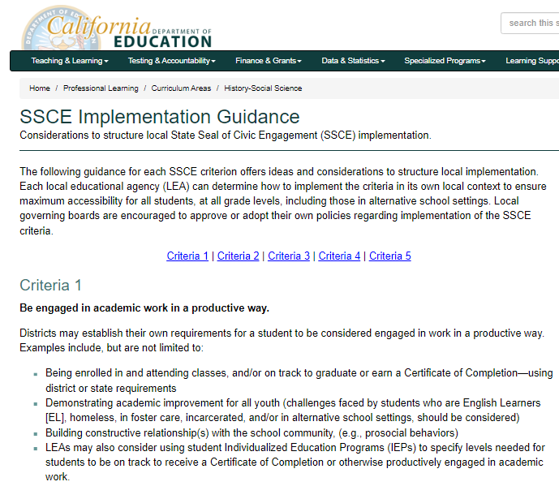
Implementation Guidance
The Implementation Guidance for each criterion offers ideas, questions, and considerations to structure local requirements to award the SSCE, using the criteria set forward by the CDE as a foundation.
The “Local Programming” presentation on the SSCE web page breaks down criteria with key questions from the implementation guidance.
Notes:
When the SBE adopted statewide criteria in September of 2020, it also adopted implementation guidance for each criterion. [https://www.cde.ca.gov/pd/ca/hs/ssceguidance.asp]
This guidance offers ideas, questions, and considerations to structure local requirements to award the SSCE, using the criteria set forward by the CDE as a foundation.
The “Local Programming” presentation on the SSSCE web page breaks down the criteria with key questions from the implementation guidance. [https://www.cde.ca.gov/pd/ca/hs/hssstateseal.asp]

Slide 11

Who is eligible to earn a State Seal of Civic Engagement?
Notes:
Before getting into implementation, we’ll briefly review eligibility for a SSCE.

Slide 12
Student Eligibility-
Any grade eleven or grade twelve pupil enrolled in California public schools, direct funded charter schools, the juvenile justice system, and/or in alternative school settings at a participating LEA is eligible to earn a SSCE.
The SSCE may only be offered at the LEA level.
Individual school sites may not offer the SSCE without it also being available districtwide.
Students may not earn an SSCE before grade eleven. However, LEAs are encouraged to develop local means of recognition for younger students as a pathway to earning the SSCE, such as promotion certificates and/or cords.
Notes:
Any grade eleven or grade twelve pupil enrolled in California public schools, direct-funded charter schools, the juvenile justice system, and/or in alternative school settings at a participating LEA is eligible to earn a SSCE.
The SSCE may only be offered at the LEA level; individual school sites may not offer the SSCE without it also being available district-wide.
Students may not earn an SSCE before grade eleven. However, LEAs are encouraged to develop local means of recognition for younger students as a pathway to earning the SSCE. Examples may include certificates received at promotion, or promotion cords.

Slide 13
Eligible Documents
Students receive one gold embossed insignia, which may be placed on one document:
  High School Diplomas
  General Educational Development Certificates
  Certificates of Completion
  Transcripts (grades eleven or twelve)
A black and white insignia for placement on transcripts in addition to a diploma is not provided. LEAs may choose to develop additional local forms of recognition.
Notes:
Eligible students receive one gold embossed insignia, which may be placed on one document of the student’s choosing:
High School Diplomas
General Educational Development Certificates
Certificates of Completion
Transcripts (grades eleven or twelve)
A separate black and white insignia for placement on transcripts in addition to a diploma is not provided. LEAs may choose to develop local forms of recognition.

Slide 14
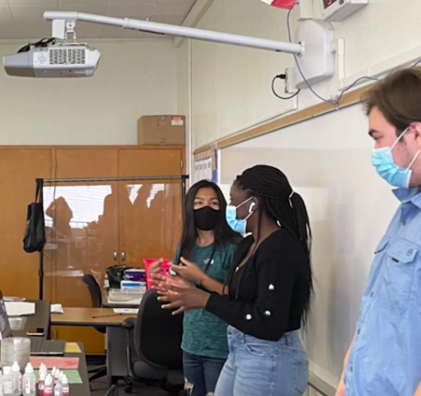
How is the State Seal of Civic Engagement implemented locally?
Notes:
This presentation will now provide some guidance related to implementing the SSCE locally.

Slide 15
Local Guidelines
The SSCE is a local opportunity, and the process through which a student earns a SSCE differs from LEA to LEA.
Leveraging Equity and Access in Democratic Education (UCLA) published reports that highlight examples of local programs:
  Breaking New Ground with California’s State Seal of Civic Engagement: Lessons from Year 1 (Civic Engagement Research Group)
  California’s Commitment to K–12 Civic Learning: A 2022 Assessment (Civic Engagement Research Group)
The Authentic Preparation Today (Civic Seal) working group created resources (Civic Seal) to support LEAs in developing local guidelines.
Notes:
The SSCE is a local opportunity, and the process through which a student earns a SSCE differs from LEA to LEA.
Leveraging Equity and Access in Democratic Education [https://centerx.gseis.ucla.edu/leade/] provided two reports that highlight examples of local SSCE programs:
Breaking New Ground with California’s State Seal of Civic Engagement: Lessons from Year 1 [https://www.civicsurvey.org/publications/breaking-new-ground-with-californias-state-seal-of-civic-engagement]
California’s Commitment to K–12 Civic Learning: A 2022 Assessment [https://www.civicsurvey.org/publications/californias-commitment-to-k-12-civic-learning-a-2022-assessment]
The Authentic Preparation Today [https://www.civicseal.org/home] working group created resources to support LEAs in developing local procedures. [https://www.civicseal.org/for-administrators-teachers/supporting-resources]

Slide 16
Sample General Process
Create Local Team, Develop Board Resolution, Take Inventory
Develop and Adopt Local Criteria
Design and Implement Programming Components
Request Insignias from the CDE and Distribute to Students
Notes:
One example of a general process for developing and adopting local programming to support civic learning and attainment of the SSCE could include the following steps:
Create a local SSCE implementation team and develop a resolution for the local governing board to secure support for adoption of local criteria and programming;
Draft and adopt local criteria to use in awarding students with the SSCE;
Design and implement local programming components to support students to meet the locally-adopted criteria to earn a SSCE in grades eleven or twelve; and
Request insignias from the CDE and affix them to diplomas, transcripts, and certificates of completion for eligible students.
This presentation will now provide some recommendations and considerations for each step.

Slide 17
Create Implementation Team (1)
Create implementation teams to coordinate development of criteria, policies, and procedures to earn the SSCE:
  County, district, and site leadership
  Elementary and secondary educators representing a variety of subjects
  Students
  Community representatives and local officials
The Civic Engagement Research Group (CERG) Educating 4 Democracy (CERG) team created a SSCE planning packet (CERG) that includes guidance on establishing implementation teams.
Notes:
Initially, given the complex nature of determining eligibility and awarding students with a SSCE, many LEAs form implementation teams that include the following representatives:
County, district, and site leadership;
Elementary and secondary educators from a variety of subject areas in addition to HSS, as well as representatives from a variety of school sites, including traditional sites, magnet or charter sites, continuation sites, and any other alternative education sites;
Students;
Community representatives; and
Other local officials who may be able to help connect students with opportunities to practice civic engagement and learning.
This implementation team would be tasked with identifying the overarching goals and principles that must be in place for students to earn the SSCE, outlining the process for developing and adopting criteria, identifying curricular supports, providing opportunities for civic engagement, and awarding insignias to students.
The Civic Engagement Research Group (CERG) Educating 4 Democracy team [https://www.ed4democracy.org/topics/ca-state-seal-of-civic-engagement] created a SSCE planning packet that includes guidance, including guiding questions and templates to support establishment of implementation teams. [https://bit.ly/CERGToolkit]

Slide 18
Create Implementation Team (2)
If possible, include elementary and middle school representatives on implementation teams.
The Orange County Department of Education (OCDE), along with the San Diego County Office of Education, created a kindergarten through grade eight (K–8) pathway program wherein participating districts can honor students in grades three, five, and eight:
  OCDE Civic Learning Pathways
  K–8 Civic Pathway Program (OCDE)
  K–8 Pathway Program Timeline (OCDE)
Notes:
Although elementary and middle schools cannot award the state seal, the legislative intent of the SSCE is to encourage students to become civically engaged in the younger grades. LEAs that serve elementary and middle school students are encouraged to participate by helping develop pathways to earn the SSCE in later grades. Ensuring elementary and middle school representatives on implementation teams can support this goal.
The Orange County Department of Education (OCDE), along with the San Diego County Office of Education, created a kindergarten through grade eight (K–8) pathway program wherein participating districts can honor students in grades three, five, and eight:
OCDE Civic Learning Pathways [https://ocde.us/EducationalServices/CurriculumInstructionandAcademicEnrichment/History/Pages/Civic_Learning.aspx]
K–8 Civic Pathway Program [https://drive.google.com/file/d/1xyMAeE9KF_uCr3VQuAJTuvKo5kAAdgyb/view?usp=drive_link]
K–8 Pathway Program Timeline [https://drive.google.com/file/d/1vKiW1-_G3ObvOBiAB56vxzdPR9QZjVCP/view?usp=drive_link]

Slide 19



Develop Board Resolution
      Develop a county, district, or charter site board resolution supporting the statewide SSCE criteria with the intent to design a process for earning the SSCE locally (optional).
      Consider including Local Control and Accountability Plan language related to civic engagement opportunities.
      The Los Angeles County Office of Education (LACOE) SSCE Collaborative offers sample governing board resolutions, and many other resources to support local implementation.
Notes:
After forming an implementation team and identifying an overarching purpose of and strategy for local SSCE programming, the LEA may also consider adopting a county, district, or charter site board resolution supporting the statewide SSCE criteria with the intent to design a process for earning the SSCE locally.
Please note that governing board resolutions are optional. While recommended for implementing the SSCE locally, board resolutions are not a required part of the process.
LEAs may also consider including Local Control and Accountability Plan language related to civic engagement opportunities for students.
The Los Angeles County Office of Education SSCE Collaborative web page offers sample governing board resolutions, among many other resources to support local implementation. [https://classic.lacoe.edu/curriculum-instruction/history-social-science/state-seal-of-civic-engagement]

Slide 20
Take Inventory
Take inventory of the LEA’s assets and needs related to civic learning and engagement:
  What opportunities and community connections already exist?
  What courses cover civic curriculum or civic projects, and where is there room to infuse this in other subject areas?
  Who already participates, and what barriers to entry may currently exist?
The CERG Educating 4 Democracy and SSCE planning packet includes forms and guiding questions to help implementation teams take inventory.
Notes:
After forming an implementation team and identifying an overarching purpose of and strategy for local SSCE programming, the implementation team is encouraged to consider taking inventory of the LEA’s assets and needs related to civic learning and engagement. This will help focus efforts and develop an overarching strategy and goals for local implementation of the SSCE.
Some key questions to start with may include:
What opportunities and community connections already exist?
What courses cover civic curriculum or civic projects, and where is there room to infuse this in other subject areas?
Who already participates, and what barriers to entry may currently exist?
The CERG Educating 4 Democracy [https://www.ed4democracy.org/topics/ca-state-seal-of-civic-engagement] SSCE planning packet also includes forms and guiding questions to help implementation teams take inventory. [https://bit.ly/CERGToolkit]

Slide 21


Develop and Adopt Local Criteria
      In addition to the five statewide criteria adopted by the SBE, LEAs are also encouraged, wherever possible and practical, to develop specific criteria that reflect their local communities and school populations.
      Local criteria must be aligned to the statewide criteria. This criteria can be crucial in ensuring maximum accessibility for all students, including students in alternative school settings.
      The Santa Clara County Office of Education SSCE web page includes a variety of resources to support development of accessible local SSCE programs.
Notes:
In addition to the five statewide criteria adopted by the SBE, LEAs are also encouraged, wherever possible and practical, to develop specific criteria that reflect their local communities and school populations.
Local criteria must be aligned to the statewide criteria. This criteria can be crucial in ensuring maximum accessibility for all students, including students in alternative school settings.
The Santa Clara County Office of Education web page includes a variety of resources to support development of accessible local SSCE programs. [https://www.sccoe.org/history/Pages/State-Seal-of-Civic-Engagement.aspx]

Slide 22
Design Requirements and Procedures
The LEA will need to develop the local requirements and procedures that students will go through to earn a SSCE:
  Course enrollment, grade requirements, local assessments
  Civic engagement project guidelines and procedures
  Procedures for self-reflection and external recommendations
  Application and insignia distribution processes
  Any additional local requirements
Sacramento City Unified School District (SCUSD) created local criteria and procedures (SCUSD) for students working towards a SSCE.
Notes:
Next, the LEA will need to develop the specific local requirements and procedures that students will go through to earn a SSCE:
Course enrollment, grade requirements, or local assessments (if using these)
Civic engagement project guidelines
Procedures for self-reflection and external recommendations
Application and insignia distribution processes
Any additional local requirements
Sacramento City Unified School District created local criteria and procedures for students working towards a SSCE. [https://www.scusd.edu/california-state-seal-civic-engagement]

Slide 23

Special Considerations
Interdisciplinarity
Involve other content and disciplines in addition to History–Social Science (HSS)
Depth
Elementary and middle schools
Long-term, evolving engagement
Accessibility
Continuation schools, juvenile justice, low income, special education, English learners, etc.
Notes:
Some additional considerations to keep in mind while developing local programming (processes and procedures) to earn the SSCE include:
How to maintain accessibility to all students, even those who may struggle academically or be hard to reach:
This means including continuation schools, juvenile justice programs, low income students, special education students, English learners, and other underrepresented students in plans for awarding the SSCE.
How to encourage long-term civic engagement:
This includes involving elementary and middle schools in students’ efforts to earning a SSCE in grade eleven or twelve, and taking other measures to encourage deep, long-lasting civic engagement over time as opposed to single short-term projects.
And finally, how to encourage interdisciplinary collaboration:
This includes involving other subjects in addition to HSS in development of local programming.
For instance, LEAs may specifically consider connections to environmental literacy, or visual and performing arts, world languages, or Career Technical Education.

Slide 24

How do Local Educational Agencies request insignias?
Notes:
This presentation will now provide some guidance on the process for requesting insignias from the CDE.

Slide 25
Requesting Insignias
The SSCE Insignia Request Form is updated annually and is available by the early spring from the SSCE web page.
The participating LEA must submit the SSCE Insignia Request Form; individual sites may not request insignias.
  Also used to request additional insignias or correct previous requests.
No deadline; requests are processed on an ongoing basis.
Request insignias from the CDE at least four weeks before they will be affixed to eligible documents and distributed to students.
Notes:
The SSCE Insignia Request Form is updated annually and is available by March from the SSCE web page.
The participating LEA must submit the SSCE Insignia Request Form; individual school sites may not request insignias.
The form may also be used to request additional insignias or correct pervious requests.
The CDE processes requests on an ongoing basis, from the posting of the updated insignia request form through early fall, when the CDE processes corrections.
Please request insignias from the CDE at least four weeks before they will be affixed to eligible documents and distributed to students.

Slide 26
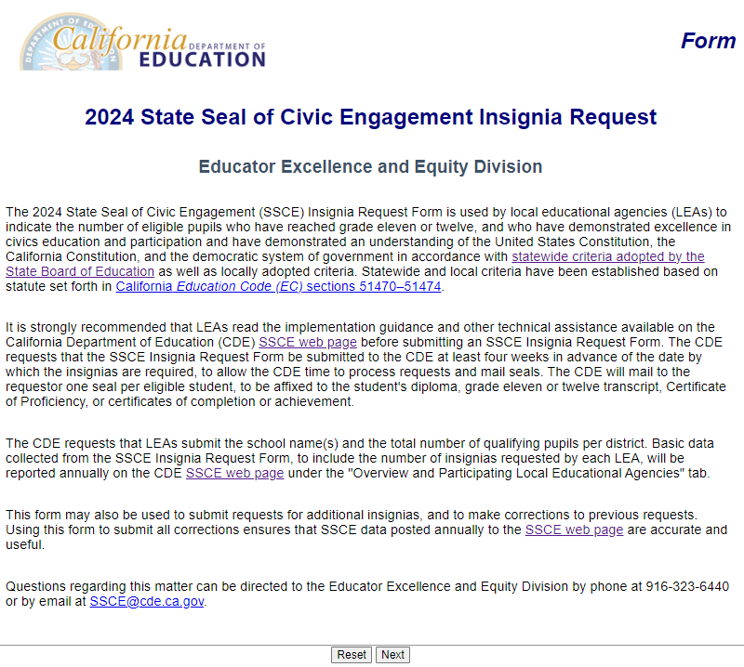
Insignia Request Form (1)
Available from SSCE web page.
Information Requested:
  LEA identification and contact information
  Number of insignia requested, broken down by eligible document
  School sites with students receiving insignias
Notes:
The online Insignia Request Form is available from the SSCE web page. [https://www.cde.ca.gov/pd/ca/hs/hssstateseal.asp]
The form can be completed by the district superintendent, charter school administrator, or other authorized designee.
The CDE requires contact information for the person requesting the seals on the LEA’s behalf and details including the county, district, County-District-School Code, and School Name.
The CDE requests the total number of seals needed, as well as information on how the LEA anticipates those seals will be distributed among diplomas, GED certificates, Certificates of Completion, and transcripts.
LEAs may fill out this form for a single school, or may request insignia (seals) for multiple schools in the same district with a single form.
The request form also includes options for LEAs that need to correct information previously submitted, and for those that need to request additional insignias for the current school year.

Slide 27
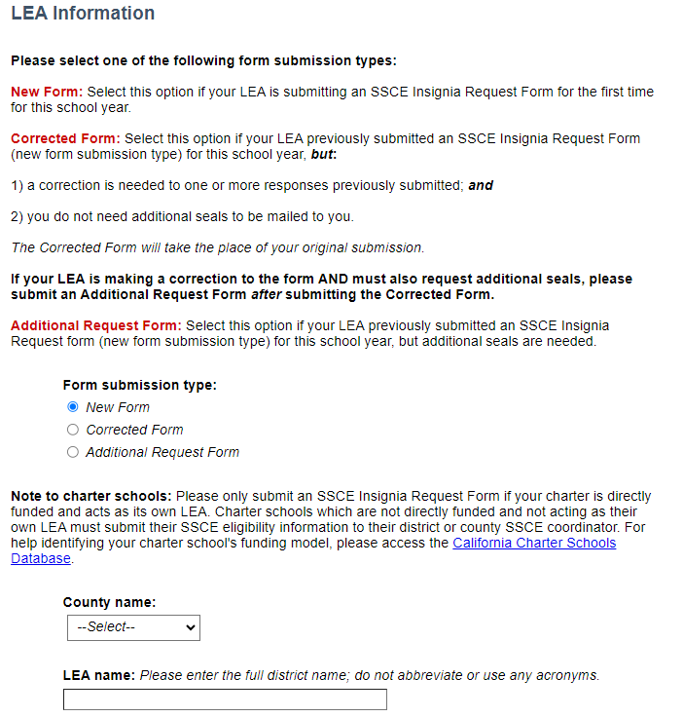
Insignia Request Form (2)
Form may be used for new requests, corrected requests, or additional requests.
  Choose “Corrected Request” to update total insignias distributed, insignia distribution, or school sites.
  Choose “Additional Request” to request additional insignias be sent to the LEA.
Notes:
In addition to submitting the initial request for insignias, the form may be used for corrected and additional requests, as well.
These options are especially useful, as LEAs often need to estimate the number of insignias required weeks before the end of the school year.
Choose “Corrected Request” to update total insignias distributed, insignia distribution, or school sites. This may be especially useful at the end of the school year, if an LEA needs to update the number of students actually receiving insignias, the school sites that have students receiving insignias, or the distribution of insignias.
Choose “Additional Request” to request additional insignias be sent to the LEA.

Slide 28
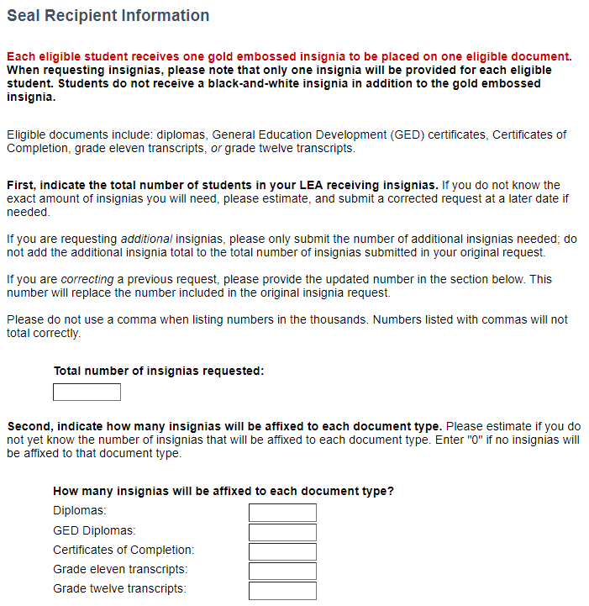
Insignia Request Form (3)
Enter the total number of insignias requested.
  Each student receives one insignia.
  Amounts entered under “How many insignias will be affixed to each document type?” should equal the total number of insignias requested.
  Estimate the distribution and correct later, as needed.
Notes:
When getting to the “Seal Recipient Information” page of the request form, LEAs should start by entering the total number of insignias requested.
Each student receives only one gold embossed insignia.
The amounts entered under “How many insignias will be affixed to each document type?” should equal the total number of insignias requested.
Please estimate the distribution and correct later, as needed, using the Insignia Request Form.

Slide 29
Suggested Record Keeping
Local criteria and student tracking records
Site staff leads or advisors
Identified community partners
Pathway agreements (if applicable)
Timeline or list of activities
Student applications
Summary of evidence submitted by students
Participating students
Number of insignias distributed each year
Distribution of those insignias among eligible documents
Students who did not qualify for an SSCE
Notes:
Record keeping is at the discretion of each local SSCE Program. At a minimum, the CDE recommends that the following records are kept in program and/or individual student files:
Locally-adopted criteria and district or county contacts
Identified site staff leads or SSCE advisors
Identified community partners
Pathway agreements between elementary, middle, and high school programs
Timeline and/or list of promotional activities
Student applications
Locally-adopted criteria tracking record for each eligible student
Summary of evidence submitted by students to verify eligibility
Names of students at each site who earned a SSCE each academic year
Information on students who applied for, but did not receive, a SSCE (if applicable)
Number of insignias distributed each year
Number of insignias distributed each year
How those insignias were distributed (diplomas, transcripts, etc.)

Slide 30



Data Reporting (1)
CDE captures and reports data provided by LEAs through the Insignia Request Form.
Student names are not collected.
The CDE publishes this statewide data in a spreadsheet on the SSCE web page each fall.
Spreadsheets are available dating back to the 2020–21 school year.
Notes:
The CDE captures and reports request data provided by LEAs through the Insignia Request Form.
Student names are not collected.
The CDE publishes this statewide data in a spreadsheet on the SSCE web page each fall. [https://www.cde.ca.gov/pd/ca/hs/hssstateseal.asp]
Spreadsheets are available dating back to the 2020–21 school year.

Slide 31




Data Reporting (2)
    Student-level SSCE data is not currently required through statewide data reporting systems.
    The CDE is investigating ways to incorporate additional criteria for recognizing civic engagement in the College/Career Indicator.
    Visit the California Longitudinal Pupil Achievement Data System web page for updates on an ad hoc data collection tool under development to support this work.
    Background information is available from the SBE Items Related to the SSCE web page.
Notes:
Student-level SSCE data is not currently required through statewide data reporting systems.
The CDE is investigating ways to incorporate additional criteria for recognizing civic engagement in the College/Career Indicator on the California School Dashboard.
Visit the California Longitudinal Pupil Achievement Data System web page for updates on an ad hoc data collection tool under development to support this work.
Background information is available from the SBE Items Related to the SSCE web page.

Slide 32
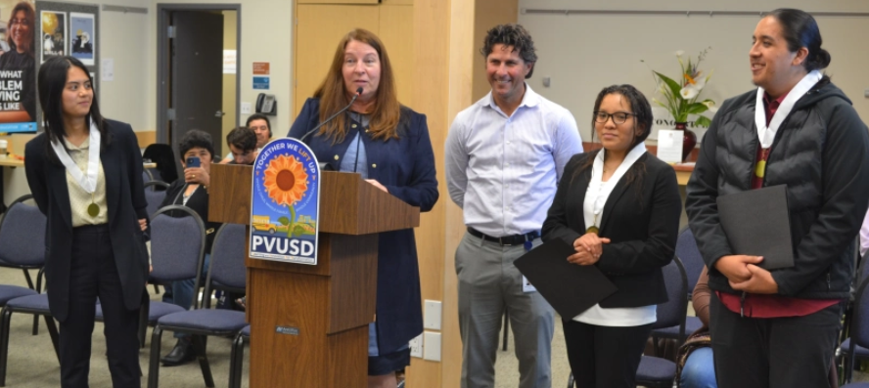
What additional resources are available?
Notes:
This presentation will end with an overview of additional online resources that are available to support local implementation of the SSCE.

Slide 33


Additional Civic Awards and Programs
LACOE’s California Democracy School Awards Civic Learning Initiative’s Civic Learning Awards, facilitated by the Power of Democracy Steering Committee
  Judges in the Classroom
Notes:
The California Democracy School Civic Learning Initiative and Civic Learning Awards are two currently-available statewide programs that recognize exceptional civic learning and engagement. LEAs may consider pursuing these opportunities while also working towards developing local programming to support the SSCE.
The LACOE administers the California Democracy School program. Information bout the California Democracy School program is available online. [https://classic.lacoe.edu/Curriculum-Instruction/History-Social-Science/California-Democracy-School]
The Power of Democracy (POD) Steering Committee [https://www.courts.ca.gov/21763.htm] administers the Civic Learning Awards. Information about the POD and the Civic Learning Awards is available online. [https://www.courts.ca.gov/20902.htm]
The POD also facilitates the popular Judges in the Classroom program, which pairs public schools with judicial officers with public school classrooms and can help support students working to fulfill SSCE criterion 2. [https://www.judgesintheclassroom.org/]

Slide 34
California Department of Education Implementation Resources
SSCE Implementation Guidance
SSCE Frequently Asked Questions
Related SBE Items
Resources to Support Civic Engagement
California Educators Together SSCE Group (free logon required)
Notes:
In addition to the main SSCE web page referenced several times in this presentation, the CDE provides several statewide resources to support local implementation and administration of the SSCE:
SSCE Implementation Guidance: https://www.cde.ca.gov/pd/ca/hs/ssceguidance.asp
SSCE Frequently Asked Questions: https://www.cde.ca.gov/pd/ca/hs/sscefaq.asp
Related SBE Items: https://www.cde.ca.gov/pd/ca/hs/sbe2ssce.asp
Resources to Support Civic Engagement: https://www.cde.ca.gov/pd/ca/hs/civicengprojects.asp
California Educators Together SSCE Group: https://www.caeducatorstogether.org/groups/zb6rpkwt/state-seal-of-civic-engagement

Slide 35
Staying Updated
SSCE Inbox
SSCE@cde.ca.gov
HSS Listserv
To join, send a blank email message to
join-history-social-science@mlist.cde.ca.gov
CDE Twitter/X Accounts
HSS: @CaEdHSS
Professional Learning: @CaProfLearning
CDE: CaDeptEd
Notes:
For additional questions about the SSCE, please email the SSCE team. [SSCE@cde.ca.gov]
Please subscribe to the CDE HSS Listserv to receive updates related to the SSCE. Subscribe by sending a blank email to join-history-social-science@mlist.cde.ca.gov.
The CDE also posts updates to various Twitter/X accounts:
HSS: @CaEdHSS
Professional Learning: @CaProfLearning
CDE: CaDeptEd

Slide 36
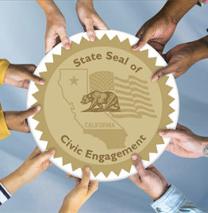
Thank you!
California Department of Education
Professional Learning Support Division
SSCE@cde.ca.gov
CALIFORNIA DEPARTMENT OF EDUCATION
Tony Thurmond, State Superintendent of Public Instruction
Notes:
Thank you for viewing this presentation!

