Slide 1
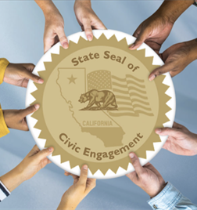
Getting Started with the
State Seal of
Civic Engagement
September 16, 2024
CALIFORNIA DEPARTMENT OF EDUCATION
Tony Thurmond, State Superintendent of Public Instruction

Slide 2
Introductions
Havana Cheng, Staff Services Analyst
Sarah Smith, Education Programs Consultant
Julia Agostinelli, Education Administrator
Professional Learning Innovations Office (PLIO)
Professional Learning Support Division (PLSD)

Slide 3
Agenda
Welcome and Housekeeping
Overview
Statewide Criteria and Eligibility
Local Implementation
Insignia Requests and Data Reporting
Related Opportunities, Questions, and Contact Information

Slide 4
Housekeeping
Webinar participants have been placed on mute.
Webinar will be recorded.
Question/Answer session toward the end of the webinar.
Slide deck and recording will be shared via email after the webinar.

Slide 5
What is the State Seal of Civic Engagement?

Slide 6
The State Seal of Civic Engagement
The State Seal of Civic Engagement (SSCE) is a recognition conferred by the State Superintendent of Public Instruction for California public school students in grades ten, eleven, or twelve who demonstrate excellence in civics education and participation, as well as an understanding of the United States Constitution, the California Constitution, and the democratic system of government.

Slide 7
Background and Purpose
Assembly Bill 24 (2017) instructed the California Department of Education (CDE) to develop a set of criteria to recognize students who have demonstrated excellence in civic education.
“It is the intent of the Legislature to establish a SSCE to encourage, and create pathways for, pupils in elementary and secondary schools to become civically engaged in democratic governmental institutions at the local, state, and national levels.”
-California Education Code (EC) Section 51470

Slide 8
Timeline
October 2017: AB 24 signed into law.
November 2018–April 2019: Development of draft SSCE statewide criteria and guidance.
July and September 2019: Draft criteria presented to the State Board of Education (SBE).
September 2020: Final criteria adopted by the SBE.
2020–21: First year of statewide SSCE implementation.

Slide 9
What are the statewide criteria for earning a State Seal of Civic Engagement?

Slide 10
Statewide Criteria (1)
To be eligible to earn a SSCE, students must be enrolled in grade ten, eleven, or twelve at a participating local educational agency (LEA), and must fulfill each of the following five statewide criteria:
Be engaged in academic work in a productive way.
Demonstrate a competent understanding of United States and California constitutions; functions and governance of local governments; tribal government structures and organizations; the role of the citizen in a constitutional democracy; and democratic principles, concepts, and processes.

Slide 11
Statewide Criteria (2)
The student must:
Participate in one or more informed civic engagement project(s) that address real-world problems and require students to identify and inquire into civic needs or problems, consider varied responses, take action, and reflect on efforts.

Slide 12
Statewide Criteria (3)
The student must:
Demonstrate civic knowledge, skills, and dispositions through self-reflection.
Exhibit character traits that reflect civic-mindedness and a commitment to positively impact the classroom, school, community and/or society.

Slide 13
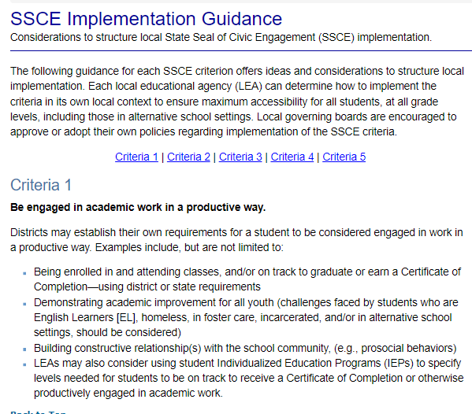
Implementation Guidance
The Implementation Guidance (https://www.cde.ca.gov/618335) offers ideas, questions, and considerations to structure local SSCE requirements.
The “Local Programming” presentation on the SSCE web page (https://www.cde.ca.gov/620836) breaks down criteria with questions from the implementation guidance.

Slide 14

Who is eligible to earn a State Seal of Civic Engagement?

Slide 15
Institutional Eligibility
The SSCE is offered at the LEA level. This includes county offices of education (COEs), school districts, charter schools.
Individual school sites may not offer the SSCE without it also being available district- or county-wide.
Private schools are not eligible to offer the SSCE; however, they may establish their own civic recognition opportunities.
Students schooled through an Independent Study Program, with oversight of a credentialed teacher in a participating LEA, are eligible.

Slide 16
Student Eligibility
Any grade ten, eleven or grade twelve pupil enrolled in California public schools, direct funded charter schools, the juvenile justice system, and/or in alternative school settings at a participating LEA is eligible to earn a SSCE.
Students must demonstrate attainment of all five statewide criteria, as well as any locally-adopted requirements, to be eligible for an SSCE.
Students may not earn an SSCE before grade ten. However, LEAs are encouraged to develop local means of recognition for younger students as a pathway to earning the SSCE, such as promotion certificates and/or cords.

Slide 17
Eligible Documents
Eligible documents include:
  High school diploma
  Alternative high school diploma (EC 51225.31); https://www.cde.ca.gov/613733
  General Educational Development Certificates
  Certificates of Completion (EC Section 56390)
  Transcripts (grades eleven or twelve)

Slide 18
The Insignia
Each eligible student receives one gold-embossed insignia to affix to one eligible document.
An extra embossed insignia, or a black and white insignia for placement on transcripts, is not provided.
LEAs may develop local forms of recognition (local seals, certificates, transcript notations, etc.).

Slide 19
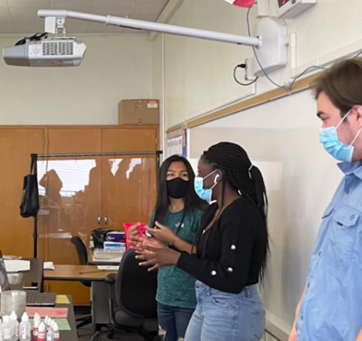
How is the State Seal of Civic Engagement implemented locally?

Slide 20
Local Guidelines (1)
The SSCE is a local opportunity, and the process through which a student earns a SSCE differs from LEA to LEA.
Leveraging Equity and Access in Democratic Education (UCLA) reports highlight examples of local programs:
  Breaking New Ground with California’s SSCE—Lessons from Year 1: https://bit.ly/SSCEYEAR1
  California’s Commitment to K–12 Civic Learning: A 2022 Assessment: https://bit.ly/CIVICLEARN

Slide 21
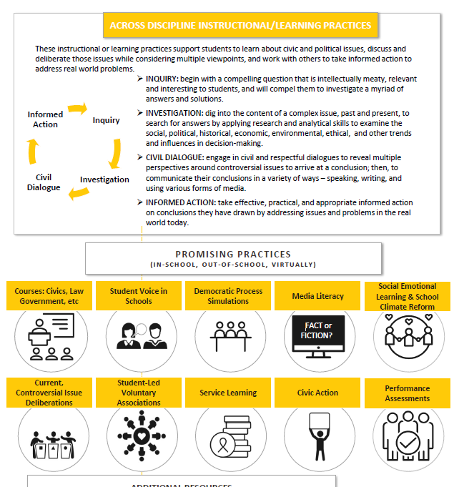
Local Guidelines (2)
The Authentic Preparation Today working group, which also developed the image used on the statewide insignia, created resources to support LEAs in developing local guidelines, including an implementation roadmap: https://bit.ly/APTWG

Slide 22
Sample General Process
Create Local Team, Develop Board Resolution, Take Inventory
Adopt Statewide SSCE Criteria, Local Criteria (Optional)
Design and Implement Programming Components
Request Insignias from the CDE and Distribute to Students

Slide 23
Create Implementation Team
Create local implementation teams to coordinate development of criteria, policies, and procedures to earn the SSCE:
  County, district, and site leadership
  Local educators representing a variety of subjects
  Students
  Community representatives and local officials
Civic Engagement Research Group (CERG) Educating 4 Democracy SSCE planning packet: https://bit.ly/CERGToolkit

Slide 24
Develop Board Resolution
Develop a county, district, or charter site board resolution supporting the statewide SSCE criteria with the intent to design a process for earning the SSCE locally (optional)
Consider including Local Control and Accountability Plan language related to civic engagement opportunities.
Los Angeles COE SSCE Collaborative (https://bit.ly/LACOE_SSCE): sample governing board resolutions and other implementation resources

Slide 25
Take Inventory
Take inventory of the LEA’s civic assets and needs:
  What opportunities and community connections already exist?
  What courses cover civic curriculum or civic projects, and where is there room to infuse this in other subject areas?
  Who already participates, and what barriers to entry exist?
The CERG Educating 4 Democracy SSCE planning packet (https://bit.ly/CERGToolkit) includes forms and guiding questions to help implementation teams take inventory.

Slide 26



Develop and Adopt Local Criteria
      LEAs are also encouraged, wherever possible and practical, to develop criteria that reflect local communities and school populations.
      Local criteria must be aligned to the statewide criteria. This criteria can be crucial in ensuring maximum accessibility for all students, including students in alternative school settings.
      The Santa Clara COE SSCE web page (https://bit.ly/SSCOESSCE) includes a variety of resources to support development of accessible local SSCE programs.

Slide 27
Design Local Requirements and Procedures
The LEA should develop the local requirements and procedures that students will go through to earn a SSCE:
  Course enrollment, grade requirements, local assessments
  Civic engagement project guidelines and procedures
  Procedures for self-reflection and external recommendations
  Application, insignia distribution, and record-keeping processes
  Any additional local requirements or processes
Sacramento City Unified School District local criteria and procedures: https://bit.ly/scusdssce

Slide 28

Special Considerations
Depth
Elementary and middle schools
Long-term, evolving engagement
Interdisciplinarity
Involve other disciplines in addition to History–Social Science (HSS)
Accessibility
Continuation schools, juvenile justice, special education, English learners, etc.

Slide 29
Encourage Pathways
The Orange County Department of Education, along with the San Diego COE, created a kindergarten through grade eight (K–8) pathway program wherein participating districts can honor students in grades three, five, and eight: https://bit.ly/OCDECivics

Slide 30

How do Local Educational Agencies request insignias?

Slide 31
Insignia Request Form
Updated and posted each fall on SSCE web page: https://www.cde.ca.gov/620836
Used for new, additional, and corrected requests.
Requests come from the participating LEA.
No deadline; requests are processed on an ongoing basis.
  Request insignias from the CDE at least four weeks before they will be needed.
  Most requests are submitted from April 1–June 15.

Slide 32
Suggested Record Keeping
Local student requirements
Site staff leads or advisors
Community partners
Pathway agreements
Timeline or list of activities
Student applications
Summary of evidence
Participating students
Insignia distribution
Students who did not qualify

Slide 33



Statewide Data Reporting
CDE captures and reports data provided by LEAs through the Insignia Request Form. Student names are not collected.
CDE publishes this statewide data in a spreadsheet on the SSCE web page each fall.
Spreadsheets are available dating back to the 2020–21 school year.

Slide 34




Student-Level Data Reporting
    This summer, the CDE collected data on the individual students who earn the SSCE for determining its use in the College and Career Indicator (CCI) on the California School Dashboard.
    This new data collection is based on an SBE request to the CDE to consider the inclusion of civic engagement in the CCI.
    Visit the California Longitudinal Pupil Achievement Data System web page for updates: https://www.cde.ca.gov/621911
    Background information is available from the SBE Items Related to the SSCE web page: https://www.cde.ca.gov/618330

Slide 35
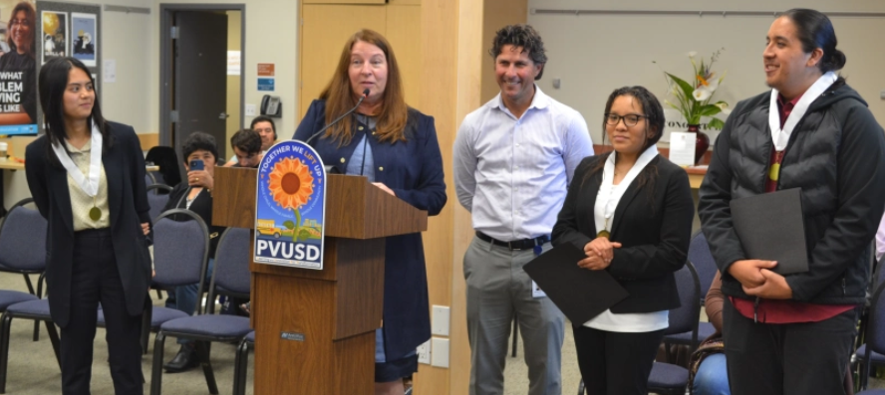
What additional resources are available?

Slide 36


Additional Civic Awards and Programs
California Democracy School Awards: https://bit.ly/caldemschool
Power of Democracy Civic Learning Initiative:
  Civic Learning Awards: https://bit.ly/civiclearningawards
  Judges in the Classroom: https://bit.ly/JICLASSROOM

Slide 37
Staying Updated
SSCE Inbox
SSCE@cde.ca.gov
HSS Listserv
To join, send a blank email message to
join-history-social-science@mlist.cde.ca.gov
CDE Twitter/X Accounts
HSS: @CaEdHSS
Professional Learning: @CaProfLearning
CDE: @CaDeptEd

Slide 38
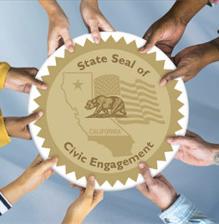
Thank you!
California Department of Education
Professional Learning Support Division
SSCE@cde.ca.gov
CALIFORNIA DEPARTMENT OF EDUCATION
Tony Thurmond, State Superintendent of Public Instruction

