Slide 1
Social and Emotional Distance Learning
Webinar Series
Engaging Youth and Building Life Skills
Session 4: Youth
October 5, 2020
Notes:
Presenter:
Hello and welcome to the Social and Emotional Distance Learning Webinar Series. My name is Julia Agostinelli from the California Department of Education (CDE). I work in the Educator Excellence and Equity Division in the Professional Learning Innovations Office.
As participants continue to join, please feel free to introduce yourselves in the chat. Include your name and how to pronounce it, as well as where you attend school .

Slide 2
Housekeeping: Using Zoom
Please keep your microphone muted unless otherwise directed.
Click the ^ next to the microphone icon to start or change your audio connection.
The chat will open a chat window on the right side of the screen.
Post questions in the chat window and the speaker will address them when possible.
Notes:
Presenter:
There are a few housekeeping items we need to review.
All participants will be muted during the webinar, so please keep your microphone muted unless otherwise directed. Click the small arrow next to the microphone to start or change your audio connection. Post questions in the chat and the speaker will address them when possible.

Slide 3

Welcome
Notes:
Presenter:
Welcome everyone, and thank you for taking the time to be with us this afternoon for the fourth in our four-part series on Social and Emotional Learning (SEL). We know that your time is important, and we hope to share some valuable information with you that can transfer directly to your life as you continue in school this year.

Slide 4
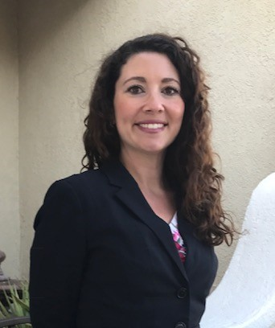
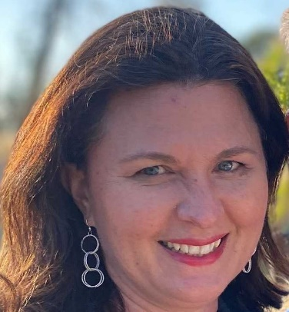
Introductions
Erika St. Andre
Julia Agostinelli
Notes:
Presenter:
We also have three very special guest speakers, Aaron Bryan, Arts Director for the Fresno County Superintendent of Schools; Tony Sanders, Arts teacher and administrator at Big Picture Educational Academy (Fresno County); and Michael Gray, a teacher at Poly High School in Long Beach.

Slide 5
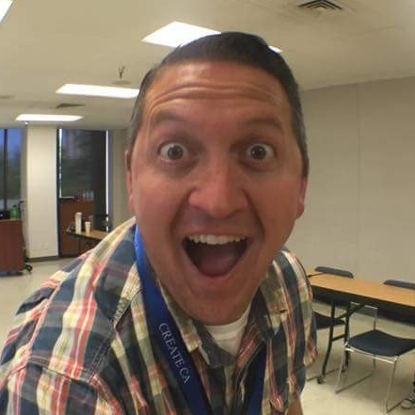
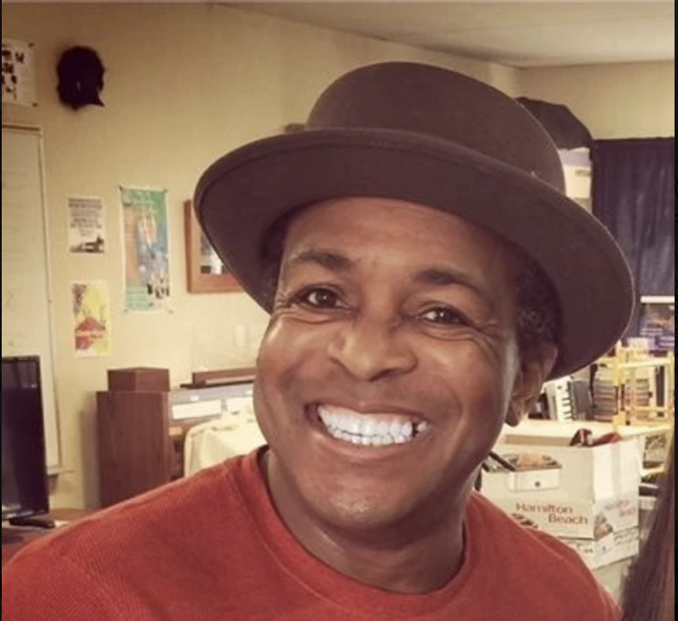
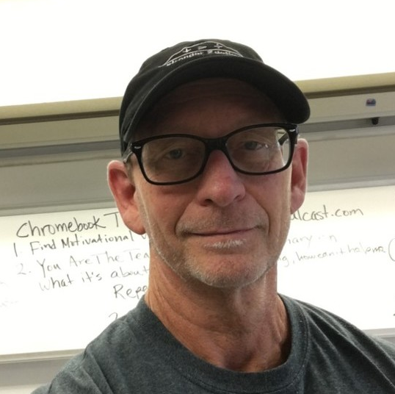
Guest Speakers
Aaron Bryan
Tony Sanders
Michael Gray
Notes:
Presenter:
We also have three very special guest speakers, Aaron Bryan, Arts Director for the Fresno County Superintendent of Schools; Tony Sanders, Arts teacher and administrator at Big Picture Educational Academy (Fresno County); and Michael Gray, a teacher at Poly High School in Long Beach.

Slide 6
Agenda
Welcoming Ritual
Self-Care Activity
Engaging Practice: What is Social and Emotional Learning (SEL)?
Questions and Answers
Notes:
Presenter:
In today’s webinar, we will begin with a welcoming ritual. Next we will learn about SEL. Finally, we will engage in what is called an optimistic closure. Finally, we will open up for questions and provide answers.

Slide 7
Today’s Outcomes
Today, we will:
Introduce/review what is meant by “SEL”
Provide skills and strategies to practice SEL at home
Experience creative SEL Strategies
Notes:
Presenter:
[Read from slide.]
We want to start by acknowledging that youth are already doing this work with their teachers, you just may be using different language or terminology when you talk about it.

Slide 8

Welcoming Ritual
“Mindful Minute” Exercise:
Hinges
Notes:
Aaron:
Before we get started with our content, we would like to check in with you to see how you are doing. Mindfulness activities like these at the start of the day or at mealtimes can be a quick but effective way to check in with yourself and your family.
One of the important points we are going to hear about today is that we can teach ourselves to think about our thoughts, what is called metacognition, and to learn techniques for acknowledging thoughts we are having and then move forward with the task at hand. We must practice these skills in order to effectively manage the many competing interests in our daily lives. My team and I have developed what we call “Mindful Minute” exercises. These are creative ways in which we can engage in mindfulness, beyond breathing activities, but that can still be accomplished quickly and effectively. “Mindful Minutes” are meant to be focusing activities, giving your brain a chance to reset and prepare for what’s next. You can do an activity like this anytime you feel you need a breather, or you’re getting ready to jump into some activity that is going to require your full and focused attention. So, let’s jump right into a simple movement activity called “Hinges.”
• Face the palms of your hands towards each other.
• In just a moment I’m going to ask you to inhale deeply. As you slowly exhale, I invite you to move something on your right hand that hinges, for example your fingers or wrists as I count to 8.
• So now, inhale deeply…
• Exhale...1...2...3...4...5...6...7...8
• Take another deep breath in and as you slowly exhale, move something that hinges on your left hand as I count.
• Exhale...1...2...3...4...5...6...7...8
• Another deep breath in
• Exhale slowly and move something on your arms that hinges.
• Exhale...1...2...3...4...5...6...7...8
• And one final breath in, exhaling slowly and moving anything above the waist that hinges.
• Exhale...1...2...3...4...5...6...7...8
Thank you for participating in this “Mindful Minute” exercise.
Image source: https://thenounproject.com/search/?q=66159&i&i=66159

Slide 9
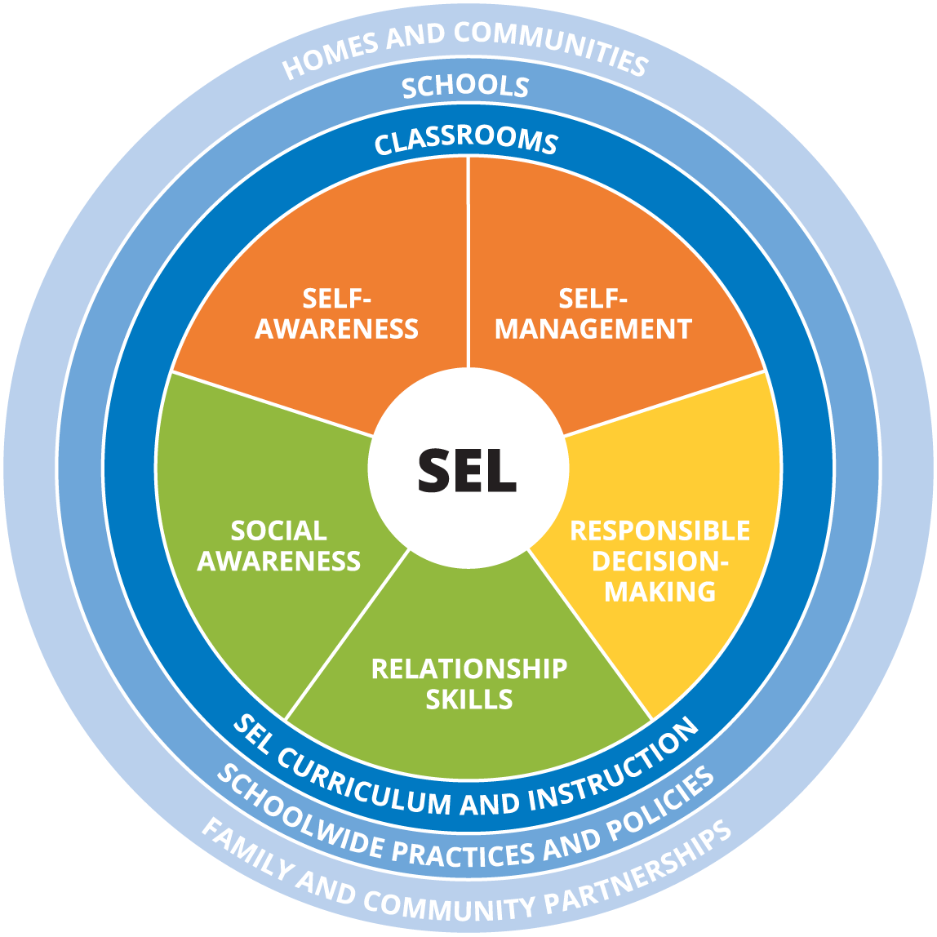
What Is Social and Emotional Learning?
Notes:
Aaron:
Many young people are wondering what SEL is and how it can help them. It is possible that you are already engaging in SEL strategies and skills. SEL, is how people process and manage emotions, set and achieve positive goals, feel and show empathy for others, establish and maintain positive relationships, and make responsible decisions. SEL is very important, and has become even more important due to this Pandemic, wildfires raging around our state, and the racial injustice and social unrest that are highly visible this year.
SEL is something that is taught in different settings. Students receive a lot of SEL at school by either their teacher(s), school counselor, staff, and even their peers.
SEL can also be something that continues in the home. With the Pandemic, students are engaging in distance learning and it is very important to also maintain the SEL in the home. SEL also helps prevent bullying and protect kids from abuse. SEL helps promote kindness and healthy social skills. And SEL is a natural byproduct of creativity and high-quality arts education. Students who participate in the arts and regularly engage their creativity develop stronger self-awareness, self-management, social awareness, relationship skills, and exhibit responsible decision-making.
This isn’t an accident. This is because the arts directly impact the brain...when we engage in creativity, we’re engaging the prefrontal cortex, which has been implicated in planning complex cognitive behavior, personality expression, decision making, stress management, and moderating social behavior. Engaging in creativity directly impacts this region of the brain and can help us better support our social emotional development. So, why is it important for young people to understand this?

Slide 10
Dr. Daniel Siegel
Author, and leading expert in pediatric,
child, adolescent, and adult psychiatry.
“The major innovations in art, music, technology and science come from adolescent minds.”
Notes:
Aaron:
Dr. Daniel Sigel, author and pioneer in the field of mental health, states that "the major innovations in art, music, technology and science come from adolescent minds.” Sadly, our schools and the adults in your life may often provide very little opportunity for creativity and self-expression. In our efforts to create routines and establish order, we often end up undermining your creativity. The more our schools can do to provide creative explorations for students, the better off your brains will be.
Link to quote source: https://www.psychotherapynetworker.org/blog/details/785/video-dan-siegel-on-embracing-the-energy-and-creativity

Slide 11
Engaging Practice
Notes:
Presenter:
An Engaging Practice is simply a topic or strategy we engage in to learn more.

Slide 12
Creative Social and Emotional Strategy (1)
“My Name, My Identity”
Notes:
Aaron and Tony:
Aaron:
We’ve talked a lot about SEL and creativity, but now I want to give you a chance to actually EXPERIENCE it. I’m going to turn it over to my friend and colleague, Tony Sanders, who is going to take you through a Creative SEL Strategy called “My Name, My Identity.” For this exercise, you’re going to need a blank piece of paper and a pen, pencil, or marker. Tony, take it away.
Tony:
Thanks Aaron! As Aaron said, you’ll need a blank piece of paper and a pen, pencil, or marker for this creative SEL strategy. We’re going to create our name stories, an important part of the “My Name, My Identity” initiative, which came from the Santa Clara County Office of Education in an effort to raise awareness around the importance of correctly pronouncing a student’s name and recognizing that our names, whether given names or chosen names, are part of our identity. For more information on the “My Name, My Identity” initiative, please visit MYNAMEMYIDENTITY.ORG.

Slide 13
Creative Social and Emotional Strategy (2)
“My Name, My Identity”
What’s your name story?
Step 1: Write your name
Step 2: Add 5 to 7 images, icons, or words around your name that help to tell your name story.
Share: Breakout rooms (4 minutes)
Notes:
Tony:
The process is very simple with only 2 steps. Please listen to both steps before starting and I will give you time to complete.
STEP 1: You’re going to write your name, nice and large, in the center of your paper. You can choose to use just your first name, or your full name. You can use the name you were given at birth, or another name that people know you as. The important thing is that you share the name you want to be referred to in this space. Your name helps tell the story about who you are.
STEP 2: You’re going to add 5–7 images, icons, or words around your name that help to tell your name story. For example, [Tony, provide your own example here] sample: being a father is a HUGE part of my identity, so I might draw stick figures representing my kids, or I might draw something symbolizing music to recognize my passion as a music educator.
I’m going to give us 5 minutes to create, then we will each have a chance to share.
To recap: Step 1: write your name LARGE. Step 2: add 5–7 icons, images, or words that help tell who you are. Ready? Set. CREATE! Aaron will play music while they create (royalty and copyright free music from www.bensound.com)
SHARE
At this time we’re going to send you all into breakout rooms to share your name stories. If you do not wish to share, you are welcome to say pass, but I would encourage you to turn your camera on if it is off, IF YOU’RE COMFORTABLE DOING SO. If you’re using a virtual background it might be good to turn it off so we can better see your creation when you hold it up to share, but again, only if you’re comfortable turning off your virtual background. You’ll have about 4 minutes to share, so please keep an eye on the time and make sure everyone has a chance to speak. Share your name and use the images, icons, or words you’ve added to your name story to help tell others a little more about who you are. There won’t be an identified leader in your breakout room, so one of you just step up, be bold, and get the ball rolling.
One last thing, if you get to your breakout room and no one else has their camera on, please feel free to head back to the main room and we will be here happy to hear from you.
Ok....here we go – see you in about 4 minutes! (Send students to breakout rooms with 3–4 people per room)

Slide 14
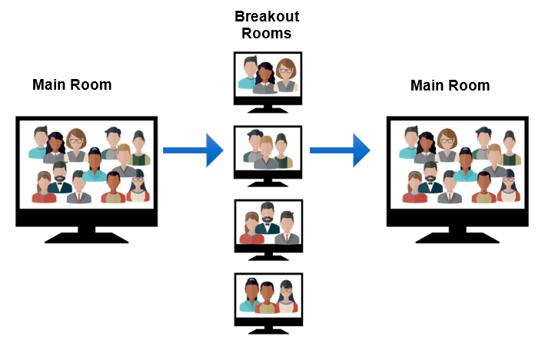
Breakout Activity: Interaction Flow
The host of the webinar will invite you to join a Breakout Room. When the Breakout Room session is over, you will return to the Main Room.
Notes:
Presenter:
We are now going to discuss what we just learned about with small groups in breakout rooms.

Slide 15
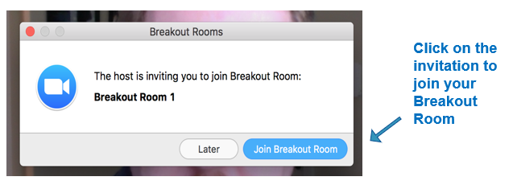
Breakout Room Assignment
The host of the webinar will invite you to join a Breakout Room. Click on the Join Breakout Room button to join.
Notes:
Presenter:
Once we set up the breakout rooms, click on the invitation to join your breakout room.

Slide 16
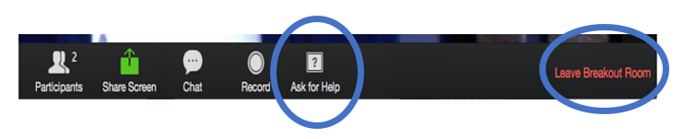
Breakout Room Navigation
Once you have joined a Breakout Room, you can click on the ? Ask for Help button if you need assistance, or click on the Leave Breakout Room if you want to leave.
Notes:
Presenter:
Once in your breakout room, your bottom navigation will change slightly, providing you with a new Ask for Help button, which will invite the host to your breakout room, and a Leave Breakout Room button, which will return you to the main room.

Slide 17
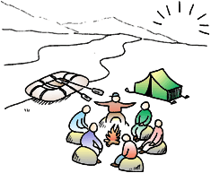
Whole Group Share
What are you taking away from your group discussion?
Why do you think that our names, for some of us, are closely tied to our identity?
How did adding words or images to your name help tell more about you?
How do you feel after doing this activity?
Notes:
Tony and Aaron:
Tony:
Welcome back! I hope each of you had a chance to share a bit about yourselves.
Remember, your name, whether a chosen name, a nickname, or your birth name, is part of your identity. It is ok to insist that people pronounce your name correctly, even if it is difficult for them. Be gracious to them. Give gentle reminders about how to pronounce your name, and allow them space to make mistakes, but help them understand that it is important to you. And of course, you need to make sure you’re doing the same for anyone you encounter. Remember, for many, our names are closely tied to our identity, so dismissing their name can feel like you are dismissing them altogether.
As we wrap-up this creative SEL exercise I want to leave you with a quote from a great author, Dr. Seuss:
“Today you are you, that is truer than true.
There is no one alive who is you’er than you.”
Thank you all so much for participating. Aaron, back to you!
Aaron:
Thanks for leading us in that activity, Tony. I’d like to hear from a few of you about your reflections on the ”My Name, My Identity” activity.
Questions for reflection:
• Why do you think that our names, for some of us, are closely tied to our identity?
• How did adding words or images to your name help tell more about you?
• How do you feel after doing this activity.
[Participants share out]
Aaron:
Thank you all for sharing. I’m going to turn it over to another friend, and an AMAZING dude, Mr. Michael Gray from Long Beach Poly High School. Mr. Gray, you’re up!
Image source: https://thenounproject.com/search/?q=66159&i&i=66159

Slide 18
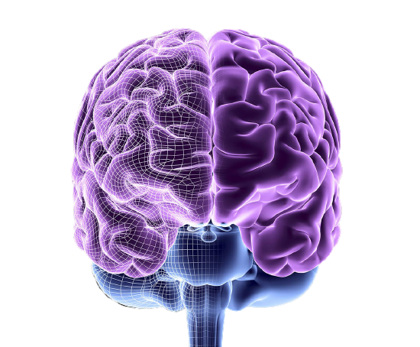
The Brain and Creativity
Notes:
Aaron:
It’s important to understand how our brains develop. In general, they develop from bottom to top and back to front.
Link to source information: https://www.drdansiegel.com/blog/2014/09/16/brain-insights-and-well-being/
Image source: https://www.google.com/url?sa=i&url=https%3A%2F%2Fwww.amnh.org%2Flearn-teach%2Fseminars-on-science%2Fcourses%2Fthe-brain-structure-function-and-evolution&psig=AOvVaw1ZNk44SizDSvXSZq3W5_qK&ust=1601405708982000&source=images&cd=vfe&ved=0CAIQjRxqFwoTCMCHpqXDjOwCFQAAAAAdAAAAABAD

Slide 19
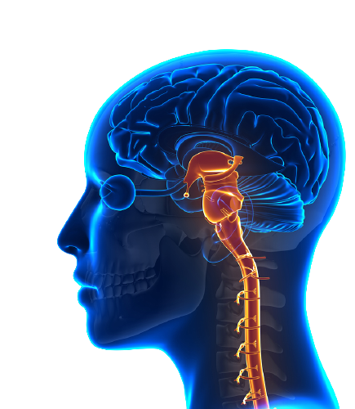
Brain Stem
Develops first
Controls essential physiological functions, tasks, systems, etc.
Information superhighway
Notes:
Aaron:
So the brainstem, which develops first, is essentially fully formed at birth and controls our basic functions, like our circulatory and respiratory systems, and it works as an information superhighway for the entire body. Stress greatly impacts the brain stem, which is why some of us may eat less when we are stressed, or others...ME...may eat more. Particularly stressful times can lead to sleepless nights, because sleep patterns are directly controlled by the brain stem. So our efforts to manage our stress can literally impact our entire physiological makeup through the brain stem.
Link to source information: https://www.drdansiegel.com/blog/2015/01/22/brain-insights-and-well-being-3/
Image source: https://www.google.com/url?sa=i&url=https%3A%2F%2Fvalientemott.com%2Fblog%2Fbrain-stem-injury-symptoms-and-causes-explained%2F&psig=AOvVaw1QNVezhgSqNiGOtKY4oUWt&ust=1601405639619000&source=images&cd=vfe&ved=0CAIQjRxqFwoTCLinmIbDjOwCFQAAAAAdAAAAABAD

Slide 20
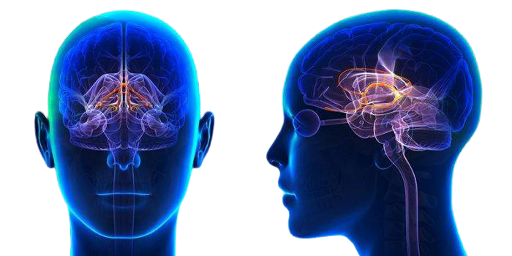
Limbic System
Emotional centers
Threat perception
Memory
Attachment relationships
Notes:
Aaron:
The next region of the brain to form is the Limbic System. The limbic system is partially formed at birth and works seamlessly with the brain stem for 4 main purposes:
1. It houses our emotional centers
2. Threat perception
Memory
Attachment Relationships
Link to source information: https://www.drdansiegel.com/blog/2015/01/22/brain-insights-and-well-being-3/
Image source: https://www.google.com/url?sa=i&url=https%3A%2F%2Fwww.amenclinics.com%2Fblog%2Flimbic-system-caring-brains-limbic-system%2F&psig=AOvVaw1GZcAAZfHySP3hUi0qSEvj&ust=1601405739423000&source=images&cd=vfe&ved=0CAIQjRxqFwoTCNjRqLfDjOwCFQAAAAAdAAAAABAD

Slide 21
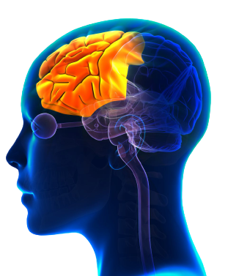
Prefrontal Cortex
Planning
Self-awareness
Empathy
Flexibility
Adaptation
Self-regulation
Notes:
Aaron:
The final region of the brain to form, and in evolutionary terms, the youngest part of our brains, is most commonly known as the “cortex.” The forward-most part of this region is the prefrontal cortex, which is where planning, self-awareness, empathy, flexibility, adaptation, and self-regulation occur. This region, responsible for higher-level thinking, is the last part of the brain to develop and is not fully-formed until our 30’s! So if anyone ever accuses you of being irrational or flying off the handle, kindly remind them that your brain is still developing.
Link to source information: https://www.drdansiegel.com/blog/2015/01/22/brain-insights-and-well-being-3/
Image source: https://www.google.com/url?sa=i&url=https%3A%2F%2Fwww.neeuro.com%2Fprefrontal-cortex-exercises%2F&psig=AOvVaw0lFG-Cf6U3FW1ezl1TpNzq&ust=1601405771659000&source=images&cd=vfe&ved=0CAIQjRxqFwoTCMCImcXDjOwCFQAAAAAdAAAAABAD

Slide 22
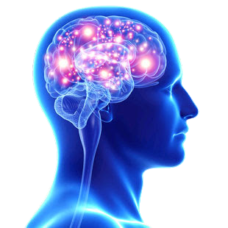
Health = Integration
Notes:
Aaron:
Dr. Siegal defines health as the integration between these three regions or systems of the brain so that they are consistently working together to manage your neurological, physiological, and emotional responses. Mindfulness is one way that we can help promote this integration.
Link to source information: https://www.drdansiegel.com/blog/2014/09/16/brain-insights-and-well-being/
Image source: https://www.google.com/url?sa=i&url=https%3A%2F%2Fcihr-irsc.gc.ca%2Fe%2F49963.html&psig=AOvVaw2CV5OkB2KMBlx3LHyy0_uG&ust=1601415297330000&source=images&cd=vfe&ved=0CAIQjRxqFwoTCKiPuYbnjOwCFQAAAAAdAAAAABAE

Slide 23
Mindfulness
Awareness of one’s breath
Awareness of physical sensation
Notes:
Aaron:
You may have heard of mindfulness before. You may have even participated in mindfulness activities, but did you know that you can make just about ANYTHING a mindfulness exercise? It’s true! All that is needed for an activity to be mindful are two things:
1. An awareness of your breath
2. An awareness of physical sensation
So this means if these two items are present, any activity can be a mindfulness activity. You can have mindful dance, mindful painting, mindful playing, mindful eating, mindful gardening...anything can be a mindful activity if you’re focusing on your breath and your senses.
If you think back to our “Mindful Minute” exercise from earlier, you’ll recall that I had you slow your breathing and control the exhalation. I also had you focus on intentional movement. This is why many utilize yoga for mindfulness. It’s also why I saw in my choir classes that students who entered class in a frenzy and were just a ball of unregulated energy were often completely different after the first 8 minutes of class. I didn’t know it at the time, but I was helping promote neural integration in my students through our vocal warm-ups. In many music classes, the warm-up process typically begins with a physical warm-up, leading to respiratory exercises. In the first few minutes of my class students were moving and breathing with intention, and by the end of those warm-ups we were ALL in a better physical and mental space, ready to move onto more complex tasks.
These ideas could absolutely be applied to non-music classes! You could take a moment to focus on your breathing and check-in with how your body is feeling at ANY TIME throughout the day: as part of your wake-up routine in the morning, before a test, when your internet connection is slow and making distance learning very frustrating, when someone in your house is on your last nerve, or when your just need a little boost of energy and focus. The more often we engage in these mindfulness practices, the better our brains become at integration.
Image source: https://www.google.com/url?sa=i&url=https%3A%2F%2Fcihr-irsc.gc.ca%2Fe%2F49963.html&psig=AOvVaw2CV5OkB2KMBlx3LHyy0_uG&ust=1601415297330000&source=images&cd=vfe&ved=0CAIQjRxqFwoTCKiPuYbnjOwCFQAAAAAdAAAAABAE

Slide 24
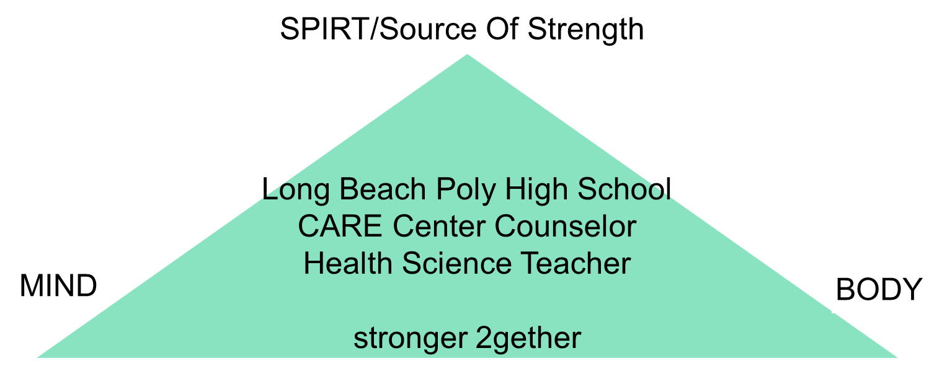
Michael Gray
Long Beach Poly High School
Notes:
Michael introduces himself and shares that we will speak about how the mind, sources of strength, and the body and how the interconnection affects people.

Slide 25
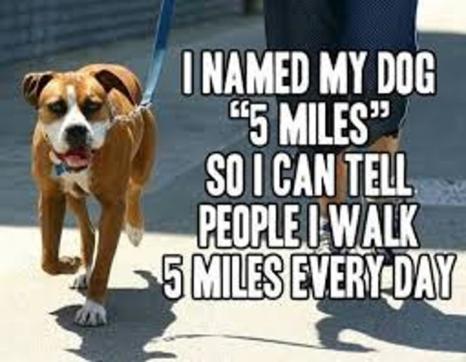
5 Miles
Notes:
Michael tells short joke about how he named his dog “5 miles.”

Slide 26
Elevate
Mental Wellness Skills
Equal to Academics
Notes:
Michael discusses how encouraging students to engage their teachers, counselors, and principals in the concept of elevating mental wellness skills is equal to academics in importance.

Slide 27
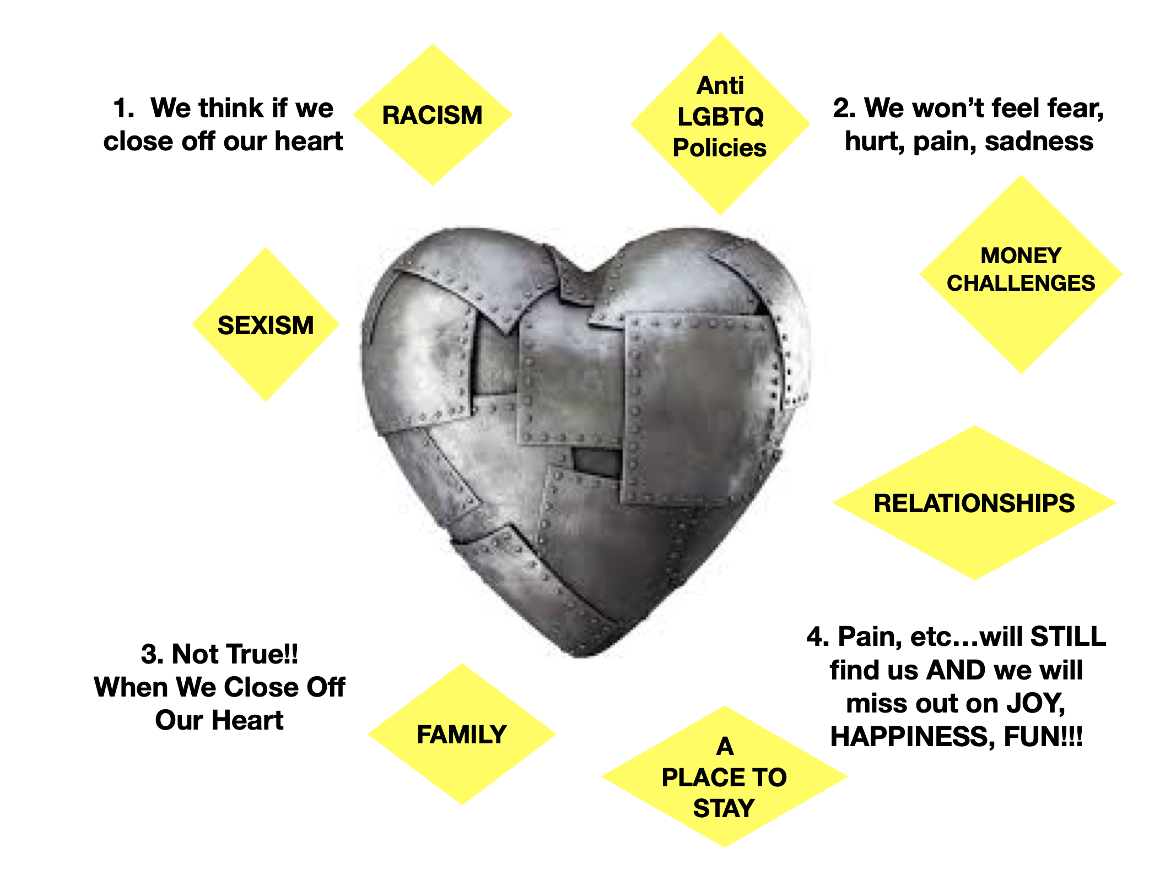
Closed Heart
We think if we close off our heart because of things like racism, anti LGBTQ policies, money challenges, relationships, a place to stay, family, and sexism, we won't feel fear, hurt, pain, or sadness. Not true! When we close off our heart, pain, etc…will still find us and we will miss out on joy, happiness, and fun!!
Notes:
Michael:
Our young people have so many valid reasons to be angry, disappointed, etc. The science of what happens when we close off our hearts/numb ourselves is important to show. We encourage you to use the skills we are showing in this webinar to keep your heart open.

Slide 28

Change
*Why is it so hard to make changes?
*How can you make change happen?
*What are a few things to work on?
https://youtu.be/PLYuHS-U_4o

Slide 29
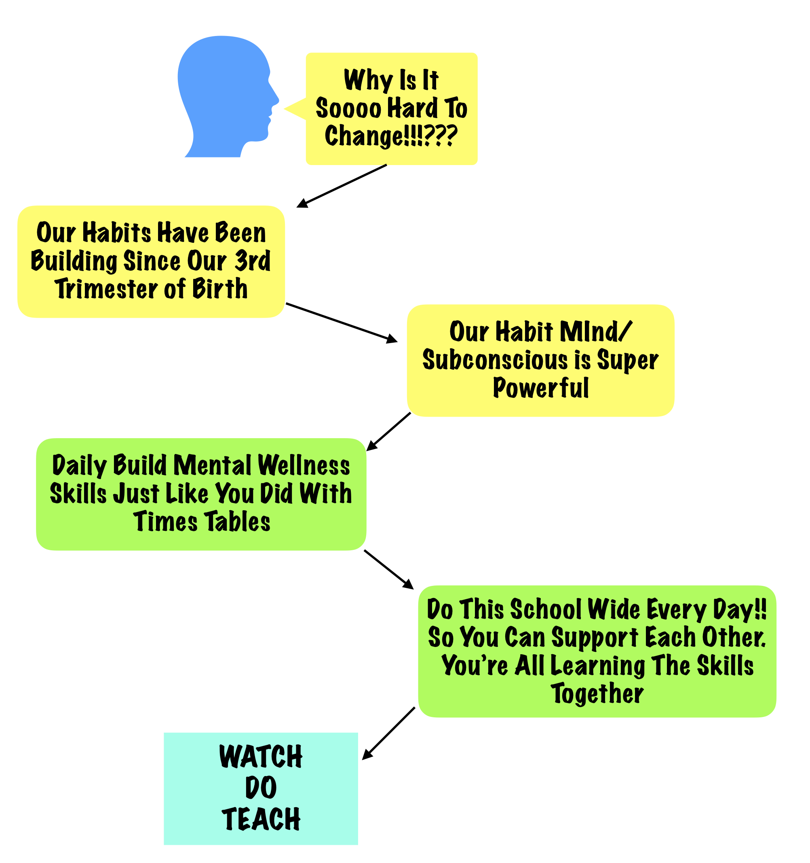
Why Is it so Hard to Change?
Why is it so hard to change? Our habits have been building since our 3rd trimester of birth. Our habit mind is super powerful. Daily build mental wellness skills just like you did with times tables. Do this schoolwide every day. Support each other. You are all learning the skills together. Watch, do, teach.
Notes:
Michael:
A brief explanation of the science of why change is so difficult. A brief illustration of how even the simple action of changing how we fold our hands creates an uncomfortable feeling that keeps us from wanting to change. What is a proven and effective way to build new skills and helpful habits?

Slide 30

The Fears I Do Not Climb
Become My Walls
https://www.youtube.com/watch?v=V8Iz7ZuXZL4&feature=emb_logo
Notes:
Michael:
2gether Tuesday
Fear of Failure

Slide 31
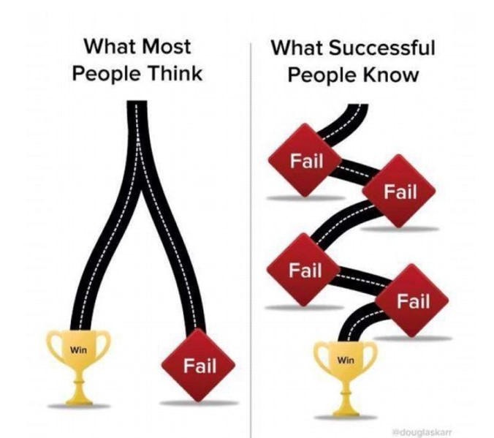
Lastly
When you mess up…learn from it.
When something is difficult, learn from it.
Don’t try hard only on what you are good at. Try hard on what you aren’t good at. Fail (and learn) your way to greatness and significance.
Notes:
Michael:
A lot of our limitations come from our fears. One of our biggest fears is the fear of failure. When you learn and use the skill of accurate thinking you challenge your fearful thoughts. Those that become good at what they want to become good at understand learning from “failures” leads to growth and wisdom.

Slide 32

Five Skills to Use Daily for Just a Couple of Minutes
Stop Speaking Negatively Out Loud
The Power of Living in Gratitude
Accurate Thinking
Exercise
Breath Work
Notes:
Michael:
Here’s a brief description of five skills to start using each day for just a couple minutes. Become self aware of how you feel when you are doing these skills and increase your daily use to make them habits. Our mantra is Watch (learn)…Do (practice/use) …Teach (share/spread the knowledge).

Slide 33
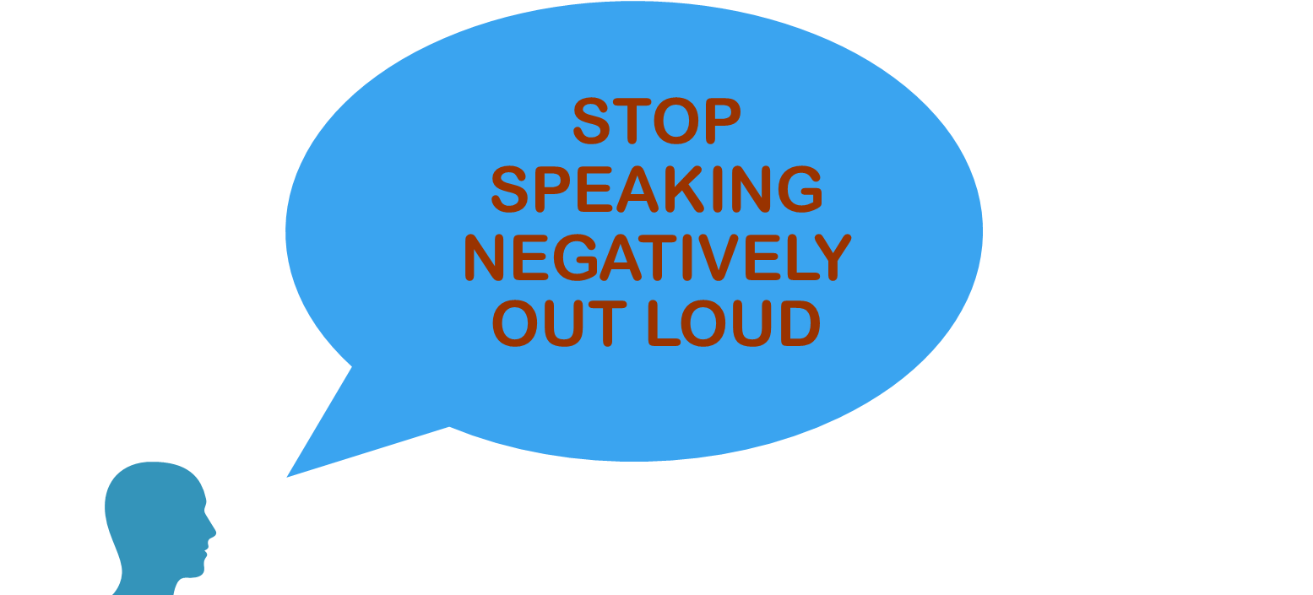
Negativity
Notes:
Michael:
Research shows that negative speaking and negative actions are exponentially more powerful than “positive.” One of the first habits to create is “Stop Speaking Negatively Out Loud.”
Discuss: Bad Is Stronger Than Good video
Roy F. Baumeister and Ellen Bratslavsky Case Western Reserve University
Catrin Finkenauer Free University of Amsterdam
Kathleen D. Vohs Case Western Reserve University
Review of General Psychology 2001, Volume 5, Number 4, Pgs 323-370

Slide 34
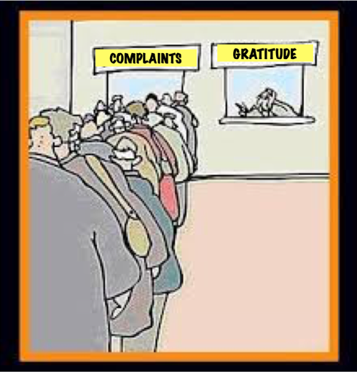
Complaining vs. Gratitude
Notes:
Michael:

Slide 35
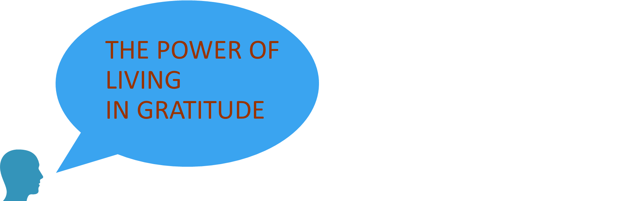
Gratitude
Notes:
Michael:
The science of The Power of Living In Gratitude. This is the perfect skill to learn in community with Stop Speaking Negatively Out Loud. When you live in gratitude (which involves action more than simply lists) you create a way of focusing on what is possible…what is good. Here’s an activity that illustrates how this daily habit not only affects you, but has an effect on everyone around you. You can complete the activity after the webinar.
The Science of Gratitude Greater Good Science Center U.C. Berkeley May 2018

Slide 36
Time to Do the “Power of Living in Gratitude” Exercise
Take a moment and visualize someone in your life that had a positive impact on your life and is still living.
Write them a short note of gratitude. 2 minutes.
Notes:
Michael:
Read from slide. Then tell them, “Call or text them. Read them the note if possible. Then consider, how it made that person feel, how did it make you feel?”

Slide 37
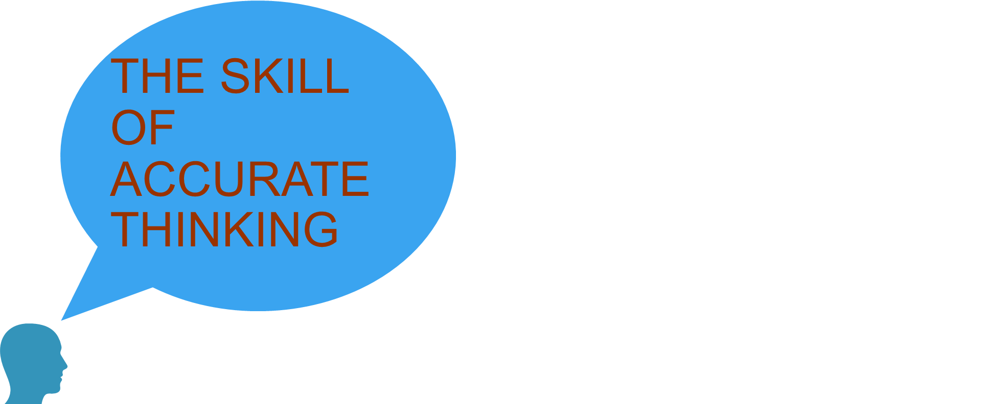

Accurate Thinking
https://youtu.be/n5JQIUfLaoc
Notes:
Michael:
Let’s talk about the Basics of the skill of Accurate Thinking. A big part of Accurate Thinking (like we said earlier when challenging our fears) is learning to challenge the lies of our thoughts. Another huge part of accurate thinking is not letting what others say define us. The power of what you believe to be true about yourself is your superpower!! Introduce Don Miguel Ruiz and reference his book “The Four Agreements.”
https://youtu.be/n5JQIUfLaoc

Slide 38
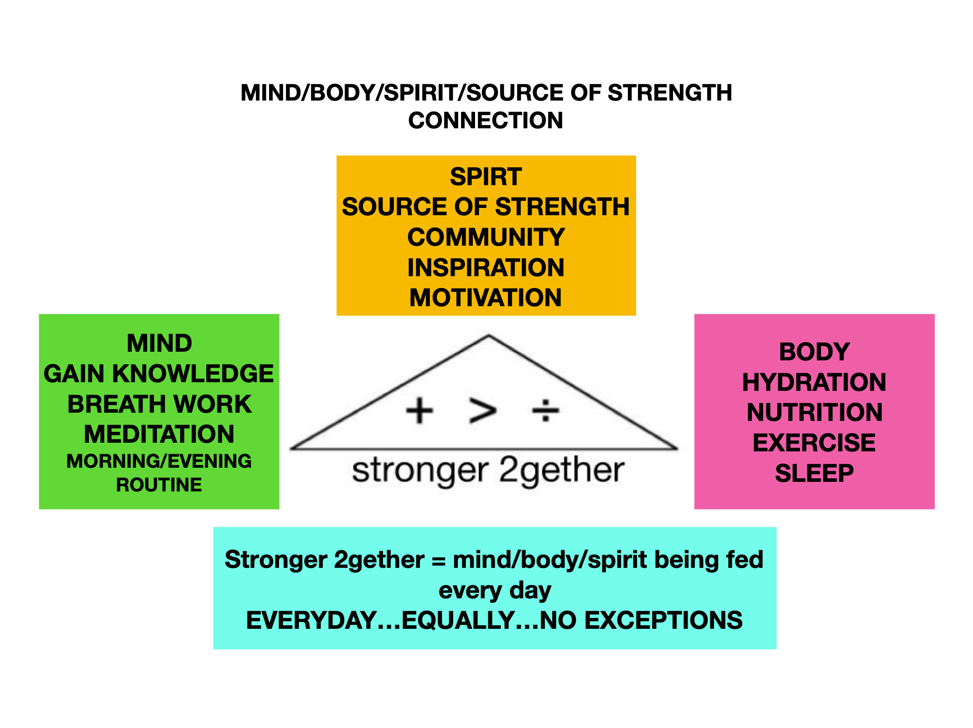
Mind/Body/Spirit
U.S. National Library of Medicine, National Institutes of Health
The following slide has a detailed description of the graphic.
Notes:
Michael:
Quick encouragement to understand how we can’t neglect any parts of us. That daily taking actions in all 3 areas creates real strength and real self power. When you are not feeling or acting your best…take an inventory, “am I getting enough sleep, am I doing my breath work, am I staying hydrated, am I watching what information I’m consuming?” etc.
U S National Library of Medicine
National Institutes of Health
EMBO Reports 2006 Apr; 7(4): 358–361.
The benefits of exercise. Start with 2 minutes a day and work up to 15. Then work up to 30. Any amount of exercise helps…but especially at least 15 minutes A DAY helps with depression, anxiety, ADHD, your immune system, helps you get “unstuck” from the stress response to trauma, helps you be able to focus, helps CREATE energy when you’re feeling unmotivated or mentally/emotionally tired. Why We Should Exercise Harvard Health Publishing August 2019. The Mental Health Benefits of Exercise
helpguide.org

Slide 39
Mind/Body/Spirit/Source of Strength Connection
First point of triangle: Spirit, source of strength, community, inspiration, motivation.
Second point of triangle: Mind, gain knowledge, breath work, meditation, morning/evening routine.
Third point of triangle: Body, hydration, nutrition, exercise, sleep.
Stronger 2gether = mind/body/spirit being fed every day. Everyday…Equally…No exceptions.

Slide 40

Breath Work
Notes:
Michael:
Show youth the breathing pamphlet. (access at https://bit.ly/2G7Y9YI)
I just want to echo what Aaron covers in his presentation about how powerful Breath Work is. Yes, meditation is cool and super effective. But! The simple act of breathing helps manage our emotions/feelings. [Briefly speak about the {Philipott study). Not only are there breathing patterns associated with different states of mind…you can move a person from calm to anxious just by having them do an “anxious breathing pattern” as well as from anxious to calm using a “calm breathing pattern.”
Respiratory Feedback In The Generation of Emotion
Philipott, Chapelle & Blairy
September 2010
Taylor and Francis Online
Breathing: The Little Known Secret To Peace Of Mind
Psychology Today
4/15/2013.

Slide 41
The Most Important Skills
Self Awareness
Empathy
Mental Balance
Building Community
Integrity
Flexibility
Resiliency/Don’t Give Up
Notes:
Michael:
These are the Emotional Intelligence Skills that are in high demand for any career as well as those that want to be an entrepreneur. This is another reason we are encouraging students, parents, and educators to go to their school and district encouraging them to Elevate Mental Wellness Skills Equal To Academics.
Dr. Yuval Noah Harari
21 Lessons For The 21st Century
Dr. Kai-Fu Lee
AI Super Powers

Slide 42
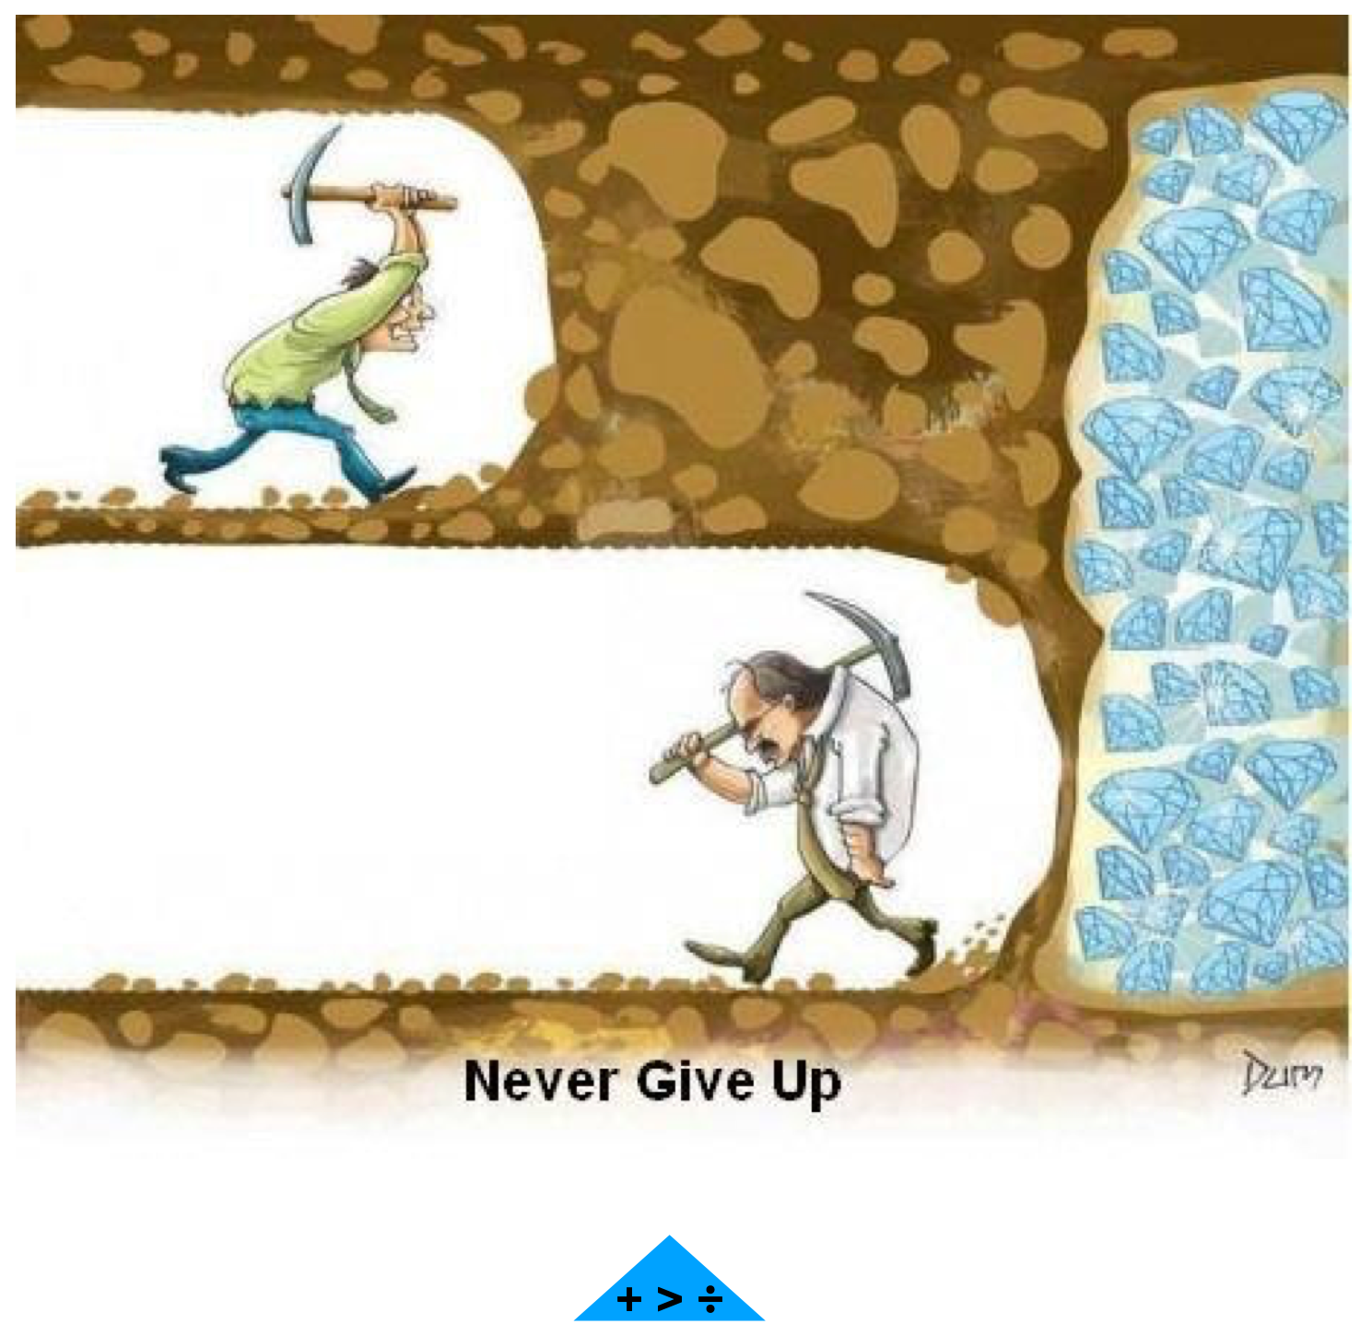
Never Give Up

Slide 43

Questions and Answers
Notes:
Presenter:
If time, ASK: Are there any questions or comments? Please share in the chat.

Slide 44
Social and Emotional Distance Learning Web Page
http://www.cde.ca.gov/ci/se/seldistance.asp
Resources for teachers, school leaders, parents, and students
Notes:
Presenter:
You can find the CDE’s SEL Distance Learning web page at [read URL]. The web page has four distinct areas: teachers, school leaders, parents, and students.

Slide 45

Thank You For Joining Us!
Notes:
Presenter:
Thank you everyone for their support today. I also want to extend a special thank you to Aaron Bryan and Michael Gray for sharing their expertise. Stay safe and be well.

Slide 46
Educator Excellence and Equity Division Communications
Facebook
California Department of Education
SEL Twitter
@CDE_SEL
Notes:
Presenter:
Our division shares ongoing information about SEL. We hope you will follow us on Facebook at the CDE and on Twitter @CDE_SEL.

