Slide 1
Screening for Risk of Reading Difficulties - Overview Statewide Literacy Office Webinar, January 21, 2025

Slide 2

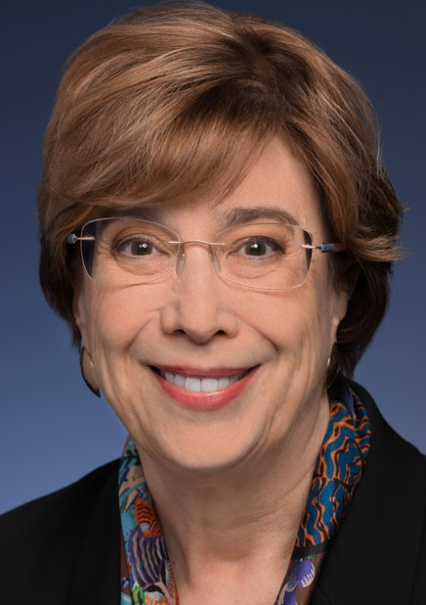

Welcome & Introductions
Cheryl Cotton
Deputy Superintendent
Nancy Brynelson
Statewide Literacy Co-Director
Dr. Bonnie Garcia
Statewide Literacy Co-Director

Slide 3
Agenda
Welcome & Introductions
Opening & Key Questions
Purpose
Selection of Screening Instruments
Resources
Suggested Next Steps (1)
Timelines
Suggested Next Steps (2)
Other Requirements
Assessing Multilingual Learners
Opt-outs & Exemptions
Supports & Services for Students Identified as Being at Risk
Unacceptable Uses Of Screening Results
Questions & Answers

Slide 4
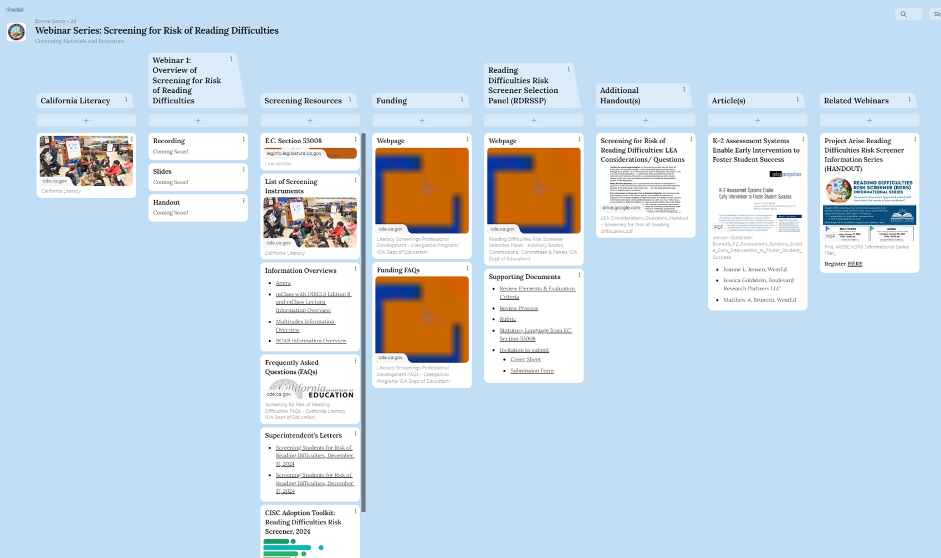
Webinar Padlet
https://tinyurl.com/cdescreenerwebseries

Slide 5
“California for All Kids”
“All kindergarten through second grade students will be screened for risk of reading difficulties, increasing early identification and support.”
Quoted from the Governor’s Budget Summary ― 2025‒26, pp. 13‒14

Slide 6
Required in California
“Beginning in 2025‒26, and annually thereafter, a local educational agency (LEA)… shall assess each pupil in kindergarten and grades one and two for risk of reading difficulties,” … “including possible neurological disorders such as dyslexia ...” Education Code (EC) Section 53008 (e) & (b)
LEAs shall use a “screening instrument … adopted by their governing board” from “an approved list of evidence-based, culturally, linguistically, and developmentally appropriate screening instruments ...” “… in languages reflecting the primary language of pupils in the state, to the extent assessments in those languages are available.” EC Section 53008 (d), (b), & (c) (2)

Slide 7
Key Questions
What is the purpose of screening all Kindergarten (K) through grade two (K‒2) students for risk of reading difficulties?
How were the screening instruments selected?
What resources are available to us?
What do we do now?

Slide 8
Purpose

Slide 9
What is the purpose of screening all K‒2 students for risk of reading difficulties? (1)
“Screening should be considered part of a schools’ comprehensive instructional strategy, and should be used … to inform individualized instruction, measure progress, identify learning needs, & enable parents & educators to discuss learning needs in a more informed way.” Education Code (EC) Section 53008 (a) (1)
[Screening] … can help families & teachers achieve the best learning & life outcomes for all pupils and close academic achievement gaps.” EC Section 53008 (a) (2)

Slide 10
What is the purpose of screening all K‒2 students for risk of reading difficulties? (2)
“Screening results shall be used as a flag for potential risk for reading difficulties, not as a diagnosis of a disability.” EC Section 53008 (l)
“Results … shall be used as a part of a broader process that further evaluates pupil needs and progress, identifies supports for classroom instruction, enables targeted individual intervention as needed, & allows for further diagnosis if concerns do not resolve.” EC Section 53008 (l)

Slide 11
Selection of Screening Instruments

Slide 12
How were the screening instruments selected? (1)
Screening instruments were selected by an expert panel, the Reading Difficulties Risk Screener Selection Panel (RDRSSP), based on a process and criteria approved by the State Board of Education (SBE) in accordance with EC Section 53008 (b), (c), & (g).
See RDRSSP web page (https://www.cde.ca.gov/be/cc/rd/) for meeting agendas, minutes, and recordings.

Slide 13
How were the screening instruments selected? (2)
The process was deliberate, rigorous, careful, and public.
The SBE approved evaluation criteria developed by the RDRSSP.
Based on the criteria, the RDRSSP reviewed applications in the following three areas:
Description of Assessment Battery
Psychometrics
Communication and Resources

Slide 14
How were the screening instruments selected? (3)
Applications that did not meet the moderate evidence level on the rubric for the overall sample and relevant grades for 2.d.i. Reliability, 2.d.i. Content Validity, 2.d.ii. Criterion Validity, & 2.d.iii. Criterion Validity were not considered further.
Applications had to meet moderate or strong evidence levels in all other areas, except for 3.e.ii., 3.e.iii (for only paper-based instruments), 3.f.i, & 3.f.ii, to be approved.
See RDRSSP Basis for Application Approval https://www.cde.ca.gov/be/cc/rd/basisforappapproval.asp.

Slide 15
How were the screening instruments selected? (4)
The following were used by the RDRSSP to solicit and evaluate the screening instruments:
Review Elements & Evaluation Criteria
Review Process
Rubric
Statutory Language from Education Code Section 53008
Invitation to Submit
Cover Sheet
Submission Form
All documents are available on the RDRSSP web page. See Padlet for direct links to all documents https://tinyurl.com/cdescreenerwebseries.

Slide 16
Resources

Slide 17
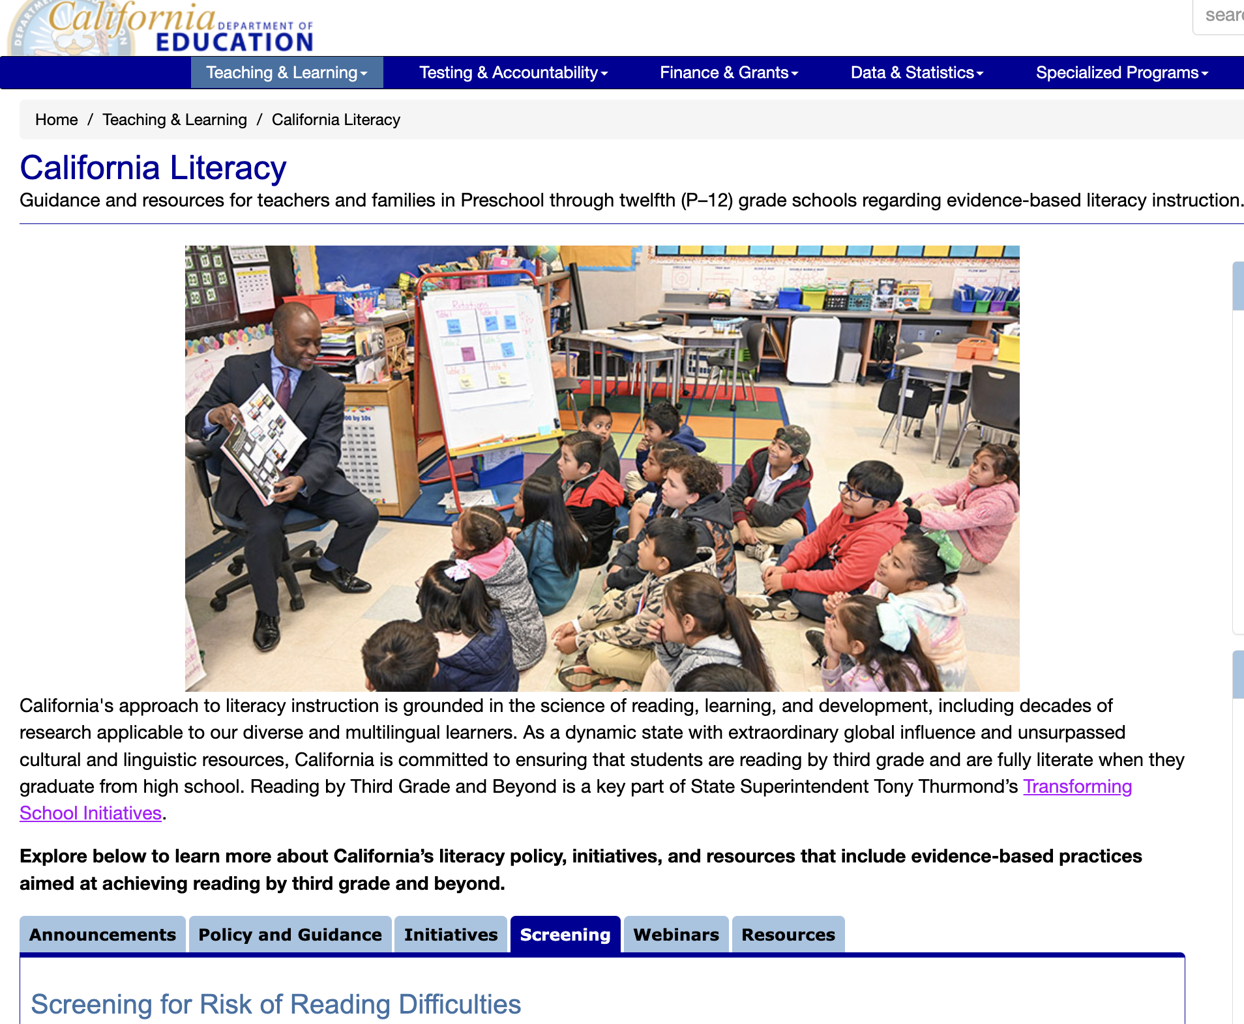
California Literacy

Slide 18
What resources are available to us? (1)
California Literacy > Screening Tab (https://www.cde.ca.gov/ci/cl/)
Screening Instruments & Information Overviews
Communication & Resources
Frequently Asked Questions
Letters to the Field
“Adoption Toolkit” (Curricular & Improvement Support Committee, CA County Superintendents)
Literacy Screening Professional Development Funding 2024–25
Policy
Education Code Section 53008
Reading Difficulties Risk Screener Selection Panel
California Dyslexia Guidelines
Announcements & Webinars tabs will include future and archived webinars
See Padlet for all resources https://tinyurl.com/cdescreenerwebseries

Slide 19

Information Overview
Amira
General Information https://www.cde.ca.gov/ci/cl/amirainfooverview.asp

Slide 20
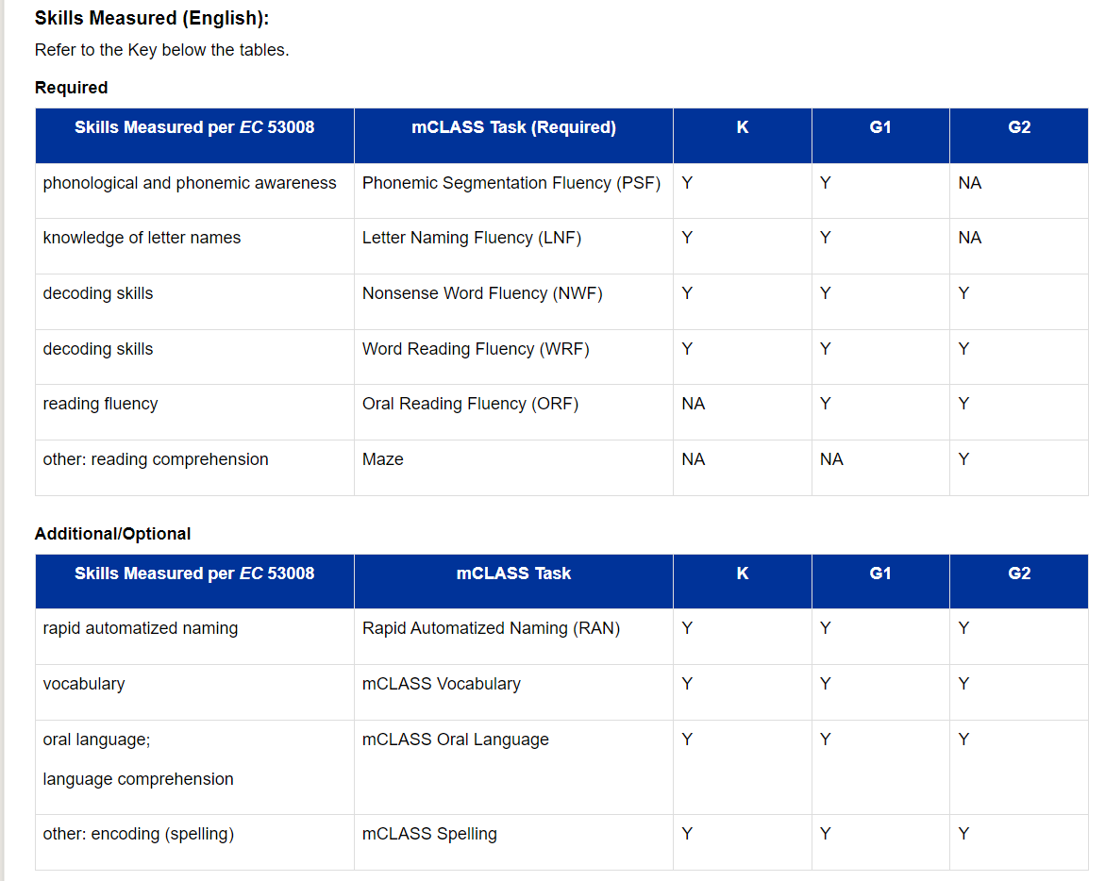
Information Overview (2)
mClass w/ DIBELS Ed 8 & mClass Lectura
General Information: Skills Measured (English) https://www.cde.ca.gov/ci/cl/mclassinfooverview.asp

Slide 21
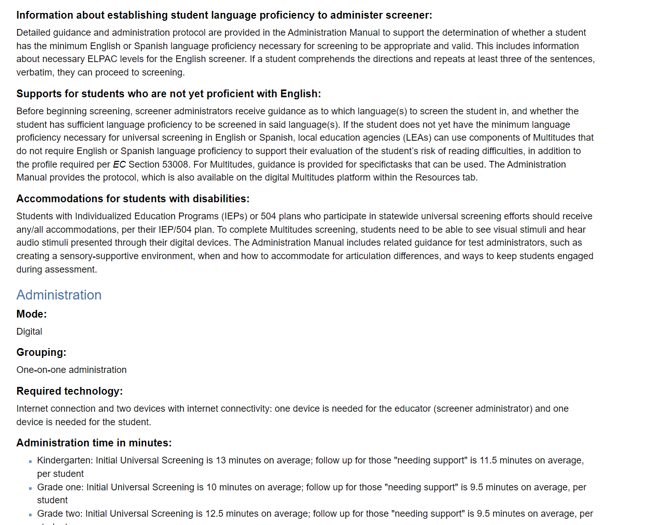
Information Overview (3)
Multitudes
General Information (cont.)
Administration
https://www.cde.ca.gov/ci/cl/multitudesinfooverview.asp

Slide 22

Information Overview (4)
ROAR
Training
Scoring
Cost Information
https://www.cde.ca.gov/ci/cl/roarinfooverview.asp

Slide 23
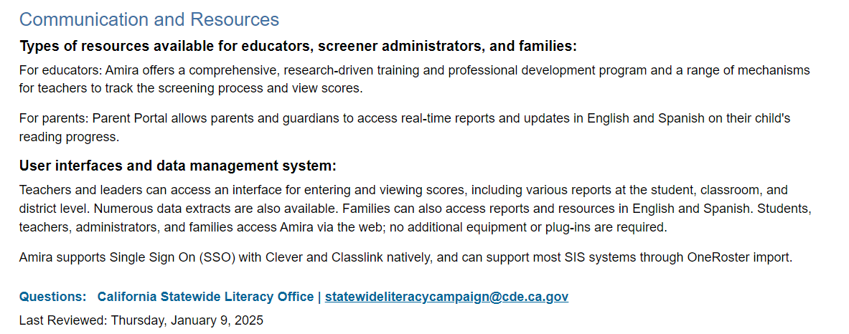
Information Overview (5)
Amira
Communication & Resources
https://www.cde.ca.gov/ci/cl/amirainfooverview.asp

Slide 24
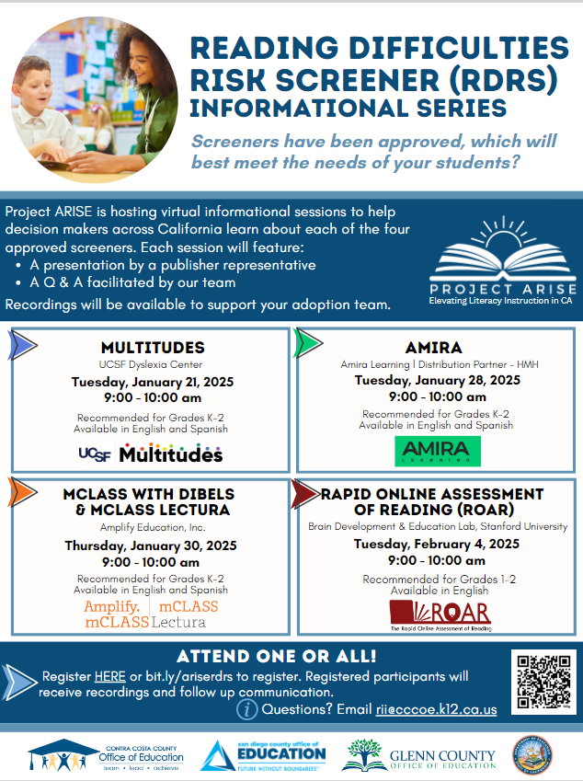
Project ARISE
Informational sessions for all approved screening instruments https://ccee-ca.org/wp-content/uploads/2025/01/Project-ARISE-RDRS-Informational-Series.pdf

Slide 25
What resources are available to us? (2)
Funding
2024‒25
$25 million one-time Prop 98 General Funds to support training for educators to administer screenings
Funds apportioned January 2025 @ $21.16 per K-2 pupil
2025‒26 as proposed by the Governor
$40 million one-time Prop 98 General Funds to support necessary costs, including purchasing screening materials and training for educators to administer literacy screenings

Slide 26
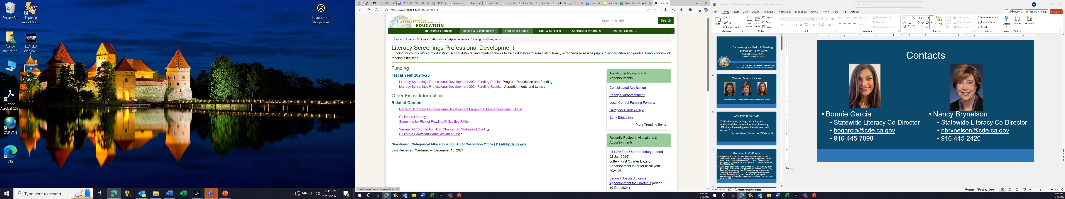


What Resources are available to us? (3)
Funding pages on CDE website: https://www.cde.ca.gov/fg/aa/ca/lspd.asp

Slide 27
Suggested Next Steps (1)

Slide 28
What do we do now? (1)
Read & re-read Education Code (EC) Section 53008 to identify LEA responsibilities & important timelines.
Review & revise, as needed, LEA’s “comprehensive instructional strategy,” including “broader process that
Further evaluates pupil needs & progress,
Identifies supports for classroom instruction,
Enables targeted individual intervention as needed, &
Allows for further diagnosis if concerns do not resolve.” EC Section 53008 (a) & (l)

Slide 29
What do we do now? (2)
Be aware that approved screening instruments were to include “guidance & resources … informed by
ELA/ELD Framework
CA Dyslexia Guidelines
Knowledge of effective interventions for the specific needs of individual students
…and reflect a tiered interventions model aligned with the Multi-Tiered Systems of Support.” EC Section 53008 (g)(1)(E)
Review ELA/ELD Framework, Ch. 8, Assessment, & other information on assessment literacy & comprehensive assessment systems.

Slide 30
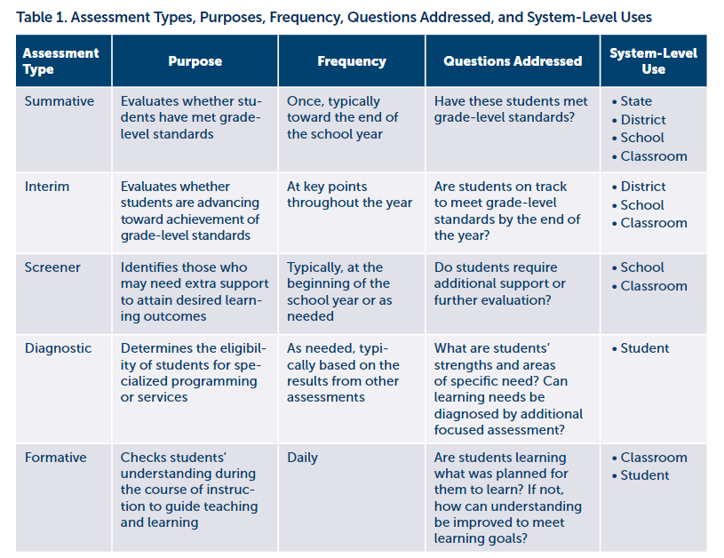
What do we do now? (3)
Consider the purposes for each assessment type.
“K-2 Assessment Systems Enable Early Intervention to Foster Student Success,” by Jensen, Goldstein, & Brunetti, WestEd, 2021, Table 1, p. 2

Slide 31
Timelines

Slide 32
Timelines (1)
Adopt one or more approved instruments in English & primary language(s) in a public meeting of governing board by June 30, 2025. EC Section 53008 (d)
Screen all K-2 students beginning in 2025‒26 & annually thereafter. EC Section 53008 (e)
Determine when to screen K‒2 students during the school year. EC Section 53008 (e)
Consider whether students have received sufficient instruction in foundational reading skills to support a valid assessment. EC Section 53008 (e)

Slide 33
Timelines (2)
Students enrolled after screening is conducted must be assessed within 45 days unless documentation is provided that shows that similar screening occurred & that parent/guardian was notified. EC Section 53008 (f)
Information about screening, date(s), & instructions for opting out must be provided to parents/guardians at least 15 days before screening. LEAs are encouraged to provide information about screening with other back-to-school materials at beginning of the year. EC Section 53008 (j)
Screening results, including how to interpret results & next steps must be provided to parents/guardians within 45 days of screening. EC Section 53008 (k)

Slide 34
Suggested Next Steps (2)

Slide 35
What do we do now? (4)
Investigate & select screening instrument(s)
Consult CISC “Adoption Toolkit”
Determine selection process
Engage teachers, specialists, administrators, & paraprofessionals
Selection process
Professional development
Learn about each screening instrument; consult posted Information Overviews.
Consider piloting screening instruments
Obtain governing board approval

Slide 36
What do we do now? (5)
Determine supports & services that will be provided to students identified as at risk.
Develop procedures, staffing, & schedules for conducting screenings.
Develop notification letters for parents/guardians, including translations as required. EC Sections 48985 & 53008 (j), (k), & (n)
Provide professional development to screening administrators and other educators.

Slide 37
Other Requirements

Slide 38
Assessing Multilingual Learners (1)
Students “who do not speak sufficient English to be screened with an English-language instrument” must be screened in their primary language (if an approved instrument is available). EC Section 53008 (h)
Determine if students “speak sufficient English to be screened with an English-language instrument.” EC Section 53008 (h)
Consult information provided with the approved screening instrument for guidance on making this determination.
Review the posted Information Overview for each instrument:
“Information about establishing student language proficiency…”
“Supports for students who are not English proficient”

Slide 39
Assessing Multilingual Learners (2)
If no approved instrument is available in the student’s primary language, the LEA must develop & implement a process for evaluating risk. EC Section 53008 (h)
The process must
Analyze the student’s developmental history, educational history, & literacy progress. EC Section 53008 (h)
Take into account the student’s home background and evolving English language abilities, including speaking, listening, reading, and writing, consistent with CA Dyslexia Guidelines. EC Section 53008 (h)

Slide 40
Opt-Outs & Exemptions
Parents & guardians may opt out of screening but must do so in writing. EC Section 53008 (e), (f), & (j)
Student may be exempted with prior written consent of parent or guardian if the student
Has a current identification or diagnosis of reading difficulty, reading disorder, or other disability,
Is eligible for special education services or has a 504 plan,
Is in the process of being assessed for eligibility for special education or 504 plan. EC Section 53008 (i) (1)‒(3)

Slide 41
Supports & Services for Students Identified as Being at Risk
If a student is identified as being at risk, LEAs “shall provide … supports & services, appropriate to the specific challenges identified …, which may include, among other[s], any of the following:
Evidence-based literacy instruction focused on specific needs.
Progress monitoring.
Early intervention in the regular general education program.
One-on-one or small group tutoring.
Further evaluation or diagnostic assessment.”
EC Section 53008 (l)

Slide 42
Unacceptable Uses of Screening Results (1)
Screenings shall not be “considered an evaluation or diagnostic tool to establish eligibility for special education … services … or … a plan pursuant to Section 504.” EC Section 53008 (g) (2)
However, screenings “shall not be used to delay the child find process” … [&] “may be used … to recommend that a student receive further assessment & evaluation to establish eligibility…” EC Section 53008 (g) (2)

Slide 43
Unacceptable Uses of Screening Results (2)
Screening results “shall not to be used for any high-stakes purpose, including but not limited to,
Teacher evaluation
Accountability
Grade promotion or retention
Identification for gifted or talented education
Reclassification of English learners
Identification as an individual with exceptional needs.”
EC Section 53008 (m)

Slide 44
Questions & Answers

Slide 45
Contacts
Bonnie Garcia
Statewide Literacy Co-Director
bogarcia@cde.ca.gov
916-445-7098
Nancy Brynelson
Statewide Literacy Co-Director
nbrynelson@cde.ca.gov
916-445-2426

