Slide 1
Universal Design for Learning in Distance Learning for Early Childhood
Partner(s):
California UDL Coalition
Kathy Wahl, Santa Clara County Office of Education
Kelly Wylie, Santa Clara County Office of Education
&
Brittany Holm, Franklin-McKinley School District
Olivia DeMarais, California Department of Education

Slide 2
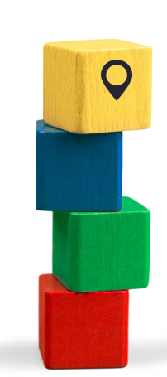
Agenda (1)
Introductions
Overview of Universal Design for Learning (UDL)
How Does UDL Relate to Early Learning?
How Does UDL for Early Learning Relate to Distance Learning?

Slide 3
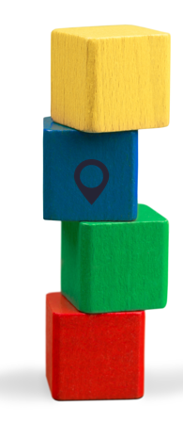
Agenda (2)
Introductions
Overview of Universal Design for Learning (UDL)
How Does UDL Relate to Early Learning?
How Does UDL for Early Learning Relate to Distance Learning?

Slide 4
What is UDL?
Universal design for learning (UDL) is a framework to improve and optimize teaching and learning for all people based on scientific insights into how humans learn

Slide 5
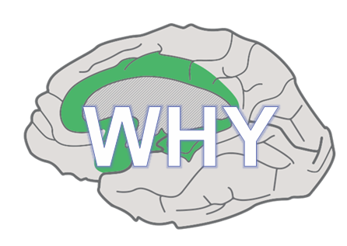
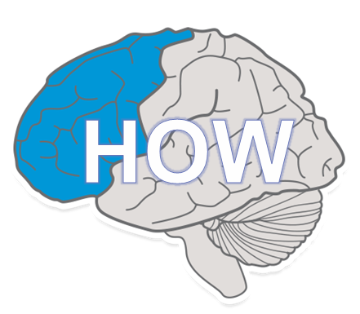
Brain Research
Affective
Recognition
Strategic

Slide 6
Learner Variability
There is no single way a human brain will engage with, perceive, or act upon a task.
Variability is predictable.
What we can predict, we can plan for.

Slide 7
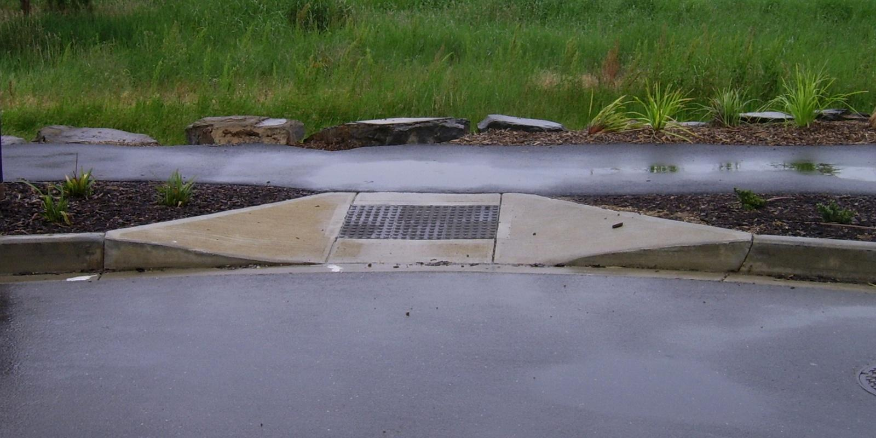
Curb-Cut Effect

Slide 8
Universal Design for Learning is..
...a lens, not a checklist
...a marathon, not a sprint
...a journey, not a destination
...standards-based, not standardized

Slide 9
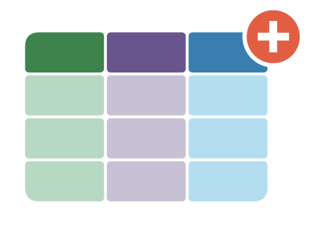
The UDL Framework
Set Clear, Rigorous Goals
Anticipate Barriers
Design Options

Slide 10
Set Clear, Rigorous Goals
Clear Goals, Flexible Means
Goals should be flexible
–avoid including the “how”
Goals should be clear and discreet –only one goal at a time.
Goals should be rigorous!

Slide 11
Clarified Goals
UDL is not about lowering expectations.
It’s about clarifying them!

Slide 12
Anticipate Barriers
Where/what can we anticipate that students will find difficult?
Why is that problem occuring?

Slide 13
Design Options
Design options to address barriers
Engagement Options
Representation Options
Action & Expression Options

Slide 14
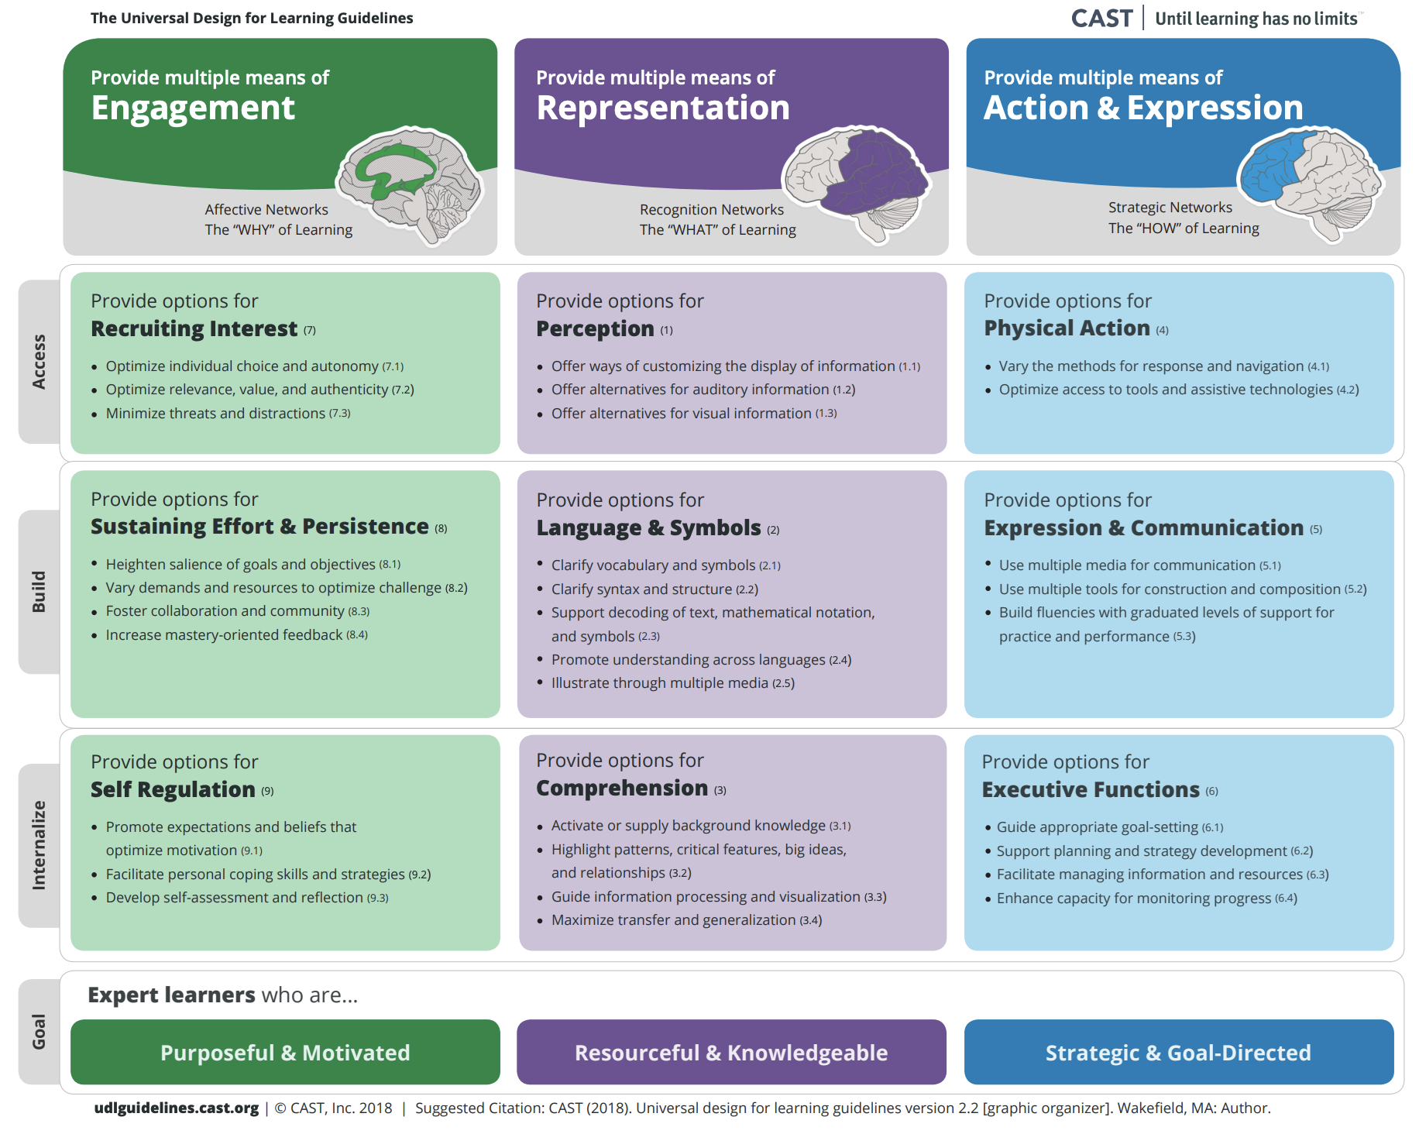
The UDL Guidelines
http://udlguidelines.cast.org/​

Slide 15
The Goal of Universal Design for Learning
Teach students how to learn, not just what to learn.

Slide 16
Teaching Students How to Learn
How will students engage?
How will students perceive?
How will students act on their understanding?

Slide 17
Organization of the UDL Guidelines
http://udlguidelines.cast.org/​

Slide 18
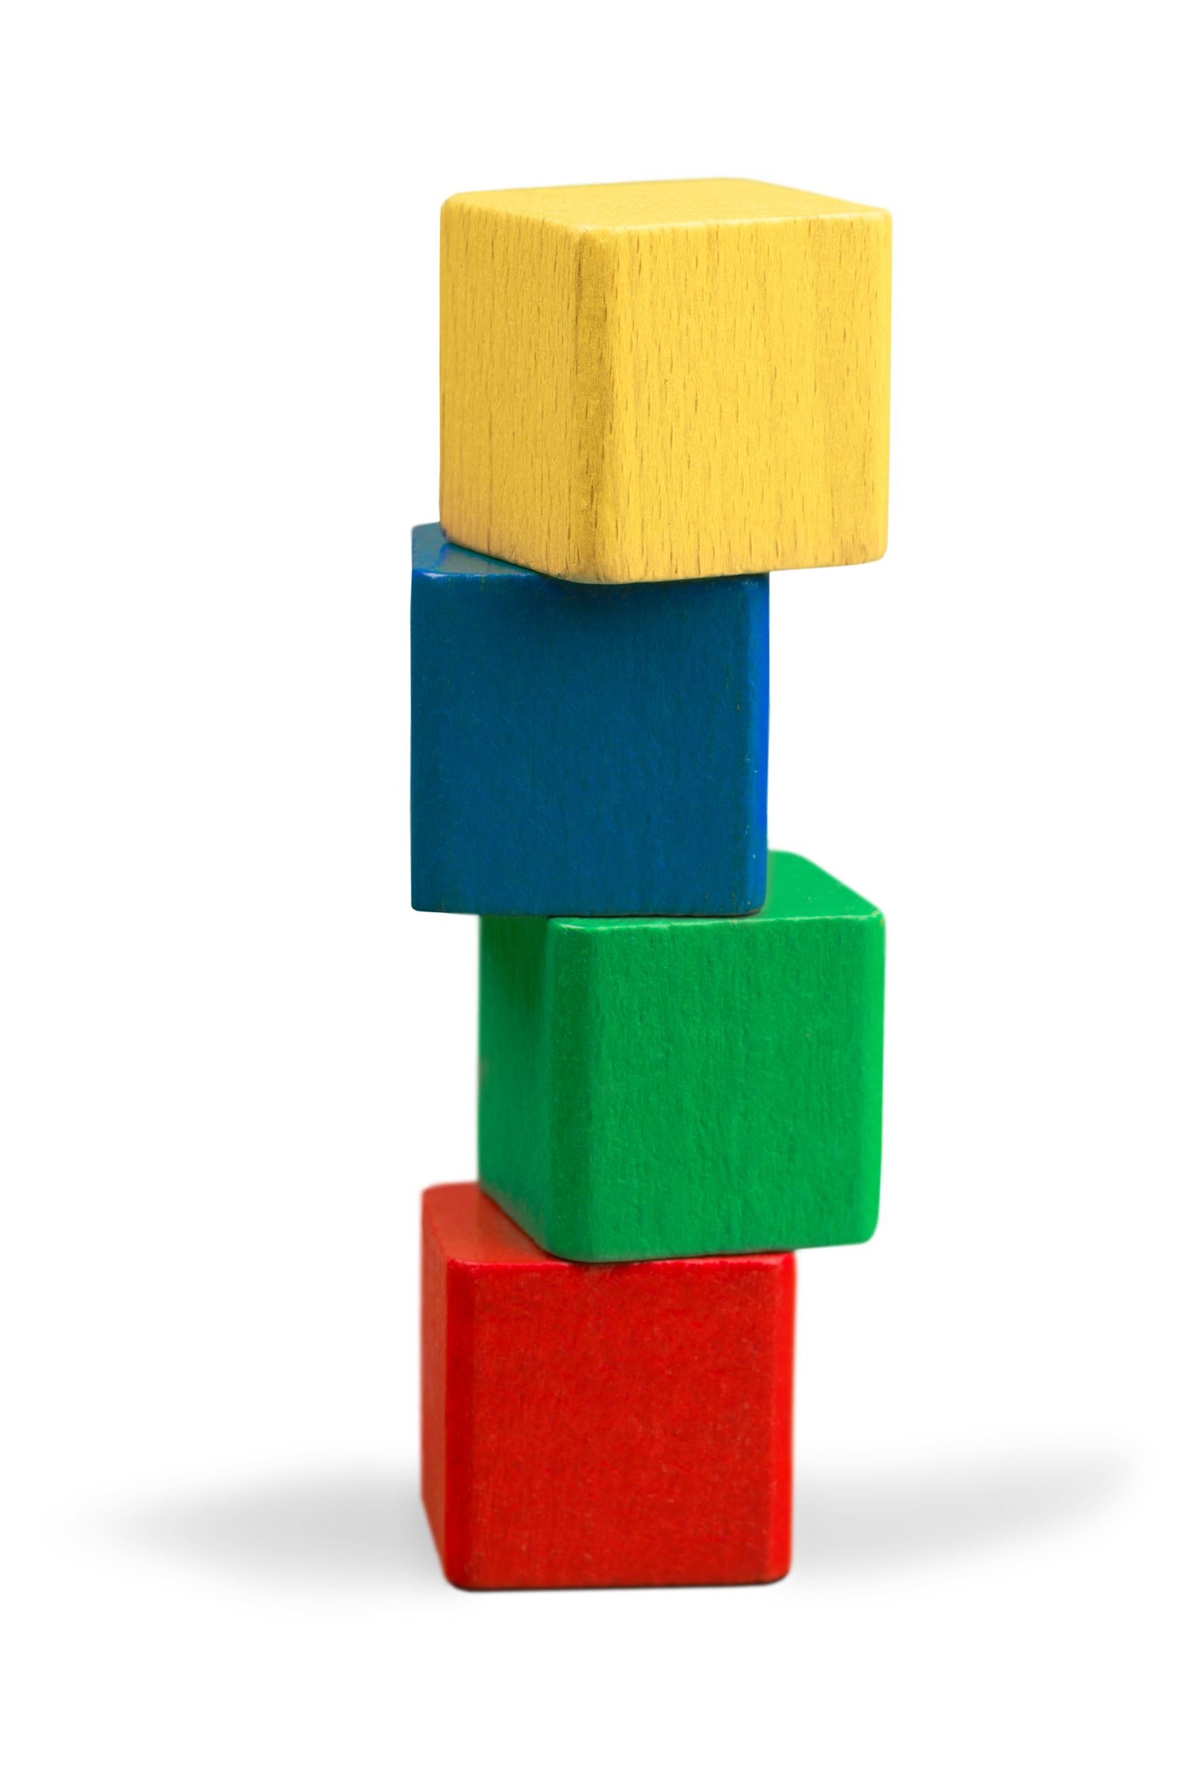
Agenda (3)
Introductions
Overview of Universal Design for Learning (UDL)
How Does UDL Relate to Early Learning?
How Does UDL for Early Learning Relate to Distance Learning?

Slide 19
Mythbusting (1)
My early learning classroom is already practicing UDL –
“I set up stations”
Having the choice of which station to visit is a step in the right direction.
UDL would allow for multiple access points at each station.

Slide 20
Mythbusting (2)
My early learning classroom is already practicing UDL –
“I teach thematic units”
While thematic units allow for multiple means of exploration within the theme, UDL would allow for multiple access points within each exploration.

Slide 21
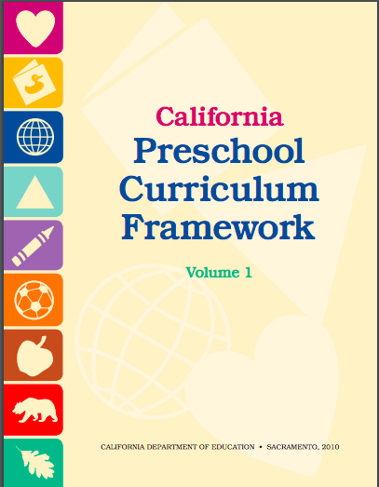
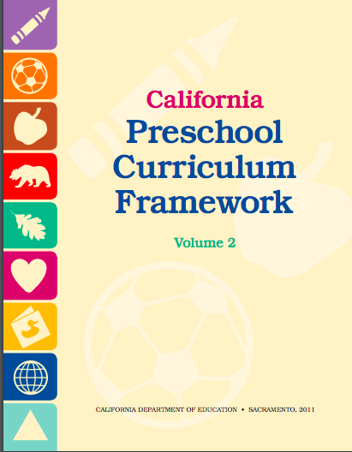
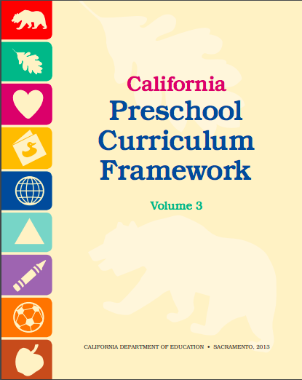
UDL and the Preschool Frameworks

Slide 22
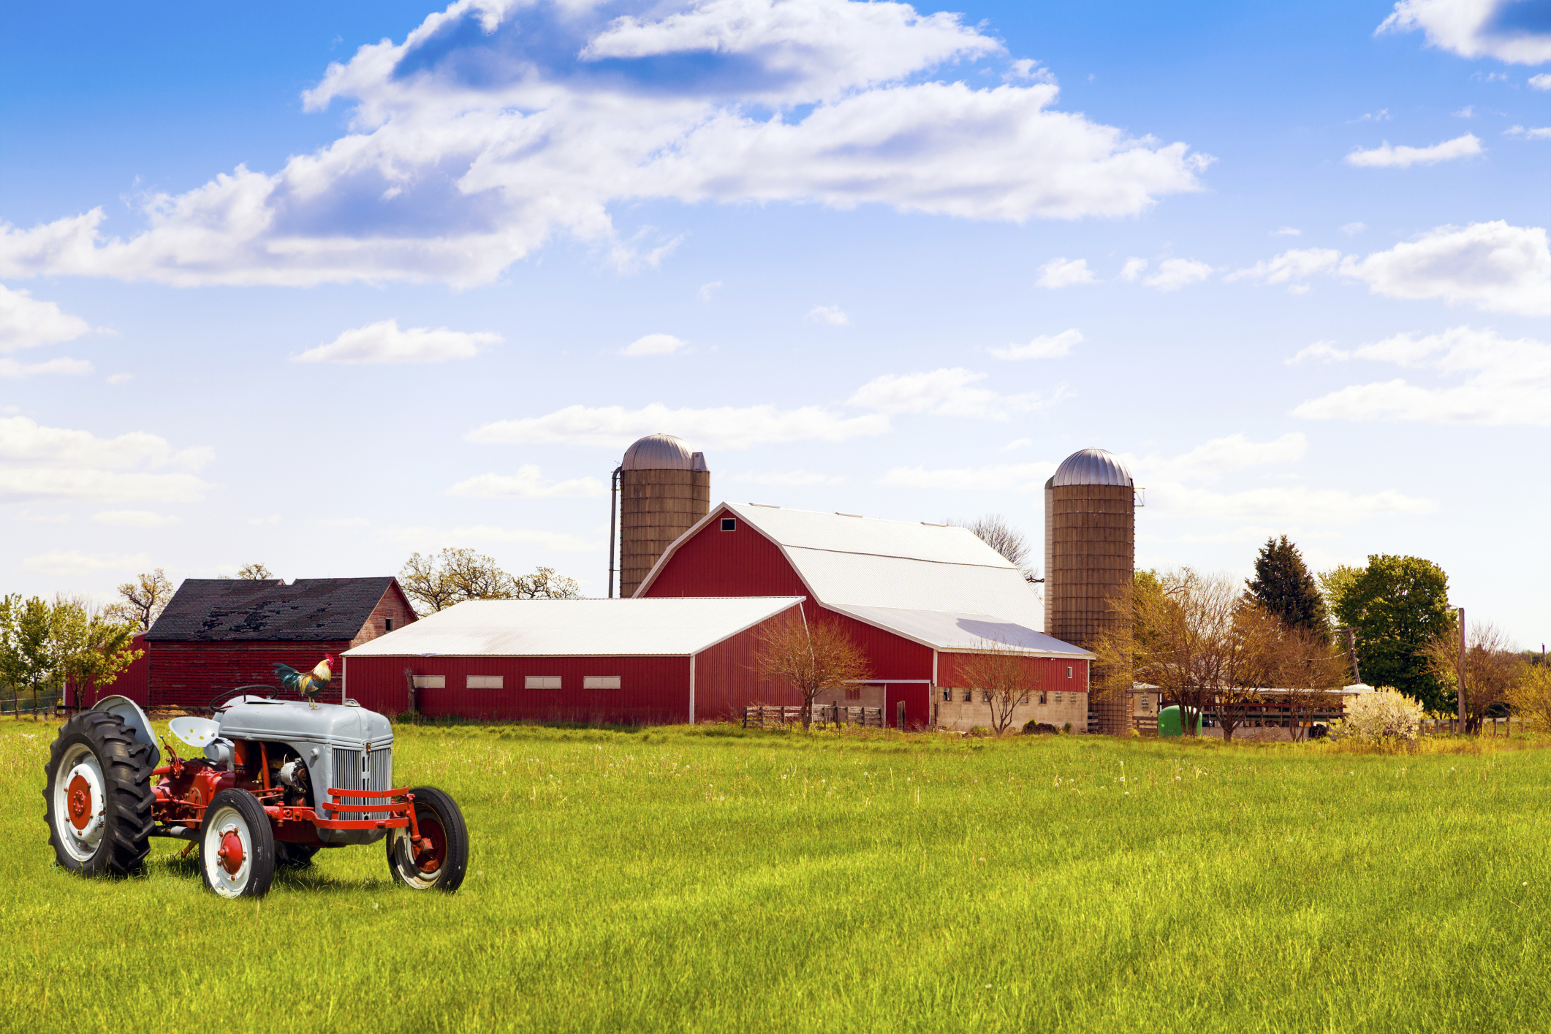
Exploring UDL in Early Learning

Slide 23
Down on the Farm Lesson Plan Example (1)
Music & Movement: Old MacDonald & Dancing with Shakers
Block Area: Blocks with farm animals, tractors, barns, etc.
Art Area: Making Animal Footprints or Tracks

Slide 24
Down on the Farm Lesson Plan Example (2)
Literacy Area (Writing & Books): Before We Eat From Farm to Table by Pat Brisson & Chicken and Egg Letter Matching
Math & Science Area: Farm Fence Patterns with Loose Parts & Seed Counting with 1:1 Correspondence

Slide 25
How to Incorporate UDL (1)
Literacy Area (Writing & Books)
Before We Eat From Farm to Table by Margaret Wise Brown
Chicken and Egg Letter Matching
Felt board story pieces
Interactive storybooks
Audible story or sound effects
“I Spy” the animals and letters
Exploring animal names/sounds in multiple languages
Gamify the letter matching

Slide 26
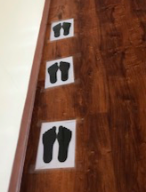
How to Incorporate UDL (2)
Art Area
Making Animal Footprints or Tracks
Have animal tracks on the ground leading to the classroom.
Children may work together to build tracks.
Vary the track-making options – using 3D figures, cutting out patterns.

Slide 27
What does Access look like in early learning?
Recruiting Interest
Perception
Physical Action

Slide 28
What does Build look like in early learning?
Sustaining Effort & Practice
Language & Symbols
Expression & Communication

Slide 29
What does Internalize look like in early learning?
Self Regulation
Comprehension
Executive Functions

Slide 30
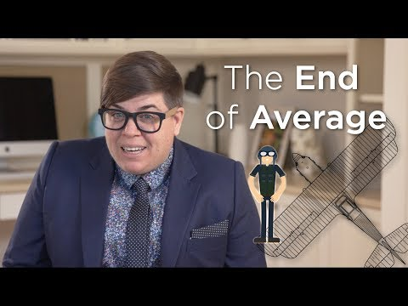
The End of Average
http://www.youtube.com/watch?v=Krec84KwbHE

Slide 31
Agenda (4)
Introductions
Overview of Universal Design for Learning (UDL)
How Does UDL Relate to Early Learning?
How Does UDL for Early Learning Relate to Distance Learning?

Slide 32
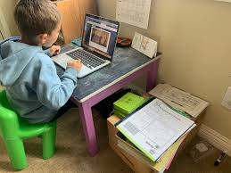
What is Distance Learning?
Distance learning is learning that is happening outside of an in-person classroom.
It may be conducted in a digital capacity or with learning packets.

Slide 33
How Can UDL be Applied to Distance Learning?
Flexible Methods
Flexible Materials
Flexible Assessment

Slide 34
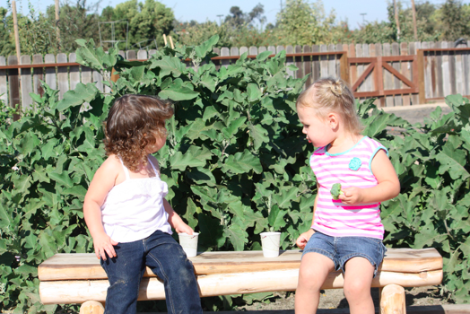
Examples of Flexible Methods
Opportunities to engage the five senses as much as possible
Multiple medias

Slide 35
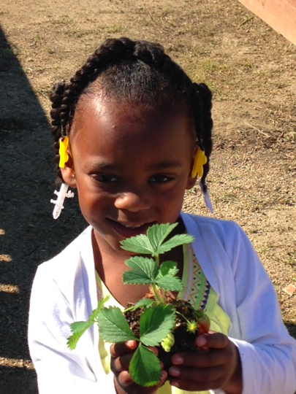
Examples of Flexible Materials
Interactive storybooks to support literacy and circle time
Opportunities to engage the five senses as much as possible
Multiple medias

Slide 36
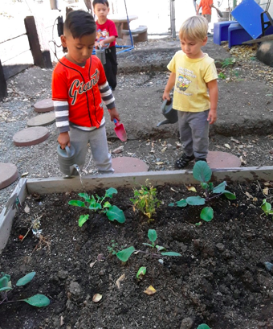
Examples of Flexible Assessment
Multiple means of representation
Multiple means of action and expression
How does the student demonstrate their learning?

Slide 37
Distance Learning Models
Synchronous Learning = learning done alongside the teacher(s) and classmates
Asynchronous Learning = learning that the parent(s) support at home

Slide 38
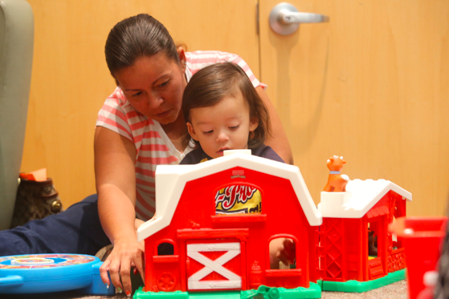
Connecting Parents as Experts
Parents need to be clear of learning goals.
Supports need to be in place for parents.
Synchronous learning is often limited a “classroom” setting.

Slide 39
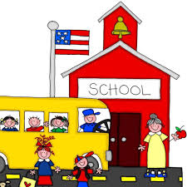
UDL and School Readiness
Promotes self-regulation
Means of action and expression
Promotes perseverance
Promotes self advocacy or agency
Allows for deeper exploration and understanding

Slide 40
Importance of Mastery Feedback
Needs to be timely and frequent.
Needs to be informative.
Should emphasizes effort, improvement, and achieving a standard rather than on relative performance.

Slide 41
Takeaways
Methods, materials, and assessments need to be flexible.
Design to the edges – the average learner is a myth.
Start small – it’s a journey, not the destination.
It’s the environment that needs to change, not the children.

Slide 42
Additional Resources
For additional resources, including the slide deck, please visit the Padlet at:
https://inclusioncollaborative.padlet.org/inclusion5/ELUDL

Slide 43
Thank you for joining us today!
For more information on past or future webinars, please visit: https://www.cde.ca.gov/ci/cr/dl/.
For questions please contact us at: DistanceLearning@cde.ca.gov
For weekly email updates from the California Department of Education on COVID-19, send a blank email to: join-covid19-update@mlist.cde.ca.gov

Slide 44
California Department of Education Posted July 2020

