Slide 1
Universal PreKindergarten (UPK) Implementation
Office Hour
Early Education Division (EED)
April 13, 2022

Slide 2
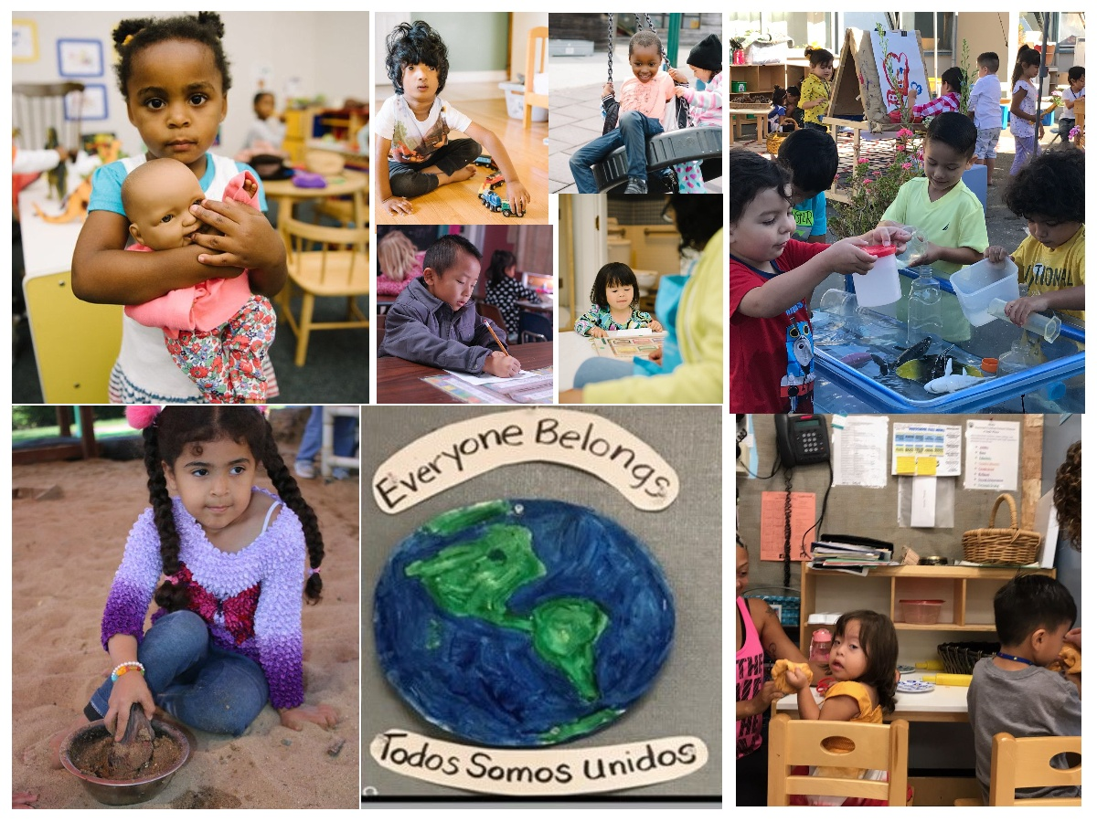
Welcome and Introductions

Slide 3
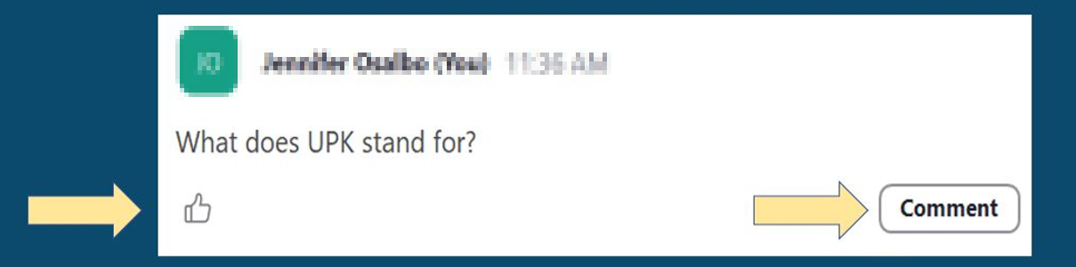
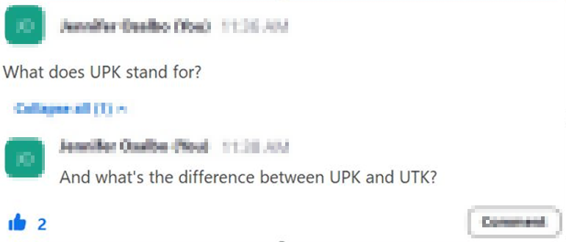
Asking Questions and Upvoting

Slide 4
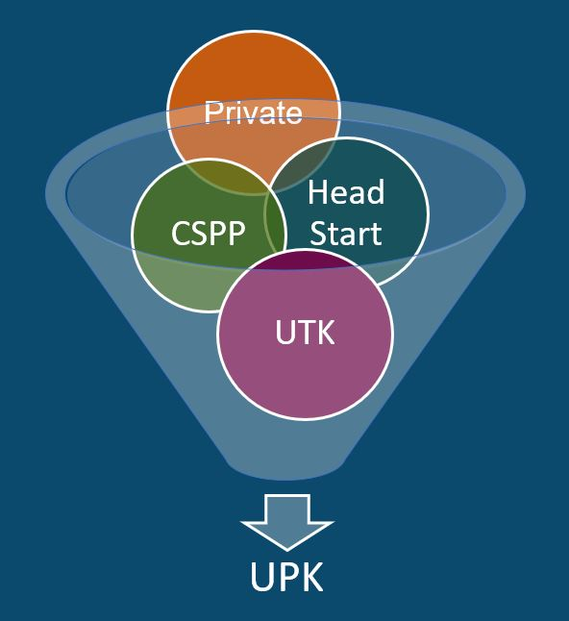
What is UPK?
UPK will bring together programs across early learning and K-12, relying heavily on Universal Transitional Kindergarten (UTK) and California State Preschool Program (CSPP), as well as Head Start, community-based organizations (CBOs), and private preschool.
Universal means that by 2025–26,
regardless of background, race, zip code, immigration status, or income level – every child– has access to a quality learning experience the year before Kindergarten.

Slide 5
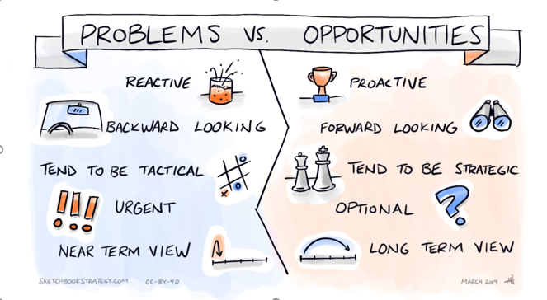
Problems versus Opportunities
Reactive vs. Proactive
Backward looking vs. Forward looking
Tend to be Tactical vs. Tend to be Strategic
Urgent vs. Optional
Near Term View vs. Long Term View
Image Credit: Sketchbookstrategy.com, CC-BY-40, March 2019

Slide 6
Elephants and Rumors
Districts don’t actually need to plan (rumor)
There is a Special Education Template (rumor)
There is a UPK wavier (rumor)

Slide 7
Live Questions and Answers (Q&A)

Slide 8
Closing and Next Steps
  Inbox for questions and comments: UPK@cde.ca.gov
  We will post this week's slides on: https://www.cde.ca.gov/ci/gs/em/
We look forward to more opportunities to discuss
the implementation of UPK!
Thank you!

Slide 9
Resources (1)
California Educators Together:
  https://www.caeducatorstogether.org/groups/e0cfjrjf/upk-p-3
UPK Resources:
  https://www.cde.ca.gov/ci/gs/em/
UPK FAQs:
  https://www.cde.ca.gov/ci/gs/em/kinderfaq.asp
UPK Office Hour:
  https://www.cde.ca.gov/ci/gs/em/upkofficehours.asp
System of Support for Expanded Learning:
  https://www.cde.ca.gov/ls/ex/sosexplearncontacts.asp
K-12 Omnibus Trailer Bill:
  https://esd.dof.ca.gov/trailer-bill/public/trailerBill/pdf/527

Slide 10
Resources (2)
Early Learning Opportunities Program (ELO-P) Main Page:
  https://www.cde.ca.gov/ls/ex/elopinfo.asp#elopfaqs
ELO-P Program Plan Guide:
  https://www.cde.ca.gov/ls/ex/documents/elopprogplanguide.pdf
ELO-P FAQs:
  https://www.cde.ca.gov/ls/ex/elofaq.asp
ELO-P Fireside Chats:
  https://www.afterschoolnetwork.org/elo-program
CSPP Consultant Regional Assignments:
  https://www.cde.ca.gov/sp/cd/ci/assignments.asp

