Slide 1
Universal PreKindergarten (UPK) Implementation
Office Hour
Early Education Division (EED)
August 3, 2022

Slide 2

Welcome and Introductions

Slide 3
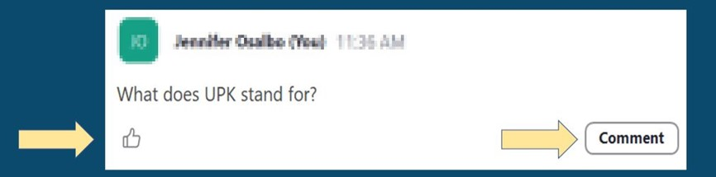
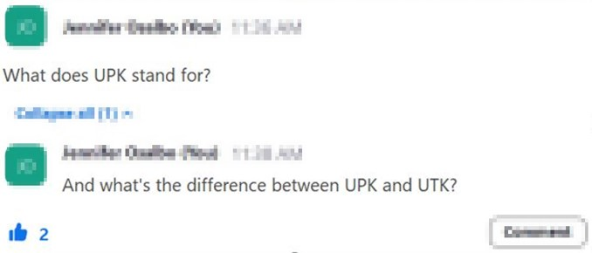

Asking Questions

Slide 4

2022–23 Final Budget
Photo Credit: Kidango Decoto Center; Union City, CA

Slide 5
Universal Transitional Kindergarten (UTK)
Provides $614 million for the first year of Transitional Kindergarten (TK) expansion
Includes $383 million for an additional adult to reduce ratios to 1 adult to 12 students
Makes it easier to staff TK classrooms by:
  Allowing the Commission on Teacher Credentialing (CTC) to issue a one-year emergency specialist teaching permit teach TK
  Clarifying that substitute TK teachers are not required to meet the additional TK teacher requirements around child development
Requires TK data to be collected separately from kindergarten data

Slide 6
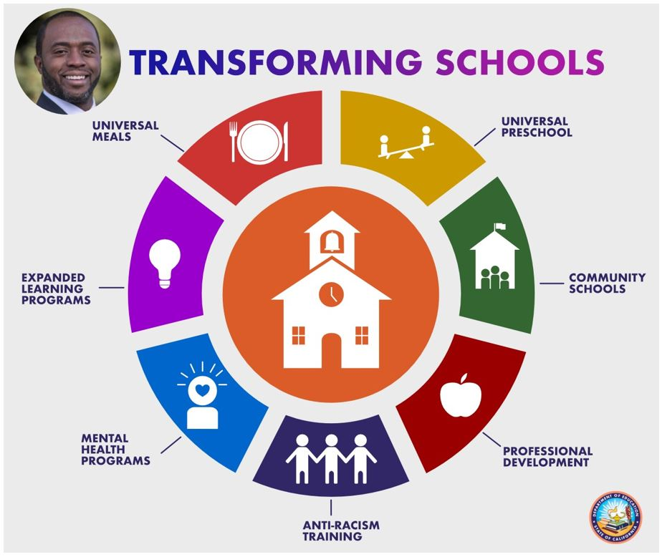
UPK Planning and Implementation Supports
$300 million for UPK Planning and Implementation for districts that have kindergarten enrollment
$18.3 million per year for three years for California Universal Preschool Planning Grant Program to support preschool planning in Mixed Delivery system.
Link to Transforming Schools chart: https://www.cde.ca.gov/eo/in/index.asp

Slide 7
California State Preschool Program (CSPP)
Fiscal Changes
Increases adjustment factors for children with disabilities, children 47 months or younger, children who are dual language learners, and early childhood mental health consultation.
Provides a 6.56 percent Cost of Living Adjustment (COLA)
Includes $21.3 million to waive family fees and extends hold harmless for 2022–23
Changes audit threshold for yearly audits in CSPP

Slide 8
CSPP Eligibility and Certification Changes
Increases eligibility threshold in CSPP to 100 percent of the State Median Income (SMI), from 85 percent
Allows children with exceptional needs to be categorically eligible for CSPP
Allows all students participating in State Preschool to maintain continuous eligibility for 24 months

Slide 9
Additional Support for Children with Disabilities
In addition to categorical eligibility for children with disabilities and an increased adjustment factor for those children, the budget includes:
  Requirement for CSPP contractors to reserve 5 percent of funded enrollment for children with disabilities in 2022–23, moving to 7.5 percent in 2023–24 and 10 percent in 2024–25. Contractors will be fully funded for that enrollment, regardless of attendance.
  Provides $250 million to support the Inclusive Early Education Expansion Program
  Provides $2 million for the CDE to develop a process and tools for early identification of children at risk for developmental delays and learning disabilities.

Slide 10
Infrastructure
Nearly $6 billion for Prek-12 education facilities, including:
  $1.4 billion General Fund for TK-12 school facilities construction
  $4.2 billion for the School Facility Program
  $100 million for the California Preschool, TK, and Full-Day Kindergarten Facilities Grant in 2023–24, with another $550 million intended for 2023–24
Amends language to allow Community Colleges to receive this funding
  Provides $30 million per year for two years to support eligible facilities costs for the Charter School Facility Grant Program.
$100 million to develop and repair existing child care and preschool infrastructure at non-local educational agencies (LEAs), especially in low-income communities

Slide 11

Questions
&
Answers
Photo Credit: Kidango Decoto Center; Union City, CA

Slide 12
Closing and Next Steps
  Inbox for questions and comments: UPK@cde.ca.gov
  We will post this week's slides on: https://www.cde.ca.gov/ci/gs/em/
We look forward to more opportunities to discuss
the implementation of UPK!
Thank you!

Slide 13
Resources
PQI Office Regional Consultants
  https://www.cde.ca.gov/sp/cd/ci/assignments.asp
    Consultants are most easily reached by email
    or by phone at 916-322-6233
EENFS, Fiscal Apportionment Analyst Directory
  https://www.cde.ca.gov/fg/aa/cd/faad.asp
Regulation Related Questions
  EEDTitle5@cde.ca.gov

Slide 14
UPK Resources
California Educators Together:
  https://www.caeducatorstogether.org/groups/e0cfjrjf/upk-p-3
UPK Resources:
  https://www.cde.ca.gov/ci/gs/em/
UPK FAQs:
  https://www.cde.ca.gov/ci/gs/em/kinderfaq.asp
UPK Office Hour:
  https://www.cde.ca.gov/ci/gs/em/upkofficehours.asp
System of Support for Expanded Learning:
  https://www.cde.ca.gov/ls/ex/sosexplearncontacts.asp
K-12 Omnibus Trailer Bill:
  https://esd.dof.ca.gov/trailer-bill/public/trailerBill/pdf/527 [Link no longer available]

Slide 15
Budget Resources
Final Budget Summary
  https://www.ebudget.ca.gov/FullBudgetSummary.pdf
Senate Bill (SB) 154
  https://leginfo.legislature.ca.gov/faces/billNavClient.xhtml?bill_id=202120220SB154
Assembly Bill (AB) 210
  https://leginfo.legislature.ca.gov/faces/billNavClient.xhtml?bill_id=202120220AB210
AB 181
  Bill Text - AB-181 Education finance: education omnibus budget trailer bill.

Slide 16
Expanded Learning Opportunities Program (ELO-P) Resources
ELO-P Main Page:
  https://www.cde.ca.gov/ls/ex/elopinfo.asp#elopfaqs
ELO-P Program Plan Guide:
  https://www.cde.ca.gov/ls/ex/documents/elopprogplanguide.pdf
ELO-P FAQs:
  https://www.cde.ca.gov/ls/ex/elofaq.asp
ELO-P Fireside Chats:
  https://www.afterschoolnetwork.org/elo-program
ELO-P Email Box:
  ExpandedLearning@cde.ca.gov

Slide 17
Facilities Resources
Access California Preschool, Transitional, Kindergarten and Full-Day Kindergarten Facilities Grant Program Funding (FDK grant program)
  https://www.dgs.ca.gov/OPSC/Services/Page-Content/Office-of-Public-School-Construction-Services-List-Folder/Access-Full-Day-Kindergarten-Facilities-Grant-Program-Funding
Facilities Contacts:
  Joshua Potter
    Phone: 279-946-8454
    E-mail: Joshua.Potter@dgs.ca.gov
  Lindsey Gordon
    Phone: 279-946-8458
    E-mail: Lindsey.Gordon@dgs.ca.gov

