Slide 1
Mathematics Framework
for California Public Schools
Kindergarten Through Grade Twelve
Adopted by the California State Board of Education, July 2023
Published by the California Department of Education, 2024
(Slide notes are used throughout the document)
Notes:
The Mathematics Framework for California Public Schools, Kindergarten through Grade Twelve.
The Framework was adopted by the California State Board of Education in July 2023 and published by the California Department of Education in 2024.

Slide 2

The 2023 Mathematics Framework
It provides implementation guidance grounded in research and reflects best practices across the globe.
It supports equitable and engaging teaching and learning of mathematics for all students!
Notes:
We want to start by stating that the Common Core State Standards for Mathematics remain the same.
Built upon underlying and updated principles of focus, coherence, and rigor, the standards map out what California students need to know and be able to do, grade by grade, in mathematics.
The standards hold the promise of enabling all California students to become powerful users of mathematics in order to better understand and positively impact the world—in their careers, in college, and in civic life.
The 2023 Mathematics Framework was written as a guide to implementing the California Common Core State Standards for Mathematics.
It is grounded in research and reflects best practices across the globe for supporting equitable and engaging teaching and learning of mathematics for all students.
The Mathematics Framework lays out the curricular and instructional approaches that research and evidence show will afford all students the opportunities they need to learn meaningful and rigorous mathematics, meet the standards, access pathways to high level math courses, and achieve success.
To help educators attain the goal of ensuring deep, active learning of mathematics for all students, the Mathematics Framework is centered around the investigation of big ideas in mathematics, connected to each other and to authentic, real-world contexts and taught in multidimensional ways that meet varied learning needs.
This framework invites readers to reimagine mathematics and move toward a new century of mathematical excellence for all.

Slide 3

Why a New Framework?
Notes:
So why do we have a new framework?
It’s been more than 10 years since the last framework was adopted, and collectively educators and researchers have learned so much more about implementation of the common core state standards since then.
Examples of this include:
Designing lessons and units so that topics are studied more deeply, with applications to real world problems.
Instructional practices include collaborative problem-solving strategies, heterogeneously grouped classrooms, and an integrated approach to mathematics from grade school through high school.
Seeing opportunities for growth in math capacity by supporting students to move from a fixed mindset to a growth mindset.
Multiple studies have found that students with a growth mindset achieve at higher levels in mathematics.
The need for classrooms to be an inclusive environment for all students by encouraging students to leverage the knowledge and experience they bring with them.
Remember, students learn math more deeply and robustly when lessons engage them with multiple mathematical representations such as numerals, words, visuals, models, algorithms, tables, and graphs and different forms of expression.
Our new framework takes this approach to make every student a “math student.”

Slide 4
Another Reason for a New Framework
2018–19
2023–24
39.73 percent
Met or Exceeded
standards in Math
35.54 percent
Met or Exceeded
standards in Math
Notes:
The primary reason is that across all tested grades, 35.54 percent of all students tested in 2023–24 met or exceeded the mathematics standard for their grade level. Although, we know that all of our children are capable of math achievement at much greater levels than reflected by current test scores, and we believe that every child can learn math.
This is down from the 39.73 percent of students in the 2018–19 school year, before the start of the COVID-19 pandemic.
The differences between White and Asian students and other student groups are stark.
Prior to the pandemic, except for White and Asian students, fewer than 32 percent of students in each student group met or exceeded the standard, and all groups lost ground between 2019 and 2022.
Efforts to improve math achievement since 2022 have improved student test scores, but we want to make sure that every child’s achievement in math reflects their potential and supports them to thrive.

Slide 5
Supporting Student Growth in Mathematics
2021–22
2022–23
2023–24
Notes:
While we continue to navigate the long-term effects of the pandemic, we want to focus on supporting the growth that our students are already showing.
In 2023–24, 35.54 percent of all students across all tested grades met or exceeded the mathematics standard.
This is an increase from the 33.38 percent in 2021–22 and the 34.62 percent in 2022–23.
We see this as a solid foundation to build on as we accelerate learning and deepen engagement with math.
We recognize that students bring diverse strengths and experiences to the classroom, and it's clear that with the right supports, all students can thrive.
We believe that targeted, equity-driven investments can make the biggest difference.
As we move forward, this data helps us focus our energy where it’s most needed—and reminds us of the incredible potential that exists in every student group.
Our goal is to ensure all students have the opportunity to succeed, with high expectations and the support to reach them.

Slide 6

Three Dimensions of Systemic Change
Assets-based approach to instruction
Active engagement through investigation and connection
Cultural and personal relevance
Notes:
The Mathematics Framework names Three Dimensions of Systemic Change to support equitable outcomes for all students.
These include an assets-based approach to instruction, active engagement through investigation and connection, and cultural and personal relevance.
The framework’s instructional approach connects learning to the real world through authentic examples and use of data, both heightening engagement and preparing all students for an increasingly data-driven world.

Slide 7

Big Ideas
The framework organizes instruction into a number of Big Ideas that integrate multiple content standards, allowing teachers to guide students in connecting mathematical concepts within and across grade levels.
Notes:
The framework organizes instruction at each grade level into a number of Big Ideas that integrate, rather than isolate, multiple content standards, allowing teachers to guide students in connecting mathematical concepts within and across grade levels.
Learning scientists find that people learn more effectively when they understand a map of the domain and how the Big Ideas fit together.
This is based on research from the National Research Council in 2000.
Within that map, they can then locate facts and details and see how they, too, fit.
To reach the goal of deep, active learning of mathematics for all, this framework encourages teachers to think about TK–12 math as a series of big ideas that, across grade levels, enfold clusters of standards and connect mathematical concepts.
In the classroom, teachers teach their grade level’s big ideas by designing instruction around student investigations of intriguing, authentic problems.
These Big Ideas structure and guide investigations that pique curiosity and engage students.
Such investigations motivate students to learn focused, coherent, and rigorous mathematics.
The investigations are framed by a conception of the why, how, and what of mathematics—a conception that makes connections across different aspects of content and also connects content with mathematical practices.

Slide 8

Why, What, and How
Drivers of Investigation (Why)
Standards for Mathematical Practice (How)
Content Connections (What)
Notes:
Within the framework, the Drivers of Investigation (Why), Standards for Mathematical Practice (How), and Content Connections (What) of Mathematics underpin instructional design to enhance student opportunities for investigation and connection of mathematics concepts.
To help teachers design this kind of instruction, the Framework maps out the interplay at work when this conception of the why, how, and what of mathematics is used to structure and guide student investigations.
One or more of the three Drivers of Investigation—sense-making, predicting, and having an impact—provide the “why” of an activity.
California’s eight Standards for Mathematical Practice provide the “how.”
And four types of Content Connections—which ensure coherence throughout the grades—provide the “what.”
The DIs, SMPs, and CCs are interrelated; the activities within each can be combined with any of the activities within the others in a multiplicity of ways.

Slide 9
Coherence, Rigor, and Focus
The framework provides additional insight into the development of Number Sense, Standards for Mathematical Practice, Data Science, and Content Connections across grade levels from transitional kindergarten through grade twelve.
This is referred to as coherence.
It guides educators in planning instruction around major mathematical concepts, or Big Ideas.
This is referred to as rigor.
It also supports offering multiple opportunities for students to develop depth of understanding and mastery of the standards in authentic contexts.
This is referred to as focus.
Notes:
The framework provides additional insight into the development of Number Sense, Standards for Mathematical Practice, Data Science, and Content Connections across the grades from transitional kindergarten through grade twelve.
This is referred to as coherence.
It guides educators in planning instruction around major mathematical concepts, or Big Ideas.
This is referred to as rigor.
It also supports offering multiple opportunities for students to develop depth of understanding and mastery of the standards in authentic contexts.
This is referred to as focus

Slide 10

Students and Math
Notes:
Instead of students working independently on pages of math problems with no context or relevance in the real world, you can expect your child to more often be working on mathematics investigations collaboratively with other students, where they will use real data, critical thinking, and their growing understanding of math concepts to investigate authentic problems and build their mathematical skills.
They will be encouraged to ask questions about their work and justify the answers that they come up with.
Math learning designed this way heightens student engagement in the math learning, supports those who may struggle, and makes increased math achievement attainable for all students.
Lets look at a few examples.

Slide 11
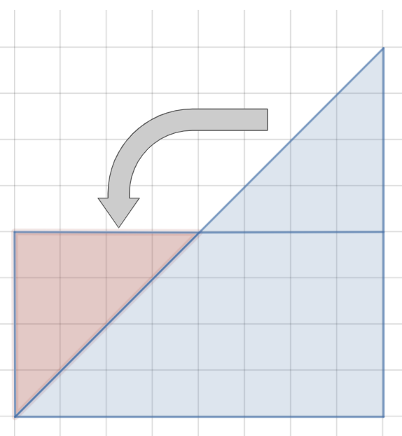
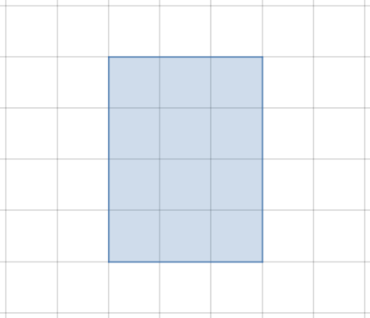
A Middle School Example
Example 1
Example 2
Notes:
One example of this from the appendix of the Framework is in middle school.
Our example school takes an approach to math that lets each student, grades six through eight, progress on his or her own learning path.
This is done through teacher-led, collaborative, and independent learning so that students can build deep understanding of math concepts and apply their learnings in real-world contexts.
At the start of the year, each student will take a diagnostic assessment.
The data will be used to build a personalized set of mathematical ideas that the student will learn for the year.
This will help the students, their teachers, and their parents understand what their learning will focus on this year and why.
So Monique, who is a currently high achieving sixth grade student, and Darren, who is less experienced in geometry than Monique, will be able to engage in the same project because it is accessible at many levels.
So in our example one on the slide or a rectangle on a grid, when the teacher asks the students how they would describe this rectangle, possible answers include:
“It’s a 3×4 rectangle.”
“It’s made up of 12 squares.”
“Its perimeter is 14 units.”
“Its area is 12 square units. I know that because 3×4=12.”
This can then be translated into harder shapes such as triangles, using the same basic knowledge, as shown in example two, which is a series of triangles moved to make a rectangle.
In this example:
Students might count or otherwise calculate the number of whole squares first, and then move on to the partial squares. They could count these as halves, or pair them up to make wholes.
Students might recognize that two of the triangles make a square, and thus the area of one triangle must be half the area of the square.
Students might notice that the top portion of the triangle can be rotated down to make a rectangle.
This is an example of equity in math, meaning each student brings their own understanding and level to the problem, and the problem is open enough to be solved in many ways, which is equitable for all students.

Slide 12
An Elementary School Example
Problem 1
Problem 2
10+10=□
13+13=□
Notes:
Let’s look at one more example from the appendix of the Framework, this time in elementary school.
In this example, early in the school year, second-graders have started work with addition. They have been building on first-grade concepts, now finding “doubles” with sums greater than 20.
The teacher is seeking to elevate students’ understanding of a powerful idea in mathematics: taking things apart and refitting them back together can be both strategic and efficient.
To do this, the teacher begins with a number talk.
The intention is to model verbal processing based on a string of problems the children have explored in the preceding week with manipulative materials, story problems, and equations, and then to challenge students to calculate mentally, extending their thinking one step beyond previous work.
The problem is written on the board and students take several minutes of quiet thinking time.
When they have a solution, students show a quiet thumbs-up signal.
If students solve the problem in more than one way, they show a corresponding number of fingers.
When all (or almost all) students signal that they have a solution, the teacher asks students to share their responses with their elbow partner and to show a thumbs up when they are ready to share with the class.
Student responses are recorded on the board without comment on correctness.
Students explain, defend, or challenge the recorded solutions, and reach consensus as a class.
The teacher refers students to familiar sentence frames for articulating their explanation, defense, or challenges. These provide a foundation for rich discussion of mathematics and can help reduce students’ reluctance to engage.
The first problem posed is 10 + 10 = $◻$.
As expected on this familiar, well-practiced addition problem, almost all the children signal a thumbs up within a short time, and all children agree on the answer.
The teacher writes a second problem below the first:
13 + 13 = $◻$.
Several thumbs rise quickly.
Some children use their fingers to calculate, while others nod their heads, as if counting mentally.
After three minutes, almost all children have found a solution; they whisper to share their answers with their partners.
When the teacher calls for answers, a majority of children say the sum is 26; three children think it is 25.
Three students explain how they found 26:
“I know that 13 is 3 more than 10, but there were two thirteens, and 10 + 10 = 20, so 6 more makes it 26.”
“I started at 13 and counted on 13 more: 14, 15, 16, 17, 18, 19, 20, 21, 22, 23, 24, 25, 26.”
“Well, I knew that 10 + 10 was 20, so I just took off the threes (in the ones place) and added those, and that made 6. So, 20 + 6 = 26.”
The teacher then continues to clarify the learning in a way that is accessible to all students in the class.

Slide 13
Students and Math Revisited
Notes:
Now that we have seen a few examples, let’s think back to when we talked about how our students learn math.
I hope you now have a better understanding of how math learning designed this way heightens student engagement, supports those who may struggle, and makes increased math achievement attainable for all students. The Framework guides educators n designing high-quality math learning.

Slide 14

Thank you for joining us today!
Notes:
Thank you for joining us today as we talked through the new Mathematics Framework.

