Slide 1

2023 Mathematics Framework for California Public Schools, Kindergarten Through Grade Twelve
Publisher/Developer Webinar 1
November 7, 2023
CALIFORNIA DEPARTMENT OF EDUCATION
Tony Thurmond, State Superintendent of Public Instruction

Slide 2
Presenters
Dr. Mike Torres, Director
Curriculum Frameworks & Instructional Resources Division
Dr. Marla Clayton Johnson, Education Administrator
Instructional Materials and Access Unit
Carrie Marovich, Education Programs Consultant
Standards and Curricular Guidance Unit
Johanna Harder, Education Programs Consultant
Standards and Curricular Guidance Unit

Slide 3
Upcoming Webinars for Content Developers
November 28, 10:30 a.m.–12:30 p.m.
  The Big Ideas of the 2023 Mathematics Framework
        Kindergarten–Grade 5
        Grades 6–8
December 19, 10:30–11:30 a.m.
  Instructional Materials to Support Systemic Improvement in Mathematics

Slide 4
Resources on CDE Website
2023 Mathematics Framework
  Summary
  Chapters and appendices
  Instructional materials evaluation criteria (Ch 13)
Frequently Asked Questions
  Framework related (on California Department of Education [CDE] website)
  Instructional materials adoption (forthcoming)

Slide 5
Purpose of Today's Webinar
1. Introduce the Mathematics Framework and its Core Ideas
2. Describe the Guidance for Instructional Planning in the Mathematics Framework
3. Provide an Overview of the Chapters

Slide 6
Mathematics Framework Background

Slide 7
What is the 2023 Mathematics Framework for California Public Schools ?
Guidance on implementing mathematics standards in grades TK–12
Guidance on development and evaluation of instructional materials
Grounded in research and experience of California math educators
Offers effective and equitable practices in math instruction
Goal is to help students achieve proficiency and become powerful users of mathematics

Slide 8
Core Ideas of the 2023 Mathematics Framework (1)
All students can achieve and be successful in mathematics and are encouraged to get as far and deep into mathematics as possible.
    Emphasis on equity and access in mathematics instruction woven throughout
    Culturally responsible instruction should build from student assets and enable growth-mindset
Standards-aligned content is organized around Big Ideas at each grade level.
    Big Ideas enable rigor, focus, and coherence across grade levels

Slide 9
Core Ideas of the 2023 Mathematics Framework (2)
Inquiry-based instruction
    Teaching structured through Standards for Mathematical Practice, Drivers of Investigation, and Content Connections
    Real world connections support student curiosity and inquiry
Data Science and data use in math instruction
    Allows more focused treatment of (especially) statistics standards across grade levels

Slide 10
Core Ideas of the 2023 Mathematics Framework (3)
Authentic problem-solving, multidimensional teaching, and other engagement strategies reach all students.
    Vignettes and practical examples help teachers understand and apply these ideas
    Technology and distance learning increase options for high-quality instruction
Pathways and course options allow students to achieve, up to Calculus (or an alternate course of their interest)

Slide 11
Mathematics Framework Guidance for Instructional Planning

Slide 12
The Big Ideas
Identify overarching mathematical concepts at each grade level
Include clusters of content standards
Connect mathematical concepts
Intend to support multidimensional teaching and authentic problem solving

Slide 13
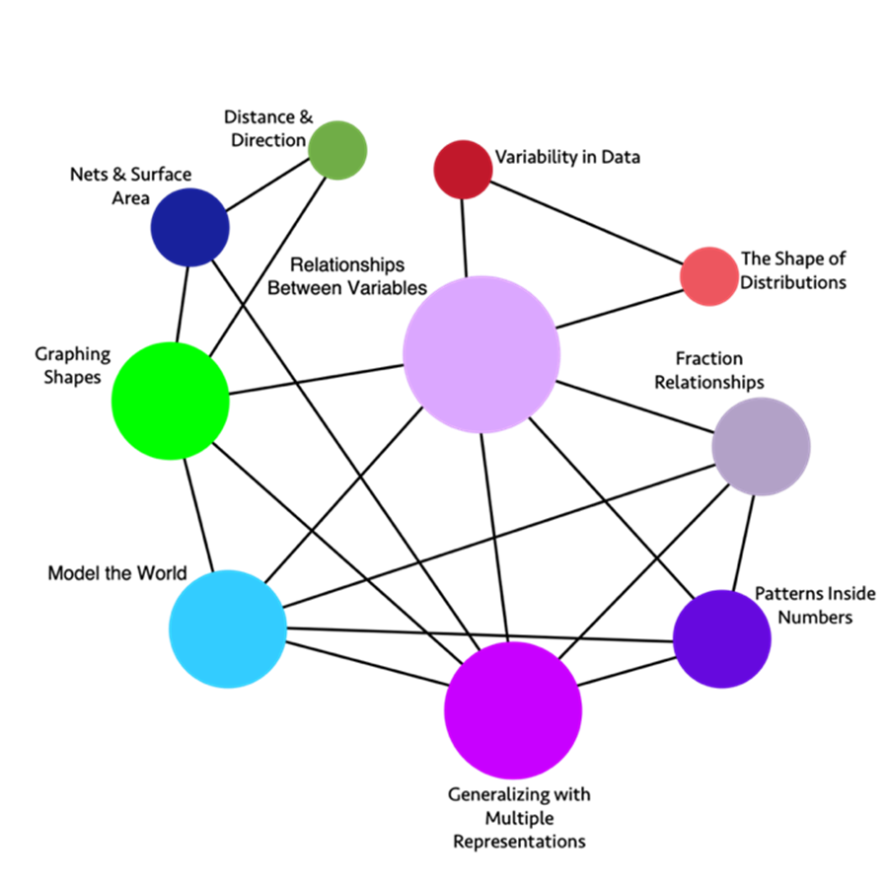
Grade 6
Big Ideas
Link to long description

Slide 14
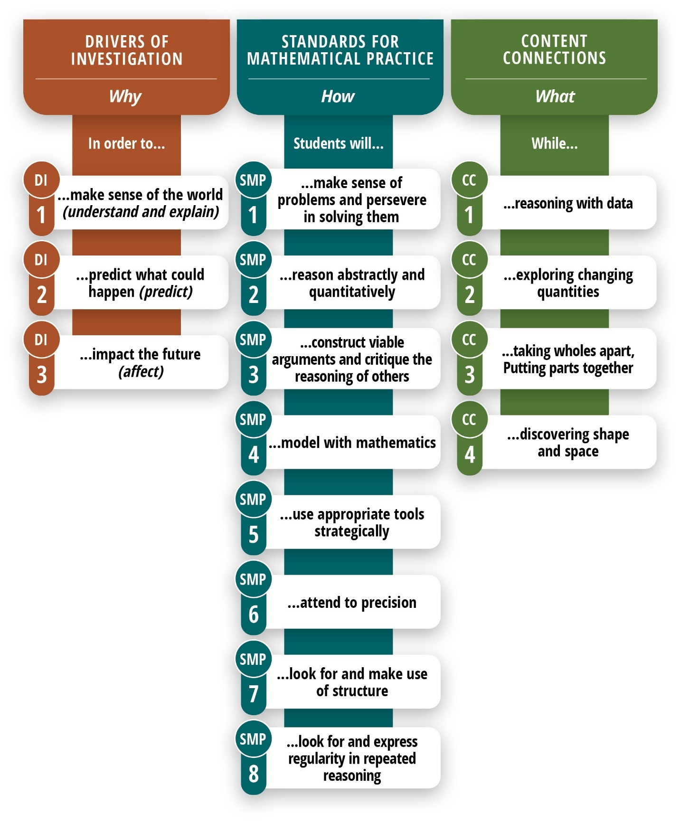
The WHY, How, and What OF MATHEMATICS INSTRUCTION
Link to long description

Slide 15
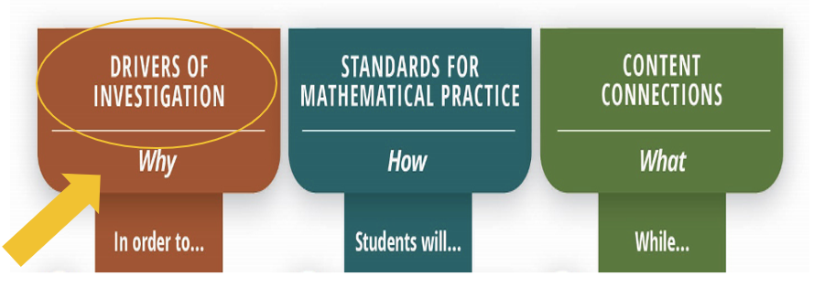
Drivers of Investigation (1)
Link to long description

Slide 16
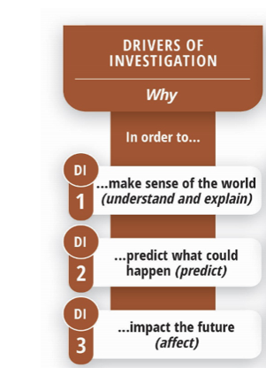
Drivers of Investigation (2)
Make sense of the world (understand and explain)
Predict what could happen (predict)
Impact the future (affect)
Link to long description

Slide 17
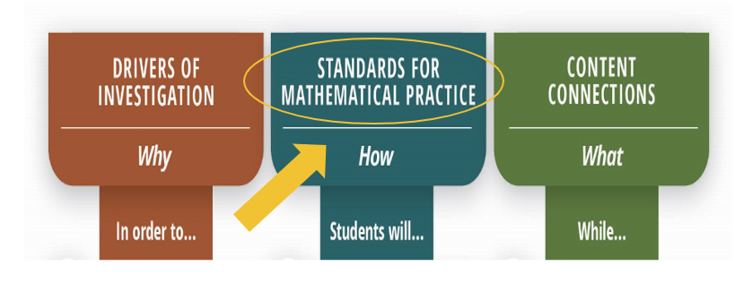
Standards for Mathematical Practice (1)
Link to long description

Slide 18
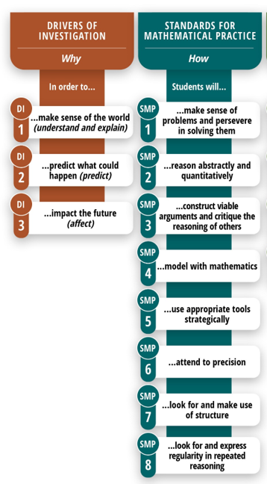
Standards for Mathematical Practice (2)
Make sense of problems and persevere in solving them
Reason abstractly and quantitatively
Construct viable arguments and critique the reasoning of others
Model with mathematics
Use appropriate tools strategically
Attend to precision
Look for and make use of structure
Look for and make use of repeated reasoning
Link to long description

Slide 19
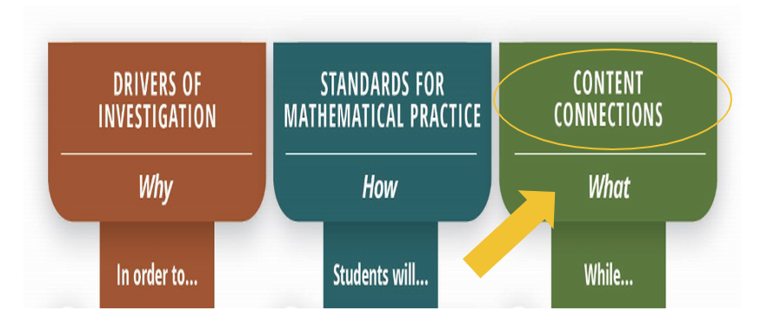
Content Connections (1)
Link to long description

Slide 20
Content Connections (2)
Reasoning with data
Exploring changing quantities
Taking wholes apart and putting parts together
Discovering shape and space
Link to long description

Slide 21
Example: Progression Chart of Big Ideas, Grades 6–8
Content Connections | Big Ideas: Grade 6 | Big Ideas: Grade 7 | Big Ideas: Grade 8
Exploring Changing Quantities | Fraction relationships | Proportional relationships | Multiple representations of functions
Exploring Changing Quantities | Patterns inside numbers | Unit rates in the world | Linear equations
Exploring Changing Quantities | Generalizing with multiple representations | Graphing relationships | Slopes and intercepts
Exploring Changing Quantities | Relationships between variables | Scale drawings | Interpret scatter plots

Slide 22
Example: Grade 6 Content Connection, Big Ideas, and Standards
Content Connections | Big Ideas: Grade 6 | CCSS Grade 6 Standards
Exploring Changing Quantities | Fraction relationships | NS.1, RP.1, RP.3
Exploring Changing Quantities | Patterns inside numbers | NS.4, RP.3
Exploring Changing Quantities | Generalizing with multiple representations | EE.2, EE.3, EE.4, EE.6, EE.7 RP.1, RP.2, RP.3
Exploring Changing Quantities | Relationships between variables | EE.5, EE.9, RP.1, RP.2, RP.3 NS.8, SP.1, SP.2

Slide 23
Example: Progression Chart of Big Ideas, Grades 3–5
Content Connections | Big Ideas: Grade 3 | Big Ideas: Grade 4 | Big Ideas: Grade 5
Exploring Changing Quantities | Patterns in four operations | Number and shape patterns | Telling a data story
Exploring Changing Quantities | Number flexibility to 100 for all four operations | Factors and area models | Factors and groups
Exploring Changing Quantities | n/a | Multi-digit numbers | Modeling
Exploring Changing Quantities | n/a | n/a | Fraction connections

Slide 24
Example: Grade 3 Content Connections, Big Ideas, and Standards
Content Connections | Big Ideas: Grade 3 | CCSS Grade 3 Standards
Exploring Changing Quantities | Patterns in Four Operations | NBT.2 OA.8, OA.9 MD.1
Exploring Changing Quantities | Number Flexibility to 100 for All Four Operations | OA.1, OA.2, OA.3, OA.4, OA.5, OA.6, OA.7, OA.8 NBT.1, NBT.3, MD.7

Slide 25
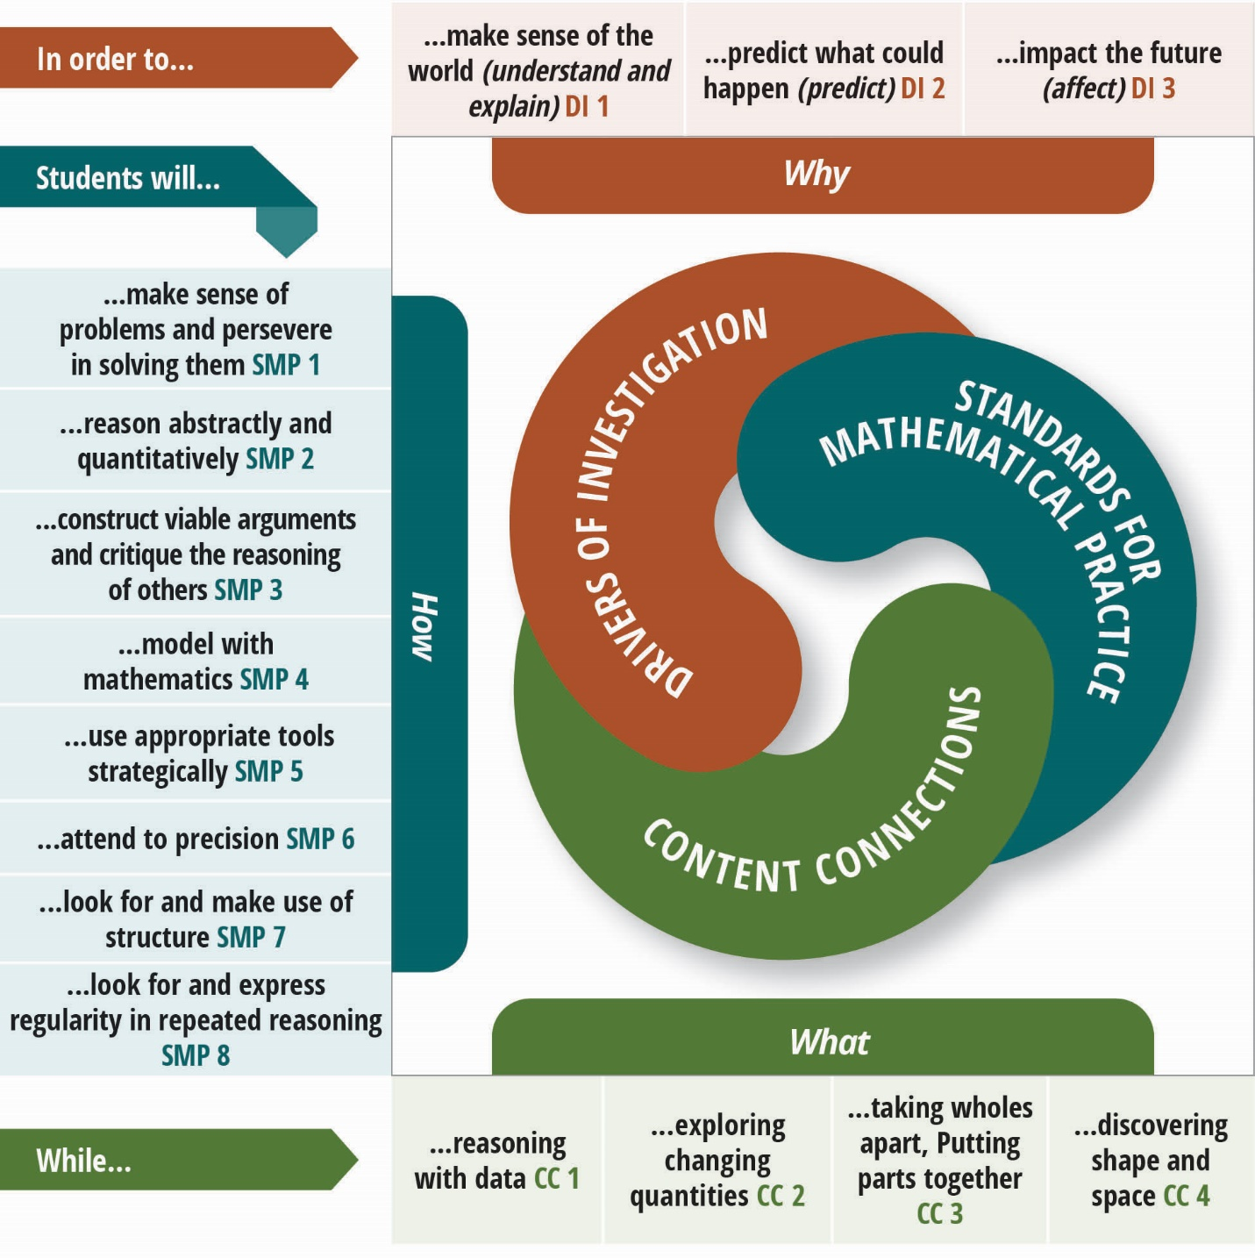
The WHY, How, and What Of Mathematics Instruction (2)
Link to long description

Slide 26
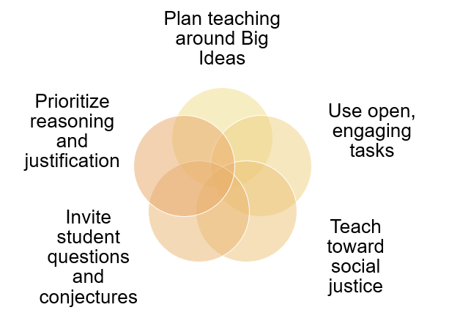
Five Components of Equitable and Engaging Teaching

Slide 27
Mathematics Framework Organization

Slide 28
Organization of the Mathematics Framework (1)
Chapter 1: Mathematics for All: Purpose, Understanding, and Connection
Chapter 2: Teaching for Equity and Engagement
Chapter 3: Number Sense
Chapter 4: Exploring, Discovering, and Reasoning With and About Mathematics

Slide 29
Organization of the Mathematics Framework (2)
Chapter 5: Mathematical Foundations of Data Science
Chapter 6: Mathematics: Investigating and Connecting, Transitional Kindergarten through Grade Five
Chapter 7: Mathematics: Investigating and Connecting, Grades Six through Eight
Chapter 8: Mathematics: Investigating and Connecting, High School

Slide 30
Organization of the Mathematics Framework (3)
Chapter 9: Structuring School Experiences for Equity and Engagement
Chapter 10: Supporting Educators in Offering Equitable and Engaging Mathematics Instruction
Chapter 11: Technology and Distance Learning in the Teaching of Mathematics

Slide 31
Organization of the Mathematics Framework (4)
Chapter 12: Mathematics Assessment in the 21st Century
Chapter 13: Instructional Materials to Support Equitable and Engaging Learning of the California Common Core State Standards for Mathematics
Chapter 14: Glossary: Acronyms and Terms
Appendices A, B, and C

Slide 32
Resources
2023 California Mathematics Framework:
https://www.cde.ca.gov/ci/ma/cf/
2025 California Mathematics Adoption:
https://www.cde.ca.gov/ci/ma/im/
Questions?
  David Almquist, Publisher Liaison
  Instructional Materials and Access Unit
  dalmquis@cde.ca.gov

Slide 33
Thank you for attending.
Please see the mathematics adoption web page https://www.cde.ca.gov/ci/ma/im/ to register for our upcoming Mathematics Instructional Materials Adoption webinars:
November 28: The Big Ideas of the 2023 Mathematics Framework
December 19: Instructional Materials to Support Systemic Improvement in Mathematics

Slide 34
Long Description for Slide 13 (1)
The graphic illustrates the connections and relationships of some sixth-grade mathematics concepts. Direct connections include:
Variability in Data directly connects to: The Shape of Distributions, Relationships Between Variables
The Shape of Distributions directly connects to: Relationships Between Variables, Variability in Data
Fraction Relationships directly connects to: Patterns Inside Numbers, Generalizing with Multiple Representations, Model the World, Relationships Between Variables
Patterns Inside Numbers directly connects to: Fraction Relationships, Generalizing with Multiple Representations, Model the World, Relationships Between Variables
(Continues on next slide)

Slide 35
Long Description for Slide 13 (2)
Generalizing with Multiple Representations directly connects to: Patterns Inside Numbers, Fraction Relationships, Model the World, Relationships Between Variables, Nets & Surface Area, Graphing Shapes
Model the World directly connects to: Fraction Relationships, Relationships Between Variables, Patterns Inside Numbers, Generalizing with Multiple Representations, Graphing Shapes
Graphing Shapes directly connects to: Model the World, Generalizing with Multiple Representations, Relationships Between Variables, Distance & Direction, Nets & Surface
(Continues on next slide)

Slide 36
Long Description for Slide 13 (3)
Nets & Surface directly connects to: Graphing Shapes, Generalizing with Multiple Representations, Distance & Direction
Distance & Direction directly connects to: Graphing Shapes, Nets & Surface
Relationships Between Variables directly connects to: Variability in Data, The Shape of Distributions, Fraction Relationships, Patterns Inside Numbers, Generalizing with Multiple Representations, Model the World, Graphing Shapes
Return to Slide 13

Slide 37
Long Description for Slide 14
The Why, How, and What of Learning Mathematics
Drivers of Investigation (Why): In order to… DI1. Make Sense of the World Understand and Explain; DI2. Predict What Could Happen (Predict); DI3. Impact the Future (Affect)
Standards for Mathematical Practice (How): Students will… SMP1. Make Sense of Problems and Persevere in Solving Them; SMP2. Reason Abstractly and Quantitatively; SMP3. Construct Viable Arguments and Critique the Reasoning of Others; SMP4. Model with Mathematics; SMP5. Use Appropriate Tools Strategically; SMP6. Attend to Precision; SMP7. Look for and Make Use of Structure; SMP8. Look for and Express Regularity in Repeated Reasoning
Content Connections (What): While… CC1. Reasoning with Data; CC2. Exploring Changing Quantities; CC3. Taking Wholes Apart, Putting Parts Together; and CC4. Discovering Shape and Space.
Return to Slide 14

Slide 38
Long Description for Slide 15
Three column headers with column 1 labeled Drivers of Investigation; Why; In order to…. This is the focus slide with the heading circled and a yellow arrow pointing to it.
Column 2 is Standards for Mathematical Practice; How; Students will….
Column 3 is Content Connections; What; While….
Return to Slide 15

Slide 39
Long Description for Slide 16
Column headed Drivers of Investigation; Why; In order to .... This is followed by Driver of Investigation 1 (DI1) ... Make sense of the world (understand and explain);
DI2 ... Predict what could happen (predict); and
DI3 ... Impact the future (affect).
Return to Slide 16

Slide 40
Long Description for Slide 17
Three column headers with column 1 labeled Drivers of Investigation; Why; In order to….
Column 2 is Standards for Mathematical Practice; How; Students will…. This is the focus slide with the heading circled and a yellow arrow pointing to it.
Column 3 is Content Connections; What; While….
Return to Slide 17

Slide 41
Long Description for Slide 18
First column is headed Drivers of Investigation; Why; In order to .... This is followed by DI1 ... Make sense of the world (understand and explain); DI2 ... Predict what could happen (predict); and DI3 ... Impact the future (affect).
Second column is headed Standards for Mathematical Practice; How; Students will …. This is followed by SMP1. Make Sense of Problems and Persevere in Solving Them; SMP2. Reason Abstractly and Quantitatively; SMP3. Construct Viable Arguments and Critique the Reasoning of Others; SMP4. Model with Mathematics; SMP5. Use Appropriate Tools Strategically; SMP6. Attend to Precision; SMP7. Look for and Make Use of Structure; SMP8. Look for and Express Regularity in Repeated Reasoning.
Return to Slide 18

Slide 42
Long Description for Slide 19
Three column headers with column 1 labeled Drivers of Investigation; Why; In order to….
Column 2 is Standards for Mathematical Practice; How; Students will….
Column 3 is Content Connections; What; While…. This is the focus slide with the heading circled and a yellow arrow pointing to it.
Return to Slide 19

Slide 43
Long Description for Slide 20 (1)
First column is headed Drivers of Investigation; Why; In order to .... This is followed by DI1 ... Make sense of the world (understand and explain); DI2 ... Predict what could happen (predict); and DI3 ... Impact the future (affect).
Second column is headed Standards for Mathematical Practice; How; Students will …. This is followed by SMP1. Make Sense of Problems and Persevere in Solving Them; SMP2. Reason Abstractly and Quantitatively; SMP3. Construct Viable Arguments and Critique the Reasoning of Others; SMP4. Model with Mathematics; SMP5. Use Appropriate Tools Strategically; SMP6. Attend to Precision; SMP7. Look for and Make Use of Structure; SMP8. Look for and Express Regularity in Repeated Reasoning.
(Continues on next slide)

Slide 44
Long Description for Slide 20 (2)
Third column is headed Content Connections; What; While .... This is followed by CC1. Reasoning with Data; CC2. Exploring Changing Quantities; CC3. Taking Wholes Apart, Putting Parts Together; and CC4. Discovering Shape and Space.
Return to Slide 20

Slide 45
Long Description for Slide 25
A spiral graphic shows how the Drivers of Investigation (DIs), Standards for Mathematical Practice (SMPs) and Content Connections (CCs) interact. The DIs are the “Why,” described as, “In order to...”: DI1. Make Sense of the World (Understand and Explain); DI2. Predict What Could Happen (Predict); DI3. Impact the Future (Affect). The SMPs are the “How,” listed under “Students will...”: SMP1. Make sense of problems and persevere in solving them; SMP2. Reason abstractly and quantitatively; SMP3. Construct viable arguments and critique the reasoning of others; SMP4. Model with mathematics; SMP5. Use appropriate tools strategically; SMP6. Attend to precision; SMP7. Look for and make use of structure; SMP8. Look for and express regularity in repeated reasoning. Finally, the CCs are the “What,” listed under, “While...”: CC1. Reasoning with Data; CC2. Exploring Changing Quantities; CC3. Taking Wholes Apart, Putting Parts Together; CC4. Discovering Shape and Space.
Return to Slide 25

