Slide 1
Title II, Part A
Supporting Effective Instruction
SEI 01: Consultation and staff development
Notes:
SEI 01: Consultation and Staff Development

Slide 2

Agenda
Legal requirements for Supporting Effective Instruction (SEI) 01: Consultation and Staff Development
Evidence request
Frequently asked questions
Slide notes are present throughout this presentation.
Notes:
In this presentation, we are going to review:
Legal requirements for Supporting Effective Instruction (SEI) 01: Consultation and Staff Development
Evidence request
Frequently asked questions

Slide 3

Title II Purpose
Increasing student achievement consistent with the challenging state academic standards.
Improving the quality and effectiveness of teachers, principals, and other school leaders.
Increasing the number of teachers, principals, and other school leaders who are effective in improving student academic achievement in schools.
Providing low-income and minority students greater access to effective teachers, principals, and other school leaders.
20 United States Code (U.S.C.) Section 6601
Notes:
Increasing student achievement consistent with the challenging state academic standards
Improving the quality and effectiveness of teachers, principals, and other school leaders
Increasing the number of teachers, principals, and other school leaders who are effective in improving student academic achievement in schools
Providing low-income and minority students greater access to effective teachers, principals, and other school leaders

Slide 4
Supporting Effective Instruction 01: Consultation and Staff Development (1)
In developing the application for Title II, Part A, funds, the local educational agency (LEA) shall meaningfully consult with teachers, principals, other school leaders, paraprofessionals (including organizations representing such individuals), specialized instructional support personnel, charter school leaders (in an LEA that has charter schools), parents, community partners, and other organizations or partners with relevant and demonstrated expertise in programs and activities designed to meet the purpose of Title II, Part A.
20 U.S.C. Sections 6601, 6612[b][3][A]
Notes:
Statute states: In developing the application for Title II, Part A, funds, the local educational agency (LEA) shall meaningfully consult with teachers, principals, other school leaders, paraprofessionals (including organizations representing such individuals), specialized instructional support personnel, charter school leaders (in an LEA that has charter schools), parents, community partners, and other organizations or partners with relevant and demonstrated expertise in programs and activities designed to meet the purpose of Title II, Part A.

Slide 5
Supporting Effective Instruction 01: Consultation and Staff Development (2)
  The LEA shall seek advice from the individuals and organizations as described above regarding how best to improve the LEA’s activities to meet the purpose of Title II, Part A, as described above.
  20 U.S.C. Section 6612[b][3][B]
  The LEA will use data and ongoing consultation with the educational partners described above to continually update and improve activities supported by Title II, Part A.
  20 U.S.C. Section 6612[b][2][D]
Notes:
The LEA shall seek advice from the individuals and organizations as described above in section 1.0 regarding how best to improve the LEAs activities to meet the purpose of Title II, Part A. The LEA will use data and ongoing consultation with the educational partners to continually update and improve activities supported by Title II, Part A.

Slide 6
Supporting Effective Instruction 01: Consultation and Staff Development Evidence (1)
LEA Level Planning Documents
Description: The currently approved Local Control and Accountability Plan (LCAP) and LCAP Federal Addendum. The currently approved LEA level planning documents, such as the currently approved Local Control and Accountability Plan (LCAP) Federal Addendum.
Item Instructions: Submit the LCAP, the LCAP Federal Addendum, and planning documents that include Title II goals and strategies.
Notes:
Local Educational Agency Level Planning Documents
Description: The currently approved Local Control and Accountability Plan (LCAP) and LCAP Federal Addendum. The currently approved LEA level planning documents, such as the current approved Local Control and Accountability Plan (LCAP) Federal Addendum.
Item Instructions: Supporting Effective Instruction (SEI) 01: Submit the LCAP, the LCAP Federal Addendum, and planning documents that include Title II goals and strategies.

Slide 7
Supporting Effective Instruction 01: Consultation and Staff Development Evidence (2)
Educational Partner Feedback
Description: Evidence that all staff and relevant educational partners collaborated regarding how best to improve the LEA’s activities.
Item Instructions: Submit evidence of the LEA’s collaboration with educational partners and use of data to update and improve Title II activities. Evidence may include agendas, meeting notes, lists of participants present, presentations, documents shared during meetings, surveys (including survey and results), data, and feedback forms.
Notes:
Educational Partner Feedback
Description: Evidence that all staff and relevant educational partners collaborated regarding how best to improve the LEA activities.
Item Instructions: SEI 01: Submit evidence of the LEA’s collaboration with educational partners and use of data to update and improve Title II activities. Evidence may include agendas, meeting notes, lists of participants present, presentations, documents shared during meetings, surveys (including survey and results), data, and feedback forms.

Slide 8

Educational Partner Evidence
Professional Development Plan
  Based on the survey, data, and leadership meeting
  Plan created
  Short- and long-term goals
Survey
Administrators, teachers, and paraprofessionals
All sites districtwide
Survey and data uploaded
Leadership Meeting
  Agenda indicating members present
  Review survey data
  Review student academic data
Notes:
Here is an example of items uploaded for SEI 01 Educational Partner Feedback
Survey provided to education partners focused on their professional learning needs. Feedback on the effectiveness of the current year’s professional development plan. The LEA provided the survey and the data.
Leadership meeting was provided as part of the upload. The goal of the leadership meeting was to review the feedback from the survey and professional development and determine the next steps for future professional development.
Finally the PD plan that was drafted as a result of the educational feedback.
The evidence here is all connected and can show evidence the LEA collaborated with educational partners.

Slide 9
List of Educational Partners (1)
Educational Partners Required for Consultation | Best Practices/Suggestions
Teachers | Elementary school, middle school, high school, alternative, charter, teacher leaders, and special education.
Principals and Assistant Principals | Elementary school, middle school, high school, alternative, and charter.
Paraprofessionals | Elementary school, middle school, high school, regular and special education
Families | Elementary school, middle school, high school, alternative, educational rights holders (foster youth), caregivers
Notes:
Here is a list of required educational partners
Teachers: Elementary school, middle school, high school, alternative, charter, teacher leaders, and special education.
Principals and Assistant Principals: Elementary school, middle school, high school, alternative, and charter.
Paraprofessionals: Elementary school, middle school, high school, regular and special education
Families: Elementary school, middle school, high school, alternative, educational rights holders (foster youth), caregivers

Slide 10
List of Educational Partners (2)
Educational Partners Required for Consultation | Best Practices/Suggestions
Community Partners | Business partners, community-based organizations, civic organizations, law enforcement, including probation offers.
Charter School Leaders | Principals and executive directors.
Other educational leaders | Private school leaders, executive directors, cabinet members, board of education members
Notes:
Community Partners: Business partners, community-based organizations, civic organizations, law enforcement, including probation offers.
Charter School Leaders: Principals and executive directors.
Other educational leaders: Private school leaders, executive directors, cabinet members, board of education members

Slide 11
List of Educational Partners (3)
Educational Partners Required for Consultation | Best Practices/Suggestions
Specialized Instructional Support Personnel | Teachers on assignment, instructional coaches, media specialists, instructional technology, counselors, resource officers, restorative justice coordinators, pathway/Career Technical Education (CTE) coaches
Other relevant organizations or partners | Teacher union, principal and assistant principal unions, before and after school programs, professional educational organizations, institutions of higher education
Notes:
Specialized Instructional Support Personnel: Teachers on assignment, instructional coaches, media specialists, instructional technology, counselors, resource officers, restorative justice coordinators, pathway/Career Technical Education (CTE) coaches
Other relevant organizations or partners: Teacher union, principal and assistant principal unions, before and after school programs, professional educational organizations, institutions of higher education

Slide 12

Consultation Question (1)
Question: Does the educational partner engagement for our LCAP meet the consultation requirement for Title II?
Answer: Maybe. 20 U.S.C. 6612[b][3][A] requires the LEA to consult with educational partners in developing the application for Title II. Consultation with educational partners shall seek educational partner advice regarding how best to improve the LEA’s activities to meet the purpose of Title II.
Notes:
Question: Does the educational partner engagement for our LCAP meet the consultation requirement for Title II?
Answer: Maybe. 20 USC 6612[b][3][A]) requires the LEA to consult with stakeholders in developing the application for Title II. Consultation with stakeholders shall seek advice from the stakeholders regarding how best to improve the LEAs activities to meet the purpose of Title II. Based on how the LEA is utilizing Title II, the consultation evidence provided should directly indicate how the LEA meaningfully engaged with education partners on how to improve activities supported by Title II.

Slide 13
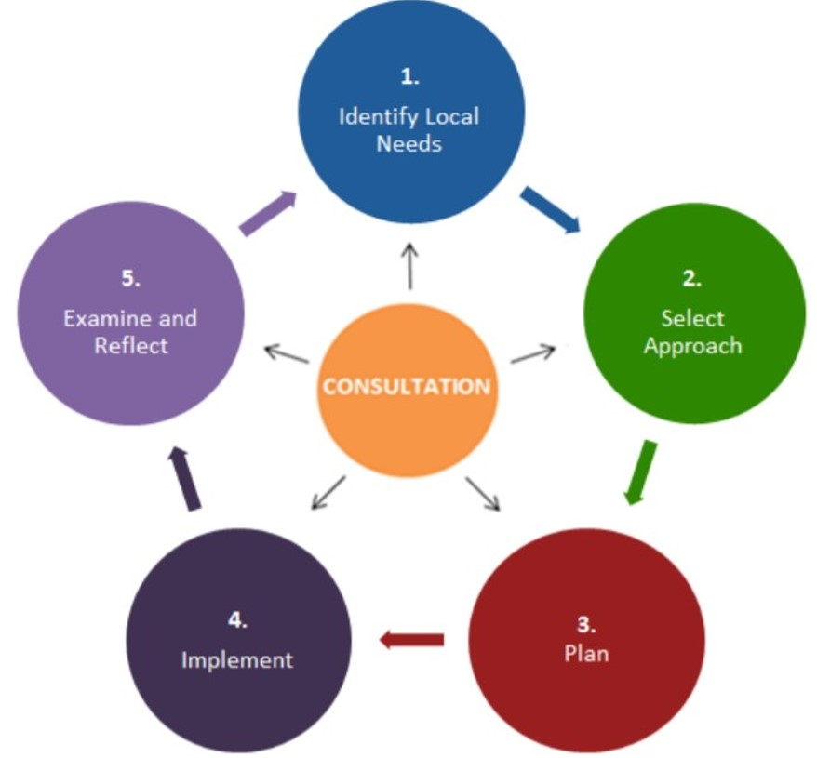
Consultation
Title II, Part A investments should align with the LEA’s overall strategies to support effective instruction to improve student academic outcomes. Consultation is a critical part of ensuring that Title II, Part A funds are used effectively and decisions about resource allocation are fully informed.
Notes:
The Title II, Part A program is designed, among other things, to provide students from low-income families and minority students with greater access to effective educators. It is critical that local educational agencies (LEAs) consider how to best use Title II, Part A funds, among other funding sources, to ensure equity of educational opportunity.
Title II, Part A investments should align with the LEA’s overall strategies to support effective instruction in order to improve student academic outcomes. Consultation is a critical part of ensuring that Title II, Part A funds are used effectively and decisions about resource allocation are fully informed. LEAs must engage in meaningful consultation.
Title II, Part A activities are more likely to result in sustained, improved outcomes for students if:
Chosen activities align with identified local needs. Needs emerge from data, not wishes. Through a process of analyzing data about students, educators, and the system, studying trends and patterns, and assessing the potential causes of contributors, needs emerge. These needs are then studied to understand what might be causing or contributing to them. (Learning Forward)
The evidence base and the local capacity are considered when selecting a strategy;
There is a robust implementation plan;
Adequate resources are provided so the implementation is well-supported;
Information is gathered regularly to examine the strategy and to reflect on and inform next steps. Indicators of success describe how planners will know whether the actions have occurred, and the goals and objectives have been achieved
This framework is designed to help decision-makers make more effective Title II, Part A investments and to make the use of evidence, research, and data part of the decision-making process.

Slide 14
Data and Ongoing Consultation
Educational Partners
Educators
Student Data
Demographics
School Data
Resources
Safety
Educator Data
Students
Families
Community
Achievement and Growth
Graduation Rates
Climate
Equity
Effectiveness
Retention Rates
Job Satisfaction
Teacher Assignment
Notes:
Evidence of Data to identify local needs. The LEA can upload multiple sets of data from any educational partners listed to justify how the LEA identified their local needs. In the LCAP Federal Addendum section for Title II LEAs are required to describe the sources of data used to evaluate Title II activities and how often they analyze the data.
During the review, we are seeking to understand how the activities supported with Title II funds are a result of the LEAs’ needs and evaluated for effectiveness.
https://www2.ed.gov/policy/elsec/leg/essa/essatitleiipartaguidance.pdf pg 32

Slide 15
Review
Upload and certify the LCAP and LCAP Federal Addendum in the CDE Monitoring Tool (CMT).
Evidence should include feedback from educational partners on the best use of Title II resources.
Notes:
In Review
Upload and certify the LCAP and LCAP Federal Addendum in the CMT.
Evidence should include feedback from educational partners on the best use of Title II resources.

Slide 16

Contact and Resources
Title II web page: https://www.cde.ca.gov/pd/ti/
Title II Email: TitleII@cde.ca.gov
If you are not already on our listserv, please take a moment and send a blank email to join-Title-II@mlist.cde.ca.gov
Thank You!

