Slide 1
Title II, Part A
Supporting Effective Instruction
SEI 02: Comprehensive Support and Targeted Support Prioritization
Notes:
Thank you for watching this presentation about Supporting Effective Instruction (SEI) 02: Comprehensive Support and Target Support Improvement.

Slide 2

Agenda
Legal requirements for Supporting Effective Instruction (SEI) 02: Comprehensive Support and Targeted Support Prioritization
Evidence requests
Frequently asked questions
Slide notes are present throughout this presentation.
Notes:
The agenda for this presentation is a review of:
Legal requirements for Supporting Effective Instruction (SEI) 02: Comprehensive Support and Targeted Support Prioritization
Evidence requests
Frequently asked questions

Slide 3
Title II Purpose
Increasing student achievement consistent with the challenging state academic standards.
Improving the quality and effectiveness of teachers, principals, and other school leaders.
Increasing the number of teachers, principals, and other school leaders who are effective in improving student academic achievement in schools.
Providing low-income and minority students greater access to effective teachers, principals, and other school leaders.
20 United States Code (U.S.C.) Section 6601
Notes:
Let’s review the purpose of Title II, Part A which is to:
Increase student achievement consistent with the challenging state academic standards
Improve the quality and effectiveness of teachers, principals, and other school leaders
Increase the number of teachers, principals, and other school leaders who are effective in improving student academic achievement in schools; and
Provide low-income and minority students greater access to effective teachers, principals, and other school leaders

Slide 4
Supporting Effective Instruction 02: Comprehensive Support and
Targeted Support Prioritization
The local educational agency (LEA) shall prioritize funds to schools served by the agency that are implementing comprehensive support and improvement (CSI) activities and targeted support and improvement (TSI) activities and have the highest percentage of children counted under Title I, Part A.
20 U.S.C. Section 6612[b][2][C]
Notes:
The local educational agency (LEA) shall prioritize funds to schools served by the agency that are implementing comprehensive support and improvement (CSI) activities and targeted support and improvement (TSI) activities and have the highest percentage of children counted under Title I, Part A. 20 U.S.C. Section 6612[b][2][C]
As of September 2023, California has not made school eligibility determinations for TSI. The CDE will use the California School Dashboard to determine school eligibility for and exit from TSI and Assisted targeted support and improvement (ATSI). Title I and non-Title I schools are eligible for TSI and ATSI. https://www.cde.ca.gov/sp/sw/t1/tsi.asp
ATSI schools are not included in this federal legal requirement; however, we encourage LEAs to consider how best to prioritize funding for the ATSI sites.

Slide 5
Supporting Effective Instruction 02: Comprehensive Support and Targeted Support Prioritization Evidence (1)
LEA Level Planning Documents
Description: The currently approved Local Control and Accountability Plan (LCAP) and LCAP Federal Addendum.
Item Instructions: Submit the LCAP, LCAP Federal Addendum, and other plans, which may include the CSI plan(s) and the School Plan for Student Achievement.
Notes:
The evidence required for SEI 02 includes LEA planning documents, as SEI 01 did. SEI 02 requires the Local Control and Accountability Plan (LCAP), LCAP Federal Addendum, and other plans, which may include the CSI plan and the School Plan for Student Achievement.
In addition to the CSI plan, LEAs may submit:
CSI Prompts and County Office of Education approval
CSI preliminary funding plan
Root cause analysis, educational partner engagement meetings, and data related to the plan.
This provision is found in the LCAP Federal Addendum under Title II - Prioritizing Funding. If an LEA has a school site in CSI, Title II resources must be prioritized to those sites. The Title II, Part A plan or budget must demonstrate how Title II resources are prioritized for eligible school sites. The LEA will describe this in a narrative form in the LCAP Federal Addendum.

Slide 6

Local Control and Accountability Plan Federal Addendum – Title II (1)
Prioritizing Funding
Provide a description of how the LEA will prioritize funds to schools served by the agency that are implementing CSI activities and TSI activities and have the highest percentage of children counted under Section 1124.
Notes:
The Title II provision in the LCAP Federal Addendum for prioritizing funding states “Provide a description of how the LEA will prioritize funds to schools served by the agency that are implementing comprehensive support and improvement (CSI) activities and targeted support and improvement (TSI) activities and have the highest percentage of children counted under Section 1124”

Slide 7

Local Control and Accountability Plan Federal Addendum - Title II (2)
What information does the LEA need to provide to meet the Title II Prioritizing Funding provision requirements of the LCAP Federal Addendum?
Describe the LEA’s process for determining Title II, Part A funding among the schools it serves.
Describe how the LEA determines funding that prioritizes CSI and TSI schools and schools serving the highest percentage of children counted under Section 1124(c).
Describe how CSI and TSI schools and schools that have the highest percentage of children counted under Section 1124(c) that the LEA serves receive priority in Title II funding decisions compared to other schools the LEA serves.
Notes:
What information does the LEA need to provide to meet the Title II Prioritizing Funding provision requirements of the LCAP Federal Addendum?
Please describe the LEA’s process for determining Title II, Part A funding among the schools it serves.
Please describe how the LEA determines funding that prioritizes CSI and TSI schools and schools serving the highest percentage of children counted under Section 1124(c).
Please describe how CSI and TSI schools and schools that have the highest percentage of children counted under Section 1124(c) that the LEA serves receive priority in Title II, Part A funding decisions compared to other schools the LEA serves.
https://www.cde.ca.gov/pd/ee/t2lcapfaq.asp#accordionfaq

Slide 8
Supporting Effective Instruction 02: Comprehensive Support and Targeted Support Prioritization Evidence (2)
Professional Development (PD) Planning Documents
Description: Provide documentation of PD planning.
Item Instructions: Submit districtwide PD calendars. Submit evidence of short- and long-term PD planning and goals. Evidence may include calendars, agendas, meeting notes, lists of participants present, presentations, documents shared during meetings, surveys (including survey and results), data, and feedback forms.
Notes:
The second set of evidence documents for SEI 02 is focused on the Professional Development (PD) Planning Documents
Description: Provide documentation of PD planning.
Item Instructions: Submit districtwide PD calendars. Submit evidence of short- and long-term PD planning and goals. Evidence may include calendars, agendas, meeting notes, lists of participants present, presentations, documents shared during meetings, surveys (including survey and results), data, and feedback forms.
This evidence should illustrate the process for how and with whom the LEA determined the Title II, Part A prioritization of funds and resources for CSI schools.

Slide 9
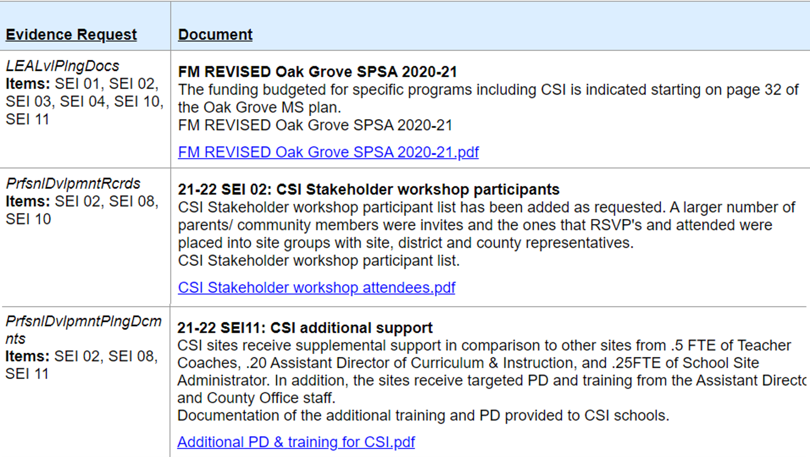
Supporting Effective Instruction 02: California Department of Education Monitoring Tool Example
Notes:
Here is an example from an LEA. The LEA provided the School Plan for Student Achievement, the educational partner feedback, and documentation of the additional training provided to the schools.

Slide 10

Questions (1)
Question: What if the LEA does not have any CSI schools?
Answer: Each LEA, except charter schools and single-school districts, must address the LCAP Federal Addendum Title II, Part A prioritized funding provision so that it is clear the LEA will have a process in place to prioritize funds should schools that the LEA serves be identified for comprehensive or targeted support.
Notes:
Question: What if the LEA does not have CSI schools?
Answer: Each LEA, except charter schools and single-school districts, must address the LCAP Federal Addendum Title II, Part A prioritized funding provision so that it is clear the LEA will have a process in place to prioritize funds should schools that the LEA serves be identified for comprehensive or targeted support.

Slide 11

Questions (2)
Question: Do charter schools or single-school districts need to respond to this provision?
Answer: Charter schools or single-school districts should use the following appropriate response:
LEA is a charter school.
LEA is a single-school district.
Notes:
Question: Do charter schools or single-school districts need to respond to this provision?
Answer: Charter schools or single-school districts should use the following appropriate response:
LEA is a charter school.
LEA is a single-school district.

Slide 12

Questions (3)
Question: What if Title II funds are used at the district level and not assigned to school sites?
Answer: The LEA must describe how Title II-funded activities at the district level will prioritize CSI and TSI schools and schools that have the highest percentage of children counted under Section 1124(c).
Notes:
Question: What if Title II funds are used at the district level and not assigned to school sites?
Answer: The LEA must describe how Title II-funded activities at the district level will prioritize CSI and TSI schools and schools that have the highest percentage of children counted under Section 1124(c). California has not yet established criteria to identify TSI schools.

Slide 13

Questions (4)
Question: What are examples of how an LEA may prioritize Title II funds or resources for CSI schools?
Answer: If an LEA’s goal is to increase the reclassification rate of English Learners, the LEA may assign additional coaching hours to CSI sites.
The LEA may also use Title II funds to recruit effective teachers to the CSI sites through recruitment stipends.
Notes:
Question: What are examples of how an LEA may prioritize Title II funds or resources for CSI schools?
Answer: If an LEA’s goal is to increase the reclassification rate of English Learners, the LEA may assign additional coaching hours to CSI sites as long as this is based on the sites needs.
The LEA may also use Title II funds to recruit effective teachers to the CSI sites through recruitment stipends.

Slide 14

Questions (5)
Question: How are schools eligible for CSI?
Answer: Schools are eligible when they meet one of the following criteria:
Low Graduation Rate: for 2022, consists of schools that have a three-year graduation rate that is below 68 percent; both Title I and non-Title I sites.
Low Performing: Schools that received Title I funding for 2021-22 and are the lowest performing based on the 2022 Dashboard.
Notes:
Question: How are schools eligible for CSI?
Answer: School eligibility:
Low Graduation Rate: for 2022, consists of schools that have a three-year graduation rate that is below 68 percent; both Title I and non-Title I sites.
Low Performing: Schools that received Title I funding for 2021-22 and are the lowest performing based on the 2022 Dashboard.
School assistance eligibility for Comprehensive Support and Improvement (CSI) and Additional Targeted Support and Improvement (ATSI) can be found on CDEs website
https://www.cde.ca.gov/sp/sw/t1/essaassistdatafiles.asp

Slide 15

Review
Title II must be prioritized to CSI sites.
Upload LCAP, LCAP Federal Addendum, and PD Planning Documents.
Notes:
In summary, Title II resources must be prioritized for CSI sites. This prioritization should be reflected in the following evidence: LCAP, LCAP Federal Addendum, and PD planning documents.

Slide 16

Contact and Resources
Title II web page: https://www.cde.ca.gov/pd/ti/
Title II Email: TitleII@cde.ca.gov
If you are not already on our listserv, please take a moment and send a blank email to join-Title-II@mlist.cde.ca.gov
Thank You!

