Slide 1
Title II, Part A
Supporting Effective Instruction
SEI 03: Review and revise local control and accountability plan federal addendum

Slide 2

Agenda
Legal requirement
Evidence requests
Questions and answers
Contacts and resources
Slide notes are present throughout this presentation.
Notes:
Agenda
Legal requirement
Evidence requests
Questions and answers
Contacts and resources

Slide 3
Title II, Part A Purpose
Increasing student achievement consistent with the challenging state academic standards;
Improving the quality and effectiveness of teachers, principals, and other school leaders;
Increasing the number of teachers, principals, and other school leaders who are effective in improving student academic achievement in schools; and
Providing low-income and minority students greater access to effective teachers, principals, and other school leaders
20 United States Code (U.S.C.) Section 6601
Notes:
Let’s take a moment to understand the purpose of Title II, Part A. The purpose of Title II, Part A is to:
Increase student achievement consistent with the challenging state academic standards
Improve the quality and effectiveness of teachers, principals, and other school leaders
Increase the number of teachers, principals, and other school leaders who are effective in improving student academic achievement in schools
Provide low-income and minority students greater access to effective teachers, principals, and other school leaders

Slide 4
Federal Addendum (1)
The Local Control and Accountability Plan (LCAP) Federal Addendum is meant to supplement the LCAP to ensure that eligible local educational agencies (LEAs) have the opportunity to meet the LEA Plan provisions of the Every Student Succeeds Act (ESSA).
The California Department of Education (CDE) emphasizes that the LCAP Federal Addendum should not drive LCAP development.
Notes:
Before we get into some of the specifics, let’s take a moment to first understand the purpose of the LCAP Federal Addendum.
The LCAP Federal Addendum is meant to supplement the LCAP to ensure that eligible LEAs have the opportunity to meet the Local Educational Agency (LEA) Plan provisions of the Every Student Succeeds Act (ESSA).
The California Department of Education (CDE) emphasizes that the LCAP Federal Addendum should not drive LCAP development.
https://www.cde.ca.gov/re/lc/addendumguidance.asp

Slide 5
Federal Addendum (2)
ESSA funds are supplemental to state funds, just as the LCAP Federal Addendum supplements your LCAP.
LEAs are encouraged to integrate their ESSA funds into their LCAP development as much as possible to promote strategic planning of all resources; however, this is not a requirement.
Notes:
ESSA funds are supplemental to state funds, just as the LCAP Federal Addendum supplements your LCAP. LEAs are encouraged to integrate their ESSA funds into their LCAP development as much as possible to promote strategic planning of all resources; however, this is not a requirement.
Citation
https://www.cde.ca.gov/re/lc/addendumguidance.asp

Slide 6



Federal Addendum Process
          The LCAP Federal Addendum Template must be completed and submitted to the CDE to apply for ESSA funding.
          After the initial approval from CDE, LEAs are encouraged to review the Addendum annually with their LCAP, as ESSA funding should be considered in yearly strategic planning.
          LEAs do not need to submit their LCAP Federal Addendum to the CDE after the initial approval.
Notes:
The LCAP Federal Addendum Template must be completed and submitted to the California Department of Education (CDE) to apply for ESSA funding. After the initial approval from CDE, LEAs are encouraged to review the LCAP Federal Addendum annually with their LCAP, as ESSA funding should be considered in yearly strategic planning.
https://www.cde.ca.gov/re/lc/addendumguidance.asp
LEAs do not need to submit their LCAP Federal Addendum to CDE after the initial approval

Slide 7
Supporting Effective Instruction 03: Review and Revise Local Control and Accountability Plan Federal Addendum
  The LEA plan shall remain in effect for the duration of the LEA’s participation in the Title II, Part A program, and said plan shall be periodically reviewed, and revised when necessary.
  20 U.S.C. sections 6312[a][4], 6312[a][5], and 6612[b][1]
Notes:
Supporting Effective Instruction (SEI) 03: Review and Revise Local Control and Accountability Plan (LCAP) Federal Addendum states the local educational agency (LEA) plan shall remain in effect for the duration of the LEA’s participation in the Title II, Part A program, and said plan shall be periodically reviewed, and revised when necessary. This is often done as part of the annual LCAP process.

Slide 8
Review and Revise Local Control and Accountability Plan Federal Addendum Evidence
Item | Item Description and Instructions
LEA Level Planning Documents | The currently approved LCAP and LCAP Federal Addendum
LEA Planning Implementation and Monitoring Documents | Evidence the LEA implements, monitors, and revises the LCAP Federal Addendum, Title II plan, and Title II budget. Evidence may include agendas, meeting notes, lists of participants, presentations, documents shared during meetings, surveys (including survey and results), data, and feedback forms.
Notes:
Evidence for SEI 03 begins with the LEA Level Planning Documents. Please upload your current approved LCAP as well as your most recently approved LCAP Federal Addendum. Please upload the entire Addendum, not just the Title II portion.
The LEA Planning Implementation and Monitoring Documents should clearly demonstrate the review and revision process. Evidence may include agendas, meeting notes, lists of participants, presentations, documents shared during meetings, surveys (including survey and results), data, and feedback forms.

Slide 9

Interview
Interview questions reviewers may ask during the Federal Program Monitoring (FPM) Review:
What is the LEA’s process for reviewing and revising the LCAP Federal Addendum?
How are educational partners involved in the review and/or revision of the LCAP Federal Addendum?
Notes:
Some questions that may be asked during a federal program monitoring review may include:
What is the LEA’s process for reviewing and revising the LCAP Federal Addendum?
How are educational partners involved in this process?

Slide 10
Local Educational Agency Planning Implementation and Monitoring Documents Evidence
Presentation to the local board of education to obtain feedback on Title II initiatives.
Meetings and agendas from advisory committees addressing Title II initiatives
Professional development planning sessions
Notes:
LEA planning implementation and monitoring evidence may include:
Presentation to the local board of education to obtain feedback on Title II initiatives.
Meetings and agendas from advisory committees addressing Title II initiatives
Professional development planning session

Slide 11

Local Control and Accountability Plan Federal Addendum Question (1)
Question: How often do we need to revise our LCAP Federal Addendum?
Answer: LEAs are encouraged to review the LCAP Federal Addendum annually with their LCAP, as ESSA funding should be considered in yearly strategic planning. LEAs are encouraged to integrate their ESSA funds into their LCAP development as much as possible to promote strategic planning of all resources; however, this is not a requirement.
Notes:
We often receive this question: How often does the LEA need to revise their LCAP Federal Addendum.
While the statute states “as necessary,” for Title II provisions, the California Department of Education encourages LEAs to review their LCAP Federal Addendum yearly with their LCAP as funding is considered in the yearly strategic planning. LEAs are encouraged to integrate their ESSA funds into their LCAP development as much as possible to promote strategic planning of all resources; however, this is not a requirement. And the LEA should also have a plan indicating when they will review their LCAP federal addendum. The plan can be as simple as stating the LEA will include the LCAP federal addendum yearly with their LCAP.
Citations LCAP Federal Addendum Instructions https://www.cde.ca.gov/re/lc/addendumguidance.asp

Slide 12
Review and Revision (1)
Federal Title | Review and Revision
Title I | Periodically review and, as necessary, revise.
Title II | Periodically reviewed and revised when necessary. If a school is eligible for Comprehensive Support and Improvement (CSI), then the LEA will need to update its Title II prioritizing funding provision. Title II must be prioritized at CSI schools or highest needs sites.
Notes:
Title I LCAP Federal Addendum Review and Revision
Section 1112(a)(5) of ESSA states that each LEA shall periodically review and, as necessary, revise its plan.
The Title II section of the LCAP Federal Addendum shall be periodically reviewed and revised when necessary.
One item to keep in mind with Title II is that if a school is eligible for Comprehensive Support and Improvement (CSI), then the LEA will need to update its Title II prioritizing funding provision. Title II must be prioritized at the CSI or highest needs sites. This can be done when the LEA reviews and revises its LCAP.

Slide 13
Review and Revision (2)
Federal Title | Review and Revision
Title III | Each fiscal year all applicants must reapply and maintain an updated plan for funds allocated for that fiscal year and meet reporting requirements.
Title IV | Shall conduct the needs assessment once every three years.
Notes:
Title III states:
Each fiscal year, all applicants must reapply and maintain an updated plan for funds allocated for that fiscal year and meet reporting requirements. (Title III, sections 3114(a), 3115(a), 3121(a)(b)
Title IV says an LEA shall periodically reviewed and revised when necessary. Also, each LEA, or consortium of LEAs, shall conduct the needs assessment once every 3 years.
A LEA receiving a Title IV, Part A LEA allocation in an amount that is less than $30,000 shall not be required to conduct a comprehensive needs assessment.

Slide 14

Local Control and Accountability Plan Federal Addendum Question (2)
Question: Do we need to submit our revised LCAP Federal Addendum to the CDE for approval?
Answer: No, if your LCAP Federal Addendum was previously approved by the CDE and the State Board of Education, LEAs do not need to submit their revised LCAP Federal Addendum. However, LEAs must keep records of their review and revision of their LCAP Federal Addendum as evidence during an FPM review. The local board should also approve the revised LCAP Federal Addendum.
Notes:
Question: Do we need to submit our revised LCAP Federal Addendum to the California Department of Education for approval?
Answer: No, if your LCAP Federal Addendum was previously approved by the CDE and the State Board of Education, LEAs do not need to submit their revised LCAP Federal Addendum. However, LEAs must keep records of their review and revision of their LCAP Federal Addendum as evidence during a Federal Program Monitoring (FPM) review. The local board should also approve the revised LCAP Federal Addendum.

Slide 15

Local Control and Accountability Plan Federal Addendum Question (3)
Question: What should an LEA do if the LCAP Federal Addendum has not been reviewed or revised since the original CDE approval?
Answer: The LEA will need to review the provisions of the LCAP Federal Addendum. Please contact the Title II office at TitleII@cde.ca.gov for support and guidance.
Notes:
Question: What should an LEA do if the LCAP Federal Addendum has not been reviewed or revised since the original CDE approval?
Answer: The LEA will need to review the provisions of the LCAP Federal Addendum. Please contact the Title II office at TitleII@cde.ca.gov for support and guidance.

Slide 16

Local Control and Accountability Plan Federal Addendum Question (4)
Question: Does the CDE have a template for the LCAP Federal Addendum review and revision process?
Answer: Yes, the LEA may use the template provided by the CDE. The template is located on the CDE’s web page located at https://www.cde.ca.gov/re/lc/documents/lcapfedadd.docx. The template in the Document Tracking Service has the template with the guiding questions as does the version in the CDE Monitoring Tool (CMT) box located https://cde.box.com/v/fpmtraining2324
Notes:
Question: Does the CDE have a template for the LCAP Federal Addendum review and revision process?
Answer: Yes, the LEA may use the template provided by the CDE. The template is located on the CDE’s web page located at
https://www.cde.ca.gov/re/lc/documents/lcapfedadd.docx. The template in the Document Tracking Service has the template with the guiding questions as does the version in the CDE Monitoring Tool (CMT) box located https://cde.box.com/v/fpmtraining2324

Slide 17
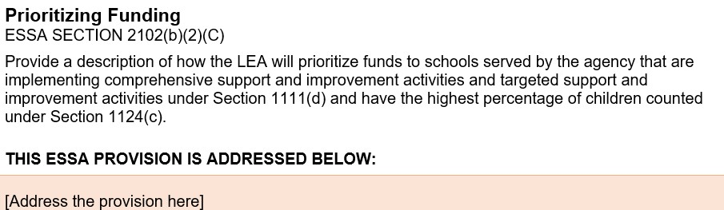
Federal Addendum Template (2)
Notes:
Here is a screenshot of the Federal Addendum for Title II Prioritizing Funding. This is the prompt on the LCAP Federal Addendum template.

Slide 18
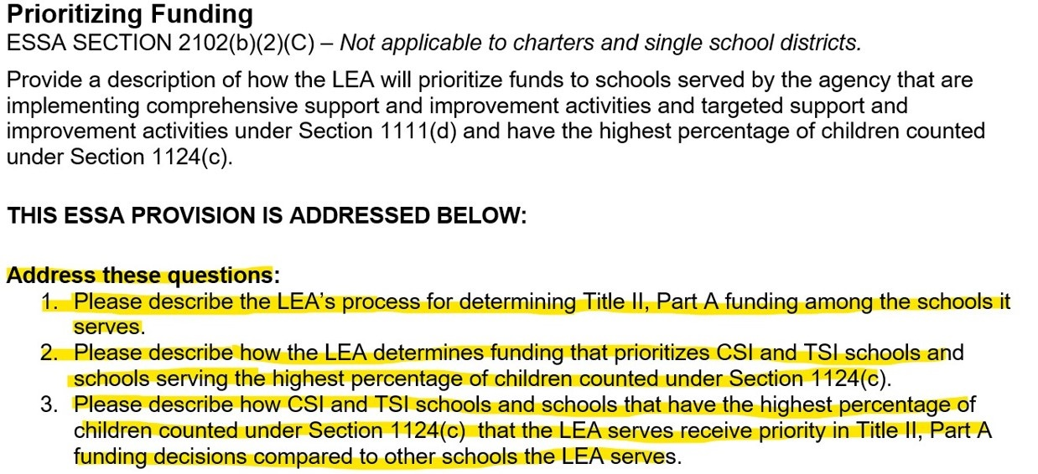
Federal Addendum Template (4)
Notes:
This is a screenshot of the LCAP Federal Addendum with the guiding questions that can be found in the Document tracking system version and the CMT box. The guiding question links are located on CDE web page https://www.cde.ca.gov/re/lc/addendumguidance.asp. If using the template downloaded from the CDE web page, please make sure to also address the guiding questions.

Slide 19

Federal Addendum Contacts
Title I, Part A: TitleI@cde.ca.gov
Title I, Part A, Educator Equity: TitleII@cde.ca.gov
Title II, Part A: TitleII@cde.ca.gov
Title III, Part A: LPLO@cde.ca.gov
Title IV: TitleIV@cde.ca.gov

Slide 20

Summary
Upload and certify your most current LCAP Federal Addendum into the CMT.
Upload and certify evidence pertaining to Title II implementation and monitoring.

Slide 21

Contacts and Resources
Tuesday @ 2 Webinar Series:
Hosted by the CDE Local Agency Systems Support Office with topics that range from California School Dashboard local indicator process, LCAP development, and annual updates. https://www.cde.ca.gov/fg/aa/lc/tuesdaysat2.asp
Title II web page: https://www.cde.ca.gov/ci/pl/title2parta.asp
Title II Email: TitleII@cde.ca.gov
If you are not already on our listserv, please take a moment and send a blank email to join-Title-II@mlist.cde.ca.gov

