Slide 1
Title II, Part A
Supporting Effective Instruction
Federal Program monitoring
September 2025
[Slide notes are used throughout this PowerPoint.]
Notes:
Thank you for attending today’s training. We know you are very busy with the start of a new school year. Thank you for taking the time to be here. My name is Jill Johnson, and I’m here with Terri Battenburg. We are Education Programs Consultants/Title II reviewers.

Slide 2
Title II Purpose
Increasing student achievement consistent with the challenging state academic standards.
Improving the quality and effectiveness of teachers, principals, and other school leaders.
Increasing the number of teachers, principals, and other school leaders who are effective in improving student academic achievement in schools.
Providing to effective teachers, principals, and other school leaders. low-income and minority students greater access.
20 United States Code (U.S.C.) Section 6601
Notes:
The purpose of Title II:
Increasing student achievement consistent with the challenging state academic standards
Improving the quality and effectiveness of teachers, principals, and other school leaders
Increasing the number of teachers, principals, and other school leaders who are effective in improving student academic achievement in schools
Providing low-income and minority students greater access to effective teachers, principals, and other school leaders
There is a misconception that Title II, Part A means professional development (PD). Title II is not just Professional Development; not all Professional Development is supported by Title II.
​

Slide 3
Agenda
Resources
Funding Evidence
Involvement and Governance and Administration Evidence
Staffing and Professional Growth

Slide 4

Resources

Slide 5

Program Review Tools
California Monitoring Tool (CMT) is a web-based system that allows local education agencies (LEAs) to facilitate a response to state and federal requirements for program monitoring.
LEAs use the CMT to:
Upload the documents of evidence to demonstrate compliance.
Communicate with the FPM Team Lead and Program Reviewer.
Notes:
Another tool that will be used during a FPM is the California Monitoring Tool (CMT). CMT is a web-based system that allows local education agencies (LEAs) to facilitate a response to state and federal requirements for program monitoring.
LEAs use the CMT to:
Upload the documents of evidence to demonstrate compliance.
Communicate with the FPM Team Lead and Program Reviewer. Please note the CMT does not send you an email message informing you when a comment is posted.

Slide 6
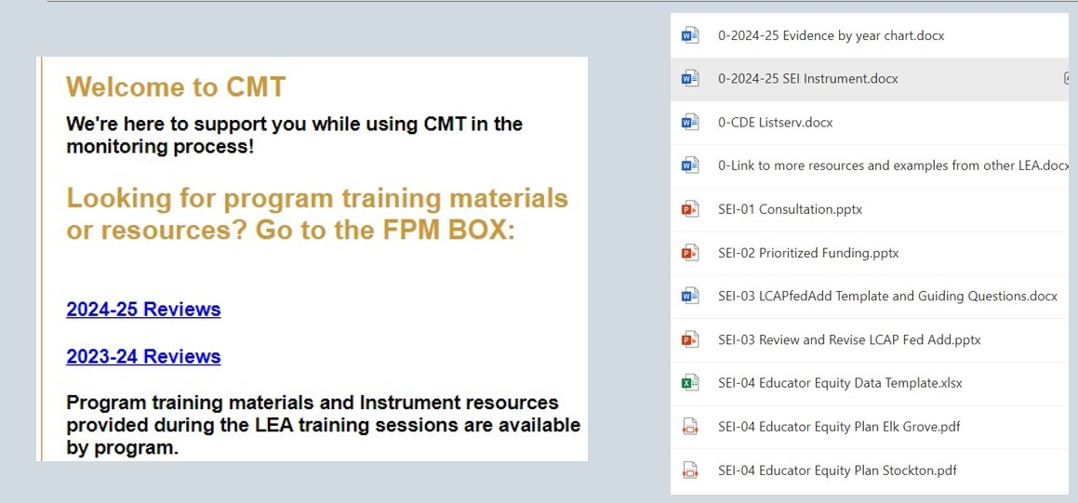
Federal Program Monitoring Box
Image text: Appendix 1
Notes:
When you login in the CMT you will see a welcome message to the right and below that you will find links to the FPM Box or CMT Box – we use the terms interchangeably. In the box you will find resources provided from the Title II team. The PowerPoint presentations from our website for each SEI item are uploaded along with this presentation. We also have other tools for each SEI item that may not be posted to our website such as examples from other LEAs.
Text description is on Appendix 1.

Slide 7
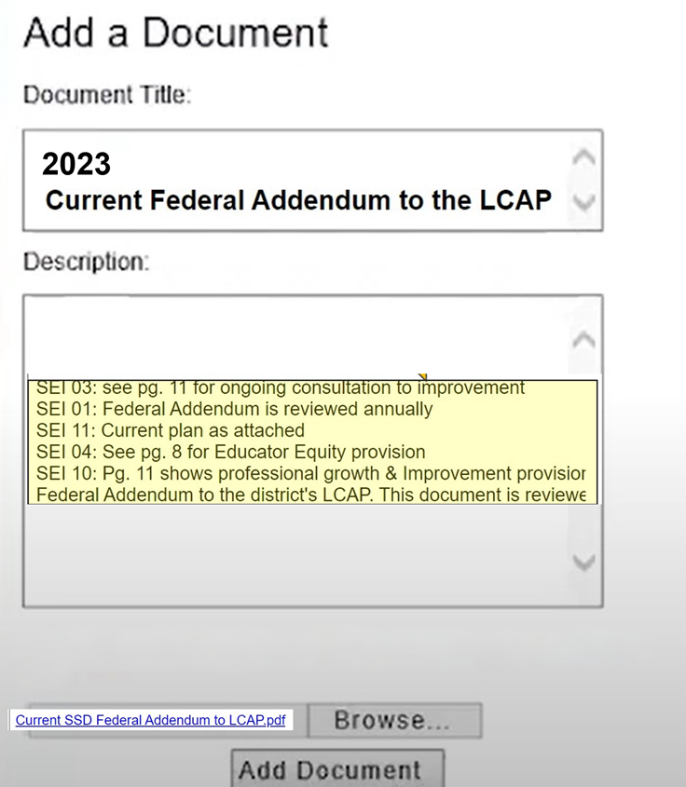
California Department of Education Monitoring Tool (1)
Documents only need to be uploaded once, even if they are for other items.
Best Practices:
Include the year in the document title.
Include the Instrument and item number in the document title.
Provide a detailed description.
Image text: Appendix 2
Notes:
Before we go further let's look at how the evidence is submitted into the CMT.
If you have uploaded the Local Control and Accountability Plan (LCAP) under LEA Level Planning Documents, then you don’t need to continue to upload the LCAP for each related SEI item as they are all linked.

Slide 8
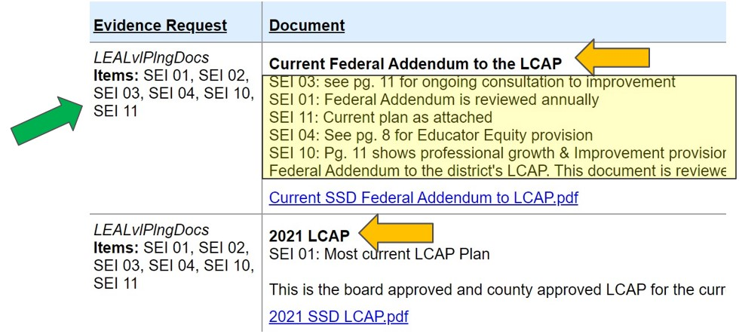
California Department of Education Monitoring Tool (2)
Image text: Appendix 3
Notes:
Here is an example from an LEA.
The green arrow indicates how the document is automatically linked to other items for SEI.
The orange arrows highlight the document title which should include the year.
The yellow box includes a good example of the document description with page numbers noted.

Slide 9
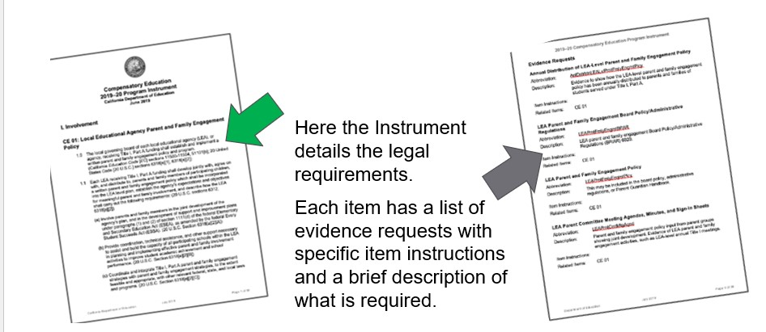
Instrument Details
Image text: Appendix 4
Notes:
The instrument is your guide through an FPM review. Each item will include a description of the law as indicated by the green arrow. The grey arrow on the right shows the evidence request with a description of what documentation needs to be provided. This information is also incorporated into the CMT.
I’d recommend printing this document for each of the programs you are being reviewed by. You’ll notice some of the evidence request items are used for multiple items through the SEI instrument and sometimes used for other programs too.

Slide 10
SEI Instrument Items Presentations (1)
SEI 01: Consultation and Staff Development https://www.cde.ca.gov/ci/pl/documents/sei01fpmpresentation.pptx
SEI 02: Comprehensive Support and Targeted Support Prioritization https://www.cde.ca.gov/ci/pl/documents/sei02fpmpresentation.pptx
SEI 03: Review and Revise the LCAP Federal addendum https://www.cde.ca.gov/ci/pl/documents/sei03fpmpresentation.pptx
SEI 04: Identify and Address Disparities https://www.cde.ca.gov/ci/pl/documents/sei04fpmpresentation.pptx
Notes:
We have 11 items in the SEI Instrument and each of items may have multiple pieces of evidence to show compliance. And many of the items may be used for multiple items such as the LCAP. We will go over the individual evidence request next.
SEI 01: Consultation and Staff Development https://www.cde.ca.gov/ci/pl/documents/sei01fpmpresentation.pptx
SEI 02: Comprehensive Support and Targeted Support Prioritization https://www.cde.ca.gov/ci/pl/documents/sei02fpmpresentation.pptx
SEI 03: Review and Revise the LCAP Federal addendum https://www.cde.ca.gov/ci/pl/documents/sei03fpmpresentation.pptx
SEI 04: Identify and Address Disparities https://www.cde.ca.gov/ci/pl/documents/sei04fpmpresentation.pptx

Slide 11
SEI Instrument Items Presentations (2)
SEI 05: Alignment, Academic Standards, and Professional Development Coordination https://www.cde.ca.gov/ci/pl/documents/sei05fpmpresentation.pptx
SEI 06: Use of Funds https://www.cde.ca.gov/ci/pl/documents/sei0607fpmpresentation.pptx
SEI 07: Supplement, Not Supplant
SEI 08: Equitable Services https://www.cde.ca.gov/ci/pl/documents/sei08fpmpresentation.pptx
Notes:
SEI 05: Alignment, Academic Standards, and Professional Development Coordination https://www.cde.ca.gov/ci/pl/documents/sei05fpmpresentation.pptx
SEI 06: Use of Funds https://www.cde.ca.gov/ci/pl/documents/sei0607fpmpresentation.pptx
SEI 07: Supplement, Not Supplant (part of SEI 06 – Use of Funds)
SEI 08: Equitable Services https://www.cde.ca.gov/ci/pl/documents/sei08fpmpresentation.pptx

Slide 12
SEI Instrument Items Presentations (3)
SEI 09: Certification and Licensure https://www.cde.ca.gov/ci/pl/documents/sei09fpmpresentation.pptx
SEI 10: Professional Growth and Improvement https://www.cde.ca.gov/ci/pl/documents/sei10fpmpresentation.pptx
SEI 11: Families Right to Know Teacher Qualifications https://www.cde.ca.gov/ci/pl/documents/sei11parttwofpm.pptx
and https://www.cde.ca.gov/ci/pl/documents/sei11parentsrightfpm.pptx
Notes:
SEI 09: Certification and Licensure https://www.cde.ca.gov/ci/pl/documents/sei09fpmpresentation.pptx
SEI 10: Professional Growth and Improvement https://www.cde.ca.gov/ci/pl/documents/sei10fpmpresentation.pptx
SEI 11: SEI 11: Four-Week Letter FPM Presentation https://www.cde.ca.gov/ci/pl/documents/sei11parttwofpm.pptx
and SEI 11: Parents' Right to Request FPM Presentation https://www.cde.ca.gov/ci/pl/documents/sei11parentsrightfpm.pptx

Slide 13

Web Page Resources
Title II Webpage
Short PowerPoint for each Supporting Effective Instruction (SEI) item that includes requirements for each item, examples of evidence when applicable, and best practices.
Resources for each item are organized by SEI instrument number.
https://www.cde.ca.gov/ci/pl/title2parta.asp
Notes:
We have a wealth of resources on our Title II page to help with a FPM. Let’s look at the webpage briefly. https://www.cde.ca.gov/ci/pl/title2parta.asp (Navigate to webpage). Each item on our webpage has a short PowerPoint presentation that reviews the legal requirement, evidence to meet the requirement, best practices, and common questions.

Slide 14
Frequency of Findings 2021–25
Top 3 SEI Findings
Use of Funds
Four-Week Letter
Educator Equity
*Use of funds includes supplement, not supplant.
Image text: Appendix 5
Notes:
The top three SEI findings from the 2021 to 2025 are:
Use of Funds, which also includes the supplement not supplant provision
Four-Week Letter – Parental Notification of Teacher Qualifications
Educator Equity – Identify and Address Disparities
The chart reflects the percentage of findings for the past four review cycles.

Slide 15
Fiscal Evidence
SEI 06 Use of Funds & SEI 07 Supplement, Not Supplant
General Ledger
Invoices
Payroll Records
Position Control
Duty Statements
Time and Effort Records
Budget
Chart of Accounts
Notes:
Fiscal Evidence consist of a Title II budget for the current year, a list of your chart of accounts, general ledgers for prior and current year, payroll records for prior and current years, position control for prior and current year, along with duty statements for individuals paid from title II and their corresponding time and effort records.

Slide 16
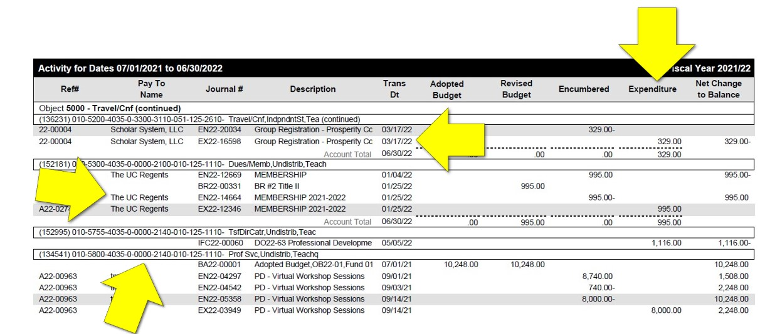
General Ledger Example
Image text: Appendix 6
Notes:
Here is an example of a detailed general ledger from an LEA. The general ledger includes the object codes, dates, vendors, and amounts which are highlighted with the arrows. After we receive the general ledgers, reviewers will select a sample of items to review further. The backup documentation will be uploaded under invoices.

Slide 17
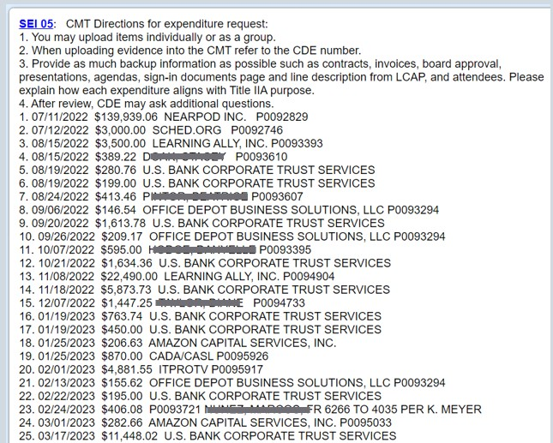
Reviewer Expenditure Sample in the California Department of Education Monitoring Toolbox
Image text: Appendix 7
Notes:
Here is an example of what your SEI Reviewer’s expenditure sample post will look like in the CMT comments. Please note that each expenditure sample has a CDE reference number to be used as backup documentation is submitted to the CMT or if providing a CMT comment about expenditures.

Slide 18
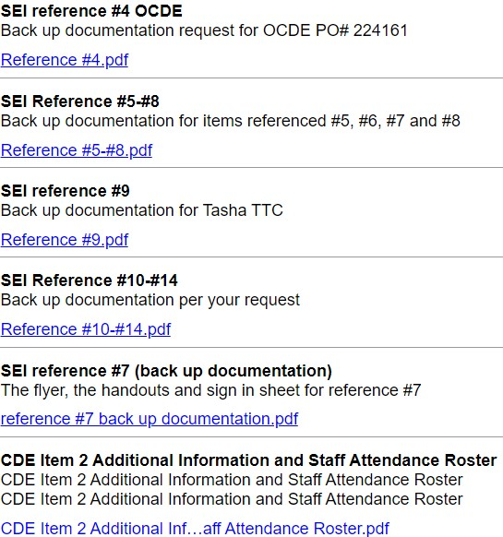
Invoices
Image text: Appendix 8
Notes:
Here is an example from an LEA uploading backup documentation into the CMT. You’ll notice that the LEA can upload items individually and use the CDE reference number such as the SEI Reference # 4. The LEA can also upload items into the CMT by grouping the backup documentation such as SEI Reference #5 - #8. When communicating in the CMT please use the CDE reference number.

Slide 19
Invoices: Expenditure Sample Backup Documentation Example (1)
US Bank statement
Purchase order
Receipt from hotel
Training agenda and proof of attendance
Training/conference request
Notes:
Here is an example of the US Bank expenditure pulled as a sample from the general ledger. The LEA provides the US Bank statement accompanied by the purchase order for the goods and/or services. This example was a hotel registration for a training, so the detailed receipt from the hotel showed a zero balance. The training agenda and proof of attendance is provided, and the original training/conference request form. Note each LEA has its own policies and procedures so the evidence provided by each LEA may differ. The above is an example to highlight all the pieces of evidence we need when reviewing an expenditure.

Slide 20
Invoices: Expenditure Sample Backup Documentation Example (2)
Detailed Purchase Order
Board Agenda Item for approval
Detailed Consultant Contract
Invoices showing dates of service
Backup documents showing services provided
Notes:
Another example is for a professional service. When all the above is provided, we often don’t need to ask for further documentation. The detailed purchase order needs to include the vendor, amount, and dates of service. If the item needs local board approval, all the documentation provided to the board should be included. The detailed full consultant contract and the corresponding invoices from the vendor. And lastly, the agenda or additional backup documentation showing the services being provided.

Slide 21
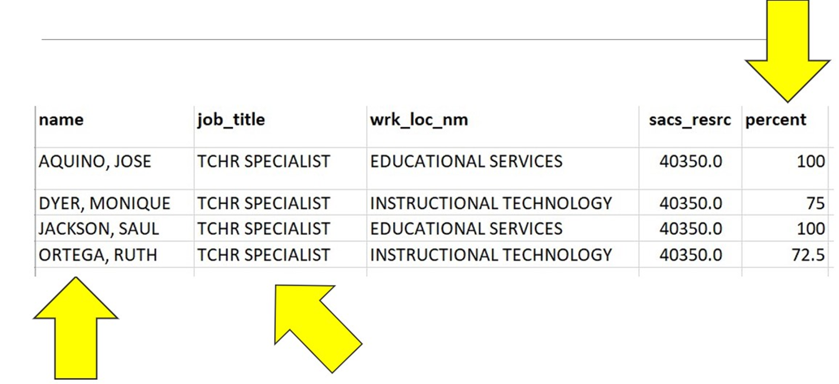
Position Control Report Example
Image text: Appendix 9
Notes:
Here is an example position control report. Here you can see the report lists the staff members who are fully or partially paid from Title II along with their job title and the percentage of salary charged to the program. Once a position control report is submitted and reviewed, the reviewer will select a sample of Title II employees. For this sample, the duty statement and time and effort records will be requested. Interviews may also be scheduled.

Slide 22
Duty Statement
Duty Statement is a personnel management tool that describes the main purpose of a position, the tasks that are performed, and how they are performed.
Specific to a position and individual person.
Different from a job description which is a generalized description for a category of position such as teacher, coach, principal.
Notes:
Duty Statement is a personnel management tool that describes the main purpose of a position, the tasks that are performed, and how they are performed
Specific to a position and individual person
Different from a job description which is a generalized description for a category of position such as teacher, coach, principal

Slide 23
Job Description vs Duty Statement
Job Description Example
Assist with the planning, development and implementation of professional learning activities as assigned; prepare and deliver oral presentations, prepare, develop and provide related professional learning activities, including coaching, and support materials.
Duty Statement Example
Create and facilitate professional development (PD) focused on kindergarten through grade three early literacy instructional strategies.
Model Lessons
Observe, debrief and coach kindergarten through grade three on early literacy instructional strategies.
Notes:
The difference here is the duty statement is specific to the position. The duty statement list the actual duties the individual is involved in whereas the job description is vague and over arching.
Pull up https://hr.fcoe.org/sites/hr.fcoe.org/files/Content%20Specialist%20I.pdf to show the vague duties. Great job description but not applicable as a duty statement

Slide 24
Types of Records
Semi-Annual Certification
Employee with 100% of time on one federal grant.
Employee worked 100% on a single cost objective.
Personnel Activity Report (PAR)* or similar
Employee with time on more than one federal grant or federal and non-federal funds.
*These forms of time and effort are commonly used and have historically met federal requirements as described in this presentation and in CSAM Section 905. Other forms of documentation may be acceptable.
Notes:
While the Personnel Activity Report (PAR) is not legally required during this presentation we will use the term PAR when referencing time and effort.

Slide 25
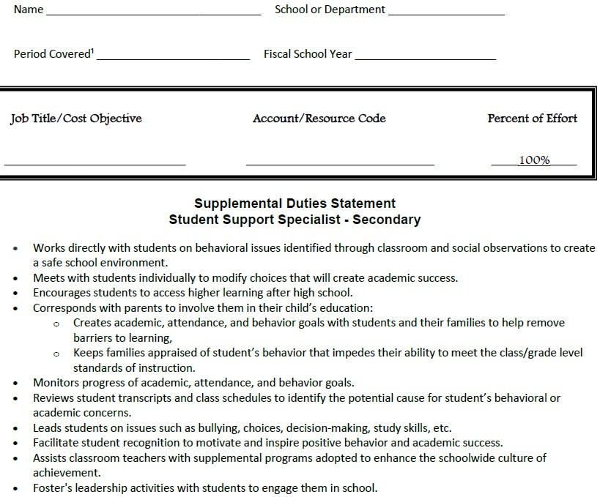
Semi-Annual Certification Example
Image text: Appendix 10
Notes:
Quality example of a semi-annual certification

Slide 26
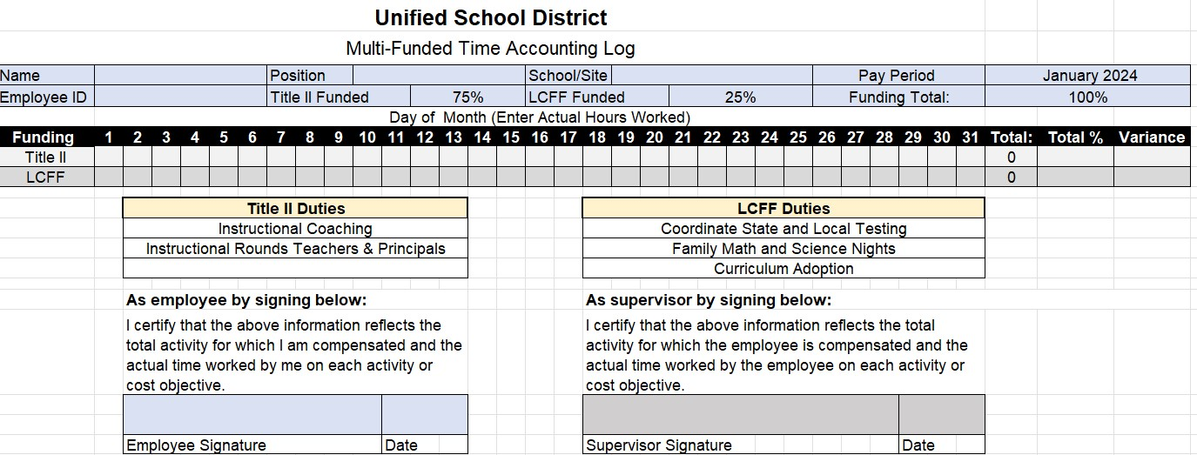
PAR Example (1)
Image text: Appendix 11

Slide 27
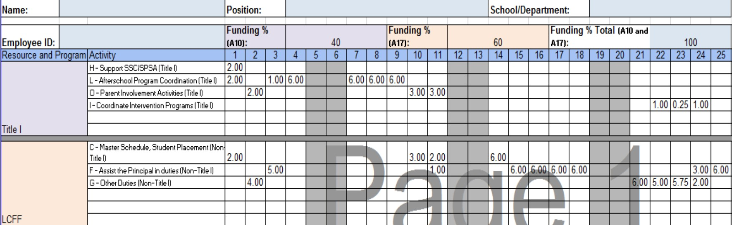
PAR Example (2)
Image text: Appendix 12

Slide 28

Title II Budget
LEAs must have a budget for Title II to ensure compliance with federal regulations and proper financial management. 2 Code of Federal Regulations (CFR) 200.302
Budgets must be detailed enough to demonstrate compliance with federal costs principals. 2 CFR 200.403
Budgets do not need to be sent to the California Department of Education (CDE) for approval and the LEA may use their own template.
Notes:
LEAs must have a budget for Title II to ensure compliance with federal regulations and proper financial management. 2 CFR 200.302
Budgets must be detailed enough to demonstrate compliance with federal costs principals 2 CFR 200.403. Budgets do not need to be sent to the CDE for approval the LEA may use their own template. If the LEA includes their Title II funds in their LCAP and meets the requirements of CFR 200.402 and 403 that may suffice. However, if you don’t have a specific Title II budget, don’t worry, we work with you to create one that meets federal requirements.

Slide 29
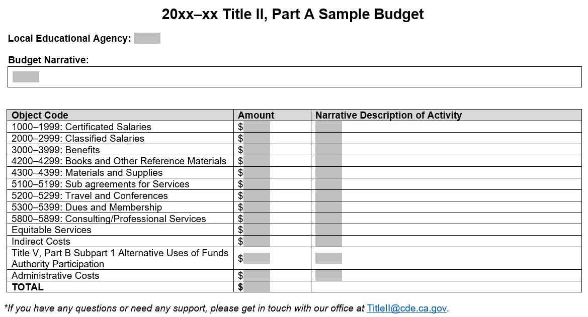
Budget Example (1)
Image text: Appendix 13
Notes:
Here is a simple template on the Title II webpage that LEAs may use. The link will be in the chat: Title II, Part A Budget Sample(DOCX) https://www.cde.ca.gov/ci/pl/documents/titleiisamplebudget.docx
This is just a resource; while the LEA must have a Title II budget they don’t have to use this template.
Slide Description:
The picture shows a Title II Budget Template Sample. There is a section to input Local Educational Agency Name, and Budget Narrative. Below this there is a table with three columns for Object Code, Amount, and Narrative Description of Activity.
1000–1999: Certificated Salaries; input field for Amount; input field for Description
2000–2999: Classified Salaries; input field for Amount; input field for Description
3000–3999: Benefits; input field for Amount; input field for Description
4200–4299: Books and Other Reference Materials; input field for Amount; input field for Description
4300–4399: Materials and Supplies; input field for Amount; input field for Description
5100–5199: Sub agreements for Services; input field for Amount; input field for Description
5200–5299: Travel and Conferences; input field for Amount; input field for Description
5300–5399: Dues and Membership; input field for Amount; input field for Description
5800–5899: Consulting/Professional Services; input field for Amount; input field for Description
Equitable Services; input field for Amount; input field for Description
Indirect Costs, input field for Amount; input field for Description
Title V, Part B Subpart 1 Alternative Uses of Funds Authority Participation; input field for Amount, input field for Description
Administrative Costs, input field for Amount; input field for Description
TOTAL; input field for Total

Slide 30
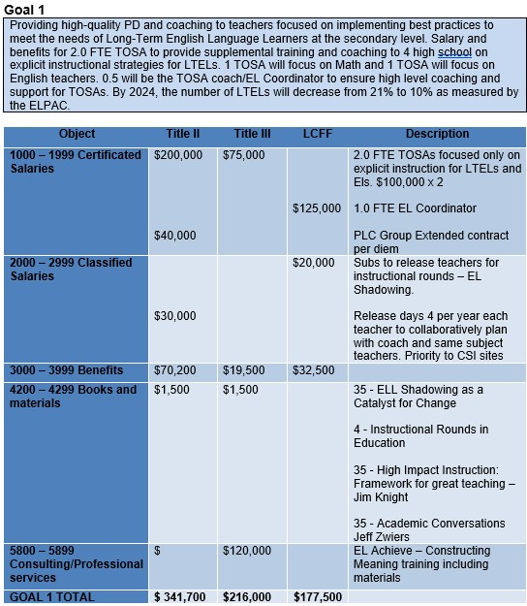
Budget Example (2)
Image text: Appendix 14
Notes:
Here is an example from and LEA who used the template and also added their goal and how they are going to measure the effectiveness. https://docs.google.com/document/d/1EbAZNUqMPJLb519tNV1pdlR_qurwZ0S7/edit?usp=drive_link&ouid=116660182617490186166&rtpof=true&sd=true
The template from this LEA can be found here: https://docs.google.com/document/d/1CG11mNJpm61n_vR7XZFqmzpvkbTmOcm6/edit?usp=drive_link&ouid=116660182617490186166&rtpof=true&sd=true and we will put this info in the chat
Please use a template and or format that works best for your LEA.
Slide Description:
Example Budget 1 Providing high-quality PD and coaching to teachers focused on implementing best practices to meet the needs of Long-Term English Language Learners at the secondary level. Salary and benefits for 2.0 FTE TOSA to provide supplemental training and coaching to 4 high school on explicit instructional strategies for LTELs. 1 TOSA will focus on Math and 1 TOSA will focus on English teachers. 0.5 will be the TOSA coach/EL Coordinator to ensure high level coaching and support for TOSAs. By 2024, the number of LTELs will decrease from 21% to 10% as measured by the ELPAC.

Slide 31
Equitable Services

Slide 32
Equitable Services Evidence
Item​ | Item Description​
Intent to Participate | Dated communication to private schools regarding eligibility for Title I, Title II, or Title III services
Consultation with Private Schools | Documents that show how the LEA consulted with private schools regarding participation in federal programs
Private School Affirmation | A written document signed and dated by private school officials that the required consultation has occurred
Notes:
Terri
Evidence Requests for private schools that receive equitable services.
Intent to Participate: Dated communication to private schools regarding eligibility for Title I, Title II, or Title III services. The notice of eligibility and intent letter/form is often one document.
Consultation with Private Schools: Documents that show how the LEA consulted with private schools regarding participation in federal programs
Private School Affirmation: A written document signed and dated by private school officials that the required consultation has occurred
The general ledger for resource code 4035 as submitted for SEI 06 Use of Funds and SEI 07 Supplement, Not Supplant will also be reviewed. Private School equitable service expenditures may be part of the SEI reviewer’s Title II expenditure sample requiring backup documentation evidence. Please view the SEI 06 and SEI 07 presentations for more information about expenditure backup documentation.

Slide 33
Intent to Participate Best Practices
Send intent letter to eligible private schools no later than spring before the next fiscal year begins; (February – April)
Provide a deadline that includes adequate time for private school response (i.e., Please respond by XX);
Identify potential consequences for not meeting the deadline (i.e., unable to participate in equitable services in the upcoming year);
Send reminders of the response deadline; and
Maintain records of attempts to communicate with the private school.
Notes:
Terri
Notice of Eligibility/Intent to Participate Best Practices
The LEA should:
send the eligibility/intent letter to eligible private schools no later than spring before the next fiscal year begins (February – April). Note: When sending., intent form later than April may cause a delay in services.
provide a deadline that includes adequate time for private school response (i.e., Please respond by XX)
identify potential consequences for not meeting the deadline (i.e. unable to participate in equitable services for the following year);
send reminders of the response deadline, and (note a good faith effort would be at lest two attempts)
maintain records of all attempts to communicate with the private school (if records are kept in someone's email this may be unavailable if that person is no longer at the LEA. Create a system of internal controls where these documents are saved on a common drive or print) See Padlet for example https://docs.google.com/spreadsheets/d/1-gR9KaZTrOixGiqJq7-EBcpyvQBrwpTXqjT8L0pkJlE/copy
Even if a private school has not responded in the past, the LEA must be able to demonstrate that it made a good faith effort to contact all private schools within the LEA boundaries. Document your due diligence. You may send a registered letter with receipt required, follow up with a phone call, or send a follow up email. The LEA should attempt to acquire documentation from the private school that they are not interested in participating.

Slide 34
Consultation with Private School Evidence during an FPM
Documents that show how the LEA consulted with private schools regarding participation in federal programs.
Examples include public notices, letters, agendas, sign-in sheets, meeting minutes, emails, equitable service, equitable service allocation, email plan or affirmation of consultation with appropriate private school officials.
Notes:
Terri
Consultation with Private School Evidence Request
Description: Documents that show how the LEA consulted with private schools regarding participation in federal programs. Examples include public notices, letters, agendas, sign-in sheets, meeting minutes, emails, or affirmation of consultation with appropriate private school officials.
Item Instructions: Submit evidence of private school consultation that include private school equitable service plan, agendas, minutes, presentations, equitable service allocation, emails, and other consultation communication.
Please note that LEAs are responsible for documenting the justification of equitable service expenses charged to Title II that aligns with the plan to best meet the identified needs of private school students and staff.
SAMPLE CONSULTATION TIMELINE:
https://www.cde.ca.gov/sp/ps/caprivtimeline.asp
Consultation should begin as early as necessary for the district and private schools to consult for the delivery of agreed upon services at the beginning of the school year.

Slide 35
Consultation Best Practices
Engaged in timely consultation, allowing for meaningful discussion between the LEA and private school officials regarding services and other benefits;
Identified the needs of private school students, teachers, and families;
Allocated a per-pupil amount of funds for services to eligible private school staff;
Evaluated programs and services for effectiveness; and
Adequately addressed problems and formal complaints raised by private school officials.
Notes:
Terri
As a best practice, the LEA should keep documentation of the entire equitable services process with each private school:
Evidence should document that the LEA:
• Engaged in timely consultation, allowing for meaningful discussion between the LEA and appropriate private school officials regarding services and other benefits;
• Identified the needs of private school students, teachers, and families;
• Allocated a per-pupil amount of funds for services to eligible private school staff;
• Evaluated programs and services for effectiveness; and
• Adequately addressed problems and formal complaints raised by private school officials

Slide 36
Private School Affirmation Evidence
A written document signed and dated by private school officials that the required consultation has occurred.
Affirmation should include the following language:
I agree that timely and meaningful consultation occurred before the LEA made any decision that affected the participation of eligible private school children, teachers, and/or other educational personnel.
I do not agree that timely and meaningful consultation occurred before the LEA made any decision that affected the participation of eligible private school children, teachers, and/or other educational personnel.
Notes:
Terri
Description: A written document signed and dated by private school officials that the required consultation has occurred.
Item Instructions: Submit the signed and dated Title II, Part A equitable services private school affirmation documents regarding consultation.
The affirmation form must be signed by the private school official after consultation occurred.
We often see missing affirmation options when on a FPM review. Pages 4-6 of the link pasted below provides an example.
https://www.cde.ca.gov/sp/sw/t1/documents/npsconsultationtemps.docx
The participating nonprofit private school official/s believe that (select all that apply):
[Check if applicable] Timely and meaningful consultation has occurred before the LEA made any decision that affected the participation of eligible private school children, teachers, and families in the listed federal title programs.
[Check if applicable] Timely and meaningful consultation has NOT occurred.
[Check if applicable] The program design is NOT equitable with respect to eligible private school children.
Public School Official and Date:
[Enter Public School Official and Date]
School District:
[Enter School District]
Nonprofit Private School Representative and Date:
[Enter Nonprofit Private School Representative and Date]
Name of Nonprofit Private School:
[Enter Name of Nonprofit Private School]
The LEA must maintain a copy of this form in its records and provide a copy to the state educational agency.

Slide 37

Professional Development Evidence
Educational Partner Feedback
LEA Level Planning Documents
LEA Level Planning Implementation and Monitoring Documents
Local Control Accountability Plan (LCAP)
LCAP Federal Addendum
PD Planning Documents
PD Records

Slide 38
Educational Partner Evidence
Survey
Administrators, teachers, and paraprofessionals
All sites districtwide
Survey and data uploaded
Leadership Meeting
Agenda indicating members present
Review survey data
Review student academic data
PD Plan
Based on the survey, data, and leadership meeting
Plan created
Short- and long-term goals
Notes:
Here is an example of items uploaded for Educational Partner Feedback:
Survey provided to education partners focused on their professional learning needs. Feedback on the effectiveness of the current year’s professional development plan. The LEA provided the survey and the data.
Leadership meeting was provided as part of the upload. The goal of the leadership meeting was to review the feedback from the survey and professional development and determine the next steps for future professional development.
Finally the professional development plan that was drafted as a result of the educational feedback.
The evidence here is all connected and can show evidence the LEA collaborated with educational partners.

Slide 39
List of Educational Partners
Educational Partners Required for Consultation | Best Practices/Suggestions
Teachers | Elementary school, middle school, high school, alternative, charter, teacher leaders, and special education.
Principals and Assistant Principals | Elementary school, middle school, high school, alternative, and charter.
Paraprofessionals | Elementary school, middle school, high school, regular and special education
Families | Elementary school, middle school, high school, alternative, educational rights holders (foster youth), caregivers
Notes:
Here is a list of required educational partners
Teachers: Elementary school, middle school, high school, alternative, charter, teacher leaders, and special education.
Principals and Assistant Principals: Elementary school, middle school, high school, alternative, and charter.
Paraprofessionals: Elementary school, middle school, high school, regular and special education
Families: Elementary school, middle school, high school, alternative, educational rights holders (foster youth), caregivers

Slide 40
Professional Development Records Example (1)
Cover Page
Balanced Literacy PD
Agenda
Sign in
Presentation Slides
Handouts
Exit Ticket
Data from Exit Tickets
This LEA created a cover page indicating the set of documents uploaded in this one upload.
Upload was about 20 pages.
One of three sets for professional develop records provided.
Every LEA is unique and this may not reflect your process.
Notes:
SEI 05: Professional Development Records
Cover Page
Balanced Literacy PD
Agenda
Sign in
Presentation Slides
Handouts
Exit Ticket for participants
Data from Exit Tickets
This LEA created a cover page indicating the set of documents uploaded in this one upload
Upload was about 20 pages
One of 3 sets for professional develop provided
Every LEA is unique and this may not reflect your process

Slide 41
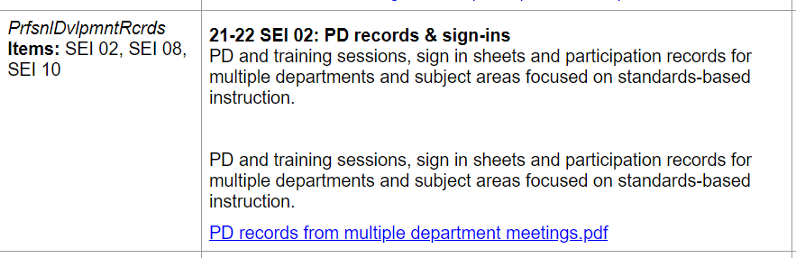
Professional Development Records Example (2)
Multiple PD sessions submitted as one document that demonstrates alignment with state academic standards.
Image text: Appendix 15
Notes:
This is an example of a PD record that was submitted in the CMT as one document that includes many pages, but an LEA may also submit pieces individually. What is important is that all the evidence requests for this item combined demonstrates coordination with other strategies, program and activities and the alignment with state academic standards.

Slide 42
Staffing Evidence
Educator Equity data
Four Week Letter
Paraprofessional Staff Authorizations
Parents Right to Request Information on Teacher Qualification
School Accountability Report Card
Staff Credentials

Slide 43
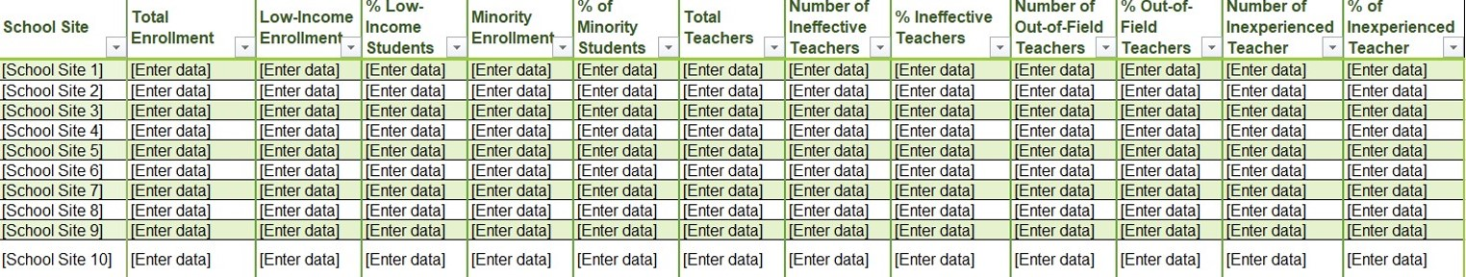
Educator Equity Data
Educator Equity Data Tables can be found on the CDE Step 2: Equity Data Collection and Analysis Tools web page at https://www.cde.ca.gov/ci/pl/documents/edequitydata.xlsx
Image text: Appendix 16
Notes:
Educator Equity Data Tables can be found on our web page.
Janet will put the link to the web page in the chat. The data tables will also be found in the CMT box.
When you use the CDE template, we also have a tab that includes the definitions for each of the categories such as ineffective, out-of-field, inexperienced, and minority.
Most of the findings for SEI 04 result from the LEA not gathering and analyzing the data yearly.
We encourage LEAs to contact our office for support.
Educator Equity Data Tables can be found on the CDE Step 2: Equity Data Collection and Analysis Tools web page at https://www.cde.ca.gov/ci/pl/documents/edequitydata.xlsx

Slide 44

Educator Equity Question
Question: What is the definition of a disparity? At what point do we need to create an Educator Equity Plan?
Answer: The Every Student Succeeds Act (ESSA) does not define when a disparity exists. However, the CDE is working to support LEAs in this process. When looking at the data, answer the question – are low-income or minority students taught at a higher rate by ineffective, inexperienced, or out-of-field teachers?
Notes:
Regarding the Educator Equity Plan, we received a few common questions that we will address here.
Question: What is the definition of a disparity? At what point do we need to create an Educator Equity Plan?
Answer: The ESSA does not define when a disparity exists. However, the California Department of Education is working to support LEAs in this process. When looking at the data, answer the question – are low-income or minority students taught at a higher rate by ineffective, inexperienced, or out-of-field teachers?

Slide 45
Example of Disparity
Definition
The difference between the rate at which low-income or minority students are taught by effective, in-field, and experienced teachers, compared to their higher-income, non-minority counterparts.
Example
Twelve percent of teachers in an LEA’s highest-poverty school are inexperienced compared to two percent of teachers in the lowest-poverty schools. This LEA has an educator equity gap of ten percentage points.
Notes:
Definition of Disparity from ESSA
The difference between the rate at which low-income or minority students are taught by effective, in-field, and experienced teachers, compared to their higher-income, non-minority counterparts.
An example is 12 percent of teachers in an LEA’s highest-poverty school are inexperienced compared to 2 percent of teachers in the lowest-poverty schools. This LEA has an equity gap of 10 percentage points.

Slide 46
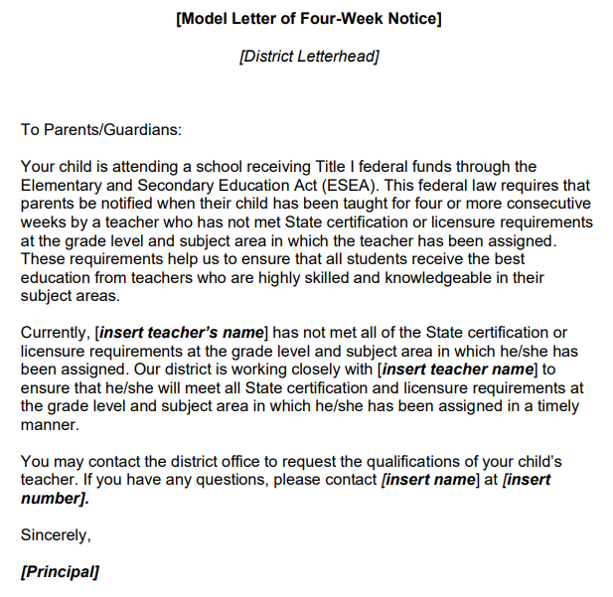
Four-Week Letter Template
Image text: Appendix 17
Notes:
You will notice that the letter specifically addresses components of the statute. LEAs may determine if they would like to have families contact the school site or the district office and insert that information into the letter. This is a local decision the LEA can make based on their needs. Some LEAs have families contact the district’s human resource department or credential analyst to elevate the burden from the site principal and to ensure that appropriate.
Please note that the teacher’s name must be included in the letter.
Information regarding the 4-week letter template can be found on the CDE Title II web page at https://www.cde.ca.gov/pd/ee/documents/modlet4weeknotieng.doc Information regarding the translated 4-week letter template can be found on the CDE Title II web page at http://inet2.cde.ca.gov/cmd/translatedparentaldoc.aspx?docid=3815,3822,3858,3829,3833,3849,3863,3855,3861,3871,3875,10075,10076,3837,3866,3853

Slide 47
Four-Week Letter Evidence
Evidence Requests:
Submit evidence of the four-week letter template.
Submit the credential monitoring process for the four-week letter, including the waiver(s), permit(s), and authorization(s) that determine the need for a four-week letter.
Submit evidence that the four-week letter was distributed to families, if necessary. Redact student names or other identifiable student information.
Notes:
Evidence for the four-week letter includes:
Submit evidence of the four-week letter template.
Submit the credential monitoring process for the four-week letter, including the waiver(s), permit(s), and authorization(s) that determine the need for a four-week letter.
Submit evidence the four-week letter was distributed to families, if necessary. Redact student names or other identifiable student information.

Slide 48

Four-Week Letter Best Practices
An effective LEA plan clearly outlines the process to monitor teacher credentials and assignments and is shared with relevant departments and sites. The plan should include:
Identification of who or what position(s) is/are responsible for each component of the plan;
A list of the teacher equity definitions under ESSA and how they determine the need for the four-week letter;
How the letter is distributed to families; and
The timeline for plan implementation.
Notes:
Four Week Letter Best Practices
An effective LEA plan clearly outlines the process to monitor teacher credentials and assignments and is shared with relevant departments and sites. The plan should include:
Identification of who or what position(s) is/are responsible for each component of the plan;
A list of the teacher equity definitions under ESSA and how they determine the need for the four-week letter;
How the letter is distributed to families; and
The timeline for plan implementation.

Slide 49
Four-Week Letter Plan Example (1)
Task | Notes | Timeframe | Position Responsible
Update 4-Week Letter | Review CDE web page for changes and incorporate into letter | Before the first day of school year | Executive Assistant to Assistant Superintendent of Human Resources (HR)
Run report of teachers who are not fully credentialed | Use determination chart to identify teachers | Six weeks after school year begins | Credential Analyst
Notes:
Here is an example Four-Week Letter process.

Slide 50
Four-Week Letter Plan Example (2)
Task | Notes | Timeframe | Position Responsible
Communicate with sites about letters | Provide site principals with a list of teachers who trigger the letters. Send talking points to principals to share with teachers Share the above info with union | Six weeks after the school year begins | Executive Assistant to Assistant Superintendent of HR
Notes:
This is an example taken from an LEA. Here the LEA ensured the site principals were aware of the letters and sent them a copy of the letter. They also provided talking points to the teachers in case students or families contact them regarding the letter. The LEA also shared the information with the teachers union which is not required but is an action they embedded into their process.

Slide 51
Four-Week Letter Plan Example (3)
Task | Notes | Timeframe | Position Responsible
Send letters electronically | Run reports of emails that bounce back and send to sites. Sites to confirm email address or mail hard copy to family. | Six weeks after the school year begins | Credential Analyst and communications dept
Repeat process 2nd semester | Repeat process. | Six weeks into 2nd semester | Credential Analyst and Executive Director of HR
Notes:
You’ll notice that the process is repeated six weeks into the second semester. The law states that after four consecutive weeks, a best practice is to complete the process once during the first semester and once during the second. Letters do not need to be sent out again for the teachers however, any new teacher that is not properly credentialed to teach the grade level and subject they are assigned will need to have letters sent to families.

Slide 52
Staff Credentials Example (1)
Last Name | First Name | Site | Position | Assignment | Credential | Subject
Lapp | Josh | Hill High School | Teacher Grades Nine to Twelve (9–12) | Chemistry | Single Subject/ English Language Art 1 (ELA1) | Chemistry
Lapp | Josh | Hill High School | Teacher 9–12 | CLAD
Tige | Peggy | Hill High School | Teacher 9–12 | English 10 | Single Subject/ELA1 | English
Notes:
Here is an example of a sortable spreadsheet with staff credentials for a high school that could be uploaded into CMT as evidence. In this example the LEA has a teacher represented on multiple lines for each credential and/or authorization they hold when applicable.

Slide 53
Staff Credentials Example (2)
Last Name | First Name | Site | Position | Assignment | Credential | Subject
Heart | Beth | Bell Elementary School | Teacher -Elementary | Grade Four | Multiple Subject/ ELA1 | General Subject
Allen | Chad | Map Middle School | Teacher-Middle | Grade Seven English/Social Studies | Multiple Subject
Allen | Chad | Map Middle School | Teacher-Middle | Grade Seven English/Social Studies | SDAIE-SB 1969
Notes:
Here is another example of a sortable spreadsheet with staff credentials for an elementary and middle school that could be uploaded into CMT as evidence. In this example the LEA has a teacher represented on multiple lines for each credential and/or authorization they hold when applicable.

Slide 54
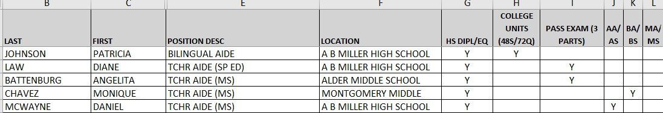
Example of Paraprofessional List
Image text: Appendix 18
Notes:
Here is an example list of paraprofessionals

Slide 55
Parents' Right to Request Teacher Qualifications Template (1)
Your child is attending a school receiving Title I federal funds through the ESEA. At the beginning of each school year, LEAs receiving Title I funds are required to notify parents whose student(s) attend a Title I school that they may request, and the agency will provide the parents on request (and in a timely manner), information regarding the professional qualifications of the student’s classroom teachers, including at a minimum:
Notes:
Your child is attending a school receiving Title I federal funds through the ESEA. At the beginning of each school year, LEAs receiving Title I funds are required to notify parents whose student(s) attend a Title I school that they may request, and the agency will provide the parents on request (and in a timely manner), information regarding the professional qualifications of the student’s classroom teachers, including at a minimum:

Slide 56
Parents' Right to Request Teacher Qualifications Template (2)
Whether the student’s teacher:
  Has met State qualification and licensing criteria for the grade levels and subject areas in which the teacher provides instruction;
  Is teaching under emergency or other provisional status through which State qualification or licensing criteria have been waived; and
  Is teaching in the field of discipline of the certification of the teacher.
Whether the child is provided services by paraprofessionals and, if so, their qualifications.
Notes:
Whether the student’s teacher:
Has met State qualification and licensing criteria for the grade levels and subject areas in which the teacher provides instruction;
Is teaching under emergency or other provisional status through which State qualification or licensing criteria have been waived; and
Is teaching in the field of discipline of the certification of the teacher.
Whether the child is provided services by paraprofessionals and, if so, their qualifications.

Slide 57
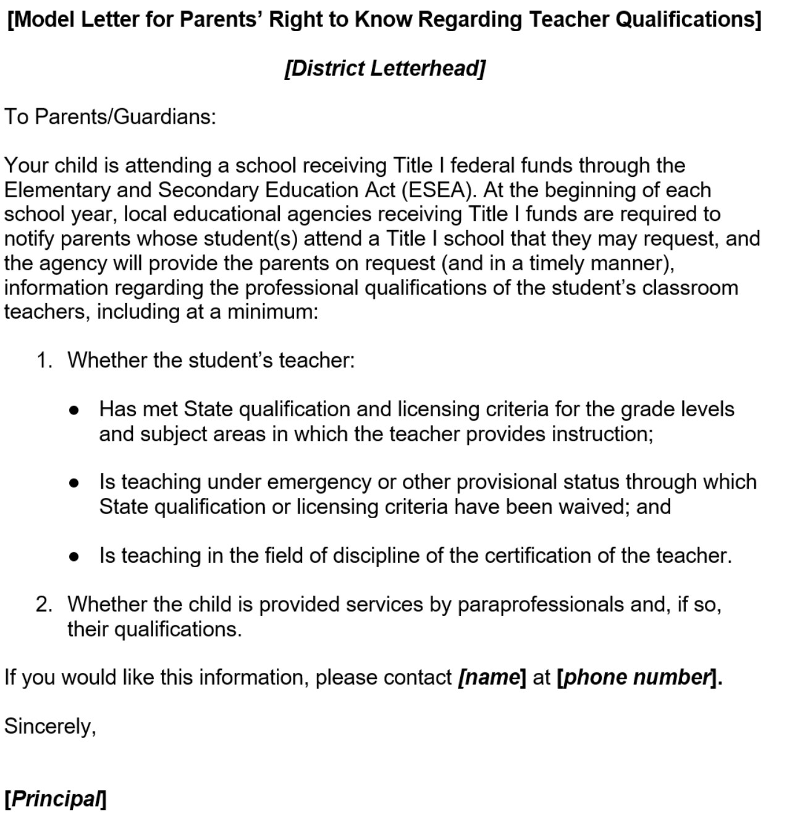
Parents’ Right to Know Letter Template
Image text: Appendix 19
Notes:
Here is the sample template for the Parents’ right-to-know notice. The template can be found on the CDEs web page located at https://www.cde.ca.gov/ls/pf/c12/documents/modltparsrtktqeng.doc. Translated versions can be found on CDEs web page located here: http://inet2.cde.ca.gov/cmd/translatedparentaldoc.aspx?docid=3789-3814,3825-3827,3839,3841,3842,3857,3859,3876,3879,3881-3886

Slide 58
Helpful Hints
The SEI Instrument is your guide.
Time and organization—It is never too early to start gathering and submitting evidence.
Use the FPM process as an opportunity to strengthen collaboration across LEA departments (instructional services, human resources, fiscal).
Contact the Title II office with questions and for support.
Notes:
As we scan the chat for more questions to answer, please keep in mind these helpful hints:
The SEI Instrument is your guide
Time and organization—It is never too early to start gathering and submitting evidence
Use the FPM process as an opportunity to collaborate across LEA departments (instructional services, human resources, fiscal)
Contact the Title II office with questions and for support

Slide 59
Reviewer Contact Information (1)
Jill Johnson | JJohnson@cde.ca.gov | 310-748-5794
Cajon Valley Union | Newman-Crows Landing | San Bruno Park Elem.
Ceres Unified | Oroville Union High | San Francisco Unified
Coalinga-Huron Unified | Palo Verde Unified | San Jacinto Unified
Escondido Union High | Perris Union High | San Jose Unified
Golden Plains Unified | Riverside Unified | Tracy Joint Unified
Hawthorne | Rowland Unified

Slide 60
Reviewer Contact Information (2)
Terri Battenburg | TBattenburg@cde.ca.gov | 916-322-5836
Central Union High | Oroville City Elementary | Roseville City Elem
Dinuba Unified | Parlier Unified | Salinas Union High
Edison Elementary | Pasadena Unified | Sylvan Union Elem
Fort Bragg Unified | Red Bluff Union Elementary | Tulare Joint Union High
Kernville Union Elementary | Riverdale Joint Unified
Madera Unified | Rocklin Unified

Slide 61
Reviewer Contact Information (3)
Lisa Fassett | Lfassett@cde.ca.gov
Calexico Unified | Tahoe-Truckee Unified
Soledad Unified | Salinas City Elementary

Slide 62
Contact and Resources
Title II web page: https://www.cde.ca.gov/pd/ti/
Title II Email: TitleII@cde.ca.gov
If you are not already on our listserv, please take a moment and send a blank email to join-Title-II@mlist.cde.ca.gov
Thank You!
Notes:
Thank you again for joining us today. We look forward to working with you during this review season and beyond.

Slide 63
Appendix 1
Screenshot of the Welcome to CMT web page.
Shows the links to the program training and instrument resources provided to LEAs during the training.
Screenshot of how the files will look in the CMT box.
Image slide: Federal Program Monitoring Box
Notes:
Slide 6

Slide 64
Appendix 2
Screenshot of the Add Document Window with fields to enter the Document Title, Description, Browse, and Add Document buttons
Image slide: California Department of Education Monitoring Tool (1)
Notes:
Slide 7

Slide 65
Appendix 3
A document uploaded into the California Department of Education Monitoring Tool. Three arrows point to important aspects of the tool:
  An arrow points to the Evidence Request. The text reads:
    LEALvlPlngDocs
    Items: SEI 01, SEI 02, SEI 03, SEI 04, SEI 10, SEI 11
An arrow points to the Document Title: Current Federal Addendum to the LCAP
An arrow points to a second Document Title: 2021 LCAP
Image slide: California Department of Education Monitoring Tool (2)
Notes:
Slide 8

Slide 66
Appendix 4
The image shows the components of the program instrument.
One arrow (green) is indicated where to find the legal statute.
The second arrow (gray) shows where the evidence request is located in the program instrument.
Image Slide: Instrument Details

Slide 67
Appendix 5
A bar chart displays the top three SEI findings from review years 2021–22 through 2024–25: Use of Funds, Four‑Week Letter, and Educator Equity. Use of Funds shows the highest percentage of findings across multiple years, peaking at around 40% in 2022–23. Four‑Week Letter findings range from roughly 22% to 29%. Educator Equity findings range from about 15% to 29%. The slide also notes that Use of Funds includes the Supplement, Not Supplant requirement.
Image slide: Frequency of Findings 2021–25

Slide 68
Appendix 6
A sample general ledger report showing multiple travel‑related expenditure entries for fiscal year 2021–22. The ledger includes columns for reference number, payee, journal number, description, transaction date, adopted budget, revised budget, encumbered amount, expenditure amount, and net change to balance. Several yellow arrows highlight key areas such as vendor names, object codes, dates, and expenditure amounts included in the reviewer sample
Image slide: General Ledger Example
Notes:
A sample general ledger report showing multiple travel‑related expenditure entries for fiscal year 2021–22. The ledger includes columns for reference number, payee, journal number, description, transaction date, adopted budget, revised budget, encumbered amount, expenditure amount, and net change to balance. Several yellow arrows highlight key areas such as vendor names, object codes, dates, and expenditure amounts included in the reviewer sample

Slide 69
Appendix 7
A screenshot of the California Department of Education Monitoring Tool showing a list of expenditure samples selected by the reviewer. The list includes numbered entries with dates, amounts, vendors such as U.S. Bank Corporate Trust Services, Amazon Capital Services, Office Depot, and others. Each line displays the date, dollar amount, vendor name, and reference number (e.g., P0093274). The heading indicates this is part of the CMT directions for expenditure requests, noting that LEAs may upload items individually or as a group and should refer to CDE numbers when uploading evidence.
Image slide: Reviewer Expenditure Sample in the California Department of Education Monitoring Toolbox
Notes:
A screenshot of the California Department of Education Monitoring Tool showing a list of expenditure samples selected by the reviewer. The list includes numbered entries with dates, amounts, vendors such as U.S. Bank Corporate Trust Services, Amazon Capital Services, Office Depot, and others. Each line displays the date, dollar amount, vendor name, and reference number (e.g., P0093274). The heading indicates this is part of the CMT directions for expenditure requests, noting that LEAs may upload items individually or as a group and should refer to CDE numbers when uploading evidence.

Slide 70
Appendix 8
Screenshot of the California Department of Education Monitoring Tool showing examples of how an LEA uploads backup documentation for expenditure samples. The list includes items labeled ‘SEI reference #4 OCDE,’ ‘SEI References #5–#8,’ and ‘SEI Reference #10–#14,’ each with links to corresponding PDF files. Additional entries include ‘SEI reference #7 (back up documentation)’ and ‘CDE Item 2 Additional Information and Staff Attendance Roster.’ The display shows multiple grouped and individual uploads used to provide supporting documentation for reviewer expenditure samples
Image slide: Invoices
Notes:
Screenshot of the California Department of Education Monitoring Tool showing examples of how an LEA uploads backup documentation for expenditure samples. The list includes items labeled ‘SEI reference #4 OCDE,’ ‘SEI References #5–#8,’ and ‘SEI Reference #10–#14,’ each with links to corresponding PDF files. Additional entries include ‘SEI reference #7 (back up documentation)’ and ‘CDE Item 2 Additional Information and Staff Attendance Roster.’ The display shows multiple grouped and individual uploads used to provide supporting documentation for reviewer expenditure samples

Slide 71
Appendix 9
Screenshot of a position control report listing staff members fully or partially paid with Title II funds. The report shows each employee’s name, job title, work location, and the percentage of their salary charged to Title II. The slide includes yellow arrows highlighting these data fields and notes that reviewers use this report to select sample employees for duty statements, time‑and‑effort records, and interviews.
Image slide: Position Control Report Example
Notes:
Screenshot of a position control report listing staff members fully or partially paid with Title II funds. The report shows each employee’s name, job title, work location, and the percentage of their salary charged to Title II. The slide includes arrows highlighting these data fields and notes that reviewers use this report to select sample employees for duty statements, time‑and‑effort records, and interviews.

Slide 72
Appendix 10
Image of a completed semi‑annual certification form. The form includes fields for the employee’s name, job title, certification period, supervisor signature, and date. It serves as an example of required documentation showing that an employee worked 100 percent on a single federal cost objective during the six‑month reporting period
Image slide: Semi Annual Certification Example
Notes:
Image of a completed semi‑annual certification form. The form includes fields for the employee’s name, job title, certification period, supervisor signature, and date. It serves as an example of required documentation showing that an employee worked 100 percent on a single federal cost objective during the six‑month reporting period

Slide 73
Appendix 11
Image of a completed Personnel Activity Report (PAR) form. The form includes fields documenting the employee’s work across multiple funding sources, with sections for reporting time distribution, dates, signatures, and certification. This example illustrates required documentation for employees working on more than one federal cost objective.
Image slide: PAR Example (1)
Notes:
Image of a completed Personnel Activity Report (PAR) form. The form includes fields documenting the employee’s work across multiple funding sources, with sections for reporting time distribution, dates, signatures, and certification. This example illustrates required documentation for employees working on more than one federal cost objective.

Slide 74
Appendix 12
Image of a completed Personnel Activity Report (PAR) form showing fields used to document an employee’s work across multiple funding sources. The form includes sections for time distribution, reporting period dates, employee and supervisor signatures, and certification. This example demonstrates required documentation for employees working on more than one federal cost objective.
Image slide: PAR Example (2)
Notes:
Image of a completed Personnel Activity Report (PAR) form showing fields used to document an employee’s work across multiple funding sources. The form includes sections for time distribution, reporting period dates, employee and supervisor signatures, and certification. This example demonstrates required documentation for employees working on more than one federal cost objective

Slide 75
Appendix 13
Image of a Title II budget template sample. The template includes fields for the Local Educational Agency name, a budget narrative, and a table with columns for object code, amount, and narrative description of activity. Rows include categories such as certificated salaries, classified salaries, benefits, books and reference materials, materials and supplies, sub‑agreements for services, travel and conferences, dues and memberships, consulting/professional services, equitable services, indirect costs, administrative costs, and a total line.
Image slide: Budget Example (1)
Notes:
Image of a Title II budget template sample. The template includes fields for the Local Educational Agency name, a budget narrative, and a table with columns for object code, amount, and narrative description of activity. Rows include categories such as certificated salaries, classified salaries, benefits, books and reference materials, materials and supplies, sub‑agreements for services, travel and conferences, dues and memberships, consulting/professional services, equitable services, indirect costs, administrative costs, and a total line.

Slide 76
Appendix 14
Image of a Title II budget example from an LEA that used the CDE budget template and added goals and measures of effectiveness. The document shows a detailed budget narrative describing a professional development plan for supporting long‑term English learners, along with staffing descriptions for TOSAs and expected outcomes. Links to the LEA’s Google Docs templates are also included
Image slide: Budget Example (2)
Notes:
Image of a Title II budget example from an LEA that used the CDE budget template and added goals and measures of effectiveness. The document shows a detailed budget narrative describing a professional development plan for supporting long‑term English learners, along with staffing descriptions for TOSAs and expected outcomes. Links to the LEA’s Google Docs templates are also included

Slide 77
Appendix 15
Image showing a professional development record submitted as one multi‑page document in the California Monitoring Tool. The document includes multiple PD sessions demonstrating alignment with state academic standards. A SmartArt graphic displays a bulleted list noting that multiple PD sessions were submitted together. The example illustrates that LEAs may upload PD records as a combined document or as individual pieces, as long as the evidence collectively shows coordination with other strategies, programs, and activities and alignment with state academic standards
Image slide: Professional Development Records example (2)
Notes:
Image showing a professional development record submitted as one multi‑page document in the California Monitoring Tool. The document includes multiple PD sessions demonstrating alignment with state academic standards. A SmartArt graphic displays a bulleted list noting that multiple PD sessions were submitted together. The example illustrates that LEAs may upload PD records as a combined document or as individual pieces, as long as the evidence collectively shows coordination with other strategies, programs, and activities and alignment with state academic standards

Slide 78
Appendix 16
Screenshot of the Educator Equity Data Tables available on the CDE’s Step 2: Equity Data Collection and Analysis Tools webpage. The image shows a spreadsheet with multiple tabs used to identify ineffective, out‑of‑field, inexperienced, and minority teacher data. Arrows highlight where LEAs can locate definitions for each category and where to access the downloadable data tables
Image slide: Educator Equity Data
Notes:
Screenshot of the Educator Equity Data Tables available on the CDE’s Step 2: Equity Data Collection and Analysis Tools webpage. The image shows a spreadsheet with multiple tabs used to identify ineffective, out‑of‑field, inexperienced, and minority teacher data. Arrows highlight where LEAs can locate definitions for each category and where to access the downloadable data tables

Slide 79
Appendix 17
Screenshot of the Four‑Week Letter template used to notify families when a teacher is not appropriately credentialed for their assignment. The letter includes required statutory language and space for an LEA to add local contact information. The slide notes that the teacher’s name must be included and provides links to English and translated versions of the template on the CDE website
Image slide: Four Week Letter Template
Notes:
Screenshot of the Four‑Week Letter template used to notify families when a teacher is not appropriately credentialed for their assignment. The letter includes required statutory language and space for an LEA to add local contact information. The slide notes that the teacher’s name must be included and provides links to English and translated versions of the template on the CDE website

Slide 80
Appendix 18
Screenshot of an example paraprofessional list showing names, positions, and assignment details for staff. The list is presented in a table format and illustrates the type of documentation an LEA may upload to demonstrate paraprofessional qualifications
Image slide: Example of Paraprofessional List
Notes:
Screenshot of an example paraprofessional list showing names, positions, and assignment details for staff. The list is presented in a table format and illustrates the type of documentation an LEA may upload to demonstrate paraprofessional qualifications

Slide 81
Appendix 19
Image of the Parents’ Right‑to‑Know letter template, which informs families at Title I schools that they may request information about the professional qualifications of their child’s teacher, including credential status, licensing, emergency or provisional permits, and whether paraprofessionals provide services. The slide provides a link to the English template and links to translated versions available on the CDE website.
Image slide: Parents’ Right to Know Letter Template
Notes:
Image of the Parents’ Right‑to‑Know letter template, which informs families at Title I schools that they may request information about the professional qualifications of their child’s teacher, including credential status, licensing, emergency or provisional permits, and whether paraprofessionals provide services. The slide provides a link to the English template and links to translated versions available on the CDE website.

