Slide 1
Title II, Part A
Supporting Effective Instruction
Use of Funds Webinar
2023
Notes:
Welcome and thank you for attending our Title II Use of Funds Webinar.

Slide 2
Purpose of Title II (1)
Increasing student achievement consistent with the challenging state academic standards
Improving the quality and effectiveness of teachers, principals, and other school leaders
Increasing the number of teachers, principals, and other school leaders who are effective in improving student academic achievement in schools
Providing low-income and minority students greater access to effective teachers, principals, and other school leaders
20 United States Code (U.S.C.) Section 6601
Notes:
Before we get into the uses of funds, it’s vital that we first understand the purpose of Title II.
The purpose of Title II, Part A is:
Increase student achievement consistent with the challenging state academic standards
Improve the quality and effectiveness of teachers, principals, and other school leaders
Increase the number of teachers, principals, and other school leaders who are effective in improving student academic achievement in schools
Provide low-income and minority students greater access to effective teachers, principals, and other school leaders
Title II, Part A funded activities in your district should address the areas of greatest need identified through the needs assessment process.

Slide 3

Purpose of Title II (2)
Local educational agencies (LEAs) are encouraged to prioritize strategies and activities that will have the highest impact on teaching and learning to result in the highest level of academic achievement.
When determining which of the many allowable Title II strategies and activities will have the highest impact, U.S. Department of Education guidance suggests LEAs use a five-step framework.
Notes:
Local educational agencies (LEA) are encouraged to prioritize strategies and activities that will have the highest impact on teaching and learning to result in the highest level of academic achievement.
Again, remember that the intent and purpose of Title II is to ensure that students from low-income families and minority students have greater access to effective teachers, principals, and other school leaders. (p. 23, Title 2 Guidance)
When determining which of the many allowable Title II strategies and activities will have the highest impact, U.S. Department of Education (ED) guidance suggests LEAs use a five-step framework.
ED 2016 Title II, Part A Guidance, p. 30. Pages 29–35 of ED’s guidance contain more information about these five steps.

Slide 4
Title II Uses of Funds Framework
Choose interventions aligned with identified local needs;
Consider the highest impact strategy based on evidence;
Develop a robust implementation plan;
Provide adequate resources so the implementation is well-supported; and
Gather information regularly to examine the effectiveness of the strategy for next steps.
Notes:
Let’s take a look at the framework.
The first step when determining how to use Title II starts with local needs. Title II does not require LEAs to conduct a separate needs assessment; rather LEAs should use their data and Local Control and Accountability Plan (LCAP) process to identify their local needs. Title II is to address these needs. What we have seen in some situations is an LEA will look at the uses of funds for Title II and select an activity based on what they want at that time. The concern with this is that it may not be connected to a larger system-wide strategy, or maybe the professional development (PD) does not meet the Every Student Succeeds Act (ESSA) definition of PD. During Federal Program Monitoring reviews, the first question we ask when determining allowability is, “what are your needs? Based on what data?” The same goes for LEAs who are conducting equitable services for private schools. The use of Title II must be based on the needs at a system level, not an individual level;
Next, consider the highest impact strategy based on evidence;
LEAs are to develop a robust implementation plan. This can be incorporated into your LCAP, and the California Department of Education (CDE) encourages LEAS to incorporate their federal funds and activities into their LCAP. Doing so provides a more transparent and robust educational plan;
Provide adequate resources so the implementation is well-supported. Here is where LEAs can braid or blend their funding; and
Of course, LEAs should gather information regularly to examine the effectiveness of the strategy for next steps.
Using this framework will help to maximize Title II funds.

Slide 5
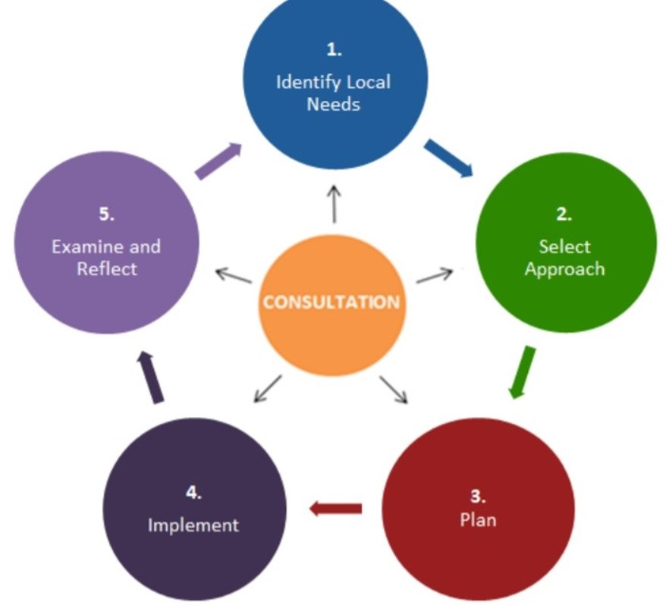
Cyclical Framework to Maximize
Title II
Notes:
In order to maximize Title II, LEAs must engage in meaningful consultation with a broad range of educational partners which includes teachers, principals, families, paraprofessionals, community partners, and other specialized instructional support personnel.
Once needs have been identified, LEAs, along with educational partners through consultation, determine the approaches most likely to be effective. The Title II plan does not happen in isolation which is why CDE recommends federal funds and activities be included in the LCAP.

Slide 6
Title II Authorized Activities (1)
Evaluation and Support System
High Quality Professional Development (PD)
Recruiting, Hiring, and Retaining Effective Teachers
Recruiting from Other Fields
In-Service Training
Effective Strategies to Support English Language Learners and Students with Disabilities
Notes:
The ESSA lists 16 authorized activities for Title II. We want to emphasize that LEAs must conduct their needs assessment through the LCAP process. The LEA can then determine what activities from Title II will support their goals and strategies. LEAs should not go directly to the use of funds and select what they would like. Furthermore, some of the activities listed under the use of funds have restrictions that make them difficult to implement.

Slide 7
Title II Authorized Activities (2)
Developing Feedback Mechanism
Child Abuse Training
Instructional Practices for Gifted and Talented
PD for College and Career Transition
Math, Science, Technology, Engineering, and Computer Science PD
Other Evidence-Based Strategies and Activities
Class Size Reduction* (See notes)
Early Education
Notes:
Here are the remaining authorized activities listed in ESSA for Title II. Again, you’ll notice that child abuse training is listed, and in California, this is a legal requirement at the State level, and using Title II funds may be supplanting.
In addition, please reach out to our office if you are using Title II funds or plan to use Title II funds to support class size reduction.

Slide 8
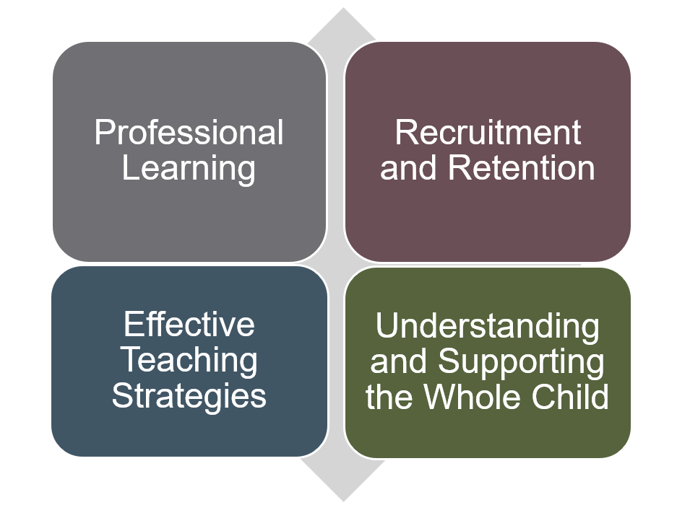
Title II Uses of Funds
Notes:
We have condensed the 16 authorized uses of funds into 4 main themes in the areas of Professional Learning, Recruitment and Retention, Effective Teaching Strategies, and Understanding and Supporting the Whole Child. During today's Webinar, we will highlight and provide examples of the most common and impactful activities funded with Title II, Part A.

Slide 9
Professional Learning
Notes:
Professional Learning

Slide 10
Professional Development (1)
The Every Student Succeeds Act (ESSA) defines PD as activities that are sustained, intensive, collaborative, job-embedded, data-driven, personalized or based on information from an evaluation and support system, and classroom-focused rather than PD that stands alone and does not connect to a larger school-wide or individualized plan.
Notes:
Before we talk about professional learning, we must review the definition of PD. The ESSA defines PD as activities that are sustained, intensive, collaborative, job-embedded, data-driven, personalized or based on information from an evaluation and support system, and classroom-focused rather than PD that stands alone and does not connect to a larger school-wide or individualized plan.

Slide 11
Professional Development (2)
Instructional Coaching
Professional Learning Communities
Principal Leadership
Teacher Leadership
Induction and Mentoring
Instructional Coaching
Professional Learning Communities
Principal Leadership
Teacher Leadership
Induction and Mentoring
Notes:
Within PD, we have additional categories. Instructional coaching, professional learning communities, principal and teacher leadership, and induction and mentoring.

Slide 12
Principal Leadership (1)
Principal leadership is second only to teaching among school-related factors as an influence on learning.
Effective pre-service and in-service principal training programs should be aligned with the California Professional Standards for Education Leaders and may include high-quality mentoring and coaching, peer observations, visits to other schools, principal's networks, and conferences, participation in PD with teachers, and guided “walk-throughs” of schools to look at practices in classrooms and consider how to evaluate/improve learning and teaching.
Notes:
Principal leadership is second only to teaching among school-related factors as an influence on learning.
Effective pre-service and in-service principal training programs should be aligned with the California Professional Standards for Education Leaders and may include high-quality mentoring and coaching, peer observations, visits to other schools, principal's networks, and conferences, participation in PD with teachers, and guided “walk-throughs” of schools to look at practices in classrooms and consider how to evaluate/improve learning and teaching.

Slide 13
Principal Leadership (2)
Based on the data, an LEA conducted a root causes analysis to better understand why certain sites had high turnover compared to other sites. All sites were Title I and had similar demographics. The LEA discovered that the effectiveness of the principal at certain sites was contributing to the turnover.
The LEA developed a 3–4-year plan focused on coach up or coach out.
Title II was used to hire site-based principal coaches. The coaching was intensive and focused on instructional leadership.
Notes:
Here is an example from an LEA that I’d like to share with you.
Based on the data, an LEA conducted a root causes analysis to better understand why certain sites had high turnover compared to other sites. All sites were Title I and had similar demographics. The LEA discovered that the effectiveness of the principal at certain sites was contributing to the turnover.
The LEA developed a 3–4-year plan focused on coach up or coach out.
Title II was used to hire site-based principal coaches. The coaching was intensive and focused on instructional leadership.
Principals reported either loving the support and growing, and others left.

Slide 14
Teacher Leadership
Teacher leadership career pathways enable individual teachers to extend the reach of their expertise beyond their own classrooms.
The use of teacher leaders, rather than vendors, to perform coaching services related to instruction, curriculum, or data provides incentives for teachers, builds upon strengths, and fosters a more cohesive staff climate and culture while building LEA capacity to increase student learning and student achievement.
Notes:
Teacher leadership career pathways enable individual teachers to extend the reach of their expertise beyond their own classrooms.
The use of teacher leaders, rather than vendors, to perform coaching services related to instruction, curriculum, or data provides incentives for teachers, builds upon strengths, and fosters a more cohesive staff climate and culture while building LEA capacity to increase student learning and student achievement.

Slide 15
Induction and Mentoring
High-quality mentoring and induction programs provide new teachers with PD, research-based resources, and formative assessment tools for beginning teachers, mentors, and school leaders, as well as technical assistance and capacity building for program leaders.
In successful models, full-time mentors are carefully selected and receive more than 100 hours of training annually. Teachers receive two years of coaching, meeting with their assigned mentors weekly for a minimum of 180 minutes per month. Mentors and teachers work through a system of formative assessments, including tools to guide observation cycles and to develop teachers’ skills in lesson planning and analyzing student work.
Notes:
Induction and mentoring
High-quality mentoring and induction programs provide new teachers with PD, research-based resources, and formative assessment tools for beginning teachers, mentors, and school leaders, as well as technical assistance and capacity building for program leaders.
In successful models, full-time mentors are carefully selected and receive more than 100 hours of training annually. Teachers receive two years of coaching, meeting with their assigned mentors weekly for a minimum of 180 minutes per month. Mentors and teachers work through a system of formative assessments, including tools to guide observation cycles and to develop teachers’ skills in lesson planning and analyzing student work.

Slide 16
Professional Development Activities (1)
Eligible Activities | Non-Eligible Activities
Activities that meet the federal definition of PD and are based on a needs assessment Teacher stipends for time outside normal scheduled hours to: 1) participate in professional learning; or 2) lead or participate in trainings that improve content knowledge or classroom practice | Training required as a school such as mandated child abuse reporting or first aid/CPR Workshop or conference that is not related to a sustainable series of PD activities Paying staff with Title II funds to attend PD activities during contract hours
Notes:
Some activities that are allowable under Title II:
Those PDs are based on a needs assessment, part of the Title II plan, and meet the federal definition of PD.
Teachers can receive stipends for time outside normal scheduled hours to: 1) participate in professional learning; or 2) lead or participate in training that improve content knowledge or classroom practice.
Non-Eligible Activities:
Training required as a school such as mandated child abuse reporting or first aid/CPR
Workshop or conference that is not related to a sustainable series of PD activities
Paying staff with Title II funds to attend PD activities during contract hours

Slide 17
Professional Development Activities (2)
Eligible Activities | Non-Eligible Activities
Professional Learning Community meetings focused on PD for staff outside of normal contract hours Increase student attendance and engagement Learn strategies for a culturally diverse classroom | Developing curriculum, assessments, or standards Basic training to implement a curriculum Purchase of any curriculum materials for students Payments for tutors Training for non-instructional staff Meals and refreshments
Notes:
Eligible activities
Professional Learning Community meetings focused on PD for staff outside of normal contract hours
Increase student attendance and engagement
Learning strategies for a culturally diverse classroom
Non-Eligible Activities
Developing curriculum, assessments, or standards
Basic training to implement a curriculum
Purchase of any curriculum materials for students
Payments for tutors
Training for non-instructional staff
Meals and refreshments

Slide 18
Professional Development Activities (3)
Eligible Activities | Non-Eligible Activities
Substitutes so teachers can attend PD (that meets the ESSA’s definition of PD) Substitutes so teachers can observe other teachers | Textbook adoption Furnishing of training rooms
Notes:
And lastly, here are a few more examples of eligible and non-eligible activities. This is not an exhaustive list, but rather a sample of a few examples to help clarify some common questions from the field. Please contact our office if you have specific questions or would like further information about anything we have presented.
Eligible activities:
Substitutes so teachers can attend PD (that meets the ESSA definition of PD)
Substitutes so teachers can observe other teachers
Non-Eligible activities:
Textbook adoption
Furnishing of training rooms

Slide 19
Use of Funds
Non-Eligible Activities:
Food (outside of travel reimbursement)*
Equipment*
Student Materials*
Positions (outside of Title II purpose)
PD (outside of Title II purpose)
*Cost that may never be charged to Title II
Notes:
Non-Eligible Activities:​
​
Food (outside of travel reimbursement)*​
Equipment*​
Student Materials*​
Positions (outside of Title II purpose) ​
PD (outside of Title II purpose)​
​
*Cost that may never be charged to Title II​
​

Slide 20
Other School Leader Definition
The ESSA’s definition of the term “school leader” means a principal, assistant principal, or other individual who is:
  An employee or officer of an elementary school or secondary school, LEA, or other entity operating an elementary school or secondary school; and
  Responsible for the daily instructional leadership and managerial operations in the elementary school or secondary school building.
  20 U.S.C. Section 8101(44)
Notes:
The ESSA definition of the term “school leader” means a principal, assistant principal, or other individual who is:
An employee or officer of an elementary school or secondary school, LEA, or other entity operating an elementary school or secondary school; and
Responsible for the daily instructional leadership and managerial operations in the elementary school or secondary school building.

Slide 21
Other School Leader
Examples of positions that do not meet the ESSA’s definition of school leader:
Counselor
Translator
Activity Director
Assistant Superintendent/Superintendent
Chief Business Officer
Notes:
Examples of positions that do not meet ESSA’s definition of school leader:
Counselor
Translator
Activity Director
Assistant Superintendent/Superintendent
Chief Business Officer

Slide 22
Use of Funds Poll (1)
Question:
May Title II, Part A funds be used to pay the salaries for the Director of Curriculum and Instruction, Curriculum Coordinator, and PD Director?
Notes:
May Title II, Part A funds be used to pay the salaries for the Director of Curriculum and Instruction, Curriculum Coordinator, and PD Director?

Slide 23
Use of Funds Poll (2)
Answer:
Probably not; please contact the Title II Office.
Notes:
May Title II, Part A funds be used to pay the salaries for the Director of Curriculum and Instruction, Curriculum Coordinator, and PD Director?
Probably not; please contact the Title II Office.
When we work with LEAs to determine allowability for these positions, we ask a few questions to help determine allowability. These are not the only factors that determine allowability, but they start the conversation.
We ask how this position was paid for in the past to check for supplanting.
In the absence of Title II, would the LEA still have this position?
The further from students, the less allowable Title II becomes; generally speaking.

Slide 24
Use of Funds Poll (3)
Question:
A teacher asks to attend a training about integrating music into their classroom instruction. Is this allowable?
Notes:
A teacher asks to attend a training about integrating music into their classroom instruction. Is this allowable?

Slide 25
Use of Funds Poll (4)
Answer:
Maybe. The ESSA’s definition of PD does not include PD that stands alone and does not connect to a larger schoolwide or individualized plan.
Notes:
A teacher asks to attend a training about integrating music into their classroom instruction. Is this allowable?
Maybe. Remember that the ESSA definition of PD does not include PD that stands alone and does not connect to a larger schoolwide or individualized plan.

Slide 26
Recruitment and Retention
Notes:
Recruitment and Retention

Slide 27
Recruitment and Retention (1)
Recruiting and retaining effective teachers
Recruiting individuals from other fields
Evaluation and support systems
Feedback mechanisms to improve working conditions
Notes:
The uses of funds from Title II that are grouped under recruitment and retention include:
Recruiting and retaining effective teachers
Recruiting individuals from other fields
Evaluation and support systems
Feedback mechanisms to improve working conditions

Slide 28
Recruitment and Retention (2)
  Example: Oakland Unified School District (OUSD) piloted an online platform that supported from beyond evaluation and compliance to personalized coaching. OUSD continued to use their formal observation process as negotiated with their union during this process.
  Title II may be used to pay for the program, training hours after contract hours, and coaches focused on the implementation and fidelity of the program. If Title II is used, the educator evaluation system must include multiple measures: value-added student achievement, student surveys, family feedback, etc.
  Title II was not used in the training and implementation of the formal observation process as required by the union.
Notes:
Example: Oakland Unified School District (OUSD) piloted an online platform that supported from beyond evaluation and compliance to personalized coaching. OUSD continued to use their formal observation process as negotiated with their union during this process.
This was a multi-year investment that focused on effectively training teachers and principal evaluators to implement the program.
Title II may be used to pay for the program, training hours after contract hours, and coaches focused on the implementation and fidelity of the program.
Title II was not used in the training and implementation of the formal observation process as required by the union.
(For reference only: https://www2.ed.gov/policy/elsec/leg/essa/essatitleiipartaguidance.pdf - p. 13)

Slide 29
Recruitment Activities (1)
Eligible Activities | Non-Eligible Activities
Advertising and job fairs Stipend or bonus for recruiting a teacher, principal, or other school leader Signing bonuses Salary differentials Incentive pay to work in high-need subjects or schools Relocation costs | Not allowed for non-instructional staff Supplanting state funds received for recruiting Fees and other costs associated with acquiring a new home A loss on the sale of a former home
Notes:
Let’s review a few activities that are allowable and some that are not.
Remember, all of these must first be based on a needs assessment.
Advertising and job fairs – this would be above and beyond what the LEA is currently doing. For example, the annual EdJoin subscription is not allowable. This is considered part of what an LEA would do regardless of Title II funding. Please also remember that advertising and job fairs charged to Title II must only be for teachers, principals, and other school leaders. Other school leaders are those who directly impact instruction. Counselors are not considered “other school leaders” under this definition.
Stipends, bonuses, or signing bonuses are all an option. Again, this would only be for teachers, principals, and other school leaders. If you are interested in pursuing this option, our office is happy to provide support.
Other allowable activities include incentives to work in high-need schools, which may also need to also negotiated with unions, but is still an option with Title II.
Some activities that are not allowable under Title II for recruitment include supplanting state funds that the LEA has received for recruiting, fees or other costs associated with acquiring a new home, and the loss on the sale of a former home.
(For reference only: https://education.mn.gov/MDE/dse/ESEA/t2/)

Slide 30
Recruitment Activities (2)
Eligible Activities | Non-Eligible Activities
Costs of state-approved assessments to qualify as an instructional paraprofessional Travel costs of employees while engaged in recruiting events | Continuing mortgage principal and interest payments on a home being sold Income taxes paid by an employee related to reimbursed relocation costs
Notes:
Continuing with additional recruitment activities that are allowable under Title II. LEAs can use Title II to cover travel costs associated with recruiting events as long as the recruitment is supplemental.
A few more activities that Title II will not support surrounding recruitment include:
Continuing mortgage principal and interest payments on a home being sold
Income taxes paid by an employee related to reimbursed relocation costs.
(For reference only: https://education.mn.gov/MDE/dse/ESEA/t2/)

Slide 31
Retention Activities (3)
Eligible Activities | Non-Eligible Activities
Bonuses Differential pay Costs of state tests for a teacher to add a license endorsement | Not allowed for private schools Not allowed for non-instructional staff Supplanting state funds Cost-of-living or collective bargaining increases Costs for required Continuing Education Units and license renewal
Notes:
Retention activities allowable under Title II include:
Bonuses
Differential Pay
Costs of state testes for a teacher to add a licensure endorsement
These activities are not allowable for private schools or staff members that are not supported by Title II. Title II can not be used for cost-of-living or collective bargaining increases.

Slide 32
Effective Teaching Strategies
Notes:
Now let’s take a look at how Title II can support effective teaching strategies.

Slide 33
Effective Teaching Strategies (1)
Effective teaching of English Language Learning
Effective teaching of children with disabilities
Increased knowledge and ability to teach early childhood
High-quality instruction of science, technology, engineering and mathematics
Implementation of formative assessments
Instructional services provided by libraries
Effectively integrate technology into curricula and instruction
Notes:
The effective teaching strategies listed under Title II allowable uses of funds include:
Effective teaching of English Language Learning
Effective teaching of children with disabilities
Increased knowledge and ability to teach early childhood
High-quality instruction of science, technology, engineering, and mathematics
Implementation of formative assessments
Instructional services provided by libraries
Effectively integrate technology into curricula and instruction

Slide 34
Effective Teaching Strategies (2)
Effectively integrating technology into curricula and instruction.
Example: Coaches might help educators learn to use selected devices, platforms, online assessments, or digital materials, or to implement technology-supported, content-specific instructional practice.
Title II can not be used to purchase technology such as laptops, servers, screens, projectors, TVs, headphones, or other equipment.
Notes:
Effectively integrating technology into curricula and instruction.
Example: Coaches might help educators learn to use selected devices, platforms, online assessments, or digital materials, or to implement technology-supported, content-specific instructional practice.
Title II can not be used to purchase technology such as laptops, servers, screens, projectors, TVs, headphones, or other equipment

Slide 35
Effective Teaching Strategies (3)
Effectively integrate technology into curricula and instruction.
Charging Title II for an entire online PD system may not be allowable. All PD offerings would need to be Title II allowable and supplemental.
Please contact our office if your LEA is considering this option.
Notes:
Charging Title II for an entire online PD system may not be allowable. All PD offerings would need to be Title II allowable and supplemental.
Please contact our office if your LEA is considering this option.

Slide 36
Understanding and Supporting the Whole Child
Notes:
And the last category: Understanding and Supporting the Whole Child.

Slide 37
Understanding and Supporting the Whole Child
Career readiness education
Training to recognize and prevent sexual abuse
Instructional practices for gifted and talented students
Supporting students affected by trauma and/or mental illness
School conditions for student learning
Notes:
The Title II uses of funds grouped under Understanding and Supporting the Whole Child are:
Career readiness education
Training to recognize and prevent sexual abuse
Instructional practices for gifted and talented students
Supporting students affected by trauma and/or mental illness
School conditions for student learning

Slide 38
Supplement,
Not Supplant
Notes:
Supplement, Not Supplant

Slide 39
Supplement, Not Supplant (1)
Funds made under this title shall be used to supplement, and not supplant, non-federal funds that would otherwise be used for activities authorized under this title.
The LEA may not use Title II funds to pay for activities that, in the absence of these funds, would be provided with state and local funds.
Notes:
Funds made under this title shall be used to supplement, and not supplant, non-federal funds that would otherwise be used for activities authorized under this title.
The LEA may not use Title II funds to pay for activities that, in the absence of these funds, would be provided with state and local funds.
(For reference only: Georgia Title II, Part A Handbook p. 11)

Slide 40
Supplement, Not Supplant (2)ant (2)
To determine whether a fiscal expenditure supplements and does not supplant, school districts must run the following tests:
Test I: Are the services that the district wants to fund with ESSA funds required under state, local, or another federal law? If they are, then it is presumed to supplant.
Test II: Were state or local funds used in the past to pay for these services? If they were, it is presumed to supplant.
Test III: Are the same services being provided in other schools paid for with state or local funds? If they are, then it is presumed to supplant.
Notes:
To determine whether a fiscal expenditure supplements and does not supplant, school districts must run the following tests:
Test I: Are the services that the district wants to fund with ESSA funds required under state, local, or another federal law? If they are, then it is presumed to supplant.
Test II: Were state or local funds used in the past to pay for these services? If they were, it is presumed to supplant.
Test III: Are the same services being provided in other schools paid for with state or local funds? If they are, then it is presumed to supplant.

Slide 41
Supplement, Not Supplant (3)
For example, suppose that state law requires a minimum amount of state funding to be used for professional development to improve teacher knowledge of core academic subjects, which is an allowed use of local Title II, Part A funds.​
LEAs would be expected to expend the minimum amount of state funding on professional development, and only use Title II-A funding for supplemental professional development (above the minimum state-funded amount).​
The LEA could not count its Title II funds toward meeting the state law requirement, as that would be considered supplanting. ​
Notes:
For example, suppose that state law requires a minimum amount of state funding to be used for professional development to improve teacher knowledge of core academic subjects, which is an allowed use of local Title II, Part A funds.​
​
LEAs would be expected to expend the minimum amount of state funding on professional development, and only use Title II-A funding for supplemental professional development (above the minimum state-funded amount).​
​
The LEA could not count its Title II funds toward meeting the state law requirement, as that would be considered supplanting. ​
(For reference only: Georgia Handbook p. 11; 2 CFR Section 200.403(d); ESEA/ESSA, Section 2301, 8521(c); FP Handbook; Audit Compliance Supplement; SBOE Rule Section 160-5-1-.22) ​

Slide 42
Supplement, Not Supplant (4)
If an LEA has a precipitous decline in financial resources, they may be able to use federal funds to supplement the loss in funding.
The ESSA does not define “precipitous.”
However, if there has been an abrupt, steep drop in financial resources available to support elementary or secondary education, this may be considered a precipitous decline.
Please reach out to the Title II office to discuss.
Notes:
If an LEA has a precipitous decline in financial resources, they may be able to use federal funds to supplement the loss in funding. ​
​
The ESSA does not define “precipitous.”​
​
However, if there has been an abrupt, steep drop in financial resources available to support elementary or secondary education, this may be considered a precipitous decline.​
​
An LEA may rebut a presumption of supplanting by demonstrating that, absent the Title II funds, the LEA would not have paid for the cost. ​
​
For example, suppose that last year an LEA paid for a PD on reading interventions in its elementary and middle schools, but this year, due to a decline in non-federal resources, it is only offering the PD in elementary schools. If the LEA establishes that the decline in non-federal sources resulted in it being unable to continue the PD, that rebuts the presumption of supplanting based on the service being paid previously with non-federal funds, and Title II could pick up the supplemental PD costs. ​
​
Please reach out to the Title II office to discuss this. ​
​
(For reference only: https://oese.ed.gov/files/2020/06/CARES-Act-Programs-Maintenance-of-Effort-FAQ.pdf)

Slide 43

Questions to Consider
Is this reasonable and necessary?
Is this required?
How would this be paid for in the absence of
Title II, Part A funds?
Which funding source paid for this last year?
Which areas of need were identified in the needs assessments (district and school levels)?
How can the district maximize funding?
Is this the best use of these funds?
How is the district coordinating programs?
Notes:
Some questions to consider
Is this reasonable and necessary?
Is this required?
How would this be paid for in the absence of Title II, Part A funds?
Which funding source paid for this last year?
Which areas of need were identified in the needs assessments (district and school levels)?
How can the district maximize funding?
Is this the best use of these funds?
How is the district coordinating programs?

Slide 44

Important Reminders
Not all allowable expenses are Impactful
  Too costly
  Failure to build capacity
  Not using resources to support identified needs from needs assessment
Must be aligned to the needs assessment
Must be reasonable, allowable, and necessary
Must supplement, not supplant
Notes:
Important reminders
Not all allowable expenses are Impactful
Too costly
Failure to build capacity
Not using resources to support identified needs from needs assessment
Must be aligned to the needs assessment
Must be reasonable, allowable, and necessary
May not supplant

Slide 45

Contact and Resources
Title II web page is found at https://www.cde.ca.gov/ci/pl/title2parta.asp
Title II Email: TitleII@cde.ca.gov
If you are not already on our listserv, please take a moment and send a blank email to
join-Title-II@mlist.cde.ca.gov
Thank You!
Notes:
Contact and resources are found on the slide.

