Slide 1
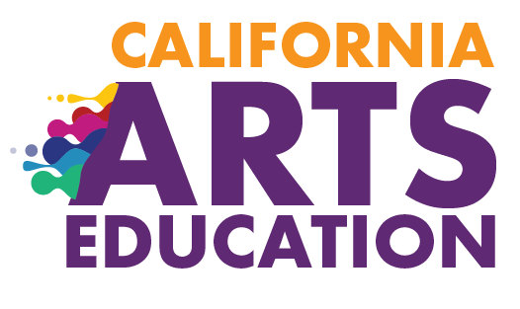



Chapter 9:
Implementing Effective Arts Education
2020 Arts Education Framework for California Public Schools, Transitional Kindergarten Through Grade Twelve
California Department of Education
Tony Thurmond, State Superintendent of Public Instruction
Notes:
Chapter 9: Implementing Effective Arts Education
This presentation deck includes content from chapter 9 of the 2020 Arts Education Framework for California Public Schools, Transitional Kindergarten Through Grade Twelve (Arts Framework).
The content was selected and refined in collaboration with leaders from California County Superintendents Educational Services Association (CCSESA) Statewide Arts Initiative and The California Arts Project (TCAP).
The slides are mostly self-explanatory, but in some places the slide notes contain clarifying talking points, possible reflection questions, or notes that may be useful for anyone facilitating a group.
The presentation deck
is meant to be a resource for educators and education partners to use to guide their reading of the Arts Framework;
is designed to use for self- or group study; and
captures highlights and provides entry points to the chapter, but the slides and the notes are not meant to be exhaustive and represent all content in the chapter.
The slides and notes are not intended to be a substitute for reading the chapter.
The slide notes also reference chapter pages from which the slide content originates.
Educators may download and modify the presentation for personal use.
The content may be used as a base for workshops and presentations.
Please contact the Curriculum Framework and Instructional Resources Division at cfird@cde.ca.gov with any questions about the content or use the presentation deck.

Slide 2
Introduction to Chapter 9
Chapter 9 provides holistic guidance and recommendations needed for full implementation of the California Arts Standards.
Local educational agencies (LEAs) determine and tailor approaches to their specific local context when establishing, improving, and ensuring a sequential, comprehensive, standards-based arts education for all students.
The chapter is intended for district and school leaders, teachers, school counselors, county office of education leaders, higher education representatives, and others who support arts education.
Chapter 9 should be used in combination with the discipline-specific guidance provided in chapters 3 through 7.
Notes:
Introduction to Chapter 9
Chapter Page: 2

Slide 3
Contents of Chapter 9
Effective and Equitable Arts Education Programs
Improving Arts Education Through Strategic Program Evaluation and Planning
Professional Learning in Support of Effective and Equitable Arts Learning
Engaging in Leadership and Advocacy for Arts Education
Notes:
Contents of Chapter 9
Effective and Equitable Arts Education Programs includes
guidance for elementary, middle, and high school; and
fundamental components of a comprehensive arts program.
Improving Arts Education Through Strategic Program Evaluation and Planning includes
guidance for assessing and improving programs.
Professional Learning in Support of Effective and Equitable Arts Learning includes
why professional learning is essential for school leaders and teachers; and
qualities of effective professional learning models for leaders, multiple subject teachers, and single subject arts teachers.
Engaging in Leadership and Advocacy for Arts Education includes
the role of arts education in the Local Control Funding Formula (LCFF) priorities.
Chapter Page: 3

Slide 4

Focusing Questions for Chapter 9
What are the elements of effective and equitable arts education programs?
What are some considerations when developing an arts education improvement plan?
How does professional learning support effective and equitable arts learning?
How can leaders and others advocate for arts education?
Notes:
Focusing Questions for Chapter 9
Chapter Pages: n/a

Slide 5
Q1—What are the elements of effective and equitable arts education programs?
Notes:
What are the Elements of Effective and Equitable Arts Education Programs?
Consider pausing here to collect initial responses to this question.
Chapter Pages: 2–29

Slide 6
Arts Education and the Whole Child
The arts are a major area of human cognition, one of the ways in which we know about the world and express our knowledge. Much of what is said in the arts cannot be said in another way. To withhold artistic means of understanding is as much a malpractice as to withhold mathematics…Since schools traditionally develop only linguistic and logical/mathematical skills, they are missing an enormous opportunity to develop the whole child.
-Dr. Howard Gardner—Harvard Graduate School of Education
Notes:
Arts Education and the Whole Child
To make some connections and spark some initial thinking about effective and equitable arts education programs, read the quotes and consider this reflection/discussion prompt:
What stands out?
What resonates with you?
What questions does it raise?
Chapter Page: 2

Slide 7
California’s Vision Includes Arts Education for All Students
California’s arts education policies prepare students to learn, work, and thrive. The arts are required
subjects in the California Education Code, sections 51210 and 51220;
for high school graduation (one year of a visual or performing arts or world language or career technical education); and
as one of the A–G preparatory courses needed for admission to the California State University and to the University of California.
Notes:
California’s Vision Includes Arts Education for All Students
See Appendix A for a complete list of Education Code references for arts education in California.
Chapter Pages: 4–5

Slide 8
Equity in Arts Education
CREATE CA defines EQUITY in Arts Education … as the right of every student to engage and succeed in powerful, high quality, standards-based arts learning PreK–12.
—Declaration of the Rights of All Students to Equity in Arts Learning. CreateCA California’s Statewide Arts Education Coalition
Notes:
Equity in Arts Education
Full quote from the chapter: “CREATE CA defines in EQUITY in Arts Education … as the right of every student to engage and succeed in powerful, high quality, standards-based arts learning PreK–12. All students from every race, culture, language background, geographic region, and socio-economic level must have the opportunity to fully develop their own artistic, cultural, and linguistic heritage while expanding opportunities to study and explore artistic expressions across different cultures and time periods.”
Possible reflection/discussion:
What is meant by high quality standards-based arts learning? What does that look like?
What are some of the obstacles or potential barriers that create inequity and inhibit students, or groups of students, the right to “engage and succeed in powerful, high-quality arts learning PK–12?”
Chapter Page: 5

Slide 9
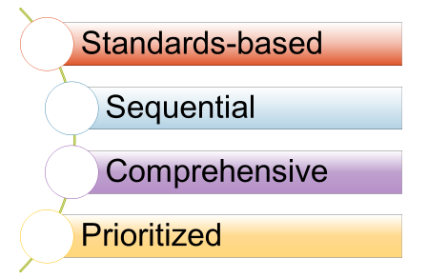
The Essentials of Comprehensive TK–12 Arts Education Programs
Notes:
The Essentials of Comprehensive Arts Education Programs
For students to develop into artistically literate, creative, and capable individuals, it is essential that arts instruction is sequential, standards-based, comprehensive, and prioritized.
Comprehensive means standards-based sequential instruction for all students, in all five arts disciplines, during the regular school day, each year from TK through grade twelve is prioritized.
Access to each of the arts disciplines includes through articulated feeder programs that support transitions between school levels to continue learning in the arts without interruption.
Chapter Page: 2

Slide 10
A Note About Prekindergarten vs. Transitional Kindergarten
The Arts Framework provides guidance for implementation of the prekindergarten (PK) Arts Standards which are intended for use in transitional kindergarten (TK).
In the Arts Framework, the PK standards from the Arts Standards document are referred to as TK standards.
PK educators should use the California Preschool Learning Foundations, Volume 2, which addresses the development of children 36 to 48 months.
Notes:
Prekindergarten vs. Transitional Kindergarten
The following guidance was developed in consultation with the Early Learning and Care Division at the California Department of Education (CDE).
The Arts Framework provides guidance for implementation of the prekindergarten (PK) Arts Standards which are intended for California’s local educational agencies (LEAs) to apply to transitional kindergarten (TK). As such, in the Arts Framework, PK standards are referred to as TK standards.
Because TK and kindergarten provide two years of preparation for the first grade, students’ arts education experiences should be unique in each of those years. The TK standards should be used by educators to ensure readiness for first grade.
When planning arts education lessons, PK educators should use the California Preschool Learning Foundations documents developed by the CDE which address arts development of children of approximately four years of age. California Preschool Learning Foundations, Volume 2 can be accessed online at https://www.cde.ca.gov/sp/cd/re/psfoundations.asp#psfoundvol2.
Chapter Pages: 5–6

Slide 11
A Comprehensive TK–12 Arts Education
ELEMENTARY SCHOOL | MIDDLE SCHOOL | HIGH SCHOOL
Learning in elementary school builds a foundation for basic artistic literacy, creative thinking, exploration, and artistic processes needed for middle and high school. | Studies in each arts discipline continue with specialization in one or more arts disciplines. Exploration remains critical as students increase and refine their artistic knowledge and skills. Instruction may be daily throughout the year, or through multiple, shorter courses. | At the high school level, students continue in-depth study in one or more arts disciplines and preparation to study in an arts discipline after high school. Specialized opportunities for arts learning, through programs such as Advanced Placement, International Baccalaureate, and concentrated arts pathways, provide additional preparation for students seeking postsecondary arts learning or career entry
Notes:
A Comprehensive TK–12 Arts Education
Elementary School
A comprehensive TK–12 arts education means that in grades PK–5 arts learning builds a foundation for basic artistic literacy, creative thinking, exploration, and artistic processes needed for middle and high school.
Learning is provided by a combination of single subject credentialed arts educators and well-prepared multiple subject teachers.
Middle School
A comprehensive TK–12 arts education means that in middle school students have access to arts education to specialize and/or continue to explore one or more arts disciplines.
As students transfer from one level to the next, their arts learning should be seamless, allowing them to continue learning in the arts without interruption.
High School
A comprehensive TK–12 arts education means that in high school students have access to arts education to continue in-depth study and or prepare for postsecondary arts learning or career entry.
High schools may identify gaps in learning due to different learning models in feeder schools.
As LEAs engage in processes to address gaps in arts learning, they may revise existing arts educational programs and expand or add new arts education programs to provide access for all students.
Chapter Pages: 5–7

Slide 12
Steps to Ensure Equitable Access to Sequential Arts Learning
Establish well-articulated standards-based arts education districtwide and develop supportive feeder patterns between school levels.
Identify gaps and remove existing barriers to participation.
Take local context into account and identify an appropriate model or approach.
Revise existing programs and expand or add new arts education programs.
Notes:
Ensuring Equitable Access to Sequential Arts Learning
Chapter Pages: 5–7

Slide 13
Elements of Successful Feeder Patterns TK–12
Educators examine the standards to agree on a vision of what graduates should know and be able to do in the arts.
District supports required staffing, provides equipment and supplies to champion the vision, and ensures coordination among schools.
Principals and counselors communicate to ensure the prioritization of arts education within the master schedule and recruit students for programs.
Teachers in each arts discipline engage in vertical communication to support standards-based expectations and feeder patterns.
District/school communicates with parents about the value of arts education, the programs available to students, and the importance of sequential study.
Notes:
Key Elements for a Successful TK–12 Arts Feeder Pattern
Consider pausing to read and discuss the Vignettes One Districts’ Approach in Moving Toward a Comprehensive Arts Education for All and Establishing Feeder Patterns on pages 8–14.
Possible Reflection/Discussion:
How is arts learning supported in your school district as students transfer from one level to the next?
How might the approach in the vignette be useful in your context?
Chapter Pages: 8–14

Slide 14
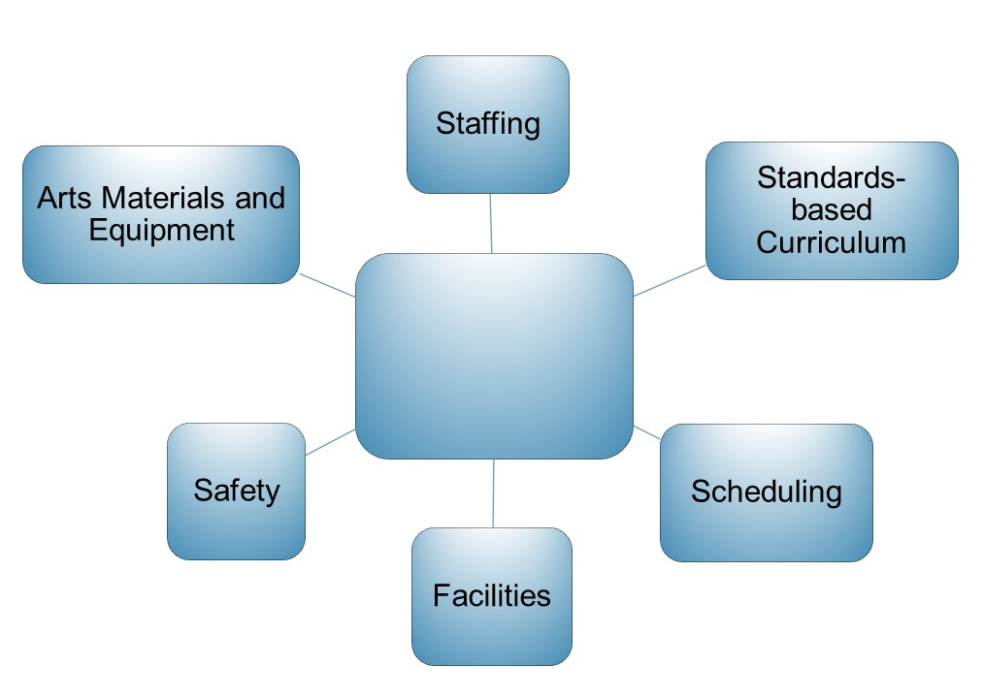

Fundamental Components of Arts Education
Notes:
Fundamental Components of Arts Education
The four national professional arts education associations have each developed Opportunity to Learn Standards (OTLS) related to these components.
These components form the basics of any arts education program.
Using these components to develop and evaluate district plans such as Local Control Accountability Plans (LCAPS) can help improve arts education programs and provide a roadmap to ensure every California student has access to a sequential, standards-based, effective TK–12 arts education.
The next 11 slides provide additional detail on each component.
Additional, discipline-specific discussion is provided in the discipline chapters 3–7.
Chapter Page: 14

Slide 15

STANDARDS-BASED CURRICULUM
Guides Arts Instruction
Curriculum, or course of study, is the content and plan for instruction. It is made up of the instructional resources, methods, and assessments needed to help students develop critical skills and knowledge. Along with high-quality and effective instruction, curriculum is an essential element that enables students to learn and thrive.
See CDE Curriculum web page at https://www.cde.ca.gov/qs/ci/
Notes:
Standards-Based Curriculum Guides Arts Instruction
Effective curriculum articulates the sequence of instruction and student learning expectations for all students.
Teachers, individually or collaboratively, use, develop new, and revise the curriculum and use the principles of Universal Design for Learning (UDL) to design specific classroom units of instruction and assessments that give all students equal opportunities to succeed.
In LEAs that include cross-disciplinary approaches, the curriculum may also provide teachers guidance for integrated instruction that includes the arts.
While the benefits of strategic and well-crafted arts integration are known, integration should not supersede or replace discrete arts education.
Chapter Pages: 16–19

Slide 16
Standards-Based Curriculum
Articulates the Sequence of Instruction and Learning Expectations. It
provides general guidance on diverse student learning needs and suggestions for accommodations and modifications;
attends to the range of novice through advanced learners;
provides a basis for formative and summative classroom assessment; and
is grounded in the appropriate disciplinary pedagogies and methodologies.
Notes:
Standards-based Curriculum
Possible brainstorm and discussion—what are some investigative questions that could help you gather data about the arts curriculum, learning expectations, and assessment in your district?
Chapter Pages: 16–19

Slide 17
SCHEDULING
Considerations for Elementary
  Discrete instruction in each arts discipline builds foundational arts literacy, language, knowledge, and skills.
  Careful scheduling and planning of services ensures students are not missing arts learning time.
  Single-subject teachers may be assigned to work in multiple schools.
Notes:
Scheduling Considerations for Elementary
In elementary, include time for discrete instruction in each arts discipline to build foundational literacy, language, knowledge, and skills.
In districts where it is not possible to add single subject credentialed arts teachers to support multiple subject teachers, professional learning is needed to make arts education equitably accessible to all of California’s students.
Section 60811.8 of the California Education Code prohibits denial to English learners of equal participation in courses that are required to meet state or local graduation requirements and courses required for middle school grade promotion.
See page 18 for a list of additional considerations for administrators when teachers are assigned to more than one school.
Possible brainstorm and discussion—what are some investigative questions that could help you gather data about scheduling in your district?
Chapter Pages: 19–20

Slide 18
SCHEDULING
Considerations for Secondary
Middle School
  Students have access courses in all arts disciplines to continue to deepen learning in one arts discipline or possibly continue study in multiple arts disciplines.
High School
  Students have access to opportunities to take yearlong courses in one or more arts disciplines and advanced courses in each year.
  Counselors and teachers are knowledgeable about requirements needed for postsecondary education and/or careers in the arts.
  Master scheduling should provide access to advanced course of study in the arts every year.
Notes:
Scheduling Considerations for Secondary
As required subjects in California Education Code, in the middle grades students need access to courses in all arts disciplines.
They may continue to deepen learning in one arts discipline or may continue study in multiple arts disciplines.
In high school, effective scheduling provides students access to opportunities to take yearlong courses in one or more arts disciplines and advanced courses in each year.
Scheduling at this level should provide students interested in pursuing postsecondary arts learning or arts careers after high school with opportunities for advanced learning through discipline-specific sequenced and articulated arts courses.
Students should have access to advanced courses of study in the arts every year.
Careful master scheduling of courses by counselors who are knowledgeable about requirements needed for postsecondary or careers in the arts help ensure that all students have access to courses that fulfill their high school requirements, meet the freshman admission to the University of California and the California State University, and provide preparation for entry-level careers or postsecondary learning in the arts.
See page 19 for snapshot with an example of LEA including the arts in the master schedule conversations.
Chapter Pages: 19–20

Slide 19
STAFFING
Teachers Assigned to More than One School
To support teachers, administrators can ensure
adequate and protected time to teach beyond one short block of time;
dedicated classrooms designed for safe learning in the arts;
a secure place for storage and sufficient supplies, equipment, and resources for each student to use for arts learning;
access to appropriate and needed technologies for teaching and for student learning and creating; and
time to collaborate and build relationships with school site administration, staff, and parents.
Notes:
STAFFING: Teachers Assigned to More than One School
Chapter Pages: 23–24

Slide 20
STAFFING
Administrators and Other Personnel
Administrators and other personnel include district superintendents, arts coordinators, resource teachers, counselors, and support staff who
are informed and knowledgeable about arts education to provide necessary and effective administrative and fiscal support;
provide leadership and professional support to arts educators;
advocate for high-quality arts education and understand the structure, differing needs, and nature of authentic learning in each arts discipline; and
administrators are attentive to student-to-teacher ratios in arts classes in order to provide a safe learning environment for students to achieve the standards.
Notes:
STAFFING: Administrators and Other Personnel
Possible brainstorm and discussion—what are some investigative questions that could help you gather data about staffing for arts instruction in your district?
Chapter Pages: 23–24

Slide 21
STAFFING
Qualified Teachers
Arts educators include multiple subject, single subject, and career technical education teachers who are
recognized and respected as part of the school community and equal contributors to students’ well-rounded education;
supported like teachers of other content areas, with resources and materials necessary to teach the arts, and with ongoing professional learning; and
included and invited to contribute as equal members in district and school efforts, initiatives, and decisions.
Notes:
STAFFING: Qualified Teachers
Chapter Pages: 23–24

Slide 22
FACILITIES
Spaces for Arts Instruction
Authentic learning in the arts requires dedicated, appropriate spaces for instruction that provide safe environments for students to learn; create; revise; and produce, perform, or present their work. This means
  Facilities built and maintained to provide teaching, learning, and performing environments that are physically safe
  Spaces that enable a creative, inclusive environment offer a foundation for students to authentically learn and safely thrive in the arts
*While not all schools can provide studio-like spaces, with a few strategic modifications, classrooms can be effective arts teaching environments.
Notes:
FACILITIES: Spaces for Arts Instruction
Regularly scheduled access to venues for student performances, productions, and presentations of student artworks provides students with authentic experiences and learning within the arts.
Priority scheduling of such school and district spaces should be given to arts educators first, before outside groups or others wishing to utilize these specialized educational venues.
Chapter Page: 25

Slide 23
FACILITIES
Attributes That Support Arts Learning
Space for safe individual, small, and large group movement (theatre and dance)
Space to accommodate individual, small group, and collaborative art making and presentation (visual arts, media arts, technical theatre)
Access to water, proper ventilation, space for safe use of tools, and cleaning and storage areas (visual arts).
Room for individual, ensemble, and whole group practice and rehearsal while protecting the hearing of teachers and students (music)
Lighting, sound, climate control, and security for classrooms and performance/presentation venues (all)
Suitable space, power, and appropriate internet connections for multiple computers and other electronic equipment (all)
Notes:
Facilities Attributes That Support Arts Learning
When districts or school construct new or refurbish facilities for arts learning, visual, performing, and media arts educators should be consulted and included on planning committees.
Possible brainstorm and discussion—what are some investigative questions that could help you gather data about facilities for arts learning in your district?
Chapter Page: 25

Slide 24
SAFETY
Teachers and students
Should know, understand, and adhere to safety guidelines and codes in classrooms and performance venues
Should follow safety guidelines in art making practices to protect themselves and others
Are trained for safe use and handling of tools, facilities, artistic supplies, equipment, and materials
Can access appropriate and well-maintained safety apparel and equipment
Know the location of safety kits and fire extinguishers in classrooms and creative-making spaces and are trained in their use
Follow fire, stage, and shop safety protocol outlines in guidelines from the Occupational Safety and Health Administration
Notes:
SAFETY
Occupational Safety and Health Administration (OSHA) guidelines can be found at https://www.cde.ca.gov/ls/fa/hs/. Additional safety measures related to COVID-19 may also be needed.
Chapter Pages: 26–27

Slide 25
ARTS MATERIALS AND EQUIPMENT
Technology—Students have access to and choices of technologies to engage in emerging and contemporary art practices, explore multiple approaches to developing portfolios, engage in collaboration and access to additional instructional supports as needed.
Funding—District and school budgets support equal access to necessary arts education-related expenditures and instructional materials, and provide for ongoing maintenance of tools, equipment, and technology.
Safety—Students have access to safe and healthy arts materials and equipment.
California Guidance—Instructional materials follow Education Code sections 60040–60045 and 60048 as well as the State Board of Education guidelines in Standards for Evaluating Instructional Materials for Social Content, 2013 Edition and Chapter 10: Instructional Materials of the framework.
Notes:
Authentic and Appropriate Arts Materials and Equipment
Possible brainstorm and discussion—what are some investigative questions that could help you gather data about safety, equipment, and materials for arts instruction in your district?
Chapter Pages: 27–29

Slide 26
Reflection on Opportunity to Learn Standards and Improving Programs
Consider the categories of the Opportunity to Learn Standards
How might LEAs use these to identify gaps and remove barriers to participation?
How might these categories inform plans to revise existing programs and expand or add new arts education programs?
Notes:
Reflection on Opportunity to Learn Standards and Improving Programs
Chapter Pages: 14–29

Slide 27
Q2—What are some considerations when developing an arts education improvement plan?
Notes:
What are some considerations when developing an arts education improvement plan?
Chapter Pages: 30–37

Slide 28
Considerations for Developing an Arts Education Improvement Plan
Compare current arts education programs to the education code and guiding documents for arts education to evaluate current programs.
Determine if there are specific practices already in place for developing improvement plans to ensure a smooth and successful conclusion.
Consider engaging in assessment of program and development of an improvement plan as a professional learning process.
Embed the process with the development of a Local Control and Accountability Plan (LCAP).
Notes:
General Considerations for Developing an Arts Education Improvement Plan
See https://www.cde.ca.gov/re/lc/ for information about LCAPs from the California Department of Education.
Chapter Page: 30

Slide 29
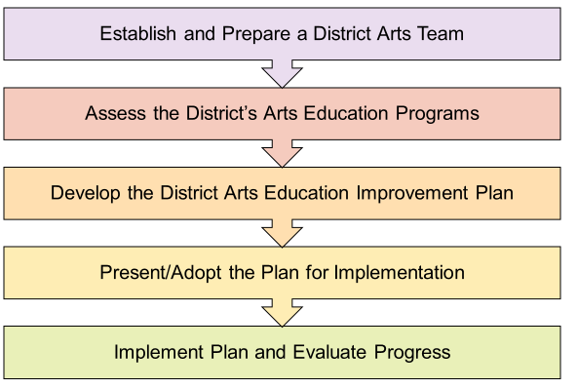
Steps for Strategic Program Evaluation and Planning
Notes:
Steps for Strategic Program Evaluation and Planning
The district arts team should be representative of all schools and all arts subject areas within the district and include special education teachers and district level personnel
It is important that the assessment of programs be conducted in a similar fashion and with common questions district-wide to ensure data that can be analyzed. The assessment should
ask the same prompts across all schools, with variations as needed for elementary, middle and high school contexts;
be administrated in a consistent approach; and
collect the data in a way that the results can be analyzed.
Chapter Pages: 30–37

Slide 30
Sample Evaluation Prompts for Programs (1)
What arts disciplines are being taught?
Who is teaching the arts?
Which students have access to learn in dance, media arts, music, theatre, and visual arts? Which do not? What are the barriers or challenges preventing access?
How much instructional time is allocated and in what scheduling formats?
How is the instruction aligned to the California Arts Standards?
Notes:
Sample Evaluation Prompts (1)
Chapter Pages: 33–34

Slide 31
Sample Evaluation Prompts for Programs(2)
What arts classroom and programmatic assessment strategies are in place?
What arts facilities, equipment, materials, and supplies exist? Who has access?
How are the arts education programs funded?
If there is funding expended, what does it pay for?
What does it not pay for?
Notes:
Sample Evaluation Prompts (2)
Possible reflection and discussion:
Choose 1–2 of the prompts from this slide and/or the previous slide to assess the current conditions and circumstances in your district.
How might the OTLS be useful in this process?
Chapter Pages: 33–34

Slide 32
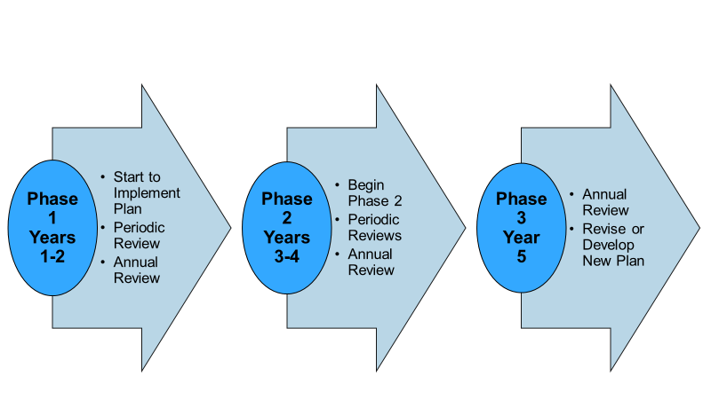
Sample District Arts Education Improvement Plan Phase Timeline: Phase 1 & 2
Notes:
Sample District Arts Education Improvement Plan Phase Timeline: Phase 1 & 2
An improvement plan may be implemented after engaging in strategic program evaluation.
See pages 33–34 for a sample template for a written plan.
Chapter Pages: 35–36

Slide 33
Sample District Arts Education Improvement Plan Phase Timeline: Phase 3
Notes:
Sample District Arts Education Improvement Plan Phase Timeline
An improvement plan may be implemented after engaging in strategic program evaluation.
See pages 33–34 for a sample template for a written plan.
Chapter Pages: 35–36

Slide 34
Q3—How does professional learning support effective and equitable arts learning?
Notes:
How does professional learning support effective and equitable arts learning?
What are the roles?
What are the qualities?
What are some models?
Chapter Pages: 38–55

Slide 35
Professional Learning for Leaders—a Leading Factor in Student Success
School leaders and teachers who understand the what and the why of arts education are better able to provide effective leadership. Professional learning content for leaders
  highlights the overlapping and expanded literacy development students gain through the arts;
  includes insights into effective teaching in the arts; and
  provides illustrations of the benefits gained by all students from a sequential, standards-based arts education.
Notes:
Professional Learning for Leaders—a Leading Factor in Student Success
Professional learning is a critical ongoing part of every administrator’s and teacher’s career and a leading factor in student success in any content area.
School leaders and teachers who understand the what and the why of arts education are better able to provide effective leadership.
Administrators and teachers need professional learning that includes an overview on quality indicators of standards-based arts education that supports them in gaining an understanding of the intent and goals of the California Arts Standards and Framework.
Administrators and other school leaders who understand the aspects listed on the slide can articulate a vision for arts education and lead in ways that create conditions for and support quality arts learning.
Chapter Pages: 38–39

Slide 36
Professional Learning for Teachers—an Investment in Student Success
Arts teachers’ benefit when professional learning is targeted to their role, their needs, and their students’ needs. Professional learning content for teachers
  builds multiple subject teachers’ capacity to provide standards-based arts education;
  is relevant and discipline-specific for single subject arts teachers;
  fosters opportunities for arts teachers to collaboratively address problems of practice and acquire new skills and strategies; and
  is informed by best practices and current research in arts education.
Notes:
Professional Learning for Teachers—an Investment in Student Success
An investment of time and allocation of resources for professional learning is necessary.
Chapter Pages: 38–39

Slide 37
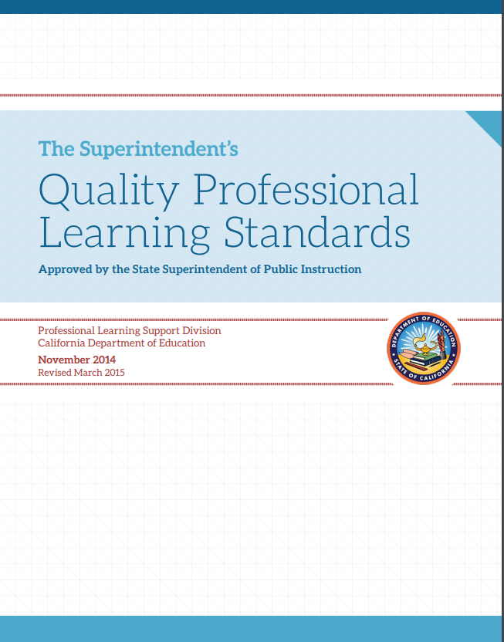
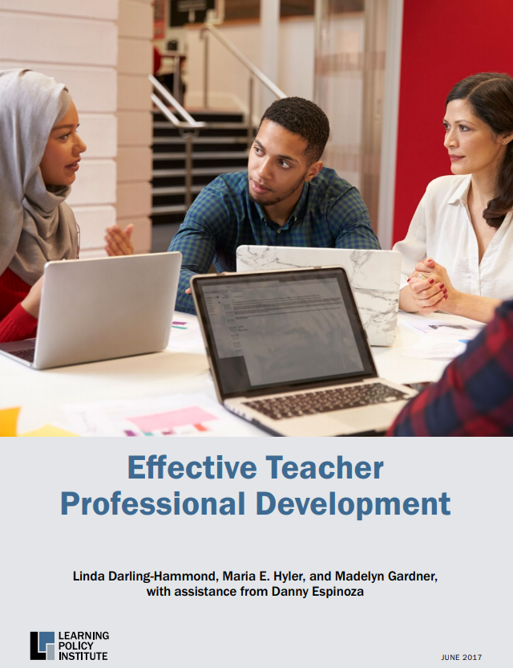
Qualities of Effective Professional Learning Models
The Quality Professional Learning Standards (QPLS) describe characteristics of professional learning that are “…most likely to support educators in building individual and collective capacity to meet professional, school, and student performance expectations.”
The Learning Policy Institute (LPI) report Effective Teacher Professional Development identifies effective design elements for professional learning design.
Notes:
Qualities of Effective Professional Learning Models
Two documents, Effective Teacher Professional Development Report and Quality Professional Learning Standards, provide insight into effective professional learning models and related attributes that are useful for arts education.
The LPI’s seven elements, combined with California Department of Education’s QPLS, articulate effective professional learning attributes that should be present to support arts educators and administrators.
The design elements and standards are useful guides for administrators to guide the design or selection of professional learning.
Teachers may find the elements and standards descriptions useful when selecting professional learning activities to meet their needs and enhance their practice.
Chapter Pages: 40–42

Slide 38
Elements of Effective Professional Learning
According to the LPI report, seven effective design elements present in most effective professional learning include the following:
  Focus on content
  Active learning utilizing adult learning theory
  Collaboration, typically in job-embedded contexts
  Models and modeling of effective practice
  Coaching and expert support
  Opportunities for feedback and reflection
  Sustained over time
Notes:
Elements of Effective Professional Learning
The authors of the report define effective professional development as ”structured professional learning that results in changes in teacher practices and improvements in student learning outcomes.”
The LPI report can be downloaded at https://learningpolicyinstitute.org/product/effective-teacher-professional-development-report.
Chapter Pages: 40–42

Slide 39
Characteristics of Quality Professional Learning
The QPLS identify seven interdependent characteristics of professional learning to guide systems of professional learning:
  Rooted in student and educator needs based on data
  Focused on content and pedagogy
  Designed to ensure equitable outcomes
  Designed and structured to be ongoing, intensive, and embedded in practice
  Collaborative with an emphasis on shared accountability
  Supported by adequate resources
  Coherent and aligned with other standards, policies, and programs
Notes:
Characteristics of Quality Professional Learning
The QPLS can be downloaded at https://www.cde.ca.gov/pd/ps/qpls.asp.
Chapter Pages: 40–42

Slide 40
Reflection on the Qualities of Effective Professional Learning
To what degree/how often does arts professional learning you design, or experience, align with these elements and characteristics?
What are the most challenging elements and characteristics to include?
How can these challenges be addressed?
Notes:
Reflection on the Qualities of Effective Professional Learning
An additional question for administrators to consider is—what professional learning do you need, as an instructional leader to, support and strengthen arts education and programming for students and teachers at your site or district?
Chapter Pages: 40–42

Slide 41
Professional Learning for Administrators, School, and District Leaders
Leaders and personnel assigned responsibility for arts education benefit from arts education-focused professional learning.
Leaders may have disciplinary expertise or experience in one of the arts content areas, but not all.
Engagement in Professional Learning Communities (PLCs) focused on arts education can be effective to foster collaborative professional learning.
PLCs can be regional or district-based and organized through partnerships or collaborations with established arts education agencies.
Notes:
Professional Learning for Administrators, School, and District Leaders
Professional learning is a necessary support for administrators and counselors assigned to be responsible for arts education.
Those supporting arts education may not be fully prepared, knowledgeable about current arts education policies, or empowered to facilitate change.
School board members and counselors also play critical roles in supporting, creating policies, and implementing practices that provide or prohibit students’ access to arts education.
Given the multiple demands on their time, engagement in regional or local networks (PLCs) that meet for a few hours monthly or a full day quarterly offer opportunities for ongoing support.
The addition of an outside arts education expert to help facilitate the PLC, provide guidance, and offer information has been found to be an effective approach
Chapter Pages 42–44

Slide 42
Professional Learning Needs: Multiple and Single Subject Teachers
For Multiple Subject Teachers
For Single Subject Teachers
Builds content knowledge, language, skills, and pedagogical content knowledge in the five arts disciplines
Boosts confidence and ability to provide discrete, sequential arts learning experiences
Increases capacity to design and implement effective integrated arts learning experiences
Provides continued growth in contemporary arts practices, new technologies, new skill development, etc.
Provides opportunity for collaboration related to standards, assessment, and instructional design
Addresses the content and the arts subject area taught
Notes:
Professional Learning Needs: Multiple and Single Subject Teachers
In some districts an arts teacher may be the only teacher in their subject area on their campus, and professional learning with same subject area arts teachers that crosses school sites can be useful for collaborative professional learning.
Professional Learning Communities (PLCs) can be organized in a variety of ways, such as by grade level (vertical and horizontal), disciplines, and by teaching contexts (such as within a pathway, multiple schools, or self-contained classrooms) to mediate teacher isolation.
The PLC groupings should be ongoing, learning focused, inquiry based, and action orientated to achieve improved student learning.
See pages 49–51 for a summary of DuFour’s big ideas of professional learning communities, examples, and a Snapshot Focus on Practice, which provides an example of a regional professional learning community structure for the arts focused on problems of practice.
Chapter Pages: 44–55

Slide 43
Q4—How can leaders and others advocate for arts education?
Notes:
Q4—How can leaders and others advocate for arts education?
Chapter Pages: 56–59

Slide 44
Arts—Not Just “Nice to Have”
The arts are not a frill. The arts are a response to our individuality and our nature, and help to shape our identity. What is there that can transcend deep difference and stubborn divisions? The arts. They have a wonderful universality. Art has the potential to unify. It can speak in many languages without a translator. The arts do not discriminate. The arts can lift us up.
— Barbara Jordan, Former Congresswoman
Notes:
Arts—Not Just “Nice to Have”
Chapter Page: 56

Slide 45
Engaging in Leadership and Advocacy for Arts Education
Advocating for arts education is a necessary ongoing activity for arts educators, community members, parents, students, and industry leaders.
California’s Local Control and Accountability Plan (LCAP) provides an authentic process for districts and communities to provide advocacy leadership for arts education.
Arts education has a role in each of the Local Control Funding Formula (LCFF) priorities that are aimed at serving the needs of the whole child.
LEAs that attend to arts education as they craft LCAP goals, plan actions, and leverage resources, can address the LCFF priorities and improve and expand arts education for all students.
Notes:
Engaging in Leadership and Advocacy for Arts Education
Chapter Page: 56

Slide 46
LCFF Priorities and Arts Education #1–5
Priority | Arts Education Role/Connection/Expectation
#1 Basic Services | Teachers teaching the arts are fully credentialed, have access to arts standards-aligned instructional materials and resources, and school facilities for arts education are maintained in good repair.
#2 State Standards | Resources are allocated for implementation of California Arts Standards for all students.
#3 Parent Involvement | Resources are included for family engagement and participation in their student’s arts education.
#4 Student Achievement | Ensuring access to courses in the arts (F) that support completion of the entrance requirements courses for University of California and California State University.
#5 Student Engagement | Arts education provides students with positive connections to school that can support school attendance and completion of high school graduation requirements.
Notes:
LCFF Priorities and Arts Education #1–5
Answers to frequently asked questions are available at https://www.cde.ca.gov/fg/aa/lc/lcfffaq.asp.
Chapter Pages: 56–57

Slide 47
LCFF Priorities and Arts Education #6–10
Priority | Arts Education Role/Connection/Expectation
#6 School Climate | A thriving arts education program supports a positive school climate and culture and provides students with creative outlets for the expression.
#7 Course Access | All students must have access to learning in the arts that are inclusive, flexible, meet their specific needs, and promote potential areas of growth.
#8 Student Outcomes | Student achievement in dance, media arts, music, theatre, and visual arts is measured through a variety of authentic means. The assessment data informs decision-making related to instruction. The academic progress in these content areas, are shared with educators, students, and families.
#9 Expelled Youth | Arts education is included in the coordination of instruction of expelled students.
#10 Foster Youth | Foster youths’ arts education needs and rights are addressed in the coordination of services.
Notes:
LCFF Priorities and Arts Education #6–10
Answers to frequently asked questions are available at https://www.cde.ca.gov/fg/aa/lc/lcfffaq.asp.
Chapter Pages: 56–57

Slide 48
Reflecting on Arts Education, the LCFF, and the LCAP
As you read each LCFF Priority, pause to reflect on your district’s successes and challenges or barriers in achieving an effective and equitable arts education program.
Select one of the Priorities you feel has the most opportunity for growth and consider what steps you can take to move forward.
Consider—Who in your district writes your LCAP? Are there other key persons with whom you can share this information?
Notes:
Reflecting on Arts Education, the LCFF, and the LCAP
Chapter Pages: 56–57

Slide 49
Sample Advocacy Talking Points
Research continues to demonstrate and support the claim that arts make a positive difference in the lives of students. An education in the arts
  provides students with skills needed for their future;
  opens a doorway into the creative economy;
  supports social and emotional well-being;
  promotes a sense of belonging to a wider community; and
  provides a constructive creative outlet for self-expression.
Notes:
Sample Advocacy Talking Points
Also see Chapter 1: Vision and Goals for Standards-Based Arts Education for a summary of research about the importance and benefits of an arts education that may be useful for developing additional talking points.
Chapter Page: 58

Slide 50
In Conclusion
Effective and equitable arts education programs are sequential, standards-based, comprehensive, and prioritized.
Articulated feeder programs ensure TK–12 access to each of the arts disciplines for all students.
An arts education improvement plan can be developed to strengthen arts education programs.
Professional learning must be customized to meet the unique needs of teachers, administrators, counselors, and other personnel.
Leaders and community members can advocate for arts education by including arts education in LCAPs.
Notes:
In Conclusion

Slide 51
Resources for Professional Learning
The California Arts Project https://csmp.ucop.edu/tcap
California County Superintendents Arts Statewide Initiative https://ccsesaarts.org/
California Art Education Association https://www.caea-arteducation.org/
California Dance Education Association https://www.cdeadance.org/
California Educational Theatre Association http://cetoweb.org/ceta/
California Music Educators Association https://www.calmusiced.com/
Notes:
Resources for Professional Learning

Slide 52
For Reflection
What else do I want to explore in the Framework?
What concepts and approaches can I apply (now, soon, next year) in my classroom or when supporting other teachers?
What’s the next conversation I’m going to have about this and with whom?
Notes:
For Reflection
Consider exploring the discipline-specific guidance related to the information in chapter 2 in the discipline chapters for Dance, Media Arts, Music, Theatre, and Visual Arts.

