Slide 1
Chapter 2: The Instructional Cycle
2020 Arts Education Framework for California Public Schools, Transitional Kindergarten Through Grade Twelve
California Department of Education
Tony Thurmond, State Superintendent of Public Instruction
Notes:
Chapter 2: The Instructional Cycle
This presentation deck includes content from Chapter 2 of the 2020 Arts Education Framework for California Public Schools, Transitional Kindergarten Through Grade Twelve (Arts Framework).
The content was selected and refined in collaboration with leaders from California County Superintendents Educational Services Association (CCSESA) Statewide Arts Initiative and The California Arts Project (TCAP).
The slides are mostly self-explanatory, but in some places the slide notes contain clarifying talking points, possible reflection questions, or notes that may be useful for anyone facilitating a group.
The presentation deck
is meant to be a resource for educators and education partners to use to guide their reading of the Arts Framework;
is designed to use for self- or group study; and
captures highlights and provides entry points to the chapter, but the slides and the notes are not meant to be exhaustive and represent all content in the chapter.
The slides and notes are not intended to be a substitute for reading the chapter.
The slide notes also reference chapter pages from which the slide content originates.
Educators may download and modify the presentation for personal use.
The content may be used as a base for workshops and presentations.
Please contact the Curriculum Framework and Instructional Resources Division at cfird@cde.ca.gov with any questions about the content or use the presentation deck.

Slide 2
Introduction to Chapter 2
This chapter provides fundamental support for teachers to
design and implement instruction aligned to the 2019 California Arts Standards;
assess student learning; and
provide instructional supports for all learners.
Additional discipline-specific guidance can be found in chapters 3–7, the five discipline chapters.
Notes:
Introduction to Chapter 2
It may be helpful to reference a copy of the California Arts Standards for Public Schools, Prekindergarten Through Grades Twelve (Arts Standards) when reading Chapter 2.
Access the Arts Standards at https://www.cde.ca.gov/be/st/ss/vapacontentstds.asp.
Chapter Page: 2

Slide 3
Contents of Chapter 2 (1)
Overview of the Content Standards
The Structure of the California Arts Standards
Coding of the Standards
Discipline-Specific Student Performance Standards
Setting Clear Learning Expectations
The Structure of the California Arts Standards
Coding of the Standards
Discipline-Specific Student Performance Standards
Notes:
Contents of Chapter 2
Chapter 2 is organized into three main sections.
The first two sections and their subsections are listed on the slide in the order they appear in the chapter.
When reading the chapter in Word format, consider selecting the Navigation Pane under the View menu to easily jump from one section to another.
Chapter Page: 3

Slide 4
Contents of Chapter 2 (2)
Supporting Learning for All Students
Shared Responsibility—Developing Artistically Literate Individuals
Supporting Learners Through Inclusive Learning Environments in the Arts
Zone of Proximal Development in Arts Learning
Scaffolding in Arts Learning
Culturally Responsive Teaching in the Arts Disciplines
Optimizing Arts Learning
Notes:
Contents of Chapter 2
This is the third section in the chapter with subsections listed.

Slide 5
Focusing Questions for Chapter 2
How are the 2019 Arts Standards organized to inform instructional design that supports student achievement of artistic literacy?
How can the 2019 Arts Standards be used to set clear learning expectations?
In developing artistic literacy, what considerations for instructional design support learning for all students?
How can the principles of Universal Design for Learning be used to optimize learning for all students?
Notes:
Focusing Questions for Chapter 2
Chapter Pages: n/a

Slide 6
Q1—How are the 2019 Arts Standards organized to inform instructional design that supports student achievement of artistic literacy?
Notes:
How are the 2019 Arts Standards organized to inform instructional design that supports student achievement of artistic literacy?
Chapter Pages: 4–26

Slide 7
Elements of the 2019 California Arts Standards
Four Artistic Processes | Eleven Anchor Standards | Enduring Understandings and Process Components | Discipline-Specific Student Performance Standards
Creating Performing (for Dance, Music, and Theatre), Presenting (for Visual Arts), or Producing (for Media Arts) Responding Connecting | Describe expectations for general behaviors, artistic skills, and habits of mind Parallel across the artistic disciplines | Enduring Understandings with related Essential Questions to guide student inquiry Process Components that operationalize the standards | PK–Grade 8 High School Proficient Accomplished Advanced
Notes:
Elements of the 2019 California Arts Standards
The standards are comprised of Artistic Processes, overarching Anchor Standards, related Enduring Understandings and Essential Questions, Process Components, and Student Performance Standards.
The Artistic Processes and Anchor Standards are common to all disciplines, while the Enduring Understandings, Essential Questions, Process Components, and Student Performance Standards are distinct to each arts discipline.
Teachers can design instruction to begin from any entry point within the Artistic Processes.
Together, the structural elements promote the development of artistically literate students.
Chapter Pages: 5–8

Slide 8
Artistic Processes
Process | Definition
Cr | Creating—conceive and develop new artistic ideas and work
Pr | Performing/Presenting/Producing—realize artistic ideas and work through interpretation and presentation
Re | Responding—understand and evaluate how the arts convey meaning to themselves as artists and to the viewer or audience throughout time
Cn | Connecting—relate artistic ideas and work with personal meaning and external context
Notes:
Artistic Processes
The arts standards specify student learning as art making within four categories, or Artistic Processes—Creating, Performing/Presenting/Producing, responding, and Connecting.
The Artistic Processes reflect the cognitive and physical actions of arts learning and making.
Creating—conceive and develop new artistic ideas and work. Students learn and gain the ability to communicate and create using the unique academic and technical discipline languages.
Performing (for dance, music, and theatre) Presenting (for visual arts) Producing (for media arts)—realize artistic ideas and work through interpretation and presentation. Students share their work with others and make their learning public.
Responding—understand and evaluate how the arts convey meaning to themselves as artists and to the viewer or audience throughout time.
Connecting—relate artistic ideas and work with personal meaning and external context.
Chapter Page: 7

Slide 9
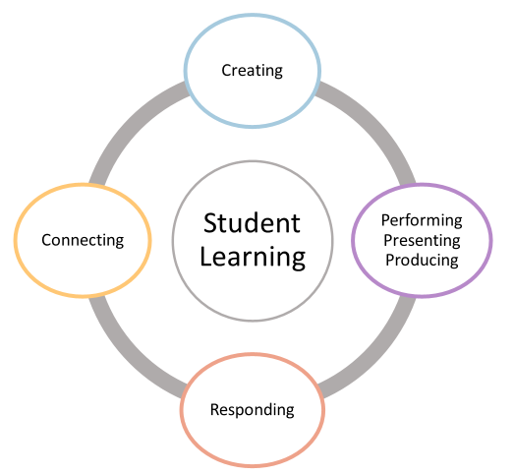
Multiple Entry Points for Learning
Notes:
Multiple Entry Points for Learning
The Artistic Processes provide multiple entry points for learning.
Teachers can engage students first in one artistic process and then build in one or more of the remaining processes.
Teachers can also engage students in multiple processes simultaneously to support learning and creating authentically in an arts discipline.
The combination and delivery of the processes is guided by the teacher’s intended learning outcomes.
As students grow in the Artistic Processes, they develop depth of understanding.
Throughout a grade span or proficiency level, instruction should address all Artistic Processes, providing a balanced approach.
Possible discussion/reflection question: What are some examples of how students might enter this cyclical model of learning?
Chapter Page: 9

Slide 10
Process Components
The Artistic Processes break down into Process Components which:
define the behaviors and artistic practices that students engage in as they work through the Artistic Processes;
serve as fluid and dynamic guideposts through art making processes and not linear or prescriptive actions; and
mark entry points for students to enter and reenter the artistic process at varying points depending on circumstance or purpose.
Notes:
Process Components
The Artistic Processes break down into Process Components
They define the behaviors and artistic practices that students engage in as they work through the Artistic Processes.
They provide paths for students to engage in Creating, Performing/Presenting/Producing, Responding, and Connecting within an arts discipline.
They are fluid and dynamic guideposts through art-making processes and are not linear or prescriptive actions.
Students can and should enter and reenter the process at varying points depending on circumstance or purpose.
Completion is not required each time students engage in a process component.
Chapter Pages: 18–20

Slide 11
Exploring Process Components
Consider how Process Components might inform a lesson or unit of study in a discipline of your choice:
Choose a discipline and one or more Artistic Processes.
Read the Process Components.
Consider how this might inform how instruction is organized.
Access the Arts Standards at https://www.cde.ca.gov/be/st/ss/vapacontentstds.asp
Notes:
Exploring Process Components
The Process Components, combined with the Enduring Understandings and Essential Questions, promote student discovery and development of their artistic sensibilities and abilities. (See slide 16 for more about Enduring Understandings and Essential Questions)
When planning instruction, teachers can use the Process Components to direct student-based inquiries.
Instruction that fosters student inquiry in the arts requires design that builds students’ creative capacities as well as their artistic academic knowledge and technical skills.
Suggested activity—consider how Process Components might inform a lesson or unit of study in a discipline of your choice:
Choose a discipline and one or more Artistic Processes.
Read the Process Components.
Consider how this might inform how instruction is organized.
Chapter Pages: 18–20

Slide 12
Process Components for Visual Arts & Media Arts
CREATING | PRESENTING | RESPONDING | CONNECTING
Imagine, Plan, Make Investigate Reflect, Refine, Revise | Select, Analyze; Prepare; Present | Perceive, Analyze; Interpret; Evaluate | Synthesize Relate
VA
CREATING | PRODUCING | RESPONDING | CONNECTING
Conceive Develop Construct | Integrate Practice Present | Perceive Interpret Evaluate | Synthesize Relate
MA
Notes:
Process Components for Visual Arts & Media Arts
This slide is for use with the activity on the Exploring Process Components slide.
Consider how Process Components might inform a lesson or unit of study in a discipline of your choice:
Choose a discipline and one or more Artistic Processes.
Read the Process Components.
Consider how this might inform how instruction is organized.
Chapter Pages: 18–20

Slide 13
Process Components for Dance & Theatre
CREATING | PERFORMING | RESPONDING | CONNECTING
Explore Plan Revise | Express Embody Present | Analyze Interpret Critique | Synthesize Relate
DA
CREATING | PERFORMING | RESPONDING | CONNECTING
Envision Conceptualize Develop Rehearse | Select Prepare Share Present | Reflect Interpret Evaluate | Empathize Interrelate Research
TH
Notes:
Process Components for Dance & Theatre
This slide is for use with the activity on the Exploring Process Components slide.
Consider how Process Components might inform a lesson or unit of study in a discipline of your choice:
Choose a discipline and one or more Artistic Processes.
Read the Process Components.
Consider how this might inform how instruction is organized.
Chapter Pages: 18–20

Slide 14
Process Components for Music
CREATING | PERFORMING | RESPONDING | CONNECTING
Imagine Plan and Make Evaluate and Refine Present | Select Analyze Interpret Rehearse, Evaluate, and Refine Present | Select Analyze Interpret Evaluate | Synthesize Relate
MU
Notes:
Process Components for Music
This slide is for use with the activity on the Exploring Process Components slide.
Consider how Process Components might inform a lesson or unit of study in a discipline of your choice:
Choose a discipline and one or more Artistic Processes.
Read the Process Components.
Consider how this might inform how instruction is organized.
Chapter Pages: 18–20

Slide 15
Shared Artistic Processes and Anchor Standards
Artistic Process | Anchor Standard: Students will…
Cr (Creating) | 1. Generate and conceptualize artistic ideas and work. 2. Organize and develop artistic ideas and work. 3. Refine and complete artistic work.
Pr (Performing, Presenting, Producing) | 4. Analyze, interpret, and select artistic work for presentation. 5. Develop and refine artistic work for presentation. 6. Convey meaning through the presentation of artistic work.
Re (Responding) | 7. Perceive and analyze artistic work. 8. Interpret intent and meaning in artistic work. 9. Apply criteria to evaluate artistic work.
Cn (Connecting) | 10. Synthesize and relate knowledge and personal experiences to make art. 11. Relate artistic ideas and works with societal, cultural, and historical context to deepen understanding.
Notes:
Shared Artistic Processes and Anchor Standards
The Arts Standards include two types of standards:
The Anchor Standards, which are the same for all arts disciplines and for all grade levels
The Student Performance Standards, which are specific to each arts discipline and specific to each grade level or proficiency level
The Artistic Processes and Anchor Standards are shared by the five disciplines.
The Anchor Standards articulate the generalized outcomes of students’ TK–12 learning, shared by all five arts disciplines.
The Anchor Standards should not be confused with the discipline-specific Student Performance Standards.
The Student Performance Standards are discipline-specific learning expectations for each grade or proficiency level.
The shared Artistic Processes and Anchor Standards offer opportunities for arts educators to have cross-arts-discipline discussions focused on supporting student learning in the arts.
Chapter Pages: 4–8

Slide 16
Enduring Understandings (EUs) and Essential Questions (EQs)
Notes:
Enduring Understandings (EUs) and Essential Questions (EQs)
Chapter Pages: 10–14

Slide 17
EUs & EQs as Organizers for Instruction
EUs & EQs help organize information, skills, and experiences during instruction. They
capture big ideas central to the arts discipline;
clarify the intentions and goals of the standards;
promote activation of prior knowledge; and
enable transfer of information and skills.
EUs and EQs are not meant to limit what students may explore.
Notes:
EUs & EQs as Organizers for Instruction
EUs & EQs help organize the information, skills, and experiences within Artistic Processes.
In Understanding by Design (2005), Grant Wiggins and Jay McTighe emphasize that Enduring Understandings and Essential Questions are those that encourage transfer beyond the topic in which students first encounter them.
For this reason, EUs and EQs remain constant through the grade levels to promote the evolution of concepts and enable curriculum coherence over the grade levels.
Consider the sample sets of EUs and EQs from page 8–9
Is this a shift in how instruction has been organized in the past?
What challenges may come with this structure?
What opportunities does this structure provide?
Chapter Pages: 10–14

Slide 18
Student Performance Standards
Student Performance Standards articulate what students will achieve and translate the standards into measurable goals.
In PK–8 performance standards are assigned to each grade.
In high school there are performance standards for three levels—Proficient, Accomplished, Advanced.
The Student Performance Standards translate the Anchor Standards into discipline-specific, explicit, and measurable learning goals for each grade level, proficiency level, or high school course level.
Notes:
Student Performance Standards
Chapter Pages: 20–26

Slide 19
Proficiency Levels for High School Performance Standards
High School Proficient | High School Accomplished | High School Advanced
A level of achievement attainable by most students who complete a high- school level course in the arts (or equivalent) beyond the foundation of quality PK–8 instruction | A level of achievement attainable by most students who complete a rigorous sequence of high-school level courses (or equivalent) beyond the Proficient level. | A level and scope of achievement that significantly exceeds the Accomplished level. Achievement at this level is indisputably rigorous and substantially expands students’ knowledge, skills, and understandings beyond the expectations articulated for Accomplished achievement.
Notes:
Proficiency Levels for High School Performance Standards
See page 22 for the full chart
The music standards for Harmonizing and Ensembles also include the proficiency levels Novice (nominally assigned to grade five) and Intermediate (nominally assigned to grade eight).
Chapter Pages: 20–26

Slide 20
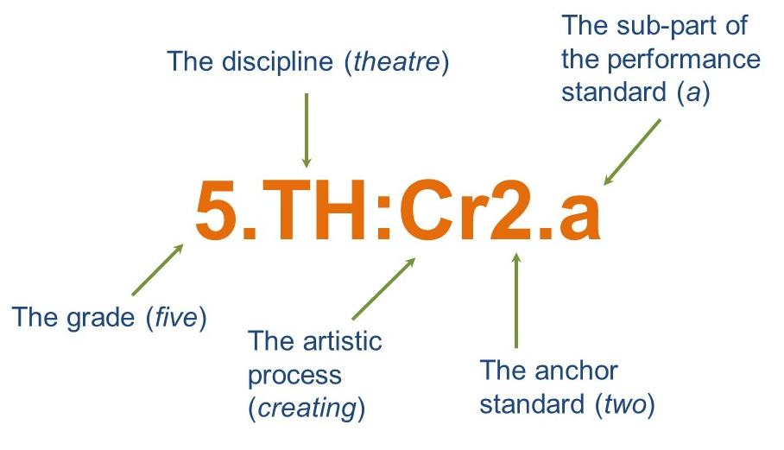
Coding System for the Standards
Notes:
Coding System for the Standards
An agreed-upon system for coding allows educators to reference the performance standards more efficiently when planning lessons and units of study.
The coding system of the performance standards is illustrated on this slide.
The coding is more complex for music and visual arts, so this is just a simple example.
Sample of the coding system for Theatre, grade five: 5.TH:Cr2.a
Grade: 5
Artistic Discipline: Theatre
Anchor Standard: Creating, 2 (of 11)
Process Component: Develop—the process component is not indicated in the coding because there is only one process component.
Subpart of Performance Standard: a
Chapter Pages: 14–17

Slide 21
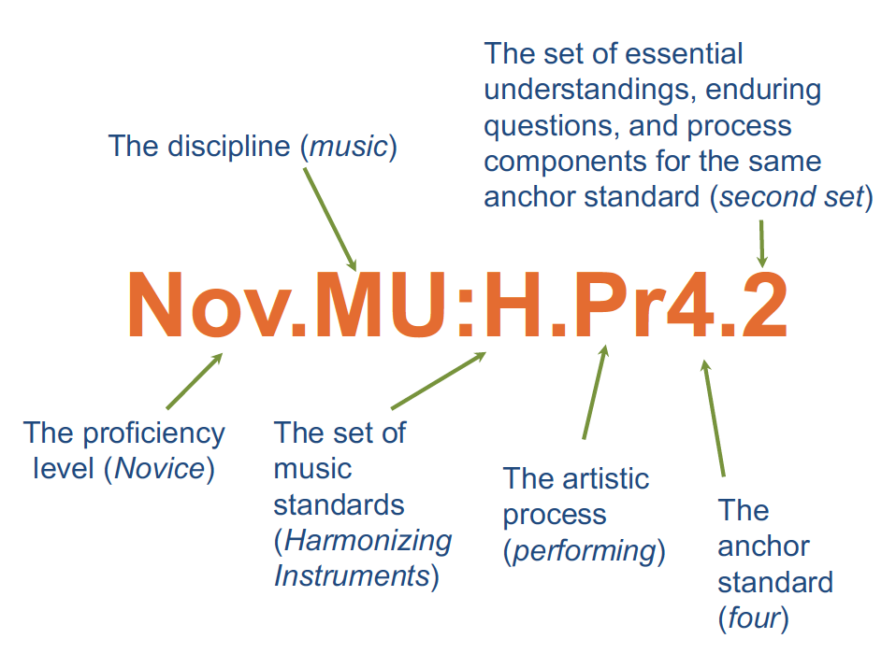
Sample Coding For Music
Notes:
Sample Coding For Music
Unlike the other arts disciplines, there are five sets of performance standards for music.
A one-letter code is added after the artistic discipline code for all but one set of the performance standards (PK–8) as follows: Harmonizing Instruments (H), Ensembles (E); Composition and Theory (C), Technology (T).
In addition, there are two additional levels for the Music Harmonizing performance standards, with the codes indicated in the parentheses:
Novice (Nov), nominally assigned to the fifth-grade level
Intermediate (Int), nominally assigned to the eighth-grade level
Chapter Pages: 14–17

Slide 22
Example of How the Structural Elements of The Arts Standards Work Together—2.MU:Cr1a
CREATING—Anchor Standard 1: Generate and conceptualize artistic ideas and work.
Enduring Understanding: The creative ideas, concepts, and feelings that influence musicians’ work emerge from a variety of sources.
Essential Question: How do musicians generate creative ideas?
Process Component: Imagine
Performance Standard: a. Improvise rhythmic and melodic patterns and musical ideas for a specific purpose.
The music standards have an additional distinct “strand” structure that reflects the increasing variety of music courses available to students. See Chapter 5, Music, for more information.
Notes:
Example of How the Structural Elements of The Arts Standards Work Together—2.MU:Cr1a
An Artistic Process, Anchor Standard, Enduring Understanding, Essential Question, and related Process Component is aligned in each grade and proficiency level with one or more discipline-specific Student Performance Standard.
Chapter Pages: 4–25

Slide 23
Suggestions for Reading the Discipline-Specific Student Performance Standards
Grade-to-grade Reading: The standards can be read across grade levels as a progression to
attend to grade-level standards and understand the scaffolding and spiral design of the standards; and
meet the individual needs of students who may be performing above or below grade level.
Within-grade Reading: The standards may be read to understand all outcomes for a grade level including
the learning outcomes for a subset of standards in a specific grade level; and
all standards for a particular grade level.
Notes:
Suggestions for Reading the Discipline-Specific Student Performance Standards
The performance standards are designed to be approached in holistic ways to design robust lessons within units of study.
They are presented as grade-level progressions by individual standard so that teachers can see not only their own grade level, but also the standards for previous grade levels and future ones.
They can be read in a variety of ways, two of which are suggested here: grade-to-grade and within-grade.
Within-grade reading allows teachers to see what all of the outcomes for their grade level are so that they can integrate standards as appropriate for lesson and unit learning goals.
Chapter Pages: 21–22

Slide 24
Q2—How can the 2019 Arts Standards be used to set clear learning expectations?
Notes:
How can the 2019 Arts Standards be used to set clear learning expectations?
Chapter Pages: 26–32

Slide 25
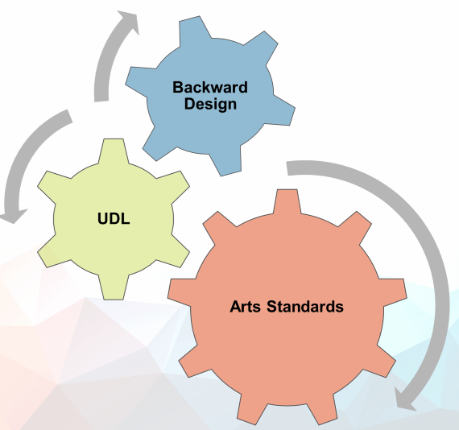
Planning Tools
When developing instruction using Backward Design; principles of Universal Design for Learning (UDL); and the content, skills, and processes of the arts disciplines, the Arts Standards become a powerful tool for teaching and learning.
Notes:
Planning Tools
The Arts Standards embody the principles of instructional design that begin with the outcome in mind (backward design) and UDL. They are
process-oriented, grade-appropriate indicators of what students need to know and be able to do;
student centered and rooted in backward design; and
outcomes based, communicating high and achievable goals.
Backward design
is the process of defining intended outcomes prior to designing educational experiences to ensure students attain those outcomes; and
focuses on what students will know and be able to do and how they will demonstrate it.
UDL focuses on providing instruction that recognizes and removes barriers to learning for all students.
Chapter Pages: 26–32

Slide 26
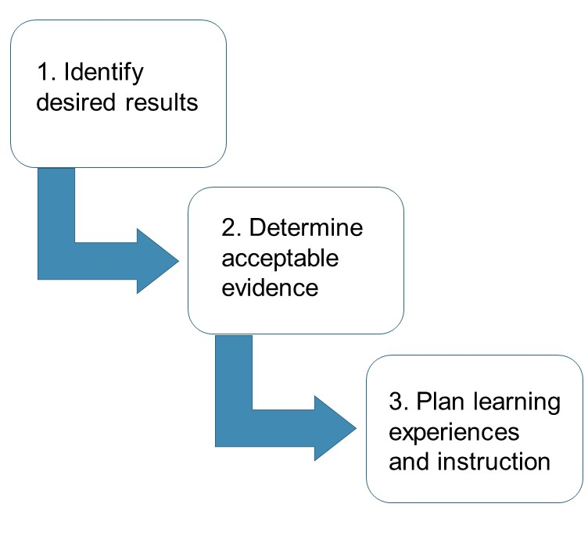
Planning Process
Map the curriculum.
Use the Arts Standards to plan instruction.
Design formative and summative assessments (results should yield qualitative as well and quantitative data).
This topic is addressed in the Supporting Learning for All Students section.
Notes:
Planning Process
The focus of the Backward Design Process (according to Wiggins and McTighe 1998) is what students will know and be able to do and how they will demonstrate it.
Chapter Pages: 26–32

Slide 27
Step 1: Map the Curriculum to Set Yearlong Course Learning Goals
The course learning goals for all disciplines are articulated by grade level (TK–8) and secondary proficiency levels in the performance standards component of the Arts Standards.
The performance standards are the desired results for course learning goals.
Curriculum maps can be valuable aids in implementation of arts learning and in articulating learning goals to all school leaders, teachers, and the broader community.
Notes:
Step 1: Map the Curriculum to Set Yearlong Course Learning Goals
NOTE: “Curriculum mapping is the process of indexing or diagraming a curriculum to identify and address academic gaps, redundancies, and misalignments for purposes of improving the overall coherence of a course of study and, by extension, its effectiveness …” (Great Schools Partnership: Glossary of Education Reform, November 2013).
Chapter Pages: 28–31

Slide 28
Research Supports a Comprehensive Approach to Instructional Planning
Children who see themselves developing competence are more motivated to learn. As students gain expertise, they understand that exerting effort brings success. When faced with activities based on incoherent organization, students are more likely to see themselves as subjects of seemingly random events. They show less agency and possess less knowledge about steps needed to succeed. If an instructional approach lacks cohesion it undermines opportunities to gain mastery and the confidence that motivates future learning
—Newmann et al., 2001
Notes:
Research Supports a Comprehensive Approach to Instructional Planning
Read pages 24 and 25 and discuss: Have you experienced the positive effects of a comprehensive approach to instructional planning? What might get in the way of taking a comprehensive approach?
Chapter Pages: 28–29

Slide 29
Effective Curriculum Maps for Comprehensive Arts Learning
Notes:
Effective Curriculum Maps for Comprehensive Arts Learning
Curriculum maps articulate a sequence and progression of arts learning, within and across grades and proficiency levels, aligned to the California Arts Standards.
Effective curriculum maps are living documents that provide scaffolds for the discipline-specific knowledge and content skills, and facilitate sequential learning aligned to Artistic Processes, Process Components, and Student Performance Standards.
Successful curriculum maps identify the discipline-specific knowledge and skills students learn when they complete the course or grade level.
Curriculum that is based on clear identification and articulation of learning goals in relationship to the instructional delivery model(s) and actual in school learning time is critical in creating arts literacy. Curriculum maps for arts education should serve to articulate teaching and instructional approaches used in teaching the arts and aligned with district/school instructional goals.
Chapter Page: 29

Slide 30
Step 2: Determining Acceptable Evidence and Designing Assessments
Assessment is most effective when it
is provided on a regular, ongoing basis;
provides a comprehensive view of student knowledge and skills;
is seen as an opportunity to promote learning rather than as a final judgment;
shows learners their strengths and opportunities for growth; and
provides information to redirect efforts, make plans, and establish future learning goals.
Notes:
Step 2: Determining Acceptable Evidence and Designing Assessments
Chapter Page: 32

Slide 31
Sample Questions to Consider When Linking Assessment to Evidence
What type of assessments are needed?
How will the assessments provide options for action and expression?
What are the possible actual assessment tasks that will provide opportunities for students to demonstrate their understanding?
How will the assessments provide multiple options for students to demonstrate their learning?
What criteria will be used to determine evidence for, of, and as learning?
Notes:
Sample Questions to Consider When Linking Assessment to Evidence
The full list of questions from the chapter includes:
What type of assessments are needed? Formative assessment or summative assessment? Or a combination?
Will the assessment(s) be formal or informal? Or a combination?
How will the assessments provide options for action and expression?
What are the possible actual assessment tasks that will provide opportunities for students to demonstrate their understanding?
How will the assessments provide multiple options for students to demonstrate their learning?
What is the student product/performance that will show evidence of student understanding?
How will the assessment task optimize individual student choice and autonomy in demonstrating their learning?
What criteria will be used to determine evidence for, of, and as learning?
Chapter Pages: 33–34

Slide 32
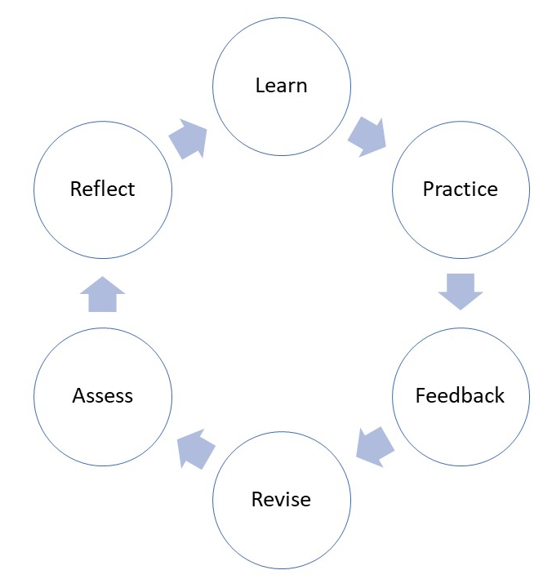
Cyclical Process for Learning, of Learning, and as Learning
Notes:
Cyclical Process for Learning, of Learning and as Learning
The learning process is cyclical.
Assessments should affirm students’ ways of knowing and provide students with multiple opportunities to demonstrate growth and mastery of learning in the arts discipline.
Chapter Page: 35

Slide 33
Summative Assessment
Summative assessment of arts learning
Measures student learning, understanding, and skill acquisition at the conclusion of a specified instructional period
Happens at the end of an instructional unit, a lesson series, a season, or production
Provides the opportunity for students to demonstrate that they have achieved the learning objective(s)
Provides teachers and students with feedback they can use to determine next steps in instruction and decide course placement
Notes:
Summative Assessment
Chapter Page: 36

Slide 34
Authentic Assessment
Summative assessment can be designed as an authentic assessment task which
emulates a performance that would be required of students in real-life situations;
allows demonstration and understanding of accumulated knowledge; and
provides varying methods for response and navigation.
Authentic assessment tasks are NOT
Daily lesson plans or daily lesson activities
Learning activities to introduce any new knowledge
Complete without a scoring tool
Notes:
Authentic Assessment
Authentic Assessment emulates the performance that would be required of a student in real-life situations (NCAS 2014).
It can be used to assess a student’s ability to create an artistic product, to assess the attributes of the product itself such as the performing of a solo, a specific dance genre or style, or a scene from a play, the design of a sculpture, or developing a trailer for a film.
It can be used while the skill is being performed (a student’s role within a musical piece, a specific monologue from a play, the creation of a three-dimensional space on a two-dimensional plane, etc.).
Authentic assessment tasks
are not daily lesson plans or daily lesson activities;
do not introduce any new knowledge;
are incomplete without a scoring tool;
demonstrate an understanding of accumulated knowledge; and
provide varying methods for response and navigation. (Understanding by Design 2013, CAST 2011).
See the chapter for more about Wiggins and McTighe and Understanding by Design (UbD).
Chapter Pages: 36–37

Slide 35
Questions to Inform Design of Authentic Assessments
What is convincing evidence of understanding?
How do I know students are not just giving back what was taught without understanding it?
What evidence could show whether students have real or apparent understanding?
What are the potential misunderstandings, misconceptions, and areas where learners may meet barriers?
How might these barriers be overcome?
Notes:
Questions to Inform Design of Authentic Assessments
The questions on the slide can be used as reflection points when initiating and designing authentic assessment.
Wiggins and McTighe caution that authentic assessment tasks designed as assessment tools can easily be confused with learning activities, so teachers must focus on using authentic assessment tasks to evaluate learning rather than to teach new concepts.
Chapter Page: 37

Slide 36
Snapshot: Cumulative Authentic Assessment Task
Read the snapshot on page 35 and use the following questions to analyze and discuss the task:
Does the task match the outcome(s) being measured?
Does the task require the students to use critical thinking skills?
Does the task use engaging tasks from the “real world?”
Does the task provide learners multiple ways and options to authentically engage in the process, take action, and demonstrate understanding?
Is the task a worthwhile use of time; credible, feasible and clearly defined; fair and free from bias?
Notes:
Snapshot: Cumulative Authentic Assessment Task
Cumulative assessments are a type of authentic assessment that
can be set in real or simulated settings and include the constraints, background noise, and circumstances an adult would find in a similar situation;
identifies the task’s specific purpose as it relates to an identified audience;
should be shared with the students at the beginning of the unit as an end goal;
offers students opportunities to demonstrate the synthesis of their learning; and
provides students agency in personalizing their response.
The Snapshot on page 35 is an example of a cumulative authentic assessment task in an advanced high school dance class.
Chapter Pages: 38–40

Slide 37
Portfolios as Summative Assessment (1)
An arts portfolio is “a purposeful collection of student work across time which exhibits a student’s efforts, progress, or level of proficiency.”
Contents vary and may include artifacts, samples, methods of goal setting, and include student self-reflection.
Types described in chapter 2 include Project, Growth, Achievement, Competence, and Celebration.
Notes:
Portfolios as Summative Assessment (1)
Chapter Pages: 40–47

Slide 38
Portfolios as Summative Assessment (2)
Read about the different types of portfolios on pages 41–47
What are the differences?
Which portfolio types have you applied or will you consider for your teaching and context? Why?
Notes:
Portfolios as Summative Assessment (2)
Chapter Pages: 40–47

Slide 39
Formative Assessment
Effective formative assessment in the arts is
aligned with an artistic process;
based on performance standard(s) and criteria that describes high-quality processes and products; and
a fluid process with continuous exchange of feedback that informs instruction and guides learning.
Students who engage in the formative assessment process gain greater independence, stronger motivation, and lasting understanding.
Notes:
Formative Assessment
Formative assessment provides students opportunities to
provide evidence of learning;
analyze and reflect on feedback as abilities develop; and
act according to developing understanding.
“A hallmark of formative assessment is its emphasis on student efficacy, as students are encouraged to be responsible for their learning and the classroom is turned into a learning community (Gardner 2006; Harlen 2006). To assume that responsibility, students must clearly understand what learning is expected of them, including its nature and quality. Students receive feedback that helps them to understand and master performance gaps, and they are involved in assessing and responding to their own work and that of their peers (see also Heritage 2010).” (Hilton, M. L., & Pellegrino, J. W. (Eds.). (2012)—Education for Life and Work: Developing Transferable Knowledge and Skills in the 21st Century. Washington, DC: The National Academies Press.)
Chapter Pages: 47–48

Slide 40
Communication and Formative Assessment
Communication-based formative assessment strategies
Can yield responses that recall information, explain, describe, identify, tell, give examples, define, choose, and select
Include questions that prompt students to analyze, compare and contrast, synthesize, classify, infer and deduce, and evaluate
Additional methods to demonstrate understanding, set goals, and create next steps in partnership with the teacher include
Teacher-student conferences
Student-led interviews
Notes:
Communication and Formative Assessment
Communication is fundamental for formative assessment in arts learning.
Continuous personal communication between the teacher and each student should be a fundamental aspect of formative assessment in the arts classroom.
Teacher–student conferences and student-led interviews are additional methods for implementing communication-based formative assessment.
Teachers and students can develop questions prior to the conference or interview to prepare each party for specific learning targets and ensure that concepts are communicated in advance.
This practice also creates next steps in partnership with the teacher.
Chapter Pages: 47–48

Slide 41
Effective Feedback in Formative Assessment
Correlates with clear evaluation criteria
Identifies what is evident in student work and what needs development without prescribing fixes
Is free from judgment, promotes growth, and encourages risk-taking
Cultivates individual expression and self-discovery
Helps students see their role in contributing to what is needed and what can be improved
When timely and ongoing, feedback supports the development of a growth mindset and reinforces the concept that learning takes time and practice.
Notes:
Effective Feedback in Formative Assessment
Read the snapshot on page 45 and consider how the example of feedback provided supports students in sustaining effort and persistence.
Chapter Pages: 48–50

Slide 42
Self & Peer Assessment in Formative Feedback
Self and peer assessment are student-centered and help develop student independence.
Teachers and students can select and agree upon criteria for meeting learning expectations together.
Generating feedback this way includes students in guiding aspects of their learning and informs their next steps.
Notes:
Self & Peer Assessment in Formative Feedback
Self and peer assessment make assessment student centered.
Teachers can design self- and peer-assessment approaches to develop student independence.
Together, teachers and students can use methods to agree upon criteria for meeting learning expectations:
Students develop capacities for making judgments about whether an artwork does or does not meet the agreed-upon expectations.
The feedback generated informs next steps and includes the students in guiding aspects of the learning.
Chapter Pages: 50–52

Slide 43
Feedback for Generating Formative Assessment
Review the sampling of standards on pages 51 and 52.
Choose one standard and describe how you might facilitate the generation of feedback for formative assessment purposes.
Notes:
Generating Feedback for Formative Assessment
Examples from pages 51 and 52 for the practice activity:
CREATING—Anchor Standard 3: Refine and complete artistic work.
Dance: Process Component: Revise
Performance Standard: 7.DA:Cr3a: Evaluate possible revisions of dance compositions and, if necessary, consider revisions of artistic criteria based on self-reflection and feedback of others. Explain reasons for choices and how they clarify artistic intent.
RESPONDING—Anchor Standard 9: Apply criteria to evaluate artistic work.
Media Arts: Process Component: Evaluate
Performance Standard: 5.MA:Re9: Determine and apply criteria for evaluating media artworks and production processes, considering context, and practicing constructive feedback.
PERFORMING—Anchor Standard 5: Develop and refine artistic techniques and work for presentation.
Music PK–8: Process Component: Rehearse, Evaluate, and Refine
Performance Standard: 3:MU:Pr5a: Apply teacher provided and collaboratively developed criteria and feedback to evaluate accuracy of ensemble performances.
CREATING—Anchor Standard 3: Refine and complete artistic work.
Theatre: Process Component: Rehearse
Performance Standard: 6.TH:Cr3a: Receive and incorporate feedback to refine a devised or scripted drama/theatre work.
CREATING—Anchor Standard 3: Refine and complete artistic work.
Visual Arts: Process Component: Reflect, Refine, Revise
Performance Standard: 4.VA:Cr3: Revise artwork in progress on the basis of insights gained through peer discussion.
Chapter Pages: 51–52

Slide 44
Additional Considerations for Quality Classroom Assessment
Why are we assessing? What is the purpose and who will use the results?
What should be assessed? Are there clear learning targets?
How do we assess? What are our methods and how do we sample them?
Do all our assessments communicate to the learner first and foremost, and then to other users, parents, administration, and others who support arts education?
Notes:
Additional Considerations for Quality Classroom Assessment
Comprehensive discussion and discipline-specific guidance on assessment is provided in chapters 3–7.
Chapter Page: 33

Slide 45
Additional Chapter 2 Assessment Topics
Discussions of different types of assessments (pp. 53–56)
Selected Response
Extended Written Response
Cornerstone Assessments
Rubrics as scoring tools for arts learning (pp. 56–63)
Types, benefits, and how to evaluate a rubric prior to use
Assessment and grading (pp. 63–64)
Recommendations from Marzano and Heflebower
Notes:
Additional Chapter 2 Assessment Topics
Chapter Pages: 53–64

Slide 46
Q3—In developing artistic literacy, what considerations for instructional design support learning for all students?
Notes:
In developing artistic literacy, what considerations for instructional design support learning for all students?
Chapter Pages: 64–90

Slide 47
Planning Learning Experiences and Instruction to Support All Students
Notes:
Planning Learning Experiences and Instruction to Support All Students
Earlier slides focused on Step 1 (Identify desired results—map the curriculum and use the Arts Standards to plan instruction) and Step 2 (Determine acceptable evidence—design formative and summative assessments).
Step 3 (plan learning experiences and instruction) is addressed in the Supporting Learning for All Students section of chapter 2.
Chapter Pages: 64–90

Slide 48
Shared Responsibility—Developing Artistically Literate Individuals
Teachers in all content areas share the responsibility to ensure that students are broadly literate and prepared for college and career.
In the CA CCSS for ELA/Literacy, the arts are considered a technical subject:
The reading standards require reading in BOTH literal English language texts AND complex discipline-specific texts that contain unique symbol systems, syntax, and visual representations (e.g., a painting, a dance, a theatre production, etc.).
The writing standards require students to write to communicate, sometimes in combination with, and sometimes only in discipline-specific technical notation, graphics, images, or symbol systems.
Notes:
Shared Responsibility—Developing Artistically Literate Individuals
Reminder from chapter 1: Artistic literacy is the ability to understand, create, perform or present or produce, respond, and connect through the arts and transfer knowledge and skills learned from authentic experiences in the arts that transcend historical, cultural, and societal contexts.
The arts empower and amplify student voice and provide an academic avenue through which to express thoughts, emotions, and ideas.
These benefits hinge on student access to high-quality curriculum and effective instruction in all five arts disciplines, including opportunities to meet or exceed the Arts Standards; the California Common Core State Standards for English Language Arts and Literacy in History/Social Studies, Science, and Technical Subjects (CA CCSS for ELA/Literacy); and the California English Language Development Standards.
The CA CCSS for ELA/Literacy, when used in conjunction with the Arts Standards, provide additional guidance for student learning expectations and outcomes related to literacy.
Arts educators and teachers of other content areas share the responsibility to ensure that students achieve arts and English language literacy capacities and are prepared to enter college and career.
The discipline-specific chapters contain additional guidance on the shared responsibility to develop multiliterate individuals.
Chapter Page: 65

Slide 49
What is “Text” in the Arts?
The term text in the context of the arts disciplines can refer to the artwork itself or linguistic language of or about the artwork or arts discipline. To read is to derive meaning. When one derives meaning from an arts experience, a performance or viewing of artwork, one is reading it. Writing is expressing meaning through making art, creating a performance, or writing about artwork through linguistic language. Developing literacy in the arts disciplines includes developing skills, vocabularies, and methods to read, write, and understand a variety of texts within the arts discipline.
—Chapter 2, page 66
Notes:
What is “Text” in the Arts?
Read the chapter excerpt on the slide.
What are some examples of this that you can think of in one or more arts discipline?
Share your example with the group.
Examples from Chapter 1:
Dance: a dance performance, live or recorded; an article critiquing a performance; Labanotation or other written form of choreography
Media Arts: a photograph, logo, or film; a manual or guide for software or applications; an article critiquing a film or documentary
Music: a musical score; a concert or musical performance, live or recorded; program notes for a specific performance
Theatre: a lighting plot or blocking/staging notes; a script or spoken dialogue in improvisation; a play or musical performance, live or recorded
Visual Arts: a drawing, painting, sculpture, or installation; mockups and sketchbooks; an artist’s statement for an artwork, exhibit, or show
Chapter Page: 66

Slide 50
Culturally Responsive Teaching in the Arts
Culturally responsive planning and teaching ensures that instruction addresses the whole child.
Culturally responsive educators connect the development of knowledge and skills in the arts with students’ cultural identities.
“When used effectively, culturally responsive pedagogy has the ability to help students build intellective capacity and intellective competence.”
—Hammond, 2015
Notes:
Culturally Responsive Teaching in the Arts
Chapter pages: 75–78

Slide 51
Hammond’s Framework of Considerations for Culturally Responsive Teaching
Notes:
Hammond’s Framework of Considerations for Culturally Responsive Teaching
Zaretta Hammond’s Ready for Rigor framework identifies key elements of cultural responsiveness and organizes them into four practice areas for culturally responsive educators.
Chapter pages: 75–78

Slide 52
Culturally Responsive Teachers
Have awareness of self, implicit bias, and the larger socio-political context
Build and support learning partnerships with students
Provide students culturally relevant content and authentic opportunities to engage in information processing
Focus on the community of learners and learning environment by providing a socially and intellectually safe space that promotes self directed learning
Explore further: Ready for Rigor: A Framework for Culturally Responsive Teaching
https://crtandthebrain.com/wp-content/uploads/READY-FOR-RIGOR_Final.pdf
Notes:
Culturally Responsive Teachers
Use the link to download the Ready for Rigor Framework to use with the next slide.
Chapter pages: 75–78

Slide 53
Vignette: Culturally Responsive Teaching in Theatre
1. Read the Vignette on pages 77–78.
2. Reflect and Discuss:
What aspects of the teaching practices in the Ready for Rigor Framework does this example reflect?
What are the additional preparation or supports that are implied or assumed in the example?
Can you think of an example of an arts lesson (or unit) in another arts discipline that is informed by these teaching practices?
Notes:
Vignette: Culturally Responsive Teaching in Theatre
Read the vignette and use the prompts on the slide and Zaretta Hammond’s Ready for Rigor Framework to analyze the vignette on page 72.
Chapter pages: 75–78

Slide 54
Q4—How can the principles of Universal Design for Learning (UDL) optimize learning for all students?
Notes:
How can the principles of Universal Design for Learning (UDL) optimize learning for all students?
Chapter Pages: 78–90

Slide 55
Optimizing Arts Learning
Instructional design should include time for developing artistic literacy, engaging in student-driven inquiry, and creating authentically in the disciplines.
Through day-to-day arts learning which includes all four artistic processes, students acquire academic language and develop technical artistic skills.
UDL principles and guidelines help optimize arts learning and ensure accessible and meaningful arts learning experiences for all students.
Notes:
Optimizing Arts Learning
More information on UDL principles and guidelines, as well as practical suggestions for classroom teaching and learning, can be found at the National Center for UDL and in the California ELA/ELD Framework (2015).
Chapter Page: 78

Slide 56
UDL Principles Connect With Student Goals
Principle for designing learning: Provide multiple means of… | Goal for students: Creating expert learners who are…
ENGAGEMENT | Purposeful & Motivated
REPRESENTATION | Resourceful & Knowledgeable
ACTION & EXPRESSION | Strategic & Goal-Directed
Notes:
UDL Principles Connect With Student Goals
This table is not included in the chapter but may be helpful for understanding the point of using UDL principles when designing learning experiences.
Though chapter 2 addresses the principles in the order of 1) Representation, 2) Action and Expression, and 3) Engagement, it is sometimes useful to consider Engagement first.
The table illustrates the relationship between the UDL principles, or categories, being employed in lesson design and how they correlate to the specific goals for students as they develop into expert learners.
Providing multiple means of ENGAGEMENT addresses the “WHY” of learning and supports students to become purposeful and motivated.
Providing multiple means of REPRESENTATION addresses the “WHAT” of learning and supports students to become resourceful and knowledgeable.
Providing multiple means of ACTION and EXPRESSION addresses the “HOW” of learning and supports students to become strategic and goal directed.
For more general information about UDL, including a list of frequently answered questions, go to the CAST website at https://udlguidelines.cast.org/.
Chapter Pages: 78–90

Slide 57
Universal Design for Learning
Principles Provide multiple means of… | Guidelines Provide options for…
I. Engagement Provide multiple ways to engage students’ interests and motivation. | Recruiting interest Sustaining effort and persistence Self-regulation
II. Representation Represent information in multiple formats and media. | Perception Language and symbols Comprehension
III. Action and Expression Provide multiple pathways for students’ actions and expressions. | Physical action Expression and communication Executive functions
(ELA-ELD Framework 2015, and CAST 2018)
Notes:
Universal Design for Learning
The UDL principles provide useful guidelines for teachers to develop accessible and meaningful arts learning.
More information on UDL principles and guidelines, as well as practical suggestions for teaching and learning, can be found at the National Center for UDL and in the California ELA/ELD Framework (2015).
Chapter Page: 79

Slide 58
Multiple Means of Representation in Arts Learning
Options for Perception Ensure concepts, skills, and processes are perceptible for all learners Offer multiple modalities for information, including visual, auditory, tactile
Learning Language and Symbols of the Arts Support English language development and include support to decode text and symbols in the language of the arts discipline Provide multiple media forms for ways to perceive, read, express, and develop fluency
Supporting Comprehension Activate background and prior knowledge when introducing new information Use the Enduring Understandings and Essential Questions to show patterns, critical features, and relationships, and enable transfer of knowledge
Notes:
Multiple Means of Representation
Multiple Means of Representation refers to the “what” of learning.
Teachers can present information through a variety of approaches that are accessible to all learners, including options to customize how information is displayed.
The purple color of the title field of the slide corresponds to the use of purple for multiple means of representation in the graphic organizers created by CAST.
See the discipline-specific chapters for examples of UDL strategies for each principle in each discipline.
Chapter Pages: 79–81

Slide 59
Multiple Means of Action and Expression in Arts Learning
Physical Action in the Arts Include various methods for physical action to navigate learning and investigate and create solutions to artistic problems Provide a variety of tools and any needed assistive technologies
Expression and Communication in the Arts Disciplines Provide multiple means of presenting or performing learning and allow a wide and flexible range of expression For differentiation, use models and examples that demonstrate clear outcomes that can be achieved through different strategies, approaches, or skills Gradually release learning scaffolds as skills and independence develop
Developing Students’ Executive Functions Provide prompts, guides, and scaffolds for support as students work toward self-identified goals Use opportunities for reflection on past work to inform future goals
Notes:
Multiple Means of Action and Expression in Arts Learning
Multiple Means of Action and Expression refers to the “how” of learning.
Just as students perceive, process, and comprehend concepts and skills in multiple ways, students also use, demonstrate, and express what they know and are able to do in different ways.
As students engage in the artistic processes of any, one, or all, of the arts disciplines, there should be many ways in which they can create, share, respond, and connect with the art.
The blue color of the title field of the slide corresponds to the use of blue for multiple means of action and expression in the graphic organizers created by CAST.
See the discipline specific chapters for examples of UDL strategies for each principle in each discipline.
Chapter Pages: 81–84

Slide 60
Multiple Means of Engagement with the Arts Disciplines
Enlisting Students Interest Provide opportunities for individual choice and autonomy Consider cultural, historical, contemporary, political, and social relevance when creating investigations for students
Opportunities for Sustained Effort and Persistence Ensure students see connection between individual tasks and learning objectives Guide collaboration with clear models and expectations and devote time to demonstrate, model, and assess ensemble work Ensure meaningful assessment, feedback, and engage in ongoing communication with students
Options for Student Self-Regulation Ensure instruction and assessment provide opportunities to develop and refine rehearsal and practice techniques to develop student capacity to monitor their growth
Notes:
Multiple Means of Engagement with the Arts Disciplines
Multiple Means of Engagement refers to the “why” of learning.
A critical component of learning is having a desire to learn, develop and maintain an emotional connection to the learning.
Learners’ engagement and the motivation differ greatly among students.
Teachers who recognize what influences and impacts their students’ motivation—such as culture, personal relevance, background knowledge, learning environment, collaborative versus independent tasks—are much more likely to encourage and foster conditions that will support student engagement and motivation for learning.
The green color of the title field of the slide corresponds to the use of green for multiple means of engagement in the graphic organizers created by CAST.
See the discipline specific chapters for examples of UDL strategies for each principle in each discipline.
Chapter Pages: 85–87

Slide 61
Vignette: Personalized Learning Supporting Development of Self-regulation
1. Read the vignette on pp. 88–89
2. Reflect and Discuss—
What are the ways that the teacher is supporting the development of student self-regulation?
What is an example of an approach in another discipline lesson that could support the development of student self-regulation ?
Notes:
Vignette: Personalized Learning Supporting Development of Self-regulation
Read the vignette on pages 88–89.
Reflect/Discuss:
What are the ways that the teacher is supporting the development of student self-regulation?
What is an example of an approach in another discipline lesson that could support the development of student self-regulation?
Chapter Pages: 88–89

Slide 62
In Conclusion
Designing and implementing standards-aligned instruction including assessment “for learning,” “of learning,” and “as learning” will support student achievement of artistic literacy.
Setting clear learning expectations in the arts cultivates artistically literate, creative, and capable students.
Supporting students with effective and purposeful attention to their needs creates inclusive, student-centered arts learning environments that foster inquiry and creativity, and develop independent and self-reflective learners.
Effective standards-based instructional design that removes barriers to learning and creates inclusive student-centered arts learning environments makes arts education equitable and accessible to each and every student.
Notes:
In Conclusion
For further discipline-specific guidance on the Arts Standards and standards-aligned instruction refer to Chapter 3: Dance, Chapter 4: Media Arts, Chapter 5: Music, Chapter 6: Theatre, and Chapter 7: Visual Arts.

Slide 63
For Reflection
What else do I want to explore in the framework?
What concepts and approaches can I apply (now, soon, next year) in my classroom or when supporting other teachers?
What’s the next conversation I’m going to have about this and with whom?
Notes:
For Reflection…
Consider exploring the discipline-specific guidance related to the information in chapter 2 in the discipline chapters for Dance, Media Arts, Music, Theatre, and Visual Arts.

