Slide 1




Chapter 1: Vision and Goals for Standards-Based Arts Education
2020 Arts Education Framework for California Public Schools, Transitional Kindergarten Through Grade Twelve
California Department of Education
Tony Thurmond, State Superintendent of Public Instruction
Notes:
About this Presentation
This presentation deck includes content from Chapter 1 of the 2020 Arts Education Framework for California Public Schools, Transitional Kindergarten Through Grade Twelve (Arts Framework).
The content was selected and refined in collaboration with leaders from California County Superintendents Educational Services Association (CCSESA) Statewide Arts Initiative and The California Arts Project (TCAP).
The slides are mostly self-explanatory, but in some places the slide notes contain clarifying talking points, possible reflection questions, or notes that may be useful for anyone facilitating a group.
The presentation deck
is meant to be a resource for educators and education partners to use to guide their reading of the Arts Framework;
is designed to use for self- or group study; and
captures highlights and provides entry points to the chapter, but the slides and the notes are not meant to be exhaustive and represent all content in the chapter.
The slides and notes are not intended to be a substitute for reading the chapter.
The slide notes also reference chapter pages from which the slide content originates.
Educators may download and modify the presentation for personal use.
The content may be used as a foundation from which to build workshops and presentations.
Contact the Curriculum Frameworks and Instructional Resources Division at cfird@cde.ca.gov with any questions about the content or use of the presentation deck.

Slide 2
Introduction to Chapter 1
The 2019 California Arts Standards for Public Schools, Prekindergarten Through Grade Twelve (Arts Standards) map out a pathway for a standards-based arts education in dance, media arts, music, theatre, and visual arts.
The California Arts Education Framework for California Public Schools: Transitional Kindergarten Through Grade Twelve provides guidance for implementation of the Arts Standards.
Chapter 1 articulates the vision and goals for arts education and the vital role of the arts disciplines in cognitive, creative, social, cultural, and emotional development.
Notes:
Introduction to Chapter 1
Chapter Pages: 1–2

Slide 3
Contents of Chapter 1
Developing Artistically Literate Students
The California Arts Standards
Preparing Students for Careers
Learning in the Arts: Part of a California Students’ Well-rounded Education
Opportunity to Learn in the Arts
Inclusive Arts Education
Digital Citizenship
Relationship and Connection to other Content Standards
Notes:
Contents of Chapter 1
Developing Artistically Literate Students is the largest section of the chapter and includes topics such as the philosophical foundations and lifelong goals of the standards; why an arts education; how the arts contribute to cognitive development, critical thinking, community and cultural development, social and emotional well-being; and more.
The next several sections focus on the role of the California Arts Standards and preparing students for careers.
The section on the arts as part of California students’ well-rounded education includes discussions of laws and systems including the Every Student Succeeds Act (ESSA), California Education Code, University of California/California State University requirements, and the Local Control Funding Formula (LCFF).
Opportunity to Learn standards for the arts are introduced and outlined.
In the Inclusive Arts Education section, the framework’s approach and perspective on accessibility of arts instruction as a matter of equity is introduced.
The next section discusses the importance of Digital Citizenship in an era where students are able to use technology to create and share works freely.
The chapter closes with a discussion about how the 2019 California Arts Standards connect to other California content standards.

Slide 4
Questions for Chapter 1: Focus on Artistic Literacy
What is artistic literacy?
What are the foundational concepts that drive California’s vision of artistic literacy?
What are the benefits of a sequential, standards-based arts education?
What role does arts education play in cognitive, creative, social, cultural, and emotional development?
Notes:
Questions for Chapter 1: Focus on Artistic Literacy
Since artistic literacy is a major focus of chapter 1, half of the questions are related to artistic literacy.
Chapter Pages: n/a

Slide 5
Additional Questions for Chapter 1
What role can arts education play in career readiness?
How do federal and state policies support arts learning as part of a students’ well-rounded education?
What planning and considerations should be in place to provide students with opportunities to learn in the arts?
What is the relationship and connection of the 2019 California Arts Standards to other standards?
Notes:
Additional Questions for Chapter 1
Chapter Pages: n/a

Slide 6
Q1—What is artistic literacy?
Notes:
What is artistic literacy?
Chapter Pages: 1–8

Slide 7
The Goal of a Sequential Standards-based Arts Education in California is to Develop Artistic Literacy
ARTISTIC LITERACY IS DEFINED IN THE FRAMEWORK AS…
…the ability to understand, create, perform or present or produce, respond, and connect through the arts and transfer knowledge and skills learned from authentic experiences in the arts that transcend historical, cultural, and societal contexts.
Notes:
The Goal of a Sequential Standards-based Arts Education in California is to Develop Artistic Literacy
Possible discussion/reflection:
Notice the artistic processes from the standards that are included in the definition—create, perform (for dance, music, and theatre) or present (visual arts) or produce (for media arts), respond, and connect. What are some examples of these in arts learning experiences?
What does it mean to transfer knowledge and skills learned from authentic experiences in the arts?
What does it mean to transcend historical, cultural, and societal contexts?
Chapter Page: 1

Slide 8
Achieving Artistic Literacy
Students achieve artistic literacy when they:
practice the skills of creativity, collaboration, communication, critical thinking, and cultural awareness;
engage in creative practices and artistic processes using tools, equipment, instruments, or arts materials in spaces appropriate for authentic practice; and
develop the ability to transfer knowledge and skills to new experiences and contexts.
Notes:
Achieving Artistic Literacy
Chapter Pages: 6–7

Slide 9
Q2—What are the foundational concepts that drive California’s vision of artistic literacy?
Notes:
What are the foundational concepts that drive California’s vision of artistic literacy?
Chapter Pages: 1–8

Slide 10
California’s Vision of Artistic Literacy is Grounded in The Foundational Concepts of The Arts Standards
The philosophical principles and lifelong goals provide a portrait of artistic literacy and illuminate how
students can continue to learn and participate in the arts beyond high school; and
involvement in the arts contributes to the creation of lifelong learners who are prepared to accomplish their own goals in life and to participate collaboratively in a global community.
Notes:
California’s Vision of Artistic Literacy is Grounded In The Foundational Concepts of The Arts Standards
Chapter Pages: 4–7

Slide 11
Exploration of the Philosophical Foundations and Lifelong Goals
Read through the philosophical foundations and lifelong goals (the next six slides).
Choose one that resonates with you.
Respond—what does learning look and sound like when instruction is based on the foundation and designed to move students towards the goal?
Record/Share your thoughts…
Notes:
Philosophical Foundations and Lifelong Goals of the Standards
Chapter Pages: 1–6

Slide 12
The Arts as Communication
Philosophical Foundation | Lifelong Goal
In today’s multimedia society, the arts are the media, and therefore provide powerful and essential means of communication. The arts provide unique symbol systems and metaphors that convey and inform life experience (i.e., the arts are ways of knowing). | Artistically Literate Citizens use a variety of artistic media, symbols, and metaphors to independently create and perform work that expresses and communicates their own ideas and are able to respond by analyzing and interpreting the artistic communications of others.
Notes:
The Arts as Communication
Chapter Pages: 1–6

Slide 13
The Arts as Creative Personal Realization
Philosophical Foundation | Lifelong Goal
Participation in each of the arts as creators, performers, and audience members (responders) enables individuals to discover and develop their own creative capacity, thereby providing a source of lifelong satisfaction. | Artistically Literate Citizens find at least one arts discipline in which they develop sufficient competence to continue active involvement in creating, performing, and responding to art as an adult.
Notes:
The Arts as Creative Personal Realization
Chapter Pages: 1–6

Slide 14
The Arts as Culture, History, and Connectors
Philosophical Foundation | Lifelong Goal
…Understanding artwork provides insights into individuals’ own and others’ cultures and societies, while also providing opportunities to access, express, and integrate meaning across a variety of content areas. | Artistically Literate Citizens know and understand artwork from varied historical periods and cultures, and actively seek and appreciate diverse forms and genres of artwork of enduring quality and significance. They also seek to cultivate habits of searching for and identifying patterns to understand relationships among the arts and between the arts and other content knowledge.
Notes:
The Arts as Culture, History, and Connectors
The philosophical foundation was excerpted to fit the slide. The full quote is provided below.
Full Quote:
The Arts as Culture, History, and Connectors. Throughout history the arts have provided essential means for individuals and communities to express their ideas, experiences, feelings, and deepest beliefs. Each discipline shares common goals but approaches them through distinct media and techniques. Understanding artwork provides insights into individuals’ own and others’ cultures and societies, while also providing opportunities to access, express, and integrate meaning across a variety of content areas. Artistically literate citizens know and understand artwork from varied historical periods and cultures, and actively seek and appreciate diverse forms and genres of artwork of enduring quality and significance. They also seek to cultivate habits of searching for and identifying patterns to understand relationships among the arts and between the arts and other content knowledge.
Chapter Pages: 1–6

Slide 15
The Arts as a Means to Wellbeing
Philosophical Foundation | Lifelong Goal
Participation in the arts as creators, performers, and audience members (responders) enhances mental, physical, and emotional wellbeing. | Artistically Literate Citizens find joy, inspiration, peace, intellectual stimulation, meaning, and other life-enhancing qualities through participation in all of the arts.
Notes:
The Arts as a Means to Wellbeing
Chapter Pages: 1–6

Slide 16
The Arts as Community Engagement
Philosophical Foundation | Lifelong Goal
The arts provide means for individuals to collaborate and connect with others in an enjoyable inclusive environment as they create, prepare, and share artwork that bring communities together. | Artistically Literate Citizens seek artistic experiences and support the arts in their local, state, national, and global communities.
Notes:
The Arts as Community Engagement
Chapter Pages: 1–6

Slide 17
The Arts as Profession
Philosophical Foundation | Lifelong Goal
Professional artists weave the cultural and aesthetic fabric of communities and cultivate beauty, enjoyment, curiosity, awareness, activism and personal, social, and cultural connection and reflection. This fabric strengthens communities, enhances the lives of individuals, and inspires the global community. | Artistically Literate Citizens appreciate the value of supporting the arts as a profession by engaging with the arts and by supporting the funding of the arts. Some artistically literate individuals will pursue a career in the arts, thereby enriching local, state, national, and global communities and economies.
Notes:
The Arts as Profession
Chapter Pages: 1–6

Slide 18
Artistically Literate Individuals
Acknowledge and appreciate the relationship between the arts disciplines and other content areas and seek to develop, express, and integrate meaning across content areas
Value the arts as a means of expression and the significance of civic engagement in communities
Understand that each arts discipline has a unique and evolving language and use it to convey and interpret meaning
Collaborate and connect with others to create, prepare, and share artwork that brings communities together
Have the capacity to transfer arts knowledge and skills to multiple situations and settings, both in and outside the school environment
Notes:
Artistically Literate Individuals…
Possible Reflection/Discussion:
What aspects of artistic literacy as described in this section stand out to you?
What resonates?
Are there any surprises?
Chapter Pages: 1–6

Slide 19
Q3—What are the benefits of a sequential, standards-based arts education?
Notes:
What are the benefits of a sequential, standards-based arts education?
Chapter Pages: 9–16

Slide 20
Benefits of a Standards-Based Arts Education
Providing standards-based arts education in all five disciplines
Furthers academic goals
Enhances student engagement
Enhances parent and community engagement
Contributes to positive school culture and climate
Ensures equitable arts learning for all students
Notes:
Benefits of a Standards-Based Arts Education
Chapter Page: 2

Slide 21
Arts Education and Individuality
Education is a process of learning how to become the architect of your own experience and therefore learning how to create yourself. The arts have distinctive contributions to make to that end through their emphasis on the expression of individuality and through the exercise and development of the imaginative capacities.
Elliot W. Eisner — Professor of Arts and Education
Notes:
Arts Education and Individuality
For more from Elliot W. Eisner, Professor of Arts and Education and author of The Arts and the Creation of the Mind, see pages 9, 11, 19, 20, , 24, 41, and 44.
Chapter Pages: 9–16

Slide 22
Cognitive Skill Development
  Cognitive flexibility and agility are required for college and career.
  The arts strengthen ability to perceive, observe, make connections, recognize relationships, be flexible in thinking, and accept ambiguity.
  The emphasis on creativity in the arts engages students in higher-order thinking skills.
Notes:
Cognitive Skill Development
Cognitive flexibility and agility are required for college and career.
The arts strengthen ability to perceive, observe, make connections, recognize relationships, be flexible in thinking, and accept ambiguity.
Each arts discipline provides a unique way of thinking, seeing, engaging, and understanding the world.
The arts place great emphasis on creativity and require students to engage in higher-order thinking skills (inclusive of the creative practices).
Chapter Pages: 9–16

Slide 23
Creative Practices Inherent in Arts Education
        Creative problem-solving
        Inquisitiveness and perseverance
        Problem identification and research
        Interpretation and communication
        Precision and accuracy
  *These creative practices provide opportunities for students to learn and transfer knowledge, skills, and habits to other contexts and settings
Notes:
Creative Practices Inherent in Arts Education
Chapter Pages: 9–16

Slide 24
Creativity Can Be Developed
We take it for granted that nearly everybody can learn to read and write. If a person can’t read or write, you don’t assume that this person is incapable of it, just that he or she hasn’t learned how to do it. The same is true of creativity.
Sir Ken Robinson — Author, Arts Educator
Notes:
Creativity Can Be Developed
Possible Reflection/discussion
How are imagination, empathy, innovation, and creativity linked?
What are the implications for instruction?
For more from Sir Ken Robinson see pages 8–11
Chapter Pages: 9–16

Slide 25
What are some discipline-specific examples of how the arts contribute to cognitive development?
Choose an excerpt and read to identify some examples
  Dance, p.11
  Music, p.12
  Theatre, p.13
  Visual Arts, p.13
Notes:
What are some discipline-specific examples of how the arts contribute to cognitive development?
Media arts is left out of this activity because, as noted on page 14, while “many of the effects on cognitive development gained by students learning in the other arts disciplines may transfer to their learning and work in media arts…the unique impact of media arts on cognitive development requires continued investigation in future research.”
Chapter Pages: 9–16

Slide 26
Arts Education is a Necessary Part of a Democratic Education
A democratic education means that we educate people in a way that ensures they can think independently, that they can use information, knowledge, and technology, among other things, to draw their own conclusions.
Linda Darling-Hammond —California State Board of Education President
The intent of arts education in California is that it is equitable and accessible to each and every student
Notes:
Arts Education is a Necessary Part of a Democratic Education
Linda Darling-Hammond is the president of the State Board of Education and Charles E. Ducommun is a Professor of Education Emeritus at Stanford University and founding president of the Learning Policy Institute.
Chapter Pages: 16–17

Slide 27
Q4—What role does arts education play in cognitive, social, cultural, and emotional development?
Notes:
What role does arts education play in cognitive, social, cultural, and emotional development?
Chapter Pages: 16–26

Slide 28
Arts Education Cultivates Communication, Cooperation, and Empathy (1)
  An increase of arts in the curriculum results in better social adjustment, greater self reliance, and greater social cohesion among students.
  Expression makes personal development possible by providing individual students with multiple ways to “be themselves.”
  Collaborative art-making may serve an evolutionary purpose of increasing communication, coordination, cooperation, and empathy within a group.
  Civic engagement is a significant outcome of arts education and the acquisition of artistic literacy—students understand they have the power and responsibility to affect the community and society at large and can use the arts as “powerful agents of change.”
Notes:
Arts Education Cultivates Communication, Cooperation, and Empathy (1)
Research suggests that collaborative art-making may serve an evolutionary purpose of increasing communication, coordination, cooperation, and even empathy within a group (Miendlarzewska and Trost 2014).
Expression makes personal development possible by providing individual students with multiple ways to “be themselves” that they may not be able to access otherwise.
Research shows an increase in social cohesion among students, a greater self-reliance among students, better social adjustment, and more positive attitudes in students through an increase of arts in the curriculum (Hallam 2010).
Civic engagement is a significant outcome of arts education and the acquisition of artistic literacy. Students understand that they each have the power and responsibility to affect the community and society at large and are able to do this through the arts. As a result, students can use the arts as “powerful agents of change” (Seidel et al. 2009).
Chapter Pages: 18–20

Slide 29
Arts Education Cultivates Communication, Cooperation, and Empathy (2)
Reflect and Discuss
How do the statements on the previous slide confirm or challenge your current assumptions?
Identify and share related examples from your curriculum
Notes:
Arts Education Cultivates Communication, Cooperation, and Empathy (2)
Chapter Pages: 18–20

Slide 30
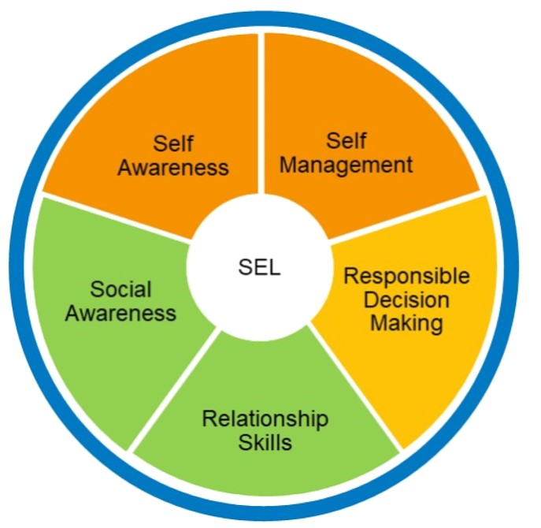
Arts Education Supports Social and Emotional Development
Through the artistic processes, creative practices, and social interactions inherent in the arts, students
acquire and apply knowledge and skills necessary to establish and maintain positive relationships;
set and achieve goals;
practice empathy for others;
recognize and effectively express emotions; and
make responsible decisions.
Notes:
Arts Education Supports Social and Emotional Development
Possible Extension Activity—Read pages 18–20 and discuss:
How can social emotional learning (SEL) be embedded within sequential standards-based arts learning experiences?
What examples resonate with you?
Can you think of any additional discipline-specific examples?
Chapter Pages: 20–22

Slide 31
Through Arts Education, Students Have Opportunities to Develop and Maintain a Growth Mindset
Arts learning experiences
Develop capacity for creativity, innovation, and invention as well as experimentation, investigation, and revision
Provide opportunities to realize that practice and persistence yield progress
“In the fixed mindset, everything is about the outcome. If you fail—or if you’re not the best—it’s all been wasted. The growth mindset allows people to value what they’re doing regardless of the outcome. They’re tackling problems, charting new courses, working on important issues” (Dweck 2016).
Notes:
Through Arts Education, Students Have Opportunities to Develop and Maintain a Growth Mindset
Possible reflection/discussion questions:
Does this confirm or challenge your current assumptions?
Do you have any related examples to share?
Chapter Pages: 23–25

Slide 32
The Arts Teach Valuable Skills and Develop Students in Unique Ways
The Arts:
Connect students to themselves and each other
Transform the environment for learning
Connect learning experiences to the world
Reach students who are not otherwise being reached
Provide new challenges for those students already considered successful
Notes:
The Arts Teach Valuable Skills and Develop Students in Unique Ways
From Champions of Change: The Impact of the Arts on Learning (Fiske et al. 1999)
Chapter Pages: 23–26

Slide 33
Sequential, Standards-Based Arts Education in California is Guided by the 2019 Arts Standards
  The 2019 Arts Standards:
  Articulate and identify what students know and are able to do
  Promote authentic learning in each arts discipline
  Are process-oriented
  Call for an increased attention to process and consideration of balance with process and product-oriented learning
  Articulate what students do, not what teachers teach
Notes:
Sequential, Standards-Based Arts Education in California is Guided by the 2019 Arts Standards
The 2019 Arts Standards:
Articulate and identify discipline-specific, grade-appropriate achievement and demonstration of what students know and are able to do
Describe the intended outcomes of student learning
Promote authentic learning in each arts discipline, including all aspects of the discipline
Are process-oriented, delineating authentic practices and performance within each arts discipline
Call for an increased attention to process and consideration of balance with process and product-oriented learning
Articulate what the students are doing, not what teachers are teaching
The 2019 Arts Standards are discussed further in Chapter 2: The Instructional Cycle.
Chapter Pages: 27–28

Slide 34
Inclusive Arts Education
Rather than providing a separate chapter to ensure access and equity in arts education, each chapter of the Arts Framework embeds guidance to support all students.
Guidance is provided for students with a wide range of needs, abilities, and experiences.
Guidance is provided for educators to use principles of Universal Design for Learning to remove barriers to learning.
Chapters include strategies and conditions for differentiation, approaches to assessment, and examples for modifications and accommodations.
Notes:
Inclusive Arts Education
Instruction in the arts disciplines must be accessible by all students. The Arts Framework supports teachers, administrators, and other education partners in developing and delivering high-quality, discrete arts curriculum and instruction that meets the needs of each and every student.
This includes support for students with a wide range of needs, abilities, and experiences, including students who are English learners; at promise students (Per Education Code Section 96, the term “at-risk” is replaced in the Education Code with the term “at-promise.”); lesbian, gay, bisexual, transgender, queer, and questioning (LGBTQ+) students; advanced learners; and students with visible and non-visible disabilities.
Rather than providing a separate chapter to ensure access and equity in arts education, each chapter of the Arts Framework is designed to include guidance to support ways that arts educators can ensure that all students receive instruction designed for universal access.
This support includes strategies and conditions for differentiation of instruction, approaches to formative and summative assessment, and examples for modifications and accommodations within arts classrooms.

Slide 35
Q5—What role can arts education play in career readiness?
Notes:
What role can arts education play in career readiness?
Chapter Pages: 28–30

Slide 36
Arts Education Develops Career Skills
Creativity, innovation, critical thinking and problem-solving, communication, collaboration, and cooperation skills are needed for many fields and industries
There is no doubt that creativity is the most important human resource of all. Without creativity, there would be no progress and we would be forever repeating the same patterns.
— Edward de Bono, Otis Report of the Creative Economy of the Los Angeles Region and the State of California, 2018.
Notes:
Arts Education Develops Career Skills
Creativity, innovation, critical thinking and problem-solving, communication, collaboration, and cooperation skills are needed for many fields and industries.
Arts learning guided by The 2019 California Arts Standards prepares students to make connections and utilize their acquired arts knowledge and artistic skills in multiple contexts.
The Otis Report recognizes the strong and consistent link shown in research between high-quality arts education and a wide range of student outcomes, including “increased student engagement, improved attendance, focused attention, heightened educational aspirations, and development of habits of mind such as problem solving, critical and creative thinking, dealing with complexity, and integration of multiple skill sets.” The Otis Report further acknowledges the link the arts have to the “development of social competencies including collaboration and teamwork skills, social tolerance, and self-confidence” (Los Angeles County Economic Development Corporation 2018).
For more on the creative economy including the most recent report, see the Otis Report on Creativity and the Economy https://www.otis.edu/creative-economy from the Otis College of Arts and Design
Chapter Pages: 28–29

Slide 37
Career and Technical Education—Arts, Media, and Entertainment (CTE AME)
CTE AME pathways prepare students to continue their arts education in university and arts school studies or to enter the creative workforce immediately.
Through these pathways, students
  experience challenging academic and career-related learning;
  benefit from learning opportunities and partnerships that increase career guidance and educational relevance; and
  acquire industry certifications in the arts prior to graduation and prepare for entry into the industry.
Notes:
Career and Technical Education—Arts, Media, and Entertainment
Careful planning of comprehensive programs in the arts disciplines is necessary to prepare students for careers in the arts and for postsecondary study of the arts. Such planning may involve collaboration and cooperation with Career and Technical Education (CTE), Arts, Media, and Entertainment (AME) programs.
CTE AME pathways can prepare students to continue their arts education in university and arts school studies or to enter the creative workforce immediately.
CTE AME pathways provide access to arts career and academic curriculum that includes industry-based standards. Through these pathways students can
experience challenging academic and career-related learning;
benefit from learning opportunities and partnerships that increase career guidance and educational relevance; and
acquire industry certifications in the arts prior to graduation and be prepared for entry into the industry.
Chapter Pages: 28–29

Slide 38
Q6—How do federal and state policies support arts learning as part of a student’s well-rounded education?
Notes:
How do federal and state policies support arts learning as part of a students’ well-rounded education?
Chapter Pages: 31–34

Slide 39
The Every Student Succeeds Act (ESSA)
ESSA (2015) provides clear intent to support all students through a “well-rounded” education to include…
…courses, activities, and programming in subjects such as English, reading or language arts, writing, science, technology, engineering, mathematics, foreign languages, civics and government, economics, arts, history, geography, computer science, music, career and technical education, health, physical education, and any other subject, as determined by the State or local educational agency, with the purpose of providing all students access to an enriched curriculum and educational experience.
Notes:
The Every Student Succeeds Act (ESSA)
Chapter Pages: 31–34

Slide 40
Under ESSA
  Flexibility in Title I funds can provide supplemental funds for a well-rounded education including the arts.
  Professional learning and development for teachers of the arts disciplines (single subject and multiple subject teachers) can be provided through ESSA Titles I, II and IV funds.
  Removing students from the classroom, including arts classrooms, for remedial instruction is discouraged.
Notes:
Under ESSA
ESSA places new emphasis on the arts as part of every students’ education, regardless of student circumstances, classifications, or conditions.
It requires local educational agencies (LEAs) to measure the effectiveness of their curricula.
Under Title IV, Part A of ESSA, LEAs can conduct needs assessments to identify gaps and deficiencies and improve the scope and depth of a student’s education by applying additional federal funds available under that Title as needed.
ESSA provides for ways to promote an inclusive environment, and discourages the removal of students from the classroom, including arts classrooms, for remedial instruction. Throughout ESSA, education—including access to arts education for all—is supported by the protection of instructional time. This means that students are not “pulled out” from arts (or “elective”) courses to receive remedial instruction, English language instruction, or any other necessary service supporting students’ learning and success in school.
Chapter Pages: 31–34

Slide 41
California Education Code
Includes minimum requirements for graduation and expectations for arts education in grades 1–12
EC Section 51222.3 — high school graduation requirements include one year of visual and performing arts, foreign language, or career technical education
EC Section 51210 — requires that all students in grades 1 to 6 shall receive instruction in visual and performing arts
EC Section 51220 — stipulates that all students grades 7 to 12, shall have access to courses in visual and performing arts
Notes:
California Education Code
Chapter Pages: 31–34

Slide 42
University of California (UC) and
California State University (CSU)
The UC/CSU systems have established a uniform minimum set of courses required for admission as a freshman, including one year of visual and performing arts.
The UC maintains public “A–G” course lists that provide complete information about the high school courses.
The Visual and Performing Arts requirement (“F”) consists of one year of college-preparatory visual and performing arts in one of the following disciplines: dance, music, theatre, visual arts, or interdisciplinary arts.
A–G courses that are approved by the UC system are accepted by the CSU system.
Notes:
University of California (UC) and California State University (CSU)
The UC and CSUs have established a uniform minimum set of courses required for admission as a freshman.
The UC maintains public “A–G” course lists on its A–G Course List website that provide complete information about the high school courses. The “F” Visual and Performing Arts requirement consists of one year of college-preparatory visual and performing arts in one of the following disciplines: dance, music, theatre, visual arts, or interdisciplinary arts.
Admission as a first-time freshman into the CSU system requires a minimum of a 15-unit pattern of the “A–G” courses.
Courses that are approved by the UC system as an A–G course are accepted by the CSU system.
Chapter Pages: 31–34

Slide 43
Local Control Funding Formula
The Local Control Funding Formula (LCFF)
Creates funding targets based on student characteristics
Provides flexibility to use these funds to improve student outcomes
The Local Control Accountability Plan (LCAP)
Is a comprehensive planning tool to support student outcomes
Describes LEAs’ intent to meet annual goals for all pupils
Should clearly and specifically identify arts education with goals and related actions/services that address implementation of the arts standards
Notes:
Local Control Funding Formula
California’s Local Control Funding Formula (LCFF) creates funding targets based on student characteristics and provides greater flexibility to use these funds to improve student outcomes.
The Local Control Accountability Plan (LCAP) is intended as a comprehensive planning tool to support student outcomes and is an important component of the LCFF.
Under the LCFF, all LEAs including school districts, county offices of education (COEs), and charter schools are required to prepare an LCAP, which describes how they intend to meet annual goals for all pupils, with specific activities to address state and local priorities identified pursuant to California EC sections 52060(d), 52066(d), and 47605.
As part of California students’ well-rounded education, the arts should be clearly and specifically identified in district and county LCAPs. The LCAP must include goals and related actions/services that address implementation of the academic content and performance standards adopted by the State Board of Education, including the arts (California Department of Education 2018).
Chapter Pages: 31–34

Slide 44
Q7—What planning and considerations should be in place to provide students with opportunities to learn in the arts?
Notes:
What planning and considerations should be in place to provide students with opportunities to learn in the arts?
Chapter Pages: 34–37

Slide 45
Opportunity to Learn in the Arts
Opportunity to Learn is a set of criteria by which to assess and report whether students and teachers have access to the necessary resources for students to achieve the state standards and to create a plan for ongoing improvement and sustainability.
(Chapter 1, p. 32)
Notes:
Opportunity to Learn in the Arts
Chapter Pages: 32–35

Slide 46
Opportunity to Learn Conditions and Resources
Curriculum
Scheduling
Staffing
Facilities
Physical Safety
Materials and Equipment
Opportunity to Learn and the elements of an effective arts education program are further discussed in Chapter 9: Implementing Effective Arts Education, and additional details are provided in the discipline chapters.
Notes:
Opportunity to Learn Conditions and Resources
In assessing and monitoring Opportunity to Learn (OTL), conditions and resources include
Standards-Based Curriculum to Guide Instruction
Scheduling—Providing Time to Learn
Staffing: Qualified Teachers and Administration Personnel
Facilities to Promote Authentic and Safe Arts Learning
Physical Safety Considerations
Authentic and Appropriate Arts Materials and Equipment
Pages 33–35 elaborate on each of these conditions and resources
More about OTL is found in the discipline chapters (3–7) and chapter 9.
Chapter Pages: 32–35

Slide 47
A Note About Inclusion
The Arts Framework supports the development and implementation of high-quality, discrete arts curriculum and instruction for all students with a wide range of needs, abilities, and experiences.
Guidance related to access, equity, and inclusion is embedded throughout the Arts Framework.
The domain-specific languages of the arts provide students with alternative forms of expression and ways to demonstrate learning, and students will be on the continuum of learning fluency with this new language.
Notes:
A Note About Inclusion
The Arts Framework supports teachers, administrators, and other education partners in developing and delivering high-quality, discrete arts curriculum and instruction that meets the needs of each and every student. This includes support for students with a wide range of needs, abilities, and experiences, including students who are English learners; at promise students (Per Education Code Section 96, the term “at-risk” is replaced in the Education Code with the term “at-promise.”); lesbian, gay, bisexual, transgender, queer, and questioning (LGBTQ+) students; advanced learners; and students with visible and non-visible disabilities.
Rather than providing a separate chapter to ensure access and equity in arts education, each chapter of the Arts Framework is designed to include guidance to support ways that arts educators can ensure that all students receive instruction designed for universal access, including strategies and conditions for differentiation of instruction, approaches to formative and summative assessment, and examples for modifications and accommodations within arts classrooms.
The arts enable students to engage in collective sense making in a common language that extends beyond native languages. These domain-specific languages provide students with alternative forms of expression and ways to demonstrate learning. Each and every student is on the continuum of learning fluency with this new language, which includes opportunities to demonstrate learning and understanding in a variety of ways that often are not contingent upon the English language.
Administrators should ensure that teachers have appropriate and ongoing support to meet the needs of each and every student. Support includes the following:
Immediate and ongoing access to student case files identifying specific student needs and required modifications and accommodations and inclusion in Individualized Education Plan (IEP) and 504 meetings
Assistance, as appropriate, through instructional aides and instructional tools to ensure a safe and effective learning environment
Ongoing professional learning to ensure that all teachers (single subject and multiple subject) are current with teaching practice and research in order to provide appropriate accommodations and modifications and are current with teaching practices that support language development including skill and ability in language development, both for English and domain-specific language acquisition
Chapter Pages: 37–39

Slide 48
Q8—What is the relationship and connection of the 2019 California Arts Standards to other standards?
Notes:
What is the relationship and connection of the 2019 California Arts Standards to other standards?
Chapter Pages: 40–44

Slide 49
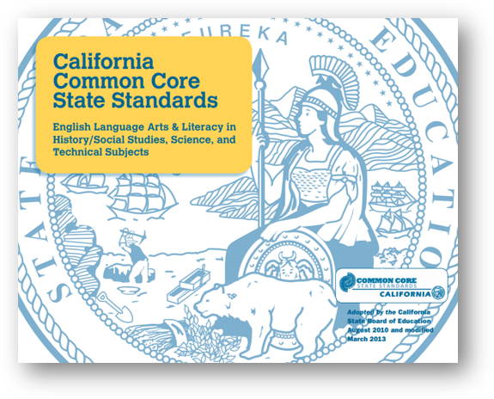
The California Common Core State Standards: English Language Arts and Literacy in History/Social Studies, Science, and Technical Subjects (CA CCSS for ELA/Literacy)
These standards provide guidance for literacy learning expectations and outcomes.
The language of each arts discipline extends traditional notions of text, reading, and writing from the CA CCSS for ELA/Literacy.
Literacy in the arts includes skills and capacities to read, write, and communicate effectively using the unique language or symbols of the arts discipline.
Notes:
The California Common Core State Standards: English Language Arts and Literacy in History/Social Studies, Science, and Technical Subjects (CA CCSS for ELA/Literacy)
In CA CCSS for ELA/Literacy, the arts are considered as technical subjects.
The CA CCSS for ELA/Literacy, when used in conjunction with the 2019 California Arts Standards, provide additional guidance for student learning expectations and outcomes related to literacy.
Developing literacy in the arts disciplines includes developing skills and capacities to read, write, and communicate effectively within linguistic language as well as read, write, and communicate effectively using the unique language or symbols of the arts discipline.
In the study of all arts disciplines, students should have ample opportunities to read and write about the art discipline and art works and performances. Yet, reading and writing about the art discipline is not sufficient in developing artistic literacy. Reading and writing within the language of each artistic discipline is the method of creating, sharing, and responding using the language of the arts discipline, and these methods can vary across cultures and time periods.
Chapter Pages: 40–44

Slide 50
Text in the Arts Disciplines
“Text” refers to print and non-print forms in an arts discipline, including a variety of formats such as an artwork, a performance, an exhibit, as well as any printed document discussing an artwork, performance or an arts discipline.
To “read” is to derive meaning—When one derives meaning from an arts experience, a performance, or viewing of artwork, one is “reading” it.
To “write” is to convey meaning—Meaning can be conveyed in the arts through a variety of methods such as making art, creating a performance, or drafting a printed document about an artistic endeavor.
Notes:
Text in the Arts Disciplines
Considering the language of each arts discipline extends traditional notions of text, reading, and writing, “Text” refers to print and non-print forms in an arts discipline, including a variety of formats such as an artwork, a performance, musical score, lighting plot in theatre, dance or choreographic notation, as well as any printed document discussing an artwork, performance, or an arts discipline.
To “read” is to derive meaning. When one derives meaning from an arts experience, a performance, or viewing of artwork, one is “reading” it.
Similarly, to “write” is to convey meaning. One can convey meaning in an arts discipline through a variety of methods such as making art, creating a performance, or drafting a printed document about an artistic endeavor.
Literacy in the arts includes possessing the skills, vocabularies, and methods to read, write, and understand a variety of texts within the arts discipline. The artistic processes of the arts standards each include different aspects of literacy within the discipline.
For example, the language of dance includes movement, theatrical elements, and Labanotation (or other choreographic notation methods). When a choreographer creates a series of movements, they are writing in dance. When a dancer is learning choreography, they are simultaneously reading what the choreographer has written and writing through their own movement. When an audience watches a dance performance, they are reading the performance, the combination of movement and theatrical elements.
Chapter Pages: 40–44

Slide 51
Examples of Text in the Arts Disciplines (1)
Visual Arts
A drawing, painting, sculpture, or installation
Mockups and sketchbooks
An artist’s statement for an artwork, exhibit, or show
Media Arts
A photograph, logo, or film
A manual or guide for software or applications
An article critiquing a film or documentary
Notes:
Examples of Text in the Arts Disciplines
Chapter Pages: 40–44

Slide 52
Examples of Text in the Arts Disciplines (2)
Music
A musical score
A concert or musical performance, live or recorded
Program notes for a specific performance
Theatre
A lighting plot or blocking/staging notes
A script or spoken dialogue in improvisation
A play or musical performance, live or recorded
Dance
A dance performance, live or recorded
An article critiquing a performance
Labanotation or other written form of choreography
Notes:
Examples of Text in the Arts Disciplines
Chapter Pages: 40–44

Slide 53
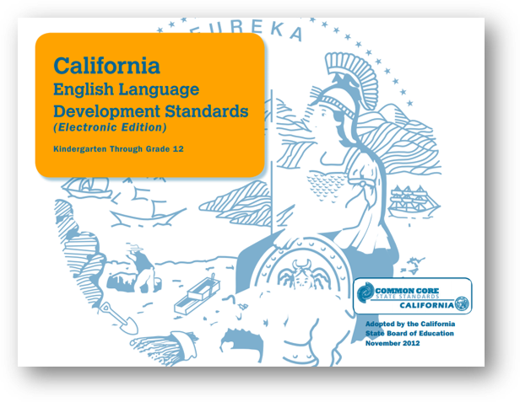
California English Language Development Standards (ELD Standards)
Students learning English require support as they are engaging in arts learning while also gaining proficiency in English.
The ELD Standards provide guidance to the learning expectations in all content areas to support English learners while accessing all the components of a well-rounded education.
The ELD Standards should be used in tandem with the 2019 California Arts Standards in all arts instruction.
Notes:
California English Language Development Standards
Students learning English, like all arts learners, require support as they are gaining proficiency in English.
The ELD Standards provide guidance to the learning expectations in all content areas, including the arts, to ensure students learning English are simultaneously developing academic English while accessing all the components of a well-rounded education.
Arts disciplines, which recognize all students as language learners, rely on the ELD Standards for guidance to support language acquisition.
The ELD Standards should be used in tandem with the 2019 California Arts Standards in all arts instruction.
Chapter Pages: 40–44

Slide 54
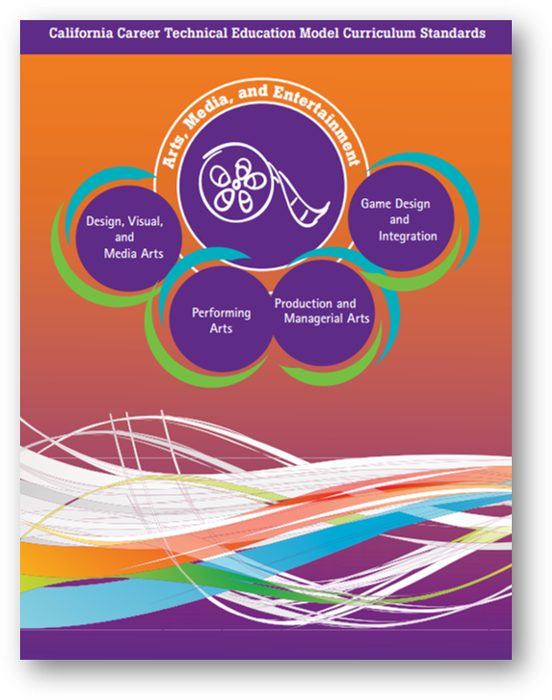
Career and Technical Education Model Curriculum Standards for the Arts, Media, and Entertainment (CTE AME)
The CTE AME standards provide guidance and student learning expectations for courses and pathways.
They complement and work in tandem with the 2019 California Arts Standards and arts courses to develop foundational knowledge.
Notes:
Career and Technical Education Model Curriculum Standards for the Arts, Media, and Entertainment (CTE AME)
CTE AME provide guidance and student learning expectations for courses and pathways designed to equip students with skills and experiences sufficient to enter postsecondary education and training to prepare for a smooth transition into the workforce in the Arts, Media, and Entertainment sector
These standards complement and should work in tandem with the 2019 California Arts Standards and arts courses to ensure students develop foundational knowledge in the arts disciplines as they develop and progress in a specialized pathway.
For more about the CTE AME sector see https://www.cde.ca.gov/ci/ct/gi/ameindustrysector.asp.
Chapter Pages: 40–44

Slide 55
In Conclusion
A comprehensive and sequential arts education for all California students offers the promise of a society of engaged, creative, expressive, responsive, and artistically literate members of society who are active in local and extended communities.
Notes:
In Conclusion

Slide 56
Students Who Achieve Literacy in the Arts
experience joy, inspiration, and a life-long appreciation of the arts;
are well-rounded; and
are prepared for the twenty-first century workforce.
Notes:
Students who achieve literacy in the arts…
Chapter Pages: 1

Slide 57
Reflection
Reflect on one or more of the following:
  What topics in this chapter stood out for me?
  What’s the next conversation I’m going to have about this and with whom?
  What are my next steps?
Notes:
Reflection

