Slide 1
Goals and Actions
In The 2022–23 Local Control and Accountability Plan (LCAP)
California Department of Education
December 9, 2021

Slide 2
Webinar Series
Tuesdays @ 2
12/14: Increased or Improved Services, Part I
1/11: 2022 Dashboard Local Indicator Process
Thursdays @ 3
12/9: Goals and Actions
12/16: Increased or Improved Services, Part II
1/18: Local Control and Accountability Plan (LCAP) Required Goals

Slide 3
Template Files
The LCAP Template: https://www.cde.ca.gov/re/lc/documents/lcaptemplate2022.docx
LCAP Action Tables Template: https://www.cde.ca.gov/re/lc/documents/lcapactiontables.xlsx
Supplement to the Annual Update to the 2021–22 LCAP Template (2021–22 Supplement): https://www.cde.ca.gov/re/lc/documents/lcapsupplement.docx
The Budget Overview for Parents Template is being revised to remove the references to the 2020–21 Learning Continuity and Attendance Plan and to align to the LCAP Template.

Slide 4
Purpose
To provide an overview of the Goals and Actions section of the LCAP and the connection to the Action Tables.
To highlight aspects of the Goals and Actions that will be implemented for the first time with the 2022–23 LCAP.
Notes:
In this presentation, we will briefly touch on all of the various components of the LCAP template and instructions, however we will spend a majority of our time focusing on the elements that will be implemented for the first time as part of the development of the 2022–23 LCAP.

Slide 5
This presentation will not…
Address the requirement to increase or improve services;
Address specifics related to actions that contribute towards meeting the requirement to increase or improve services; or
Address the Action tables related to the these requirements and actions.

Slide 6
Intended Audience
The intended audience for this presentation is anyone who will complete, review, or interact with the 2022–23 LCAP, including:
  Parents and students
  Teachers
  Administrators
  Advisory committees
  Members of governing boards or bodies
  Community members

Slide 7
A Word About the Term “Educational Partners”
At its November 2021 meeting, the State Board of Education (SBE) adopted the use of the term “educational partners” as a replacement for the term “stakeholder”.
Moving forward, “educational partners” will be used to refer to groups that LEAs are required to engage with in developing the LCAP.
  For school districts and county offices of education (COEs) this includes teachers, principals, administrators, other school personnel, local bargaining units of the LEA, parents, and students.
  For charter schools this includes teachers, principals, administrators, other school personnel, parents, and students.
Notes:
For additional information related to this change in terminology, please see Item 03 from the SBEs September 2021 meeting (https://www.cde.ca.gov/be/ag/ag/yr21/agenda202109.asp) and Item 05 from the SBEs November 2021 meeting (https://www.cde.ca.gov/be/ag/ag/yr21/agenda202111.asp).

Slide 8
Foundations
The Local Control Funding Formula (LCFF) and the LCAP

Slide 9
Foundational Principles of the LCFF
Local education agency (LEA)-level improvement is based on multiple measures of success, both in the LCAP and the California School Dashboard
Equity: the principle of equity is operationalized through the goals, measures of progress, actions and descriptions included in the LCAP.
Subsidiarity: LEAs address local needs of students that have been identified through an analysis of data and input from educational partners utilizing flexible funding and communicate their efforts through the LCAP.
Notes:
Foundational Principles of the LCFF:
Local education agency (LEA)-level improvement that is based on multiple measures of success
Equity
Additional funding to address specific identified needs of students who are low income, English learners, and/or foster youth (i.e. unduplicated students)
Requirement to Increase or Improve Services in proportion to the increase in funding
The LCAP operationalizes this principle of equity through the goals, measures of progress, and actions described in the LCAP
Subsidiarity
Social and political issues should be dealt with at the local level
This approach necessitates transparency and collaboration with educational partners

Slide 10
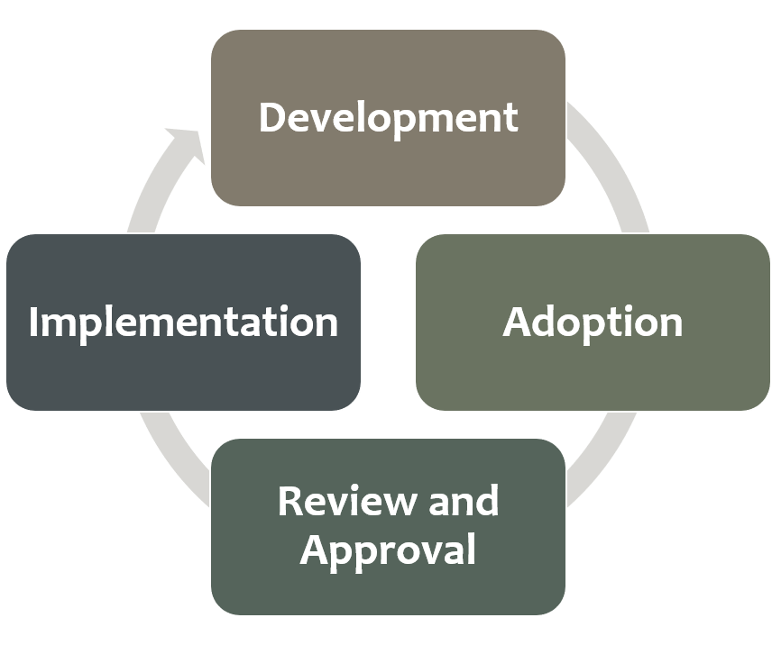
Framing the LCAP
The LCAP development process serves three distinct, but related functions:
Comprehensive Strategic Planning
Meaningful Engagement of Educational Partners
Accountability and Compliance
Notes:
Comprehensive Strategic Planning:
The process of developing and annually updating the LCAP supports comprehensive strategic planning
Strategic planning that is comprehensive connects budgetary decisions to teaching and learning performance data
LEAs should continually evaluate the hard choices they make about the use of limited resources to meet student and community needs to ensure opportunities and outcomes are improved for all students.
Meaningful Engagement of Educational Partners:
The LCAP development process should result in an LCAP that reflects decisions made through meaningful engagement of educational partners.
Local educational partners possess valuable perspectives and insights about an LEA's programs and services.
Effective strategic planning will incorporate these perspectives and insights in order to identify potential goals and actions to be included in the LCAP.
Accountability and Compliance:
The LCAP serves an important accountability function because aspects of the LCAP template require LEAs to show that they have complied with various requirements specified in the LCFF statutes and regulations.
Development Phase (data analysis and reflection, engaging educational partners in that process, writing the plan)
Adoption Phase (hearing, adoption meeting, local indicator presentation, and budget adoption for school districts and COEs)
Review and Approval Phase (COE/CDE reviews the plan, makes recs, approves plan assuming it meets requirements)
Implementation Phase (LEA is actually implementing plan)

Slide 11
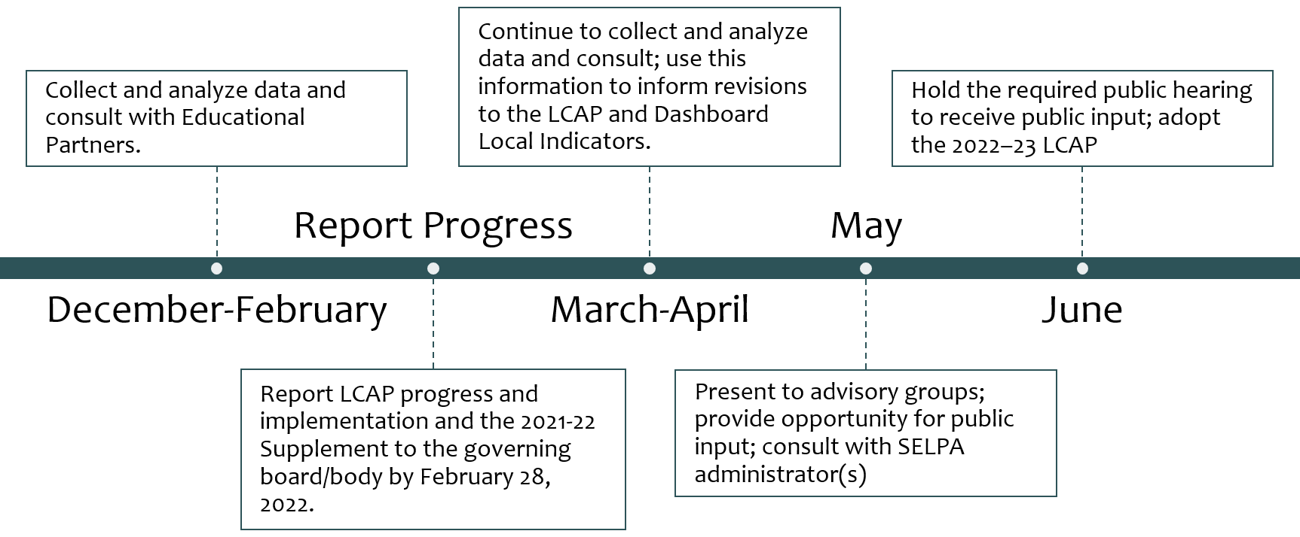
Suggested LCAP Development Timeline
*see Appendix A for descriptive text
Notes:
Development Phase (data analysis and reflection, engaging educational partners in that process, writing the plan)
Adoption Phase (hearing, adoption meeting, local indicator presentation, and budget adoption for school districts and COEs)
Review and Approval Phase (COE/CDE reviews the plan, makes recs, approves plan assuming it meets requirements)
Implementation Phase (LEA is actually implementing plan)

Slide 12
Goals and Actions General Overview

Slide 13
Purpose of the Goals and Actions Section
The purpose of the section is to communicate to educational partners:
  What the LEA plans to accomplish (the goal statement);
  Why the LEA wants to accomplish this (the “why” statement);
  What the LEA plans to do in order to accomplish the goal (the actions);
  How the LEA will know when it has accomplished the goal (the measures of progress); and
  What fiscal resources are being used in support of the goal (the action tables).

Slide 14
Quote
“If you can’t explain it simply you don’t understand it well enough.”
Albert Einstein

Slide 15
Requirement for Goals and Actions
The LCAP must include a description of the annual goals to be achieved for each student group for each state priority and for any local priorities identified by the local governing board or body of the school district or COE, or in the charter school petition
The LCAP must include an annual review of the effectiveness of the goals, actions, and services from the prior year
Notes:
Goals must address each of the state priorities and any additional local priorities; however, one goal may address multiple priorities.
An LEA may identify which school sites and subgroups have the same goals, and may group and describe those goals together.
If a single goal requires longer than one year to implement fully, the LCAP should reflect the annual incremental actions, services, and expenditures, as well as the annual anticipated progress, that the district expects to achieve for each student group.
These annual benchmarks will assist LEAs and the community to monitor the progress of the plan.

Slide 16
Considerations
Goals must address each of the state priorities and any additional local priorities; however, one goal may address multiple priorities.
A goal may be focused on the performance of all students, one or more specific student group(s), narrowing performance gaps, or the implementation of programs and strategies to improve student outcomes.
An LEA may identify that a goal is applicable only to certain school sites or student groups.

Slide 17
Student Groups
Ethnic groups
Socioeconomically disadvantaged students (i.e. low-income students)
English learners
Students with disabilities
Foster Youth
Youth experiencing homeless
Notes:
Student groups that must be addressed in the LCAP are those groups named in Education Code (EC) Section 52052:
Ethnic groups (30 or more)
Socioeconomically disadvantaged students (30 or more)
English learners (30 or more)
Pupils with disabilities (30 or more)
Foster youth (15 or more)
Homeless youth (15 or more)
Numbers denote the number of students that constitutes a numerically significant student group

Slide 18
LCFF State Priorities
Priority 1: Appropriate teacher assignment, sufficient instructional materials, and facilities in good repair
Priority 2: Implementation of academic content and performance standards
Priority 3: Parental Involvement and Family Engagement
Priority 4: Pupil Achievement
Priority 5: Pupil engagement
Priority 6: School Climate
Priority 7: Course Access
Priority 8: Other Pupil Outcomes
Priority 9: Expelled Students (COEs only)
Priority 10: Foster Youth (COEs only)
Plus Local Priorities
Notes:
From Education Code (EC) sections 52060(d) and 52066(d)
See the LCFF State Priorities Summary document for additional details: https://www.cde.ca.gov/re/lc/documents/lcffprioritiessummary.docx

Slide 19
Prioritizing the (State) Priorities
LEAs will have to prioritize how they address the LCFF state priorities through the goals, actions, and related expenditures included in the LCAP.
  LCFF State Priorities Summary document: https://www.cde.ca.gov/re/lc/documents/lcffprioritiessummary.docx
  LEAs should consider performance on available state and local indicators, as well as locally collected data when determining how to prioritize the LCFF state priorities in the LCAP.

Slide 20
Other Considerations for Goals
  Is the goal aligned with needs identified in the Plan Summary Reflections: Identified Needs and/or the Engaging Educational Partners sections?
  Are the measures of progress and actions included in the goal aligned to what the LEA plans to accomplish?

Slide 21
Types of Goals
Addressing differing needs through different goals

Slide 22
Types of Goals Overview
Focus Goal: A Focus Goal is more concentrated in scope and may focus on a fewer number of metrics to measure improvement. A Focus Goal statement is time bound and makes clear how the goal is to be measured.
Broad Goal: A Broad Goal is less concentrated in its scope and may focus on improving performance across a wide range of metrics.
Maintenance of Progress Goal: A Maintenance of Progress Goal includes actions that may be ongoing without significant changes. This type of goal allows an LEA to track performance on any metrics not addressed in the other goals of the LCAP.
Required Goal: Certain LEAs will be required to include a specific goal in their 2022–23 LCAP to address one or more consistently low-performing student groups or low-performing schools.
There are four types of goals identified in the LCAP template instructions.
Notes:
The requirement to include a specific goal in the LCAP will be addressed in greater detail as part of the Required Goals webinar.
The Planned Percentages of Improved Services and Estimated Actual Percentages of Improved Services will be addressed in greater detail as part of the Increased or Improved Services webinars.
The following is an excerpt from pages 8-9 of the LCAP template instructions:
Required Goals
In general, LEAs have flexibility in determining what goals to include in the LCAP and what those goals will address; however, beginning with the development of the 2022–23 LCAP, LEAs that meet certain criteria are required to include a specific goal in their LCAP.
Consistently low-performing student group(s) criteria: An LEA is eligible for Differentiated Assistance for three or more consecutive years based on the performance of the same student group or groups in the Dashboard. A list of the LEAs required to include a goal in the LCAP based on student group performance, and the student group(s) that lead to identification, may be found on the CDE’s Local Control Funding Formula web page at https://www.cde.ca.gov/fg/aa/lc/.
Consistently low-performing student group(s) goal requirement: An LEA meeting the consistently low-performing student group(s) criteria must include a goal in its LCAP focused on improving the performance of the student group or groups that led to the LEA’s eligibility for Differentiated Assistance. This goal must include metrics, outcomes, actions, and expenditures specific to addressing the needs of, and improving outcomes for, this student group or groups. An LEA required to address multiple student groups is not required to have a goal to address each student group; however, each student group must be specifically addressed in the goal. This requirement may not be met by combining this required goal with another goal.
Goal Description: Describe the outcomes the LEA plans to achieve to address the needs of, and improve outcomes for, the student group or groups that led to the LEA’s eligibility for Differentiated Assistance.
Explanation of why the LEA has developed this goal: Explain why the LEA is required to develop this goal, including identifying the student group(s) that lead to the LEA being required to develop this goal, how the actions and associated metrics included in this goal differ from previous efforts to improve outcomes for the student group(s), and why the LEA believes the actions, metrics, and expenditures included in this goal will help achieve the outcomes identified in the goal description.
Low-performing school(s) criteria: The following criteria only applies to a school district or COE with two or more schools; it does not apply to a single-school district. A school district or COE has one or more schools that, for two consecutive years, received the two lowest performance levels on all but one of the state indicators for which the school(s) receive performance levels in the Dashboard and the performance of the “All Students” student group for the LEA is at least one performance level higher in all of those indicators. A list of the LEAs required to include a goal in the LCAP based on school performance, and the school(s) that lead to identification, may be found on the CDE’s Local Control Funding Formula web page at https://www.cde.ca.gov/fg/aa/lc/.
Low-performing school(s) goal requirement: A school district or COE meeting the low-performing school(s) criteria must include a goal in its LCAP focusing on addressing the disparities in performance between the school(s) and the LEA as a whole. This goal must include metrics, outcomes, actions, and expenditures specific to addressing the needs of, and improving outcomes for, the students enrolled at the low-performing school or schools. An LEA required to address multiple schools is not required to have a goal to address each school; however, each school must be specifically addressed in the goal. This requirement may not be met by combining this goal with another goal.
Goal Description: Describe what outcomes the LEA plans to achieve to address the disparities in performance between the students enrolled at the low-performing school(s) and the students enrolled at the LEA as a whole.
Explanation of why the LEA has developed this goal: Explain why the LEA is required to develop this goal, including identifying the schools(s) that lead to the LEA being required to develop this goal; how the actions and associated metrics included in this goal differ from previous efforts to improve outcomes for the school(s); and why the LEA believes the actions, metrics, and expenditures included in this goal will help achieve the outcomes for students enrolled at the low-performing school or schools identified in the goal description.

Slide 23
Specifics for Broad Goals
Goal Description: Describe what the LEA plans to achieve through the actions included in the goal.
  The description of a broad goal will be clearly aligned with the expected measurable outcomes included for the goal.
  A goal description is specific enough to be measurable in either quantitative or qualitative terms.
  A broad goal is not as specific as a focus goal. While it is specific enough to be measurable, there are many different metrics for measuring progress toward the goal.
“Why”: Explain why the LEA developed this goal and how the actions and metrics grouped together will help achieve the goal.

Slide 24
Specifics for Focus Goals (1 of 2)
Goal Description: The description provided for a Focus Goal must be specific, measurable, and time bound.
  An LEA develops a Focus Goal to address areas of need that may require or benefit from a more specific and data intensive approach.
  The Focus Goal can explicitly reference the metric(s) by which achievement of the goal will be measured and the time frame according to which the LEA expects to achieve the goal.

Slide 25
Specifics for Focus Goals (2 of 2)
“Why”: Explain why the LEA has chosen to prioritize this goal.
  An explanation must be based on Dashboard data or other locally collected data.
  LEAs must describe how the LEA identified this goal for focused attention, including relevant consultation with educational partners.
  LEAs are encouraged to promote transparency and understanding around the decision to pursue a focus goal.

Slide 26
Specifics for Maintenance Goals (1 of 2)
Goal Description: Describe how the LEA intends to maintain the progress made in the LCFF State Priorities not addressed by the other goals in the LCAP.
  Use this type of goal to address the state priorities and applicable metrics not addressed within the other goals in the LCAP.
  The state priorities and metrics addressed in a maintenance goal are those for which the LEA, in consultation with its educational partners, has determined to maintain actions and monitor progress while focusing implementation efforts on the actions covered by other goals in the LCAP.

Slide 27
Specifics for Maintenance Goals (2 of 2)
“Why”: Explain how the actions will sustain the progress exemplified by the related metrics.

Slide 28
Required Goals (NEW!)
As previously mentioned, certain LEAs will be required to include a specific goal in their LCAP to address one or more consistently low-performing student groups or low-performing schools.
Only applies to certain identified LEAs.
The requirement to include a specific goal in the LCAP will be addressed in greater detail as part of the Required Goals webinar scheduled for January 18, 2022.
See pages 8–9 of the LCAP template instructions for specifics.

Slide 29
Measuring and Reporting Outcomes
Tracking progress to achieve the goal

Slide 30
Tracking progress to achieve the goal
Measuring and Reporting Results
Metric | Baseline | Year 1 Outcome* | Year 2 Outcome | Year 3 Outcome | Desired Outcome for 2023-24
[Respond here] | [Respond here] | [Insert outcome here]* | [Insert outcome here] | [Insert outcome here] | [Respond here]
[Respond here] | [Respond here] | [Insert outcome here]* | [Insert outcome here] | [Insert outcome here] | [Respond here]
*If possible, these outcomes should be used as part of the Analysis and Annual Update Process

Slide 31
Metrics Instructions
Metrics: Identify the metric(s) that the LEA will use to track progress toward the expected outcome(s).
Baseline: Include the most recent available data associated with each metric available at the time of adoption. Indicate to which school year the data applies. Baseline data already established in 2021-22 will not change.
Year 1 Outcome: When completing the LCAP for 2022-23, enter the most recent available outcome data.
Desired Outcome for 2023-24: Identify the desired outcome to be achieved for the relevant metric. LEAs have the opportunity to revise the desired outcome.
Notes:
A metric indicates the unit of measurement for an expected outcome. Measuring is not an Action. Example: Measure student performance on reading comprehension. (Not an action – measuring.)
The metrics may be quantitative or qualitative; but at minimum, an LEA’s LCAP must include goals that are measured using all of the applicable metrics for the related state priorities, in each LCAP year as applicable to the type of LEA. To the extent a state priority does not specify one or more metrics (e.g., implementation of state academic content and performance standards), the LEA must identify a metric to use within the LCAP. For these state priorities, LEAs are encouraged to use metrics based on or reported through the relevant self-reflection tool for local indicators within the Dashboard.

Slide 32
Actions
How the goal will be achieved

Slide 33
The Actions Table - Descriptions
Action # | Title | Description | Total Funds | Contributing
[Action #] | [A short title for the action; this will appear in the Action tables] | [A description of what the action is; may include a description of how the action contributes to increasing or improving services] | [$0.00] | [Y/N]
Notes:
While a metric indicates the unit of measurement for an expected outcome, an action is something that is done to cause the expected outcome.
Example:
Metric: Suspension Rate as a Percentage
Expected Outcome: Reduce by 5%
Action: Staff Training in PBIS

Slide 34
Actions Instructions
Enter the Action number
Provide a short title for the action (This title will also appear in the action tables)
Provide a description of the action
Enter the total amount of expenditures associated with the action (Budgeted expenditures from funding categories are provided in the actions tables)
Indicate whether the action is contributing to meeting the increase or improved services requirement (as described in the in the Increased or Improved Services section) using a “Y” for Yes or an “N” for No.

Slide 35
Specific Actions for Student Groups
Actions for English Learners: School districts, COEs, and charter schools that have a numerically significant English learner student subgroup must include specific actions in the LCAP related to, at a minimum, the language acquisition programs, as defined in EC Section 306, provided to students and professional development activities specific to English learners.
Actions for Foster Youth: School districts, COEs, and charter schools that have a numerically significant Foster Youth student subgroup are encouraged to include specific actions in the LCAP designed to meet needs specific to Foster Youth students.

Slide 36
Goal Analysis
Reviewing progress and implementation to ensure the goal is achieved

Slide 37
Components in the Analysis
There are three components to the analysis:
  The report of Yearly Outcomes
  The responses to the Analysis prompts
  The Annual Update tables
  This information will be used to make decisions and course corrections to the LCAP for the coming year.
    It will also inform the LEAs response in the Reflections: Identified Needs portion of the Plan Summary

Slide 38
Reporting Yearly Outcomes
Measuring and Reporting Results
Metric | Baseline | Year 1 Outcome | Year 2 Outcome | Year 3 Outcome | Desired Outcome for 2023-24
[Respond here] | [Respond here] | [Insert outcome here] | [Insert outcome here] | [Insert outcome here] | [Respond here]
[Respond here] | [Respond here] | [Insert outcome here] | [Insert outcome here] | [Insert outcome here] | [Respond here]

Slide 39
Goal Analysis Instructions
Respond to the prompts as instructed for each goal:
Describe any substantive differences in planned actions and actual implementation of these actions.
Explain material differences between Budgeted Expenditures and Estimated Actual Expenditures and/or Planned Percentages of Improved Services and Estimated Actual Percentages of Improved Services.
Explain how effective the specific actions were in making progress toward the goal.
Describe any changes made to the planned goal, metrics, desired outcomes, or actions for the coming year that resulted from reflections on prior practice.
Notes:
Note: A report of the Estimated Actual Expenditures for last year’s actions may be found in the Annual Update Table.
Bullet 1 (Prompt 1)- This must include any instance where the LEA did not implement a planned action or implemented a planned action in a manner that differs substantively from how it was described in the adopted LCAP.
Bullet 2 (Prompt 2)- Minor variances in expenditures or percentages do not need to be addressed, and a dollar-for-dollar accounting is not required.
Bullet 3 (Prompt 3)- In some cases, not all actions in a goal will be intended to improve performance on all of the metrics associated with the goal. When responding to this prompt, LEAs may assess the effectiveness of a single action or group of actions within the goal in the context of performance on a single metric or group of specific metrics within the goal that are applicable to the action(s). Grouping actions with metrics will allow for more robust analysis of whether the strategy the LEA is using to impact a specified set of metrics is working and increase transparency for stakeholders. LEAs are encouraged to use such an approach when goals include multiple actions and metrics that are not closely associated.
Bullet 4 (Prompt 4)- Describe any changes made to this goal, expected outcomes, metrics, or actions to achieve this goal as a result of this analysis and analysis of the data provided in the Dashboard or other local data, as applicable.

Slide 40
Closing Thoughts

Slide 41
Keep Explanations Simple
Provide the community with descriptions that paint a succinct picture of how the needs of students are being addressed, what the goals are, and how the goals will be achieved.

Slide 42
Upcoming Opportunities
Future Trainings, opportunities to provide input, and contact information

Slide 43
Upcoming Webinars
2:00 p.m. Tuesday, December 14th: Increased or Improved Services, Part I
3:00 p.m. Thursday, December 16th: Increased or Improved Services, Part II
Additional opportunities will be provided in the new year!

Slide 44
Share Your Input: LCAPs Survey
The California Department of Education and San Joaquin County Office of Education are gathering input from partners like you to inform the development of the LCAP electronic template system and a potential database connected to that system.
The goal for a new data tool and database would be to provide information to school and district staff, families, and communities about each school district’s plan for supporting positive student outcomes through the school district LCAPs.

Slide 45
Share Your Input: LCAPs Survey Links
Please share your input through a short survey by December 13, 2021!
The survey is available in English and Spanish:
  Link to English survey version: https://www.surveymonkey.com/r/GCCKJJQ
  Link to Spanish survey version: https://www.surveymonkey.com/r/GC7JNGK

Slide 46
Past Webinars in This Series (1)
Supplement to the Annual Update to the 2021–22 LCAP PowerPoint, available at https://www.cde.ca.gov/fg/aa/lc/documents/tues2supplement.pptx
Introduction to the Local Control Funding Formula PowerPoint, available at https://www.cde.ca.gov/fg/aa/lc/documents/tues2introlcff113021.pptx

Slide 47
Past Webinars in This Series (2)
The Template and Instructions for the 2022–23 Local Control and Accountability Plan PowerPoint, available at https://www.cde.ca.gov/fg/aa/lc/documents/thurs3tempinst120221.pptx
Engaging Educational Partners PowerPoint, available at https://www.cde.ca.gov/fg/aa/lc/documents/tues2edpartners120721.pptx

Slide 48
Contact Information
  If you have any questions related to the LCAP or LCFF, please contact the Local Agency Systems Support Office at LCFF@cde.ca.gov
  For additional information about this or other webinars in this series, including PowerPoint files, please see the Tuesdays @ 2 webpage at https://www.cde.ca.gov/fg/aa/lc/tuesdaysat2.asp

Slide 49
Thank you for attending!

Slide 50
Appendix A
Timeline with five rectangular boxes from left to right. First box with the label “December-February” contains the text: “Collect and analyze data and consult with Educational Partners”. Second box with the label “Report Progress” contains the text: “Report LCAP progress and implementation and the 2021–22 Supplement to the governing board/body by February 28, 2022”. Third box with the label “March-April” contains the text” “Continue to collect and analyze data and consult; use this information to inform revisions to the LCAP and Dashboard Local Indicators”. Fourth box with the label “May” contains the text: “Present to advisory groups; provide opportunity for public input’ consult with SELPA administrator(s)”. Fifth box with the label “June” contains the text: “Hold the required public hearing to receive public input; adopt the 2022–23 LCAP”.

