Slide 1
Goals and Actions
In The 2023–24 Local Control and Accountability Plan (LCAP)
California Department of Education
December 15, 2022

Slide 2
Webinar Series
Tuesdays @ 2
1/10/23: Increased or Improved Services, Part II
1/17/23: 2023 Dashboard Local Indicator Process
Thursdays @ 3
12/15: Goals and Actions
1/5/23: Increased or Improved Services, Part I
1/26/23: LCAP Required Goals

Slide 3
Template Files
The LCAP Template: https://www.cde.ca.gov/re/lc/documents/adoptedlcaptemplate.docx
LCAP Action Tables Template: https://www.cde.ca.gov/re/lc/documents/lcapactiontables.xlsx
The Budget Overview for Parents Template: https://www.cde.ca.gov/re/lc/documents/budgetoverviewparent.xlsx

Slide 4
Purpose
To provide an overview of the Goals and Actions section of the LCAP and the connection to the Action Tables.
Notes:
In this presentation we will touch on all of the various components of the Goals and Actions section LCAP template and instructions. The Goals and Actions were implemented for the first time with the 2022–23 LCAP. For the 2023-24 LCAP, there are no changes, we will spend a majority of our time focusing on the elements related to the development of the 2023 – 24 LCAP.

Slide 5
This presentation will not…
Address the requirement to increase or improve services;
Address specifics related to actions that contribute towards meeting the requirement to increase or improve services; or
Address the Action tables related to the these requirements and actions.

Slide 6
Intended Audience
The intended audience for this presentation is anyone who will complete, review, or interact with the 2023–24 LCAP, including:
  Parents and students
  Teachers
  Staff
  Administrators
  Advisory committees
  Members of governing boards or bodies
  Community members

Slide 7
A Word About the Term “Educational Partners”
At its November 2021 meeting, the State Board of Education (SBE) adopted the use of the term “educational partners” as a replacement for the term “stakeholder”.
“Educational partners” is used to refer to groups that LEAs are required to engage with in developing the LCAP.
  For school districts and county offices of education (COEs), this includes teachers, principals, administrators, other school personnel, local bargaining units of the LEA, parents, and students.
  For charter schools this includes teachers, principals, administrators, other school personnel, parents, and students.
Notes:
For additional information related to this change in terminology, please see Item 03 from the SBEs September 2021 meeting (https://www.cde.ca.gov/be/ag/ag/yr21/agenda202109.asp) and Item 05 from the SBEs November 2021 meeting (https://www.cde.ca.gov/be/ag/ag/yr21/agenda202111.asp).

Slide 8
Foundations
The Local Control Funding Formula (LCFF) and the LCAP

Slide 9
Foundational Principles of the LCFF
Local education agency (LEA)-level improvement is based on multiple measures of success, both communicated in the LCAP and the California School Dashboard
Equity: the principle of equity is operationalized through the goals, measures of progress, actions and descriptions included in the LCAP.
Subsidiarity: LEAs address local needs of students that have been identified through an analysis of data and input from educational partners utilizing flexible funding and communicate their efforts through the LCAP.
Notes:
Foundational Principles of the LCFF:
Local education agency (LEA)-level improvement that is based on multiple measures of success
Equity
Additional funding to address specific identified needs of students who are low income, English learners, and/or foster youth (i.e. unduplicated students)
Requirement to Increase or Improve Services in proportion to the increase in funding
The LCAP operationalizes this principle of equity through the goals, measures of progress, and actions described in the LCAP
Subsidiarity
Social and political issues should be dealt with at the local level
This approach necessitates transparency and collaboration with educational partners

Slide 10
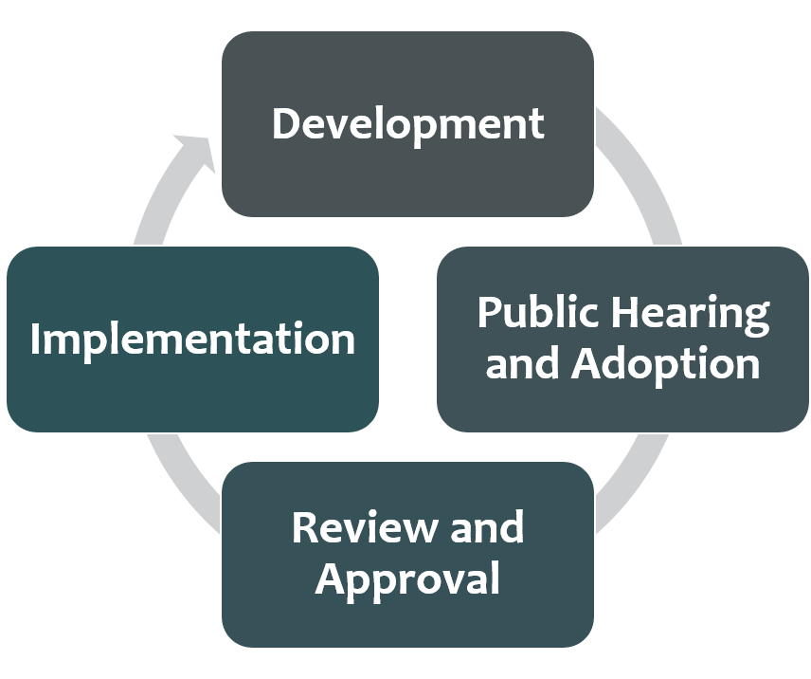
Framing the LCAP
The LCAP development process serves three distinct, but related functions:
Comprehensive Strategic Planning
Meaningful Engagement of Educational Partners
Accountability and Compliance
Notes:
Comprehensive Strategic Planning:
The process of developing and annually updating the LCAP supports comprehensive strategic planning
Strategic planning that is comprehensive connects budgetary decisions to teaching and learning performance data
LEAs should continually evaluate the hard choices they make about the use of limited resources to meet student and community needs to ensure opportunities and outcomes are improved for all students.
Meaningful Engagement of Educational Partners:
The LCAP development process should result in an LCAP that reflects decisions made through meaningful engagement of educational partners.
Local educational partners possess valuable perspectives and insights about an LEA's programs and services.
Effective strategic planning will incorporate these perspectives and insights in order to identify potential goals and actions to be included in the LCAP.
Accountability and Compliance:
The LCAP serves an important accountability function because aspects of the LCAP template require LEAs to show that they have complied with various requirements specified in the LCFF statutes and regulations.
Development Phase (data analysis and reflection, engaging educational partners in that process, writing the plan)
Adoption Phase (hearing, adoption meeting, local indicator presentation, and budget adoption for school districts and COEs)
Review and Approval Phase (COE/CDE reviews the plan, makes recs, approves plan assuming it meets requirements)
Implementation Phase (LEA is actually implementing plan)

Slide 11
Phases of the LCAP
Development
  Conduct and review data analysis while engaging educational partners as part of the annual update and plan development process.
Public Hearing and Adoption
  Public hearing to solicit feedback, public meeting to present progress on local indicators, adopt the LCAP and budget.
Review and Approval
  COE/CDE reviews the plan, makes recommendations, and approves plan once it meets requirements.
Implementation
  LEA implements the LCAP during the upcoming school year.
Notes:
Notes:
Development
Public Hearing and Adoption
COEs and districts must have two separate public meetings on two different days. First, the public hearing to solicit feedback from the community. Second, the public board meeting to adopt the LCAP and budget and present progress on local indicators.
Charter schools may execute the public hearing to solicit feedback at the same meeting the LCAP and budget are adopted and the local indicator progress is presented.
Review and Approval Phase (COE/CDE reviews the plan, makes recs, approves plan assuming it meets requirements)
Districts submit their board-adopted LCAPs to their COE for review and approval within 5 days of board adoption
COEs submit their board-adopted LCAPs to the CDE for review and approval within 5 days of board adoption
Charter schools’ LCAPs are not approved by the COE or CDE. However, charter schools must submit their board-adopted LCAP to their charter authorizer and COE (or just the COE if the COE is the authorizer) on or before July 1st each year
Implementation Phase (LEA is actually implementing plan)

Slide 12
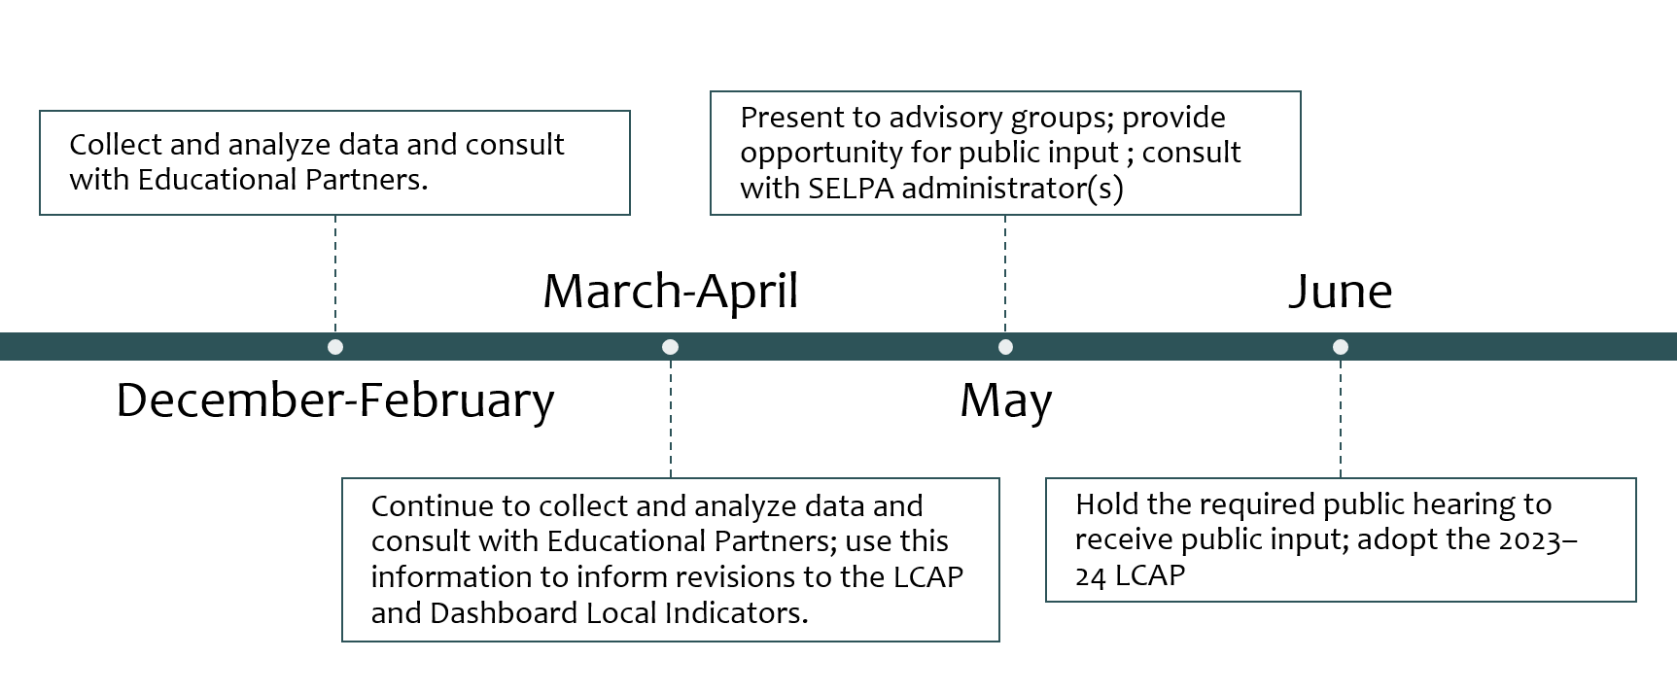
Suggested LCAP Development Timeline
*see Appendix A for descriptive text
Notes:
Development Phase (data analysis and reflection, engaging educational partners in that process, writing the plan)
Adoption Phase (hearing, adoption meeting, local indicator presentation, and budget adoption for school districts and COEs)
Review and Approval Phase (COE/CDE reviews the plan, makes recs, approves plan assuming it meets requirements)
Implementation Phase (LEA is actually implementing plan)

Slide 13
Goals and Actions General Overview

Slide 14
The Purpose of the Goals and Actions Section
The purpose of the section is to communicate to educational partners the following:
General Guiding Questions: | Where can this be addressed?
What the LEA plans to accomplish? | The goal statement
Why the LEA wants to accomplish this? | The “why” statement
What the LEA plans to do in order to accomplish the goal? | The actions
How the LEA will measure progress towards the goal, and determine when it has accomplished the goal? | The measures of progress
What fiscal resources are being used in support of the goal? | The action tables
What was learned through the analysis of the goal and how did the analysis inform changes made to the goal? | The goal analysis

Slide 15
Quote
“If you can’t explain it simply you don’t understand it well enough.”
Albert Einstein
Notes:
Take a moment and share how clear descriptions can help communication build the through line within the LCAP.

Slide 16
Requirement for Goals and Actions
The LCAP must include a description of the annual goals to be achieved for each student group for each state priority and for any local priorities identified by the local governing board or body of the school district or COE, or in the charter school petition
The LCAP must include an annual review of the effectiveness of the goals, actions, and services from the prior year
Notes:
Goals must address each of the state priorities and any additional local priorities; however, one goal may address multiple priorities.
An LEA may identify which school sites and subgroups have the same goals, and may group and describe those goals together.
If a single goal requires longer than one year to implement fully, the LCAP should reflect the annual incremental actions, services, and expenditures, as well as the annual anticipated progress, that the district expects to achieve for each student group.
These annual benchmarks will assist LEAs and the community to monitor the progress of the plan.

Slide 17
Considerations
Goals must address each of the LCFF state priorities and any additional local priorities; however, one goal may address multiple priorities.
A goal may be focused on the performance of all students, one or more specific student group(s), narrowing performance gaps, or the implementation of programs and strategies to improve student outcomes.
An LEA may identify that a goal is applicable only to certain school sites or student groups.

Slide 18
Student Groups
Ethnic groups
Socioeconomically disadvantaged students (i.e. low-income students)
English learners
Students with disabilities
Foster Youth
Youth experiencing homeless
Notes:
Student groups that must be addressed in the LCAP are those groups named in Education Code (EC) Section 52052:
Ethnic groups (30 or more)
Socioeconomically disadvantaged students (30 or more)
English learners (30 or more)
Pupils with disabilities (30 or more)
Foster youth (15 or more)
Homeless youth (15 or more)
Numbers denote the number of students that constitutes a numerically significant student group

Slide 19
LCFF State Priorities
Priority 1: Appropriate teacher assignment, sufficient instructional materials, and facilities in good repair
Priority 2: Implementation of academic content and performance standards
Priority 3: Parental Involvement and Family Engagement
Priority 4: Pupil Achievement
Priority 5: Pupil engagement
Priority 6: School Climate
Priority 7: Course Access
Priority 8: Other Pupil Outcomes
Priority 9: Expelled Students (COEs only)
Priority 10: Foster Youth (COEs only)
Plus Local Priorities
Notes:
From Education Code (EC) sections 52060(d) and 52066(d)
See the LCFF State Priorities Summary document for additional details: https://www.cde.ca.gov/re/lc/documents/lcffprioritiessummary.docx

Slide 20
Prioritizing the (State) Priorities
LEAs will have to prioritize how they address the LCFF state priorities through the goals, actions, and related expenditures included in the LCAP.
  LCFF State Priorities Summary document: https://www.cde.ca.gov/re/lc/documents/lcffprioritiessummary.docx
  LEAs should consider performance on available state and local indicators, as well as locally collected data when determining how to prioritize the LCFF state priorities in the LCAP.
    Dashboard Communications:
    https://www.cde.ca.gov/ta/ac/cm/dashboardtoolkit.asp

Slide 21
Other Considerations for Goals
  Is the goal aligned with needs identified in the Plan Summary Reflections: Identified Needs and/or the Engaging Educational Partners sections?
    The "why" statement's purpose is to communicate why the goal is needed. This prompt can help connect the information stated in the Plan Summary to show a "through line " within the LCAP.
  Are the measures of progress and actions included in the goal aligned to what the LEA plans to accomplish?
Notes:
Note: Plan Summary-Reflection/Educational Partners Sections

Slide 22
Types of Goals
Addressing differing needs through different goals

Slide 23
Types of Goals Overview
Focus Goal: A Focus Goal is more concentrated in scope and may focus on a fewer number of metrics to measure improvement. A Focus Goal statement is time bound and makes clear how the goal is to be measured.
Broad Goal: A Broad Goal is less concentrated in its scope and may focus on improving performance across a wide range of metrics.
Maintenance of Progress Goal: A Maintenance of Progress Goal includes actions that may be ongoing without significant changes. This type of goal allows an LEA to track performance on any metrics not addressed in the other goals of the LCAP.
Required Goal: Certain LEAs will be required to include a specific goal in their 2023–24 LCAP to address one or more consistently low-performing student groups or low-performing schools.
There are four types of goals identified in the LCAP template instructions.
Notes:
In the next slide you can see more specifics how this is addressed in the LCAP template.

Slide 24
Specifics for Broad Goals
Goal Description: Describe what the LEA plans to achieve through the actions included in the goal.
  The description of a broad goal will be clearly aligned with the expected measurable outcomes included for the goal.
  A goal description is specific enough to be measurable in either quantitative or qualitative terms.
  A broad goal is not as specific as a focus goal. While it is specific enough to be measurable, there are many different metrics for measuring progress toward the goal.
“Why”: Explain why the LEA developed this goal and how the actions and metrics grouped together will help achieve the goal.

Slide 25
Specifics for Focus Goals (1 of 2)
Goal Description: The description provided for a Focus Goal must be specific, measurable, and time bound.
  An LEA develops a Focus Goal to address areas of need that may require or benefit from a more specific and data intensive approach.
  The Focus Goal can explicitly reference the metric(s) by which achievement of the goal will be measured and the time frame according to which the LEA expects to achieve the goal.

Slide 26
Specifics for Focus Goals (2 of 2)
“Why”: Explain why the LEA has chosen to prioritize this goal.
  An explanation must be based on Dashboard data or other locally collected data.
  LEAs must describe how the LEA identified this goal for focused attention, including relevant consultation with educational partners.
  LEAs are encouraged to promote transparency and understanding around the decision to pursue a focus goal.

Slide 27
Specifics for Maintenance Goals (1 of 2)
Goal Description: Describe how the LEA intends to maintain the progress made in the LCFF State Priorities not addressed by the other goals in the LCAP.
  Use this type of goal to address the state priorities and applicable metrics not addressed within the other goals in the LCAP.
  The state priorities and metrics addressed in a maintenance goal are those for which the LEA, in consultation with its educational partners, has determined to maintain actions and monitor progress while focusing implementation efforts on the actions covered by other goals in the LCAP.

Slide 28
Specifics for Maintenance Goals (2 of 2)
“Why”: Explain how the actions will sustain the progress exemplified by the related metrics.

Slide 29
Required Goals
As previously mentioned, certain LEAs will be required to include a specific goal in their LCAP to address one or more consistently low-performing student groups or low-performing schools.
Only applies to certain identified LEAs.
The requirement to include a specific goal in the LCAP will be addressed in greater detail as part of the Required Goals webinar scheduled for January 26, 2023.
See pages 8–9 of the LCAP template instructions for specifics.

Slide 30
Measuring and Reporting Outcomes
Tracking progress to achieve the goal

Slide 31
Tracking progress to achieve the goal
Measuring and Reporting Results
Metric | Baseline | Year 1 Outcome* | Year 2 Outcome | Year 3 Outcome | Desired Outcome for 2023-24
[Respond here] | [Respond here] | [Insert outcome here]* | [Insert outcome here] | [Insert outcome here] | [Respond here]
[Respond here] | [Respond here] | [Insert outcome here]* | [Insert outcome here] | [Insert outcome here] | [Respond here]
*If possible, these outcomes should be used as part of the Analysis and Annual Update Process
Notes:
Complete the Year 2 Outcome

Slide 32
Metrics Instructions (1 of 2)
Metrics: Identify the metric(s) that the LEA will use to track progress toward the expected outcome(s).
Baseline: Include the most recent available data associated with each metric available at the time of adoption. Indicate to which school year the data applies. (Baseline data was already established in 2021-22 and will not change.)
Year 1 Outcome: When completing the LCAP for 2022-23, enter the most recent data available. Indicate the school year to which the data applies, consistent with the instructions above.
Notes:
Note: Baseline-If you are a new school, it will be this year.

Slide 33
Metrics Instructions (2 of 2)
Year 2 Outcome: When completing the LCAP for 2023–24, enter the most recent data available. Indicate the school year to which the data applies, consistent with the instructions above.
Year 3 Outcome: When completing the LCAP for 2024–25, enter the most recent data available. Indicate the school year to which the data applies, consistent with the instructions above. The 2024–25 LCAP will be the first year in the next three-year cycle. Completing this column will be part of the Annual Update for that year.
Desired Outcome for 2023–24: When completing the first year of the LCAP, enter the desired outcome for the relevant metric the LEA expects to achieve by the end of the 2023–24 LCAP year.
Notes:
A metric indicates the unit of measurement for an expected outcome. Measuring is not an Action. Example: Measure student performance on reading comprehension. (Not an action – measuring.)
The metrics may be quantitative or qualitative; but at minimum, an LEA’s LCAP must include goals that are measured using all of the applicable metrics for the related state priorities, in each LCAP year as applicable to the type of LEA. To the extent a state priority does not specify one or more metrics (e.g., implementation of state academic content and performance standards), the LEA must identify a metric to use within the LCAP. For these state priorities, LEAs are encouraged to use metrics based on or reported through the relevant self-reflection tool for local indicators within the Dashboard.

Slide 34
Actions
How the goal will be achieved

Slide 35
The Actions Table - Descriptions
Action # | Title | Description | Total Funds | Contributing
[Action #] | [A short title for the action; this will appear in the Action tables] | [A description of what the action is; may include a description of how the action contributes to increasing or improving services] | [$0.00] | [Y/N]
Notes:
While a metric indicates the unit of measurement for an expected outcome, an action is something that is done to cause the expected outcome.
Example:
Metric: Suspension Rate as a Percentage
Expected Outcome: Reduce by 5%
Action: Staff Training in PBIS

Slide 36
Actions Instructions
Enter the Action number
Provide a short title for the action (This title will also appear in the action tables)
Provide a description of the action
Enter the total amount of expenditures associated with the action (Budgeted expenditures from funding categories are provided in the actions tables)
Indicate whether the action is contributing to meeting the increase or improved services requirement (as described in the in the Increased or Improved Services section) using a “Y” for Yes or an “N” for No.

Slide 37
Specific Actions for Student Groups
Actions for English Learners: School districts, COEs, and charter schools that have a numerically significant English learner student subgroup must include specific actions in the LCAP related to, at a minimum, the language acquisition programs, as defined in EC Section 306, provided to students and professional development activities specific to English learners.
Actions for Foster Youth: School districts, COEs, and charter schools that have a numerically significant Foster Youth student subgroup are encouraged to include specific actions in the LCAP designed to meet needs specific to Foster Youth students.
Actions for Individuals with Expectational needs: COEs and districts need to consult with the SELPA administrator(s) to determine that specific actions for individuals with expectational needs are included in the LCAP.

Slide 38
Goal Analysis
Reviewing progress and implementation to ensure the goal is achieved

Slide 39
Components in the Analysis (1 of 2)
There are three components to the analysis:
  The report of Yearly Outcomes
  The responses to the Analysis prompts
  The Annual Update tables

Slide 40
Components in the Analysis
  This information will be used to make decisions and course corrections to the LCAP for the coming year.
    It will also inform the LEAs response in the Reflections: Identified Needs portion of the Plan Summary.
    LEAs are encouraged to utilize available state and local data as well as educational partner input when completing this process.

Slide 41
Goal Analysis Instructions (1 of 3)
Describe the overall implementation of the actions to achieve the articulated goal. Include a discussion of relevant challenges and successes experienced with the implementation process. This must include any instance where the LEA did not implement a planned action or implemented a planned action in a manner that differs substantively from how it was described in the adopted LCAP.
Explain material differences between Budgeted Expenditures and Estimated Actual Expenditures and between the Planned Percentages of Improved Services and Estimated Actual Percentages of Improved Services, as applicable. Minor variances in expenditures or percentages do not need to be addressed, and a dollar-for-dollar accounting is not required.
Notes:
Describe the effectiveness of the specific actions to achieve the articulated goal as measured by the LEA. In some cases, not all actions in a goal will be intended to improve performance on all of the metrics associated with the goal. When responding to this prompt, LEAs may assess the effectiveness of a single action or group of actions within the goal in the context of performance on a single metric or group of specific metrics within the goal that are applicable to the action(s). Grouping actions with metrics will allow for more robust analysis of whether the strategy the LEA is using to impact a specified set of metrics is working and increase transparency for
educational partners. LEAs are encouraged to use such an approach when goals include multiple actions and metrics that are not closely associated.

Slide 42
Goal Analysis Instructions (2 of 3)
Describe the effectiveness of the specific actions to achieve the articulated goal as measured by the LEA. In some cases, not all actions in a goal will be intended to improve performance on all of the metrics associated with the goal. When responding to this prompt, LEAs may assess the effectiveness of a single action or group of actions within the goal in the context of performance on a single metric or group of specific metrics within the goal that are applicable to the action(s). Grouping actions with metrics will allow for more robust analysis of whether the strategy the LEA is using to impact a specified set of metrics is working and increase transparency for educational partners. LEAs are encouraged to use such an approach when goals include multiple actions and metrics that are not closely associated.
Notes:
Note: A report of the Estimated Actual Expenditures for last year’s actions may be found in the Annual Update Table.
Bullet 1 (Prompt 1)- This must include any instance where the LEA did not implement a planned action or implemented a planned action in a manner that differs substantively from how it was described in the adopted LCAP.
Bullet 2 (Prompt 2)- Minor variances in expenditures or percentages do not need to be addressed, and a dollar-for-dollar accounting is not required.
Bullet 3 (Prompt 3)- In some cases, not all actions in a goal will be intended to improve performance on all of the metrics associated with the goal. When responding to this prompt, LEAs may assess the effectiveness of a single action or group of actions within the goal in the context of performance on a single metric or group of specific metrics within the goal that are applicable to the action(s). Grouping actions with metrics will allow for more robust analysis of whether the strategy the LEA is using to impact a specified set of metrics is working and increase transparency for stakeholders. LEAs are encouraged to use such an approach when goals include multiple actions and metrics that are not closely associated.
Bullet 4 (Prompt 4)- Describe any changes made to this goal, expected outcomes, metrics, or actions to achieve this goal as a result of this analysis and analysis of the data provided in the Dashboard or other local data, as applicable.

Slide 43
Goal Analysis Instructions (3 of 3)
Describe any changes made to this goal, expected outcomes, metrics, or actions to achieve this goal as a result of this analysis and analysis of the data provided in the Dashboard or other local data, as applicable.
Notes:
Note: Take a moment to highlight how the instructions goes into more details which is why it is important to look at both the prompts and instructions when writing the LCAP.

Slide 44
Annual Update Table Instructions
In the Annual Update Table, provide the following information for each action in the LCAP for the 2022–23 LCAP year:
  Estimated Actual Expenditures: Enter the total estimated actual expenditures to implement this action, if any.
  [Instructions to assist LEAs using the Microsoft Excel Spreadsheets to complete the Action Tables are available at: https://www.cde.ca.gov/re/lc/documents/actiontables2023ins.docx]
Notes:
These instructions are provided to assist LEAs using the Microsoft Excel Spreadsheets to complete the Action Tables for the 2023-24 LCAP.

Slide 45
Closing Thoughts

Slide 46
Keep Explanations Simple
Provide the community with descriptions that paint a succinct picture of how the needs of students are being addressed, what the goals are, and how the goals will be achieved.

Slide 47
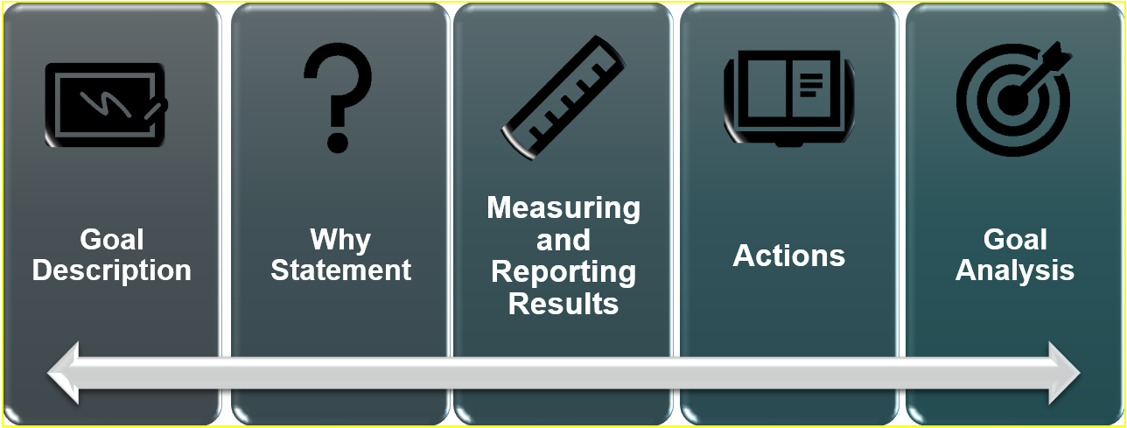
The “Through Line” in Goals and Actions (1 of 2)
*see Appendix B for descriptive text

Slide 48
The “Through Line” in Goals and Actions (2 of 2)
The Goals and Actions subsections are interrelated.
Ensure the unit of measure is consistent across each row when entering metric, baseline, yearly outcome and desired outcome data.
Each metric should contribute data which measures progress towards its associated goal.
Each action should demonstrably contribute to achieving its associated goal.
Ensure each Goal Analysis prompt response supports and informs any updates to the associated goal.

Slide 49
Upcoming Opportunities
Future Trainings and contact information

Slide 50
Upcoming Webinars
Thursday, January 5, 2023 at 3 p.m. - Increased or Improved Services, Part I
Tuesday, January 10, 2023 at 2 p.m. - Increased or Improved Services, Part II
Tuesday, January 17, 2023 at 2 p.m. - California School Dashboard Local Indicator Process for 2023
Thursday, January 26, 2023 at 3 p.m. - Required Goals

Slide 51
Contact Information
  If you have any questions related to the LCAP or LCFF, please contact the Local Agency Systems Support Office at LCFF@cde.ca.gov
  For additional information about this or other webinars in this series, including PowerPoint files, please see the Tuesdays @ 2 webpage at https://www.cde.ca.gov/fg/aa/lc/tuesdaysat2.asp

Slide 52
Thank you!
We appreciate your time and all that you do for California’s students and families!

Slide 53
Appendix A – Slide 12
Timeline with four rectangular boxes from left to right. First box with the label “December-February” contains the text: “Collect and analyze data and consult with Educational Partners”. Second box with the label “March-April” contains the text” “Continue to collect and analyze data and consult with Educational Partners; use this information to inform revisions to the LCAP and Dashboard Local Indicators”. Third box with the label “May” contains the text: “Present to advisory groups; provide opportunity for public input; consult with SELPA administrator(s)”. Fourth box with the label “June” contains the text: “Hold the required public hearing to receive public input; adopt the 2023–24 LCAP”.

Slide 54
Appendix B – Slide 47
5 gray/blue rectangular shapes arranged side-by-side on the longer side with the colors from dark gray to dark gray/blue going to the right
An ongoing arrow at the bottom of all rectangles visually connecting them together.
The rectangles have a decorative symbol and the following titles: Goal Description, Why Statement, Measuring and Reporting Results, Actions, Goal Analysis.

