Slide 1
Engaging Educational Partners
Engaging Educational Partners to Improve Outcomes for Students
California Department of Education
December 13, 2022

Slide 2
Webinar Series
Tuesdays @ 2
12/13: Engaging Educational Partners
1/10/23: Increased or Improved Services, Part II
1/17/23: 2023 Dashboard Local Indicator Process
Thursdays @ 3
12/15: Goals and Actions
1/5/23: Increased or Improved Services, Part I
1/26/23: Local Control and Accountability Plan (LCAP) Required Goals

Slide 3
Template Files
The LCAP Template: https://www.cde.ca.gov/re/lc/documents/adoptedlcaptemplate.docx
LCAP Action Tables Template: https://www.cde.ca.gov/re/lc/documents/lcapactiontables.xlsx
The Budget Overview for Parents Template: https://www.cde.ca.gov/re/lc/documents/budgetoverviewparent.xlsx

Slide 4
Purpose
To provide an overview of the requirements for engaging educational partners in the development of the LCAP
To provide an overview of the requirements for completing the Engaging Educational Partners section of the LCAP
To provide some considerations for meaningful engagement of educational partners

Slide 5
Intended Audience
The intended audience for this presentation is anyone involved in the process of engaging educational partners as part of the development of the 2023–24 LCAP or in completing the Engaging Educational Partners section of the LCAP.
This includes parents and students, teachers, staff, administrators, advisory committees, members of governing boards or bodies, and community members.

Slide 6
A Word About the Term “Educational Partners”
At its November 2021 meeting, the State Board of Education (SBE) adopted the use of the term “educational partners” as a replacement for the term “stakeholder”.
Moving forward, “educational partners” will be used to refer to groups that LEAs are required to engage with in developing the LCAP.
  For school districts and county offices of education (COEs) this includes teachers, principals, administrators, other school personnel, local bargaining units of the LEA, parents, and students
  For charter schools this includes teachers, principals, administrators, other school personnel, parents, and students
Notes:
For additional information related to this change in terminology, please see Item 03 from the SBEs September 2021 meeting (https://www.cde.ca.gov/be/ag/ag/yr21/agenda202109.asp) and Item 05 from the SBEs November 2021 meeting (https://www.cde.ca.gov/be/ag/ag/yr21/agenda202111.asp).

Slide 7
Foundational Principles
Why Engaging Educational Partners is Important

Slide 8
Foundational Principles of the Local Control Funding Formula (LCFF)
Local education agency (LEA)-level improvement that is based on multiple measures of success
Equity
  Additional funding to address specific identified needs of students who are low income, English learners, and/or foster youth (i.e. unduplicated students)
  Requirement to Increase or Improve Services in proportion to the increase in funding
Subsidiarity
  Social and political issues should be dealt with at the local level

Slide 9
Flexibility to Ensure Student Success
LCFF provides for an increased level of local flexibility to determine which programs and/or services have the greatest likelihood of ensuring that each student will succeed in relation to each of the eight LCFF state priorities.
In exchange for this flexibility, the LCFF model requires greater local responsibility for selecting appropriate and effective programs.
This necessitates transparency and engaging educational partners in analysis and decision-making.

Slide 10
Meaningful Engagement of Educational Partners
The LCAP development process should result in an LCAP that reflects decisions made through meaningful engagement of educational partners.
Local partners possess valuable perspectives and insights about student needs and how to address such needs.
Effective strategic planning will consider input from educational partners in updating the LCAP.
The primary beneficiaries of this engagement are students.

Slide 11
Benefits of Engaging Educational Partners
Engaging educational partners is not only a requirement; research has identified it as a key practice of effective LEAs. There are many benefits to partnering with local community members, such as:
  Better understanding of current needs and possible solutions
  More informed decision-making
  Greater likelihood of positive outcome given access to broader input and information
  Greater trust
  Stronger and longer lasting partnerships

Slide 12
Consultation Requirements
Engaging Educational Partners in the development of the LCAP
Notes:
The educational partner engagement process is codified in Education Code in a few places.
EC sections 47606.5(d), 52060(g), 52066(g), and 52064(e)(1) include the consultation requirements related to the development and annual update of the LCAP.
EC sections 47606.5, 52062(a), and 52068(a) include the educational partner engagement requirements related to the adoption of the LCAP and annual update to the LCAP.

Slide 13
Purpose of the Consultation Requirement
Significant and purposeful engagement of parents, students, educators, and other educational partners, including those representing the student groups identified by LCFF, is critical to the development of the LCAP and the budget process.
California Education Code Section 52064(e)(1) includes the provision that comprehensive strategic planning, accountability, and improvement across the state priorities and locally identified priorities should be reflective of meaningful engagement with educational partners.
Engagement of educational partners is an ongoing, annual process.
Notes:
EC 52064(e) (1) The process of developing and annually updating the local control and accountability plan should support school districts, county offices of education, and charter schools in comprehensive strategic planning, accountability, and improvement across the state priorities and any locally identified priorities through meaningful engagement with local stakeholders.

Slide 14
Consultation
Verb: To seek information, opinion, or advice from
Important for consultation to occur prior to making decisions about developing or revising the plan so that the input received will inform the development of, or revisions to, the plan.
Also consider how this consultation process can be used to inform the assessment of progress for each of the LEA’s local indicators.

Slide 15
Required Consultation
Districts and COEs
Teachers
Principals
Administrators
Other school personnel
Local bargaining units
Parents
Students
Charter Schools
Teachers
Principals
Administrators
Other school personnel
Parents
Students
Notes:
School Districts: EC Section 52060(g) The governing board of a school district shall consult with teachers, principals, administrators, other school personnel, local bargaining units of the school district, parents, and pupils in developing a local control and accountability plan.
COEs: EC Section 52066(g) The county superintendent of schools shall consult with teachers, principals, administrators, other school personnel, local bargaining units of the county office of education, parents, and pupils in developing a local control and accountability plan.
Charter schools: EC Section 47606.5(d) The charter school shall consult with teachers, principals, administrators, other school personnel, parents, and pupils in developing the local control and accountability plan and annual update to the local control and accountability plan.

Slide 16
A Note About Student Consultation
“What does it mean to consult with students?”
To consult with students means a process to enable students, including students who are low-income, English learners, foster youth and students from numerically significant student groups, to review and comment on the development of the LCAP.
This process may include surveys of students, forums with students, student advisory committees, or meetings with student government bodies or other groups representing students.

Slide 17
Engagement Process (1 of 2)
Collect and review data
  Metrics in the LCAP
  Local Indicators
  Other data that the LEA wants to include
Consult with Educational Partners
  Review data and ask for advice about how to address identified needs
Develop/Revise the LCAP
  Report progress for each of the LEA’s Local Indicators
A process for intentionally engaging the LEA's educational partners

Slide 18
Engagement Process (2 of 2)
Other Engagement Opportunities
  Parent Advisory Committee
  English Learner Parent Advisory Committee
  School Plans
  Public Opportunity to submit written comments regarding the specific actions and expenditures proposed for the LCAP
  Special Education Local Plan Area (SELPA) Administrator(s)
Public Hearing to solicit recommendations and comments regarding the specific actions and expenditures in the LCAP
A process for intentionally engaging the LEA's educational partners

Slide 19
Other Requirements

Slide 20
Parent Advisory Committee (Current Requirement)
The governing board of a school district or COE must establish a parent advisory committee. The committee is composed of a majority of parents, including parents of low-income, English learner, and foster youth students.
  Beginning with the 2023–24 LCAP, the parent advisory committee shall also include parents or legal guardians of currently enrolled students with disabilities in the school district.
Notes:
If a charter school is using the LCAP to meet federal schoolwide plan requirements, it is required to adhere to the educational partner engagement requirements pursuant to EC Section 52062(a), which include:
1) Presenting the LCAP to the Parent Advisory Committee and English Learner Parent Advisory Committee, as applicable, for review and comment
2) Providing opportunity for the public to submit written comments about the actions and expenditures in the LCAP and/or the annual update to the LCAP
3) Consulting with the SELPA to ensure there are specific actions for students with disabilities in the LCAP
It is important to note: If a charter school is not using the LCAP to meet federal schoolwide plan requirements and instead is completing a SPSA in addition to the LCAP, the charter school is not required to follow the educational partner engagement requirements in EC Section 52062.

Slide 21
Parent Advisory Committee (Future Requirement) (1)
Beginning July 1, 2024, a parent advisory committee of a school district or COE serving middle school or high school students shall include at least two pupils as full members of the parent advisory committee unless it already has an established student advisory committee. The pupils shall serve for a renewable term of one full school year. [EC sections 52063(a)(3) and 52069(a)(3)]
The governing board of the district or COE shall establish a student advisory committee to provide advice to the governing board and the superintendent of the school district regarding the requirements of this article unless it already has established:
Notes:
SB 997
Bill Text - SB-997 Local control and accountability plans: parent advisory committee: student advisory committee.

Slide 22
Parent Advisory Committee (Future Requirement) (2)
  (continued)
  A student advisory committee that meets the requirements of this subdivision, or
  Two pupil positions on the parent advisory committee pursuant to subdivision (a). [EC Section 52063(b) (1-2) and 52069 (b) (1-2)]
  The school district shall take into consideration that the pupil members of a parent advisory committee or student advisory committee represent the diversity of the school district’s pupils, including geographical, socioeconomic, cultural, physical, and educational diversity. [EC Section 52063(d) 52069(d)]

Slide 23
Parent Advisory Committee (Future Requirement) (3)
  (continued)
  Particular effort should be made to reach out to at-risk or disadvantaged pupils to serve as members of a parent advisory committee or student advisory committee, as their participation will provide keen insight into many of the issues that pupils face in their day-to-day lives. [EC Section 52063(d) and 52069(d)]

Slide 24
English Learner Parent Advisory Committee
If the enrollment of the school district or COE includes at least 15% English learners and the school district or COE enrolls at least 50 students who are English learners, the school district or COE must establish an English learner parent advisory committee.

Slide 25
Advisory Committee Review Requirement
Before the governing board of a school district or COE considers the adoption of the LCAP, the superintendent of the district or county superintendent of schools must:
  Present the LCAP to the parent advisory committee and the English learner parent advisory committee, as applicable, for review and comment; and
  Respond in writing to comments received from the advisory committee(s).

Slide 26
Public Opportunity to Submit Written Comment
School districts and COEs are required to provide members of the public with the opportunity to submit written comments regarding the actions and expenditures proposed in the LCAP.
  Notifications should be made using the most efficient method of notification possible.
  School districts and COEs are required to ensure that written notifications are translated into the primary language of any student population that make up 15% or more of the LEA’s students who speak a primary language other than English.

Slide 27
Review of School Plans
A school district or COE is required to review the School Plans for Student Achievement (SPSAs) for schools within the district or COE to ensure that the specific actions included in the LCAP are consistent with strategies included in the schools’ SPSAs.

Slide 28
Consultation With SELPA
A school district or COE is required to consult with its Special Education Local Plan Area (SELPA) administrator(s) to:
  Determine that specific actions for individuals with exceptional needs (i.e. Students with Disabilities) are included in the LCAP; and
  Are consistent with strategies included in the annual assurances support plan for the education of individuals with exceptional needs.
  *Note: AB 181 amended EC Section 56122(c) and extended the deadline for the CDE to develop the annual assurances support plan to July 1, 2026. LEAs will develop the annual assurances support plan during the 2026-2027 school year and implement the plan beginning July 1, 2027.
Notes:
EC 52062 (a)(5): The superintendent of the school district shall consult with its special education local plan area administrator or administrators to determine that specific actions for individuals with exceptional needs are included in the local control and accountability plan or annual update to the local control and accountability plan, and are consistent with strategies included in the annual assurances support plan for the education of individuals with exceptional needs.
EC 52068 (a)(5): The county superintendent of schools shall consult with its special education local plan area administrator or administrators to determine that specific actions for individuals with exceptional needs are included in the local control and accountability plan or annual update to the local control and accountability plan, and are consistent with strategies included in the annual assurances support plan for the education of individuals with exceptional needs.
Bill Text - AB-181 Education finance: education omnibus budget trailer bill.
NOTE: AB 181 amended EC Section 56122(c) and extended the deadline for the CDE to develop the annual assurances support plan to July 1, 2026. LEAs will develop the annual assurances support plan during the 2026-2027 school year, and implement the plan beginning July 1, 2027.

Slide 29
Public Hearing (School Districts and COEs)
Before a school district or COE adopts the LCAP, it must hold at least one public hearing to solicit recommendations and comments from members of the public regarding the specific actions and expenditures proposed to be included in the LCAP.
  The agenda for the public hearing must be posted at least 72 hours in advance and must include the location where the LCAP will be available for public inspection.

Slide 30
LCAP Adoption for School Districts and COEs
The governing board of a school district or COE must adopt the LCAP at a public meeting on or before July 1 of each year.
  This meeting must be held after, but not on the same day as, the public hearing discussed in the previous slide.
  This meeting must be the same meeting at which the governing board of the school district or COE adopts its budget.
  The school district or COE must also report its California School Dashboard (Dashboard) local indicators at this meeting.

Slide 31
LCAP Adoption for Charter Schools
The governing body of a charter school must hold a public hearing to adopt the LCAP on or before July 1 of each year.
  At this meeting the governing body of the charter school must update the goals and annual actions to achieve those goals identified in the charter petition.
  The charter school must also report its Dashboard local indicators at this meeting.

Slide 32
Statute defines the floor, not the ceiling.

Slide 33
Locally Determined Engagement Opportunities

Slide 34
Locally Determined Opportunities
In addition to seeking input from all required educational partner groups, LEAs may seek input from other local committees, groups, organizations/agencies to better address the needs of their students. For example:
The Community Advisory Committee
Other locally determined committees or groups
Community-based organizations or agencies

Slide 35
The Engaging Educational Partners Section
Requirements for Documenting the Engagement Process and its Influence on the LCAP

Slide 36
Purpose of the Section
The Engaging Educational Partners section of the LCAP is intended to document how the LEA’s engagement with its educational partners influenced the adopted LCAP.
This section allows educational partners that participated in the LCAP development process, as well as the broader public, to understand how the LEA engaged its partners and the impact of that engagement on the plan.
LEAs are encouraged to keep this in mind when completing the LCAP.
Notes:
The LCAP template, like each LEA’s final adopted LCAP, is a document, not a process. LEAs must use the template to memorialize the outcome of their LCAP development process, which should: (a) reflect comprehensive strategic planning (b) through meaningful engagement with educational partners that (c) meets legal requirements, as reflected in the final adopted LCAP. The sections included within the LCAP template do not and cannot reflect the full development process, just as the LCAP template itself is not intended as a stakeholder engagement tool.

Slide 37
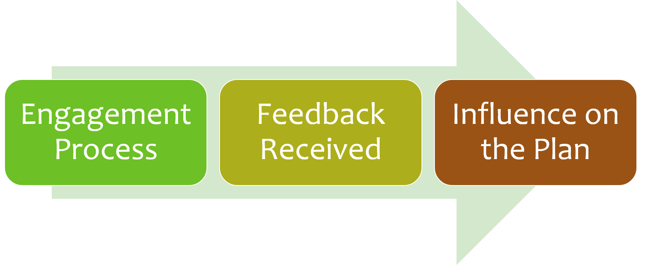
The “Through Line”

Slide 38
Reminders
The instructions provide the requirements for addressing each prompt in the LCAP and the technical information for LEAs to complete the template properly.
The responses to the prompts in the LCAP Template are required to be written in a way that is understandable and accessible to parents.
LEAs are strongly encouraged to use language and a level of detail in their adopted LCAPs intended to be meaningful and accessible for the LEA’s diverse educational partners and the broader public.

Slide 39
Prompt 1
Prompt 1: “A summary of the process used to engage educational partners and how this engagement was considered before finalizing the LCAP.”
Must describe the engagement process used by the LEA
Must describe how the LEA met its obligation to consult with all required educational partners
Must include information about the timeline of the process and meetings with educational partners
See page 5 for instructions.
Notes:
The method of describing the timeline is determined locally.
For school districts and county offices of education (COEs) this includes teachers, principals, administrators, other school personnel, local bargaining units of the LEA, parents, and students.
For charter schools this includes teachers, principals, administrators, other school personnel, parents, and students.

Slide 40
Prompt 2
Prompt 2: “A summary of the feedback provided by specific educational partners.”
Must describe and summarize the feedback provided by the educational partners that the LEA consulted (i.e. the LEAs required educational partners)
For the response to be considered sufficient, it must specify ideas, trends, and/or input that emerged from an analysis of the feedback received from the LEA's educational partners
See page 5 for instructions.

Slide 41
Prompt 3
Prompt 3: “A description of the aspects of the LCAP that were influenced by specific input from educational partners.”
Must provide a clear, specific description about how the engagement process influenced the development of the LCAP
Must describe aspects of the LCAP that were influenced by, or developed in response to, the feedback provided by the LEA's educational partners
See page 6 for instructions, including a list of potential aspects of the LCAP that may have been influenced by feedback.
Notes:
For the purposes of this prompt, “aspects” of an LCAP that may have been influenced by educational partner input can include, but are not necessarily limited to:
Inclusion of a goal or decision to pursue a Focus Goal (as described below)
Inclusion of metrics other than the statutorily required metrics
Determination of the desired outcome on one or more metrics
Inclusion of performance by one or more student groups in the Measuring and Reporting Results subsection
Inclusion of action(s) or a group of actions
Elimination of action(s) or group of actions
Changes to the level of proposed expenditures for one or more actions
Inclusion of action(s) as contributing to increased or improved services for unduplicated services
Determination of effectiveness of the specific actions to achieve the goal
Determination of material differences in expenditures
Determination of changes made to a goal for the ensuing LCAP year based on the annual update process
Determination of challenges or successes in the implementation of actions

Slide 42
Reviewing Responses
Notes:
Addressed instructions?
See the Through Line?

Slide 43
Considerations for Engaging Educational Partners

Slide 44
Planning
In general, LEAs are encouraged to consider developing approaches that will promote:
Inclusiveness, accessibility and equity
Strong relationships (focus on building respectful, collaborative and trusting relationships)
Shared responsibility
Transparency
The knowledge, skills, and abilities of school staff and families to meaningfully engage with each other in support of improved student outcomes (referred to as dual capacity-building)
Meaningful engagement in the LCAP development process
Improved student outcomes

Slide 45
Strategies: Continuous Improvement
Ask for feedback to improve engagement efforts/outcomes over time
Reflect upon prior practices and approaches for engaging educational partners
Understand needs and interests of each educational partner group
Identify strategies that have worked well and areas for possible improvement
Update engagement plans/practices based on requirements, data, information, reflection, needs, resources, etc.
Keep educational partners informed of engagement opportunities

Slide 46
Strategies: Systems/Structures
Dedicate resources and staff to support engagement of educational partners
Dedicate time for collaboration
Develop practices to embed partner engagement into the “fabric” of the LEA vs “one-time engagement events”
Establish partnerships with community based organizations to support student learning/development

Slide 47
Strategies: Conditions and Climate
Build trust, relationships, shared responsibility, and collaboration
Understand the languages and cultures of student groups
Communicate early and often using multiple formats/strategies
Create and maintain welcoming environments where all educational partners are valued
Promote understanding of content to be discussed
Provide multiple opportunities for consultation/engagement
Clearly reflect how the process for engaging educational partners influenced the development of the LCAP

Slide 48
Strategies: Knowledge and Capacity
Support staff capacity for engagement and consultation
Implement strategies to build staff capacity (e.g., engagement, facilitation, seeking input, cultural competency, facilitating data conversations, etc.)
Provide training to administrators and staff in planning and facilitating engagement sessions
Support the development of educational partner capacity so that educational partners may take an active role in the engagement process

Slide 49
Strategies: Participation and Representation
Implement practices that help to determine underrepresented educational partner groups
Reach out to underrepresented educational partner groups and request input to understand why they might not be attending and how they might be able to participate
Consider potential barriers to engagement and possible options for addressing those barriers (e.g., providing opportunities at varying times, places, formats, etc.)
Implement a communication strategy that uses multiple methods, avenues, and opportunities to reach educational partners, including those who may be difficult to reach and underrepresented
Notes:
Facilitating broad participation beyond the representatives that will be attending the meetings or hearings in person (for example, by working with trusted stakeholders to gather input from other stakeholders who may not be able or inclined to attend a hearing);

Slide 50
Strategies: Meaningful Engagement
Provide educational partners with information regarding data and content in a clear, timely, and understandable manner
Allow time for information to be reviewed, translated, and made accessible
Provide accommodations and supports to ensure that engagement opportunities are accessible (e.g., provide materials in alternative formats for use by persons with disabilities and in different languages)
Implement practices that solicit input from all educational partners and promote their ability to provide substantive input

Slide 51
Closing Thoughts

Slide 52
Trusting Relationships Are Key
Subsidiarity will not work without trusting relationships
  Trusting relationships must be developed and maintained
    Respect
    Honesty
    Openness
    Responsiveness
Building and maintaining trusting relationships is a responsibility of both LEAs and their educational partners.

Slide 53
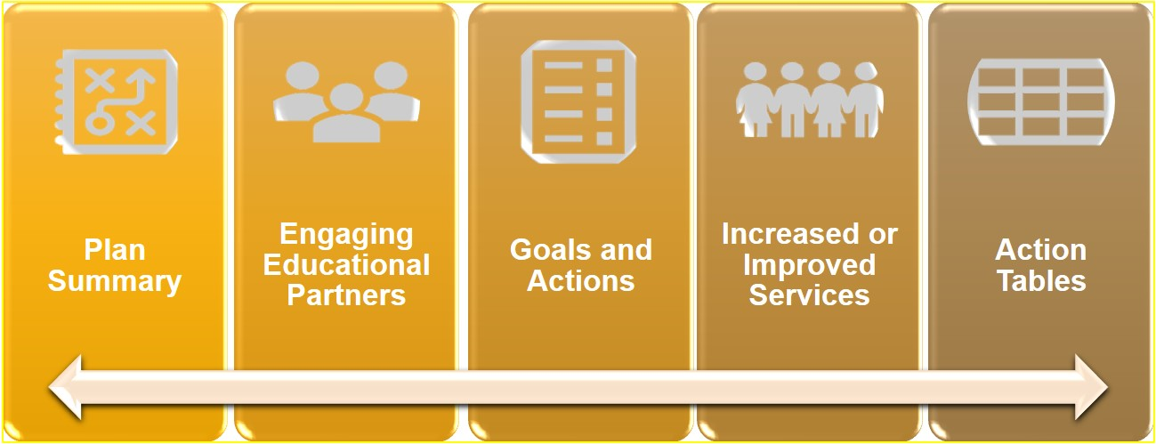
The LCAP “Through Line” (1)
See Appendix 1 for description.

Slide 54
The LCAP “Through Line” (2)
It is also important to look at the LCAP as a whole.
The LCAP is composed of different sections.
The sections are interrelated.
The document is greater than the sum of its parts.

Slide 55
Upcoming Opportunities
Future Trainings, opportunities to provide input, and contact information

Slide 56
Upcoming Webinars
3 p.m. Thursday, December 15: Goals and Actions
3 p.m. Thursday, January 5, 2023: Increased or Improved Services, Part I
2 p.m. Tuesday, January 10, 2023: Increased or Improved Services, Part II
2 p.m. Tuesday, January 17, 2023: California School Dashboard Local Indicator Process for 2023
3 p.m. Thursday, January 26, 2023: Required Goals

Slide 57
Contact Information
  If you have any questions related to the LCAP or LCFF, please contact the Local Agency Systems Support Office at LCFF@cde.ca.gov
  For additional information about this or other webinars in this series, including PowerPoint files, please see the Tuesdays @ 2 webpage at https://www.cde.ca.gov/fg/aa/lc/tuesdaysat2.asp
  For email updates regarding the LCFF, subscribe to the LCFF listserv by sending a "blank" message to join-LCFF-list@mlist.cde.ca.gov

Slide 58
Thank you for attending!

Slide 59
Appendix 1 – Slide 53
5 orange rectangular shapes arranged side-by-side on the longer side with the colors getting darker going to the right
An ongoing arrow at the bottom of all rectangles visually connecting them together.
The rectangles have a decorative symbol and the following titles: Plan Summary, Engaging Educational Partners, Goals and Actions, Increased or Improved Services, and Action Tables.

