Slide 1
Introduction to the Local Control Funding Formula
California Department of Education
November 4, 2025

Slide 2
Webinar Series
November 6: Local Control and Accountability Plan (LCAP) Template & Instructions
November 18: Local Indicators
November 20: Engaging Educational Partners
December 2: Goals and Measuring and Reporting Results
December 4: Goal Analysis
December 9: Actions and Action Tables
December 11: Increased or Improved Services, Part 1
December 16: Increased or Improved Services, Part 2
To register, please visit the Tuesdays @ 2 Webinar Series web page.

Slide 3
Purpose
To provide an overview of the following:
The history of the Local Control Funding Formula (LCFF) and its foundational principles; and
The connection between the Local Control and Accountability Plan (LCAP), the California School Dashboard (Dashboard) California’s Statewide System of Support.
*see notes throughout presentation

Slide 4

Intended Audience
The intended audience for this presentation is anyone who is new to the LCFF, the LCAP, the Dashboard, and the Statewide System of Support.
This may include
Parents
Teachers
Staff
Administrators
Community members

Slide 5
Why?
Understanding the foundational principles upon which the LCFF, the LCAP, the Dashboard and the Statewide System of Support are based aids in understanding the requirements for the LCAP, the LCAP development process, and LCFF requirements.
It helps us see the “through line” between the vision and the requirements

Slide 6
Background
Funding and Accountability Before the LCFF

Slide 7
Funding Before the LCFF (1)
Until 1971: local control / local funding through property taxes
1972: Revenue Limits (frozen at then current level) - beginning of State control
Serano vs. Priest: inequities in funding unconstitutional
1978: Prop 13, which shifted a preponderance of funding away from local property taxes

Slide 8
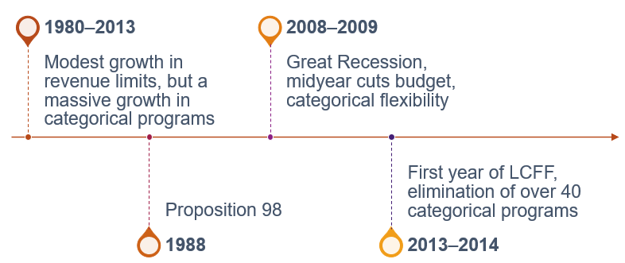
Funding Before the LCFF (2)
*see Appendix A for descriptive text

Slide 9
Accountability Before the LCFF
Accountability before LCFF was a top-down system characterized by a single measure of success and a one-size-fits-all approach to improvement.
The Public Schools Accountability Act (1999)
The Academic Performance Index (API)
The Immediate Intervention/ Underperforming Schools Program
School Assistance and Intervention Team (SAIT)
District Assistance and Intervention Team (DAIT)
The No Child Left Behind Act of 2001 (NCLB)
Adequate Yearly Progress (AYP)
Program Improvement
Corrective Action

Slide 10
Foundational Principles of the LCFF
Local education agency (LEA)-level improvement that is based on multiple measures of success
Equity
Additional funding to address specific identified needs of students who are low income, English learners, and/or foster youth (i.e., unduplicated students)
Requirement to Increase or Improve Services in proportion to the increase in funding
Subsidiarity
Social and political issues are best dealt with at the local level
This approach necessitates transparency and collaboration with educational partners

Slide 11
Key Components of the LCFF
LCFF Funding
Requirement to Increase or Improve Services
The LCFF State Priorities
The LCAP
The California School Dashboard (Dashboard)
The Statewide System of Support

Slide 12
LCFF Funding
Flexible Funding to Address Identified Needs
Notes:
LCFF-Local Control Funding Formula

Slide 13
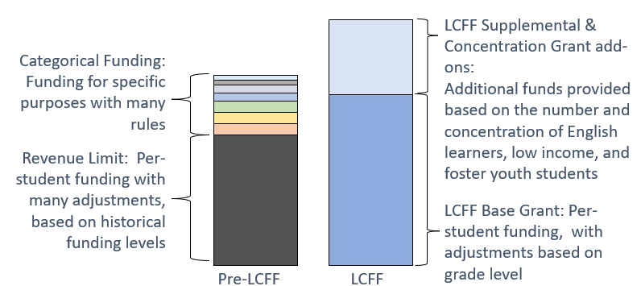
Funding Changes Made by LCFF
*see Appendix B for descriptive text
Notes:
The 2013–14 budget package replaces the previous K–12 finance system with a new Local Control Funding Formula (LCFF). For school districts and charter schools, the LCFF creates base, supplemental, and concentration grants in place of most previously existing K–12 funding streams, including revenue limits and most state categorical programs. For county offices of education (COEs), the LCFF creates separate funding streams for oversight activities and instructional programs.

Slide 14
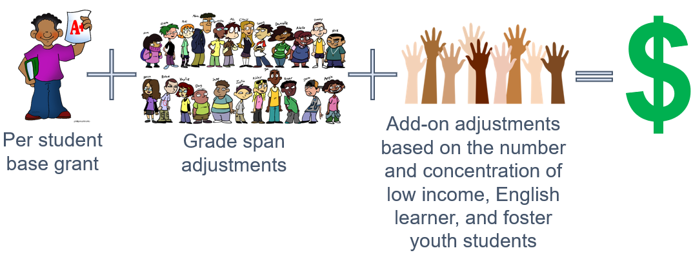
LCFF Funding Formula Basics
*see and Appendix C for descriptive text
Notes:
The LCFF includes the following components for school districts and charter schools:
Provides a base grant for each LEA based on average daily attendance (ADA). The actual base grants vary based on grade span.
Provides a supplemental grant equal to 20 percent of the adjusted base grant for targeted disadvantaged students. Targeted students are those classified as English learners (EL), eligible to receive a free or reduced-price meal (FRPM), foster youth, or any combination of these factors (unduplicated count).
Provides a concentration grant equal to 65 percent of the adjusted base grant for targeted students exceeding 55 percent of an LEA’s enrollment.
COEs receive LCFF funding through a two-part formula with funding for oversight responsibilities and instructional activities. The oversight responsibilities are funded through a COE operations grant, with amounts based on (1) a minimum grant per county, (2) the number of school districts in the county, and (3) the ADA in the county attributable to school districts, charter schools, and schools operated by the county superintendent.
Photos by Unknown Author is licensed under CC BY-SA-NC

Slide 15
Unrestricted Funds
All LCFF funding, regardless of whether it is calculated using the formula for the base grant, the formula for the supplemental grant add-on, or the formula for the concentration grant add-on, is unrestricted funding
LCFF funds may be spent on any purpose allowable under the California’s Education Code

Slide 16
Funding Flexibility to Ensure Student Success
LCFF provides for an increased level of local flexibility to determine which programs and/or services have the greatest likelihood of ensuring that each student will succeed in relation to each of the LCFF state priorities.
In exchange for this flexibility, the LCFF requires greater local responsibility for selecting appropriate and effective programs.
This necessitates transparency and engaging the LEAs educational partners in analysis and decision-making.

Slide 17
Equity Multiplier Funding
Equity Multiplier funding is not an add-on to the LCFF entitlement
Equity Multiplier funding is a separate source of funding allocated outside of the LCFF entitlement and is not offset by the LEA’s local revenue
Funding is identified as a separate line item of the Principal Apportionment Summary and revenue and expenditures are tracked with a unique Standardized Account Code Structure (SACS) code
For additional information please see the Local Control Funding Formula Equity Multiplier web page

Slide 18
Requirement to Increase or Improve Services
Additional Funding with a Focus on Equity

Slide 19
Increasing or Improving Services (1)
LEAs are required to demonstrate in the LCAP how they are meeting the requirement to increase or improve services for students who are low income, English learners, and/or foster youth as compared to the services provided to all pupils.
Services must be increased or improved in proportion to the increase in funding apportioned on the basis of the number and concentration of low income, English learners, or foster youth students
Notes:
To improve services means to grow services in quality and to increase services means to grow services in quantity.

Slide 20
Increasing or Improving Services (2)
LEAs that are unable to demonstrate that they have increased or improved services by the required percentage are required to carry over the unmet portion of the percentage into the coming year.

Slide 21
Specific Training Sessions
The following trainings related to the requirement to increase or improve services for students who are foster youth, English learners, and low-income are scheduled:
Increased or Improved Services (Part I)
Date: Thursday, December 11
Time: 2 p.m.
Increased or Improved Services (Part II)
Date: Tuesday, December 16
Time: 2 p.m.
Register for these trainings on the Tuesdays @ 2 Webinar Series web page.

Slide 22
The LCFF State Priorities
Areas of Focus for California’s LEAs

Slide 23
LCFF State Priorities
Priority 1: Appropriate teacher assignment, sufficient instructional materials, and facilities in good repair
Priority 2: Implementation of academic content and performance standards adopted by the State Board of Education (SBE)
Priority 3: Parental Involvement and Family Engagement
Priority 4: Pupil Achievement
Priority 5: Pupil engagement
Priority 6: School Climate
Priority 7: Course Access
Priority 8: Other Pupil Outcomes
Priority 9: Expelled Students (COEs only)
Priority 10: Foster Youth (COEs only)
Plus, any Local Priorities
Please see the LCFF State Priorities Summary for a summary of the state priority areas.
Notes:
From Education Code (EC) sections 52060(d) and 52066(d)

Slide 24

Priority 1: Basic Conditions and Services
The degree to which:
Teachers in the LEA are appropriately assigned and fully credentialed in the subject area and for the students they are teaching;
Every student in the LEA has sufficient access to the standards-aligned instructional materials; and
School facilities are maintained in good repair
Notes:
From EC sections 52060(d)(1) and 52066(d)(1):
The degree to which the teachers of the school district are appropriately assigned in accordance with Section 44258.9, and fully credentialed in the subject areas, and, for the pupils they are teaching, every pupil in the school district has sufficient access to the standards-aligned instructional materials as determined pursuant to Section 60119, and school facilities are maintained in good repair, as defined in subdivision (d) of Section 17002

Slide 25
Priority 2: State Standards
The implementation of State Board adopted academic content and performance standards for all students; and
How the programs and services provided by the LEA will enable English learners to access the Common Core State Standards and the English Learner Development standards for purposes of gaining academic content knowledge and English language proficiency
Notes:
From EC sections 52060(d)(2) and 52066(d)(2):
Implementation of the academic content and performance standards adopted by the state board, including how the programs and services will enable English learners to access the common core academic content standards adopted pursuant to Section 60605.8 and the English language development standards adopted pursuant to former Section 60811.3, as that section read on June 30, 2013, or former Section 60811.4, as that section read on June 30, 2016, for purposes of gaining academic content knowledge and English language proficiency.

Slide 26

Priority 3: Parental Involvement and Family Engagement
The efforts the LEA makes to seek parent input in making decisions for the school district and each individual schoolsite;
How the LEA will promote parental participation in programs for students who are low income, English learners, and foster youth; and
How the LEA will promote parental participation in programs for students with disabilities
Notes:
From EC sections 52060(d)(3) and 52066(d)(3):
(A) Parental involvement and family engagement, including efforts the school district makes to seek parent input in making decisions for the school district and each individual schoolsite, and including how the school district will promote parental participation in programs for unduplicated pupils and individuals with exceptional needs.
(B) Family engagement may include, but need not be limited to, efforts by the school district and each individual schoolsite to apply research-based practices, such as welcoming all families into the school community, engaging in effective two-way communication, supporting pupil success, and empowering families to advocate for equity and access. Family engagement may include, but need not be limited to, treating families as partners to inform, influence, and create practices and programs that support pupil success and collaboration with families and the broader community, expand pupil learning opportunities and community services, and promote civic participation.

Slide 27
Priority 4: Pupil Achievement (1)
Measured by all of the following, as applicable to the LEA:
statewide standardized assessments;
the percentage of students who have successfully completed courses that satisfy University of California or California State University entrance requirements;
The percentage of students who have successfully completed courses that satisfy the requirements for career technical education (CTE) sequences or programs of study that align with state board-approved CTE standards and frameworks;
The percentage of students who have successfully completed both types of courses described in the two previous bullets;
Notes:
From EC sections 52060(d)(4) and 52066(d)(4):
(4) Pupil achievement, as measured by all of the following, as applicable:
(A) Statewide assessments administered pursuant to Article 4 (commencing with Section 60640) of Chapter 5 of Part 33 or any subsequent assessment, as certified by the state board.
(B) The percentage of pupils who have successfully completed courses that satisfy the requirements for entrance to the University of California and the California State University.
(C) The percentage of pupils who have successfully completed courses that satisfy the requirements for career technical education sequences or programs of study that align with state board-approved career technical education standards and frameworks, including, but not limited to, those described in subdivision (a) of Section 52302, subdivision (a) of Section 52372.5, or paragraph (2) of subdivision (e) of Section 54692.
(D) The percentage of pupils who have successfully completed both types of courses described in subparagraphs (B) and (C).
(E) The percentage of English learner pupils who make progress toward English proficiency as measured by the English Language Proficiency Assessments for California or any subsequent assessment of English proficiency, as certified by the state board.
(F) The English learner reclassification rate.
(G) The percentage of pupils who have passed an advanced placement examination with a score of 3 or higher.
(H) The percentage of pupils who demonstrate college preparedness pursuant to the Early Assessment Program, as described in Chapter 6 (commencing with Section 99300) of Part 65 of Division 14 of Title 3, or any subsequent assessment of college preparedness.

Slide 28
Priority 4: Pupil Achievement (2)
(Continued from previous slide)
the percentage of students who are English learners who make progress toward English proficiency as measured by the English Language Proficiency Assessments for California;
the English learner reclassification rate;
the percentage of students who have passed an advanced placement examination with a score of 3 or higher; and
the percentage of students who demonstrate college preparedness pursuant to the Early Assessment Program, or any subsequent assessment of college preparedness
Notes:
From EC sections 52060(d)(4) and 52066(d)(4):
(4) Pupil achievement, as measured by all of the following, as applicable:
(A) Statewide assessments administered pursuant to Article 4 (commencing with Section 60640) of Chapter 5 of Part 33 or any subsequent assessment, as certified by the state board.
(B) The percentage of pupils who have successfully completed courses that satisfy the requirements for entrance to the University of California and the California State University.
(C) The percentage of pupils who have successfully completed courses that satisfy the requirements for career technical education sequences or programs of study that align with state board-approved career technical education standards and frameworks, including, but not limited to, those described in subdivision (a) of Section 52302, subdivision (a) of Section 52372.5, or paragraph (2) of subdivision (e) of Section 54692.
(D) The percentage of pupils who have successfully completed both types of courses described in subparagraphs (B) and (C).
(E) The percentage of English learner pupils who make progress toward English proficiency as measured by the English Language Proficiency Assessments for California or any subsequent assessment of English proficiency, as certified by the state board.
(F) The English learner reclassification rate.
(G) The percentage of pupils who have passed an advanced placement examination with a score of 3 or higher.
(H) The percentage of pupils who demonstrate college preparedness pursuant to the Early Assessment Program, as described in Chapter 6 (commencing with Section 99300) of Part 65 of Division 14 of Title 3, or any subsequent assessment of college preparedness.

Slide 29

Priority 5: Pupil Engagement
Measured by all of the following, as applicable to the LEA:
school attendance rates;
chronic absenteeism rates;
middle school dropout rates;
high school dropout rates; and
high school graduation rates
Notes:
From EC sections 52060(d)(5) and 52066(d)(5):
(5) Pupil engagement, as measured by all of the following, as applicable:
(A) School attendance rates.
(B) Chronic absenteeism rates.
(C) Middle school dropout rates.
(D) High school dropout rates.
(E) High school graduation rates.

Slide 30

Priority 6: School Climate
Measured by all of the following, as applicable:
suspension rates;
expulsion rates; and
other local measures, including surveys of students, parents, and teachers on the sense of safety and school connectedness.
Notes:
From EC sections 52060(d)(6) and 52066(d)(6):
(6) School climate, as measured by all of the following, as applicable:
(A) Pupil suspension rates.
(B) Pupil expulsion rates.
(C) Other local measures, including surveys of pupils, parents, and teachers on the sense of safety and school connectedness.

Slide 31

Priority 7: Course Access
Addresses the extent to which students have access to and are enrolled in:
the adopted course of study for grades 1 to 6 and/or the adopted course of study for grades 7 to 12, as applicable;
programs and services developed and provided to students who are low income, English learners, and foster youth; and
programs and services developed and provided to students with disabilities

Slide 32

Priority 8: Student Outcomes
Addresses student outcomes, if available, for the adopted course of study for grades 1 to 6 and/or the adopted course of study for grades 7 to 12, as applicable to the LEA
Notes:
From EC sections 52060(d)(8) and 52066(d)(8):
(8) Pupil outcomes, if available, in the subject areas described in Section 51210 and subdivisions (a) to (i), inclusive, of Section 51220, as applicable.

Slide 33

Priority 9: Coordination of Instruction
Coordination of instruction for expelled students
For COEs only
Addresses how the COE will coordinate instruction for expelled students with school districts within the county

Slide 34

Priority 10: Coordination of Services (1)
Coordination of Services for Foster Youth
For COEs only
Addresses how the COEs will coordinate services for foster youth, including:
working with the county child welfare agency to minimize changes in school placement
providing education-related information to the county child welfare agency, including educational status and progress information that is required to be included in court reports;
Notes:
From EC sections 52066(d)(10):
(10) How the county superintendent of schools will coordinate services for foster children, including, but not limited to, all of the following:
(A) Working with the county child welfare agency to minimize changes in school placement.
(B) Providing education-related information to the county child welfare agency to assist the county child welfare agency in the delivery of services to foster children, including, but not limited to, educational status and progress information that is required to be included in court reports.
(C) Responding to requests from the juvenile court for information and working with the juvenile court to ensure the delivery and coordination of necessary educational services.
(D) Establishing a mechanism for the efficient expeditious transfer of health and education records and the health and education passport.

Slide 35
Priority 10: Coordination of Services (2)
(Continued from previous slide)
responding to requests from the juvenile court for information and working with the juvenile court to ensure the delivery and coordination of necessary educational services; and
establishing a mechanism for the efficient expeditious transfer of health and education records and the health and education passport

Slide 36
Local Priorities
LEAs also have flexibility to identify local priorities
Local priorities include:
Identifying goals of the local priority; and
The methods for measuring progress towards achieving those local goals.
Notes:
From EC sections 52060(h) and 52066(h):
(h) A school district or COE may identify local priorities, goals in regard to the local priorities, and the method for measuring the school district’s progress toward achieving those goals.

Slide 37
The LCAP
A tool to set goals, plan actions, and leverage resources to improve student outcomes

Slide 38
The Local Control and Accountability Plan
As part of the LCFF, LEAs are required to develop, adopt, and annually update a three-year LCAP using the template adopted by the California State Board of Education (SBE)
The LCAP must include a description of the annual goals to be achieved for each student group for each state priority and for any local priorities identified by the local governing board or body of the school district or COE, or in the charter school petition
The LCAP must include an annual review of the effectiveness of the goals, actions, and services from the prior year
Notes:
Student groups that must be addressed in the LCAP are those subgroups named in EC Section 52052:
Ethnic subgroups
Socioeconomically disadvantaged pupils
English learners
Pupils with disabilities
Foster youth
Homeless youth
Goals must address each of the state priorities and any additional local priorities; however, one goal may address multiple priorities.
An LEA may identify which school sites and subgroups have the same goals, and maygroup and describe those goals together.
If a single goal requires longer than one year to implement fully, the LCAP should reflect the annual incremental actions, services, and expenditures, as well as the annual anticipated progress, that the district expects to achieve for each student group.
These annual benchmarks will assist LEAs and the community to monitor the progress of the plan.

Slide 39
New Requirement: LCAP Adoption Fiscal Penalty
Beginning with the annual audit for 2025, auditors will be verifying that the LEA has adopted its LCAP on or before July 1, as required by California Education Code (EC) Section 52065.1.
If an LEA has not adopted its LCAP on or before July 1 the auditor is required to assess a fiscal penalty equal to 20 percent of the LEAs second principal apportionment. This penalty will be increased by 1 percent for each additional business day after July 1 that the LEA failed to adopt the LCAP.
As part of this requirement LEAs must adhere to the requirements of EC sections 47606.5(a) and (f), 52062(b), or 52068(b), as applicable.
See EC sections 1631(c) and 42128(c) for additional information.

Slide 40

Student Groups
Ethnic groups (30 or more)
Socioeconomically disadvantaged students (30 or more)
English learners (30 or more)
Long-term English learners (15 or more) Students with disabilities (30 or more)
Foster youth (15 or more)
Homeless youth (15 or more)
Notes:
Student groups that must be addressed in the LCAP are those subgroups named in Education Code (EC) Section 52052:
Ethnic subgroups
Socioeconomically disadvantaged pupils
English learners
Long-term English learners
Pupils with disabilities
Foster youth
Homeless youth

Slide 41

Framing the LCAP (1)
California Education Code Section 52064(e)(1): “The process of developing and annually updating the local control and accountability plan shall support school districts, county offices of education, and charter schools in comprehensive strategic planning, accountability, and improvement across the state priorities, particularly to address and reduce disparities in opportunities and outcomes between pupil groups indicated by the California School Dashboard, and any locally identified priorities through meaningful engagement with local [educational partners].”

Slide 42

Framing the LCAP (2)
The LCAP development process serves three distinct, but related functions:
Comprehensive Strategic Planning:
The process of developing and annually updating the LCAP supports comprehensive strategic planning
Strategic planning that is comprehensive connects budgetary decisions to teaching and learning performance data
LEAs need to continually evaluate the hard choices they make about the use of limited resources to meet student and community needs to ensure opportunities and outcomes are improved for all students.

Slide 43
Framing the LCAP (3)
Meaningful Engagement of Educational Partners:
The LCAP development process should result in an LCAP that reflects decisions made through meaningful engagement of educational partners.
Local educational partners possess valuable perspectives and insights about an LEA's programs and services.
Effective strategic planning will incorporate these perspectives and insights to identify potential goals and actions to be included in the LCAP.

Slide 44

Framing the LCAP (4)
Accountability and Compliance:
The LCAP serves an important accountability function because aspects of the LCAP template require LEAs to show that they have complied with various requirements specified in the LCFF statutes and regulations.

Slide 45
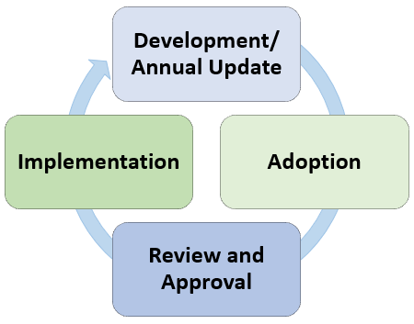
LCAP Development Process
Development/Annual Update
Data analysis and reflection
Engage educational partners
Write/revise the plan
Adoption
Public Hearing to solicit public input
Public Meeting to adopt the LCAP, the budget, and report on local indicator progress
Review and Approval (districts and COEs only)
Implementation
Notes:
Development Phase (data analysis and reflection, engaging educational partners in that process, writing the plan)
Adoption Phase (hearing, adoption meeting, local indicator presentation)
Review and Approval Phase (COE/CDE reviews the plan, makes recs, approves plan assuming it meets requirements)
Implementation Phase (LEA is actually implementing plan)

Slide 46
Approval Criteria for the LCAP
School District and COEs must submit their LCAPs for review and approval. Statute requires the LCAP to be approved if the following review and approval criteria are met:
The LEA has adhered to the template and has followed the instructions for completing the template;
The LEA budget for the fiscal year includes expenditures that are sufficient to implement the actions in the LCAP;
The LEA has demonstrated how it is meeting its requirement to increase or improve services for students who are low-income, English learners, or foster youth; and
The LEA has included the related calculations required to meet the increased or improved services requirement.
Notes:
School Districts submit their LCAP to their COE; COEs submit their LCAP to the CDE.
Approval criteria #4: Relates to the carryover calculation and LEAs accounting for how unmet MPP (carryover %) from previous year will be met in current year. These calculations are documented in the Increased or Improved Services section and the Contributing Actions tables and LCFF Carryover Table. The related contributing actions are captured in the Goals and Actions section and the Increased or Improved Services section.

Slide 47
The California School Dashboard
A powerful online tool to help identify strengths and weaknesses

Slide 48
Multiple Measures
The LCFF created an accountability system that utilizes multiple measures to inform educators, parents, and the public of student achievement
Statute required the SBE to develop evaluation rubrics to
assist LEAs in evaluating their strengths, weaknesses, and areas that require improvement, and
assist in identifying LEAs in need of technical assistance and the specific priorities that the technical assistance should focus on

Slide 49
State and Local Indicators
The SBE adopted state and local indicators to measure LEA and schoolsite performance in regard to each of the state priorities, as required by law
Performance data on state and local indicators is publicly reported in the Dashboard
State Indicators apply to all LEAs, schools, and student groups and are based on data that is collected consistently across the state(Priorities 4, 5, 6 and 8)
Local Indicators apply at the LEA and charter school level and are based on data collected at the local level (Priorities 1, 2, 3, 6, 7, 9and 10)
LEAs are eligible for assistance based on criteria adopted by the SBE

Slide 50

The Role of the Dashboard in the LCAP (1)
The Dashboard provides LEAs with a robust set of data to guide local data analysis and planning
As a reminder, the LCAP planning process is particularly intended to address and reduce disparities in opportunities and outcomes between student groups indicated by the Dashboard

Slide 51
The Role of the Dashboard in the LCAP (2)
Within the LCAP LEAs must:
Reflect on the annual performance on the Dashboard and local data; and
Consider performance on the state and local indicators on the Dashboard in determining LCAP goals and actions

Slide 52
California Statewide System of Support
Tiered Support for LEAs and Schools

Slide 53
The Goal of the System of Support
California's system of support is one of the central components of the accountability and continuous improvement system.
The overarching goal of California’s System of Support is to help LEAs and their schools meet the needs of each student they serve, with a focus on building local capacity to sustain improvement and to effectively address disparities in opportunities and outcomes.

Slide 54
Support for All LEAs
The purpose of the System of Support is to build the capacity of LEAs in the following areas:
Support the continuous improvement of student performance in each of the eight state priorities
Address the gaps in achievement between student groups
Improve outreach and collaboration with educational partners to ensure that goals, actions, and services described in LEA LCAPs reflect the needs of students and the community, especially for historically underrepresented or low-achieving groups.

Slide 55
Characteristics of the System of Support
Reducing redundancy across state and federal programs
Integrating guidance and resources across state and federal programs
Supporting LEAs to meet identified student needs through the LCAP process

Slide 56
Various Support Providers
The California Statewide System of Support encompasses 45 separate publicly funded initiatives in the state of California on a wide variety of topics within education. These include
COEs
Geographic Lead Agencies
Various Resource Leads and Initiatives
The California Department of Education
The California Collaborative for Educational Excellence (CCEE)
Additional information may be found on the Statewide System of Support Directory.

Slide 57
Levels of Support
Support for All LEAs and Schools (Level 1)
Resources, tools, and technical assistance that all LEAs may use to improve student performance at the LEA and school level
Differentiated Assistance (Level 2)
Provided for eligible LEAs in the form of individually designed assistance to address identified performance issues
Intensive – Direct Technical Assistance (Level 3)
The CCEE provides more intensive and customized support for eligible LEAs.

Slide 58
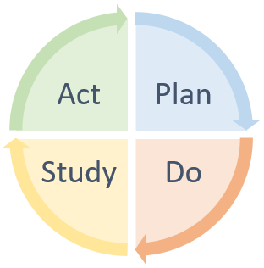
A Cycle of Continuous Improvement
Support for LEAs and schools is not based on the “test and judge” methods of the past
Support providers partner with LEAs to build capacity to improve outcomes for students
Identifying needs based on data analysis and input from educational partners
Providing or connecting LEAs to tools, resources and supports available to them
Utilizing plan-do-study-act cycles to implement change ideas
Making use of the flexibility provided through the LCFF statute to make course corrections

Slide 59
Memorializing the Support Process
LEAs eligible for Differentiated Assistance must
provide a summary of the work underway as part of receiving support within the LCAP; and
identify specific actions within the LCAP related to the implementation of the work underway as part of receiving support
The intent of these requirements is to ensure that the work of receiving support is aligned with the goals articulated in the LCAP

Slide 60
Closing Thoughts

Slide 61
Building on the Foundation
This webinar has provided an explanation of the foundational basis of the LCFF, the LCAP and the accountability system
In the coming weeks we will build on this foundation as we take an in-depth look at the LCAP, engaging educational partners, the requirement to increase or improve services and other applicable requirements

Slide 62
Upcoming Webinars
Tuesdays @ 2
Thursdays @ 3
11/18: Local Indicators​
12/2: Goals and Reporting and Measuring Results
12/9: Actions and Action Tables
12/16: Increased or Improved Services, Part II
11/6: Template and Instructions
11/20: Engaging Educational Partners
12/4: Goal Analysis
12/11: Increased or Improved Services, Part I

Slide 63
For More Information
Local Control Funding Formula web page
Local Control and Accountability Plan (LCAP) web page
California School Dashboard web page
California's System of Support web page
LCFF Updates:
Send a blank email to join-LCFF-list@mlist.cde.ca.gov

Slide 64
Contact Information
If you have any questions related to the LCAP or LCFF, please contact the Local Agency Systems Support Office at LCFF@cde.ca.gov
For additional information about this or other webinars in this series, including PowerPoint files, please see the Tuesdays @ 2 webpage
For questions related to the Dashboard please contact the Analysis Measurement and Accountability Team at Dashboard@cde.ca.gov
For questions related to the System of Support please contact the System of Support Office at CASystemofSupport@cde.ca.gov

Slide 65
Thank you for attending!

Slide 66
Appendix A – Slide 8
Funding before the LCFF timeline going from left to right
1980-2013 – Modest growth in revenue limits, but a massive growth in categorical programs
1988 – Proposition 98
2008-2009 – Great Recession, midyear budget cuts, categorical flexibility
2013-2014 – First year of LCFF, elimination of over 40 categorical programs

Slide 67
Appendix B – Slide 13
Funding changes made by the LCFF
2 bar graphs are situated side by side vertically.
The left bar graph is labeled as "Pre-LCFF" and separated into 2 sections:
Categorical Funding: Funding for specific purposes with many rules
Revenue Limit: Per-student funding with many adjustments, based on historical funding levels
The right bar graph is labeled as "LCFF" and separated into 2 sections:
LCFF Supplemental & Concentration Grant add-ons: Additional funds provided based on the number and concentration of English learners, low-income, and foster youth students
LCFF Base Grant: Per-student funding, with adjustments based on grade level

Slide 68
Appendix C – Slide 14
LCFF Funding Formula Basics
The following images are placed in a right linear fashion:
Picture of student holding a paper with an "A+" grade labeled with "Per student base grant“
Plus sign
Picture of multiple students lined up labeled with "Grade span adjustments“
Plus sign
Picture of multiple-colored hands raised labeled with "Add-on adjustments based on the number and concentration of low-income, English learner, and foster youth students“
Equals sign
Green dollar sign

