Slide 1
Supporting English Learners through California’s System of Support
November 10, 2020

Slide 2
Purpose
To provide an overview of data reports and accountability data for English learner students available from the California Department of Education (CDE)
To provide an overview of resources to support English learners (ELs) available to local educational agencies (LEAs), teachers, and parents and families through California’s System of Support

Slide 3
English Learner Students and
Educational Outcomes
Jonathan Isler, Administrator
Justin Lane, Consultant
Analysis, Measurement, and Accountability Reporting Division
November 10, 2020

Slide 4
Agenda
English Learner (EL), Re-designated Fluent English Proficient (RFEP) students, Long Term ELs (LTELs), At-Risk LTELs (AR-LTELs) Data Quest Reports
State Level Educational Outcomes of ELs
Accountability Outcomes for ELs on the California School Dashboard (Dashboard)
EL Students in California Web Page
District and School Support for ELs

Slide 5
2019–20 EL and RFEP Data Reports
EL Data
Statewide EL Dataquest Reports are available at https://dq.cde.ca.gov/dataquest/longtermel/ELAS.aspx?cds=00&agglevel=State&year=2019-20.
EL downloadable data files are available at https://www.cde.ca.gov/ds/sd/sd/fileselsch.asp.
RFEP Data
Statewide RFEP Dataquest Reports are available at https://dq.cde.ca.gov/dataquest/Cbeds1.asp?Enroll=on&PctEL=on&PctFEP=on&PctRe=on&cChoice=StatProf1&cYear=2019-20.
RFEP download data files are available at https://www.cde.ca.gov/ds/sd/sd/filesreclass.asp.

Slide 6
Enrollment Counts by EL Type and Year
EL Type | 2016–17 | 2017–18 | 2018–19 | 2019–20
ELs | 1,332,405 | 1,271,150 | 1,195,988 | 1,148,024
RFEPs | 1,047,267 | 1,104,495 | 1,131,092 | 1,133,977

Slide 7
Enrollment Percentage by EL Type and Year
EL Type | 2016–17 | 2017–18 | 2018–19 | 2019–20
ELs | 21.4% | 20.4% | 19.3% | 18.6%
RFEPs | 16.8% | 17.8% | 18.3% | 18.4%

Slide 8
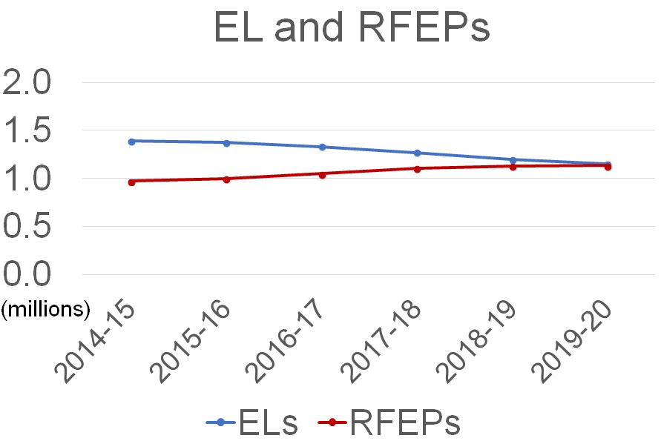
ELs and RFEPs

Slide 9
2019–20 LTEL and AR-LTEL Data Reports
For 2018–19, the criteria to use EL Proficiency assessment data could not be used to determine EL students who are considered AR-LTEL or LTEL because two years of English Language Proficiency Assessments for California (ELPAC) Summative Assessment results are required. For 2019–20, two years of ELPAC Summative results were available.
Statewide LTEL and AR-LTEL Dataquest Reports are available at https://dq.cde.ca.gov/dataquest/longtermel/EverElType.aspx?cds=00&agglevel=State&year=2018-19.
LTEL and AR-LTEL downloadable data files are available at https://www.cde.ca.gov/ds/sd/sd/filesltel.asp.

Slide 10
2019-20 LTEL and AR-LTEL Counts
Statewide LTEL and AR-LTEL Dataquest Reports are available at https://dq.cde.ca.gov/dataquest/longtermel/EverElType.aspx?cds=00&agglevel=State&year=2019-20.
EL Type | 2016–17 | 2017–18 | 2018–19 | 2019–20
LTELs | 230,119 | 218,135 | 342,983 | 204,042
AR-LTEL | 152,669 | 144,146 | 220,738 | 130,783
EL 4+ Years Not At-Risk or LTEL | 265,929 | 250,479 | 24,379 | 236,394

Slide 11
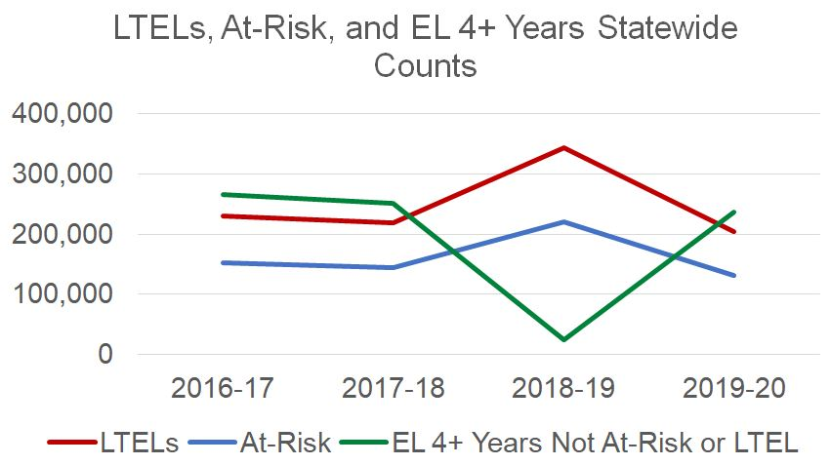
AR-LTEL and LTEL Graph By
EL Type and Year

Slide 12

State Level Educational Outcomes of ELs

Slide 13
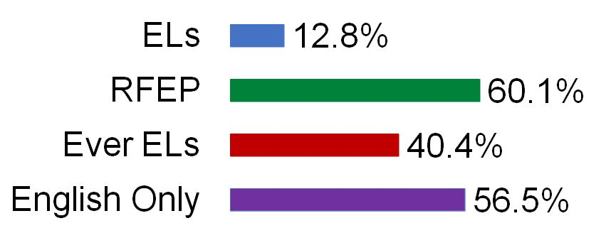
2018-2019 English Language Arts/Literacy (ELA) Data
The graph below displays the 2018-2019 school year percent of students meeting or exceeding standards on the Smarter Balanced Summative Assessment in English language arts/literacy (ELA) for EL students, Reclassified Fluent English Proficient (RFEP), Ever ELs, and English only students.
Notes:
Non-ELs = English Only students

Slide 14
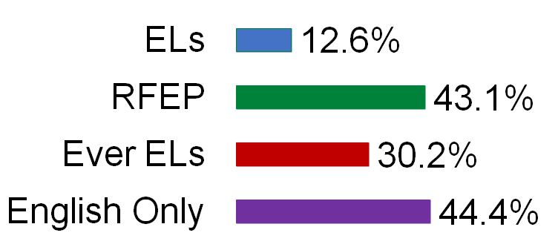
2018-2019 Mathematics Data
The graph below displays the 2018-2019 school year percent of students meeting or exceeding standards on the Smarter Balanced Summative Assessment in mathematics for EL, RFEP students, Ever ELs, and English only students.
Notes:
Non-ELs = English Only students

Slide 15
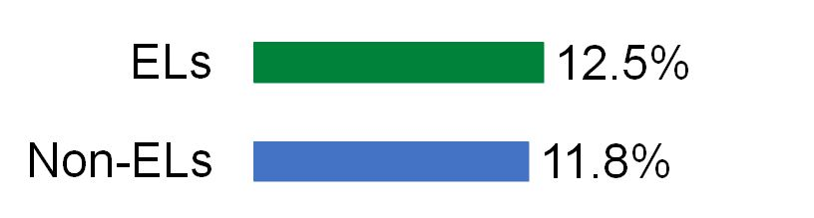
2018-2019 Chronic Absence Data
The graph below displays the 2018-2019 school year chronic absence rates for EL and non-EL students. Chronic absenteeism rate is calculated as the percent of students who miss ten percent or more of the days they are expected to attend.

Slide 16
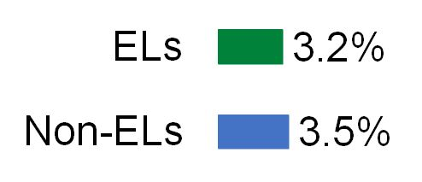
2018-2019 Suspension Data
The graph below displays the 2018-2019 school year suspension rates for EL and non-EL students. Suspension rate is calculated as the percent of all students who were suspended one or more times during the school year for an in-school or out-of-school suspension.

Slide 17
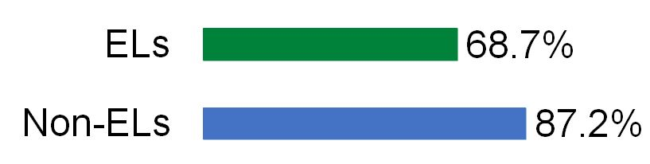
2018-19 Four-Year Cohort Graduation Rate Data
The graph below displays the 2018-2019 school year four-year cohort graduation rates for EL and non-EL students. The four-year cohort graduation rate is calculated as the percent of students who graduate high school within four years from the time they enter ninth grade with a traditional high school diploma.
Notes:
Non-ELs = English Only students

Slide 18
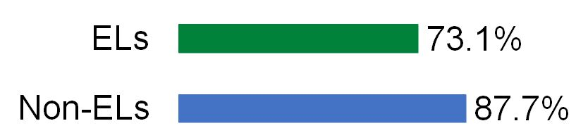
2018-19 Five-Year Cohort Graduation Rate Data
The graph below displays the 2018-2019 school year five-year cohort graduation rates for EL and non-EL students. The five-year cohort graduation rate is calculated as the percent of students who graduate high school within five years from the time they enter ninth grade with a traditional high school diploma.
Notes:
Non-ELs = English Only students

Slide 19

Accountability Outcomes for ELs
https://www.caschooldashboard.org/

Slide 20
ELs on the Dashboard
The EL student group is represented on every state indicator on the Dashboard.
The ELPI is the only state indicator that reports on only one student group (i.e., EL student group).
For the 2019 Dashboard, only ELPI Status was reported because only two years of ELPAC Summative Assessment (SA) results were available. For the 2021 Dashboard, ELPI Status, Change, and overall performance color will be reported when three years of ELPAC SA results become available.
EL determination is different based on state indicator. For more information see the California Department of Education’s (CDE) flyer on who is counted as an EL for each state indicator, (https://www.cde.ca.gov/ta/ac/cm/documents/whoisenglishlearner.pdf).
Notes:
Non-ELs = English Only students

Slide 21
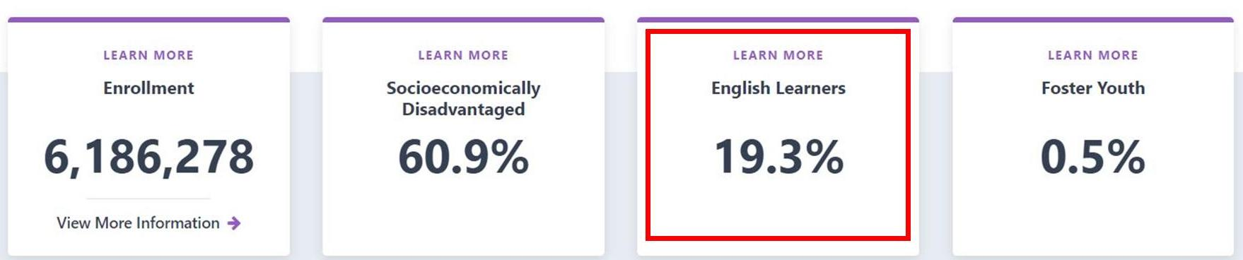
EL State Summary on 2019 Dashboard

Slide 22
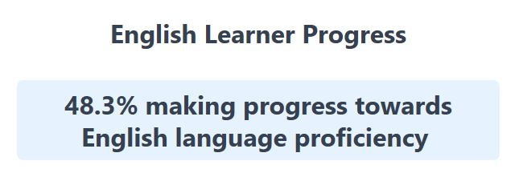
English Learner Progress Indicator (ELPI) Outcomes
Statewide ELPI Status of Medium

Slide 23
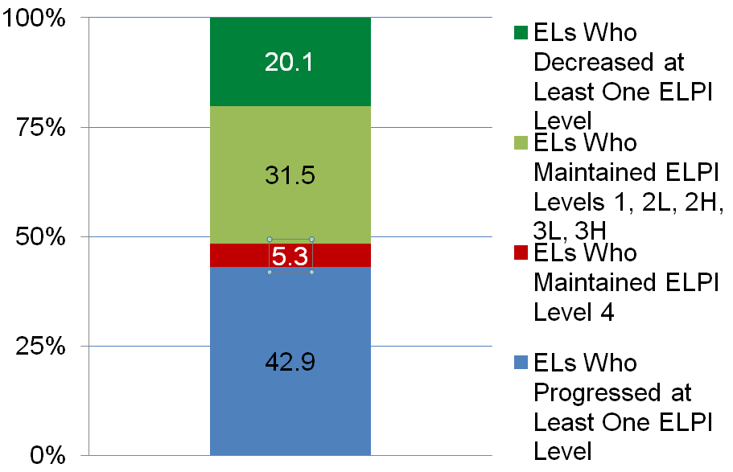
ELs Progressing Towards English Language Proficiency (ELP) on the ELPI

Slide 24
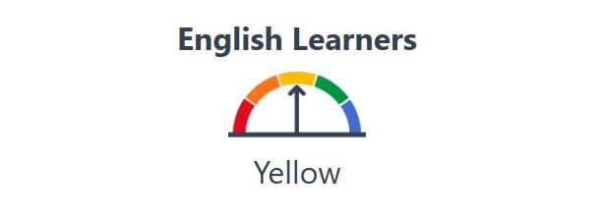
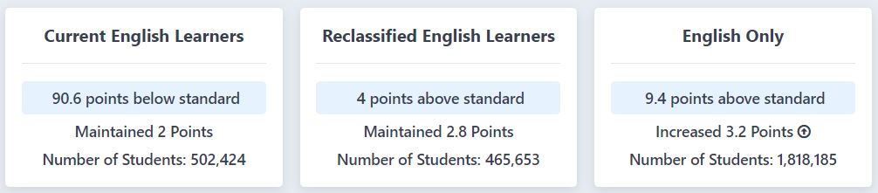
EL Outcomes on the ELA Indicator

Slide 25
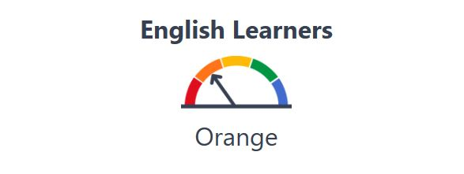
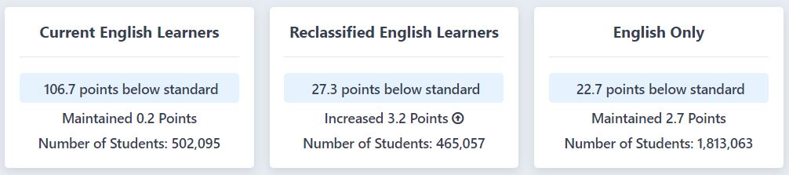
EL Outcomes on the Math Indicator

Slide 26
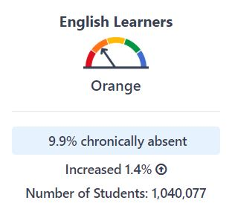
EL Outcomes on the
Chronic Absenteeism Indicator

Slide 27
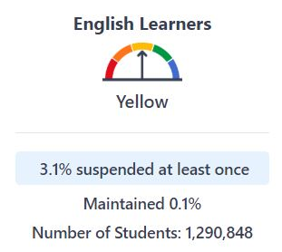
EL Outcomes on the
Suspension Rate Indicator

Slide 28
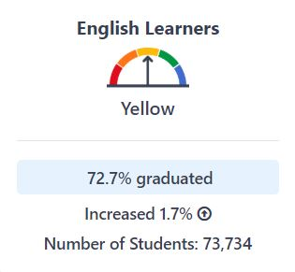
EL Outcomes on the
Graduation Rate Indicator

Slide 29
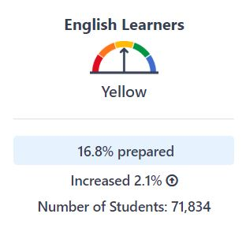
EL Outcomes on the
College/Career Indicator

Slide 30
EL Students in California Web Page
The CDE recently launched a Student Group web page (https://www.cde.ca.gov/ds/sg) which provides information and data about specific student groups that are of public and legislative interest.
The Foster Youth web page was the first student group developed and consolidates student data in one central webpage from various CDE web pages.
EL students in California is the next student group web page that will be developed. The CDE plans to continue develop this web page to include all student groups.

Slide 31
Proposed EL Data/Information for Web page
EL Outcomes (e.g., four-year cohort graduation rate for ELs and non-ELS).
EL Accountability (e.g., EL performance on the College/Career Indicator)
Links to the EL Roadmap, COVID-19 EL resources and webinars, and EL Legislation

Slide 32
District and School Support for ELs
Local Control Funding Formula (LCFF) Eligibility and Differentiated Assistance Criteria
Every Student Succeeds Act (ESSA) Eligibility Criteria for Comprehensive Support and Improvement (CSI) and Additional Targeted Support and Improvement (ATSI).

Slide 33
LCFF Eligibility Criteria
LCFF State Priority Areas 1-5 | LCFF State Priority Areas 6-10
Basics (Priority 1) Not Met for Two or More Years on Local Performance Indicator | School Climate (Priority 6) Red on Suspension Rate Indicator, or Not Met for Two or More Years on Local Performance Indicator
Implementation of State Academic Standards (Priority 2) Not Met for Two or More Years on Local Performance Indicator | Access to a Broad Course of Study (Priority 7) Not Met for Two or More Years on Local Performance Indicator
Parent and Family Engagement (Priority 3) Not Met for Two or More Years on Local Performance Indicator | Outcomes in a Broad Course of Study (Priority 8) Red on College/Career Indicator
Pupil Achievement (Priority 4) Red on both English language arts and math tests, or Red on English language arts or math test and Orange on the other test, or Status of 'Very Low' on the English Learner Progress Indicator (ELPI) (EL student group only) (Note: ELPI Status Only available in 2019) | Coordination of Services for Expelled Pupils – COEs Only (Priority 9) Not Met for Two or More Years on Local Performance Indicator
Pupil Engagement (Priority 5) Red on Graduation Rate Indicator, or Red on Chronic Absence Indicator | Coordination of Services for Foster Youth – COEs Only (Priority 10) Not Met for Two or More Years on Local Performance Indicator
Notes:
Table 1 identifies all LCFF Priority Areas and eligibility criteria for LCFF support.
The red highlighted text represents the criteria based on state indicator data. Notice that for the Academic Indicator, we look at both ELA and math results. While for all the other indictors, a Red is needed to be potentially eligible for LCFF support, for the Academic Indicator a student group needs either:
A Red for both the subject areas, or
A Red in one area and an Orange in the other.

Slide 34
Example Including ELPI Status for LCFF District Eligibility for Assistance Determination
Example: Crystal Unified School District
Performance levels achieved by EL student group in all applicable indicators:
LCFF State Priority Area | State Indicator | 2019 Dashboard
Priority 4 | English Language Arts/Literacy (ELA) | Orange
Priority 4 | Mathematics | Yellow
Priority 4 | ELPI Status | Very Low
Priority 5 | Chronic Absenteeism | Red
Priority 5 | Graduation Rate | Yellow
Priority 6 | Suspension Rate | Green
Priority 8 | College/Career Indicator (CCI) | Orange
Priority 1, 2, 3, 6, & 7 | Local Indicators | Met

Slide 35
Example Including ELPI Status for LCFF District Not Eligibility for Assistance Determination
Example: Amethyst Unified School District
Performance levels achieved by EL student group in all applicable indicators:
LCFF State Priority Area | State Indicator | 2019 Dashboard
Priority 4 | English Language Arts/Literacy (ELA) | Red
Priority 4 | Mathematics | Red
Priority 4 | ELPI Status | Very Low
Priority 5 | Chronic Absenteeism | Green
Priority 5 | Graduation Rate | Yellow
Priority 6 | Suspension Rate | Green
Priority 8 | College/Career Indicator (CCI) | Orange
Priority 1, 2, 3, 6, & 7 | Local Indicators | Met

Slide 36
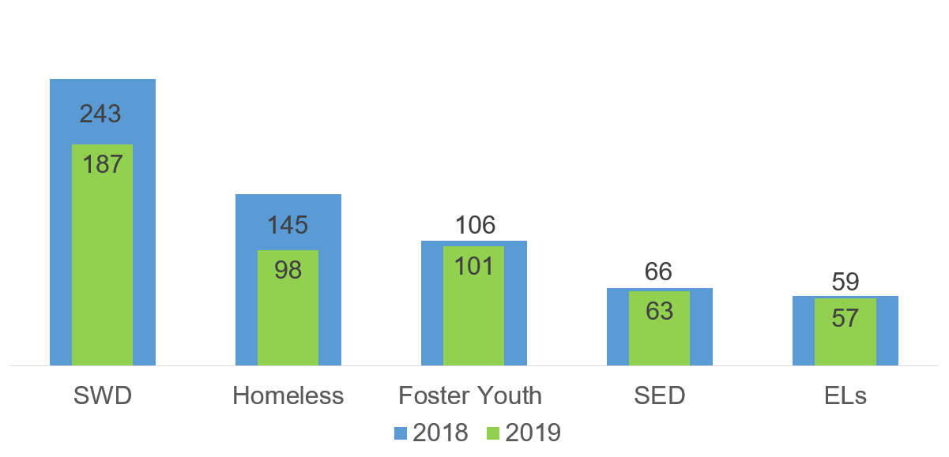
Decrease in Districts Identified for
Differentiated Assistance from 2018 to 2019
Notes:
The 2019 Dashboard results show a positive trend for most of the state indicators, including the Academic Indicator, Suspension Rate, Graduation Rate, and College\Career Indicators.
However, the Chronic Absenteeism Indicator showed increases in chronically absent students (students who are absent 10 percent or more of the instructional days they were enrolled).

Slide 37
Data for Decrease in Districts Identified for
Differentiated Assistance from 2018 to 2019
Student Group | 2018 | 2019
SWD | 243 | 187
Homeless | 145 | 98
Foster Youth | 106 | 101
SED | 66 | 63
Els | 59 | 57

Slide 38
EL Student Group’s Impact on LCFF LEA Eligibility for Assistance
In 2019, there were 37 LEAs that had an ELPI Status of “Very Low”.
Of those 37 LEAs, 13 LEAs were eligible for DA because they met the criteria for Priority Area 4 and the criteria in at least one other priority area.
Of those 13 LEAs, 2 LEAs met the criteria for Priority Area 4 based on both the Academic Indicator and the ELPI.
Additionally, EL performance on all state indicators contributed to 57 LEAs being eligible for DA for their EL student group.
In April, the SBE received a memorandum that provided an Update on Differentiated Assistance (https://www.cde.ca.gov/be/pn/im/documents/apr20memoamard01.docx).

Slide 39

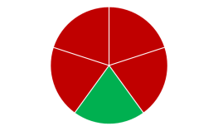
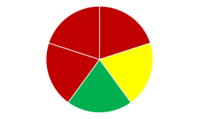
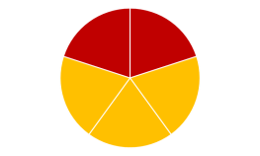
Eligibility Criteria for School Support
For 2019, any school with a school level combined four-and five-year graduation rate less than 68 percent averaged over two years will be eligible for CSI required by ESSA.
After, schools determined to be eligible for ‘CSI–Low Graduation Rate’ are removed from the pool of Title I–funded schools, schools that meet the criteria for ‘CSI–Lowest Performing Schools’ are determined next. The selection criteria are:
  All red (or ‘Very Low’ ELPI status) indicators
  All red (or ‘Very Low’ ELPI status) but one indicator of any other color
  Five or more indicators where majority are red (or ‘Very Low’ ELPI status)
  All red (or ‘Very Low’ ELPI status) and orange indicators
Notes:
JI

Slide 40
Example Including ELPI Status for CSI Eligibility Determinations
Example: Amethyst Elementary School
Amethyst received Title I funds for the 2018–19 school year and would be eligible for CSI because it met the criterion of having five or more indicators where the majority are Red or the ELPI Status is “Very Low”.
State Indicators | 2019 Dashboard
ELA | Red
Math | Red
ELPI Status | Very Low
Chronic Absenteeism | Orange
Suspension Rate | Yellow
Notes:
JI

Slide 41
EL Student Group’s Impact on CSI/ATSI Eligibility Determinations
In 2019, there were 372 schools that were eligible for CSI – Low Performing for the first time. An ELPI Status of “Very Low” contributed to 69 schools of these schools being eligible for CSI – Low Performing.
There were 5 schools eligible for CSI solely due to an ELPI Status of “Very Low”.
Additionally, 102 schools were eligible for ATSI based on the EL student group, 16 of those schools had an ELPI Status of “Very Low”.
In April, the CDE provided the State Board of Education (SBE) with an updated memorandum on CSI and ATSI (https://www.cde.ca.gov/be/pn/im/documents/apr20memoamard02.docx)
Notes:
VN

Slide 42

Questions

Slide 43
Contact Information
Justin Lane, Consultant
Data Visualization & Reporting Office
jlane@cde.ca.gov
916-323-3071
Jonathan Isler, Administrator
Data Visualization & Reporting Office
jisler@cde.ca.gov
916-319-0306
EL Accountability Questions email: ELAccountability@cde.ca.gov
LCFF/ESSA Eligibility Determinations: LCFFESSAdata@cde.ca.gov

Slide 44
The System of Support
The purpose of the system of support is to assist LEAs and their schools in meeting the needs of each student served, with a focus on building capacity to sustain improvement and effectively address inequities in student opportunities and outcomes
  Lead Agencies (Geographic Leads, Special Education Local Plan Area Leads, Title III EL Specialist Leads, etc.)
  State Leads (CDE, California Collaborative for Educational Excellence)
For more information please see the California System of Support web page: https://www.cde.ca.gov/sp/sw/t1/csss.asp

Slide 45
Multilingualism and the
System of Support
Multilingual Support Division (MSD)
California Department of Education (CDE)
Notes:
Good afternoon everyone. My name is Sandra Covarrubias and I am here today from the Multilingual Support Division at the California Department of Education with some information and resources for you focused on supporting multilingual learners through English language development during distance learning and to continue dual language instruction via distance learning. As we continue to work to provide the appropriate supports for ELs using the concentration funds within the LCAP, we are highlighting the many resources available.

Slide 46
Ongoing Network Meetings
Bilingual Coordinators Network (BCN)
https://www.cde.ca.gov/sp/el/t3/bcn.asp
Notes:
Since March 2020, the Multilingual Support Division has held monthly convenings of the Bilingual Coordinators’ Network, or BCN, through virtual meetings. The BCN is comprised of representatives from school districts, county offices of education, the 11 Regional English Learner Specialists, institutions of higher education that offer bilingual teacher preparation programs, and organizations that specialize in services and programs for English learners. The top 20 LEAs that enroll the highest number of English Learners in the state are part of this network.
This network is a venue for disseminating policy, best practices, new and current research, and other pertinent information to local educational agencies, or LEAs, within their area. Typically this network meets quarterly, however in response to the need for information, the network has met every month without exception to discuss critical English learner, or EL, issues during the COVID-19 pandemic. LEAs should receive information directly from their local BCN representative.

Slide 47
Ongoing Migrant Network Meetings
Migrant Education Director’s Meetings and State Parent Advisory Committee (SPAC)
https://www.cde.ca.gov/sp/me/mt/spacmep.asp
Notes:
The Multilingual Support Division has also continued to meet with the Migrant Education Program Directors monthly to provide the most up to date information for migratory families that are served by Title I part C federal funds.
The State Parent Advisory Committee continues to meet virtually to provide necessary information and professional development in support of migratory students and program implementation efforts.

Slide 48
Regional Resources
California Regional English Learner (EL) Specialists
  Web page: https://www.cde.ca.gov/sp/el/t3/t3leads.asp
  Comprehensive English Language Development (ELD) Resources for LEAs Padlet:
  https://padlet.com/carelspecialists/ELD
Notes:
In partnership, the California Department of Education and the California County Superintendents' Educational Services Association designate the Regional English Learner Specialists to provide technical assistance to the LEAs within each of the 11 County Superintendent regions. If you would like more information or would like to contact the Regional EL Specialist in your region for support to your LEA, please refer to the link listed at the beginning of this slide for the Regional EL Specialists web page, which also contains contact information for each of the eleven specialists and resources for teachers.
The Regional EL Specialists, in collaboration with the Educator Workforce Investment Grant: EL Roadmap Policy Implementation grantees, have been mobilizing and leveraging partnerships to collect and publish resources for the Comprehensive ELD Resources for LEAs Padlet. This padlet contains documents and links to videos and resources related to integrated and designated ELD, as well as other areas such as services for English learners with disabilities, newcomers, and long-term English learners.
The California RELS’ Comprehensive ELD Resources for LEAs Padlet is available at the link shown at the bottom of this slide. Contact the RELS in your region for direct support to your LEA.

Slide 49
English Learners with Disabilities Resources
CDE Educating English Learners with Disabilities web page:
  https://www.cde.ca.gov/sp/el/er/pracguide.asp
  Imperial County SELPA – State Content Lead web page:
  https://www.icoe.org/selpa/el-swd
Notes:
The CDE Educating English Learners with Disabilities web page contains several resources to support dually-identified students, including the California Practitioners’ Guide for Educating English Learners with Disabilities and contact information for the Special Education Local Plan Area, or SELPA, Resource leads. Contact your SELPA Resource Lead for direct support to your LEA.
In addition, the Imperial County SELPA is the State Content Lead that provides professional development on dually identified students across the state. If you have not avail yourself of this wonderful resource please take time to see that many resources available for English Learners with disabilities on the website.

Slide 50
Upcoming Resources
  Formative Indicators of English Language Development (FIELD)
  Send email to join-ed-for-el@mlist.cde.ca.gov
Notes:
The Formative Indicators for English Language Development, or FIELD, is a resource to support formative practices for observation of language use and development, build the capacity of all educators to regularly engage these formative practices and maximize necessary instructional supports in service of students, both in virtual and traditional classroom environments. Professional development providing guidance for using this process is expected in early January 2021. If you would like more information, please join the ed-for-el listserv using the email address on this slide. The listserv is a teacher network designed to communicate directly with teachers. Encourage your teachers to join the list.

Slide 51
Educator Workforce Investment Grant: EL Roadmap Policy Implementation
CDE Educator Workforce Investment Grant (EWIG): EL Roadmap (ELR) Policy Implementation
https://www.cde.ca.gov/sp/el/rm/ewigelrmpolicy.asp
Notes:
The resources available for implementation of the EL Roadmap Policy, or ELR Policy, are also incredibly relevant during instruction via distance learning. In recognition of the need to build capacity throughout the state to implement the comprehensive California EL Roadmap Policy, the California Legislature earmarked $10 million in the Educator Workforce Investment Grant, or EWIG, to specifically focus on implementation of the ELR Policy in LEAs with teachers, administrators and the system at large. The two grantees, Californians Together and the California Association for Bilingual Education, are available to bring research-based strategies and resources to administrators and educators in order to dramatically accelerate and improve multilingual academic opportunities and outcomes for English Learners across California.
These resources address parent engagement, distance learning, and EL Roadmap Policy implementation, including several webinars that focus on English learner instruction during distance learning, hybrid, and in-person instruction. The resources are linked from the CDE EWIG: ELR web page, shown on this slide.

Slide 52
Educator Workforce Investment Grant: EL Roadmap Policy Implementation (2)
Multilingual California Project (MCaP) web page: https://mcap.gocabe.org
English Learner Roadmap Implementation for Systemic Excellence (EL RISE!) web page: https://www.californianstogether.org/el-rise/
Notes:
For more information about the Multilingual California Project, or MCAP, and the project for English Learner Roadmap Implementation for Systemic Excellence, also known as EL RISE!, please visit the links shown on the slide.

Slide 53
Integrated and Designated ELD During Remote Instruction
ELD Frequently Asked Questions (FAQs)
https://www.cde.ca.gov/sp/el/er/eldfaqs.asp
Notes:
The Multilingual Support Division also created two web pages to house frequently asked questions, resources, and guidance for supporting multilingual learners as an assets oriented perspective. The CDE ELD FAQs and the COVID-19 EL Resources web pages found at the links on this slide highlight essential resources for providing integrated and designated EL instruction including lessons, activities, strategies, and sample schedules for teachers, schools, and LEAs. These resources also include alternatives to digital access for temporary use with students waiting for devices and internet access to be provided, or where there are connectivity limitations. These resources provide critical options so all students continue accessing instruction.

Slide 54
Integrated and Designated ELD During Remote Instruction (2)
COVID-19 EL Resources and Model Programs
https://www.cde.ca.gov/sp/el/er/covidelresources.asp
Notes:
The Multilingual Support Division organized two web pages to house frequently asked questions, resources, and guidance for supporting multilingual learners through an assets perspective. The CDE ELD FAQs and the COVID-19 EL Resources web pages, found at the links on this and the following slide, highlight even more essential resources for providing integrated and designated EL instruction including lessons, activities, strategies, as well as sample schedules for teachers, schools, and LEAs. These resources also include alternatives to digital access for temporary use with students waiting for devices and internet access to be provided or where connectivity is unavailable.

Slide 55
Supporting English Learners and Parents Remotely During COVID-19
CDE EL Updates Newsletters
https://www.cde.ca.gov/sp/el/er/elnewsletters.asp
Notes:
The Multilingual Support Division releases two monthly newsletters that provide updates on resources and parent outreach: The Distance Learning Parent Newsletter and the English Learner (EL) Updates Newsletter. These newsletters provide links to resources that include LEA examples of strategies designed in response to their own challenges. The EL Updates Newsletter covers such topics as assessment, resources, literacy, initiatives, and webinars.
The Parent Newsletter provides information addressing parent interests. This newsletter is translated into the top 5 languages spoken in California in addition to English. To read the newsletters, go to the CDE EL Updates Newsletters web page found at the link on this slide.

Slide 56
Supporting English Learners and Parents Remotely During COVID-19 (2)
COVID-19 EL Parent and Family Resources
https://www.cde.ca.gov/sp/el/er/covidelresources.asp
Notes:
The COVID-19 EL Resources page, provided again on this slide, also gives parents and school leaders information and resources to combat the effects of the pandemic. Alternatives to virtual, device-based parent meetings and other ways to engage parents during parent committees, parent conferences are discussed. Resources such as meal programs, social emotional support, and funding opportunities to address immediate needs during the pandemic are also provided on this web page along with additional resources from across the state contributed by our partnering agencies, including county offices of education, school districts, and non-profit organizations.

Slide 57
Supporting English Learners and Parents Remotely During COVID-19 (3)
CDE Parent Engagement Module Series
https://www.cde.ca.gov/sp/me/mt/pem.asp
Notes:
The Migrant Education Program has produced and posted seven parent education modules to assist parents in supporting their children. These parent modules can be found on the CDE Parent Engagement Modules Series web page at the link shown on this slide.
The seven modules are:
Module 1, Facilitator Overview of Migrant Modules and Handouts
Module 2, Using Positive Discipline to Be a More Effective Parent
Module 3, Growing Self-Confident Children Through Goal Setting and Growth Mindset
Module 4, School Systems and Multiple Cultures
Module 5, Supporting Your Child to Be Successful in School
Module 6, Understanding and Communicating with Your Teenager
Module 7, Bullying: What It is and How to Help Your Child

Slide 58
Identifying English Learners Remotely
COVID-19 EL Resources and Guidance
https://www.cde.ca.gov/sp/el/er/covidelresources.asp
Notes:
Identification of English learners is another area that is supported by resources. In response to the extra time needed to assess students with the Initial ELPAC, the CDE requested and was granted an extension for the 2020‒21 school year for administering the assessment to each potential English learner student. Frequently Asked Questions to assist LEAs were developed and are available on the CDE COVID-19 EL Resources web page, shown again on this slide, under the Guidance tab.

Slide 59
Identifying English Learners Remotely (2)
ELPAC Fall Administration: Remote Testing Guidance
https://ca-toms-help.ets.org/fall-admins/
Notes:
The CDE English Language Proficiency and Spanish Assessment Office and the Multilingual Support Division continue to provide technical assistance and guidance to LEAs to ensure that assessment and data collection are completed in a timely manner, including an optional supplemental opportunity to assess students determined to benefit from the administration of the summative ELPAC, especially those eligible for Reclassification.
Remote test administration guidance is now available for the Initial ELPAC and the optional 2019–2020 Summative ELPAC at the link shown on this slide. This guidance includes complete descriptions of the different options for administering the assessments, communication for stakeholders, as well as directions for LEAs, test examiners, parents/guardians, and students. Remote test administration guidance for the ELPAC summative assessments in spring 2021 has not yet been approved. After the fall administration, further remote test administration guidance for summative assessment will be provided as it becomes available.

Slide 60
Questions or Comments?
Sandra Covarrubias
Education Programs Consultant Multilingual Support Division
California Department of Education
Email: scovarrubias@cde.ca.gov
Notes:
If you have any questions after today’s presentation, please contact me via email using the information shown on this slide. Thank you.
[Time permitting, take a couple of questions from the chat]
Please enter any questions you have into the chat feature. If I don’t get to the question now, I will follow-up with Joshua Strong to provide the responses.

Slide 61
Closing Thoughts

Slide 62
Thank You for Attending!
Questions related to California’s System of Support?
Please contact the
System of Support Office
CASystemOfSupport@cde.ca.gov

Slide 63
Addendum 1
Slide 24
  Graphic showing data:
  Current English learners were 90.6 points below standard (maintained 2 points with 502,424 students), reclassified were 4 points above standard (maintained 2.8 points with 465,653 students), and English only were 9.4 above standard (increased 3.2 points with 1,818,185 students) on the ELA indicator.

Slide 64
Addendum 2
Slide 25
  Graphic showing data:
  Current English learners were 106.7 points below standard (maintained 0.2 points with 502,095 students), reclassified were 27.3 points below standard (increased 3.2 points with 465,057 students), and English only were 22.7 points below standard (maintained 2.7 points with 1,813,063 students) on the math indicator.

