Slide 1
Increased or Improved Services, Part 1
The Principles & The Practice
California Department of Education
December 14, 2021

Slide 2
Webinar Series
Tuesdays @ 2
11/30: Introduction to the Local Control Funding Formula
12/7: Engaging Educational Partners
12/14: Increased or Improved Services, Part I
Thursdays @ 3
12/2: The LCAP Template and Instructions for the 2022–23 School Year
12/9: Goals and Actions
12/16: Increased or Improved Services, Part II

Slide 3
Purpose
To provide the following:
The foundational principles of the Local Control Funding Formula (LCFF), as related to the requirement to increase or improve services for students who are low-income, English learner (EL), and/or foster youth;
An overview of the requirement to increase or improve services for low-income, EL, and foster youth students; and
An explanation of the three types of actions that a local educational agency (LEA) uses to demonstrate that it is meeting the requirement to increase or improve services, including recommendations for how to develop these actions and articulate them in the LCAP.

Slide 4
Intended Audience
The intended audience for this presentation is anyone who will complete, review, or interact with the 2022–23 LCAP.
This may include parents, teachers, staff, administrators, LCAP writers, members of governing boards or bodies, community members, and LCAP reviewers.

Slide 5
Foundations
The Principles Behind, and Requirements for, Increased or Improved Services

Slide 6
Foundational Principles of the LCFF (1)
LEA-level improvement based on multiple measures of success
Equity
  Additional funding to address specific identified needs of students who are low-income, EL, and/or foster youth
      Note: students who are low-income, EL, and/or foster youth are referred to as "unduplicated students" in California Education Code.
  Requirement to Increase or Improve Services in proportion to the increase in funding

Slide 7
Foundational Principles of the LCFF (2)
Subsidiarity
  Social and political issues should be dealt with at the local level
  This approach necessitates transparency and collaboration with educational partners

Slide 8
Funding Flexibility to Ensure Student Success
LCFF provides for an increased level of local flexibility to determine which programs and/or services have the greatest likelihood of ensuring that each student will succeed in relation to each of the LCFF state priorities.
In exchange for this flexibility, the LCFF requires greater local responsibility for selecting appropriate and effective programs.
This necessitates transparency and engaging the LEAs educational partners in analysis and decision-making.
Notes:
This flexibility presents an opportunity for LEAs to better integrate programs and services, but it requires the availability of sufficient information to make complex decisions and to plan effectively for implementation and monitoring.

Slide 9
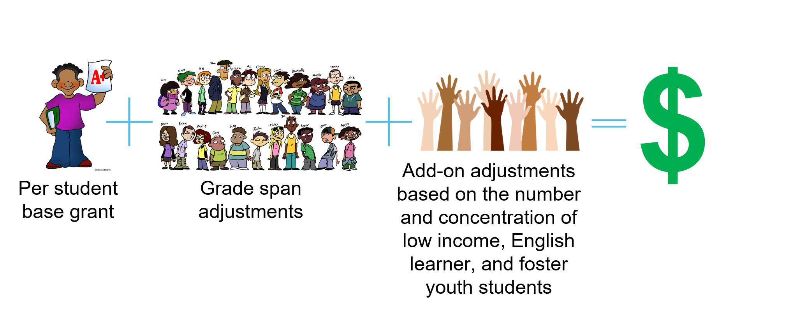
LCFF Funding Formula Basics
Notes:
The LCFF includes the following components for school districts and charter schools:
Provides a base grant for each LEA based on average daily attendance (ADA). The actual base grants vary based on grade span.
Provides a supplemental grant equal to 20 percent of the adjusted base grant for targeted disadvantaged students. Targeted students are those classified as English learners (EL), eligible to receive a free or reduced-price meal (FRPM), foster youth, or any combination of these factors (unduplicated count).
Provides a concentration grant equal to 65 percent of the adjusted base grant for targeted students exceeding 55 percent of an LEA’s enrollment.
COEs receive LCFF funding through a two-part formula with funding for oversight responsibilities and instructional activities. The oversight responsibilities are funded through a COE operations grant, with amounts based on (1) a minimum grant per county, (2) the number of school districts in the county, and (3) the ADA in the county attributable to school districts, charter schools, and schools operated by the county superintendent.

Slide 10
Unrestricted Funds
All LCFF funding, regardless of whether it is calculated using the formula for the base grant, the formula for the supplemental grant add-on, or the formula for the concentration grant add-on, is unrestricted funding
LCFF funds may be spent on any purpose allowable under the California’s Education Code

Slide 11
Requirement to Increase or Improve Services
LEAs are required to demonstrate in the LCAP how they are increasing or improving services for students who are low-income, EL, or foster youth as compared to the services provided to all students.
Services must be increased or improved in proportion to the increase in LCFF funding that is provided to the LEA (i.e., apportioned) on the basis of the number and concentration of low-income, EL, or foster youth students.
  To increase services means to grow services in quantity.
  To improve services means to grow services in quality.
Notes:
The requirement to increase or improves services is found in California Education Code (EC) Section 42238.07.
The regulations referred to in EC Section 42238.07(a) are found in Title 5 of the California Code of Regulations (5 CCR) sections 15494 – 15497.
The definition of increased and improved is found on pg. 15 of the LCAP template instructions.

Slide 12
“…In Proportion To…” (1)
LEAs must increase or improve services in proportion to the increase in LCFF funding.
To do this the LEA must determine the proportional percentage by which services must be increased or improved.
Notes:
5 California Code of Regulations Section 15496(a)(8): If the calculation in subdivision (a)(3) yields a number less than or equal to zero or when LCFF is fully implemented statewide, then an LEA shall determine its percentage for purposes of this section by dividing the amount of the LCFF target attributed to the supplemental and concentration grant for the LEA calculated pursuant to Education Code sections 42238.02 and 2574 in the fiscal year for which the LCAP is adopted by the remainder of the LEA's LCFF funding, excluding add-ons for the Targeted Instructional Improvement Grant program and the Home to School Transportation program.

Slide 13
“…In Proportion To…” (2)
LEAs are required to determine the percentage by which services for unduplicated services must be increased or improved as follows:
  Divide the amount of LCFF funds attributed to the supplemental and concentration grant for the LEA by the remainder of the LEA's LCFF funding (i.e. the LCFF funds attributed to the base grant), excluding add-ons for the Targeted Instructional Improvement Grant program and the Home to School Transportation program.
  This percentage is also referred to as the “minimum proportionality percentage” (MPP).
Notes:
5 California Code of Regulations Section 15496(a)(8): If the calculation in subdivision (a)(3) yields a number less than or equal to zero or when LCFF is fully implemented statewide, then an LEA shall determine its percentage for purposes of this section by dividing the amount of the LCFF target attributed to the supplemental and concentration grant for the LEA calculated pursuant to Education Code sections 42238.02 and 2574 in the fiscal year for which the LCAP is adopted by the remainder of the LEA's LCFF funding, excluding add-ons for the Targeted Instructional Improvement Grant program and the Home to School Transportation program.

Slide 14
How Is the Requirement Met?
An LEA meets the increased or improved services requirement when it demonstrates how services provided for students who are low-income, EL, or foster youth have been increased or improved by at least the MPP as compared to the services provided for all students.
The LEA demonstrates that services are increased or improved through the actions included in the LCAP that are identified as contributing towards meeting the increased or improved services requirement.
Notes:
From pg. 15 of the LCAP template instructions.
Requirements for actions that are increasing or improving services will be discussed in more detail as part of the Increasing or Improving Services Part II webinar.

Slide 15
Demonstration in the LCAP
The demonstration of how the LEA is meeting the requirement to increase or improve services lives in three places within the LCAP template:
The Goals and Actions section
The Action Tables, and
The required descriptions in the Increased or Improved for Foster Youth, English Learners, and Low-Income Students.

Slide 16
Carryover Requirement
Beginning with the 2021–22 school year, LEAs that are unable to demonstrate that they have increased or improved services by the MPP are required to carry over the unmet portion of the percentage into the coming year.
Notes:
The carryover requirement will be discussed in more detail as part of the Increasing or Improving Services Part II webinar.

Slide 17
Contributing Actions
LEA-wide, Schoolwide, and Limited to Unduplicated Student Group(s)

Slide 18
What is a “Contributing” Action?
A contributing action is an action that is being implemented to either increase or improve services for students who are low-income, EL, and/or foster youth.
Each action that is increasing or improving services contributes towards the demonstration of how the LEA is meeting it's MPP.
An action can contribute towards the LEA’s demonstration that it is meeting the MPP by increasing services for low-income, EL, or foster youth using LCFF funds or it can contribute towards the demonstration by improving services for low-income, EL, or foster youth without using any funds.
Notes:
There are three types of actions that may be contributing to meet the increased or improved services requirement. Once the LEA has done its Comprehensive Needs Assessment, it will determine which types of actions will be used to meet the unique needs of its unduplicated students.

Slide 19
What Constitutes a “Contributing” Action?
The action seeks to addresses one or more identified needs of students who are low-income, EL, and/or foster youth.
  An action being provided on an LEA-wide or Schoolwide basis must be designed to benefit low-income, EL, and/or foster youth students to a greater extent than students who are not low-income, EL, and/or foster youth.
  An action that is provided on a limited basis will be provided only to students who are low-income, EL, and/or foster youth.
If there is funding associated with the action, the action must include some amount of LCFF funds.
  Note: If the action does not have any funding associated with it, this does not apply.

Slide 20
Types of Contributing Actions
There are three types of contributing actions:
  LEA-wide
  Schoolwide
  Limited to Unduplicated Student Group(s)*
    *Limited actions are also referred to as "targeted actions"
Notes:
There are three types of actions that may be contributing to meet the increased or improved services requirement. Once the LEA has done its Comprehensive Needs Assessment, it will determine which types of actions will be used to meet the unique needs of its unduplicated students.

Slide 21
LEA-Wide and Schoolwide Actions
LEA-wide: Upgrades the educational program of all schools in the LEA.
  All students receive these services, regardless of unduplicated status.
Schoolwide: Upgrades the educational program of a certain school(s) or grade span(s).
  All students at the specific school(s) and/or within the specific grade span(s) receive these services, regardless of unduplicated status.

Slide 22
“Limited” Actions
Limited to Unduplicated Student Group(s): Serves only one or more unduplicated student group(s).
  Services may be provided to low-income, EL, and/or foster youth students at all schools in the LEA, specific schools in the LEA, or specific grade spans in the LEA.

Slide 23
Developing Contributing Actions – The Practice
Data Driven Decision Making

Slide 24
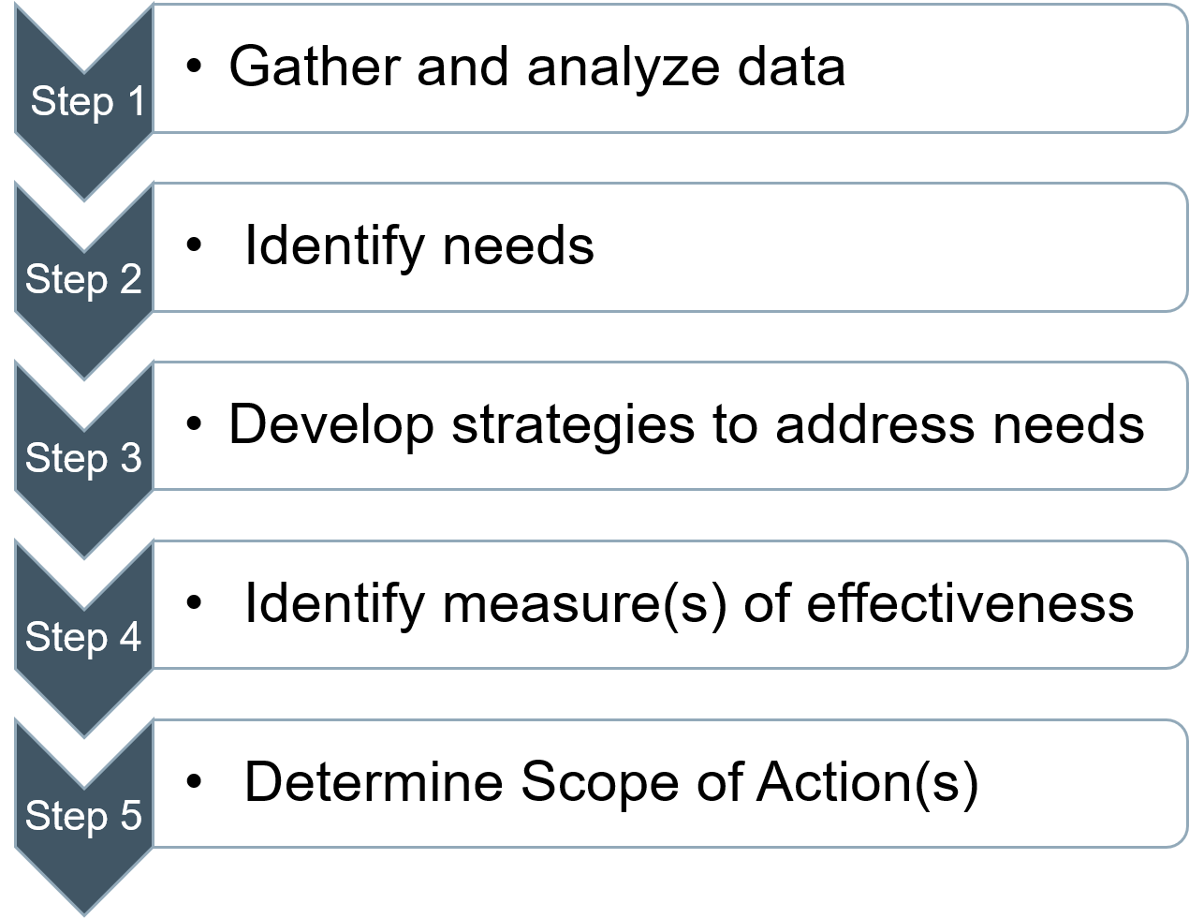
The Practice in Steps
Impacting Educational Outcomes for Low income, EL, and Foster Youth Students

Slide 25
Step 1 – Gather and Analyze Data (1)
Gather and compile data for the LEA's low-income, EL, and foster youth students from multiple sources including, but not limited to:
  State: California School Dashboard, DataQuest
  Local: LEA-level benchmark assessments, school-level assessments, student demographics, lesson plans and student work, curriculum-based assessments, teacher/student observation reports
  Educational Partner Input: Formal and informal feedback, family and community participation, student/family/community surveys, teacher and staff input, educational partner meeting notes, public comments at board meetings

Slide 26
Step 1 – Gather and Analyze Data (2)
Analyze low-income, EL, and foster youth student data with educational partners to determine students' unique needs.
Ask probing questions:
  What discrepancies do we see between low-income, EL, and foster youth students' data as compared to that of their peers?
  Why are we seeing these results?
  What barriers are the low-income, EL, and/or foster youth students facing that may be causing these results?
    Remember, not all barriers are academically related

Slide 27
Step 1 – Gather and Analyze Data (3)
Data analysis may take place through a variety of mediums, including, but not limited to:
  Parent Advisory Group or English Learner Parent Advisory Group meetings
  Schoolsite Council meetings
  School staff meetings
  Teachers' Professional Learning Committee (PLC) meetings
  Principal meetings
  District-level staff meetings
  Professional Development trainings

Slide 28
Step 2 – Identify Needs (1)
The needs of low-income, EL, and foster youth students will be different in each LEA. However, to help identify needs, LEAs may ask:
  What did our low-income, EL, and foster youth students' specific data demonstrate?
  Are there discrepancies in outcome data between low-income, EL, and/or foster youth students and their peers?
  What feedback did our low-income, EL, and foster youth students' families provide?
  What feedback did our low-income, EL, and foster youth students themselves provide?

Slide 29
Step 2 – Identify Needs (2)
What root causes were identified?
  Are low-income, EL, and/or foster youth students' basic needs being met?
  Is the discrepancy in outcomes due to something outside of school?
  Is the discrepancy in outcomes something that requires systemic change within the LEA?
What common themes did we see?
  Can we group certain needs to be addressed together?

Slide 30
Step 3 – Develop Strategies to Address Needs
How will the LEA develop strategies to address the identified needs?
  Feedback from educational partners including parents, community members, students, administrators, teachers, and staff
  Research-based practices
  Examples from other LEAs

Slide 31
Step 4 – Identify Measures of Effectiveness
How will the LEA determine if the strategies to address the identified needs of the low-income, EL, and foster youth students are impacting the outcomes of these specific student groups?
  The metrics used to identify the needs are often excellent metrics to use to measure effectiveness
  Metrics may include quantitative data like standardized test scores, or qualitative data like educational partner feedback (both formal and informal)

Slide 32
Step 5 – Determine Scope
Will the action be provided to all students on an LEA-wide or Schoolwide basis, or solely the unduplicated student group(s) on a Limited basis?
  LEA-wide or Schoolwide:
      If the action meets the unique needs of one or more unduplicated student group(s), but the entire student population can benefit, the LEA may want to consider providing the action on an LEA-wide or Schoolwide basis.
  Limited to Unduplicated Student Group(s):
      If the action meets the unique needs of one or more unduplicated student groups and students in that group(s) are the only ones receiving the service, the action is provided on a Limited basis.

Slide 33
LEA-wide Actions
All Schools

Slide 34
Example #1 – Gather and Analyze Data
Attendance data shows:
  Low-income student group attendance rate is 67%
  All students group attendance rate is 74%
Feedback from student surveys indicated low-income students are struggling to find reliable transportation, which causes them to be absent from school.
Teacher feedback indicated the LEA’s culture does not emphasize the importance of attendance.

Slide 35
Example #1 – Identify Needs
Low-income students need reliable transportation to help improve their attendance rates.
The LEA’s culture needs to be revamped to emphasize the importance of attendance.

Slide 36
Example #1 – Develop Strategies to Address Needs
Develop a new LEA-wide campaign on the benefits of high attendance rates.
Implement an LEA-wide incentive-based attendance program.
Provide additional transportation opportunities to all students, specifically focusing on the LEA’s low-income student group.

Slide 37
Example #1 – Identify Measures of Effectiveness
Attendance rate
  Low-income student group
  All students group
Student and teacher feedback about the LEA's new attendance program

Slide 38
Example #1 – Determine Scope
Attendance rate is a predominant concern with low-income students, but the LEA's entire culture around attendance needs to be revamped.
Since the new attendance program is intended to impact the attendance of all students in the LEA, it will be provided on an LEA-wide basis.
However, the key pieces of the attendance program, including providing reliable transportation, are designed with the needs of the low-income students at the forefront (principally directed).

Slide 39
Example #1
As provided in the Engaging Educational Partners and Metrics sections, the attendance rate of our low-income students is 67%, 7% lower than for all students (74%). Additionally, teacher feedback indicated the LEA’s culture around attendance was lacking and low-income students emphasized the need for reliable transportation to school.
To address these needs, we will provide additional transportation and implement a new incentive-based program that emphasizes the importance of attendance. (Goal 2, Actions 1 and 4)
We expect that the attendance rate for low-income students will increase significantly more than the attendance rate of all other students, as the program is designed to meet needs most associated with the chronic stresses and experiences of these students. However, because we expect that all students with less than a 100% attendance rate will benefit, these actions are provided on an LEA-wide basis.
Putting it into Words

Slide 40
Schoolwide Actions
Specific Schools and/or Grade SpanS

Slide 41
Example #2 – Gather and Analyze Data (1)
Elementary school California Assessment of Student Performance and Progress (CAASPP) English Language Arts (ELA) data shows:
  Low-income student group is scoring 100 points below grade level
  All students group is scoring 50 points below grade level
Elementary school-level reading assessment data shows:
  Low-income students are reading an average of four grade levels below their non-low-income peers

Slide 42
Example #2 – Gather and Analyze Data (2)
Meeting Notes from the Parent Advisory Committee indicated many low-income elementary students struggle with:
  Finding quiet places to read because of limited space in the home
  Access to books at home because of excess cost and inability to get to the local library
  Their parents need additional resources and training to help their students with their reading at home

Slide 43
Example #2 – Identify Needs
The LEA's elementary students need:
  Assistance in bringing up their reading levels
Low-income elementary students need:
  Quiet places to read outside of the classroom
  Access to books outside of the classroom
Low-income elementary students' parents need:
  Additional resources and training to help their students with reading at home

Slide 44
Example #2 – Develop Strategies to Address Needs
Provide an after-school reading program at all elementary schools to serve students reading two or more levels below grade level.
Provide leveled libraries for the after-school reading programs that allow participating students to check out books to take home to practice their reading.
Provide training for all parents of participating students in how to best assist their students with utilizing the after-school reading program strategies at home.

Slide 45
Example #2 – Identify Measures of Effectiveness
Elementary school students' CAASPP ELA scores:
  Low-income students
  All students
After-school program participants’ school-level reading assessment data, measured in the after-school program every 6 weeks
After-school program participants' parent survey feedback, gathered through bi-annual surveys

Slide 46
Example #2 – Determine Scope
Reading level and CAASPP ELA data is a predominant concern with low-income students at the elementary level.
Since the all students group is scoring 50 points below grade level on the CAASPP ELA, the new after-school program will be provided to all elementary students reading two or more levels below grade level on a Schoolwide basis.
However, the key pieces of the after-school reading program, including providing leveled libraries with books to take home and training for all parents of participating students, are designed with the needs of the low-income students and their families at the forefront (principally directed).

Slide 47
Example #2
As demonstrated in the Identified Needs and Metrics sections, CAASPP ELA data, school-level reading assessments, and input from the Parent Advisory Committee identified low-income elementary school students are struggling with reading.
To address this need, we will implement an after-school reading program for elementary students reading two or more levels below grade level that includes quiet, designated reading spaces, access to leveled books, and training for parents. (Goal 1; Actions 1 and 2).
We expect this will have a significant impact on the reading levels and CAASPP ELA scores of low-income students participating in the after-school program. However, as all elementary students reading below grade level might also benefit, these actions are being provided on a Schoolwide basis.
Putting it into Words

Slide 48
Limited Actions: EL Students

Slide 49
Example #3 – Gather and Analyze Data
The LEA’s writing benchmark and English Language Proficiency Assessments for California (ELPAC) test scores demonstrated the district’s EL students are struggling with their writing and grammar skills.
English Language Development (ELD) Teacher feedback demonstrated that ELD teachers did not feel they had the necessary training and resources to support EL students with their writing and grammar skills.
Feedback from the English Learner Parent Advisory Committee further demonstrated that the parents of EL students did not feel they had the skills and resources to assist their children with their writing and grammar skills at home.

Slide 50
Example #3 – Identify Needs
EL students are struggling with their writing and grammar skills.
ELD Teachers need training and resources to support EL students with their writing and grammar skills.
Parents of EL students need training and resources to assist their children with their writing and grammar skills at home.

Slide 51
Example #3 – Develop Strategies to Address Needs
Implement a supplemental writing program using the Core Knowledge Language Arts: California Edition (CKLA CA) curriculum focusing on enhancing writing and grammar skills for EL students
Provide professional development for ELD teachers in using the CKLA CA curriculum and integrating it as part of designated ELD lessons
Provide training for EL parents in how to use the resources provided in the CKLA CA curriculum with their children at home

Slide 52
Example #3 – Identify Measures of Effectiveness
LEA’s writing benchmark and ELPAC test scores to measure EL students’ growth on standardized assessments
ELD Teacher feedback on the professional development provided and the success of implementing the new writing program into their classrooms
English Learner Parent Advisory Committee feedback on the success of the parent trainings and use of the CKLA CA resources at home

Slide 53
Example #3 – Determine Scope
Because the CKLA CA curriculum, ELD teacher professional development, and the parent trainings will only be provided to EL students and their families, these actions are provided on a Limited basis to EL students only.

Slide 54
Example #3
As identified in the Engaging Educational Partners and Metrics sections, district writing benchmark scores, ELPAC scores, ELD teacher feedback, and input from the English Learner (EL) Parent Advisory Committee identified EL students are struggling with writing and grammar skills.
To address this need, we will implement the CKLA CA supplemental ELD curriculum, provide professional development for ELD teachers in utilizing the curriculum, and training for parents of EL students to enable them to assist students at home (Goal 1; Actions 3, 4, and 5).
We anticipate our EL students’ district writing benchmark scores and ELPAC scores will increase. Feedback from both the ELD teachers and EL Parent Advisory Committee will continue to inform the trainings.
Putting it into Words

Slide 55
Limited Actions: Foster Youth Students

Slide 56
Example #4 – Gather and Analyze
Reports from the LEA's Foster Youth Services Coordinator (FYSC) have indicated foster youth students and their families are struggling with feeling connected at school.
Foster youth students’ attendance rate is 57% compared to 74% for all students.
Foster youth students’ suspension rate is 18% compared to 6% for all students.

Slide 57
Example #4 – Identified Needs
The LEA’s foster youth students and their families need:
  Support with feeling connected and engaged at school

Slide 58
Example #4 – Actions to Address Needs
The FYSC will develop a foster youth student engagement program where foster youth students and their families are paired up with mentors, consisting of teachers, staff, and community volunteers, at each school.
The FYSC will provide mentors with training in relationship development and positive communication specific to the needs of foster youth and their families.
Mentors will provide consistent contact and resources to help foster youth and their families feel more connected and engaged at school.

Slide 59
Example #4 – Metrics
Formal and informal feedback throughout the program from foster youth and their families
Attendance rate
  Foster youth student group
Suspension rate
  Foster youth student group

Slide 60
Example #4 – Determine Scope
Because the FYSC's student engagement program will only be provided to foster youth students and their families, these actions are provided on a Limited basis to foster youth students only.

Slide 61
Example #4 (1)
As described in the Engaging Educational Partners and Metrics sections, foster youth students’ attendance rate, discipline and suspension rates and feedback from foster youth students and their families have led to the determination that foster youth are feeling disconnected from school.
To address this need, the LEA’s Foster Youth Services Coordinator (FYSC) will implement a student engagement mentorship program. Mentors will include teachers, staff, and other community volunteers who will be trained by the FYSC in relationship development specific to foster youth and their families. Mentors will provide consistent contact and resources to help them feel more connected and engaged at school. (Goal 3; Action 5).
Putting it into Words

Slide 62
Example #4 (2)
We anticipate this program will increase our foster youth students’ attendance rate, decrease their discipline and suspension rates, and that foster youth and their families will report an increase in engagement at school.
Putting it into Words

Slide 63
Limited Actions: Low-income Students

Slide 64
Example #5 – Gather and Analyze
Low-income students’ attendance rate is 67% compared to 74% for all students.
Low-income students’ suspension rate is 16% compared to 6% for all students.
Survey feedback from low-income students indicated they are struggling with staying engaged during class because they are experiencing extreme food insecurity.
Survey feedback from low-income students' families indicated they need additional resources to prepare healthy meals as many of them live in food deserts without access to healthy foods.

Slide 65
Example #5 – Identify Needs
Low-income students are struggling with staying engaged during class because they are experiencing extreme food insecurity.
Low-income students' families need additional resources to prepare healthy meals as many of them live in food deserts without access to healthy foods.

Slide 66
Example #5 – Develop Strategies to Address Needs
The LEA's Parent and Family Engagement Coordinator will partner with local grocery stores and food banks to put together and distribute monthly food baskets for each low-income family in need.
Low-income families will be provided with healthy recipes they can cook using the ingredients provided in the food baskets to promote healthy eating habits.

Slide 67
Example #5 – Identify Measures of Effectiveness
Formal and informal feedback from low-income students and their families about the food basket program
Attendance rate
  Low-income student group
Suspension rate
  Low-income student group

Slide 68
Example #5 – Determine Scope
Because the monthly food baskets will only be provided to low-income students and their families based on Free and Reduced-Price Meal applications, these actions are provided on a Limited basis to low-income students only.

Slide 69
Example #5 (1)
As demonstrated in the Engaging Educational Partners and Metrics sections, low-income students are struggling to stay engaged during class. The attendance rate of low-income students is 67%, 7% lower than the attendance rate for all students (74%). The suspension rate of our low-income students is 16%, whereas the suspension rate for all students (6%). Our low-income students are experiencing extreme food insecurity, preventing them from being able to focus and participate in class. Additionally, families have shared the need for resources to prepare healthy meals, as many do not have access to affordable healthy food.
Putting it into Words

Slide 70
Example #5 (2)
To address these needs, the Parent and Family Engagement Coordinator will partner with local grocery stores and food banks once a month to make healthy food options available to families of low-income students. Additionally, families will be provided with recipes to promote healthy eating habits and nutrition education. (Goal 5; Action 7)
We anticipate this action will result in increased attendance, fewer behavioral outbursts, and decreased suspension rates for low-income students. Formal and informal feedback from low-income students and families will continue to guide the evolution of the program.
Putting it into Words

Slide 71
Upcoming Opportunities
Future Trainings, opportunities to provide input, and contact information

Slide 72
Upcoming Webinars
Thursday, December 16th at 3:00 p.m.
  Increased or Improved Services, Part II
Tuesday, January 11th at 2:00 p.m.
  Dashboard Local Indicators Process
Tuesday, January 18th at 2:00 p.m.
  LCAP Required Goals

Slide 73
Past Webinars in This Series (1)
Supplement to the Annual Update to the 2021–22 LCAP PowerPoint, available at https://www.cde.ca.gov/fg/aa/lc/documents/tues2supplement.pptx
Introduction to the Local Control Funding Formula PowerPoint, available at https://www.cde.ca.gov/fg/aa/lc/documents/tues2introlcff113021.pptx
The Template and Instructions for the 2022–23 Local Control and Accountability Plan PowerPoint, available at https://www.cde.ca.gov/fg/aa/lc/documents/thurs3tempinst120221.pptx

Slide 74
Past Webinars in This Series (2)
Engaging Educational Partners PowerPoint, available at https://www.cde.ca.gov/fg/aa/lc/documents/tues2edpartners120721.pptx
Goals and Actions: https://www.cde.ca.gov/fg/aa/lc/documents/thurs3goalsactions120921.pptx

Slide 75
Contact Information
  If you have any questions related to the LCAP or LCFF, please contact the Local Agency Systems Support Office at LCFF@cde.ca.gov
  For additional information about this or other webinars in this series, including PowerPoint files, please see the Tuesdays @ 2 webpage at https://www.cde.ca.gov/fg/aa/lc/tuesdaysat2.asp

Slide 76
Thank you for attending!

Slide 77
Appendix 1 – Text description of Slide 9
From left to right:
A student holding up a paper with a red “A+” labeled “Per student base grant”
An addition sign
A large group of students labeled “Grade span adjustments”
An addition sign
A group of multicolored raised hands labeled “Add-on adjustments based on the number and concentration of low income, English learner, and foster youth students”
An equal sign
A large, green dollar sign

