Slide 1
Increased or Improved Services, Part 1
The Principles & The Practice
California Department of Education (CDE)
December 17, 2024

Slide 2
2024-2025 Webinar Series
Tuesdays @ 2 in 2024
12/19/24: Increased or Improved Services, Part II
Tuesdays @ 2 in 2025
1/7/25: Equity Multiplier Goal
1/14/25: Learning Recovery and Emergency Block Grant (LREBG)
*see notes throughout presentation

Slide 3
Purpose
To provide the following:
The foundational principles of the Local Control Funding Formula (LCFF), as related to the requirement to increase or improve services for students who are low-income, English learner (EL), and/or foster youth;
An overview of the requirement to increase or improve services for low-income, EL, and foster youth students; and
An explanation of the three types of actions that a local educational agency (LEA) uses to demonstrate that it is meeting the requirement to increase or improve services, including recommendations for how to develop these actions and articulate them in the LCAP.
Notes:
This presentation is focused on the practice of Increased/Improved Services. Part II will go deeper into how it is documented in the LCAP.

Slide 4
Intended Audience
The intended audience for this presentation is anyone who will complete, review, or interact with the 2025–26 LCAP.
This may include parents, teachers, staff, administrators, LCAP writers, members of governing boards or bodies, community members, and LCAP reviewers.

Slide 5
Foundations
The Principles Behind and Requirements for Increased or Improved Services

Slide 6
Foundational Principles of the LCFF (1 of 2)
LEA-level improvement based on multiple measures of success
Equity
  Additional funding to address specific identified needs of students who are low-income, EL, and/or foster youth
      Note: students who are low-income, EL, and/or foster youth are referred to as "unduplicated students" in California Education Code (EC).
  Requirement to Increase or Improve Services in proportion to the increase in funding

Slide 7
Foundational Principles of the LCFF (2 of 2)
Subsidiarity
  Social and political issues should be dealt with at the local level
  This approach necessitates transparency and collaboration with educational partners

Slide 8
Funding Flexibility to Ensure Student Success
LCFF provides for an increased level of local flexibility to determine which programs and/or services have the greatest likelihood of ensuring that each student will succeed in relation to each of the LCFF state priorities.
In exchange for this flexibility, the LCFF requires greater local responsibility for selecting appropriate and effective programs.
This necessitates transparency and engaging the LEA’s educational partners in analysis and decision-making.
Notes:
This flexibility presents an opportunity for LEAs to better integrate programs and services, but it requires the availability of sufficient information to make complex decisions and to plan effectively for implementation and monitoring.

Slide 9
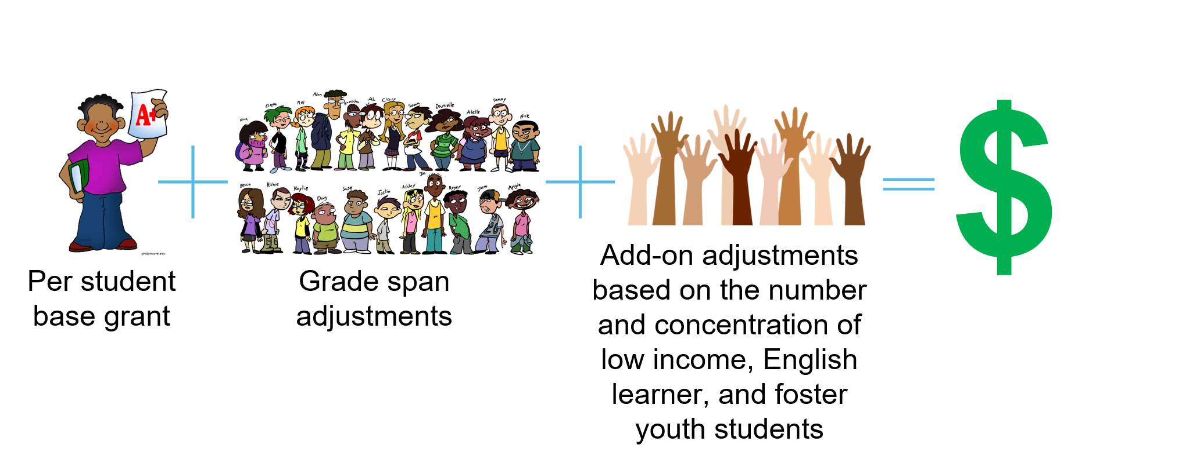
LCFF Funding Formula Basics
*see Appendix A for descriptive text
Notes:
The LCFF includes the following components for school districts and charter schools:
Provides a base grant for each LEA based on average daily attendance (ADA). The actual base grants vary based on grade span.
Provides a supplemental grant equal to 20 percent of the adjusted base grant for targeted disadvantaged students. Targeted students are those classified as English learners (EL), eligible to receive a free or reduced-price meal (FRPM), foster youth, or any combination of these factors (unduplicated count).
Provides a concentration grant equal to 65 percent of the adjusted base grant for targeted students exceeding 55 percent of an LEA’s enrollment.
COEs receive LCFF funding through a two-part formula with funding for oversight responsibilities and instructional activities. The oversight responsibilities are funded through a COE operations grant, with amounts based on (1) a minimum grant per county, (2) the number of school districts in the county, and (3) the ADA in the county attributable to school districts, charter schools, and schools operated by the county superintendent.

Slide 10
Unrestricted Funds
All LCFF funding, regardless of whether it is calculated using the formula for the base grant, the formula for the supplemental grant add-on, or the formula for the concentration grant add-on, is unrestricted funding
LCFF funds may be spent on any purpose allowable under the California’s EC

Slide 11
Requirement to Increase or Improve Services
LEAs are required to demonstrate in the LCAP how they are increasing or improving services for students who are low-income, EL, or foster youth as compared to the services provided to all students.
Services must be increased or improved in proportion to the increase in LCFF funding that is provided to the LEA (i.e., apportioned) on the basis of the number and concentration of low-income, EL, or foster youth students.
  To increase services means to grow services in quantity.
  To improve services means to grow services in quality.
Notes:
The requirement to increase or improves services is found in California Education Code (EC) Section 42238.07.
The regulations referred to in EC Section 42238.07(a) are found in Title 5 of the California Code of Regulations (5 CCR) sections 15494 – 15497.

Slide 12
“…In Proportion To…” (1 of 2)
LEAs must increase or improve services in proportion to the increase in LCFF funding.
To do this, the LEA must determine the proportional percentage by which services must be increased or improved.

Slide 13
“…In Proportion To…” (2 of 2)
LEAs are required to determine the percentage by which services for unduplicated services must be increased or improved as follows:
  Divide the amount of LCFF funds attributed to the supplemental and concentration grant for the LEA by the remainder of the LEA's LCFF funding (i.e. the LCFF funds attributed to the base grant), excluding add-ons for the Targeted Instructional Improvement Grant program and the Home to School Transportation program.
  This percentage is also referred to as the “minimum proportionality percentage” (MPP).
Notes:
5 CCR Section 15496(a)(8): If the calculation in subdivision (a)(3) yields a number less than or equal to zero or when LCFF is fully implemented statewide, then an LEA shall determine its percentage for purposes of this section by dividing the amount of the LCFF target attributed to the supplemental and concentration grant for the LEA calculated pursuant to Education Code sections 42238.02 and 2574 in the fiscal year for which the LCAP is adopted by the remainder of the LEA's LCFF funding, excluding add-ons for the Targeted Instructional Improvement Grant program and the Home to School Transportation program.

Slide 14
How Is the Requirement Met?
An LEA meets the increased or improved services requirement when it demonstrates how services provided for students who are low-income, EL, or foster youth have been increased or improved by at least the MPP as compared to the services provided for all students.
The LEA demonstrates that services are increased or improved through the actions included in the LCAP that are identified as contributing towards meeting the increased or improved services requirement.
Notes:
Requirements for actions that are increasing or improving services will be discussed in more detail as part of the Increasing or Improving Services Part II webinar.

Slide 15
Demonstration in the LCAP (1 of 4)
The demonstration of how the LEA is meeting the requirement to increase or improve services lives in five places within the LCAP template:
The Goals and Actions section

Slide 16
Demonstration in the LCAP (2 of 4)
The Measuring and Reporting Results section
  Required metrics for LEA-wide actions: For each action identified as 1) contributing towards the requirement to increase or improve services for foster youth, English learners, including long-term English learners, and low-income students and 2) being provided on an LEA-wide basis, the LEA must identify one or more metrics to monitor the effectiveness of the action and its budgeted expenditures.
  These required metrics may be identified within the action description or the first prompt in the increased or improved services section, however the description must clearly identify the metric(s) being used to monitor the effectiveness of the action and the action(s) that the metric(s) apply to.

Slide 17
Demonstration in the LCAP (3 of 4)
The Increased or Improved Services section: LEA-wide and Schoolwide Actions
The Increased or Improved Services section: Limited Actions
The Increased or Improved Services section: Additional Concentration Grant Funding
Notes:
This presentation will focus on the requirements for LEA-wide, Schoolwide, and Limited Actions in the Increased/Improved Services Section. Additional Concentration Grant Funding requirements will be addressed in the Part II presentation.

Slide 18
Demonstration in the LCAP (4 of 4)
The Goal Analysis section: Prompt 3
The Action Tables
Notes:
Note: The relevant Action Tables include the Contributing Actions Table, the Contributing Actions Annual Update Table, and the LCFF Carryover Table.
In order for the LEA to demonstrate it has met the “Total Percentage to Increase or Improve Services for the Coming School Year,” its “Planned Percentage to Increase or Improve Services for the Coming School Year” must be equal to or greater than the Total Percentage.

Slide 19
Contributing Actions
LEA-wide, Schoolwide, and Limited to Unduplicated Student Group(s)

Slide 20
What is a “Contributing” Action?
A contributing action is an action that is being implemented to either increase or improve services for students who are low-income, EL, and/or foster youth.
Each action that is increasing or improving services contributes towards the demonstration of how the LEA is meeting it's MPP.
An action can contribute towards the LEA’s demonstration that it is meeting the MPP by increasing services for low-income, EL, or foster youth using LCFF funds or it can contribute towards the demonstration by improving services for low-income, EL, or foster youth without using any funds.
Notes:
There are three types of actions that may be contributing to meet the increased or improved services requirement. Once the LEA has done its Comprehensive Needs Assessment, it will determine which types of actions will be used to meet the unique needs of its unduplicated students.
It is important to note that the only type of funds that contribute to meeting an LEA's MPP are LCFF funds. Other state funds like the LREBG, Arts Ed Grant, etc. and federal funds like ESSER and Title funds do not "count" towards meeting the increased or improved services requirement.

Slide 21
What Constitutes a “Contributing” Action?
The action seeks to address one or more identified needs of students who are low-income, EL, and/or foster youth.
  An action being provided on an LEA-wide or Schoolwide basis must be designed to benefit low-income, EL, and/or foster youth students to a greater extent than students who are not low-income, EL, and/or foster youth.
  An action that is provided on a limited basis will be provided only to students who are low-income, EL, and/or foster youth.
If there is funding associated with the action, the action must include some amount of LCFF funds.
  Note: If the action does not have any funding associated with it, this does not apply.

Slide 22
Types of Contributing Actions
There are three types of contributing actions:
  LEA-wide
  Schoolwide
  Limited to Unduplicated Student Group(s)*
    *Limited actions are also referred to as "targeted actions“
Notes:
There are three types of actions that may be contributing to meet the increased or improved services requirement. Once the LEA has done its Comprehensive Needs Assessment, it will determine which types of actions will be used to meet the unique needs of its unduplicated students.

Slide 23
LEA-Wide and Schoolwide Actions
LEA-wide: Upgrades the educational program of all schools in the LEA.
  All students receive these services, regardless of unduplicated status.
Schoolwide: Upgrades the educational program of a certain school(s) or grade span(s).
  All students at the specific school(s) and/or within the specific grade span(s) receive these services, regardless of unduplicated status.

Slide 24
Limited Actions
Limited to Unduplicated Student Group(s): Serves only one or more unduplicated student group(s).
  Services may be provided to low-income, EL, and/or foster youth students at all schools in the LEA, specific schools in the LEA, or specific grade spans in the LEA.

Slide 25
Developing Contributing Actions – The Practice
Data Driven Decision Making

Slide 26
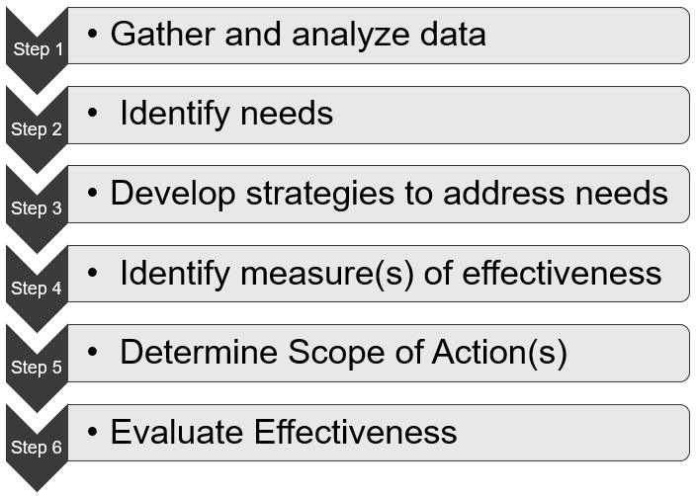
The Practice in Steps
Impacting Educational Outcomes for Low income, EL, and Foster Youth Students

Slide 27
Step 1 – Gather and Analyze Data (1 of 3)
Gather and compile data for the LEA's low-income, EL, and foster youth students from multiple sources including, but not limited to:
  State: California School Dashboard, DataQuest
  Local: Local indicator data, LEA-level benchmark assessments, school-level assessments, student demographics, lesson plans and student work, curriculum-based assessments, teacher/student observation reports
  Educational Partner Input: Formal and informal feedback, family and community participation, student/family/community surveys, teacher and staff input, educational partner meeting notes, public comments at board meetings

Slide 28
Step 1 – Gather and Analyze Data (2 of 3)
Analyze low-income, EL, and foster youth student data with educational partners to determine students' unique needs.
Ask probing questions:
  What discrepancies do we see between low-income, EL, and foster youth students' data as compared to that of their peers?
  Why are we seeing these results?
  What barriers are the low-income, EL, and/or foster youth students facing that may be causing these results?
    Remember, not all barriers are academically related

Slide 29
Step 1 – Gather and Analyze Data (3 of 3)
Data analysis may take place through a variety of mediums, including, but not limited to:
  Parent Advisory Group or EL Parent Advisory Group meetings
  Schoolsite Council meetings
  School staff meetings
  Teachers' Professional Learning Committee (PLC) meetings
  Principal meetings
  District-level staff meetings
  Professional Development trainings

Slide 30
Step 2 – Identify Needs (1 of 2)
The needs of low-income, EL, and foster youth students will be different in each LEA. However, to help identify needs, LEAs may ask:
  What did our low-income, EL, and foster youth students' specific data demonstrate?
  Are there discrepancies in outcome data between low-income, EL, and/or foster youth students and their peers?
  What feedback did our low-income, EL, and foster youth students' families provide?
  What feedback did our low-income, EL, and foster youth students themselves provide?

Slide 31
Step 2 – Identify Needs (2 of 2)
What root causes were identified?
  Are low-income, EL, and/or foster youth students' basic needs being met?
  Is the discrepancy in outcomes due to something outside of school?
  Is the discrepancy in outcomes something that requires systemic change within the LEA?
What common themes did we see?
  Can we group certain needs to be addressed together?

Slide 32
Step 3 – Develop Strategies to Address Needs
How will the LEA develop strategies to address the identified needs?
  Feedback from educational partners including parents, community members, students, administrators, teachers, and staff
  Research-based practices
  Examples from other LEAs

Slide 33
Step 4 – Identify Measures of Effectiveness
How will the LEA determine if the strategies to address the identified needs of the low-income, EL, and foster youth students are impacting the outcomes of these specific student groups?
  The metrics used to identify the needs are often excellent metrics to use to measure effectiveness
  Metrics may include quantitative data like standardized test scores, or qualitative data like educational partner feedback (both formal and informal)

Slide 34
Step 5 – Determine Scope
Will the action be provided to all students on an LEA-wide or Schoolwide basis, or solely the unduplicated student group(s) on a Limited basis?
  LEA-wide or Schoolwide:
      If the action meets the unique needs of one or more unduplicated student group(s), but the entire student population can benefit, the LEA may want to consider providing the action on an LEA-wide or Schoolwide basis.
  Limited to Unduplicated Student Group(s):
      If the action meets the unique needs of one or more unduplicated student groups and students in that group(s) are the only ones receiving the service, the action is provided on a Limited basis.

Slide 35
Step 6 – Evaluate Effectiveness
When completing the third prompt of the Goal analysis as part of the annual update process, evaluate if the actions have demonstrated effectiveness based on the outcomes of the identified metrics and feedback from educational partners.
  Have the yearly outcome(s) demonstrated that the identified needs of low income, English learners and/or foster youth students are being met based on the progress shown in the identified metric(s)?
  Has input from educational partners identified that the actions are addressing the identified needs of low income, English learners and/or foster youth students?
Reminder: LEAs must change actions that have not proven effective over a three-year period.

Slide 36
LEA-wide Action
All Schools

Slide 37
Example #1 – Gather and Analyze Data
Attendance data shows:
  Low-income student group attendance rate is 67%
  All students group attendance rate is 74%
Feedback from student surveys indicated low-income students are struggling to find reliable transportation, which causes them to be absent from school.
Teacher feedback indicated the LEA’s culture does not emphasize the importance of attendance.

Slide 38
Example #1 – Identify Needs
Low-income students need reliable transportation to help improve their attendance rates.
The LEA’s culture needs to be revamped to emphasize the importance of attendance.

Slide 39
Example #1 – Develop Strategies to Address Needs
Develop a new LEA-wide campaign on the benefits of high attendance rates.
Implement an LEA-wide incentive-based attendance program.
Provide additional transportation opportunities to all students, specifically focusing on the LEA’s low-income student group.

Slide 40
Example #1 – Identify Measures of Effectiveness
Attendance rate
  Low-income student group
  All students group
Student, parent, and staff feedback about the LEA's new attendance program.

Slide 41
Example #1 – Determine Scope
Attendance rate is a predominant concern with low-income students, but the LEA's entire culture around attendance needs to be revamped.
Since the new attendance program is intended to impact the attendance of all students in the LEA, it will be provided on an LEA-wide basis.
However, the key pieces of the attendance program, including providing reliable transportation, are designed with the needs of the low-income students at the forefront (principally directed).

Slide 42
Example #1
LEA-wide Action (1 of 3)
Identified Need(s)
The attendance rate of our low-income students is 67%, which is 7% lower than for all students (74%).
Educational partner feedback indicated we need to create a positive culture regarding attendance throughout the LEA and make transportation more accessible for low-income students.
See also: Engaging Educational Partners, Reflections: Annual Performance, and Metrics sections.

Slide 43
Example #1 LEA-wide Action
(2 of 3)
How the Action(s) Address Need(s) and Why it is Provided on an LEA-wide or Schoolwide Basis
We will provide additional transportation, with a focus on areas low-income students live in, and implement a new incentive-based program that emphasizes the importance of attendance.
These actions will create an opportunity to significantly increase attendance rates for low-income students because they are designed to address their identified needs. However, these actions are being provided on an LEA-wide basis to maximize their impact in increasing overall attendance rates for all students.

Slide 44
Example #1 LEA-wide Action
(3 of 3)
Metric(s) to Monitor Effectiveness
We will monitor progress in increasing the attendance rate of our low-income students as well as all students.
We will also seek feedback from students, parents, and staff about the new attendance program.

Slide 45
LEA-wide Action (2)
Addressing the Needs of a Racial/Ethnic Student Group

Slide 46
Example #2 – Gather and Analyze Data (1 of 2)
When disaggregating the CAASPP English Language Arts (ELA) performance of low-income students into ethnic subgroups, we found only 34.3% of low-income African American students are meeting or exceeding standard in English Language Arts, compared to 55% of low-income White students and 71.4% of low-income Latino students.
Low-income African American families shared that lack of access to culturally relevant reading material is a barrier in their students’ ability and desire to practice reading. Specifically, they indicated the books that are part of the LEA’s reading curriculum and classroom libraries do not include enough representation of African American authors, subjects, and culture.

Slide 47
Example #2 – Gather and Analyze Data (2 of 2)
Teachers reiterated the issue of lack of African American cultural representation in the LEA’s reading materials and indicated this is causing African American students to be disconnected during reading lessons.
District officials did an audit of the District’s adopted reading curriculum and various classroom libraries and came to conclusion that there is a severe lack of African American cultural representation in the District’s reading resources.

Slide 48
Example #2 – Identify Needs
The LEA's low-income African American students are struggling in reading, especially compared to their low-income White and Latino peers.
Low-income African American students are feeling disconnected and disengaged from the reading curriculum because of lack of representation of African American authors, subjects, and culture in the LEA's reading curriculum.

Slide 49
Example #2 – Develop Strategies to Address Needs
The LEA will purchase additional reading materials that include African American authors, subjects, and cultural practices.
The LEA will convene a curriculum review committee to research alternative reading curriculum that is more culturally diverse and meets the unique needs of each of the District’s student subgroups, specifically the African American subgroup.

Slide 50
Example #2 – Identify Measures of Effectiveness
CAASPP ELA Assessment (disaggregated to demonstrate low-income African American student outcomes)
District reading assessment (disaggregated to demonstrate low-income African American student outcomes)
African American student and parent feedback
District curriculum review committee results

Slide 51
Example #2 – Determine Scope
Low CAASPP ELA scores are a concern with low-income students in general, but the LEA's low-income African American students are disproportionately affected due to lack of representation in the LEA's reading curriculum and materials.
The LEA will provide the identified actions to all students because everyone will benefit from access to culturally diverse curriculum.
However, because the purchase of additional reading curriculum featuring more African American authors, subjects, and cultural practices is designed to primarily meet the needs of the low-income African American students, we anticipate the low-income African American students will see a greater benefit than their non-low-income peers.

Slide 52
Example #2
LEA-wide Action: Addressing the Needs of a Racial/Ethnic Student Group
(1 of 3)
Identified Need(s)
When disaggregating the CAASPP English Language Arts (ELA) performance of low-income students into ethnic subgroups, we found only 34.3% of our low-income African American students are meeting or exceeding standard, compared to 55% of low-income White students and 71.4% of low-income Latino students.
Educational partners indicated the LEA’s reading curriculum and classroom libraries do not include enough representation of African American authors, subjects, and cultural practices. There is a need to add culturally relevant reading materials to the curriculum to keep African American students connected during reading lessons.
See also: Engaging Educational Partners, Reflections: Annual Performance, and Metrics sections.

Slide 53
Example #2
LEA-wide Action: Addressing the Needs of a Racial/Ethnic Student Group
(2 of 3)
How the Action(s) Address Need(s) and Why it is Provided on an LEA-wide or Schoolwide Basis
The District will purchase additional reading materials to include African American authors, subjects, and culture. In addition, the District will convene a curriculum review committee to research an alternative reading curriculum that increases cultural representation of all ethnic subgroups with a specific emphasis on the African American student subgroup.
These actions are being provided on an LEA-wide basis because the purchase of additional reading materials and culturally diverse curriculum that feature African American authors, subjects, and cultural practices will enhance the inclusivity of the educational experience for all students.

Slide 54
Example #2
LEA-wide Action: Addressing the Needs of a Racial/Ethnic Student Group
(3 of 3)
Metric(s) to Monitor Effectiveness
We will monitor progress on the CAASPP ELA assessment and the District reading assessment for our low-income African American students, our low-income students, and for all students.
We will also seek feedback from our African American students and families and utilize the results from the District’s curriculum review committee in further amending the District’s reading curriculum and materials.

Slide 55
Schoolwide Actions
Specific Schools and/or Grade Spans

Slide 56
Example #3 – Gather and Analyze Data
District reading assessment data demonstrates only 36% of low-income elementary school students are reading at grade level compared to 55% of all students.
Low-income students and families indicated:
  Students struggle with finding quiet places to read because of limited space in the home.
  Students lack access to books at home because of excess cost and inability to get to the local library.
  Parents need additional resources and training to help their students with their reading at home.

Slide 57
Example #3 – Identify Needs
The LEA's elementary students need:
  Assistance in bringing up their reading levels.
Low-income elementary students need:
  Quiet places to read outside of the classroom.
  Access to books outside of the classroom.
Low-income elementary students' parents need:
  Additional resources and training to help their students with reading at home.

Slide 58
Example #3 – Develop Strategies to Address Needs
Provide an after-school reading program at all elementary schools to serve students reading two or more levels below grade level.
Provide leveled libraries for the after-school reading programs that allow participating students to check out books to take home to practice their reading.
Provide training for all parents of participating students in how to best assist their students with utilizing the after-school reading program strategies at home.

Slide 59
Example #3 – Identify Measures of Effectiveness
Elementary school students' District reading assessment scores:
  Low-income students
  All students
After-school program participants' parent feedback, gathered through bi-annual surveys.

Slide 60
Example #3 – Determine Scope
District reading assessment data is a predominant concern with low-income students at the elementary level.
Since only 55% of all elementary school students are reading at grade level , the new after-school program will be provided to all elementary students reading two or more levels below grade level on a Schoolwide basis.
However, the key pieces of the after-school reading program, including providing leveled libraries with books to take home and training for all parents of participating students, are designed with the needs of the low-income students and their families at the forefront (principally directed).

Slide 61
Example #3 Schoolwide Action
(1 of 3)
Identified Need(s)
According to our District reading assessment, only 36% of our low-income elementary school students are reading at grade level compared to 55% of all students.
Student feedback revealed many do not have a quiet place to read, or access to books at home. Low-income parents also indicated they need training in how to help their child improve their reading skills.
See also: Engaging Educational Partners and Metrics sections.

Slide 62
Example #3 Schoolwide Action (2 of 3)
How the Action(s) Address Need(s) and Why it is Provided on an LEA-wide or Schoolwide Basis
We will implement an after-school reading program for elementary students reading two or more levels below grade level, prioritizing our low-income students for service. The program will include quiet, designated reading spaces, access to books at the students’ reading levels, and training for parents.
We expect these actions to significantly improve the reading assessment scores of low-income students who participate in the after-school program as these actions are designed to address their identified needs. However, these actions will be provided on a Schoolwide basis because all students reading below grade level can benefit from opportunities to improve their reading skills.

Slide 63
Example #3 Schoolwide Action (3 of 3)
Metric(s) to Monitor Effectiveness
We will monitor progress on our District reading assessment for our low-income student group as well as all elementary students at schools receiving services.
We will also consider input from the parents of participating students to enhance the training provided.

Slide 64
Limited Actions: EL Students

Slide 65
Example #4 – Gather and Analyze Data
The LEA’s writing benchmark and English Language Proficiency Assessments for California (ELPAC) test scores demonstrated the district’s EL students are struggling with their writing and grammar skills.
Feedback from the English Learner Parent Advisory Committee further demonstrated that the parents of EL students did not feel they had the skills and resources to assist their children with their writing and grammar skills at home.

Slide 66
Example #4 – Identify Needs
EL students are struggling with their writing and grammar skills.
Parents of EL students need training and resources to assist their children with their writing and grammar skills at home.

Slide 67
Example #4 – Develop Strategies to Address Needs
Implement a supplemental ELD curriculum focusing on enhancing writing and grammar skills for EL students.
Provide professional development for ELD teachers in using the supplemental curriculum and integrating it as part of designated ELD lessons.
Provide training for EL parents in how to use the resources provided in the supplemental curriculum with their children at home.

Slide 68
Example #4 – Identify Measures of Effectiveness
LEA’s writing benchmark and ELPAC test scores to measure EL students’ growth on standardized assessments.
ELD Teacher feedback on the professional development provided and the success of implementing the new writing program into their classrooms.
English Learner Parent Advisory Committee feedback on the success of the parent trainings and use of the supplemental resources at home.

Slide 69
Example #4 – Determine Scope
Because the supplemental ELD curriculum, ELD teacher professional development, and the parent trainings will only be provided to EL students and their families, these actions are provided on a Limited basis to EL students only.

Slide 70
Example #4 Limited Action: EL Students (1 of 3)
Identified Need(s)
District writing benchmark and ELPAC test scores indicate our EL students are struggling with writing and grammar skills.
EL parents also requested support in assisting their students at home.
See also: Engaging Educational Partners and Metrics sections.

Slide 71
Example #4 Limited Action: EL Students (2 of 3)
How the Action(s) are Designed to Address Need(s)
We will implement supplemental ELD curriculum provide professional development for ELD teachers in utilizing the curriculum and provide training opportunities for parents of EL students to enable them to assist their students at home.

Slide 72
Example #4 Limited Action: EL Students (3 of 3)
Metric(s) to Monitor Effectiveness
We will monitor progress in increasing our EL students’ District writing benchmark, ELPAC test scores and feedback provided by parents and families.
We will seek feedback from ELD teachers and EL parents to continue to inform the training provided.

Slide 73
Limited Actions: Foster Youth Students

Slide 74
Example #5 – Gather and Analyze
Reports from the LEA's Foster Youth Services Coordinator (FYSC) have indicated foster youth students and their families, are struggling with feeling connected at school.
Foster youth students’ chronic absenteeism rate is 57% compared to 20% for all students.
Foster youth students’ suspension rate is 18% compared to 6% for all students.

Slide 75
Example #5 – Identified Needs
The LEA’s foster youth students and their families need:
  Support with feeling connected and engaged at school

Slide 76
Example #5 – Actions to Address Needs
The FYSC will develop a foster youth student engagement program where foster youth students and their families are paired up with volunteer mentors, consisting of teachers, staff, and community members, at each school.
The FYSC will provide mentors with training in relationship development and positive communication specific to the needs of foster youth and their families.
Mentors will provide consistent contact and resources to help foster youth and their families feel more connected and engaged at school.
Notes:
**START HERE**

Slide 77
Example #5 – Metrics
Formal and informal feedback throughout the program from foster youth and their families
Chronic Absenteeism
  Foster youth student group
Suspension rate
  Foster youth student group

Slide 78
Example #5 – Determine Scope
Because the FYSC's student engagement program will only be provided to foster youth students and their families, these actions are provided on a Limited basis to foster youth students only.

Slide 79
Example #5 Limited Action: Foster Youth Students
(1 of 3)
Identified Need(s)
Foster youth students’ chronic absenteeism and suspension rates are disproportionately higher than those of their peers. Feedback from foster youth students and their families indicates they are feeling disconnected from school.
See also: Engaging Educational Partners, Reflections: Annual Performance, and Metrics sections.

Slide 80
Example #5 Limited Action: Foster Youth Students
(2 of 3)
How the Action(s) are Designed to Address Need(s)
The LEA’s Foster Youth Services Coordinator (FYSC) will implement a student engagement mentorship program utilizing volunteers. Identified mentors include teachers, staff, and community volunteers who will be trained by the FYSC in developing nurturing relationships with foster youth and their families. Mentors will provide consistent contact, support, and resources to help them be more connected and engaged at school.

Slide 81
Example #5 Limited Action: Foster Youth Students
(3 of 3)
Metric(s) to Monitor Effectiveness
We will monitor progress in decreasing our foster youth students’ chronic absenteeism and suspension rates.
Feedback from foster youth and their families will shape the continued development of the mentorship program.

Slide 82
Limited Action: Planned Percentage of Improved Services

Slide 83
Determining Methodology
Example 5, described on the previous slides, is a limited action that does not have any funding associated with it. Instead, this action has a "percentage of improved services."
LCFF funding for the limited action would have gone to hiring additional staff, but because the LEA was able to use volunteers to implement the program, the LEA didn't need to expend LCFF funds.
To determine the percentage of improved services associated with Example 5, the LEA considered how much LCFF funding would have been needed if the action were to be funded.
The LEA used its current pay scale to calculate how much it would have needed to spend on the additional staff.

Slide 84
Calculating Planned Percentage of Improved Services
The LEA determined the additional staff needed to implement the action would have cost $450,000.
To calculate the Planned Percentage of Improved Services, the LEA divided the estimated cost of the additional staff ($450,000) by the total amount of LCFF base grant funds it received ($24,193,548).
$450,000 ÷ $24,193,548 = 1.86%
Therefore, the Planned Percentage of Improved Services for Example 5 is 1.86%.

Slide 85
Example #5 Limited Action: Planned Percentage of Improved Services Methodology
Goal 5, Action 5 includes a mentorship program to help reengage our foster youth students in school. Based on our current pay scale, the cost of hiring additional staff to provide these supports for foster youth students would be $450,000. Instead of hiring additional staff, we will be utilizing volunteer mentors, including teachers, staff, and other community members, who will be trained by the FYSC in developing nurturing relationships with foster youth and their families. In the absence of spending LCFF funds, this action will account for a 1.86% planned percentage of improved services.

Slide 86
Closing Thoughts

Slide 87
The Focus is on Students
Remember that the focus is on students
  Keep the focus on students when collecting and analyzing data.
  Keep the focus on students when engaging educational partners.
  Keep the focus on students when designing the plan.
  Keep the focus on students when describing the actions and how they are contributing towards meeting the requirement to increase or improve services.

Slide 88
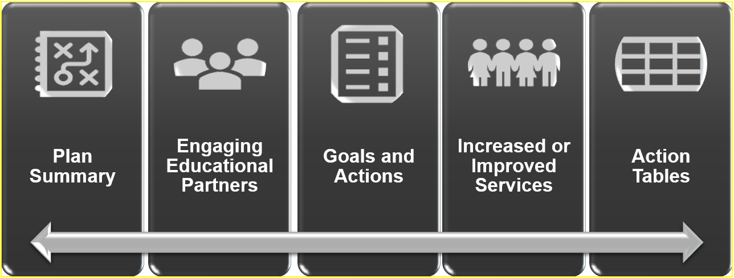
The LCAP “Through Line” (1 of 2)
*see Appendix B for descriptive text

Slide 89
The LCAP “Through Line” (2 of 2)
It is also important to look at the LCAP as a whole.
The LCAP is composed of different sections.
The sections are interrelated.
The document is greater than the sum of its parts.

Slide 90
Upcoming Opportunities
Future Trainings and contact information

Slide 91
Upcoming Webinars
Thursday, December 19, 2024, at 3 p.m.
  Increased or Improved Services, Part II
Tuesday, January 7, 2025, at 2 p.m.
  Equity Multiplier Goal
Tuesday, January 14, 2025, at 2 p.m.
  Learning Recovery and Emergency Block Grant (LREBG)

Slide 92
Contact Information
  If you have any questions related to the LCAP or LCFF, please contact the Local Agency Systems Support Office at LCFF@cde.ca.gov
  For additional information about this or other webinars in this series, including PowerPoint files, please see the Tuesdays @ 2 web page

Slide 93
Thank you for attending!

Slide 94
Appendix A – Slide 9
From left to right:
A student holding up a paper with a red “A+” labeled “Per student base grant”
An addition sign
A large group of students labeled “Grade span adjustments”
An addition sign
A group of multicolored raised hands labeled “Add-on adjustments based on the number and concentration of low income, English learner, and foster youth students”
An equal sign
A large, green dollar sign

Slide 95
Appendix B – Slide 88
5 dark gray rectangular shapes arranged side-by-side horizontally on the longer side
An ongoing arrow at the bottom of all rectangles visually connecting them together.
The rectangles have a decorative symbol and the following titles: Plan Summary, Engaging Educational Partners, Goals and Actions, Increased or Improved Services, Action Tables.

