Slide 1
Introduction to the Local Control Funding Formula
California Department of Education
November 30, 2021

Slide 2
Webinar Series
Tuesdays @ 2
11/30: Introduction to the Local Control Funding Formula
12/7: Engaging Educational Partners
12/14: Increased or Improved Services, Part I
1/11: 2022 Dashboard Local Indicator Process
Thursdays @ 3
12/2: The LCAP Template and Instructions for the 2022–23 School Year
12/9: Goals and Actions
12/16: Increased or Improved Services, Part II
1/13: LCAP Required Goals

Slide 3
Purpose
The history of the Local Control Funding Formula (LCFF) and its foundational principles;
The requirements for the Local Control Accountability Plan (LCAP); and
The connection of the LCAP to California’s accountability system and the Statewide System of Support.
To provide an overview of the following:

Slide 4
Intended Audience
The intended audience for this presentation is anyone who is new to the LCFF, the LCAP, California’s accountability system, and the Statewide System of Support.
This may include
  Parents
  Teachers
  Administrators
  Community members

Slide 5
Why?
Understanding the foundational principles upon which the LCFF and the LCAP are based aids in understanding the requirements for the LCAP, the LCAP development process, and LCFF requirements.
It helps us see the “through line” between the vision and the requirements

Slide 6
Background
Funding and Accountability Before the LCFF

Slide 7
Funding Before the LCFF (1)
Until 1971: local control / local funding through property taxes
1972: Revenue Limits (frozen at then current level) - beginning of State control
Serano vs. Priest: inequities in funding unconstitutional
1978: Prop 13, which shifted a preponderance of funding away from local property taxes

Slide 8
Funding Before the LCFF (2)
1980 – 2013: modest growth in revenue limits, but a massive growth in categorical programs
1988: Prop 98
2008 – 2009: Great Recession, midyear cuts budget, categorical flexibility
2013 – 2014: First year of LCFF, elimination of over 40 categorical programs

Slide 9
Accountability Before the LCFF (1)
Accountability before LCFF was a top-down system characterized by a single measure of success and a one-size-fits-all approach to improvement.
The Public Schools Accountability Act (1999)
  The Academic Performance Index (API)
  The Immediate Intervention/ Underperforming Schools Program
    School Assistance and Intervention Team (SAIT)
    District Assistance and Intervention Team (DAIT)
Notes:
Accountability before LCFF was a top-down system characterized by a single measure of success and a one-size-fits-all approach to improvement.

Slide 10
Accountability Before the LCFF (2)
The No Child Left Behind Act of 2001 (NCLB)
  Adequate Yearly Progress (AYP)
  Program Improvement
  Corrective Action

Slide 11
Foundational Principles of the LCFF
Local education agency (LEA)-level improvement that is based on multiple measures of success
Equity
  Additional funding to address specific identified needs of students who are low income, English learners, and/or foster youth (i.e. unduplicated students)
  Requirement to Increase or Improve Services in proportion to the increase in funding
Subsidiarity
  Social and political issues should be dealt with at the local level
  This approach necessitates transparency and collaboration with educational partners

Slide 12
A Word About the Term “Educational Partners”
At its November 2021 meeting, the State Board of Education (SBE) adopted the use of the term “educational partners” as a replacement for the term “stakeholder”.
Moving forward, “educational partners” will be used to refer to groups that LEAs are required to engage with in developing the LCAP.
  For school districts and county offices of education (COEs) this includes teachers, principals, administrators, other school personnel, local bargaining units of the LEA, parents, and students.
  For charter schools this includes teachers, principals, administrators, other school personnel, parents, and students.
Notes:
For additional information related to this change in terminology, please see Item 03 from the SBEs September 2021 meeting (https://www.cde.ca.gov/be/ag/ag/yr21/agenda202109.asp) and Item 05 from the SBEs November 2021 meeting (https://www.cde.ca.gov/be/ag/ag/yr21/agenda202111.asp).

Slide 13
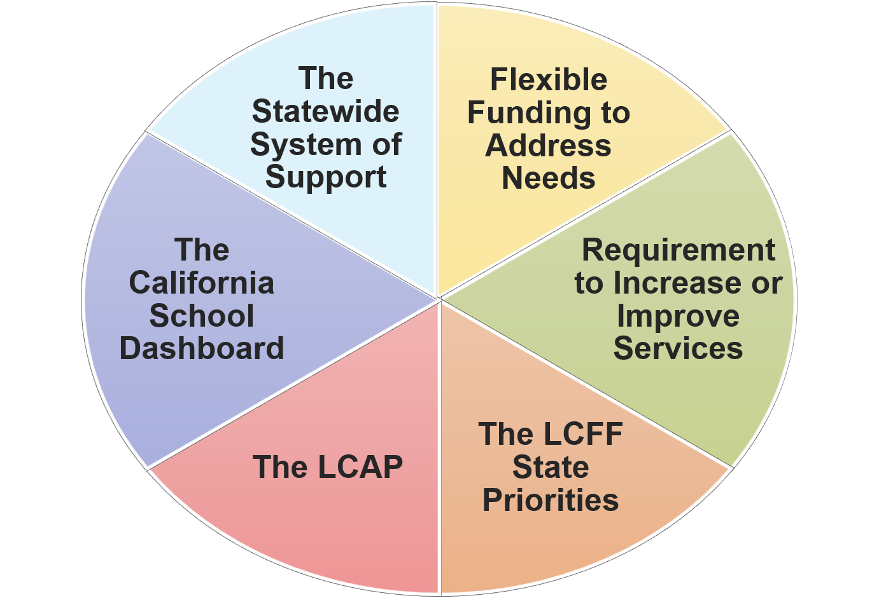
Key Components of the LCFF
The LCFF includes six key components

Slide 14
LCFF Funding
Purposeful Funding with an Focus on Equity

Slide 15
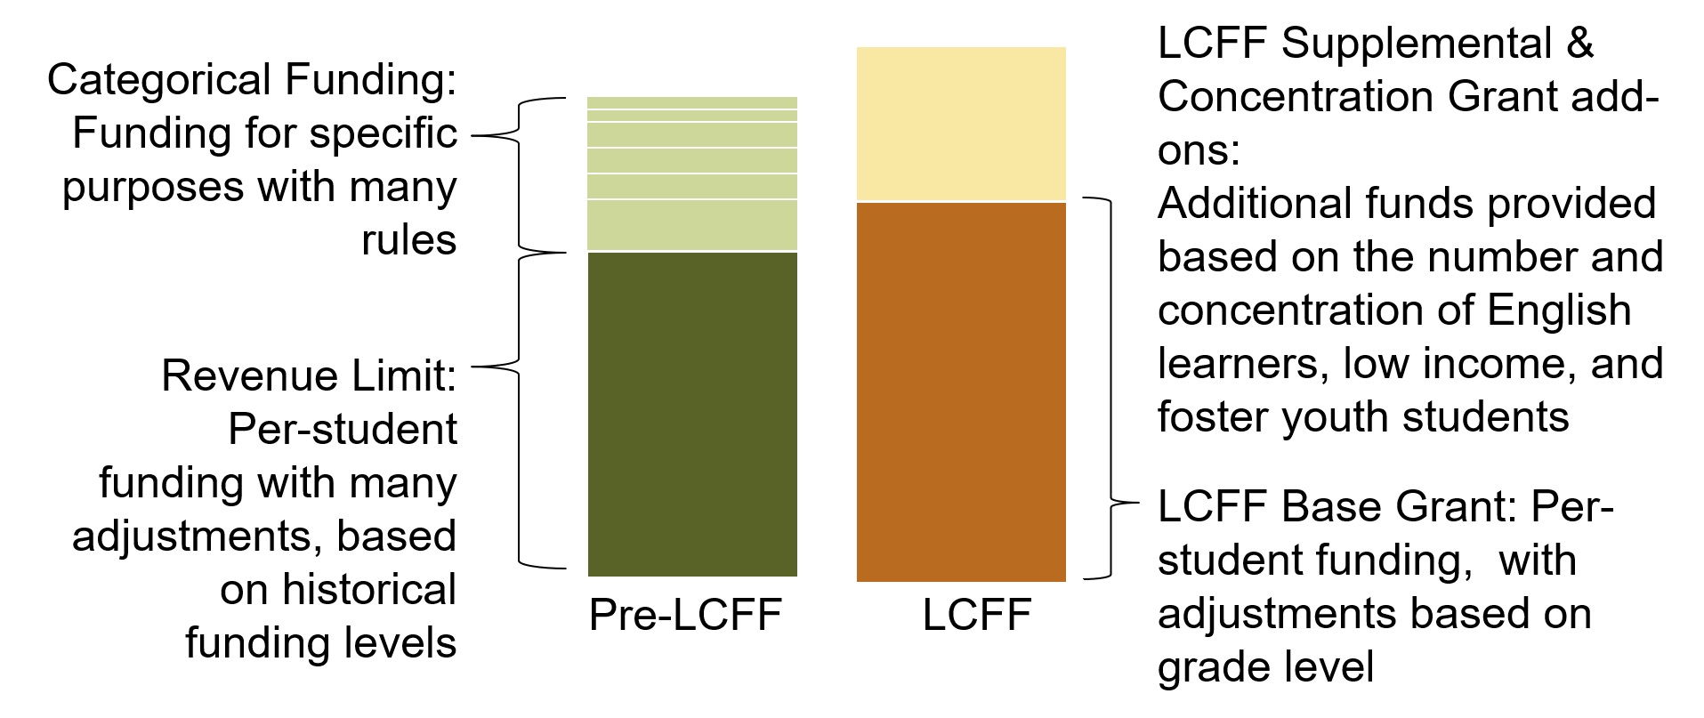
Funding Changes Made by LCFF
Notes:
The 2013–14 budget package replaces the previous K–12 finance system with a new Local Control Funding Formula (LCFF). For school districts and charter schools, the LCFF creates base, supplemental, and concentration grants in place of most previously existing K–12 funding streams, including revenue limits and most state categorical programs. For county offices of education (COEs), the LCFF creates separate funding streams for oversight activities and instructional programs.

Slide 16
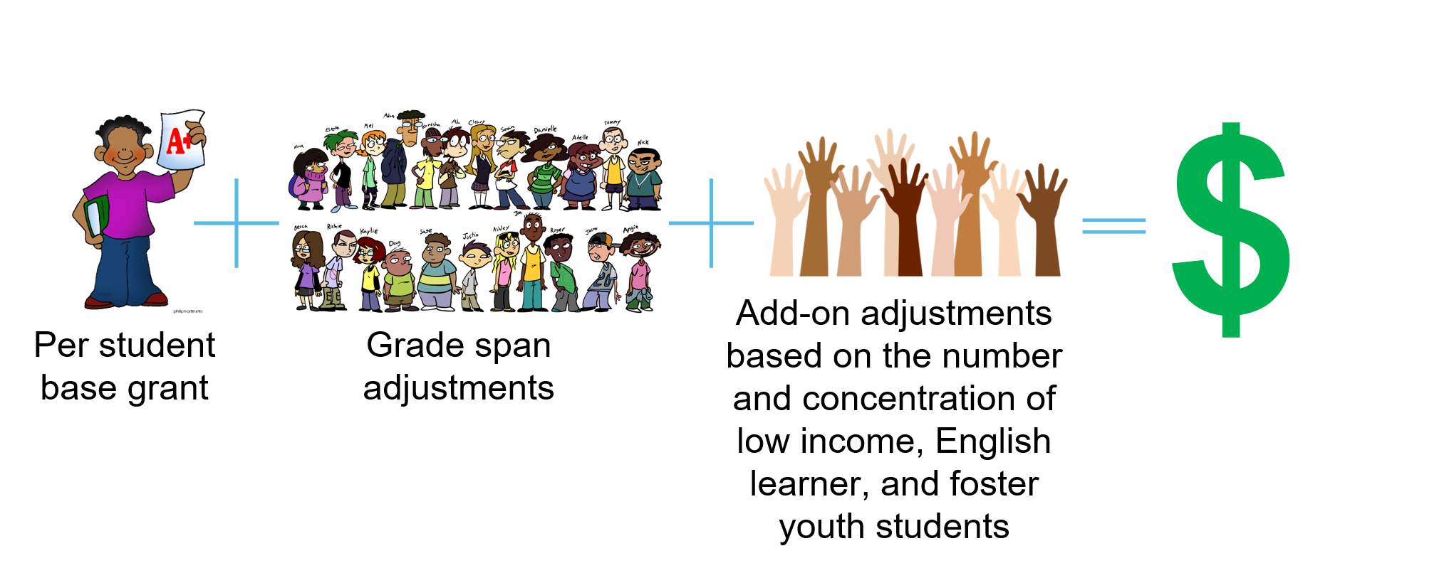
LCFF Funding Formula Basics

Slide 17

Unrestricted Funds
All LCFF funding, regardless of whether it is calculated using the formula for the base grant, the formula for the supplemental grant add-on, or the formula for the concentration grant add-on, is unrestricted funding
LCFF funds may be spent on any purpose allowable under the California Education Code

Slide 18
Funding Flexibility to Ensure Student Success
LCFF provides for an increased level of local flexibility to determine which programs and/or services have the greatest likelihood of ensuring that each student will succeed in relation to each of the LCFF state priorities.
In exchange for this flexibility, the LCFF requires greater local responsibility for selecting appropriate and effective programs.
This necessitates transparency and engaging the LEAs educational partners in analysis and decision-making.
Notes:
This flexibility presents an opportunity for LEAs to better integrate programs and services, but it requires the availability of sufficient information to make complex decisions and to plan effectively for implementation and monitoring.

Slide 19
Requirement to Increase or Improve Services
LEAs are required to demonstrate in the LCAP how they are meeting the requirement to increase or improve services for students who are low income, English learners, or foster youth as compared to the services provided to all pupils.
Services must be increased or improved in proportion to the increase in funding apportioned on the basis of the number and concentration of low income, English learners, or foster youth students
LEAs that are unable to demonstrate that they have increased or improved services by the required percentage are required to carry over the unmet portion of the percentage into the coming year.
Notes:
To improve services means to grow services in quality and to increase services means to grow services in quantity.

Slide 20
The LCAP
A tool to set goals, plan actions, and leverage resources to improve student outcomes

Slide 21
The Local Control and Accountability Plan
As part of the LCFF, LEAs are required to develop, adopt, and annually update a three-year LCAP using the template adopted by the California State Board of Education (SBE)
The LCAP must include a description of the annual goals to be achieved for each student group for each state priority and for any local priorities identified by the local governing board or body of the school district or COE, or in the charter school petition
The LCAP must include an annual review of the effectiveness of the goals, actions, and services from the prior year
Notes:
Student groups that must be addressed in the LCAP are those subgroups named in EC Section 52052:
Ethnic subgroups
Socioeconomically disadvantaged pupils
English learners
Pupils with disabilities
Foster youth
Homeless youth
Goals must address each of the state priorities and any additional local priorities; however, one goal may address multiple priorities.
An LEA may identify which school sites and subgroups have the same goals, and maygroup and describe those goals together.
If a single goal requires longer than one year to implement fully, the LCAP should reflect the annual incremental actions, services, and expenditures, as well as the annual anticipated progress, that the district expects to achieve for each student group.
These annual benchmarks will assist LEAs and the community to monitor the progress of the plan.

Slide 22
Student Groups
Ethnic groups (30 or more)
Socioeconomically disadvantaged students (30 or more)
English learners (30 or more)
Pupils with disabilities (30 or more)
Foster youth (15 or more)
Homeless youth (15 or more)
Notes:
Student groups that must be addressed in the LCAP are those subgroups named in Education Code (EC) Section 52052:
Ethnic subgroups
Socioeconomically disadvantaged pupils
English learners
Pupils with disabilities
Foster youth
Homeless youth

Slide 23
LCFF State Priorities
Priority 1: Appropriate teacher assignment, sufficient instructional materials, and facilities in good repair
Priority 2: Implementation of academic content and performance standards adopted by SBE
Priority 3: Parental Involvement and Family Engagement
Priority 4: Pupil Achievement
Priority 5: Pupil engagement
Priority 6: School Climate
Priority 7: Course Access
Priority 8: Other Pupil Outcomes
Priority 9: Expelled Students (COEs only)
Priority 10: Foster Youth (COEs only)
Plus Local Priorities
Notes:
From Education Code (EC) sections 52060(d) and 52066(d)

Slide 24
Priority 1: Basic
The degree to which:
teachers in the LEA are appropriately assigned and fully credentialed in the subject area and for the students they are teaching;
Every student in the LEA has sufficient access to the standards-aligned instructional materials; and
the LCAP addresses the degree to which school facilities are maintained in good repair
Notes:
From EC sections 52060(d)(1) and 52066(d)(1):
The degree to which the teachers of the school district are appropriately assigned in accordance with Section 44258.9, and fully credentialed in the subject areas, and, for the pupils they are teaching, every pupil in the school district has sufficient access to the standards-aligned instructional materials as determined pursuant to Section 60119, and school facilities are maintained in good repair, as defined in subdivision (d) of Section 17002

Slide 25
Priority 2: State Standards
the implementation of State Board adopted academic content and performance standards for all students; and
how the programs and services will enable English learners to access the Common Core State Standards and the English Learner Development standards for purposes of gaining academic content knowledge and English language proficiency
Notes:
From EC sections 52060(d)(2) and 52066(d)(2):
Implementation of the academic content and performance standards adopted by the state board, including how the programs and services will enable English learners to access the common core academic content standards adopted pursuant to Section 60605.8 and the English language development standards adopted pursuant to former Section 60811.3, as that section read on June 30, 2013, or former Section 60811.4, as that section read on June 30, 2016, for purposes of gaining academic content knowledge and English language proficiency.

Slide 26
Priority 3: Parental Involvement and Family Engagement
the efforts the LEA makes to seek parent input in making decisions for the school district and each individual schoolsite;
how the LEA will promote parental participation in programs for students who are low income, English learners, and foster youth; and
how the LEA will promote parental participation in programs for students with disabilities
Notes:
From EC sections 52060(d)(3) and 52066(d)(3):
(A) Parental involvement and family engagement, including efforts the school district makes to seek parent input in making decisions for the school district and each individual schoolsite, and including how the school district will promote parental participation in programs for unduplicated pupils and individuals with exceptional needs.
(B) Family engagement may include, but need not be limited to, efforts by the school district and each individual schoolsite to apply research-based practices, such as welcoming all families into the school community, engaging in effective two-way communication, supporting pupil success, and empowering families to advocate for equity and access. Family engagement may include, but need not be limited to, treating families as partners to inform, influence, and create practices and programs that support pupil success and collaboration with families and the broader community, expand pupil learning opportunities and community services, and promote civic participation.

Slide 27
Priority 4: Pupil Achievement (1 of 2)
Measured by all of the following, as applicable to the LEA:
statewide standardized assessments;
the percentage of students who have successfully completed courses that satisfy University of California or California State University entrance requirements;
The percentage of students who have successfully completed courses that satisfy the requirements for career technical education (CTE) sequences or programs of study that align with state board-approved CTE standards and frameworks;
The percentage of students who have successfully completed both types of courses described in the two previous bullets;
Notes:
From EC sections 52060(d)(4) and 52066(d)(4):
(4) Pupil achievement, as measured by all of the following, as applicable:
(A) Statewide assessments administered pursuant to Article 4 (commencing with Section 60640) of Chapter 5 of Part 33 or any subsequent assessment, as certified by the state board.
(B) The percentage of pupils who have successfully completed courses that satisfy the requirements for entrance to the University of California and the California State University.
(C) The percentage of pupils who have successfully completed courses that satisfy the requirements for career technical education sequences or programs of study that align with state board-approved career technical education standards and frameworks, including, but not limited to, those described in subdivision (a) of Section 52302, subdivision (a) of Section 52372.5, or paragraph (2) of subdivision (e) of Section 54692.
(D) The percentage of pupils who have successfully completed both types of courses described in subparagraphs (B) and (C).
(E) The percentage of English learner pupils who make progress toward English proficiency as measured by the English Language Proficiency Assessments for California or any subsequent assessment of English proficiency, as certified by the state board.
(F) The English learner reclassification rate.
(G) The percentage of pupils who have passed an advanced placement examination with a score of 3 or higher.
(H) The percentage of pupils who demonstrate college preparedness pursuant to the Early Assessment Program, as described in Chapter 6 (commencing with Section 99300) of Part 65 of Division 14 of Title 3, or any subsequent assessment of college preparedness.

Slide 28
Priority 4: Pupil Achievement (2 of 2)
the percentage of students who are English learners who make progress toward English proficiency as measured by the English Language Proficiency Assessments for California;
the English learner reclassification rate;
the percentage of students who have passed an advanced placement examination with a score of 3 or higher; and
the percentage of students who demonstrate college preparedness pursuant to the Early Assessment Program, or any subsequent assessment of college preparedness
Notes:
From EC sections 52060(d)(4) and 52066(d)(4):
(4) Pupil achievement, as measured by all of the following, as applicable:
(A) Statewide assessments administered pursuant to Article 4 (commencing with Section 60640) of Chapter 5 of Part 33 or any subsequent assessment, as certified by the state board.
(B) The percentage of pupils who have successfully completed courses that satisfy the requirements for entrance to the University of California and the California State University.
(C) The percentage of pupils who have successfully completed courses that satisfy the requirements for career technical education sequences or programs of study that align with state board-approved career technical education standards and frameworks, including, but not limited to, those described in subdivision (a) of Section 52302, subdivision (a) of Section 52372.5, or paragraph (2) of subdivision (e) of Section 54692.
(D) The percentage of pupils who have successfully completed both types of courses described in subparagraphs (B) and (C).
(E) The percentage of English learner pupils who make progress toward English proficiency as measured by the English Language Proficiency Assessments for California or any subsequent assessment of English proficiency, as certified by the state board.
(F) The English learner reclassification rate.
(G) The percentage of pupils who have passed an advanced placement examination with a score of 3 or higher.
(H) The percentage of pupils who demonstrate college preparedness pursuant to the Early Assessment Program, as described in Chapter 6 (commencing with Section 99300) of Part 65 of Division 14 of Title 3, or any subsequent assessment of college preparedness.

Slide 29

Priority 5: Pupil Engagement
Measured by all of the following, as applicable to the LEA:
school attendance rates;
chronic absenteeism rates;
middle school dropout rates;
high school dropout rates; and
high school graduation rates
Notes:
From EC sections 52060(d)(5) and 52066(d)(5):
(5) Pupil engagement, as measured by all of the following, as applicable:
(A) School attendance rates.
(B) Chronic absenteeism rates.
(C) Middle school dropout rates.
(D) High school dropout rates.
(E) High school graduation rates.

Slide 30

Priority 6: School Climate
Measured by all of the following, as applicable:
suspension rates;
expulsion rates; and
other local measures, including surveys of students, parents, and teachers on the sense of safety and school connectedness.
Notes:
From EC sections 52060(d)(6) and 52066(d)(6):
(6) School climate, as measured by all of the following, as applicable:
(A) Pupil suspension rates.
(B) Pupil expulsion rates.
(C) Other local measures, including surveys of pupils, parents, and teachers on the sense of safety and school connectedness.

Slide 31
Priority 7: Course Access
Addresses the extent to which students have access to and are enrolled in:
the adopted course of study for grades 1 to 6 and/or the adopted course of study for grades 7 to 12, as applicable;
programs and services developed and provided to students who are low income, English learners, and foster youth; and
programs and services developed and provided to students with disabilities
Notes:
From EC sections 52060(d)(7) and 52066(d)(7):
(7) The extent to which pupils have access to, and are enrolled in, a broad course of study that includes all of the subject areas described in Section 51210 and subdivisions (a) to (i), inclusive, of Section 51220, as applicable, including the programs and services developed and provided to unduplicated pupils and individuals with exceptional needs, and the programs and services that are provided to benefit these pupils as a result of the funding received pursuant to Section 42238.02, as implemented by Section 42238.03.

Slide 32

Priority 8: Student Outcomes
Addresses student outcomes, if available, for the adopted course of study for grades 1 to 6 and/or the adopted course of study for grades 7 to 12, as applicable to the LEA

Slide 33
Priority 9: Coordination of Instruction
Coordination of instruction for expelled students
For COEs only
Addresses how the COE will coordinate instruction for expelled students
Notes:
From EC sections 52066(d)(9):
(9) How the county superintendent of schools will coordinate instruction of expelled pupils pursuant to Section 48926.

Slide 34
Priority 10: Coordination of Services (1 of 2)
Coordination of Services for Foster Youth
For COEs only
Addresses how the COEs will coordinate services for foster youth, including:
working with the county child welfare agency to minimize changes in school placement
providing education-related information to the county child welfare agency, including educational status and progress information that is required to be included in court reports;
Notes:
From EC sections 52066(d)(10):
(10) How the county superintendent of schools will coordinate services for foster children, including, but not limited to, all of the following:
(A) Working with the county child welfare agency to minimize changes in school placement.
(B) Providing education-related information to the county child welfare agency to assist the county child welfare agency in the delivery of services to foster children, including, but not limited to, educational status and progress information that is required to be included in court reports.
(C) Responding to requests from the juvenile court for information and working with the juvenile court to ensure the delivery and coordination of necessary educational services.
(D) Establishing a mechanism for the efficient expeditious transfer of health and education records and the health and education passport.

Slide 35
Priority 10: Coordination of Services (2 of 2)
responding to requests from the juvenile court for information and working with the juvenile court to ensure the delivery and coordination of necessary educational services; and
establishing a mechanism for the efficient expeditious transfer of health and education records and the health and education passport
Notes:
From EC sections 52066(d)(10):
(10) How the county superintendent of schools will coordinate services for foster children, including, but not limited to, all of the following:
(A) Working with the county child welfare agency to minimize changes in school placement.
(B) Providing education-related information to the county child welfare agency to assist the county child welfare agency in the delivery of services to foster children, including, but not limited to, educational status and progress information that is required to be included in court reports.
(C) Responding to requests from the juvenile court for information and working with the juvenile court to ensure the delivery and coordination of necessary educational services.
(D) Establishing a mechanism for the efficient expeditious transfer of health and education records and the health and education passport.

Slide 36
Local Priorities
Local Priorities address:
local priority goals; and
methods for measuring progress toward local goals.
Notes:
From EC sections 52060(h) and 52066(h):
(h) A school district or COE may identify local priorities, goals in regard to the local priorities, and the method for measuring the school district’s progress toward achieving those goals.

Slide 37
Framing the LCAP (1 of 3)
The LCAP development process serves three distinct, but related functions:
Comprehensive Strategic Planning:
  The process of developing and annually updating the LCAP supports comprehensive strategic planning
  Strategic planning that is comprehensive connects budgetary decisions to teaching and learning performance data
  LEAs should continually evaluate the hard choices they make about the use of limited resources to meet student and community needs to ensure opportunities and outcomes are improved for all students.

Slide 38

Framing the LCAP (2 of 3)
Meaningful Engagement of Educational Partners:
  The LCAP development process should result in an LCAP that reflects decisions made through meaningful engagement of educational partners.
  Local educational partners possess valuable perspectives and insights about an LEA's programs and services.
  Effective strategic planning will incorporate these perspectives and insights in order to identify potential goals and actions to be included in the LCAP.

Slide 39

Framing the LCAP (3 of 3)
Accountability and Compliance:
  The LCAP serves an important accountability function because aspects of the LCAP template require LEAs to show that they have complied with various requirements specified in the LCFF statutes and regulations.

Slide 40
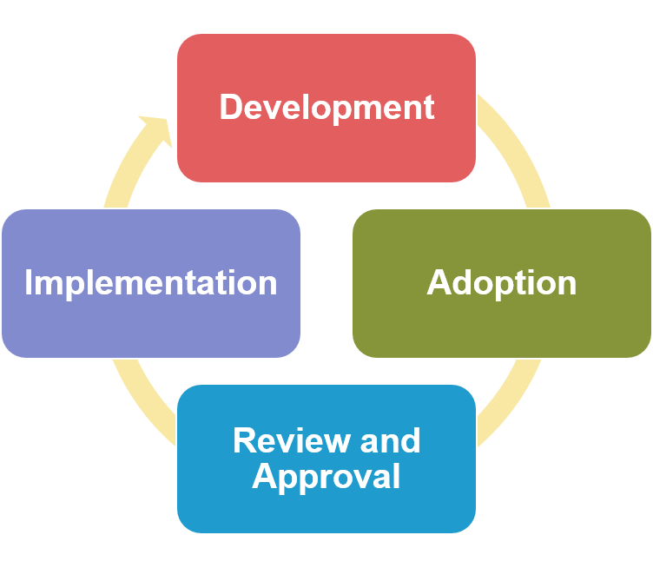
LCAP Development Process
Development
Data analysis and reflection
Engage educational partners
Write or revise the plan
Adoption
Public Hearing to solicit public input
Public Meeting to adopt the LCAP, the budget, and report on local indicator progress
Review and Approval
Implementation
Notes:
Development Phase (data analysis and reflection, engaging educational partners in that process, writing the plan)
Adoption Phase (hearing, adoption meeting, local indicator presentation)
Review and Approval Phase (COE/CDE reviews the plan, makes recs, approves plan assuming it meets requirements)
Implementation Phase (LEA is actually implementing plan)

Slide 41
Sections of the LCAP
Budget Overview For Parents
2021–22 Supplement (included as part of the 2022–23 LCAP)
Plan Summary
Engaging Educational Partners
Goals and Actions
Increased or Improved Services for Foster Youth, English Learners, and Low-Income Students
Action Tables
Notes:
The 3-year plan is a balance between a long-term plan and a yearly plan
The idea is that LEAs utilize the LCAP to create 3-year goals, but LEAs check-in each year and make adjustments, similar to what would happen with a 1-year plan

Slide 42
Approval Criteria for the LCAP
School District and COEs must submit their LCAPs for review and approval. The following are the review and approval criteria:
The LEA has adhered to the template and has followed the instructions for completing the template
The LEA budget for the fiscal year includes expenditures that are sufficient to implement the actions in the LCAP
The LEA has demonstrated how it is meeting its requirement to increase or improve services for students who are low-income, English learners, or foster youth
Notes:
School Districts submit their LCAP to their COE; COEs submit their LCAP to the CDE.

Slide 43
The California Way
Focused on Collaboratively Improving Outcomes for Students

Slide 44

A New Way to Improve
The California Way rests on the belief that educators want to excel, trusts them to improve when given the proper supports, and provides local schools and districts with the leeway and flexibility to deploy resources so they can improve.
Notes:
The implementation of the LCFF and the new California Standards drive an accountability system that differs from the previous one in almost every respect. Schools and LEAs throughout California now have a unique opportunity to reconfigure themselves as learning organizations committed to continuous improvement.
The California Way rests on the belief that educators want to excel, trusts them to improve when given the proper supports, and provides local schools and districts with the leeway and flexibility to deploy resources so they can improve.
The California Way engages students, parents, and communities as part of a collaborative decision-making process around how to fund and implement these improvement efforts, and provides supplemental resources to ensure that California’s ELs, foster youths, and students in poverty have the learning supports they need.

Slide 45
The California School Dashboard
A powerful online tool to help identify strengths and weaknesses

Slide 46
Multiple Measures
LCFF created an accountability system that utilizes multiple measures to inform educators, parents, and the public of student achievement
Statute required the (SBE to develop evaluation rubrics to
  assist LEAs in evaluating their strengths, weaknesses, and areas that require improvement, and
  assist in identifying LEAs in need of technical assistance and the specific priorities that the technical assistance should focus on

Slide 47
State and Local Indicators
The SBE adopted state and local indicators to measure school district and individual schoolsite performance in regard to each of the state priorities, as required by law
Performance data on state and local indicators is publicly reported in the California School Dashboard
  State Indicators apply to all LEAs, schools, and student groups and are based on data that is collected consistently across the state (Priorities 4, 5, 6 and 8)
  Local Indicators apply at the LEA and charter school level and are based on data collected at the local level (Priorities 1, 2, 3, 6, 7, 9 and 10)

Slide 48
The System of Support
Tiered Support for LEAs and Schools

Slide 49
Support for All LEAs
California's system of support is one of the central components of the accountability and continuous improvement system.
Purpose is to build the capacity of LEAs in the following areas:
  Support the continuous improvement of student performance in each of the eight state priorities
  Address the gaps in achievement between student groups
  Improve outreach and collaboration with educational partners to ensure that goals, actions, and services described in LEA LCAPs reflect the needs of students and the community, especially for historically underrepresented or low-achieving groups.

Slide 50
Various Support Providers
COEs
Geographic Lead Agencies
Resource Leads and Initiatives
The California Collaborative for Educational Excellence
The California Department of Education

Slide 51
Levels of Support
Support for All LEAs and Schools (Level 1)
  resources, tools, and technical assistance that all LEAs may use to improve student performance at the LEA and school level
Differentiated Assistance (Level 2)
  provided for eligible LEAs in the form of individually designed assistance to address identified performance issues
  LEAs are eligible for assistance based on criteria adopted by the SBE
Intensive Intervention (Level 3)

Slide 52
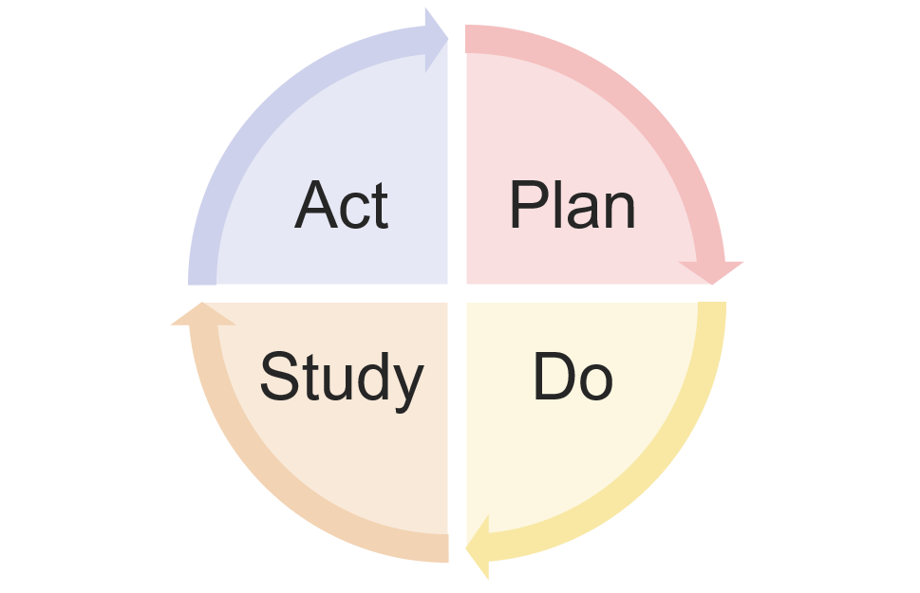
A Cycle of Continuous Improvement
Support for LEAs and schools is not based on the “test and judge” methods of the past
Support providers partner with LEAs to build capacity in order to improve outcomes for students
  Identifying needs based on data analysis and input from educational partners
  Providing or connecting LEAs to tools, resources and supports available to them
  Utilizing plan-do-study-act cycles to implement change ideas
  Making use of the flexibility provided through the LCFF statute to make course corrections

Slide 53
Closing Thoughts

Slide 54
Building on the Foundation
This webinar has provided an explanation of the foundational basis of the LCFF, the LCAP and the accountability system
In the coming weeks we will build on this foundation as we take an in-depth look at the LCAP, engaging educational partners, the requirement to increase or improve services and other applicable requirements
As you engage in the review of progress and develop the 2022-23 LCAP we hope that these foundational principles provide a point of reference which informs policies, procedures and practice in a way that leads to improved outcomes for students

Slide 55
Upcoming Webinars
3:00 p.m. Thursday, December 2nd: The LCAP Template and Instructions for the 2022–23 School Year
2:00 p.m. Tuesday, December 7th: Engaging Educational Partners
3:00 p.m. Thursday, December 9th: Goals and Actions
2:00 p.m. Tuesday, December 14th: Increased or Improved Services, Part I
3:00 p.m. Thursday, December 16th: Increased or Improved Services, Part II

Slide 56
For More Information
Local Control Funding Formula web page: https://www.cde.ca.gov/fg/aa/lc/index.asp
Local Control and Accountability Plan (LCAP) web page: https://www.cde.ca.gov/re/lc/
California School Dashboard web page: https://www.cde.ca.gov/ta/ac/cm/
California's System of Support web page: https://www.cde.ca.gov/sp/sw/t1/csss.asp

Slide 57
Share Your Input: LCAPs Survey
The California Department of Education and San Joaquin County Office of Education are gathering input from partners like you to inform the development of the LCAP electronic template system and a potential database connected to that system.
The goal for a new data tool and database would be to provide information to school and district staff, families, and communities about each school district’s plan for supporting positive student outcomes through the school district LCAPs.

Slide 58
Share Your Input: LCAPs Survey Links
Please share your input through a short survey by December 13, 2021!
The survey is available in English and Spanish:
  Link to English survey version: https://www.surveymonkey.com/r/GCCKJJQ
  Link to Spanish survey version: https://www.surveymonkey.com/r/GC7JNGK

Slide 59
Contact Information
  If you have any questions related to the LCAP or LCFF, please contact the Local Agency Systems Support Office at LCFF@cde.ca.gov
  For additional information about this or other webinars in this series, including PowerPoint files, please see the Tuesdays @ 2 webpage at https://www.cde.ca.gov/fg/aa/lc/tuesdaysat2.asp
  For questions related to the Dashboard please contact the Academic Accountability Team at aau@cde.ca.gov.
  For questions related to the System of Support please contact the System of Support Office at CASystemofSupport@cde.ca.gov.

Slide 60
Questions
If you have any questions, please contact the Local Agency Systems Support Office at LCFF@cde.ca.gov

Slide 61
Appendix 1
There are 2 vertical bars in the middle. One is green that is labeled “Pre-LCFF” at the bottom - about 1/3 is light green at the top (labeled "Categorical Funding: Funding for specific purposes with many rules”), the other 2/3 is dark green (labeled "Revenue Limit: Per-student funding with many adjustments, based on historical funding levels“). The other bar is orange, labeled “LCFF” at the bottom, that is about 1/3 pale orange at the top (labeled "LCFF Supplemental & Concentration Grant add-ons: Additional funds provided based on the number and concentration of English learners, low income, and foster youth students”), the other 2/3 is dark orange (labeled "LCFF Base Grant: Per-student funding, with adjustments based on grade level.“). The orange bar is slightly taller than the green bar.

Slide 62
Appendix 2
From left to right:
A student holding up a paper with a red “A+” labeled “Per student base grant”
An addition sign
A large group of students labeled “Grade span adjustments”
An addition sign
A group of multicolored raised hands labeled “Add-on adjustments based on the number and concentration of low income, English learner, and foster youth students”
An equal sign
A large, green dollar sign

